Slide 1
ShakeAlert® Earthquake Early Warning
Earthquake Drill Lesson
GREEN SLIDES = Teacher Preparation & Information
WHITE SLIDES = Present to Class
Grades 2-3
Lesson Length: two 30-Minute Lessons or one 1-Hour Lesson

Slide 2
To Print
Preparation
Open and edit the Family Engagement Letter.
  Add your school name at the bottom.
  If you’re emailing the letter, you can remove the QR code.
Make copies of the Family Engagement Letter and/or email to families a week before teaching the lesson. Encourage parents to discuss earthquakes with their children and to let their teachers know if it might be a difficult topic for their child.
Preview Slides. You can print out the Teaching Steps slides. The teaching steps are also located in the Speaker Notes of each slide.
Open and preview Student Sheet. Adjust for your learners, as needed, then photocopy one sheet per student.
Gather manipulatives that will help your students calculate the water their families need after an emergency, such as counting cubes or tiles.
OPTIONAL RECOMMENDED PREPARATION:
  Get a cup of water for each student, for each group, or to model for the class.
    If providing cups for each student or student groups, use a permanent marker to mark the 1 cup (8 oz.) mark on each cup.
  Get 1 gallon container per group of students, or one for the class
  Get a funnel for the class or each group of students to make pouring water into the gallon container easier.
STUDENT WORKSHEET
FAMILY ENGAGEMENT LETTER
English
Spanish
2

Slide 3
Sensitive Content Warning!
Some students or their family members may have experienced earthquakes, resulting in loss, injuries, and possible trauma. It is therefore important to approach these lessons with sensitivity and awareness. When students share information about their experiences with earthquakes in the first part of the lesson, make sure to scan the class and be aware of any heightened responses. Affirm students’ normal emotional responses. If students are too emotionally heightened, it may be prudent to allow them to forego the drill.
Even students who have never experienced an earthquake may have a strong emotional response to talking about earthquakes. Explain to students that practicing earthquake drills helps our community to stay safe in an earthquake, but that it’s normal to feel big feelings about earthquakes.
Drills build muscle memory that ensures students take the appropriate protective actions during an earthquake. Practice makes prepared, so please insist that students take the exercise seriously, remain quiet, and follow instructions.
3

Slide 4
Teaching Steps - Page 1
SLIDE 12: Tell students that today we are practicing DROP, COVER, and HOLD ON to stay safe if we feel shaking or get an earthquake early warning alert. We will also calculate how much water our family may need if there is an earthquake or other emergency so that we can continue to stay safe.
SLIDE 13: Ask students what other drills they’ve practiced at school. Students have probably practiced earthquake drills, shelter in place drills, and lockdowns among others. Ask students why we practice drills at school. They should respond that we conduct drills to practice how to respond so that if there’s ever a fire or earthquake, we’re prepared and know how to stay safe. We also practice drills so that we can help students feel safer and less afraid at school. Having fire and earthquake drills can help us to feel prepared and less scared! Tell students that our school has an earthquake early warning system that can give our school community members seconds of extra time to protect ourselves before strong shaking arrives during an earthquake.
SLIDE 14: Tell students that sometimes drills can be scary because we don't know what to do or what is happening around us. During this lesson we will practice DROP, COVER, and HOLD ON twice. After practicing, you should feel more confident and hopefully less scared or nervous. Ask students how they feel right now thinking about earthquakes and earthquake drills. Ask them to turn to a student sitting nearby and share. After students have had a chance to share with a partner, ask if any volunteers would like to share with the class. Acknowledge to students that it’s normal to feel afraid or nervous, and that we practice so we’ll feel less scared and more prepared!
4

Slide 5
Teaching Steps - Page 2
SLIDE 15: Ask students what they have seen or heard about earthquakes. It’s likely that many of them have not experienced an earthquake. They may have heard from family members about shaking, objects breaking, or even possibly injuries. It’s possible they’ve seen or heard about earthquakes through the media. Validate students’ experiences, and scan for students that may need some extra support. Tell students that we’ll learn more about what an earthquake is in this lesson. Consider recording students’ questions so that you can return to them at them end of the lesson to see which have been addressed through the lesson, and try to answer the others.
SLIDE 16: Tell students that the surface of the Earth that we stand on may seem like it is so solid it could never be moved. But actually, the surface of the Earth is broken into many pieces that move around. Most of the time, we don’t feel the movement, but sometimes we do. As the pieces of the Earth move, they can become stuck because of friction. When the pieces break free, an earthquake happens, causing ground shaking! This is natural, and it happens all the time.
SLIDE 17: Review and model correct protective actions - Drop, Cover, and Hold On. Make sure students know they should drop to their knees (not their bottoms), have one hand over their necks, and try to get away from glass or any other objects that could fall on them. If they’re able to get under a table or desk while staying on their knees, they should. Once there, they should hold on to the leg of the table.
5

Slide 6
Teaching Steps – Page 3
SLIDE 18: Tell students that Drop, Cover, and Hold On looks differently for different bodies. Review modified protective actions for people who use wheelchairs or other assistive devices. While you may not have students who use wheelchairs, etc. in your class, it is likely that there are members of your community who do. Ask students to help their family members or friends who use a wheelchair by sharing that “Lock, Cover, and Hold On” is how they can protect themselves during an earthquake. Have students repeat the phrase, “Lock, Cover, and Hold On” after you’ve said it.
SLIDE 19: Review modified protective actions for people who use a cane or walker. While you may not have students who use a cane or walker in your class, it is likely that there are members of your community who do. Ask students to help their family members or friends who use a cane or walker by sharing the correct protective actions. Have students repeat the phrase, “Drop, Cover, and Hold On” and then “Lock, Cover, and Hold On” after you’ve said it.
SLIDE 20: Ask students why DROP, COVER, and HOLD ON helps keep them safe in an earthquake. Add on to student responses, as necessary.
    DROP: Dropping to your knees protects you from falling or being hit by falling objects during ground shaking.
    COVER: We cover our neck and head with one arm and hand to protect them from becoming injured if something falls. The back of the neck is particularly important to protect because your head has a skull to protect it.
    HOLD ON: We hold on to a table leg once we’re beneath a table, so the earthquake doesn’t move us out from underneath the table that is protecting us. If there is strong enough shaking, we may move with the table/desk.
6

Slide 7
Teaching Steps – Page 4
SLIDE 21: Inform students that when you click on the slide after a brief introduction, an alert will play and students should practice Drop, Cover, and Hold On immediately. Remind students this is only a drill. Play the ShakeAlert alert by clicking anywhere on the slide. Have all students Drop, Cover, and Hold On. Ask students to stay in their protective positions while the teacher observes and offers corrections, if necessary. Once the teacher has checked in with each student, ask them to return to their seats.
SLIDE 22: Ask students how practicing DROP, COVER, and HOLD ON can help students and their families stay safe in an earthquake, and what else they can do to help prepare. For each question, ask students to turn and talk to a student nearby and then share out with the class. If it doesn’t come up during your discussion of question two, ask students what humans need to live. They should say food, water, and shelter. Tell students that we are going to focus on water since it’s something everyone needs everyday that is fairly easy to prepare before an emergency.
SLIDE 23: Use Think-Pair-Share to brainstorm the ways students use water every day and record ideas on the board. Provide each student with a copy of the student worksheet. Either provide each student with a cup of water, provide one cup of water per table, or have a cup of water in the front of the class. If you’ve provided cups for each student or student group, direct students’ attention to the permanent marker line, and tell them that marks one cup (8 fluid ounces) of water. Students should estimate the number of cups of water they think they would need per day for each use on the student sheet under part 1, “My Personal Water Use,” and then find the sum. Remind students that other needs includes pets. Consider having counting cubes or tiles to help with the addition (2nd grade) or multiplication (3rd grade) to find the total number of cups. After they’ve recorded their ideas on the student sheet, invite students to share their estimates with a partner or their table group.
7

Slide 8
Teaching Steps – Page 5
SLIDE 24: Once students have estimated the total cups of water they need per day in an emergency, ask them to estimate or measure how many cups are in a gallon. Either provide students with an empty gallon jug and ask them to carefully figure out how many of their cups of water are needed to fill the jug, demonstrate for the class how many of their cups of water are needed to fill the jug, or just tell them that there are 16 cups in a gallon. Consider providing funnels to reduce mess and increase accuracy. Direct students to complete part 2 of their student sheet, “Emergency Water Needs.” Tell students that government agencies recommend having one gallon of water per person per day for two weeks following an emergency, such as a widespread earthquake that has caused extensive damage.
SLIDE 25: Ask students whether their estimate was equal to, less than, or greater than the 1-gallon recommendation. Ask students to consider why their estimate may have been different than the emergency recommendation of 1 gallon. They should note that during an emergency, we may not be able to use as much water as we normally would. You can share with them that the average American household uses more than 300 gallons of water per day! Ask students for examples of things they do everyday with water that they don’t need to do. They may say things like taking long showers, playing in the sink, or running the water while brushing their teeth.
SLIDE 26: Ask students how much water five people would need for one day. Encourage students to show their work on the student sheet. Use counting tiles if they need a physical representation of the gallons. Click on slide reveal the answer (5 gallons).
8

Slide 9
Teaching Steps – Page 6
SLIDE 27: : Tell students that government agencies recommends having two weeks of supplies for emergencies such as earthquakes. This includes water. We’ll calculate how much our example family of five needs for one week together now. Consider modeling the problem-solving strategies you’d like them to use when calculating their own family’s water needs. Clicking on the slide will make the question mark fade away and the answer come in. Direct students to create equations or use models to calculate how much water they need for everyone in their family (including pets) for three days on their student sheet. They should record their work on part 3 of their student sheet, called “My Home’s Emergency Water Needs.” Encourage them to solve the problem by drawing a picture or writing a math equation using addition (2nd grade: 5+5+5+5+5+5+5=15) or multiplication (3rd grade: 5 x 7 = 15) to solve the problem. Invite students who finish quickly to calculate how much water their family would need for two weeks. Ask students if everyone needs the same amount of water per day in an emergency. They should respond that some people may need more, such as people taking medications, people who live someplace hot, or people who are very active. At this point, have students clean up the materials because they are going to practice Drop, Cover, and Hold On next.
SLIDE 28: Tell students that they should Drop, Cover, and Hold On immediately and without hesitation when the ground shakes, if there’s an earthquake early warning alert, or if there’s an earthquake drill.
SLIDE 29: Tell students that they will hear sound effects like earthquake shaking. This is just pretend! But it is similar to what you might hear in a real earthquake. Click to play the ground shaking noises and animation, and practice Drop, Cover, and Hold On. Ask students to stay in their protective positions while you observe and offer corrections if necessary. Once you’ve checked each student, ask them to return to their seats.
9

Slide 10
Teaching Steps – Page 7
SLIDE 30: Tell students that if they are outside when they feel shaking or get an alert, they should immediately move to an open space away from power lines or other objects that could fall on them. They should then drop to their knees and use their arms to cover their head and neck and hold on in that position until the shaking stops.
SLIDE 31: Tell students that if they are visiting the coast, the earthquake could be followed by a tsunami, which is a large wave caused by the earthquake. If they are on the coast when they feel shaking or get an alert, they should Drop, Cover and Hold On. When the shaking stops, immediately go inland, to high ground, or follow their school’s specific safety procedures. Tell students that it’s important to wait until they hear it’s safe to return because tsunami waves can continue to arrive for hours or even days after an earthquake.
SLIDE 32: Many earthquakes are followed by smaller earthquakes called aftershocks. Aftershocks can happen for even a few weeks after the main earthquake! Even though aftershocks are smaller than the main earthquake, they can still produce strong shaking and cause damage. Ask students what they should do if they feel shaking or get an alert. Remind students that they should stay alert and Drop, Cover, and Hold On if they feel shaking or get an earthquake early warning alert.
SLIDE 33: Ask students to turn and talk to each other about the earthquake drill, how they did, if they have questions, and what they think important things to remember are. After reflecting, remind students of the key takeaways to stay safe during an earthquake, including immediately dropping to your knees, getting under a table/desk if you can and holding on to the table/desk leg, facing away from glass or heavy objects that could fall, covering your head and neck, remaining silent so that you can hear teacher instructions, and holding this position until shaking stops.
10

Slide 11
Teaching Steps – Page 8
SLIDE 34: Sometimes drills can be scary, because we don't know what to do or what is happening around us. During these lessons you will practice the drill many times. After practicing, you should feel more confident and hopefully less scared or nervous.
SLIDE 35: Ask students if their feelings have changed now that they’ve learned about earthquakes and how to protect themselves. Ask students to turn and talk to a peer about whether their feelings have changed and why.
SLIDE 36: Tell students they can help the people in their families prepare for an emergency. Help them figure out how much water they need. Show members of your family how to Drop, Cover and Hold On if there’s ground shaking or they get an alert. Encourage students to share their student sheets with the members of their families.
SLIDE 37: Ask students how their conversations with their families went. Did their family members know that Drop, Cover, and Hold On are the correct protective actions? Did they talk about an emergency plan? Did they discuss how much water they may need in an emergency, and where to store it?
SLIDE 38: OPTIONAL - Please complete the ShakeAlert Ready Great ShakeOut Lesson Feedback Form.
NOTE: Please see the green slides at the end of this deck for information on earthquakes and how earthquake early warning works
11

Slide 12
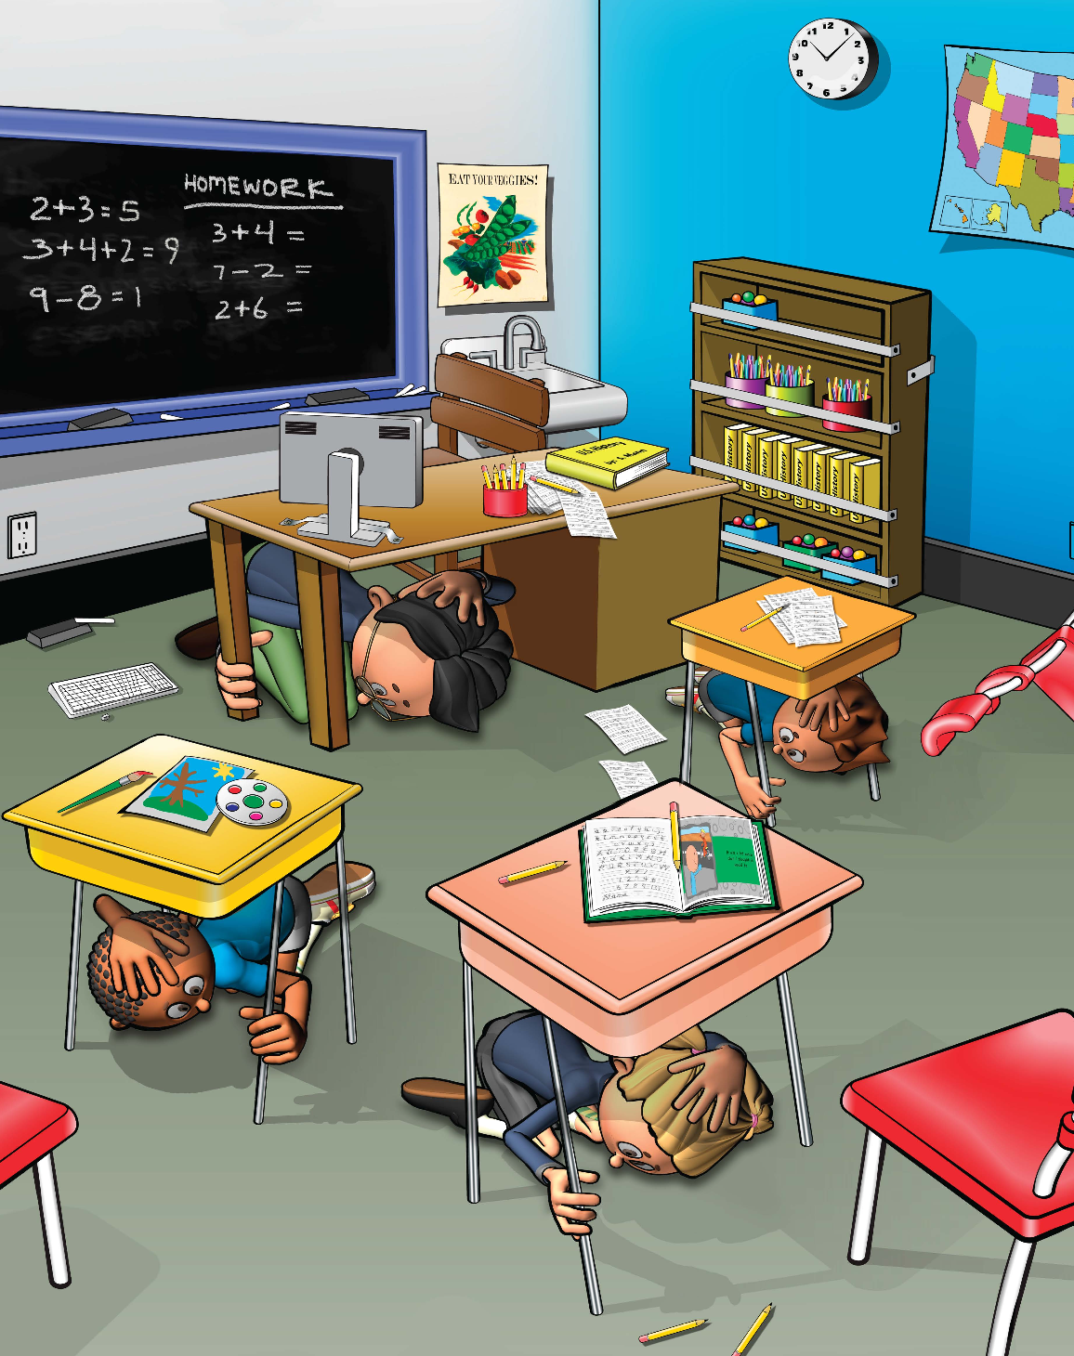
Learning Objectives
I can Drop, Cover, and Hold On if there’s ground shaking or I get an alert.
I can estimate and calculate how much water my family needs to stay safe after an emergency, such as an earthquake.
Image courtesy of FEMA
12
Notes:
Teacher Notes: Tell students that today we are practicing DROP, COVER, and HOLD ON to stay safe if we feel shaking or get an earthquake early warning alert. We will also calculate how much water our family may need if there is an earthquake or other emergency so that we can continue to stay safe.
IMAGE: Image courtesy of FEMA

Slide 13
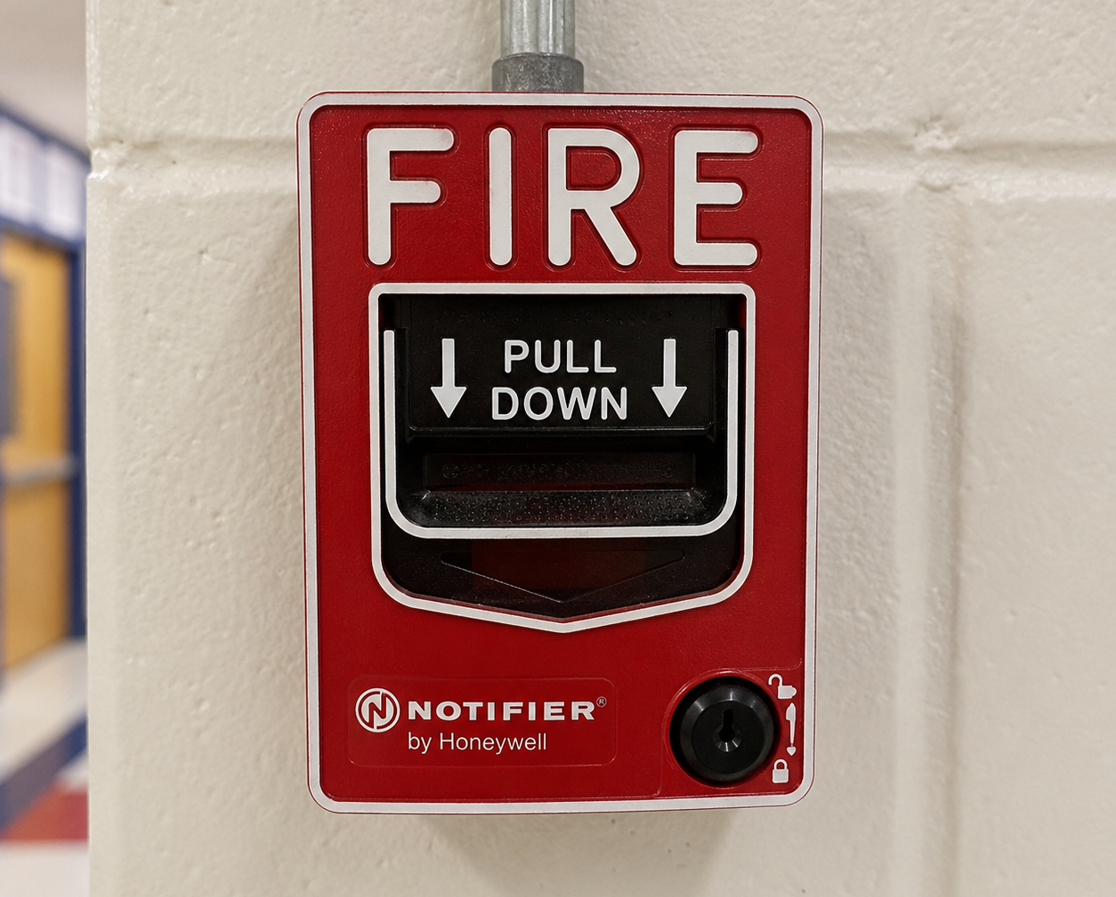

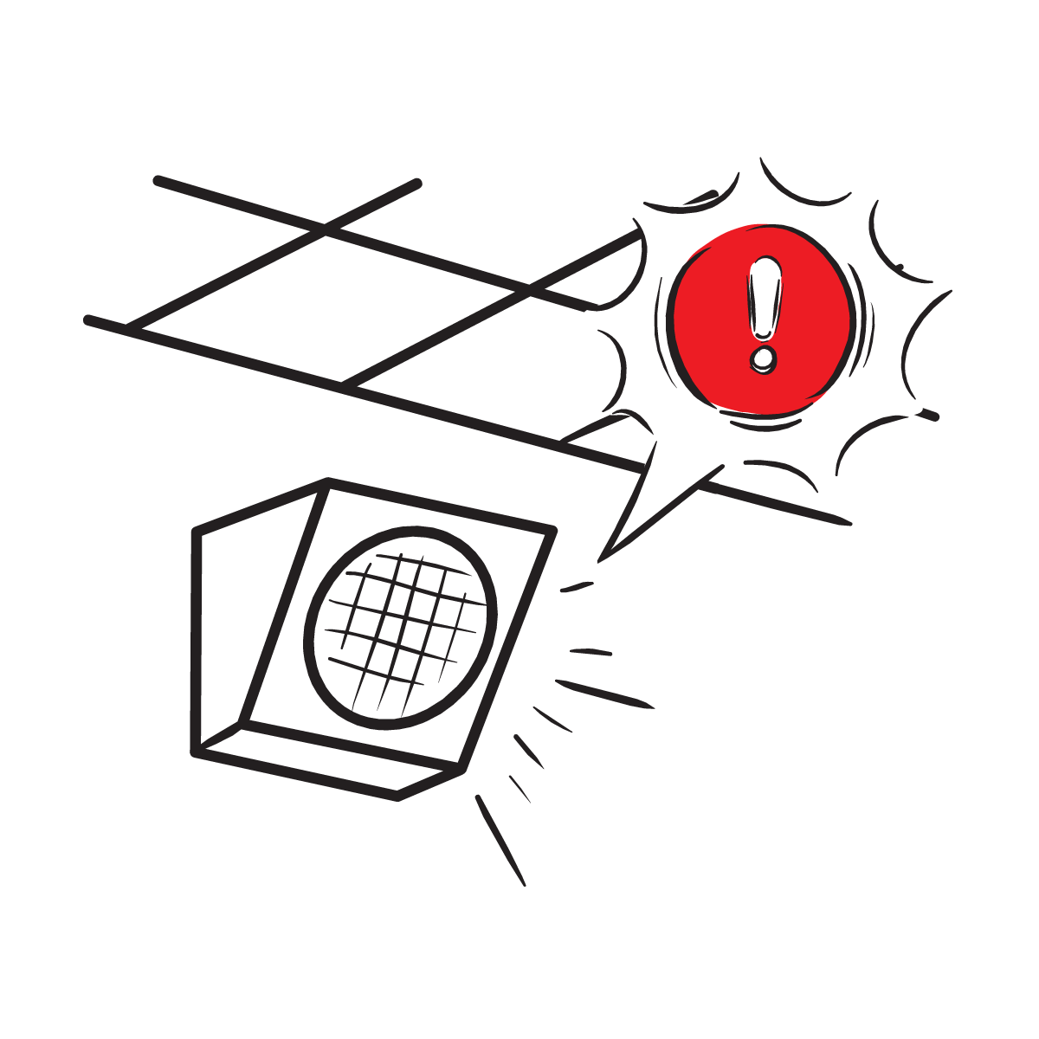
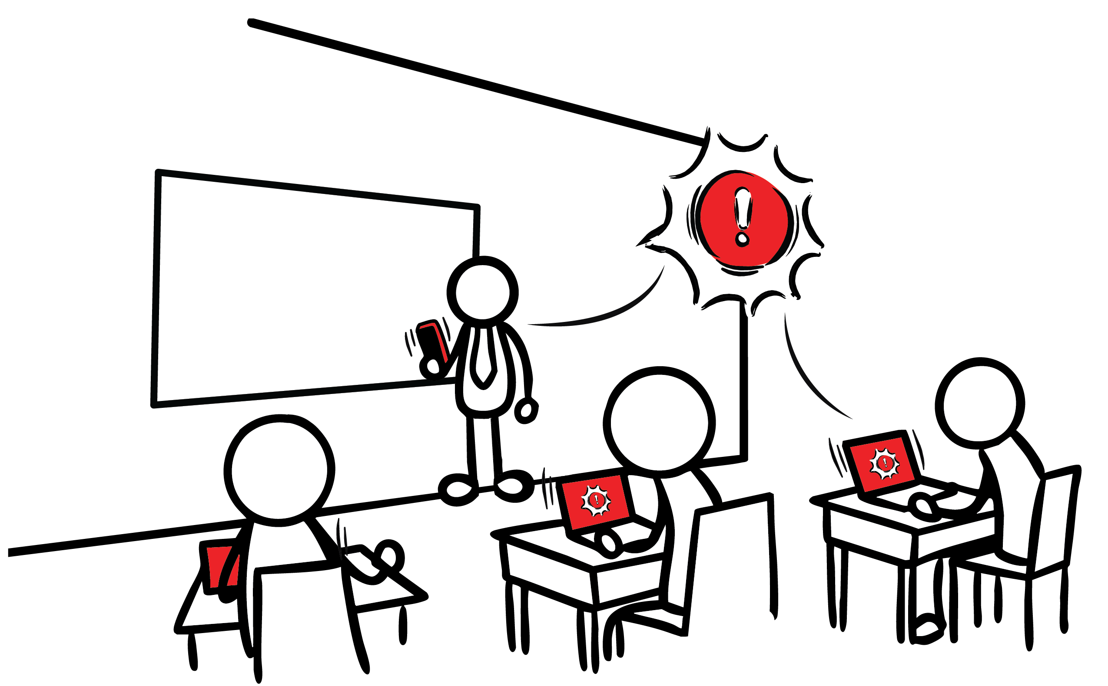
What other safety drills have we had at school?
What is the purpose of drills in schools?
We can stay safe at school during earthquakes.
Image created with A.I.
Image courtesy of The Hero in You Foundation
Image courtesy of USGS
13
Notes:
Teacher Notes: This slide is animated so the questions appear one at a time. Ask students what other drills they’ve practiced at school. Students have probably practiced earthquake drills, shelter in place drills, and lockdowns among others.
Ask students why we practice drills at school. They should respond that we conduct drills to practice how to respond so that if there’s ever a fire or earthquake, we’re prepared and know how to stay safe. We also practice drills so that we can help students feel safer and less afraid at school. Having fire and earthquake drills can help us to feel prepared and less afraid!
[PROVISIONAL, based on whether the school has integrated ShakeAlert into systems, such as public address systems. If so, tell students that our school has an earthquake early warning system that can give our school community members seconds of extra time to protect ourselves before strong shaking arrives during an earthquake.]
IMAGES: Image credits from left to right. Image courtesy of Educator Clips. Image courtesy of The Hero in You Foundation and Educator Clips. Used with permission. Image courtesy of USGS.

Slide 14
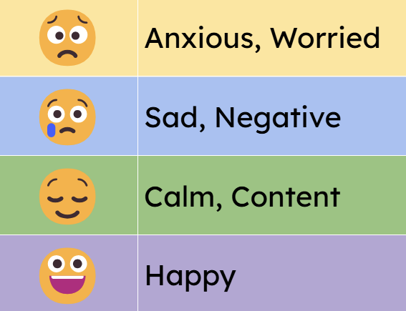
How do you feel?
Turn and talk to a partner!
14
Notes:
Teacher Notes: Tell students that sometimes drills can be scary because we don't know what to do or what is happening around us. During this lesson we will practice DROP, COVER, and HOLD ON twice. After practicing, you should feel more confident and hopefully less scared or nervous. Ask students how they feel right now thinking about earthquakes and earthquake drills. Ask them to turn to a student sitting nearby and share. After students have had a chance to share with a partner, ask if any volunteers would like to share with the class. Acknowledge to students that it’s normal to feel afraid or nervous, and that we practice so we’ll feel less scared and more prepared!

Slide 15
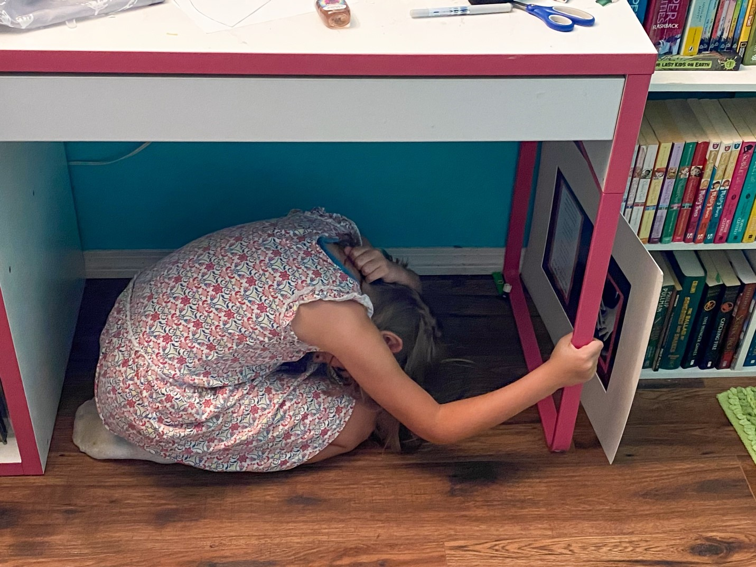
Have you experienced an earthquake?
What are some things you have seen or heard about earthquakes?
What do you wonder about earthquakes?
Image courtesy of USGS
15
Notes:
Teacher Note: Ask students what they have seen or heard about earthquakes. It’s likely that many of them have not experienced an earthquake. They may have heard from family members about shaking, objects breaking, or even possibly injuries. It’s possible they’ve seen or heard about earthquakes through the media. Validate students’ experiences, and scan for students that may need some extra support. Tell students that we’ll learn more about what an earthquake is in this lesson. Consider recording students’ questions so that you can return to them at them end of the lesson to see which have been addressed through the lesson, and try to answer the others.
IMAGE: Image courtesy of USGS

Slide 16
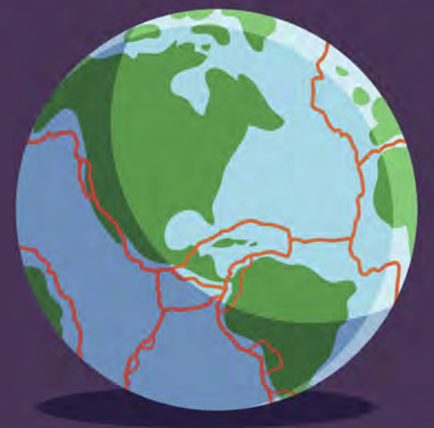
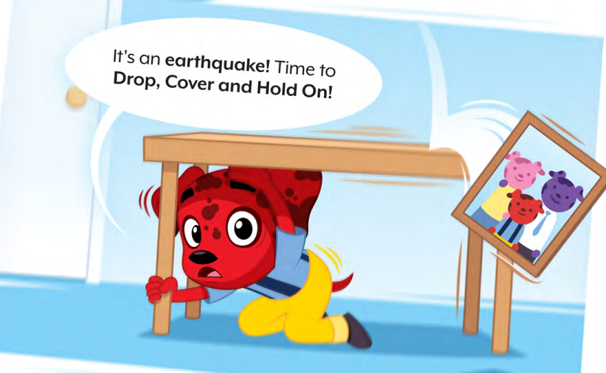
The surface of the Earth is broken into many pieces that move around.
The pieces of the Earth get stuck together. When they break free, an earthquake happens!
Images courtesy of The Hero in You Foundation
16
Notes:
Teacher Notes: Slide is animated. When you click, the second text box appears and after a short delay the image appears and shakes for seven seconds.
Tell students that now we’ll learn more about earthquakes. Tell students that the surface of the Earth that we stand on may seem like it is so solid it could never be moved. But actually, the surface of the Earth is broken into many pieces that move around. Most of the time we don’t feel the movement, but sometimes we do. As the pieces of the Earth move, they can become stuck because of friction. When the pieces break free, an earthquake happens, causing ground shaking! This is natural, and it happens all the time.
IMAGE: Image courtesy of The Hero in You Foundation. Used with permission.

Slide 17
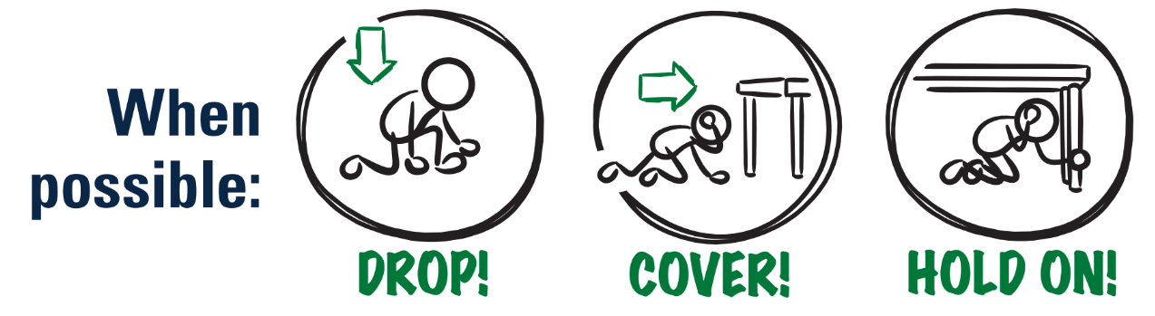
What should you do if you feel shaking or get an alert?
Image courtesy of USGS
17
Notes:
Teacher Note: This is animated. Ask the question first to elicit student responses.
Review and model correct protective actions - Drop, Cover, and Hold On. Make sure students know they should drop to their knees (not their bottoms), have one hand over their necks, and try to get away from glass or any other objects that could fall on them. If they’re able to get under a table or desk while staying on their knees, they should. Once there, they should hold on to the leg of the table.
IMAGE: Image courtesy of USGS

Slide 18
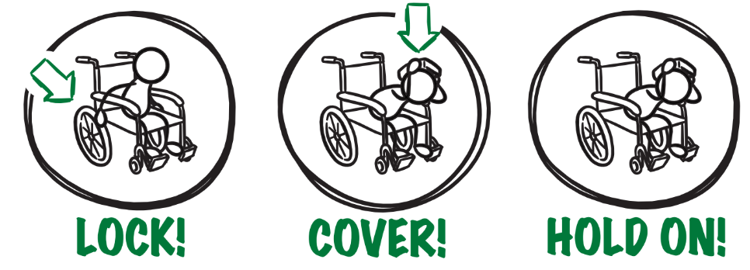
If you or someone you know uses a wheelchair:
Image courtesy of USGS
18
Notes:
Teacher Notes: Tell students that Drop, Cover, and Hold On looks differently for different bodies. Review modified protective actions for people who use wheelchairs. While you may not have students who use wheelchairs in your class, it is likely that there are members of your community who do. Ask students to help their family members or friends who use a wheelchair by sharing that “Lock, Cover, and Hold On” is how they can protect themselves during an earthquake. Have students repeat the phrase, “Lock, Cover, and Hold On” after you’ve said it.
IMAGE: Image courtesy of USGS

Slide 19


If you or someone you know uses a cane or walker:
Image courtesy of USGS
19
Notes:
Teacher Notes: Slide is animated so images come in when you click.
Review modified protective actions for people who use a cane or walker. While you may not have students who use a cane or walker in your class, it is likely that there are members of your community who do. Ask students to help their family members or friends who use a cane or walker by sharing the correct protective actions. Have students repeat the phrase, “Drop, Cover, and Hold On” and then “Lock, Cover, and Hold On” after you’ve said it.
IMAGE: Image courtesy of USGS

Slide 20
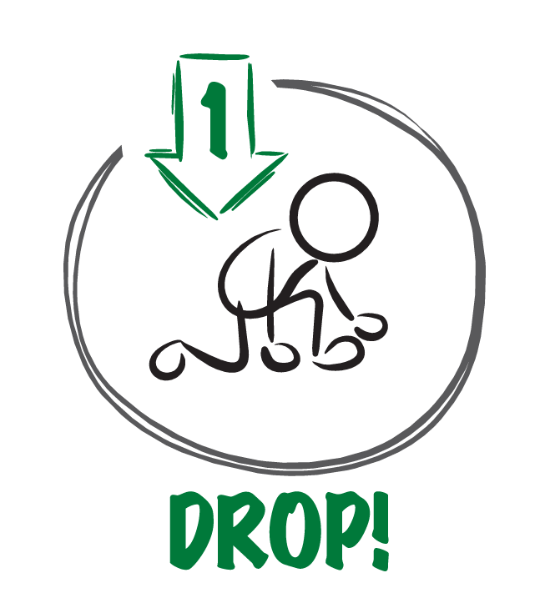

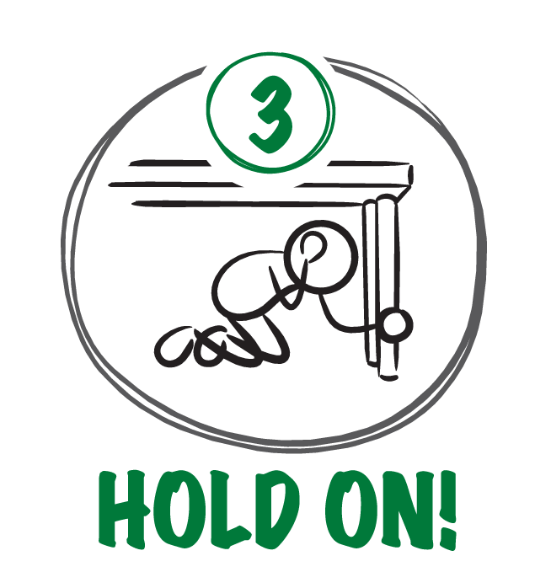
When the ground shakes or you get an alert,
why is it important to . . .?
Image courtesy of USGS
20
Notes:
TEACHER NOTE: This slide is animated and the ‘Cover’ and ‘Hold On’ images appear individually so you can discuss each action in turn. Begin by eliciting student responses for each. Add on to student responses as necessary.
DROP: Dropping to your knees protects you from falling or being hit by falling objects during ground shaking.
COVER: We cover our neck and head with one arm and hand to protect them from becoming injured if something falls. The back of the neck is particularly important to protect because your head has a skull to protect it.
HOLD ON: We hold on to a table/desk leg once we’re beneath it so the earthquake doesn’t move us out from underneath the table/desk that is protecting us.
IMAGE: Image courtesy of USGS

Slide 21

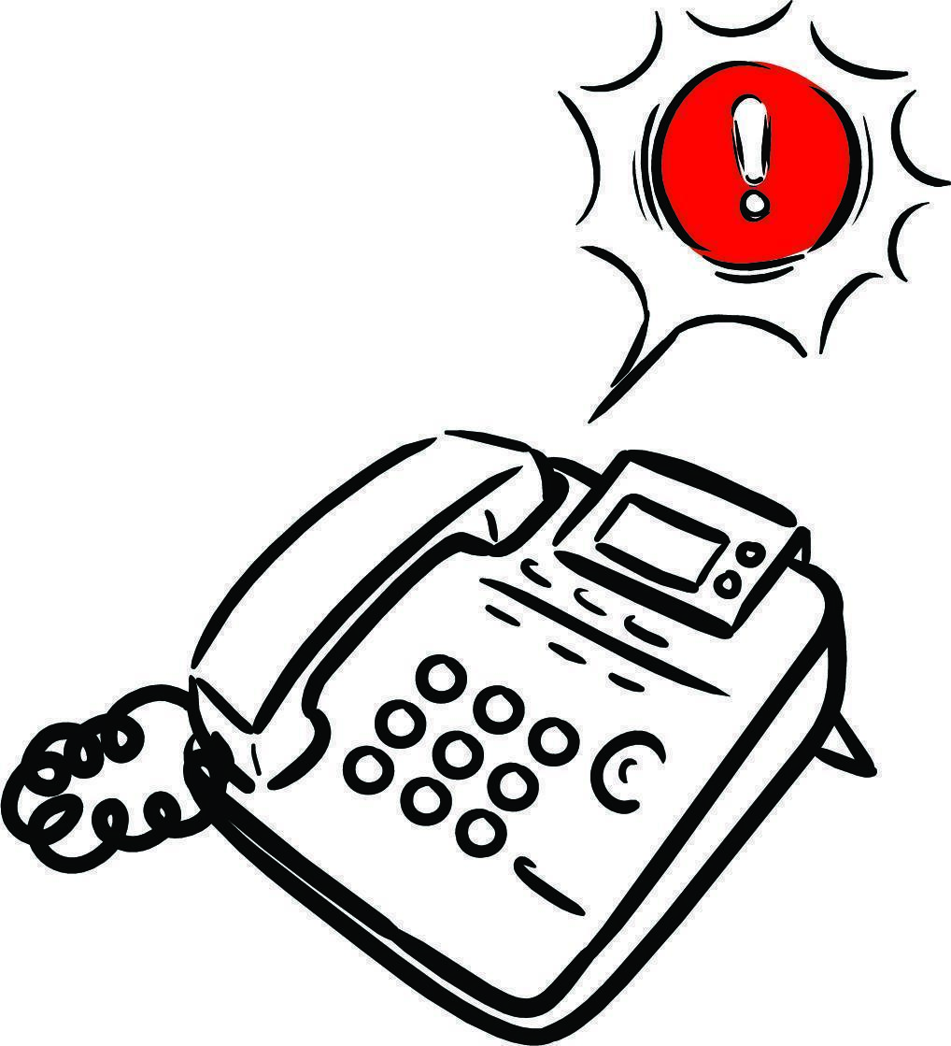

Let’s Practice!
Image courtesy USGS
21
Notes:
Teacher Notes: Inform students that when you click on the slide that, after a brief introduction, an alert will play and students should practice Drop, Cover, and Hold On immediately with the alert. Remind students this is only a drill. Play the ShakeAlert alert by clicking anywhere on the slide. Have all students Drop, Cover, and Hold On. Ask students to stay in their protective positions while the teacher observes and offers corrections if necessary. Once the teacher has checked in with each student, ask them to return to their seats.
NOTE: Your EEW alert may sound and look different than the one pictured on the slide!
IMAGES: Images courtesy of USGS

Slide 22
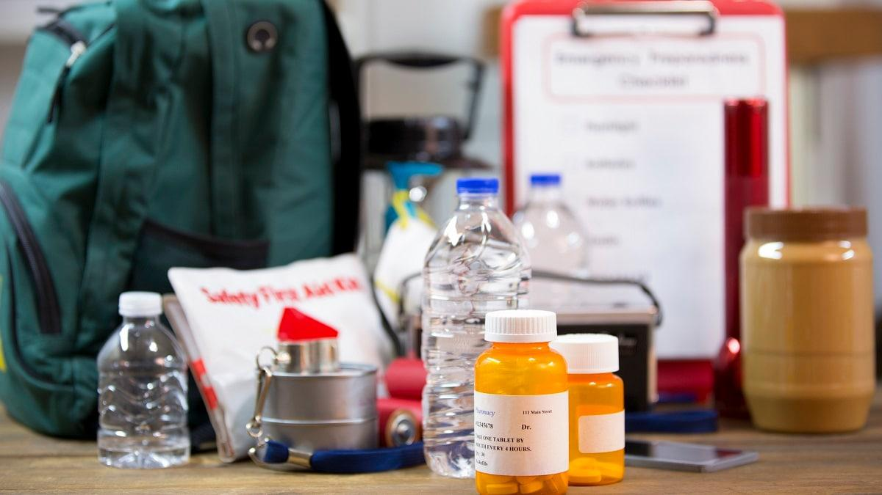
Preparing Our Families
Why is it important to practice earthquake safety with your family in different places, such as at home, at a park, or in a store?
What is one more thing you and your family can do to get ready for an earthquake?
Image courtesy of USGS
22
Notes:
Teacher Notes: Tell students that they’ll be showing their families how to DROP, COVER, and HOLD ON to stay safe during an earthquake or when they get an earthquake early warning alert tonight. Ask them how practicing helps keep them safe, and what else they can do with their families to prepare. For each question, ask students to turn and talk to a student nearby and then share out with the class.
If it doesn’t come up during your discussion of question two, ask students what humans need to live. They should say food, water, and shelter. Tell students that we are going to focus on water, since it’s something everyone needs everyday that is fairly easy to prepare before an emergency.
IMAGE: Image courtesy of USGS

Slide 23

We need water - why?
Examine the cup of water. Estimate:
How many cups do you need to drink per day?
How many cups do you need to wash?
How many cups do you need to flush the toilet?
How many cups do you need for other uses?
How many total cups do you estimate you need each day?
Image courtesy of USGS
23
Notes:
Teacher Notes: Use Think-Pair-Share to brainstorm the ways students use water every day and record ideas on the board. Provide each student with a copy of the student worksheet.
Either provide each student with a cup of water, provide one cup of water per table, or have a cup of water in the front of the class. If you’ve provided cups for each student or student group, direct students’ attention to the permanent marker line, and tell them that marks one cup (8 fluid ounces) of water. Students should estimate the number of cups of water they think they would need per day for each use on the student sheet under part 1, “My Personal Water Use,” and then find the sum. Remind students that other needs includes pets. Consider having counting cubes or tiles to help with the addition (2nd grade) or multiplication (3rd grade) to find the total number of cups.
After they’ve recorded their ideas on the student sheet, invite students to share their estimates with a partner or their table group.
IMAGE: Image courtesy of USGS

Slide 24
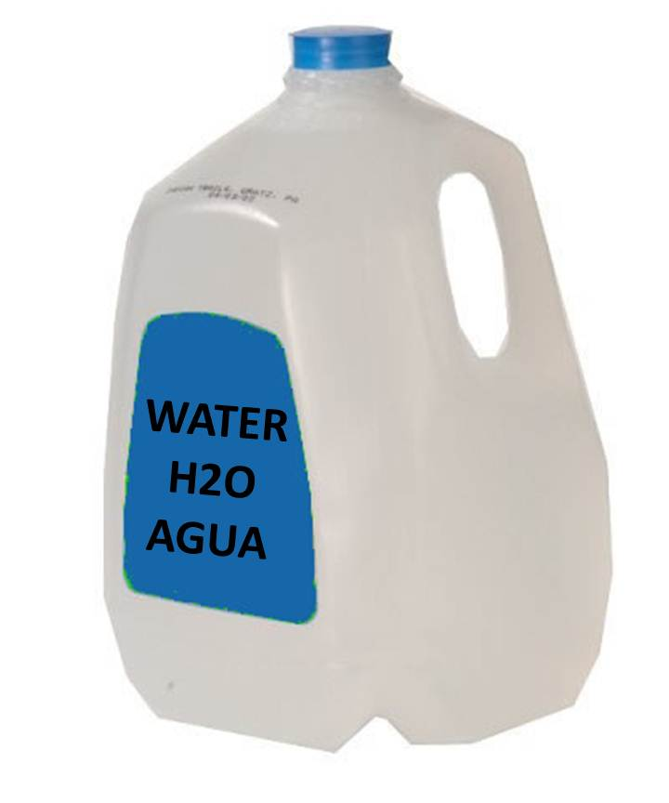
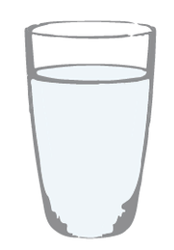
How many cups are in a gallon?
Image courtesy of National Weather Service
Image courtesy of City of Portland
24
Notes:
Teacher Notes: Once students have estimated the total cups of water they need per day in an emergency, ask them to estimate or measure how many cups are in a gallon. Either provide students with an empty gallon jug and ask them to carefully figure out how many of their cups of water are needed to fill the jug, demonstrate for the class how many of their cups of water are needed to fill the jug, or just tell them that there are 16 cups in a gallon. Consider providing funnels to reduce mess and increase accuracy.
Direct students to complete part 2 of their student sheet, “Emergency Water Needs.” Tell students that government agencies recommend having one gallon of water per person per day two weeks in an emergency.
IMAGES: Image credits from left to right. Image courtesy of the National Weather Service. Image courtesy of the City of Portland.

Slide 25
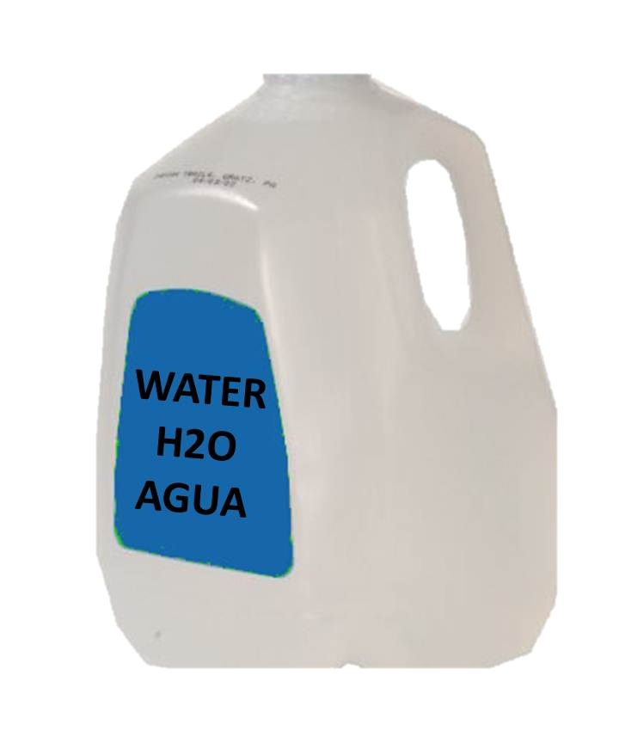
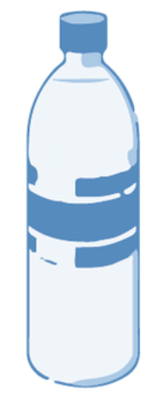
How does your estimate compare?
Equal to
Greater Than
Less Than
<
=
>
Image courtesy of City of Portland
Images courtesy of National Weather Service
25
Notes:
Teacher Notes: Ask students whether their estimate was equal to, less than, or greater than the one-gallon recommendation. Ask students to consider why their estimate may have been different than the emergency recommendation of one gallon. They should note that during an emergency, we may not be able to use as much water as we normally would. You can share with them that the average American household uses more than 300 gallons of water per day! Ask students for examples of things they do everyday with water that they don’t need to do. They may say things like taking long showers, playing in the sink, or running the water while brushing their teeth.
NOTE: If students don’t know what the < and > symbols mean, you can use this slide as is and teach the symbols, or you can delete the symbols from the text boxes.
IMAGES: Image courtesy of the City of Portland. Image credits from left to right. Image courtesy of the National Weather Service.
SOURCE: https://www.epa.gov/watersense/how-we-use-water

Slide 26
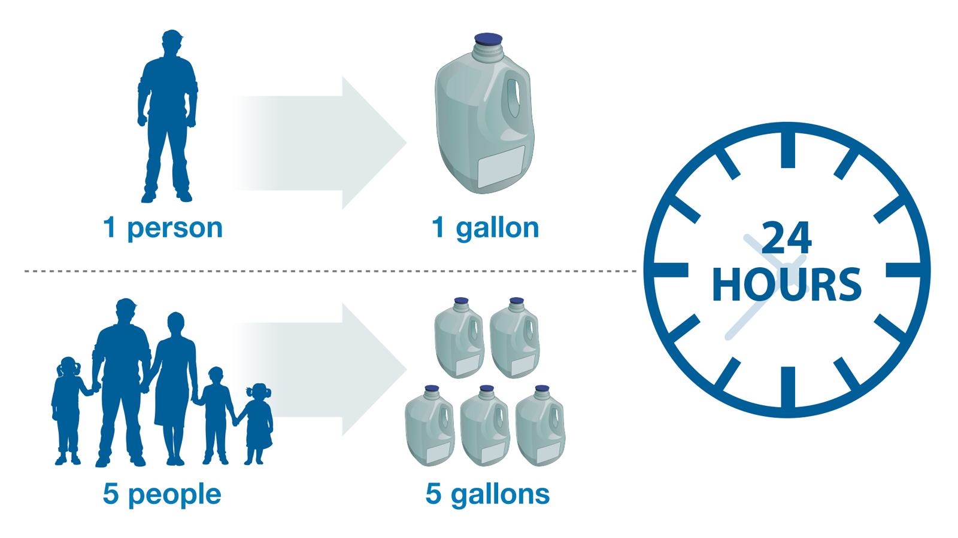
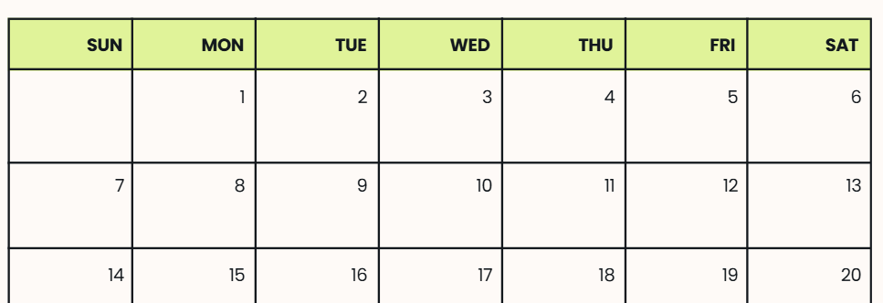
How much water does a family need during an emergency for 1 day?
If 1 person needs 1 gallon per day,
how much water would 5 people need?
?
Image courtesy of Studio Habitue on Canva
Image courtesy of U.S. Food and Drug Administration
26
Notes:
Teacher Notes: Ask students how much water five people would need for one day. Encourage students to show their work on the student sheet. Use counting tiles if they need a physical representation of the gallons. Click on slide reveal the answer (five gallons).
IMAGE: Image credits from left to right. Image courtesy of the city of South Gate, CA. Image courtesy of the US Food and Drug Administration.

Slide 27
How much water does your family need for 1 week?
If five people need five gallons of water for per day, how much water would they need for 1 week?
5 + 5 + 5 + 5 + 5 + 5 + 5
5 gallons x 7 days =
35 gallons
?
Image courtesy of U.S. Food and Drug Administration
Image courtesy of Studio Habitue on Canva
27
Notes:
Teacher Notes: Tell students that government agencies recommends having two weeks of supplies for an emergency, including water. We’ll calculate how much our example family of five needs for one week together now. Consider modeling the problem-solving strategies you’d like them to use when calculating their own family’s water needs. Clicking on the slide will make the question mark fade away and the answer come in.
Direct students to create equations or use models to calculate how much water they need for everyone in their family (including pets) for three days on their student sheet. They should record their work on part 3 of their student sheet, called “My Home’s Emergency Water Needs.” Encourage them to solve the problem by drawing a picture or writing a math equation using addition (2nd grade: 5+5+5+5+5+5+5=15) or multiplication (3rd grade: 5 x 7 = 15) to solve the problem.
Invite students who finish quickly to calculate how much water their family would need for two weeks.
Ask students if everyone needs the same amount of water per day in an emergency. They should respond that some people may need more, such as people taking medications, people who live someplace hot, or people who are very active.
At this point, have students clean up the materials because they are going to practice Drop, Cover, and Hold On next.
IMAGE: Image credits from left to right. Image courtesy of the US Food and Drug Administration. Image courtesy of the city of South Gate, CA.

Slide 28
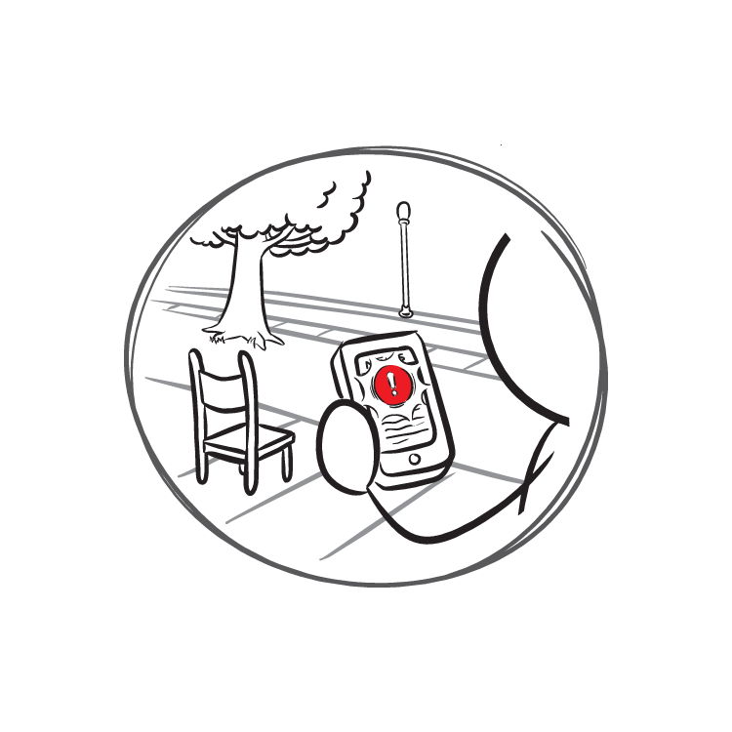
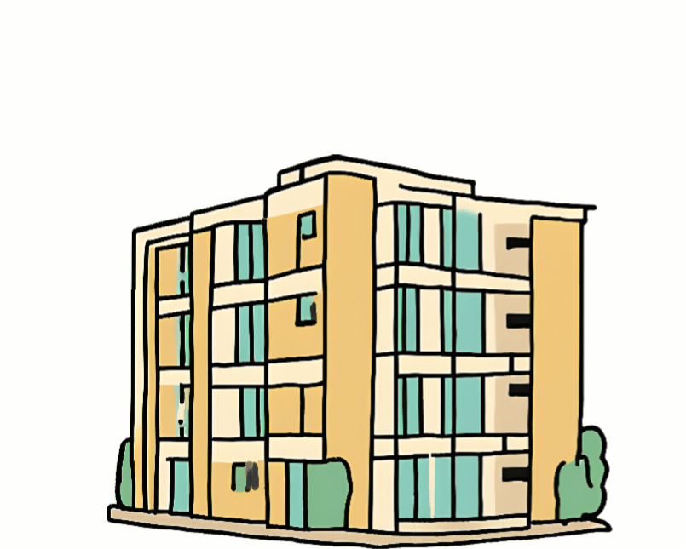
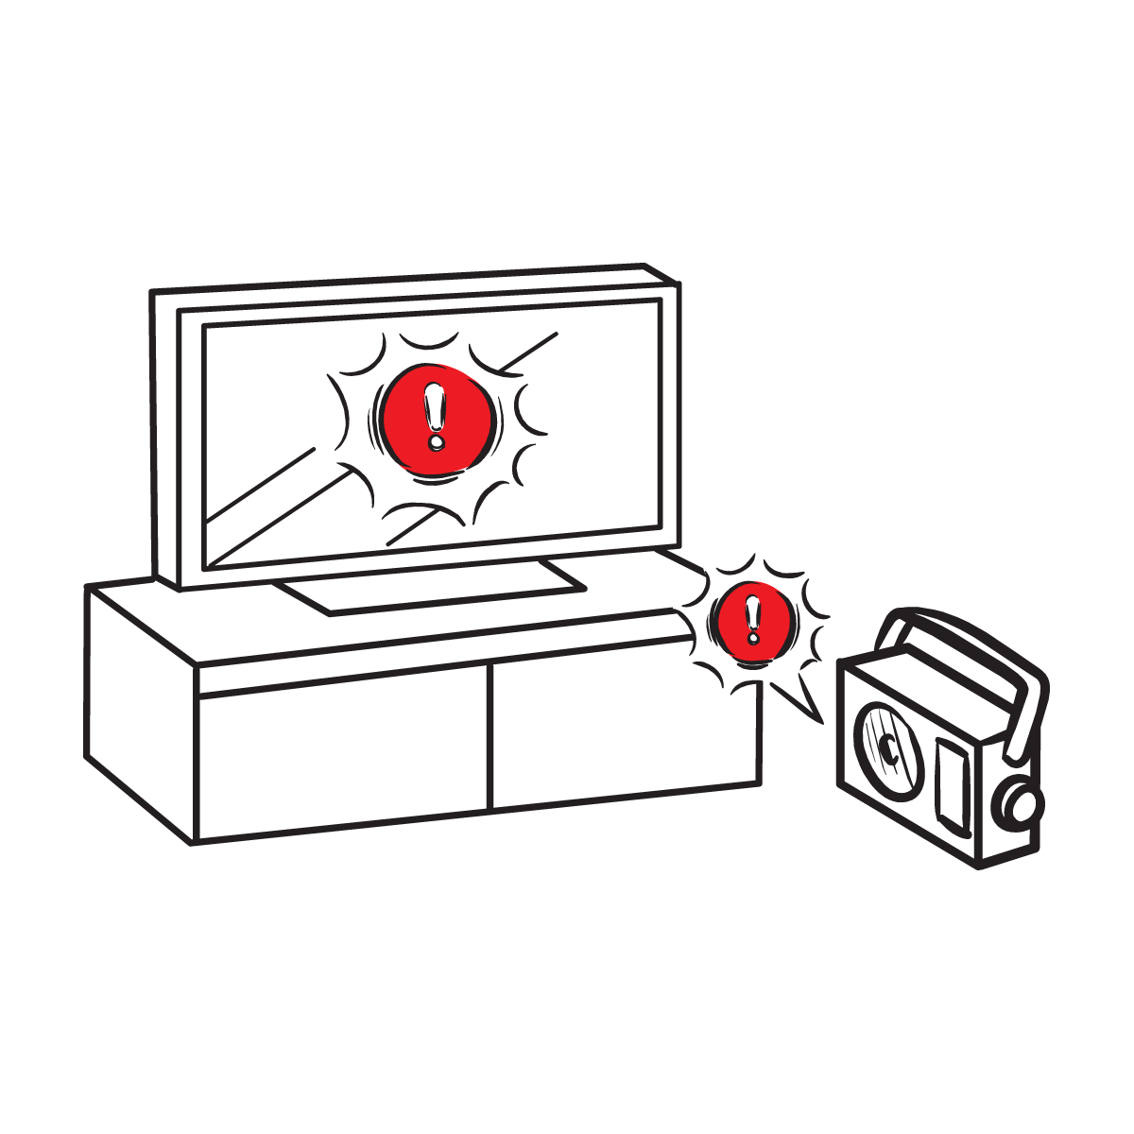
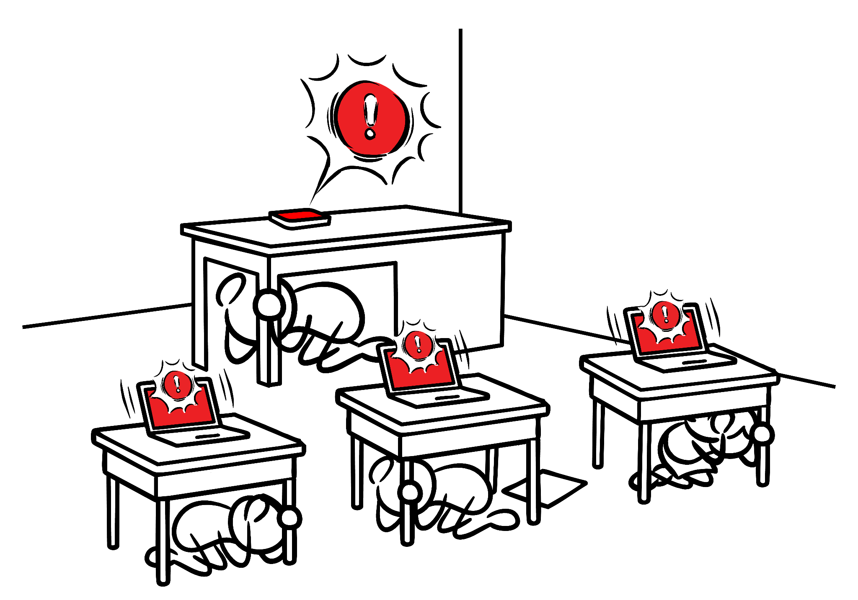
Protect yourself when there is . . .
Ground Shaking
An Earthquake Drill
An Earthquake Early Warning Alert
Gif created using A.I.
Image courtesy of USGS
Image courtesy of USGS
Notes:
Teacher Notes: Slide is animated, so images appear when you click. Tell students that they should take these protective actions when the ground shakes, if there’s an earthquake early warning alert, or if they’re participating in an earthquake drill, which we’ll do now. Tell students that it’s vital they Drop, Cover, and Hold On immediately and without hesitation.
IMAGES: Gif created using A.I. Images courtesy of the USGS.

Slide 29
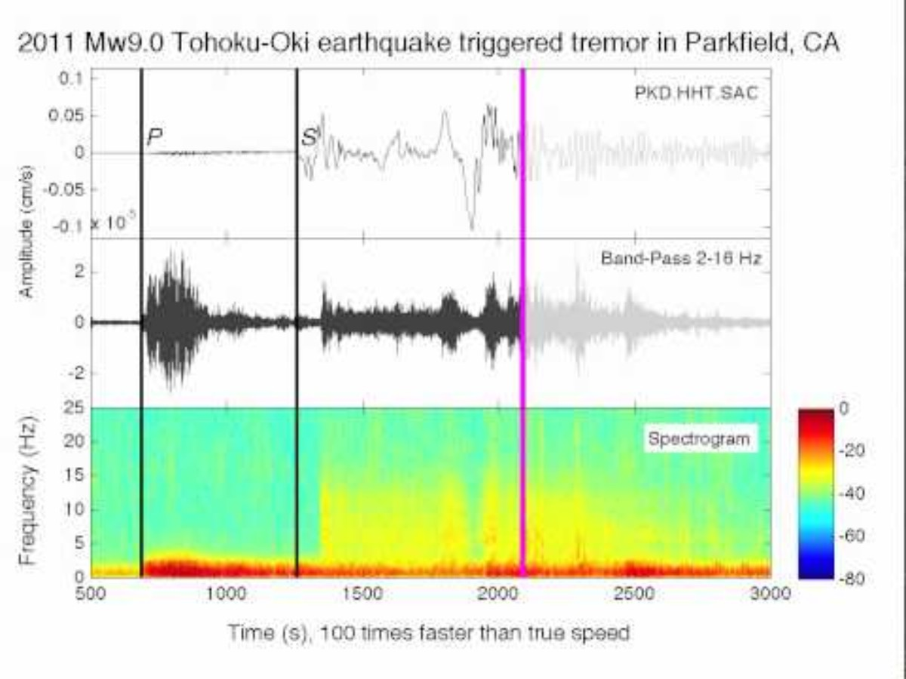
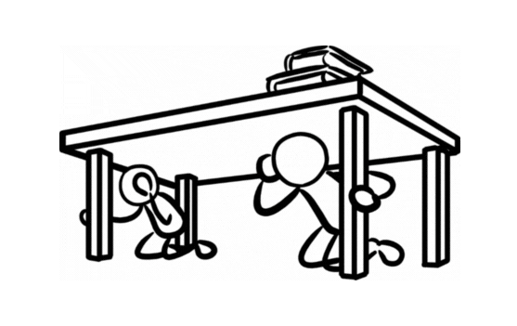
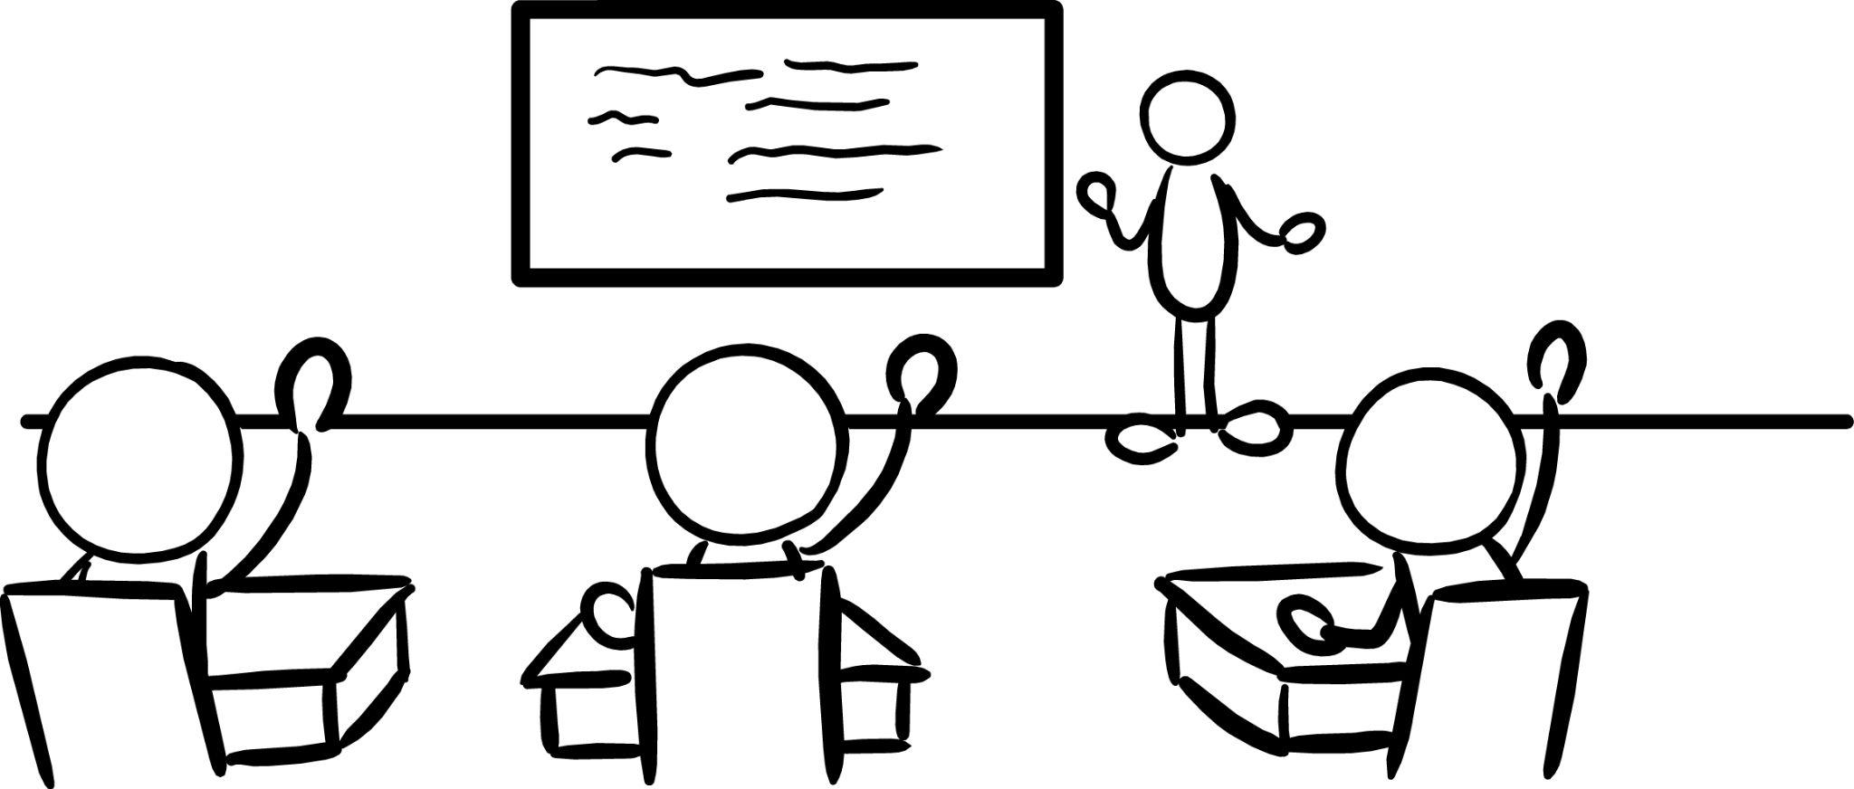
Let’s Practice!
If you feel ground shaking or get an alert:
DROP
COVER
HOLD ON
Image courtesy of USGS
29
Notes:
Animation Note: Click anywhere will do two things—the audio will play and the building image will start shaking. The audio and shaking will continue until you click to the next slide.
Teacher Notes: Tell students that they will hear sound effects like earthquake shaking. This is just pretend! But it is similar to what you might hear in a real earthquake. Click to play the ground shaking noises and animation, and practice Drop, Cover, and Hold On. Ask students to stay in their protective positions while you observe and offer corrections if necessary. Once you’ve checked each student, ask them to return to their seats.
SOUND: https://www.youtube.com/watch?v=q1wg2IbA0oo Georgia Tech - Hearing the Japanese Earthquake - Clip 3
IMAGE: Image courtesy of USGS

Slide 30
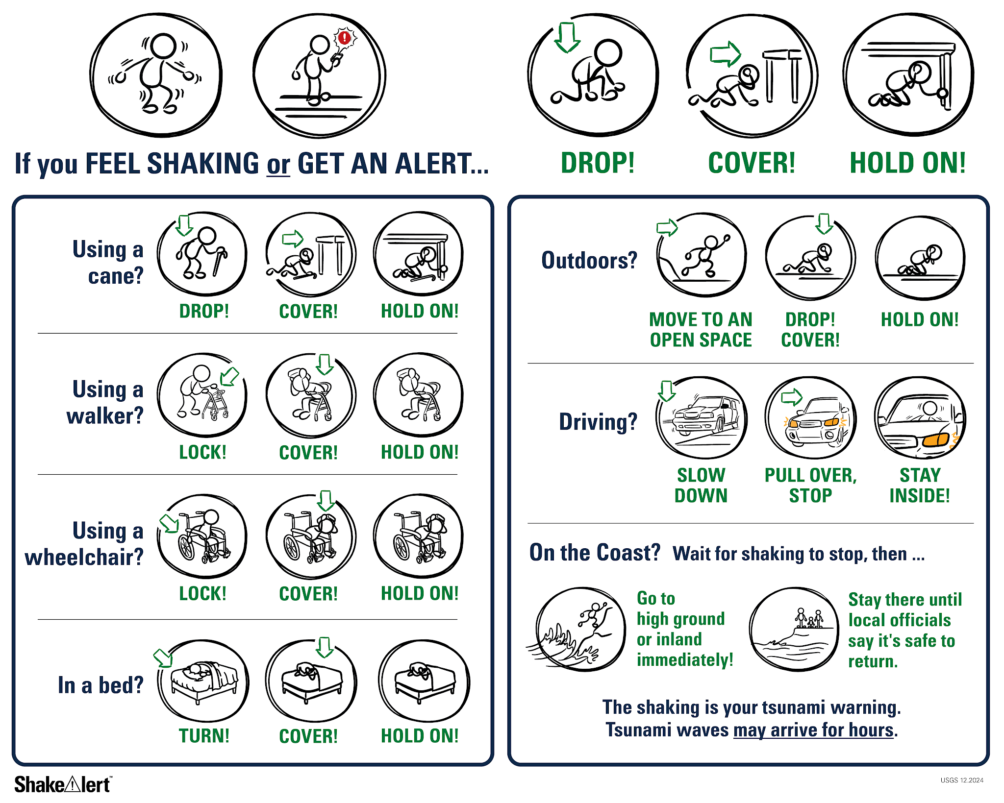
If you are outside when you feeling shaking or get an alert:
30
Notes:
Teacher Notes: Slide is animated so images appear when you click. Tell students that if they are outside when they feel shaking or get an alert, they should immediately move to an open space away from power lines or other objects that could fall on them. They should then drop to their knees and use their arms to cover their head and neck and hold on in that position until the shaking stops.
IMAGE: Image courtesy of U.S. Geological Survey

Slide 31
If you are on the coast, Drop, Cover, and Hold On.
When the shaking stops …
Image courtesy of USGS
31
Notes:
Teacher Notes: Slide is animated so images appear when you click. Tell students that if they are visiting the coast, the earthquake could be followed by a tsunami, which is a large wave caused by the earthquake. If they are on the coast when they feel shaking or get an alert, they should Drop, Cover and Hold On. When the shaking stops, immediately go inland, to high ground, or follow their school’s specific safety procedures. Tell students that it’s important to wait until they hear it’s safe to return because tsunami waves can continue to arrive for hours or even days after an earthquake.
IMAGE: Image courtesy of U.S. Geological Survey

Slide 32
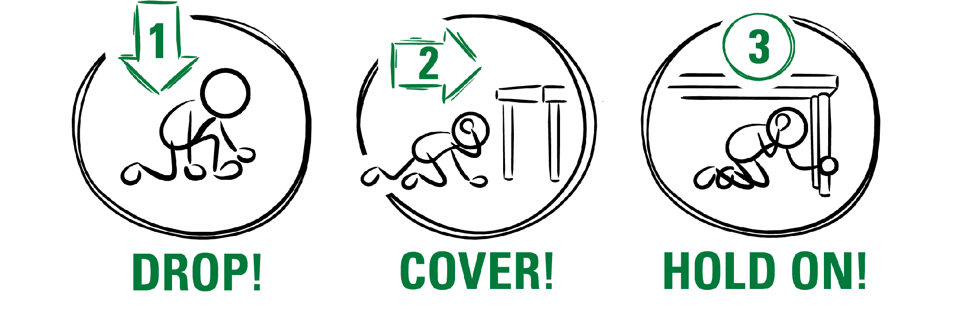

After an earthquake, there can be smaller earthquakes called aftershocks.
What should you do if you feel shaking or get an alert?
Image courtesy of USGS
Notes:
Teacher Notes: Slide is animated so images appear when you click. Many earthquakes are followed by smaller earthquakes called aftershocks. Aftershocks can happen for even a few weeks after the main earthquake! Even though aftershocks are smaller than the main earthquake, they can still produce strong shaking and cause damage. Ask students what they should do if they feel shaking or get an alert. Remind students that they should stay alert and Drop, Cover, and Hold On if they feel shaking or get an earthquake early warning alert.
SOURCE: earthquake.usgs.gov/data/oaf/overview.php
IMAGE: Image courtesy of U.S. Geological Survey

Slide 33

Let’s Reflect!
or
I can Drop, Cover, and Hold On if there’s ground shaking or I get an alert.
I can estimate and calculate how much water my family needs to stay safe after an emergency, such as an earthquake.
Turn and talk:
I can stay safe by ___, ___ and ____.
A question that I still have is______
33
Notes:
Teacher Notes: Slide is animated so prompts appear when you click. Ask students to turn and talk to each other about the earthquake drill, how they did, if they have questions, and what they think important things to remember are. After reflecting, remind students of the key takeaways to stay safe during an earthquake, including immediately dropping to your knees, getting under a table if you can and holding on to the table leg, facing away from glass or heavy objects that could fall, covering your head and neck, remaining silent so that you can hear teacher instructions, and holding this position until shaking stops.

Slide 34
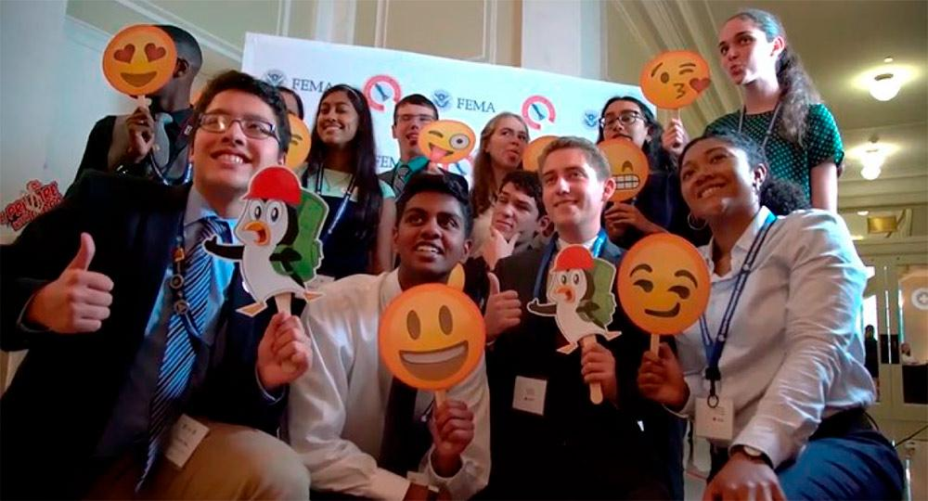
Let’s Check In
✔ Emergencies can be scary.
✔ People react differently, which is normal!
✔ Why do we practice (even though it can be uncomfortable?
Image courtesy Ready.gov
34
Notes:
Teacher Notes: Sometimes drills can be scary because we don't know what to do or what is happening around us. During these lessons you will practice the drill many times. After practicing, you should feel more confident and hopefully less scared or nervous.
IMAGE: Image courtesy Ready.gov

Slide 35
How do you feel now?
Turn and talk to a partner!
35
Notes:
Teacher Notes: Ask students how they are feeling now that they’ve learned about how and why earthquakes occur, as well as how to protect themselves during an earthquake or if they get an earthquake early warning. As students talk, scan the classroom to check for students who might need some extra support. After students have had a chance to share with a partner, ask if any volunteers would like to share with the class. Remind students that it’s normal to feel scared, and that we practice how to stay safe so they can feel less scared and more prepared!

Slide 36

Help Your Family Prepare
Help your family figure out how much water your household needs.
Show them how to Drop Cover and Hold On if they feel shaking or get an alert!
Image courtesy Ready.gov
Image courtesy of USGS
36
Notes:
Teacher Notes: Tell students that they can help the people in their families prepare for an emergency. Help them figure out how much water they need. Show members of your family how to Drop, Cover and Hold On if there’s ground shaking or they get an alert. Encourage students to share their student sheets with the members of their families.
IMAGES: Image credits from left to right. Image courtesy Ready.gov. Image courtesy USGS.

Slide 37
Welcome Back!
How did your discussions with your family go?
Did you show people how to Drop, Cover, and Hold On during an earthquake?
Did you talk about how much water you would need in an emergency?
Image courtesy USGS (top) and National Weather Service (bottom)
37
Notes:
Teacher Notes: NEXT DAY: Ask students how their conversations with their families went. Did their family members know that Drop, Cover, and Hold On are the correct protective actions? Did they talk about an emergency plan? Did they discuss how much water they may need in an emergency, and where to store it?
IMAGES: Image credits from top to bottom. Image courtesy USGS. Image courtesy National Weather Service.

Slide 38
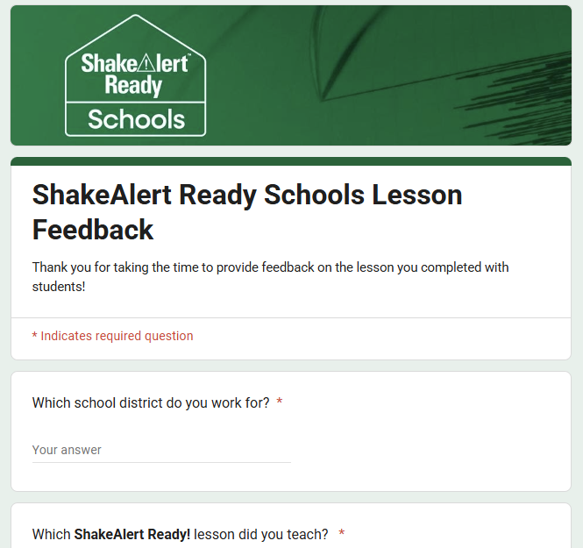
Teachers, share your feedback, please!
Please complete this short, anonymous feedback form to help us to improve ShakeAlert Ready Schools lessons.
38
Notes:
LINK: https://docs.google.com/forms/d/e/1FAIpQLSeNHAr45fDTztflhJJD3_JVS8p0RiV1MW9sKyQgFucGJyKcCA/viewform?usp=sf_link

Slide 39
Content Standards: 2nd Grade
Common Core Mathematics | CA, OR, WA | Common Core CCSS.Math.Content.2.OA.A.1 | Use addition and subtraction within 100 to solve one- and two-step word problems involving situations of adding to, taking from, putting together, taking apart, and comparing, with unknowns in all positions, e.g., by using drawings and equations with a symbol for the unknown number to represent the problem.
Common Core English Language Arts | CA, OR, WA | Common Core CCSS.ELA-Literacy.SL.2.1 | Participate in collaborative conversations with diverse partners about Grade 2 topics and texts with peers and adults in small and larger groups.
 |  | Common Core CCSS.ELA-Literacy.SL.2.3 | Ask and answer questions about what a speaker says in order to clarify comprehension, gather additional information, or deepen understanding of a topic or issue.
Health | WA | H1.Sa1.2c | Describe emergency, fire, and safety plans at home and at school.
 |  | H1.Sa2.2a | Recognize local emergency alert systems.

Slide 40
Content Standards: 3rd Grade
Common Core Mathematics | CA, OR, WA | CCSS.Math.Content.3.OA.A.3 | Use multiplication and division within 100 to solve word problems in situations involving equal groups, arrays, and measurement quantities, e.g., by using drawings and equations with a symbol for the unknown number to represent the problem.
Speaking & Listening | CA, OR, WA | CCSS.ELA-LITERACY.SL.3.1 | Engage effectively in a range of collaborative discussions (one-on-one, in groups, and teacher-led) with diverse partners on Grade 3 topics and texts, building on others' ideas and expressing their own clearly.
 |  | CCSS.ELA-LITERACY.SL.3.3 | Ask and answer questions about information from a speaker, offering appropriate elaboration and detail.
Health | OR | 3.SFA.4 | Describe how to identify and respond to emergency situations.
 |  | 3.SFA.5 | Describe safety procedures for responding to natural disasters.
Health | WA | H1.Sa1.3a | Identify ways to prevent injuries at home, at school, and in the community.
 |  | H1.Sa1.3b | Create emergency, fire, and safety plans for home.
 |  | H1.Sa2.3a | Describe safety rules to follow in a disaster.
40

Slide 41
Content Standards: 2nd – 3rd Grade
English Language Proficiency | OR |  | An ELL can construct meaning from oral presentations and literary and informational text through grade-appropriate listening, reading, and viewing.
 | WA | ELD-SI.K-3.Narrate | Share ideas about one’s own and others’ lived experiences and previous learning Connect stories with images and representations to add meaning | Ask questions about what others have shared Recount and restate ideas
 |  | ELD-SI.K-3.Inform | Describe characteristics, patterns, or behavior Summarize information from interaction with others and from learning experiences | Sort, clarify, and summarize ideas Describe parts and wholes
 | CA | Bridging Proficiency Levels | Exchanging information and ideas: Contribute to class, group, and partner discussions, including sustained dialogue by listening attentively, following turn-taking rules, asking relevant questions, affirming others, adding pertinent information, building on responses, and providing useful feedback. 3. Offering opinions: Offer opinions and negotiate with others in conversations using a variety of learned phrases (e.g., That’s a good idea, but X), as well as open responses in order to gain and/or hold the floor, provide counterarguments, elaborate on an idea, and the like. | 5. Listening actively: Demonstrate active listening to read-alouds and oral presentations by asking and answering detailed questions, with minimal prompting and light support.
Transformative Social Emotional Learning Competencies | CA | Self-Awareness | Identifying one’s emotions
 |  | Relationship Skills | Listening actively, communicating effectively, and self-advocating
 |  | Responsible Decision Making | Reflecting on one’s role to promote personal, family, and community well-being Considering personal and collective safety concerns

Slide 42
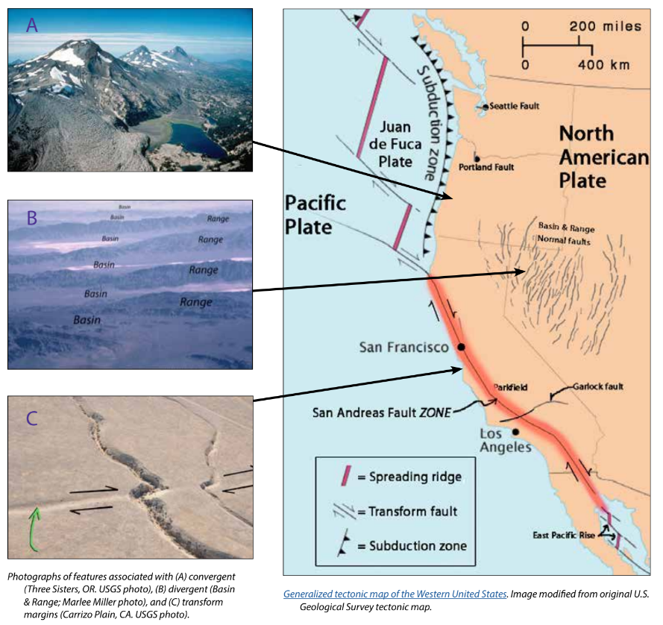
Background - Earthquake Hazard
California, Oregon, and Washington all face hazards from earthquakes because of the underlying tectonic plates, which constantly grind against each other. This friction creates "faults," lines of weakness in the Earth's tectonic plates (lithosphere) where earthquakes are most likely to occur.
California's San Andreas Fault is one example. Another example is the Cascadia Subduction Zone, which threatens all three states and British Columbia, Canada. This giant fault lies offshore, where the Juan de Fuca Plate dives beneath the North American Plate. This type of motion on other subduction zones can cause massive earthquakes, like the one that struck Japan in 2011.
While smaller earthquakes happen often, scientists think a major earthquake could happen any time, so it's important to be prepared.
For more information: Faults, Plate Tectonics & Earthquake Hazards - Animations / Videos
42
Notes:
IMAGE: https://www.iris.edu/hq/inclass/activities/introduction_to_faults_and_plate_tectonics
SOURCE: https://www.usgs.gov/programs/earthquake-hazards/science/pacific-northwest-hazards
https://www.usgs.gov/programs/earthquake-hazards/science/southern-california-earthquake-hazards

Slide 43
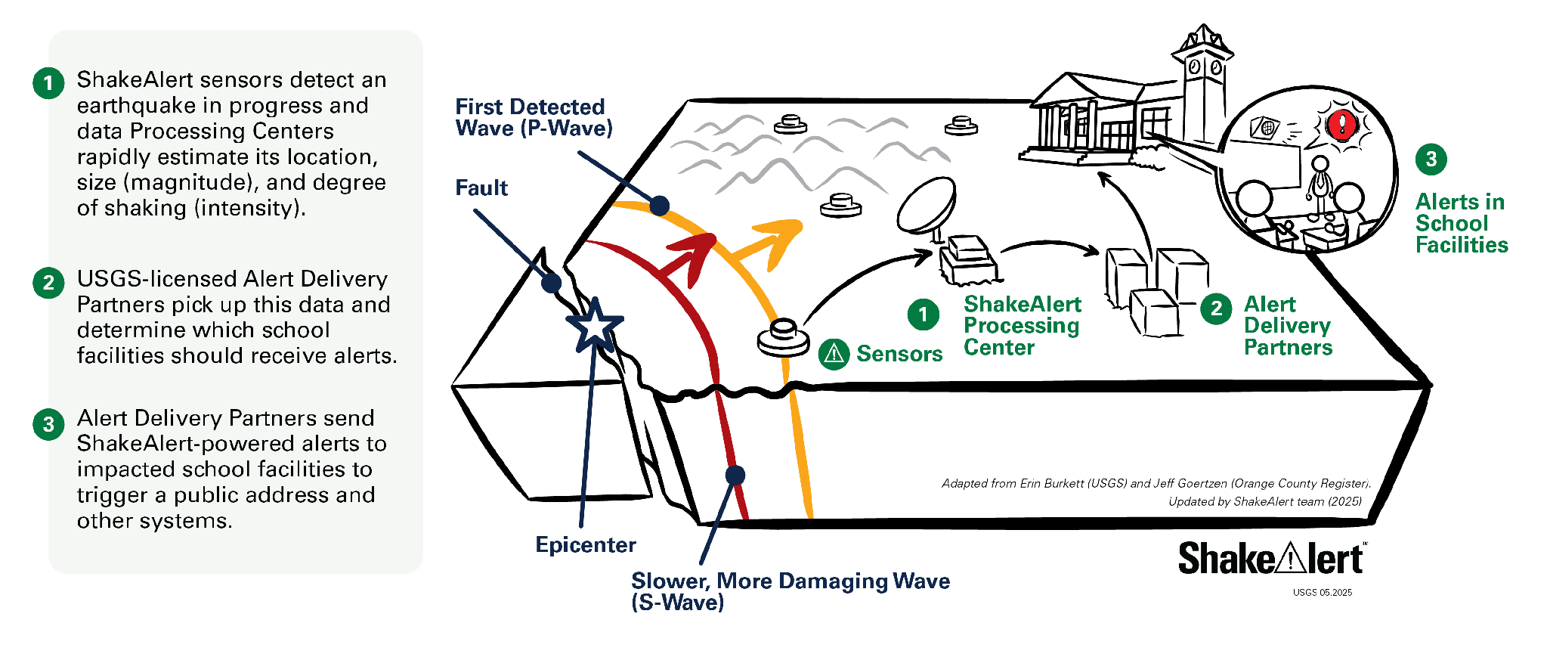
Background - How ShakeAlertⓇ Earthquake Early Warning System Works
43
Notes:
For more information on Earthquake Early Warning, go to: https://www.iris.edu/hq/inclass/sequences/earthquake_early_warning
IMAGE: Image courtesy of the USGS

Slide 44
Background - Effective Protective Actions
Most earthquake-related injuries and deaths are caused by collapsing walls and roofs, flying glass and falling objects.
If you are inside a building, move no more than a few steps, then Drop, Cover, and Hold On.
If you are outdoors when the shaking starts, you should find a clear spot away from buildings, trees, streetlights, and power lines, then Drop, Cover, and Hold On. Stay there until the shaking stops.
For protective actions in various settings (descriptions and gifs), go to https://www.earthquakecountry.org/step5/
Notes:
SOURCE: https://www.shakeout.org/whyparticipate/
IMAGE: Image courtesy of the USGS

Slide 45
Rationale
Why do we practice earthquake drills?
To react quickly you must practice often. You may only have seconds to protect yourself in an earthquake, before strong shaking knocks you down--or drops something on you.
Social science research has long shown that people who practice actions are more likely to take those actions when a safety- threatening event occurs, such as an earthquake or fire. Tests, drills, and exercises that repeat concepts build “muscle memory” of procedural knowledge and timely reaction. The more frequently a person practices a procedure or self-protective action, such as Drop, Cover, and Hold On, the more likely they will employ it— almost without thinking—when they receive an alert or feel shaking.
Why share the Family Engagement Letter?
While schools practice earthquake drills regularly, most other locations don’t. Some students’ family members may not have practiced earthquake drills since they were in school.
Family members may have outdated information about how to stay safe in an earthquake, such as the incorrect belief that standing in doorways or “the triangle of life” will keep one safe in an earthquake. Students will be able to share correct protective actions (Drop, Cover, and Hold On) with their family and community members.
Students spend more time at home than at school. Therefore, educating families will help keep students and our community safe. Additionally, families are more likely to understand their family and community members’ needs. This communication can prompt families to ensure they’re prepared to protect all members of their families in case of an earthquake.
In places like Oregon and Washington where earthquakes are less frequent, people might be unaware of the risk of an earthquake.
The Family Engagement Letter has links for family members to learn more about earthquakes and protective actions.
45
Notes:
SOURCE: https://www.shakeout.org/whyparticipate/ , https://www.shakealert.org/toolkit/introduction/

Slide 46
Additional Resources
State Emergency Management Departments
ShakeAlert Website
ShakeAlert Ready Schools
ShakeAlert Messaging Toolkit (Videos, Graphics, Factsheets)
The Hero in You Foundation (PK-5 Educational Resources in Multiple Languages)
Great ShakeOut Educational Resources
Earthquake Country Alliance
(Earthquake Resources in Multiple Languages)
California Governor's Office of Emergency Services
Oregon Department of Emergency Management
Washington Emergency Management Division
46

