Slide 1
ShakeAlert® Earthquake Early Warning
Earthquake Drill Lesson
GREEN SLIDES = Teacher Preparation & Information
WHITE SLIDES = Present to Class
Grades 9-12
Lesson length: 30 minutes

Slide 2
To Print
Preparation
FAMILY ENGAGEMENT LETTER
English
Spanish
Open and edit the Family Engagement Letter.
  Add your school name at the bottom.
  If you’re emailing the letter, you can remove the QR code.
Make copies of the Family Engagement Letter and/or email to families a week before teaching the lesson. Encourage parents to discuss earthquakes with their children and to let their teachers know if it might be a difficult topic for their child.
Preview Slides. You can print out the Teaching Steps slides. The teaching steps are also located in the Speaker Notes of each slide.
2

Slide 3
Sensitive Content Warning!
Some students or their family members may have experienced earthquakes, resulting in loss, injuries, and possible trauma. It is therefore important to approach these lessons with sensitivity and awareness. When students share information about their experiences with earthquakes in the first part of the lesson, make sure to scan the class and be aware of any heightened responses. Affirm students’ normal emotional responses. If students are too emotionally heightened, it may be prudent to allow them to forego the drill.
Even students who have never experienced an earthquake may have a strong emotional response to talking about earthquakes. Explain to students that practicing earthquake drills helps our community to stay safe in an earthquake, but that it’s normal to feel big feelings about earthquakes.
Drills build muscle memory that ensures students take the appropriate protective actions during an earthquake. Practice makes perfect, so please insist that students take the exercise seriously, remain quiet, and follow instructions.
3

Slide 4
Teaching Steps - page 1
SLIDE 11: Tell students that today they are taking part in an earthquake drill and will practice how to protect themselves during an earthquake. If you are teaching this lesson as part of the Great ShakeOut, tell students that millions of people in countries around the world take part in the Great ShakeOut on the 3rd Thursday of October every year.
SLIDE 12: Ask students what other drills they’ve practiced at school. Students have probably practiced earthquake drills, shelter-in-place drills, and lockdowns, among others. Ask students why we practice drills at school. They should respond that we conduct drills to practice how to respond, so if there’s ever a fire or earthquake, we’re prepared and know how to stay safe. We also practice drills so that we can help students feel safer and less afraid at school. Having fire and earthquake drills can help us to feel prepared and less scared! Tell students that there are many ways to get earthquake early warning alerts (and indicate if their school has an earthquake early warning system integrated into their public address system or other devices).
SLIDE 13: Ask students what they already know about earthquakes, including what they are, causes and effects.
SLIDE 14: This map shows the chance of a strong earthquake in the next 100 years. In this case, strong means an earthquake felt by all that frightens many, and moves heavy furniture, creating slight damage. Ask students to use the key to assess the chance of a strong earthquake in the next 100 years where they live.
4

Slide 5
Teaching Steps - page 2
SLIDE 15: Ask students to point out where they live on the map. Ask them what kind of plate boundary is nearby. Students in California will note that they live near a transform boundary, where the North American and Pacific Plates slide past each other. Students in Washington, Oregon, and Northern California will see they live near a subduction zone, which is a convergent boundary in which the denser plate (in this case the Juan de Fuca Plate) slides beneath the less dense plate (in this case the North American Plate). If you live in Southern California, point out the Salton Sea, which is part of the Salton Trough formed at the divergent plate boundary (that is on land) between the North American and Pacific Plates.
SLIDE 16: Tell students that faults are cracks in the Earth’s surface created at and around tectonic plate boundaries as the brittle material is deformed. Remind students that faults form at and around each kind of boundary, and that earthquakes can occur along faults, including plate boundaries. Ask students to compare the locations of plate boundaries and faults to the risk of earthquakes.
SLIDE 17: [PROVISIONAL, depending on whether or not your school as integrated ShakeAlert-powered alerting into the public address system or other devices [not personal cell phones.] Tell students that ShakeAlert uses information from two kinds of sensors: seismometers and GPS/GNSS. Seismometers record how fast the ground is shaking, and GPS/GNSS records how far the ground moves up, down, and sideways. Both sensors utilize waves; seismometers measure seismic waves, and GPS uses radio waves to send information.
5

Slide 6
Teaching Steps - page 3
SLIDE 18: Tell students that earthquakes generate seismic waves. We can model an earthquake with a snap of a finger. When we press our two fingers together, there is friction between them that prevents them from moving in the direction of the force, and building up stored potential energy. When friction is overcome, the potential energy is transformed into kinetic energy, or movement, much like an earthquake. Earthquakes can happen at faults, including plate boundaries. Ask students to share their observations of the earthquake animation.
SLIDE 19: Show the videos about different types of seismic waves. Ask students what they observe about how the distance between waves changes as they travel away from where the earthquake started. They should notice that when the earthquake starts, the waves are right on top of each other. As the waves travel through the Earth, the distance between them grows.
SLIDE 20: Tell students that seismic waves can affect people long distances from where they begin. Remind students that the P-waves move the fastest, but are less damaging, whereas S-waves and surface waves are slower but are more damaging. Tell students that as soon as the first wave is detected, alerts are sent to areas that may experience strong shaking. Therefore, as soon as you get an alert or feel shaking, you should Drop, Cover, and Hold On or take another appropriate protective action that is appropriate for your situation.
SLIDE 21: Remind students that in addition to utilizing seismometers, ShakeAlert uses GPS/GNSS during an earthquake to measure how far the ground moves. This helps to determine how great the intensity of an earthquake will be.
6

Slide 7
Teaching Steps - page 4
SLIDE 22: Remind students that ShakeAlert also uses GPS/GNSS, which stands for Global Positioning System. Global Navigation Satellite System (GNSS) refers to a network of satellites that provide positioning, navigation, and timing services globally. GNSS encompasses various systems, including GPS.
GPSGPS uses a network of satellites that orbit the Earth twice a day. They continuously send radio waves to the ground with atomic clock-generated time, and the satellite’s position. Radio waves are a type of electromagnetic radiation, so they travel through the vacuum of space at the speed of light, which is 300,000 km per second. Each GPS receiver uses messages sent from more than 4 satellites to determine its position on Earth. It needs at least 4 to get a position, but it needs more than four to produce an accurate position. That’s because data is noisy; the radio waves are distorted by variations in the atmosphere (for instance pockets of hot and cold air) as they pass from the satellite to the receiver. Having more data overcomes this noise. The accuracy of GPS is oftentimes to 5 mm, or ¼ inch.
SLIDE 23: Tell students that this video describes how ShakeAlert uses seismometers and GPS to send earthquake early warning alerts. Read the two questions on the slide to students before showing the video so that students know what to focus on. This video (2:17) describes the USGS-managed ShakeAlert System, which senses earthquakes as soon as they begin, and sends alerts to buildings and schools like yours. These alerts can give people seconds of time to Drop, Cover, and Hold On before dangerous ground shaking occurs.
SLIDE 24: Ask students what we do when there’s an earthquake or we hear an alert. They may know about Drop, Cover, and Hold On.
SLIDE 25 & 26: Tell students that Drop, Cover, and Hold On looks different for different bodies. Review modified protective actions for people who use wheelchairs, walkers or canes. While you may not have students who use wheelchairs, walkers, or canes in your class, it is likely that there are members of your community who do.
7

Slide 8
Teaching Steps - page 5
SLIDE 27: Tell students that if they are outside when they feel shaking or get an alert, they should immediately move to an open space away from power lines or other objects that could fall on them. They should then drop to their knees and use one arm to cover their head and neck. They should then hold on in that position until the shaking stops.
SLIDE 28: Tell students that if they are visiting the coast, the earthquake could be followed by a tsunami, which is a large wave caused by the earthquake. If they are on the coast when they feel shaking or get an alert, they should Drop, Cover and Hold On. When the shaking stops, immediately go inland, to high ground, or follow their school’s specific safety procedures. Tell students that it’s important to wait until they hear it’s safe to return because tsunami waves can continue to arrive for hours or even days after an earthquake.
SLIDE 29: Tell students that sometimes, smaller earthquakes will occur before the main earthquake, which are called foreshocks. Most large earthquakes are followed by smaller earthquakes, called aftershocks. Aftershocks can occur hours, days, or weeks after the main earthquake. Foreshocks and aftershocks are smaller than the main earthquake but can still cause strong shaking and damage. Remind students that they should Drop, Cover, and Hold On if they feel shaking or get an earthquake early warning alert. Tell students you’ll watch an animation of foreshocks, mainshocks, and aftershocks now. Ask them what color foreshocks, mainshocks, and aftershocks are. (They should use the key and note that foreshocks are blue, mainshocks are red, and aftershocks are yellow.) Ask students what the difference is between the map view on the left and the cross-section view on the right. (They should note that the map view is an overhead or bird’s-eye view, and the cross-section view shows us what’s happening inside earth.) Play the animation and ask students what they observe. Stress the importance of staying vigilant and the need to immediately Drop, Cover, and Hold On when they get an alert.
8

Slide 9
Teaching Steps - page 6
SLIDE 30: Ask students why we Drop, Cover, and Hold On if there’s ground shaking or we receive an alert. This slide is animated and the ‘Cover’ and ‘Hold On’ will appear individually so you can discuss each action in turn.
  DROP: Dropping to your knees protects you from falling during ground shaking.
  COVER: We cover our neck and head to protect them from becoming injured if something falls.
  HOLD ON: We hold on to a table/desk leg once we’re beneath so the earthquake doesn’t move us out from beneath it. We may move with the table/desk if shaking shifts its position. Holding on means we stay protected..
SLIDE 31: Tell students that they should take these protective actions when the ground shakes, if there’s an earthquake alert, or if they’re doing an earthquake drill, which we’ll do now. Tell students that it’s vital they Drop, Cover, and Hold On immediately and without hesitation (or take the appropriate modified protective action, depending on their situation).
SLIDE 32: Play the ShakeAlert alert message. Have all students Drop, Cover, and Hold On. Ask students to stay in their protective positions while the teacher observes and offers corrections if necessary. Once the teacher has checked in with each student, ask them to return to their seats.
  NOTE: Your EEW alert may sound and look differently than the one pictured on the slide!
SLIDE 33: Reflect on your earthquake drill by asking students how they did, and if they have questions. After reflecting, remind students of the key takeaways to stay safe during an earthquake, including immediately dropping to your knees, getting under a table/desk, and holding on to the table/desk leg, facing away from glass or heavy objects that could fall, covering your head and neck, remaining silent so that you can hear teacher instructions, and holding this position until shaking stops.
9

Slide 10
Teaching Steps - page 7
SLIDE 34: Ask students what else they can do to prepare for an earthquake. This slide is animated. Elicit student responses first. The slide contains some ideas. Validate/discuss other student ideas. “Practice” means to practice earthquake drills in multiple settings, and practice reunification with family after an earthquake.
SLIDE 35: Tell students that most of the adults they know have probably not taken part in an earthquake drill since they were students, and may have incorrect ideas about how to protect themselves in an earthquake. They can help their family and community members prepare by teaching them about Drop, Cover, and Hold On, and informing them about ways to prepare, such as making sure your cell phone is enabled to receive ShakeAlert-powered alerts and preparing an emergency kit and plan.
SLIDE 36: Ask students to share any details about their experience after sharing what they learned with their families.
SLIDE 37: OPTIONAL - Please complete the ShakeAlert Ready! Earthquake Drill Lesson Feedback Form.
NOTE: Please see the green slides at the end of this deck for information on earthquakes and how earthquake early warning works
10

Slide 11
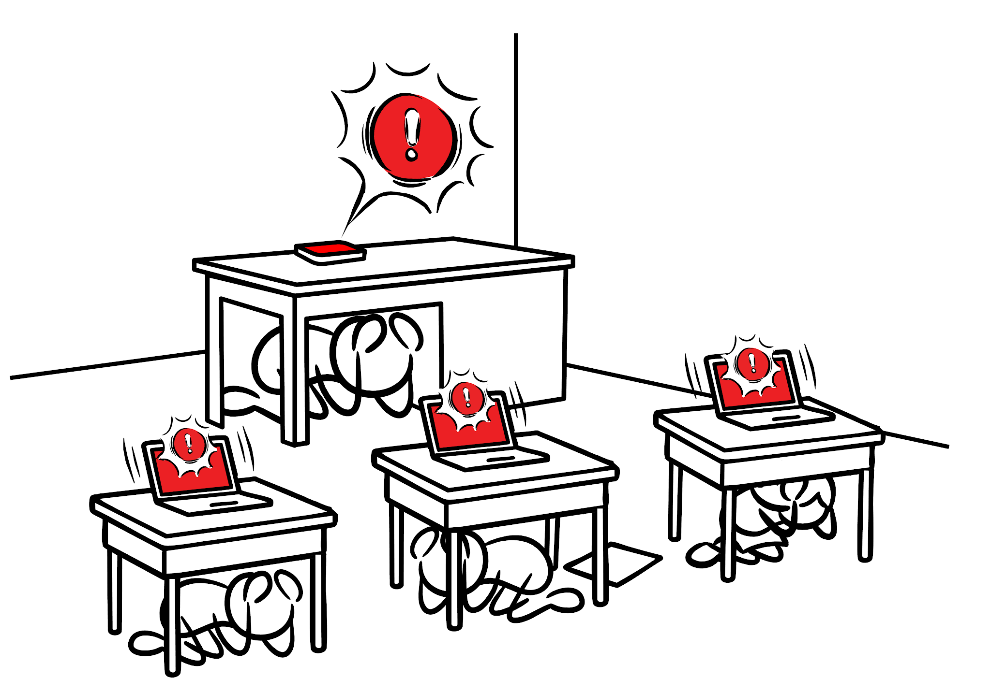
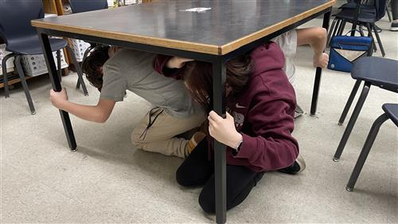
Learning Objectives:
I can explain how ShakeAlert uses information carried by waves (including seismic and radio waves) to deliver earthquake early warning alerts.
I know to Drop, Cover, and Hold On if the ground shakes or if I get an earthquake early warning alert.
Image courtesy of USGS
Image courtesy of Roger Groom
11
Notes:
Teacher Notes: Tell students that today they are taking part in an earthquake drill and will practice how to protect themselves during an earthquake. If you are teaching this lesson as part of the Great ShakeOut, tell students that millions of people in countries around the world take part in the Great ShakeOut on the 3rd Thursday of October every year.
IMAGES: Images courtesy of USGS, and Roger Groom. Used with permission.

Slide 12
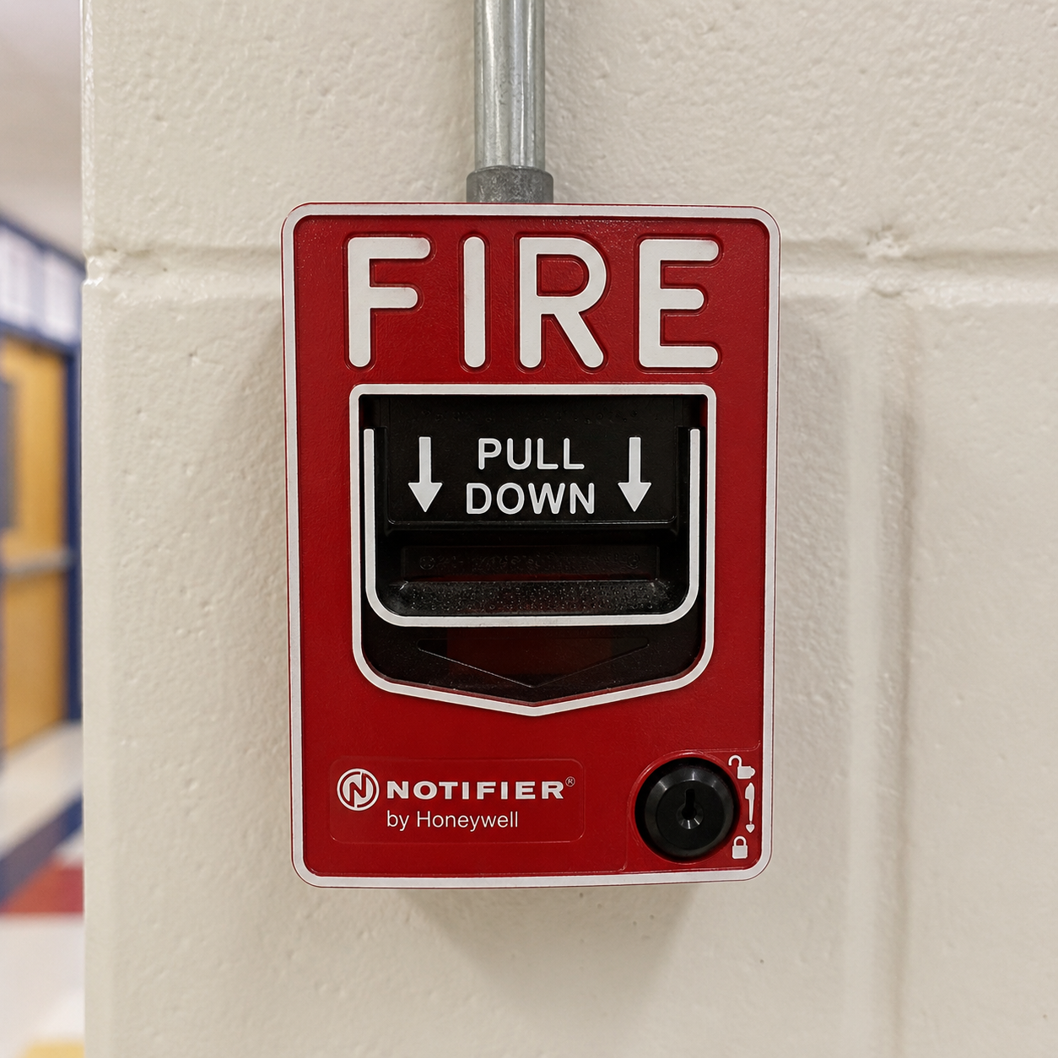
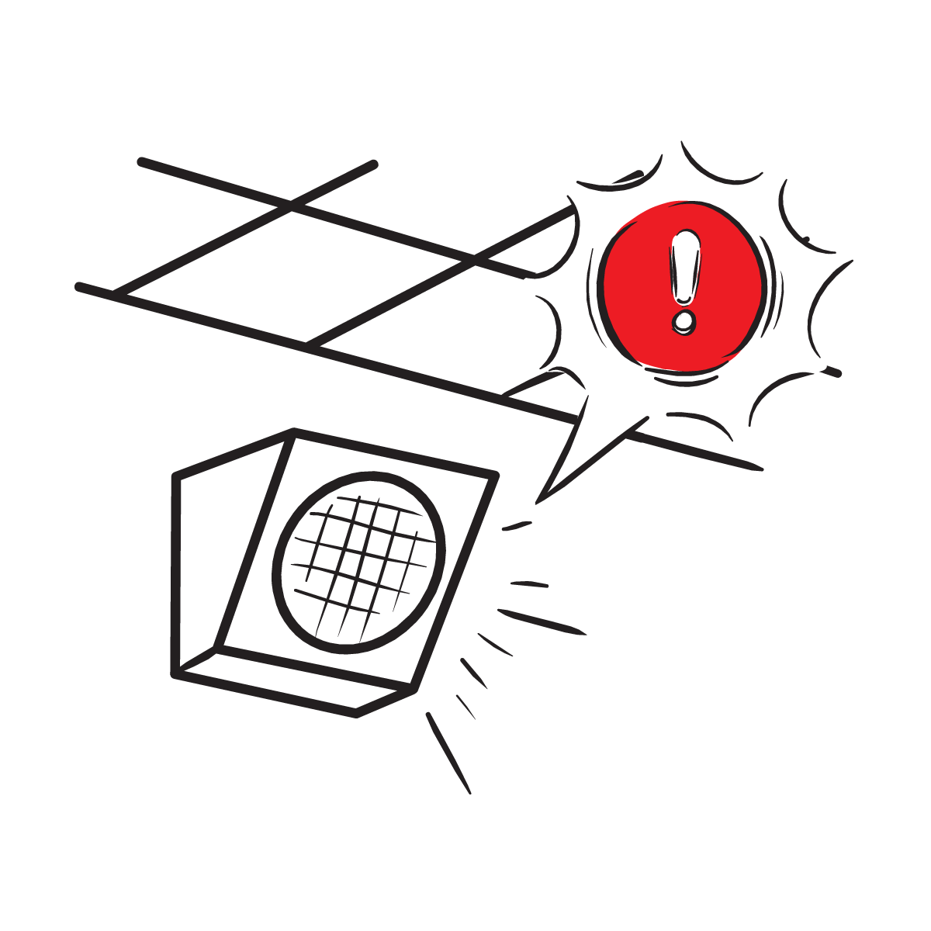
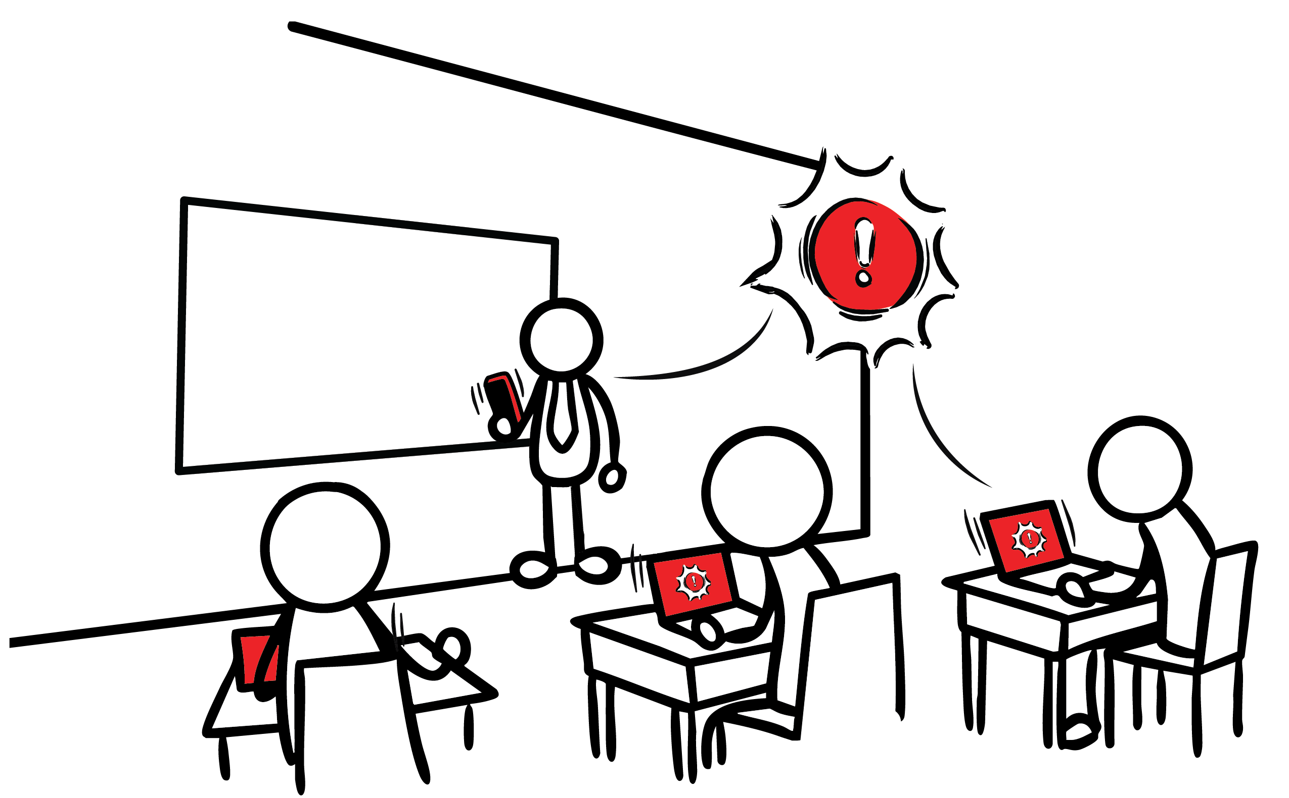
What other safety drills have we had at school?
Why do we have drills at school?
We can stay safe at school during earthquakes.
Image created with A.I.
Image courtesy or Roger Groom
Image courtesy of USGS
12
Notes:
Teacher Notes: This slide is animated so the questions appear one at a time. Ask students what other drills they’ve practiced at school. Students have probably practiced earthquake drills, shelter in place drills, and lockdowns among others.
Ask students why we practice drills at school. They should respond that we conduct drills to practice how to respond so that if there’s ever a fire or earthquake, we’re prepared and know how to stay safe. We also practice drills so that we can help students feel safer and less afraid at school. Having fire and earthquake drills can help us to feel prepared and less scared!
Tell students there are many ways to get alerts. Tell them if their school has a ShakeAlert-powered earthquake early warning system (such as the automated alert announcement through the PA system) that can give their school community members potential seconds to protect themselves before strong shaking arrives during an earthquake.
IMAGES: Image credits from left to right. Image created with A.I. Image courtesy of Roger Groom. Used with permission. Image courtesy of USGS.

Slide 13
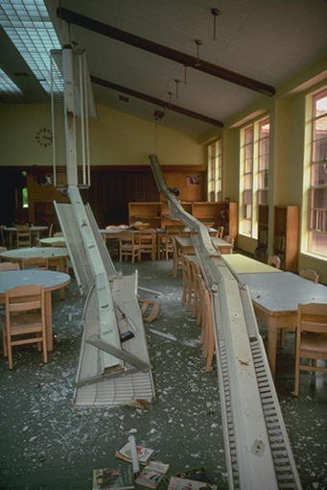
What is an earthquake?
Why do they happen?
What are some things that happen in our environments when there is an earthquake?
Image courtesy of USGS
13
Notes:
Teacher Note: Students will likely have a lot of background knowledge about plate boundaries and earthquakes.
Sample Student Response: An earthquake is a sudden release of energy in the form of seismic waves that travel away from the earthquake focus. An earthquake occurs when the friction between pieces of earth is overcome, and elastic potential energy on a fault (including a tectonic plate boundary) is transformed into kinetic energy, along with sound and thermal energy. Earthquakes can cause ground shaking, tsunamis, as well as injuries and destruction of property.
IMAGE: Earthquake damage in classroom of Dawson Elementary School in Coalinga, CA from the M6.7 May 2, 1983 Coalinga earthquake. The earthquake occurred when no students were at school.

Slide 14
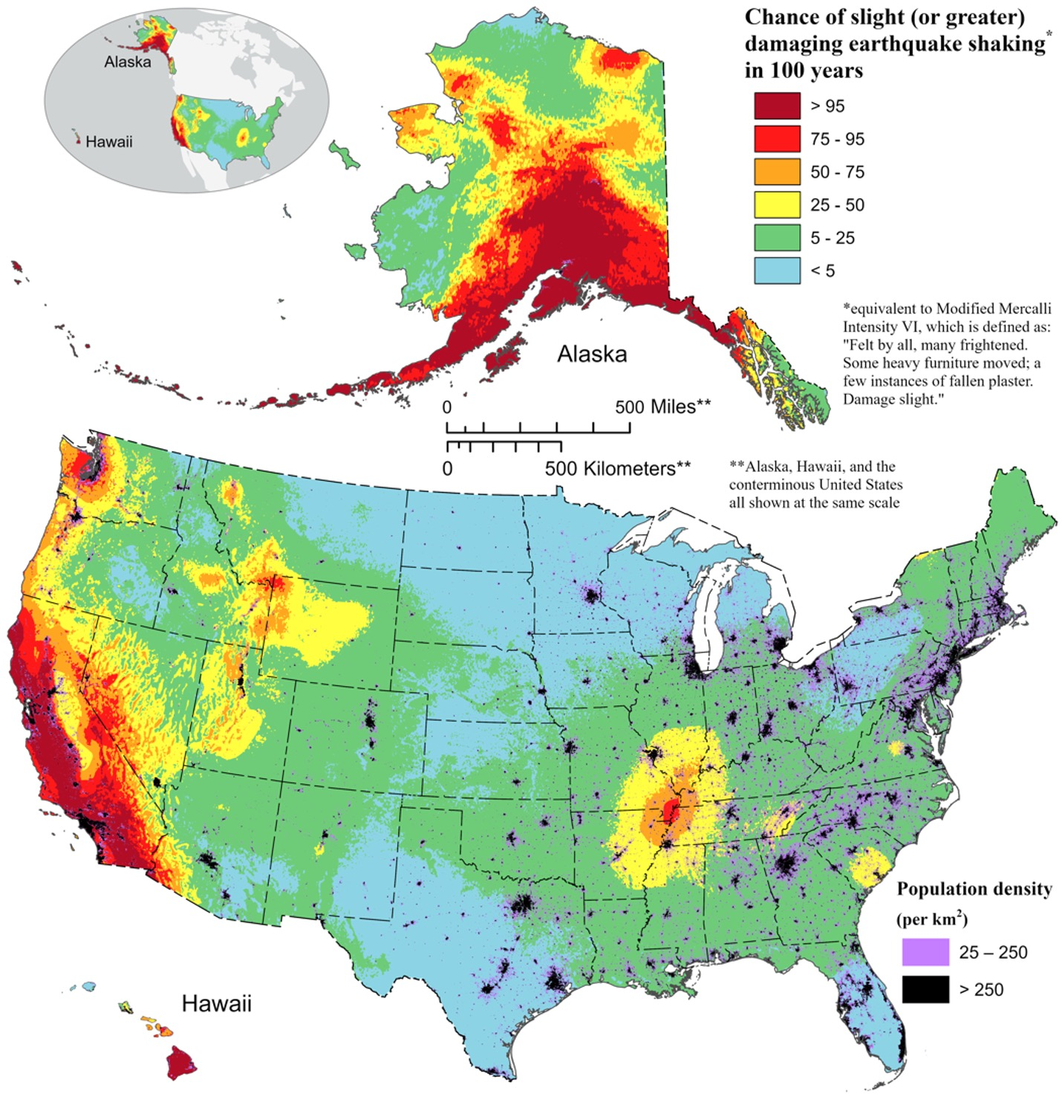
We Live in Earthquake Country!
This map shows the chance of a strong, damaging earthquake in the next 100 years.
Where are we located?
What is the chance in our area?
Image courtesy of USGS
14
Notes:
Teacher Note: This map shows the chance of a strong earthquake in the next 100 years. In this case, strong means an earthquake felt by all that frightens many, and moves heavy furniture, creating slight damage. Ask students to use the key to assess the chance of a strong earthquake in the next 100 years where they live.
IMAGE: Image courtesy of USGS
SOURCE: National Seismic Hazard Model (2023) - Chance of Damaging Earthquake Shaking, January 2023

Slide 15
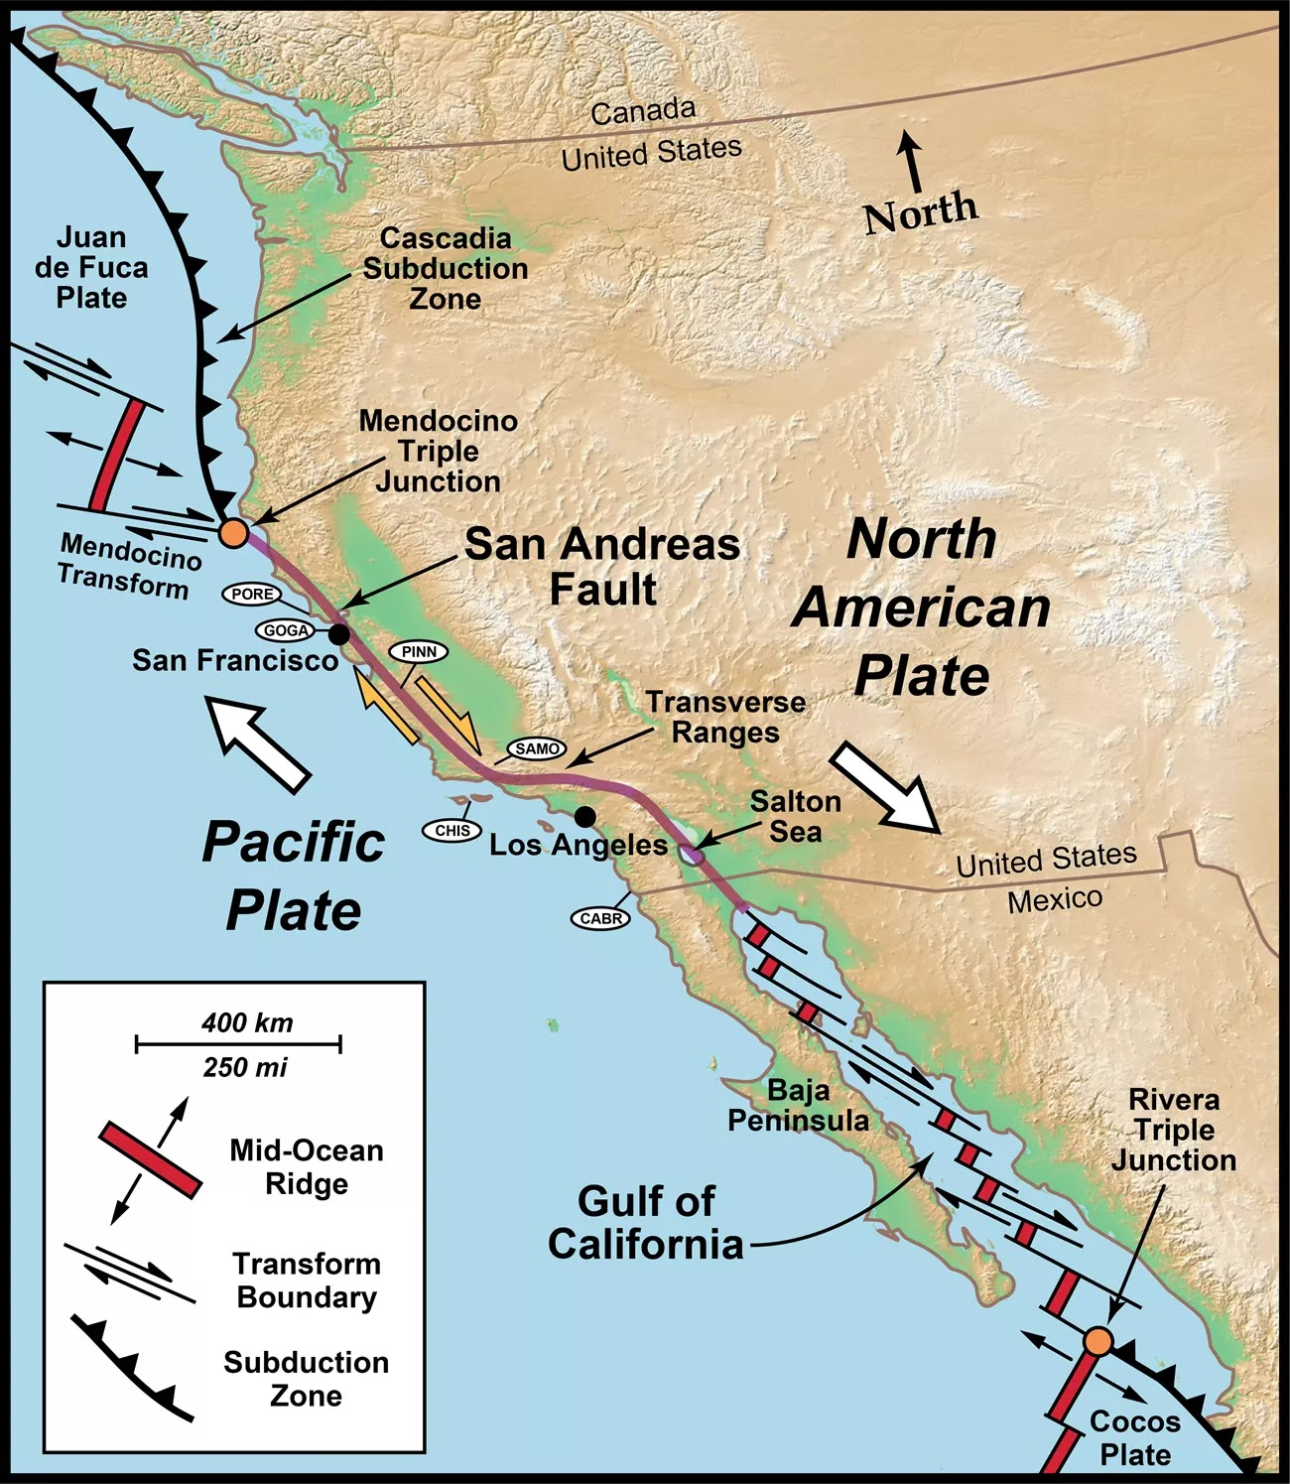
We Live Near a Tectonic Plate Boundary!
Where are we located?
What kind of plate boundary is nearby?
Image courtesy of National Park Service
15
Notes:
Teacher Note: Ask students to point out where they live on the map. Ask them what kind of plate boundary is nearby. Students in California will note that they live near a transform boundary, where the North American and Pacific Plates slide past each other. Students in Northern California will see they live near a subduction zone, which is a convergent boundary in which the denser plate (in this case the Juan de Fuca Plate) slides beneath the less dense plate (in this case the North American Plate). If you live in Southern California, point out the Salton Sea, which is part of the Salton Trough formed at the divergent plate boundary (that is on land) between the North American and Pacific Plates.
IMAGE: Image courtesy of National Park Service, San Andreas Transform Plate Boundary

Slide 16
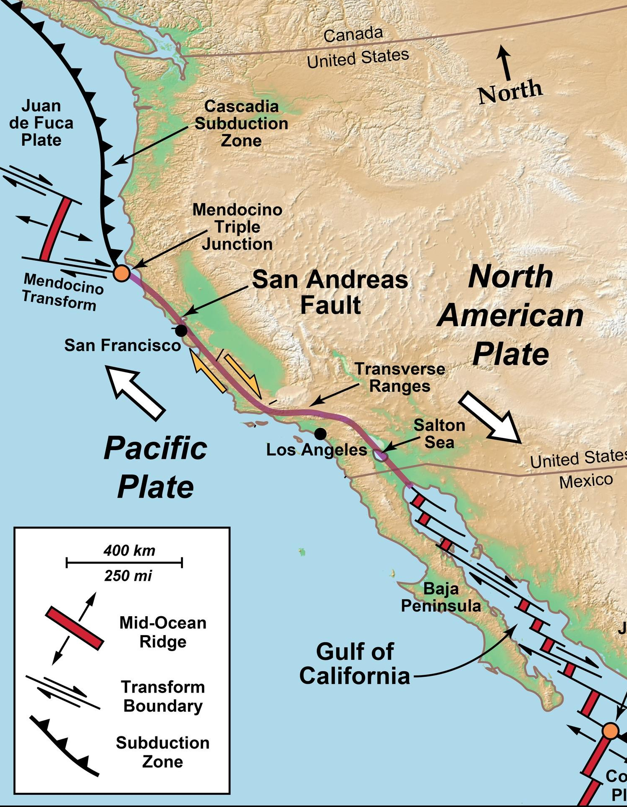
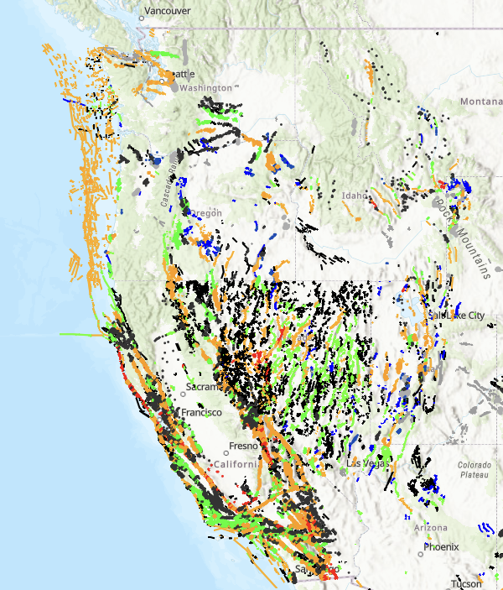
What relationship can you infer about the location of plate boundaries, faults, and the chance of strong earthquake shaking occurring in 100 years?
Images courtesy of (left) National Park Service, and (center and right) USGS
16
Notes:
Teacher Note: Tell students that faults are cracks in Earth’s surface created at and around tectonic plate boundaries as the brittle earth material is deformed. Remind students that faults form at and around each kind of boundary, and that earthquakes can occur along faults including plate boundaries. Ask students to compare the locations of plate boundaries and faults to the risk of earthquakes. They should notice that there is a higher risk of earthquakes in areas that have many faults, and that there are many faults near plate boundaries. Students may need to be reminded that an observation is something you see, hear, smell, etc., whereas an inference is a reasonable deduction based on observations.
IMAGESImages courtesy of (left) National Park Service, and (center and right) USGS

Slide 17
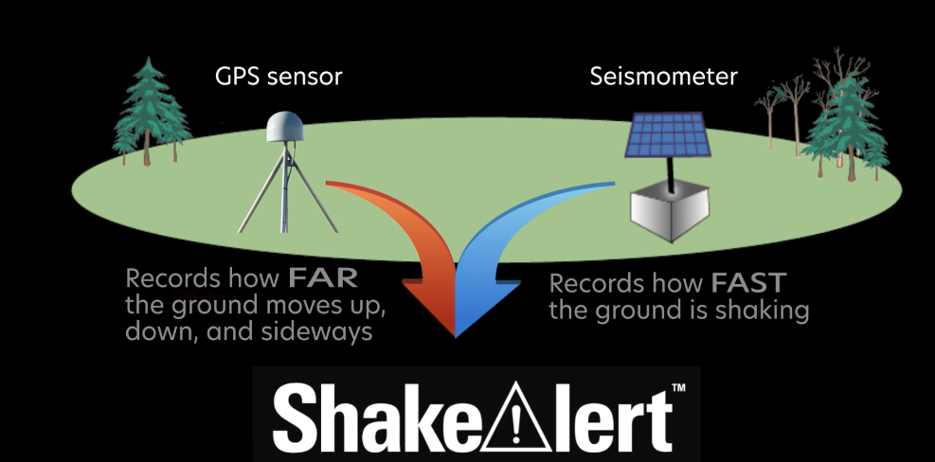
The ShakeAlert Earthquake Early Warning System Uses Earthquake Information from Seismometers & GPS/GNSS
Image courtesy of Earthscope Consortium
17
Notes:
Teacher Notes: Remind students that because of the area’s chance of experiencing a strong earthquake, their school has ShakeAlert-powered earthquake early warning. Tell students that ShakeAlert uses information from two kinds of sensors: seismometers and GPS. Seismometers record how fast the ground is shaking, and GPS records how far the ground moves up, down, and sideways. Both sensors utilize waves; seismometers measure seismic waves, and GPS uses radio waves to send information.
IMAGE: Image courtesy of EarthScope Consortium. Image is a screenshot from the video, “Using GPS to Enhance the ShakeAlert Earthquake Early Warning System.”

Slide 18

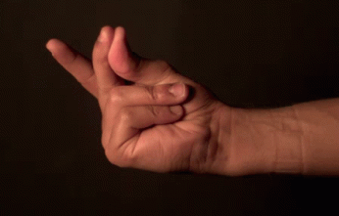
Earthquakes Generate Seismic Waves
Gif courtesy of Georgia Tech
What observations do you have of the animation?
Video courtesy of Earthscope Consortium
18
Notes:
TEACHER NOTE: This slide is animated. The snap is a gif, which will play on a loop. Clicking will play the apple tree animation.
We can model an earthquake with a snap of a finger. When we press our two fingers together, there is friction between them which prevents them from moving in the direction of the force, creating a build up of stored potential energy. When friction is overcome, the potential energy is transformed into kinetic energy, or movement, much like an earthquake. Earthquakes can happen at faults, including plate boundaries. Ask students to share their observations of the earthquake animation. In the animation, they should observe a buildup of potential energy, and then sudden, lurching motion, which sends seismic waves (earthquake waves) away from the fault in both directions.
VIDEO: Video courtesy of Earthscope Consortium
IMAGE: GIF made from: https://www.youtube.com/watch?v=cFy3uJYctZs

Slide 19
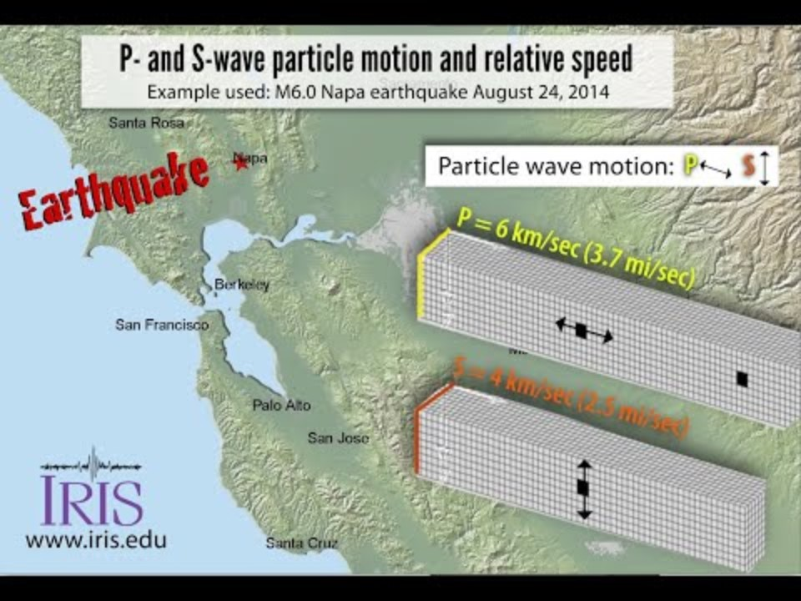
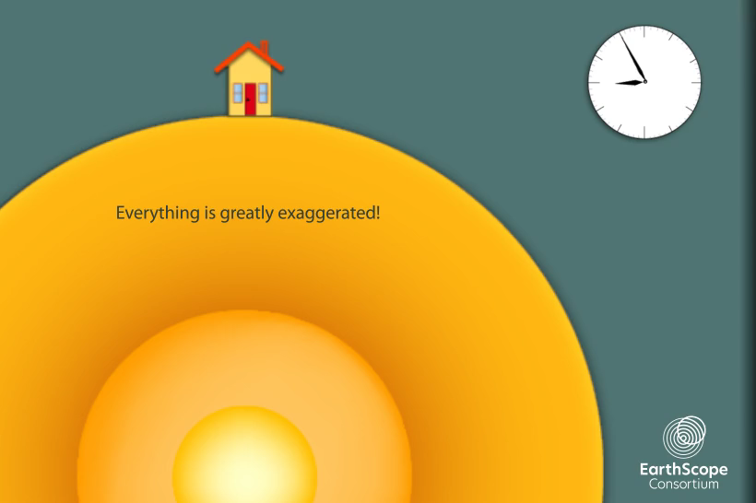
Different Kinds of Seismic Waves
How do the speeds of different types of waves compare?
How does each type of wave affect the building?
Videos courtesy of Earthscope Consortium
19
Notes:
Teacher Notes: The videos will play automatically after each question appears. To play either video again, click the white play button. NOTE: when bringing in the second question, click on the white space on the slide, not on the video.
Ask students what they observe about how the distance between waves changes as they travel away from where the earthquake started. They should notice that when the earthquake starts, the waves are right on top of each other. As the waves travel through the earth, the distance between them grows.
CREDIT: Videos from IRIS Earthquake Science. Video on the left is, “Seismic Waves--P- and S-wave particle motion and relative wave-front speeds,” and on the right is “1-Component Seismogram.”

Slide 20
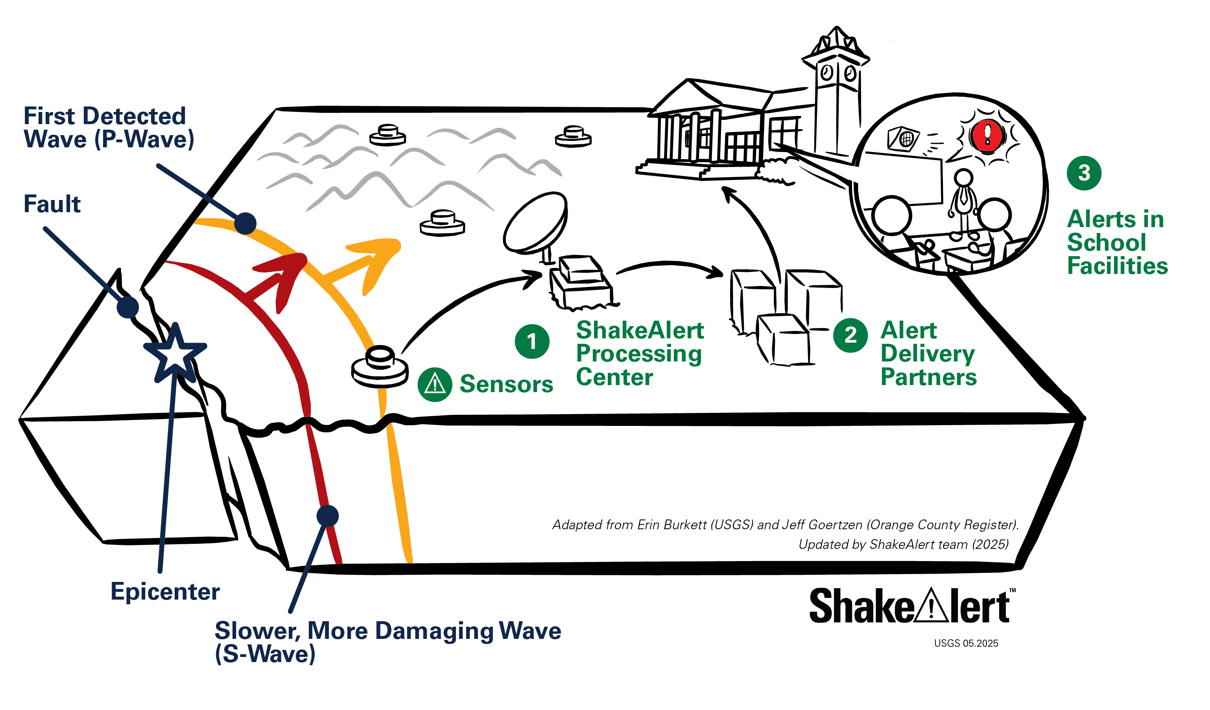
ShakeAlert Earthquake Early Warning
P-waves: faster & less damaging
S-waves and Surface waves: slower & more damaging
Alerts: delivered as soon as first earthquake wave detected.
Image courtesy of USGS
20
Notes:
Teacher Notes: The slide is animated. Point out the P-wave and S-wave in the diagram as the words appear.
Remind students that seismic waves can affect people long distances from where they begin. Tell students that the p-waves move the fastest, but are less damaging, whereas s-waves are slower but are more damaging. Tell students that as soon as the first wave is detected, alerts are sent to areas that may experience damaging shaking. Therefore, as soon as you get an alert, you should Drop, Cover, and Hold On.
IMAGE: Image courtesy of USGS

Slide 21
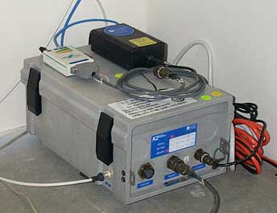
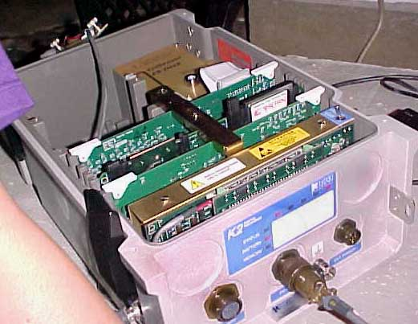
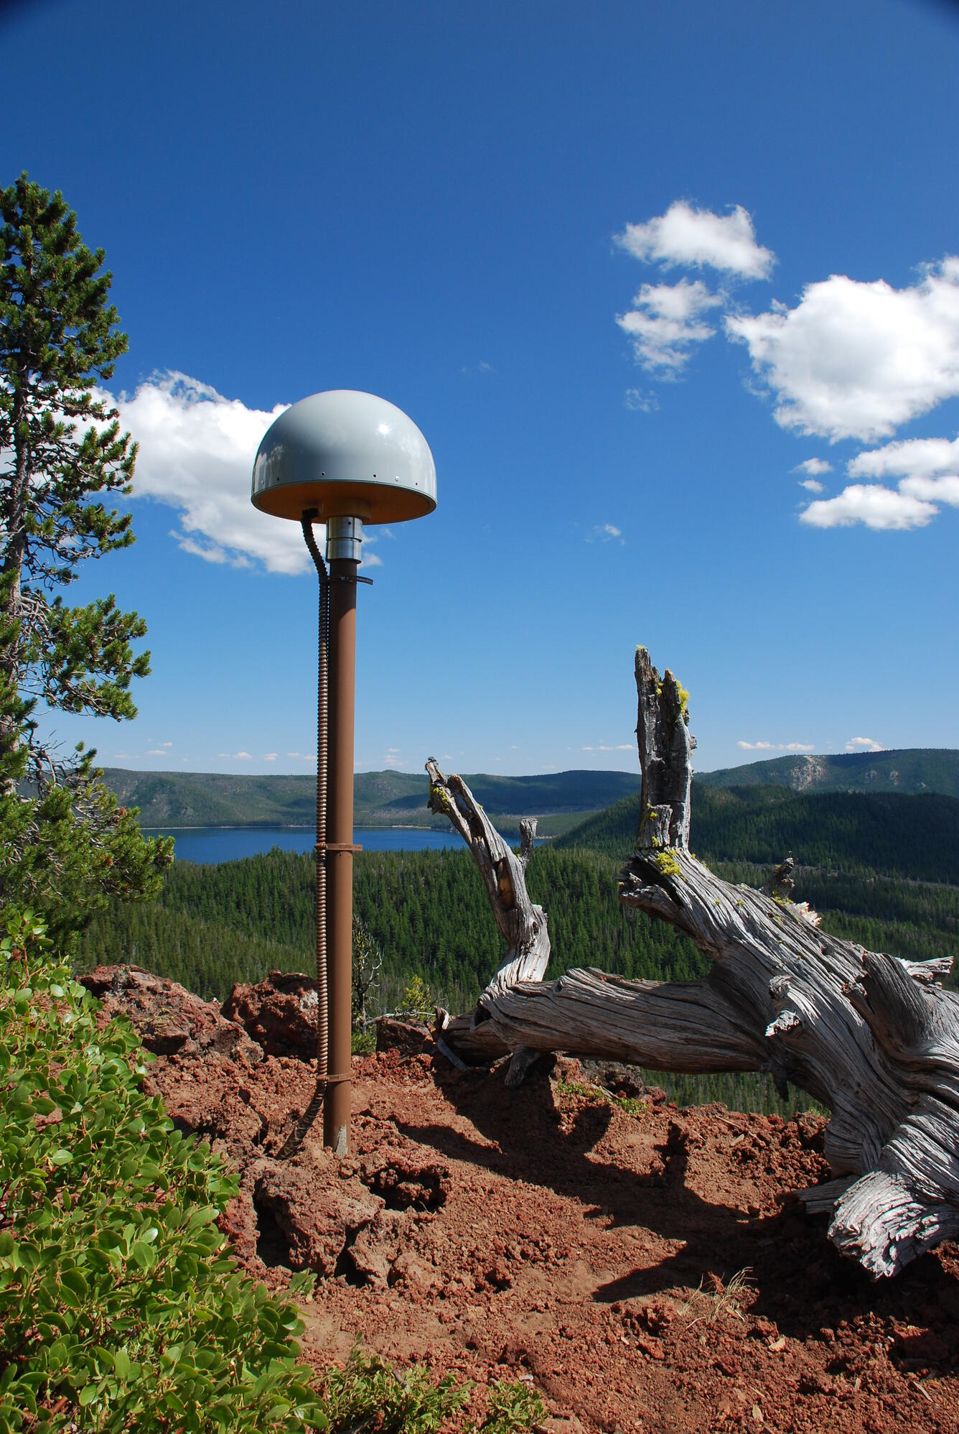
Example of Seismometer and GPS Station used for the ShakeAlert system
Example of seismometer, inside and out
Global Positioning System Receiver
Images courtesy of Pacific Northwest Seismic Network
Image courtesy of USGS
21
Notes:
Teacher Notes: In addition to utilizing seismometers, ShakeAlert uses GPS during an earthquake to measure how far the ground moves. This helps to determine how large the intensity of an earthquake will be.
IMAGE: Images courtesy the Pacific Northwest Seismic Network and USGS
Source: https://earthquake.usgs.gov/monitoring/gps/about.php

Slide 22
GPS (Global Positioning System)
Uses Radio Waves
Sent continuously from satellites to GPS receivers
Signal from >4 satellites - latitude, longitude, elevation & time check
Image courtesy of USGS
22
Notes:
Teacher Notes: The slide is animated so that the text comes in one point at a time.
Remind students that ShakeAlert also uses GPS, which stands for Global Positioning System. GPS uses a network of satellites that orbit the Earth twice a day. They continuously send radio waves to the ground with atomic clock-generated time, and the satellite’s position. Radio waves are a type of electromagnetic radiation, so they travel through the vacuum of space at the speed of light, which is 300,000 km per second. Each GPS receiver uses messages sent from more than 4 satellites to determine its position on Earth. It needs at least 4 to get a position, but it needs more than four to produce an accurate position. That’s because data is noisy; the radio waves are distorted by variations in the atmosphere (for instance pockets of hot and cold air) as they pass from the satellite to the receiver. Having more data overcomes this noise. The accuracy of GPS is oftentimes to 5 mm, or ¼ inch.
IMAGE: Image courtesy of USGS. Global Positioning System receiver (called a GPS monument) at North Rim Station, a monitoring location at Newberry volcano, Oregon.
Source: https://earthquake.usgs.gov/monitoring/gps/about.php

Slide 23
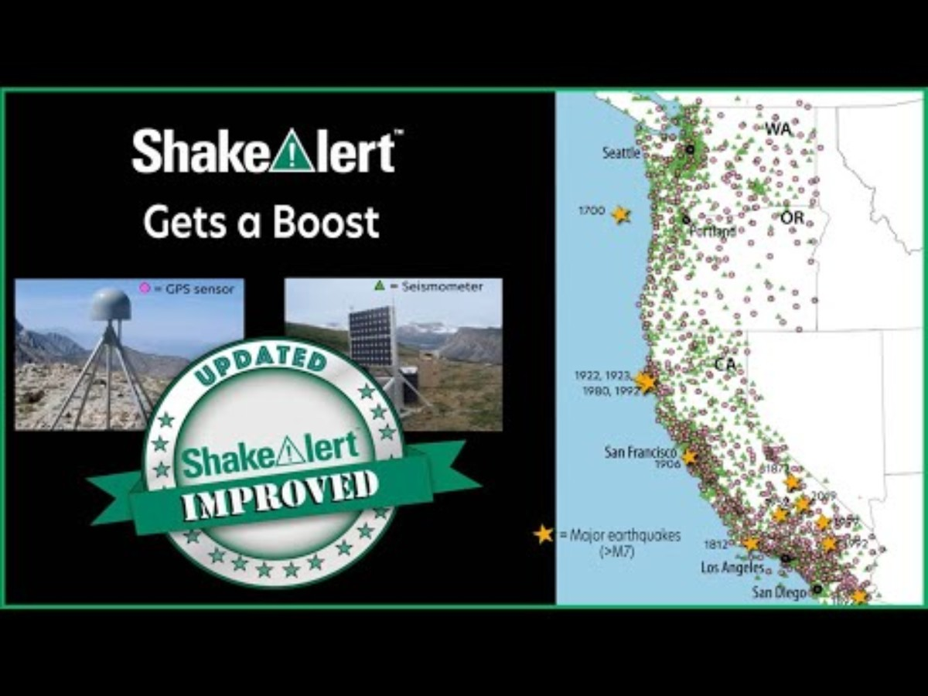
As you watch:
How does ShakeAlert utilize P- and S-wave behavior?
How does GPS contribute to ShakeAlert alerting?
Video courtesy of Earthscope Consortium
23
Notes:
Teacher Note: Tell students that this video describes how ShakeAlert uses seismometers and GPS to send earthquake early warning alerts. Read the two questions on the slide to students before showing the video so that students know what to focus on. (This video (2:17) describes the USGS-managed ShakeAlert System, which senses earthquakes as soon as they begin, and sends alerts to buildings and schools like yours. These alerts can give people seconds of time to Drop, Cover, and Hold On before dangerous ground shaking occurs.) Students should notice that ShakeAlert takes advantage of seismic wave behaviors by sending alerts as soon as faster-moving but less damaging p-waves are detected. This can give people further away from the earthquake focus time to Drop, Cover and Hold On before the slower and more damaging s-waves arrive. GPS helps to more accurately estimate the magnitude of the earthquake by measuring ground displacement during an earthquake.
VIDEO: Video courtesy Earthcope Consortium.

Slide 24
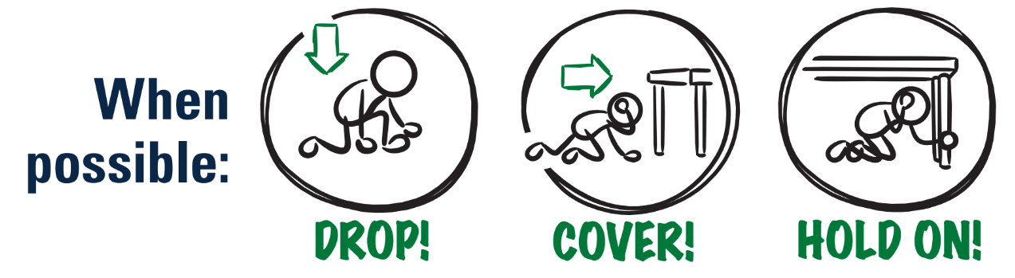
What should you do immediately if you feel shaking or get an alert?
Image courtesy of USGS
24
Notes:
Teacher Note: This is animated. Ask the question first to elicit student responses.
Review and model correct protective actions - Drop, Cover, and Hold On. Make sure students know they should drop to their knees (not their bottoms), have one hand over their necks, and try to get away from glass or any other objects that could fall on them. If they’re able to get under a table or desk while staying on their knees, they should. Once there, they should hold on to the leg of the table/desk.
IMAGE: Image courtesy of USGS.

Slide 25
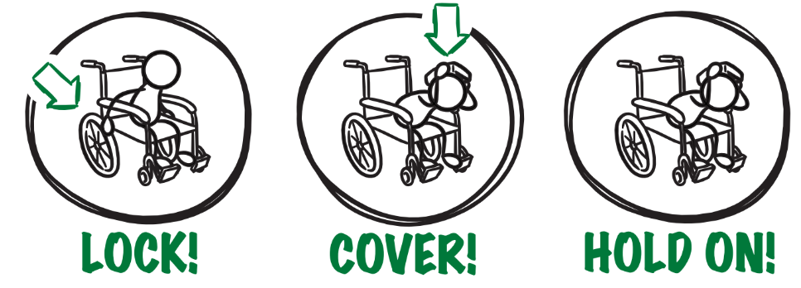
If you or someone you know uses a wheelchair:
Image courtesy of USGS
25
Notes:
Teacher Notes: Tell students that Drop, Cover, and Hold On looks different for different bodies. Review modified protective actions for people who use wheelchairs. While you may not have students who use wheelchairs in your class, it is likely that there are members of your community who do. Ask students to help their family members or friends who use a wheelchair by sharing that “Lock, Cover, and Hold On” is how they can protect themselves during an earthquake. Have students repeat the phrase, “Lock, Cover, and Hold On” after you’ve said it.
IMAGE: Image courtesy of USGS.

Slide 26


If you or someone you know uses a cane or walker:
Image courtesy of USGS
26
Notes:
Teacher Notes: Slide is animated so images come in when you click. Review modified protective actions for people who use a cane or walker. While you may not have students who use a cane or walker in your class, it is likely that there are members of your community who do. Ask students to help their family members or friends who use a cane or walker by sharing the correct protective actions. Have students repeat the phrase, “Drop, Cover, and Hold On” and then “Lock, Cover, and Hold On” after you’ve said it.
IMAGE: Image courtesy of USGS.

Slide 27
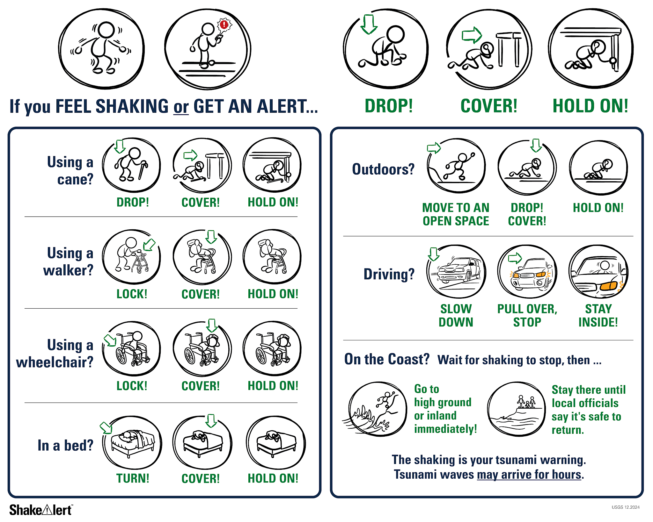
If you are outside when you feeling shaking or get an alert:
Image courtesy of USGS
27
Notes:
Teacher Notes: Slide is animated so images appear when you click. Tell students that if they are outside when they feel shaking or get an alert, they should immediately move to an open space away from power lines or other objects that could fall on them. They should then drop to their knees and use their arms to cover their head and neck and hold on in that position until the shaking stops.
IMAGE: Image courtesy of U.S. Geological Survey

Slide 28
If you are on the coast, Drop, Cover, and Hold On.
When the shaking stops…
Image courtesy of USGS
28
Notes:
Teacher Notes: Slide is animated so images appear when you click. Tell students that if they are visiting the coast, the earthquake could be followed by a tsunami, which is a large wave caused by the earthquake. If they are on the coast when they feel shaking or get an alert, they should Drop, Cover and Hold On. When the shaking stops, immediately go inland, to high ground, or follow their school’s specific safety procedures. Tell students that it’s important to wait until they hear it’s safe to return because tsunami waves can continue to arrive for hours or even days after an earthquake.
IMAGE: Image courtesy of USGS

Slide 29

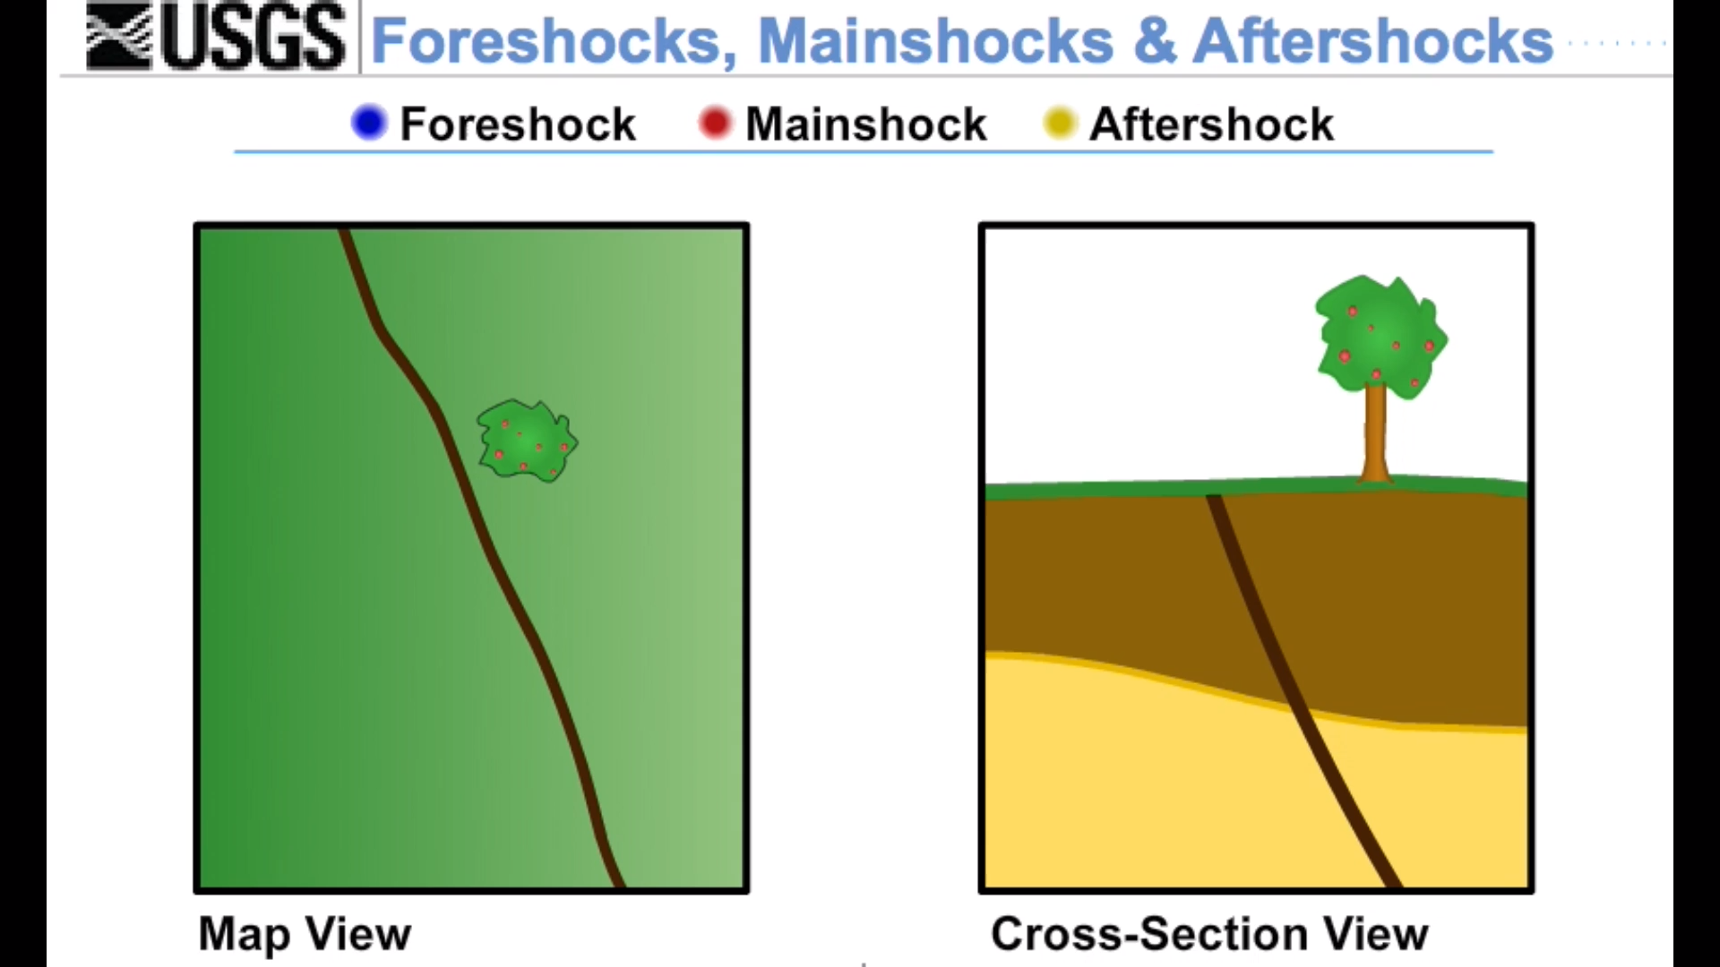
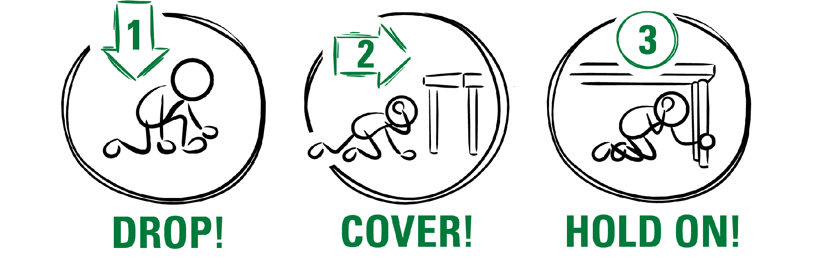
Foreshocks & Aftershocks
Foreshocks = Smaller earthquakes before the main earthquake
Aftershocks = Smaller earthquakes after the main earthquake
Video and image courtesy of USGS
Notes:
Teacher Notes: Slide is animated so images appear when you click. Tell students that sometimes smaller earthquakes will occur before the main earthquake, which are called foreshocks. Most large earthquakes are followed by smaller earthquakes called aftershocks. Aftershocks can occur hours, days, or weeks after the main earthquake. Foreshocks and aftershocks are smaller than the main earthquake but can still cause strong shaking and damage. Remind students that they should Drop, Cover, and Hold On if they feel shaking or get an earthquake early warning alert. Tell students you’ll watch an animation of foreshocks, mainshocks, and aftershocks now. Ask them what color foreshocks, mainshocks, and aftershocks are. (They should use the key and note that foreshocks are blue, mainshocks are red, and aftershocks are yellow.) Ask students what the difference is between the map view on the left and the cross-section view on the right. (They should note that the map view is an overhead or bird’s-eye view, and the cross-section view shows us what’s happening inside earth.) Play the animation and ask students what they observe. Stress the importance of staying vigilant and the need to immediately Drop, Cover, and Hold On if they feel shaking or get an alert.
SOURCE: earthquake.usgs.gov/data/oaf/overview.php
IMAGE: Video and image courtesy of USGS

Slide 30
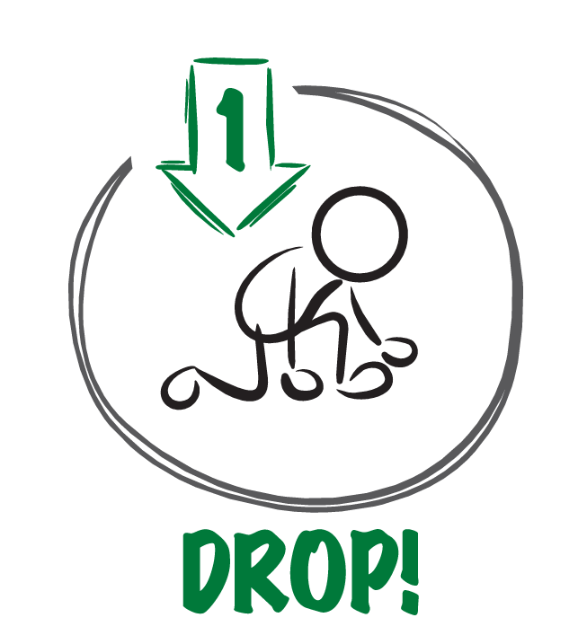

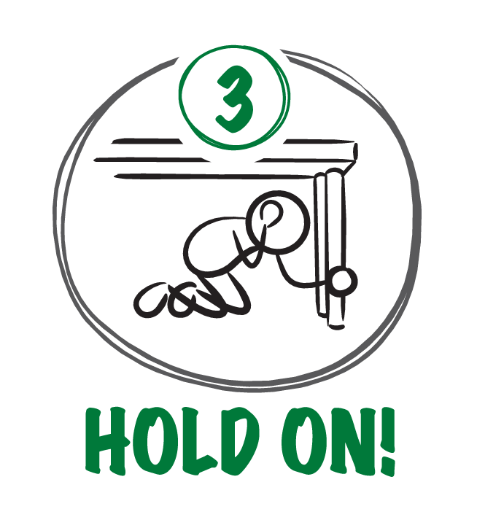
When the ground shakes or you get an alert,
why is it important to . . .?
Image courtesy of USGS
30
Notes:
TEACHER NOTE: This slide is animated and the ‘Cover’ and ‘Hold On’ appear individually so you can discuss each action in turn. Begin by eliciting student responses for each. Add on to student responses as necessary.
DROP: Dropping to your knees protects you from falling during ground shaking.
COVER: We cover our neck and head to protect them from becoming injured if something falls.
HOLD ON: We hold on to a table leg once we’re beneath a table so that the earthquake doesn’t move us out from underneath the table that is protecting us.
IMAGE: Image courtesy of USGS.

Slide 31
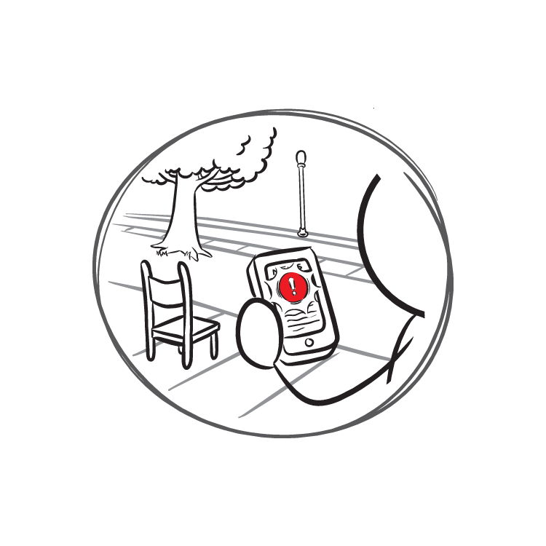
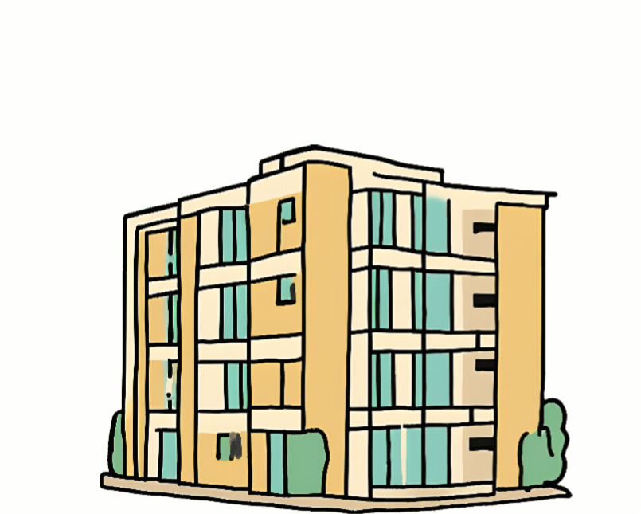
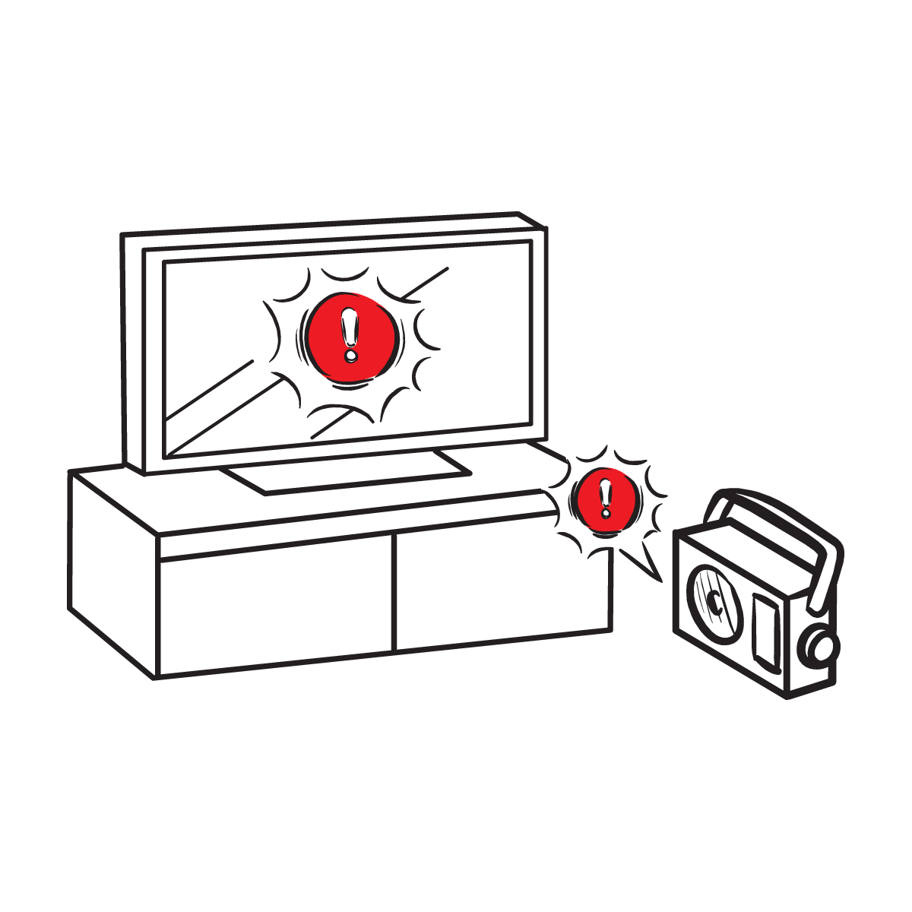
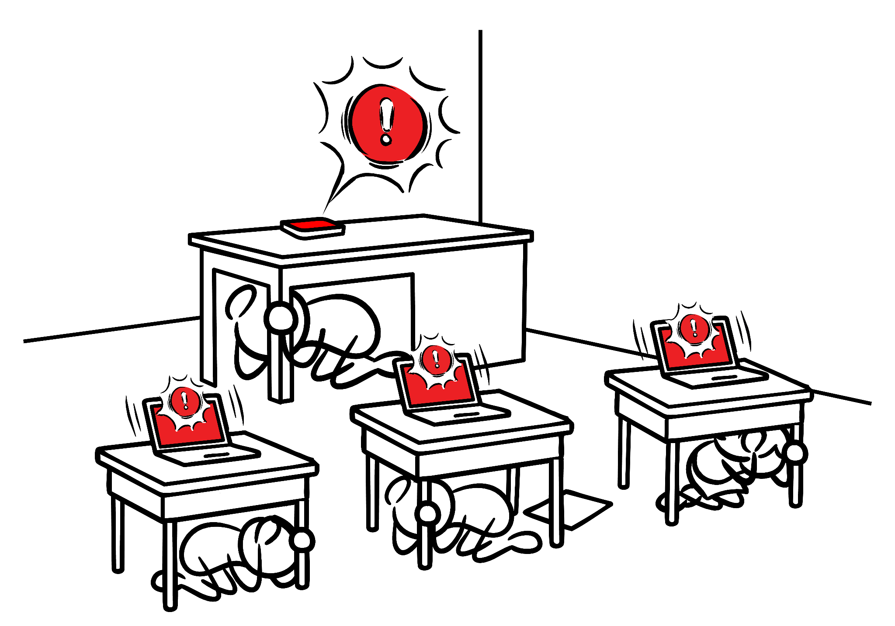
Protect yourself when there is . . .
Ground Shaking
An Earthquake Drill
An Earthquake Early Warning Alert
Gif created using A.I.
Image courtesy USGS
Image courtesy ShakeAlert
Notes:
Teacher Notes: Slide is animated, so images appear when you click. Tell students that they should take these protective actions when the ground shakes, if there’s an earthquake early warning alert, or if they’re participating in an earthquake drill, which we’ll do now. Tell students that it’s vital they Drop, Cover, and Hold On immediately and without hesitation.
IMAGES: Gif created using A.I. Images courtesy of the USGS.

Slide 32

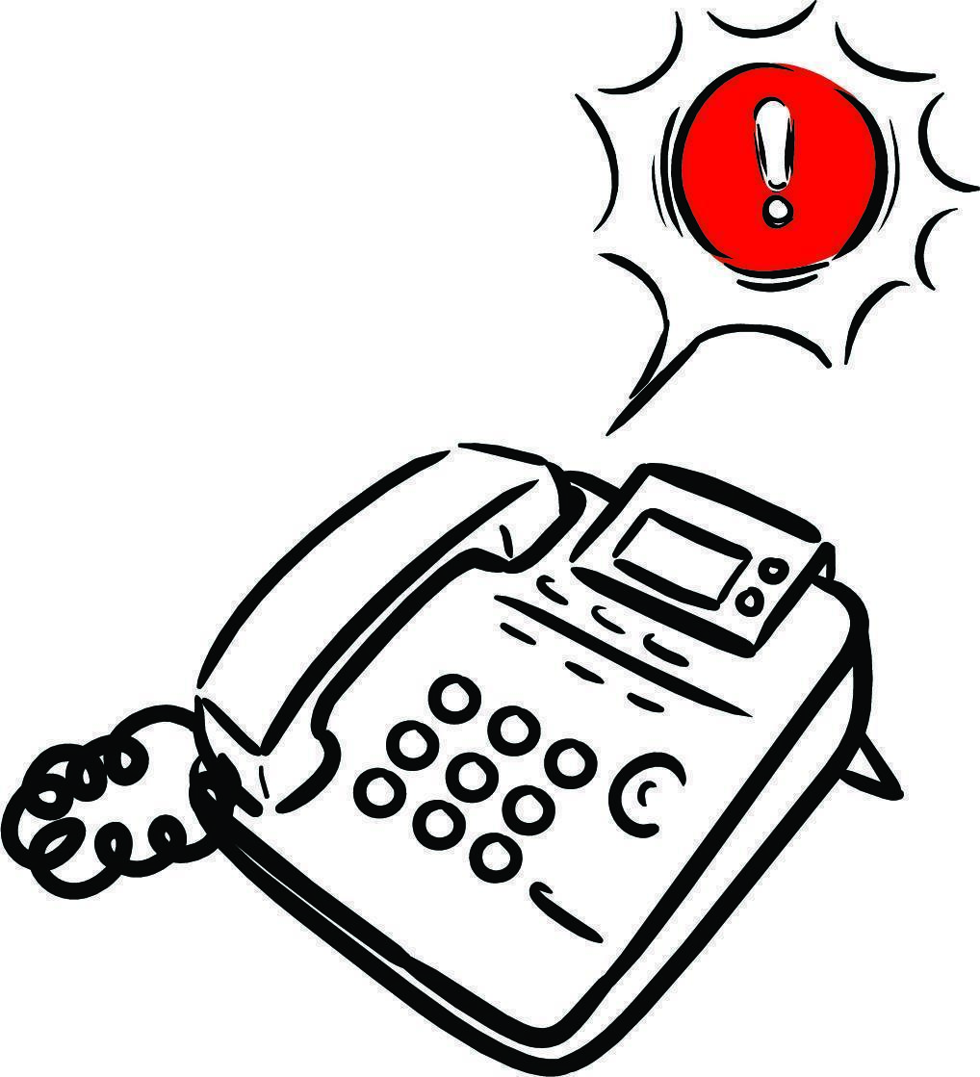


What to Expect from an Alert
Image courtesy USGS
32
Notes:
Teacher Notes: Play the ShakeAlert alert. Have all students Drop, Cover, and Hold On. Ask students to stay in their protective positions while the teacher observes and offers corrections if necessary. Once the teacher has checked in with each student, ask them to return to their seats.
NOTE: Your EEW alert may sound and look different than the one pictured on the slide!
IMAGES: Images courtesy of USGS

Slide 33

Let’s Reflect!
How did we do?
Questions?
Key things to remember?
33
Notes:
Teacher Notes: Ask students to turn and talk to reflect on the earthquake drill to discuss how they did, if they have questions, and what they think the key things to remember are. After reflecting, remind students of the key takeaways to stay safe during an earthquake, including immediately dropping to your knees, getting under a table if you can and holding on to the table leg, facing away from glass or heavy objects that could fall, covering your head and neck, remaining silent so that you can hear teacher instructions, and holding this position until shaking stops.

Slide 34
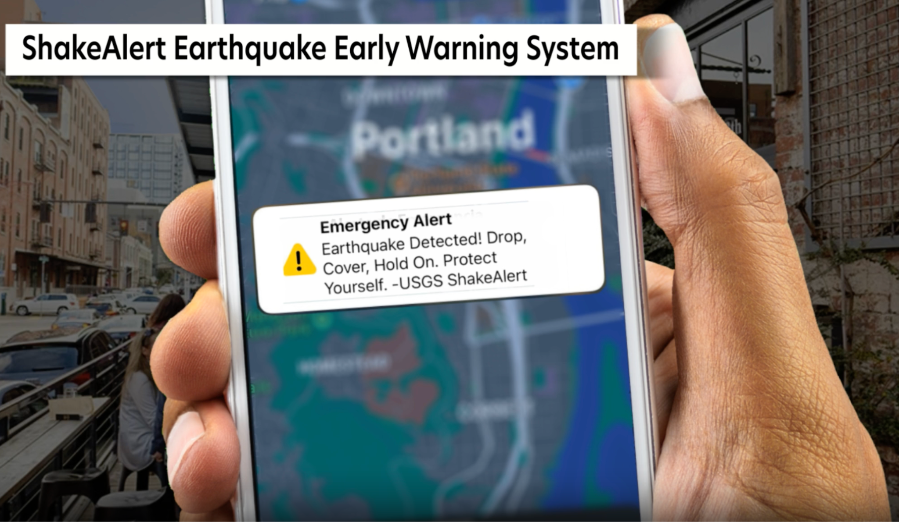
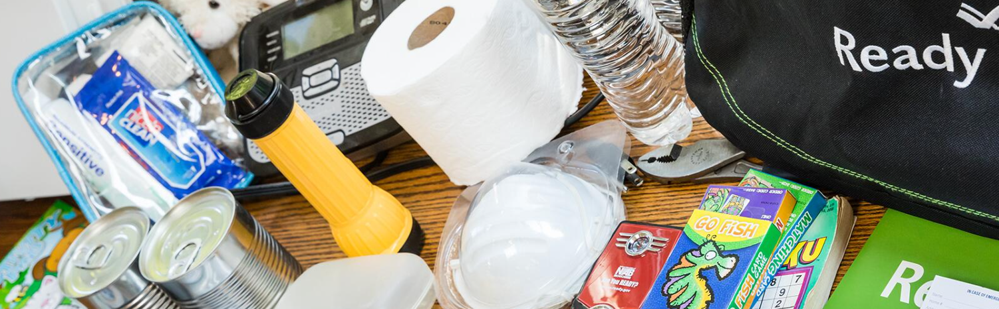
What else can the community do to prepare for an earthquake?
Be sure cell phone settings are alert-enabled.
Make an emergency plan.
Practice!
Make an emergency supply kit.
Images courtesy MyShake (top) and Ready.gov (bottom)
34
Notes:
Teacher Notes: This slide is animated. Elicit student responses first. This is not a complete list. Validate / discuss other student ideas. Practice means to practice earthquake drills in multiple settings, and practice reunification with family after an earthquake.
IMAGE: Image credits from top to bottom. Image courtresy MyShake. Used with permission. Image courtesy Ready.gov.

Slide 35
Everyone Should Prepare
Spread the word!
Tell your family and community what you learned about how to protect yourself during an earthquake.
Practice tonight!
35
Notes:
Teacher Note: Tell students that most of the adults they know have probably not taken part in an earthquake drill since they were students, and may have incorrect ideas about how to protect themselves in an earthquake. They can help the people they live with and community members prepare by teaching them about Drop, Cover, and Hold On, and informing them about ways to prepare, such as making sure your cell phone is enabled to receive ShakeAlert-powered alerts and preparing an emergency kit and plan. Ask them to share the Family Engagement Letter with their families tonight.
IMAGE: Image courtesy of USGS

Slide 36
Welcome Back!
How did your discussions go with your family?
Did you show your family how to Drop, Cover, and Hold On if they were to feel shaking or get an alert?
Image courtesy USGS
36
Notes:
Teacher Notes: NEXT DAY: Ask students how their conversations with their families went. Did their family members know that Drop, Cover, and Hold On are the correct protective actions? Did they talk about an emergency plan?
IMAGE: Image courtesy of USGS

Slide 37
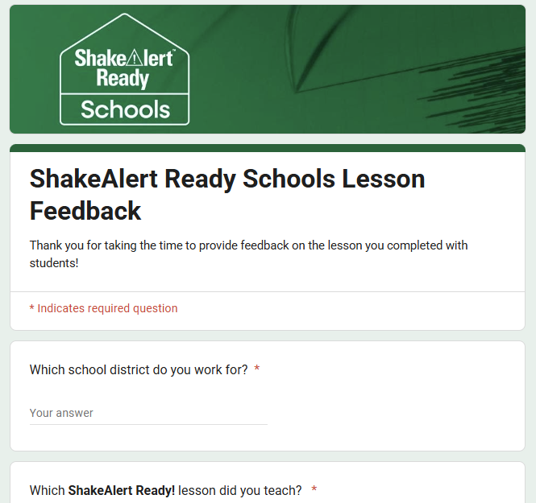
Teachers, share your feedback, please!
Please complete the short and anonymous feedback form and help us to improve our ShakeAlert Ready lessons.
37
Notes:
LINK: https://docs.google.com/forms/d/e/1FAIpQLSeNHAr45fDTztflhJJD3_JVS8p0RiV1MW9sKyQgFucGJyKcCA/viewform?usp=sf_link

Slide 38
Content Standards
Common Core English Language Arts (CA, OR, WA)
CCSS.ELA-LITERACY.RST.9-10.7
Translate quantitative or technical information expressed in words in a text into visual form (e.g., a table or chart) and translate information expressed visually or mathematically (e.g., in an equation) into words.
CCSS.ELA-LITERACY.RST.11-12.7
Integrate and evaluate multiple sources of information presented in diverse formats and media (e.g., quantitative data, video, multimedia) in order to address a question or solve a problem.
English Language Proficiency (OR)
9-12.2 An ELL can participate in grade-appropriate oral and written exchanges of information, ideas, and analyses, responding to peer, audience, or reader comments and questions.
9-12.9 An ELL can create clear and coherent grade-appropriate speech and text.
9-12.10 An ELL can make accurate use of standard English to communicate in grade-appropriate speech and writing
English Language Proficiency (WA)
ELD-SI 4-12 Narrate
Share ideas about one’s own and others’ lived experiences and previous learning
Connect stories with images and representations to add meaning
Identify and raise questions about what might be unexplained, missing, or left unsaid
ELD-SI 4-12 Inform
Report on explicit and inferred characteristics, patterns, or behavior
Describe the parts and wholes of a system
Summarize most important aspects of information
Next Generation Science Standards (CA, OR, WA)
HS-PS4-5. Communicate technical information about how some technological devices use the principles of wave behavior and wave interactions with matter to transmit and capture information and energy.*
Social Sciences (OR)
HS.G.GR.1 Use geographic tools, various kinds of maps, and geospatial technologies to examine geographic components of past and current world events or to solve geographic problems.
Social Emotional Learning (OR)
Standard 5: Demonstrate curiosity and analysis of oneself and society in order to make caring choices that impact personal, social, and collective well-being across situations and environments.
Health (OR)
HS.SFA.6 Analyze community and individual preparation and emergency response in case of natural disasters, including wildfires and earthquakes, and acts of violence.
Health Education (CA)
1.3.S Analyze emergency preparedness plans for the home, the school, and the community.
1.11.S Identify ways to stay safe during natural disasters and emergency situations (e.g., landslides, floods, earthquakes, wildfires, electrical storms, winter storms, and terrorist attacks).
3.2.S Analyze community resources for disaster preparedness.
6.1.S Develop a plan to prevent injuries during emergencies and natural disasters.
English Language Proficiency (CA) - 6 (Bridging Proficiency Levels)
1. 1. Exchanging information/ideas: Contribute to class, group, and partner discussions, sustaining conversations on a variety of age and grade-appropriate academic topics by following turn-taking rules, asking and answering relevant, on-topic questions, affirming others, and providing coherent and well-articulated comments and additional information.
3. Supporting opinions and persuading others: Negotiate with or persuade others in conversations in appropriate registers (e.g., to acknowledge new information in an academic conversation but then politely offer a counterpoint) using a variety of learned phrases, indirect reported speech (e.g., I heard you say X, and I haven’t thought about that before. However, ... ), and open responses to express and defend nuanced opinions.
5. Listening actively: Demonstrate comprehension of oral presentations and discussions on a variety of social and academic topics by asking and answering detailed and complex questions that show thoughtful consideration of the ideas and arguments, with light support.
38

Slide 39
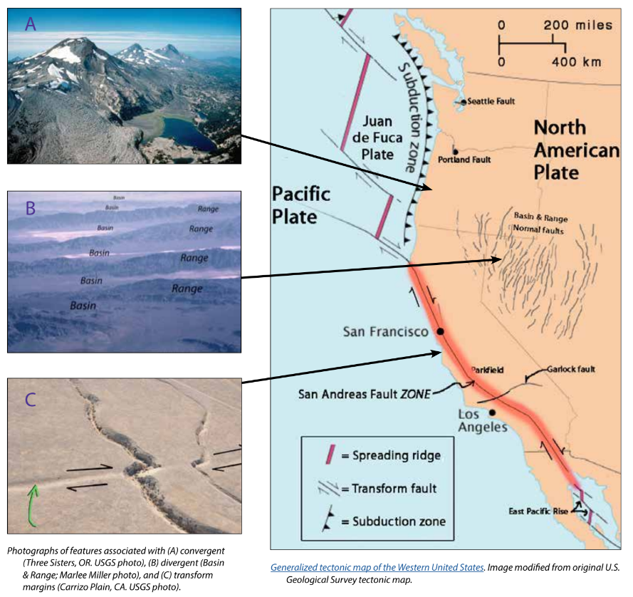
Background - Earthquake Hazard
California, Oregon, and Washington all face hazards from earthquakes because of the underlying tectonic plates, which constantly grind against each other. This friction creates "faults," lines of weakness in the Earth's tectonic plates (lithosphere) where earthquakes are most likely to occur.
California's San Andreas Fault is one example. Another example is the Cascadia Subduction Zone, which threatens all three states and British Columbia, Canada. This giant fault lies offshore, where the Juan de Fuca Plate dives beneath the North American Plate. This type of motion on other subduction zones can cause massive earthquakes, like the one that struck Japan in 2011.
While smaller earthquakes happen often, scientists think a major earthquake could happen any time, so it's important to be prepared.
For more information: Faults, Plate Tectonics & Earthquake Hazards - Animations / Videos
39
Notes:
IMAGE: https://www.iris.edu/hq/inclass/activities/introduction_to_faults_and_plate_tectonics
SOURCE: https://www.usgs.gov/programs/earthquake-hazards/science/pacific-northwest-hazards
https://www.usgs.gov/programs/earthquake-hazards/science/southern-california-earthquake-hazards

Slide 40
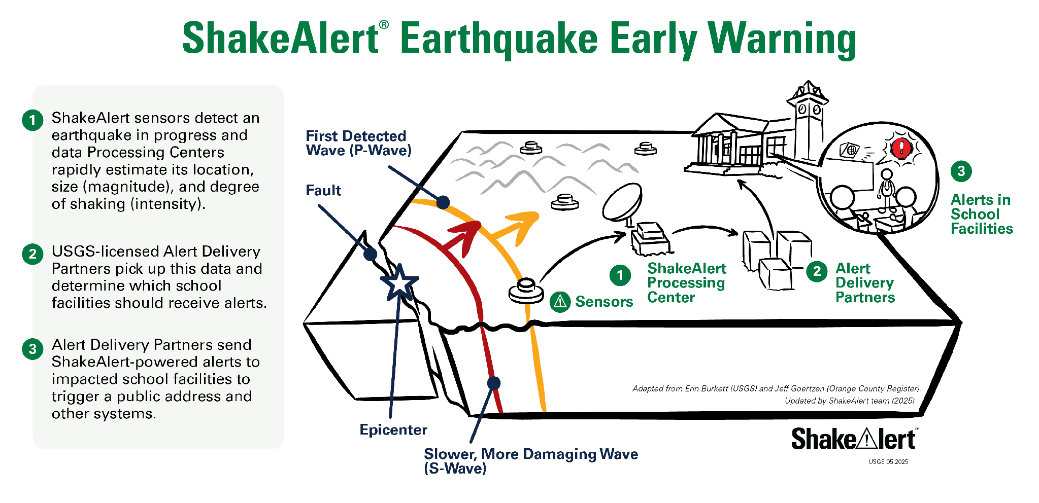
Background - How the ShakeAlert Earthquake Early Warning System Works
40
Notes:
https://drive.google.com/drive/folders/1oQOHup9P_p3DUkyIOi9DwqAlLgzdY45A?usp=drive_link
For more information on Earthquake Early Warning, go to: https://www.iris.edu/hq/inclass/sequences/earthquake_early_warning

Slide 41
Background - Effective Protective Actions
Most earthquake-related injuries and deaths are caused by collapsing walls and roofs, flying glass and falling objects.
If you are inside a building, move no more than a few steps, then Drop, Cover, and Hold On.
If you are outdoors when the shaking starts, you should find a clear spot away from buildings, trees, streetlights, and power lines, then Drop, Cover, and Hold On. Stay there until the shaking stops.
For protective actions in various settings (descriptions and gifs), go to https://www.earthquakecountry.org/step5/
Notes:
SOURCE: https://www.shakeout.org/whyparticipate/
IMAGE: Image courtesy of the USGS

Slide 42
Rationale
Why do we practice earthquake drills?
To react quickly you must practice often. You may only have seconds to protect yourself in an earthquake, before strong shaking knocks you down--or drops something on you.
Social science research has long shown that people who practice actions are more likely to take those actions when a safety- threatening event occurs, such as an earthquake or fire. Tests, drills, and exercises that repeat concepts build “muscle memory” of procedural knowledge and timely reaction. The more frequently a person practices a procedure or self-protective action, such as Drop, Cover, and Hold On, the more likely they will employ it— almost without thinking—when they receive an alert or feel shaking.
Why share the Family Engagement Letter?
While schools practice earthquake drills regularly, most other locations don’t. Some students’ family members may not have practiced earthquake drills since they were in school.
Family members may have outdated information about how to stay safe in an earthquake, such as the incorrect belief that standing in doorways or “the triangle of life” will keep one safe in an earthquake. Students will be able to share correct protective actions (Drop, Cover, and Hold On) with their family and community members.
Students spend more time at home than at school. Therefore, educating families will help keep students and our community safe. Additionally, families are more likely to understand their family and community members’ needs. This communication can prompt families to ensure they’re prepared to protect all members of their families in case of an earthquake.
Because earthquakes are infrequent in Oregon and Washington, people may be unaware of the risk of an earthquake.
The Family Engagement Letter has links for family members to learn more about earthquakes and protective actions.
42
Notes:
SOURCE: https://www.shakeout.org/whyparticipate/ , https://www.shakealert.org/toolkit/introduction/

Slide 43
Additional Resources
State Emergency Management Departments
ShakeAlert Website
ShakeAlert Ready Schools
ShakeAlert Messaging Toolkit (Videos, Graphics, Factsheets)
The Hero in You Foundation (PK-5 Educational Resources in Multiple Languages)
Great ShakeOut Educational Resources
Earthquake Country Alliance
(Earthquake Resources in Multiple Languages)
California Governor's Office of Emergency Services
Oregon Department of Emergency Management
Washington Emergency Management Division
43

