Slide 1
ShakeAlert® Earthquake Early Warning
Earthquake Drill Lesson
GREEN SLIDES = Teacher Preparation & Information
WHITE SLIDES = Present to Class
Grades K-1
Lesson Length: two 30-Minute Lessons or one 1-Hour Lesson

Slide 2
To Print
Preparation
Open and edit the Family Engagement Letter.
  Add your school name at the bottom.
  If you’re emailing the letter, you can remove the QR code.
Make copies of the Family Engagement Letter and/or email to families a week before teaching the lesson. Encourage parents to discuss earthquakes with their children and to let their teachers know if it might be a difficult topic for their child.
Preview slides. You can print out the Teaching Steps slides. The teaching steps are also located in the Speaker Notes of each slide.
Copy the Student Sheet or go to RocketRules.org/ShakeAlert to find additional student sheets, including some in Spanish.
OPTIONAL (FREE): Sign up for Rocket Live, a 20-minute, cost-free, live Zoom interactive lesson on RocketRules.org/ShakeAlert.
Student Worksheets
Kindergarten
1st Grade
Family Engagement Letter
English
Spanish

Slide 3
Sensitive Content Warning
Some students or their family members may have experienced earthquakes, resulting in loss, injuries, and possible trauma. It is important to approach these lessons with sensitivity and awareness. When students share information about their experiences with earthquakes in the first part of the lesson, make sure to scan the class and be aware of any heightened responses. Affirm students’ normal emotional responses. If students are too emotionally heightened, it may be prudent to allow them to forego the drill.
Even students who have never experienced an earthquake may have a strong emotional response to talking about earthquakes. Explain to students that practicing earthquake drills helps our community to stay safe in an earthquake, but that it’s normal to feel afraid about earthquakes.
Drills build muscle memory that ensures students take the appropriate protective action during an earthquake. Practice makes prepared, so please insist that students take the exercise seriously, remain quiet, and follow instructions.

Slide 4
Teaching Steps - page 1
SLIDE 11: Tell students that today they are taking part in an earthquake drill and will practice how to protect themselves during an earthquake. If you are teaching this lesson as part of the Great ShakeOut, tell students that millions of people in countries around the world take part in the Great ShakeOut on the 3rd Thursday of October every year.​
SLIDE 12: Ask students what other drills they’ve practiced at school. Kindergarten students may have only had fire drills at this point in the year, but first grade students have probably practiced earthquake drills, shelter in place drills, and lockdown drills, among others.
Ask students why we practice drills at school. They should respond that we conduct drills to practice how to respond, so that if there’s ever a fire or earthquake, we’re prepared and know how to stay safe. We also practice drills so that we can help students feel safer and less afraid at school. Having fire and earthquake drills can help us to feel prepared and less scared!
SLIDE 13: Tell students if your school has an earthquake early warning system that can give school community members potential seconds to take protective action before strong shaking arrives. This Early Warning System will tell us WHEN we need to use our learning target- Drop, Cover, and Hold On.
SLIDE 14: Tell students that sometimes drills can be scary because we don't know what to do or what is happening around us. During this lesson, we will practice DROP, COVER, and HOLD ON twice. After practicing, you should feel more confident and hopefully less scared or nervous. Ask students how they feel right now thinking about earthquakes and earthquake drills. Ask them to turn and tell a partner using colors or the words to describe their feelings. After students have had a chance to share with a partner, ask if any volunteers would like to share with the class. Acknowledge to students that it’s normal to feel afraid or nervous, and that we practice so we’ll feel less scared and more prepared!

Slide 5
Teaching Steps - page 2
SLIDE 15: Ask students what they’ve seen and heard about earthquakes. They may have seen images of people or buildings shaking. They may have seen a cartoon in which a giant fissure opens in Earth’s surface (which is incorrect). Tell students that we’ll learn more about what an earthquake is in this lesson. Consider recording students’ questions so that you can return to them at them end of the lesson to see which have been addressed through the lesson and try to answer the others.
SLIDE 16: Ask students if they or family members have ever experienced an earthquake. If they have, what did they see, hear, and feel?
  It’s likely that students have not experienced an earthquake but have heard family members discuss their experiences. Validate students’ experiences, and scan for students who may need some extra support.
SLIDE 17: Ask students where they are located, starting with the school they’re in, and then progressively zooming out.
SLIDE 18: Tell students that now we’ll learn more about earthquakes. Tell students that the surface of the Earth that we stand on may seem like it is so solid it could never be moved. But actually, the surface of the Earth is broken into many pieces that move around. Most of the time we don’t feel the movement, but sometimes we do. As the pieces of the Earth move, they can become stuck because of friction. When the pieces break free, an earthquake happens, causing ground shaking! This is natural, and it happens all the time. It’s happening right now!

Slide 6
Teaching Steps - page 3
SLIDE 19: Review and model correct protective action, such as Drop, Cover, and Hold On. Make sure students know they should drop to their knees (not their bottoms), have one hand over their necks, and try to get away from glass or any other objects that could fall on them. If they’re able to get under a table or desk while staying on their knees, they should. Once there, they should hold on to the leg of the table or desk.
SLIDE 20: Tell students that Drop, Cover, and Hold On looks different for different bodies. Review modified protective actions for people who use wheelchairs, walkers, or canes.
  While you may not have students who use these assistive tools/devices in your class, it is likely that there are members of your community who do. Have students repeat the phrase, “Drop, Cover, and Hold On” and then “Lock, Cover, and Hold On” after you’ve said it.
SLIDE 21: Review modified protective actions for people who use a cane or walker.
  While you may not have students who use a cane or walker in your class, it is likely that there are members of your community who do. Ask students to help their family members or friends who use a cane or walker by sharing the correct protective actions. Have students repeat the phrase, “Drop, Cover, and Hold On” and then “Lock, Cover, and Hold On” after you’ve said it.
SLIDE 22: Tell students that they should take the protective action appropriate to their situation when the ground shakes, if there’s an earthquake early warning alert, or if they’re doing an earthquake drill, which we’ll do now. Tell students that it’s vital they Drop, Cover, and Hold On immediately and without hesitation.

Slide 7
Teaching Steps - page 4
SLIDE 23: Inform students that when you click on the slide that, after a brief introduction, an alert will sound and students should practice Drop, Cover, and Hold On immediately with the alert. Remind students this is only a drill. Play the ShakeAlert alert by clicking anywhere on the slide. Have all students Drop, Cover, and Hold On. Ask students to stay in their protective positions while the teacher observes and offers corrections, if necessary. Once the teacher has checked in with each student, ask them to return to their seats.
SLIDE 24: Ask students to turn and talk to each other about the earthquake drill, how they did, if they have questions, and what they think important things to remember are. After reflecting, remind students of the key takeaways to stay safe during an earthquake, including Drop, Cover, and Hold On.
SLIDE 25: Tell students that they will be sharing information about how to stay safe in earthquakes with the adults in their homes. Provide students with the Family Engagement letter to share with their family.
SLIDE 26: LESSON BREAK - If you haven’t already, please send the Family Engagement Letter home, and photocopy the student sheet for use tomorrow. If you have extra time, consider reading the green teacher-facing slides at the end to learn more about earthquake risk in your area, how earthquake early warning works, and the rationale for teaching this lesson and sharing family engagement materials.

Slide 8
Teaching Steps - page 5
SLIDE 27: NEXT DAY - Ask students how their conversations with the people in their homes went. Ask students to give you a thumbs up if they showed their families how to Drop, Cover, and Hold On. Did the people in their homes know that Drop, Cover, and Hold On is the correct/preferred protective action? Did they talk about an emergency plan?
SLIDE 28: Review what to do if there’s an earthquake while they’re at school. They should remember Drop, Cover, and Hold On.
SLIDE 29: Review with students why protective action is important during an earthquake.
DROP: Dropping to your knees protects you from falling during ground shaking.
COVER: We cover our neck and head to protect them from becoming injured if something falls.
HOLD ON: We hold on to a table/desk leg once we’re beneath a table so that the earthquake doesn’t move us out from underneath the table that is protecting us. If there is strong shaking, we may move with the table/desk.
SLIDE 30: Remind students that they should Drop, Cover, and Hold On if they get an alert, or if there’s ground shaking. Tell students that they will hear sound effects like earthquake shaking. This is just pretend! But it is similar to what you might hear in a real earthquake. Play the ground shaking noises, and practice Drop, Cover, and Hold On.
SLIDE 31: Students may wonder what to do if they’re outside when they feel shaking or get an alert. Tell them to find a clear spot away from buildings, trees, streetlights, and power lines, then Drop, Cover, and Hold On. Stay there until the shaking stops.

Slide 9
Teaching Steps - page 6
SLIDE 32: Tell students that if they are visiting the coast, the earthquake could be followed by a tsunami, which is a large wave caused by the earthquake. If they are on the coast when they feel shaking or get an alert, they should Drop, Cover and Hold On. When the shaking stops, immediately go inland to high ground, or follow their school’s specific safety procedures. Tell students that it’s important to wait until they hear it’s safe to return because tsunami waves can continue to arrive for hours or even days after an earthquake.
SLIDE 33: Many earthquakes are followed by smaller earthquakes called aftershocks. Aftershocks can happen for a few weeks after the main earthquake! Even though aftershocks are smaller than the main earthquake, they can still produce strong shaking and cause damage. Ask students what they should do if they feel shaking or get an alert. Remind students that they should stay alert and Drop, Cover, and Hold On if they feel shaking or get an earthquake early warning alert.
SLIDE 34: Ask students to turn and talk to a student nearby and then share out with the entire class. Reflect with students on how taking protective actions during an earthquake will help us protect ourselves as well as our community. Students may note that they now know how to stay safe if there is ground shaking or an alert, and that they can tell others in their communities how to stay safe, as well.

Slide 10
Teaching Steps - page 7
SLIDE 35: Ask students how they feel now that they’ve learned how to protect themselves if there’s an earthquake or an earthquake early warning alert, and whether their feelings have changed. Ask them to Turn and Talk to a student nearby.
SLIDE 36: Provide students with the student sheet to give them the chance to review the correct protective actions if there is ground shaking or if they get an earthquake early warning alert.
SLIDE 37: OPTIONAL - Please complete the ShakeAlert Ready Great ShakeOut Lesson Feedback Form.
NOTE: Please see the green slides at the end of this deck for information on earthquakes and how earthquake early warning works

Slide 11
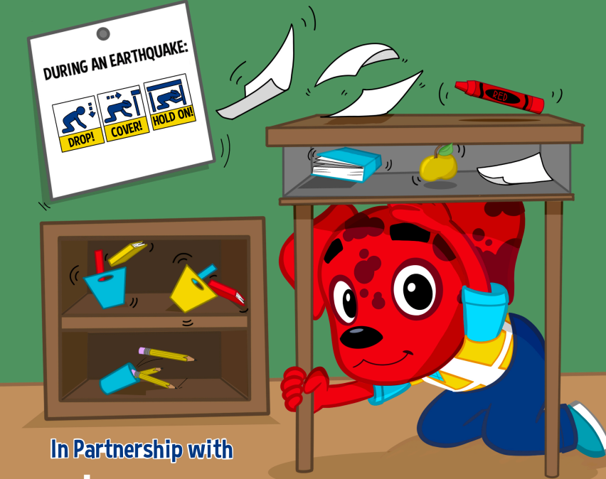
Learning Target
I can Drop, Cover, and
Hold On if there’s ground shaking or if there is an alert.
Image courtesy of The Hero in You Foundation
Notes:
Teacher Notes: Tell students that today they are taking part in an earthquake drill and will practice how to protect themselves during an earthquake. If you are teaching this lesson as part of the Great ShakeOut, tell students that millions of people in countries around the world take part in the Great ShakeOut on the 3rd Thursday of October every year.​
​
IMAGE: Image courtesy of The Hero in You Foundation. Used with permission.

Slide 12
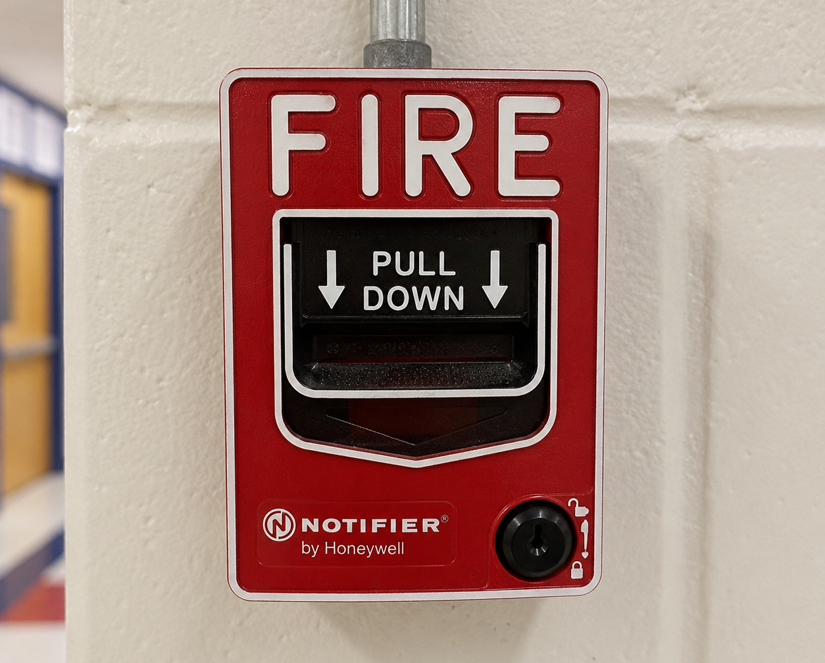
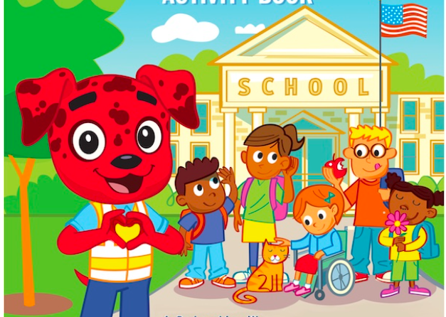
What other safety drills have we had at school?
Why do we have drills at school?
Image created with A.I.
Image courtesy of The Hero in You Foundation
Notes:
Teacher Notes: Ask students what other drills they’ve practiced at school. Kindergarten students may have only had fire drills at this point in the year, but first-grade students have probably practiced earthquake drills, shelter-in-place drills, and lockdown drills, among others.
Ask students why we practice drills at school. They should respond that we conduct drills to practice how to respond, so that if there’s ever a fire or earthquake, we’re prepared and know how to stay safe. We also practice drills so that we can help students feel safer and less afraid at school. Having fire and earthquake drills can help us to feel prepared and less scared!
Consider recording students’ responses on the board or on chart paper.
IMAGES: Image credits from left to right. Image courtesy of Educator Clips. Image courtesy of The Hero in You Foundation and Educator Clips. Used with permission.

Slide 13
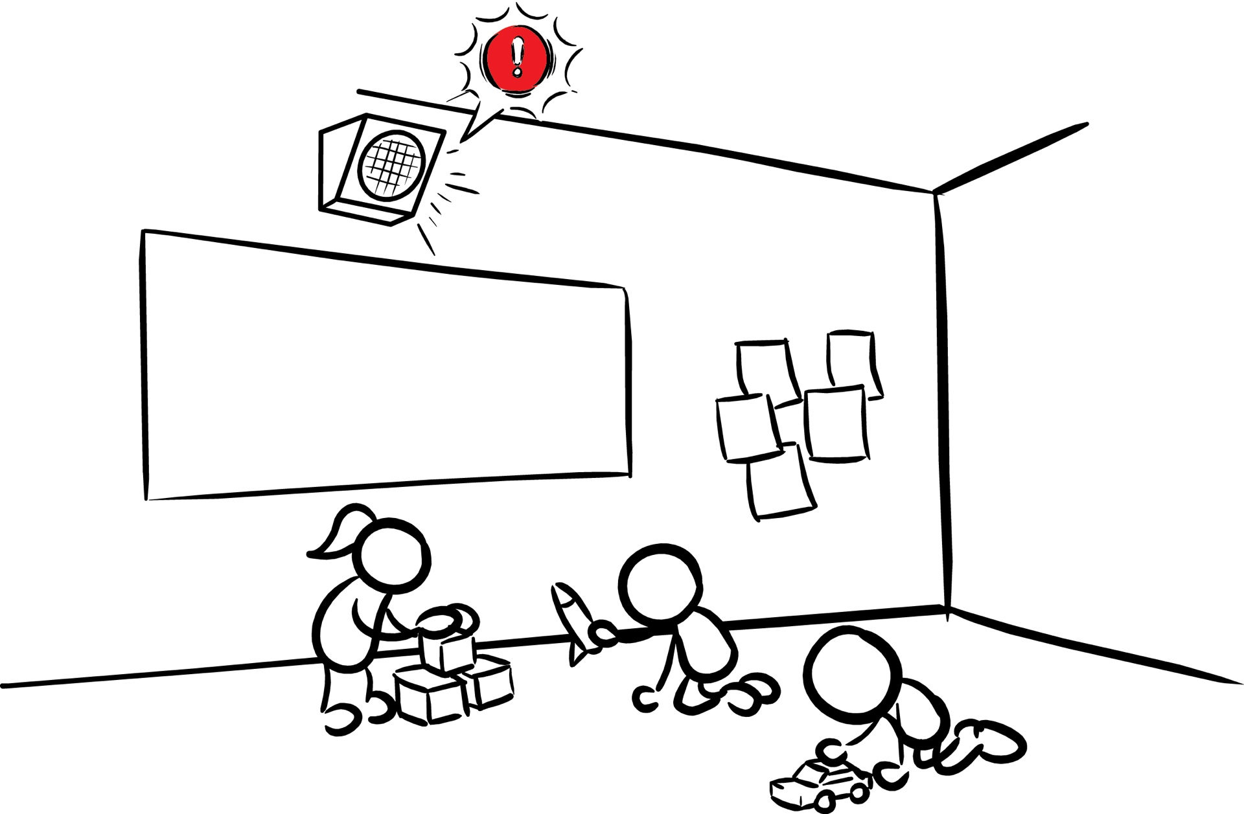
There are many ways we can stay safe at school during earthquakes!
Image courtesy of USGS
Notes:
Teacher Notes: Tell students there are many ways they can stay safe during an earthquake and if your school has earthquake early warning integrated into their public address system, or if they can get alerts over learning devices (e.g., Chromebooks) protect ourselves before strong shaking arrives during an earthquake.
IMAGE: Image courtesy of USGS

Slide 14
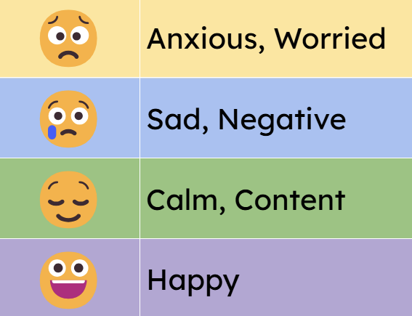
How do you feel?
Turn and talk to a partner!
14
Notes:
Teacher Notes: Tell students that sometimes drills can be scary because we don't know what to do or what is happening around us. During this lesson, we will practice DROP, COVER, and HOLD ON twice. After practicing, you should feel more confident and hopefully less scared or nervous. Ask students how they feel right now thinking about earthquakes and earthquake drills. Ask them to turn and tell a partner using the colors or the words to describe their feelings. After students have had a chance to share with a partner, ask if any volunteers would like to share with the class. Acknowledge to students that it’s normal to feel afraid or nervous, and that we practice so we’ll feel less scared and more prepared!

Slide 15
What are some
things you have
seen or heard
about earthquakes?
What do you wonder about earthquakes?
Image courtesy of The Hero in You Foundation
Notes:
Teacher Notes: Ask students what they’ve seen and heard about earthquakes. They may have seen images of people or buildings shaking. They may have seen a cartoon in which a giant fissure opens in Earth’s surface (which is incorrect, even though they may have also seen images of roadways cracking). Tell students that we’ll learn more about what an earthquake is in this lesson. Consider recording students’ questions so that you can return to them at the end of the lesson to see which have been addressed through the lesson and try to answer the others.
IMAGE: Image courtesy of The Hero in You Foundation. Used with permission.

Slide 16
Have you or family members experienced an earthquake?
What did you or family members:
SEE?
HEAR?
FEEL?
Image courtesy of The Hero in You Foundation
Notes:
Teacher Notes: Ask students if they or their family members have experienced an earthquake. It’s likely that many of them have not experienced an earthquake. They may have heard from family members about shaking, objects breaking, or even possibly injuries. Validate students’ experiences, and scan for students that may need some extra support.
IMAGE: Image courtesy of The Hero in You Foundation. Used with permission

Slide 17
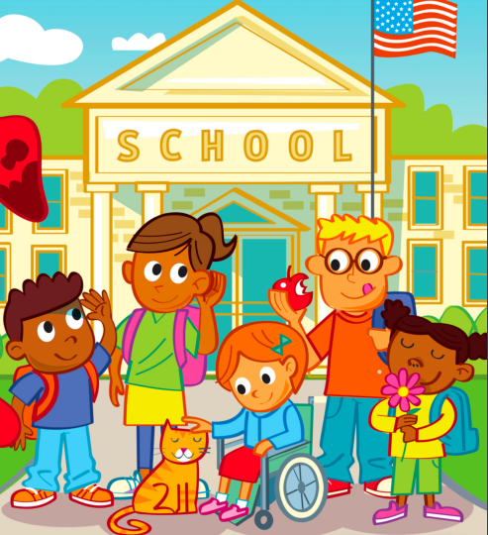
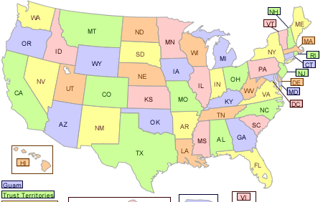

Where are We?
School
City
State
Country
Planet
Image courtesy of The Hero in You Foundation
Image courtesy of USGS
Image courtesy of NASA
Notes:
Teacher Notes: This slide is animated, so pictures and prompts appear when you click starting with the school and then zooming out to planet Earth.
Ask students where they are located, starting with the school they’re in, and then progressively zooming out.
IMAGE: Image credits from left to right. Image courtesy of The Hero in You Foundation. Used with permission. Image courtesy of USGS. Image courtesy of NASA.

Slide 18

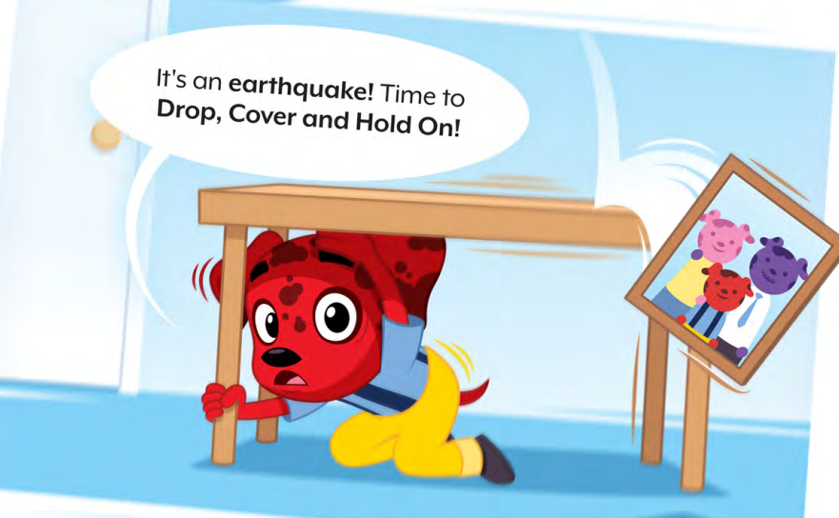
The surface of the Earth is broken into many pieces that move around.
The pieces of the Earth get stuck together. When they break free, an earthquake happens!
Images courtesy of The Hero in You Foundation
18
Notes:
Teacher Notes: Slide is animated. When you click, the second text box appears and after a short delay the image appears and shakes for seven seconds.
Tell students that now we’ll learn more about earthquakes. Tell students that the surface of the Earth that we stand on may seem like it is so solid it could never be moved. But actually, the surface of the Earth is broken into many pieces that move around. Most of the time we don’t feel the movement, but sometimes we do. As the pieces of the Earth move, they can become stuck because of friction. When the pieces break free, an earthquake happens, causing ground shaking! This is natural, and it happens all the time. It’s happening right now!
IMAGES: Images courtesy of The Hero in You Foundation. Used with permission

Slide 19
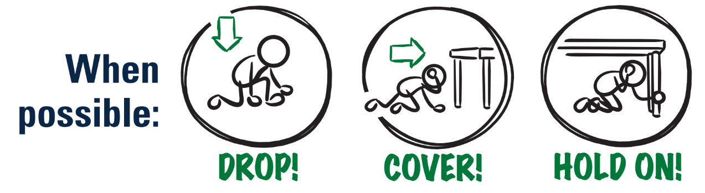
What Should You Do if You Feel Shaking or Get an Alert?
Image courtesy of USGS
Notes:
Teacher Note: This is animated. Ask the question first to elicit student responses.
Review and model correct protective actions - Drop, Cover, and Hold On. Make sure students know they should drop to their knees (not their bottoms), have one hand over their necks, and try to get away from glass or any other objects that could fall on them. If they’re able to get under a table or desk while staying on their knees, they should. Once there, they should hold on to the leg of the table.
IMAGE: Image courtesy of USGS

Slide 20
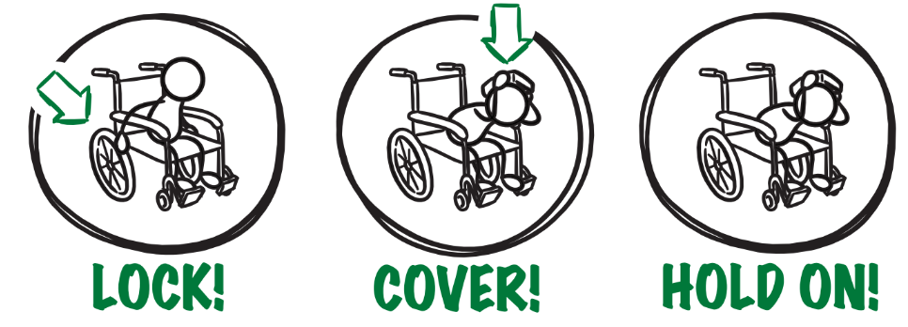
If You or Someone You Know Uses a Wheelchair:
Image courtesy of USGS
Notes:
Teacher Notes: Tell students that Drop, Cover, and Hold On looks different for different bodies. Review modified protective actions for people who use wheelchairs. While you may not have students who use wheelchairs in your class, it is likely that there are members of your community who do. Ask students to help their family members or friends who use a wheelchair by sharing that “Lock, Cover, and Hold On” is how they can protect themselves during an earthquake. Have students repeat the phrase, “Lock, Cover, and Hold On” after you’ve said it.
IMAGE: Image courtesy of USGS

Slide 21


If You or Someone You Know Uses a Cane or Walker:
Image courtesy of USGS
Notes:
Teacher Notes: Slide is animated, so images appear when you click.
Review modified protective actions for people who use a cane or walker. While you may not have students who use a cane or walker in your class, it is likely that there are members of your community who do. Ask students to help their family members or friends who use a cane or walker by sharing the correct protective actions. Have students repeat the phrase, “Drop, Cover, and Hold On” and then “Lock, Cover, and Hold On” after you’ve said it. Remind students that all these positions protect a person’s head and neck.
IMAGE: Image courtesy of USGS

Slide 22
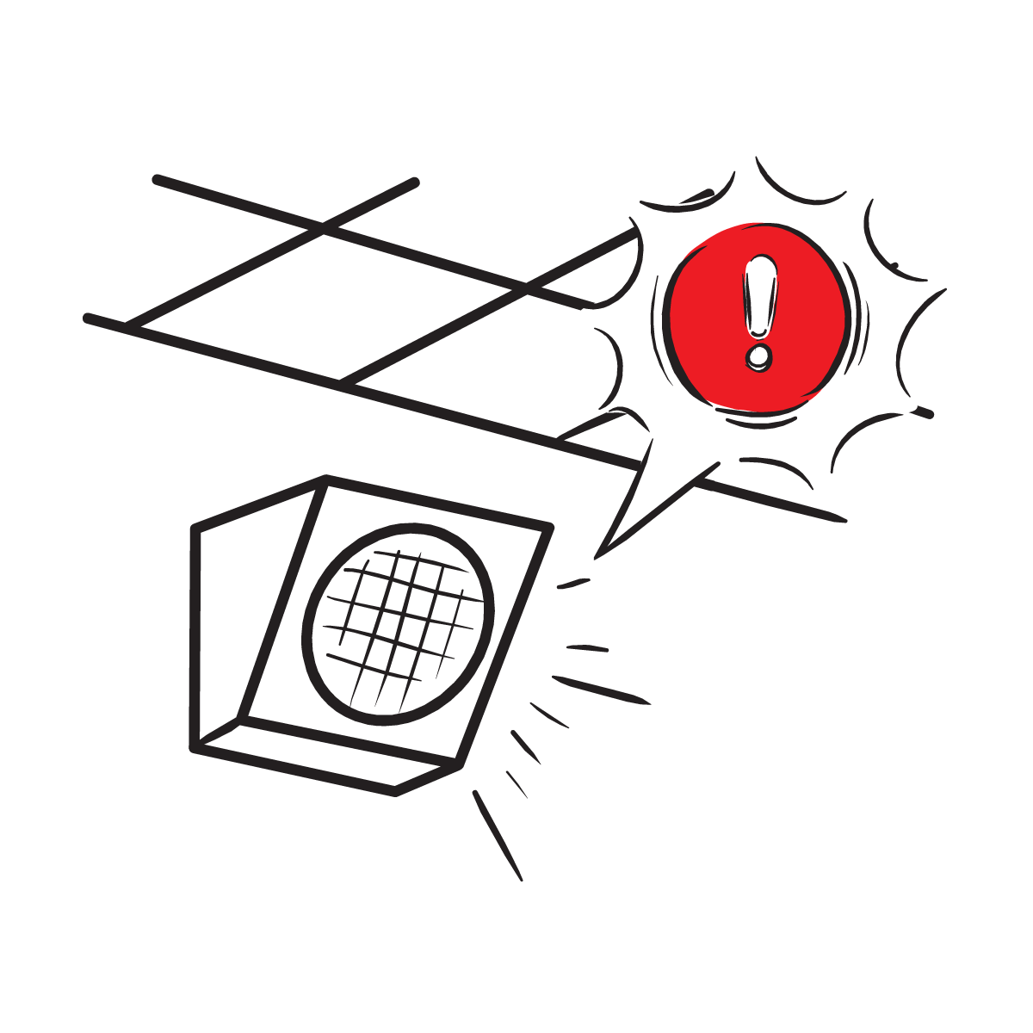
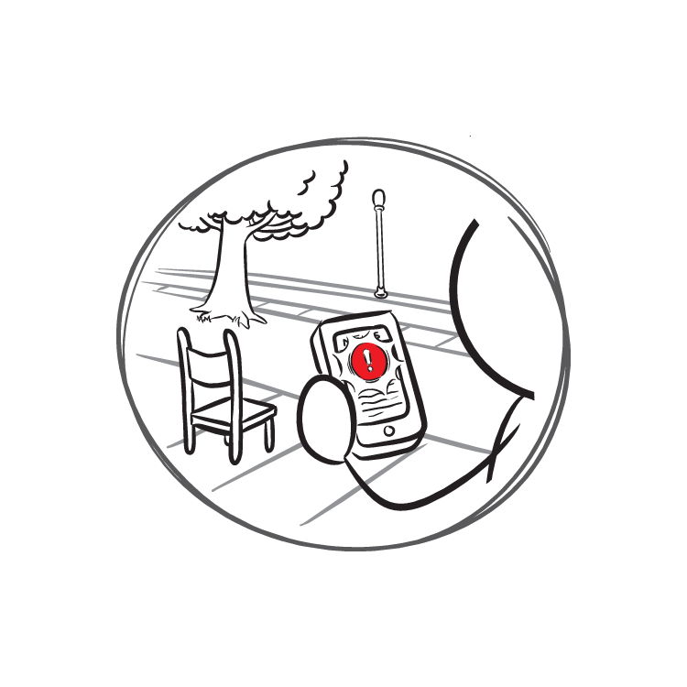
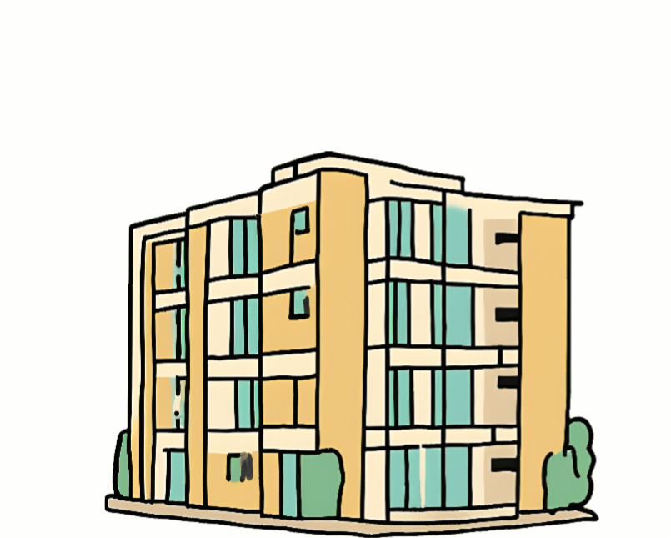
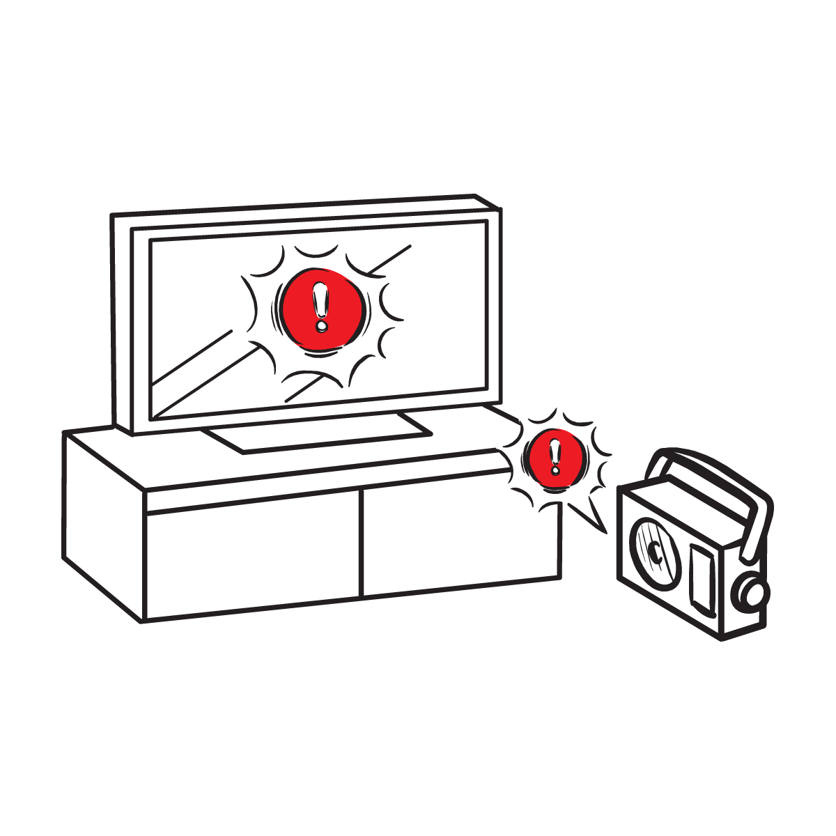
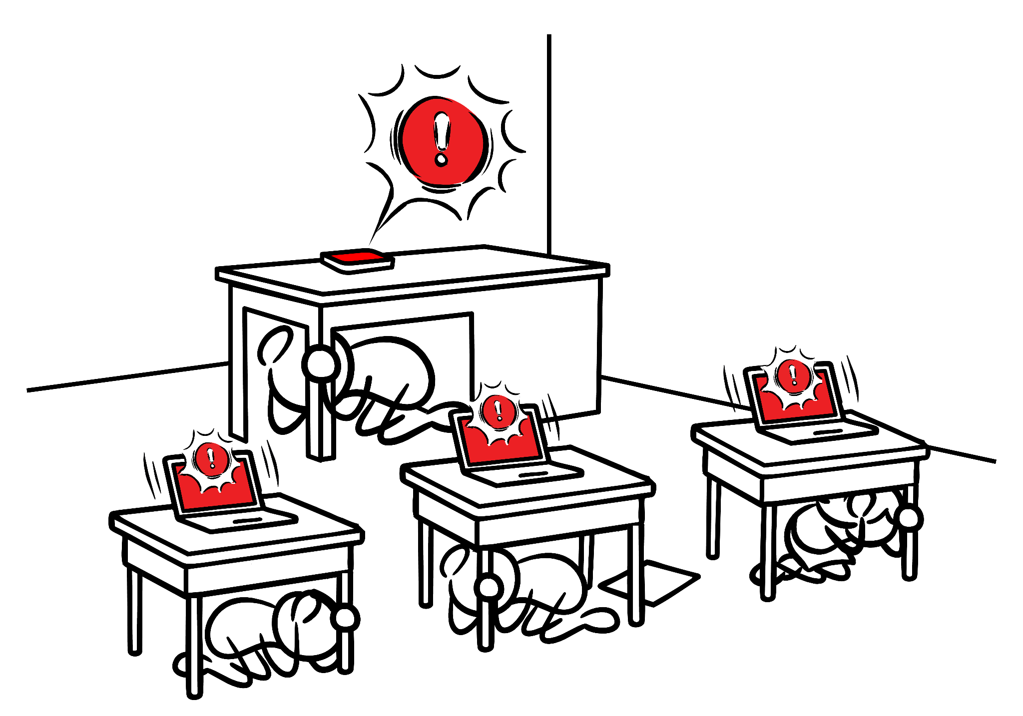
Protect Yourself When There Is . . .
Ground Shaking
An Earthquake Drill
An Earthquake Early Warning Alert
Gif created using A.I.
Image courtesy of USGS
Image courtesy of USGS
Notes:
Teacher Notes: Slide is animated, so images appear when you click. Tell students that they should take these protective actions when the ground shakes, if there’s an earthquake early warning alert, or if they’re participating in an earthquake drill, which we’ll do now. Tell students that it’s vital they Drop, Cover, and Hold On immediately and without hesitation.
IMAGES: Gif created using A.I. Images courtesy of the USGS.

Slide 23

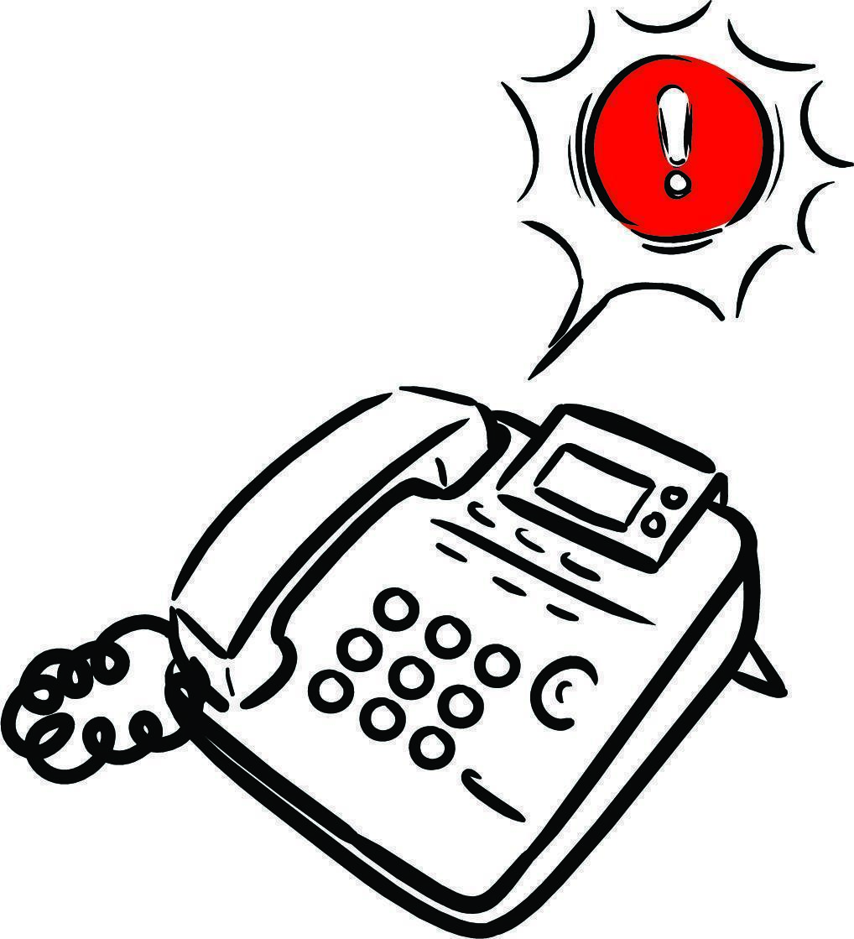

Let’s Practice!
Image courtesy USGS
23
Notes:
Teacher Notes: Inform students that when you click on the slide that, after a brief introduction, an alert will play and students should practice Drop, Cover, and Hold On immediately with the alert. Remind students this is only a drill. Consider having one student demonstrate how to drop, cover, and hold in front of the class before having the whole class practice. Play the ShakeAlert alert by clicking anywhere on the slide. Have all students Drop, Cover, and Hold On. Ask students to stay in their protective positions while the teacher observes and offers corrections if necessary. Once the teacher has checked in with each student, ask them to return to their seats.
NOTE: Your EEW alert may sound and look different than the one pictured on the slide!
IMAGES: Images courtesy of USGS

Slide 24

Let’s Reflect!
or
I can Drop, Cover, and Hold On if there’s ground shaking or I get an alert.
Turn and talk:
I can stay safe by ___, ___ and ____.
A question that I still have is______
24
Notes:
Teacher Notes: Slide is animated so prompts appear when you click. Ask students to turn and talk to each other about the earthquake drill, how they did, if they have questions, and what they think important things to remember are. After reflecting, remind students of the key takeaways to stay safe during an earthquake, including immediately dropping to your knees, getting under a table if you can and holding on to the table leg, facing away from glass or heavy objects that could fall, covering your head and neck, remaining silent so that you can hear teacher instructions, and holding this position until shaking stops.

Slide 25
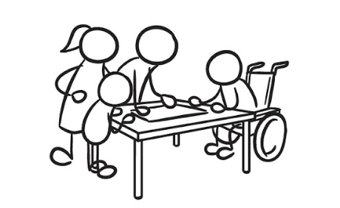
Help Family Members Prepare!
Tell the people in your home what you learned about protecting themselves in an earthquake.
Images courtesy of USGS
Notes:
Teacher Notes: Tell students that they will be sharing information about how to stay safe in earthquakes with others in their homes. Provide students with the Family Engagement letter. You could also share a student sheet from RocketRules.org/ShakeAlert that families can complete with their child.
IMAGES: Images courtesy USGS.

Slide 26
Lesson Break
Advanced Preparation
Photocopy student worksheet (if you’re using it).

Slide 27

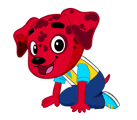

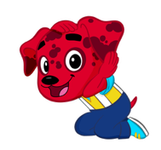

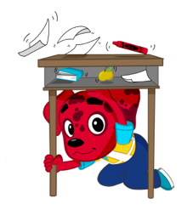
Welcome Back!
👍Thumbs up if you demonstrated how to stay safe during an earthquake by …
Did the people in your home know that Drop, Cover, and Hold On is the best protective action?
Images courtesy of The Hero in You Foundation
Notes:
Teacher Notes: This slide is animated. Drop, Cover, and Hold On appear on each click.
Ask students how their conversations with the people in their homes went. Ask students to give you a thumbs up if they showed their families how to Drop, Cover, and Hold On. Did the people in their homes know that Drop, Cover, and Hold On are the correct protective actions? Did they talk about an emergency plan?
IMAGE: Image courtesy of The Hero in You Foundation. Used with permission

Slide 28
What Do We Do at School if There’s an Earthquake?
Image courtesy of USGS
Notes:
Teacher Notes: This slide is animated. The “Drop, Cover, Hold On“ image appears when clicked.
Review with students what to do if there’s an earthquake while they’re at school. They should remember Drop, Cover, and Hold On.
IMAGE: Image courtesy of USGS

Slide 29



Why is it Important to . . .?
Images courtesy of The Hero in You Foundation
Notes:
Teacher Notes: Slide is animated, so images appear individually when you click. Review with students why each protective action is important during an earthquake. Begin by eliciting student responses for each. Add on to student responses, as necessary.
DROP: Dropping to your knees protects you from falling during ground shaking.
COVER: We cover our neck and head with one arm and hand to protect them from becoming injured if something falls. The back of the neck is particularly important to protect because your head has a skull to protect it.
HOLD ON: We hold on to a table or desk leg once we’re beneath a table so that the earthquake doesn’t move us out from underneath the table that is protecting us.
IMAGE: Image courtesy of The Hero in You Foundation. Used with permission

Slide 30
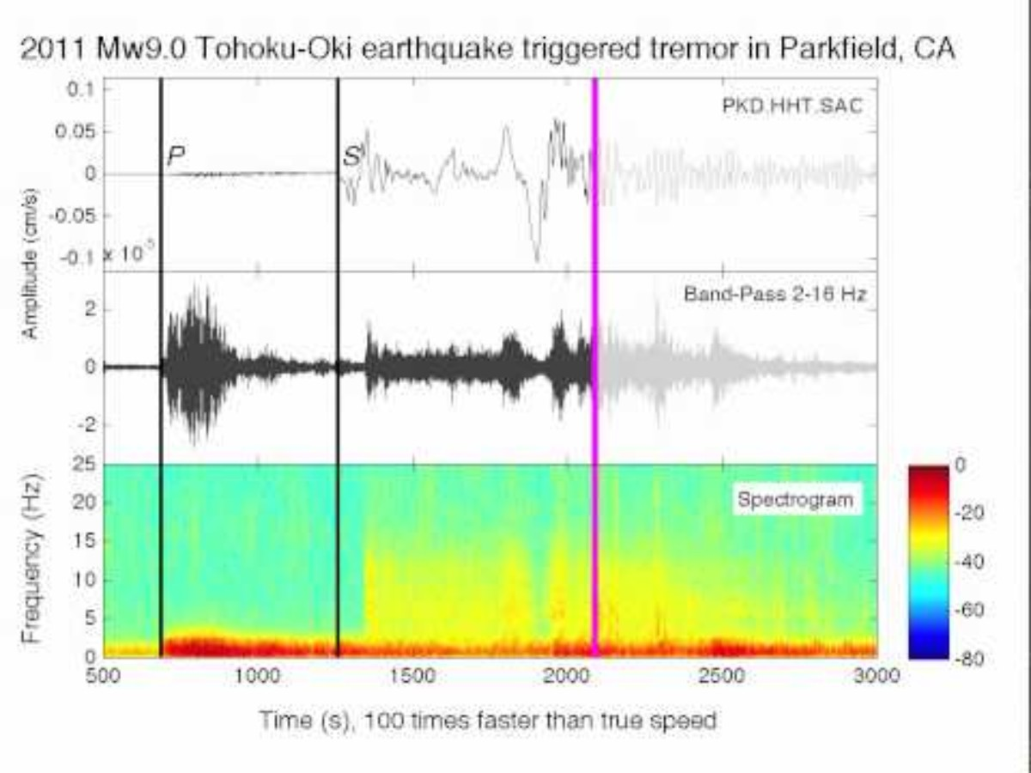
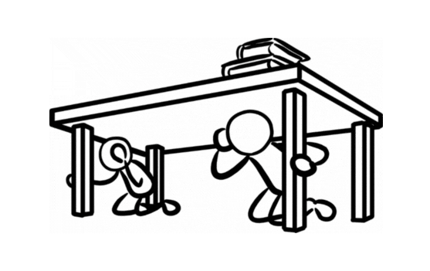
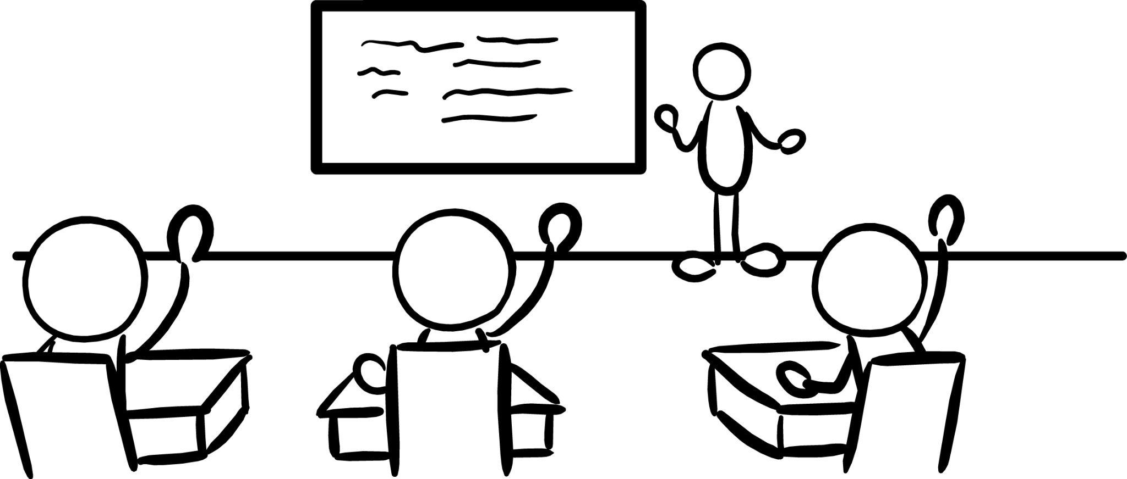
Let’s Practice!
If you experience ground shaking:
DROP
COVER
HOLD ON
Images courtesy of USGS
30
Notes:
Animation Note: Click anywhere will do two things—the audio will play, and the building image will start shaking. The audio and shaking will continue until you click to the next slide.
Teacher Notes: Tell students that they will hear sound effects like earthquake shaking. This is just pretend! But it is similar to what you might hear in a real earthquake. Click to play the ground shaking noises and animation, and practice Drop, Cover, and Hold On. Ask students to stay in their protective positions while you observe and offer corrections if necessary. Once you’ve checked each student, ask them to return to their seats.
SOUND: https://www.youtube.com/watch?v=q1wg2IbA0oo Georgia Tech - Hearing the Japanese Earthquake - Clip 3
IMAGE: Image courtesy of USGS

Slide 31
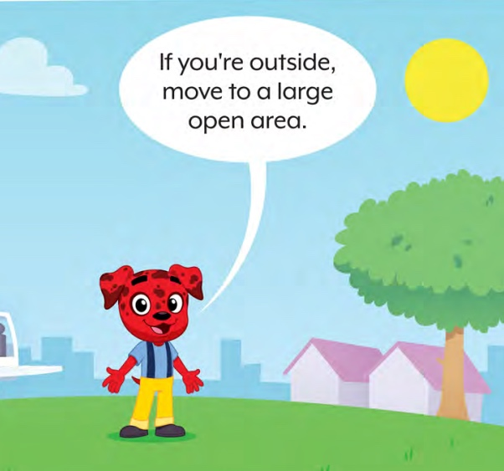
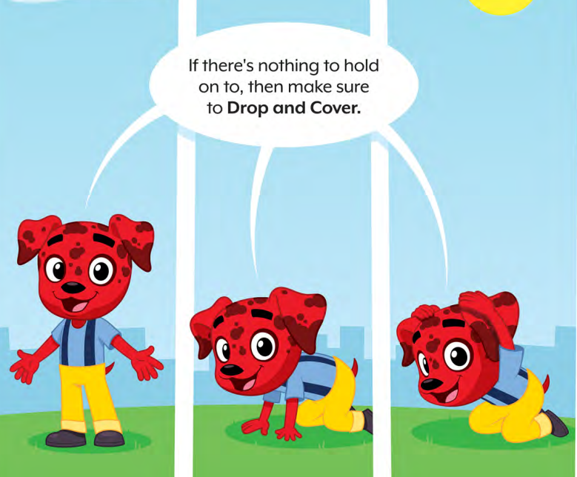
If You Are Outside When You Get an Alert or Feel Shaking …
Images courtesy of The Hero in You Foundation
Notes:
Teacher Notes: Students may wonder what to do if they’re outside when they feel shaking or get an alert. Tell them to find a clear spot away from buildings, trees, streetlights, and power lines, then Drop, Cover, and Hold On. Stay there until the shaking stops.
IMAGE: Image courtesy of The Hero in You Foundation. Used with permission

Slide 32
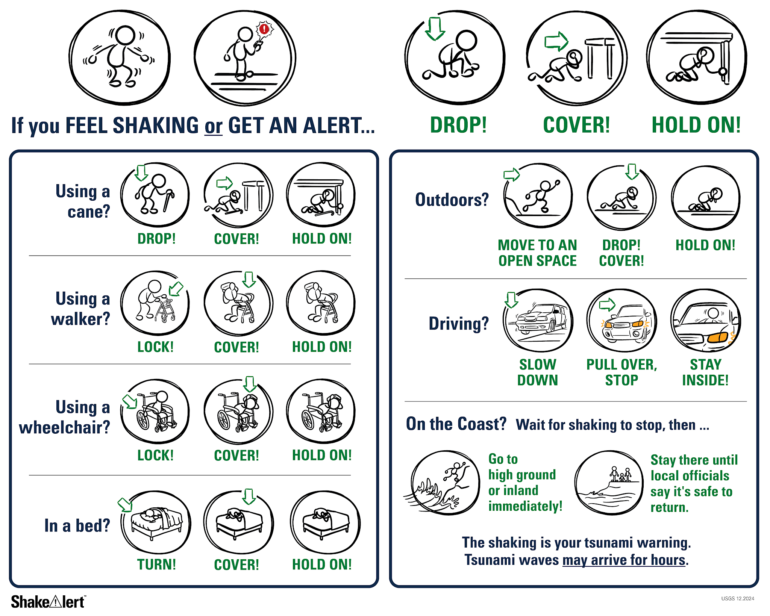
If You Are on the Coast, Drop, Cover, and Hold On.
When the shaking stops …
Image courtesy of USGS
32
Notes:
Teacher Notes: Slide is animated so images appear when you click. Tell students that if they are visiting the coast, the earthquake could be followed by a tsunami, which is a large wave caused by the earthquake. If they are on the coast when they feel shaking or get an alert, they should Drop, Cover and Hold On. When the shaking stops, immediately go inland, to high ground, or follow their school’s specific safety procedures. Tell students that it’s important to wait until they hear it’s safe to return because tsunami waves can continue to arrive for hours or even days after an earthquake.
IMAGE: Image courtesy of U.S. Geological Survey

Slide 33
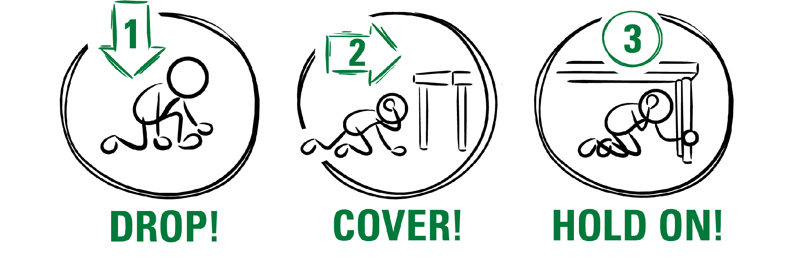

After an earthquake, there can be smaller earthquakes called aftershocks.
What should you do if you feel shaking or get an alert?
Image courtesy of USGS
Notes:
Teacher Notes: Slide is animated so images appear when you click. Many earthquakes are followed by smaller earthquakes called aftershocks. Aftershocks can happen for even a few weeks after the main earthquake! Even though aftershocks are smaller than the main earthquake, they can still produce strong shaking and cause damage. Ask students what they should do if they feel shaking or get an alert. Remind students that they should stay alert and Drop, Cover, and Hold On if they feel shaking or get an earthquake early warning alert.
SOURCE: earthquake.usgs.gov/data/oaf/overview.php
IMAGE: Image courtesy of U.S. Geological Survey

Slide 34

Keeping Our Community Safe
How does practicing to stay safe in an earthquake help to keep you safe?
How does it help your community stay safe?
Image courtesy of Ready.gov
Notes:
Teacher Notes: Ask students to turn and talk to a student nearby and then share out with the entire class. Reflect with students on how taking protective actions during an earthquake will help us protect ourselves as well as our community. Students may note that they now know how to stay safe if there is ground shaking or an alert, and that they can tell others in their communities how to stay safe as well.
IMAGE: Image courtesy of Ready.gov

Slide 35
How do you feel?
Turn and talk to a partner!
35
Notes:
Teacher Notes: Ask students how they feel now that they’ve learned how to protect themselves if there’s an earthquake or an earthquake early warning alert, and whether their feelings have changed. Ask them to Turn and Talk to a student nearby. After students have had a chance to share with a partner, ask if any volunteers would like to share with the class. Acknowledge to students that it’s normal to feel afraid or nervous, and that we practice so we’ll feel less scared and more prepared!

Slide 36
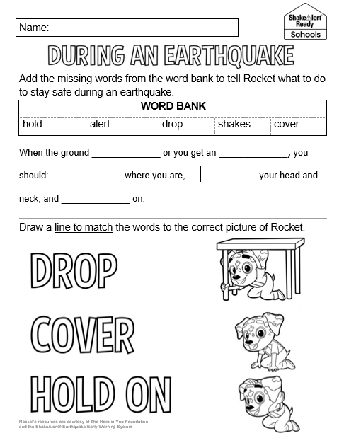
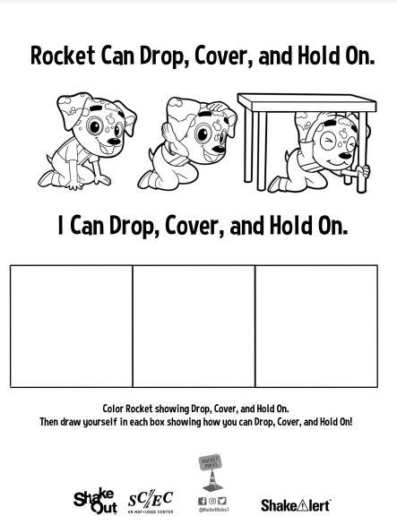
Review
Notes:
Teacher Notes: Provide students with the student sheet to give them the chance to review the correct protective actions if there is ground shaking or if they get an earthquake early warning alert.

Slide 37
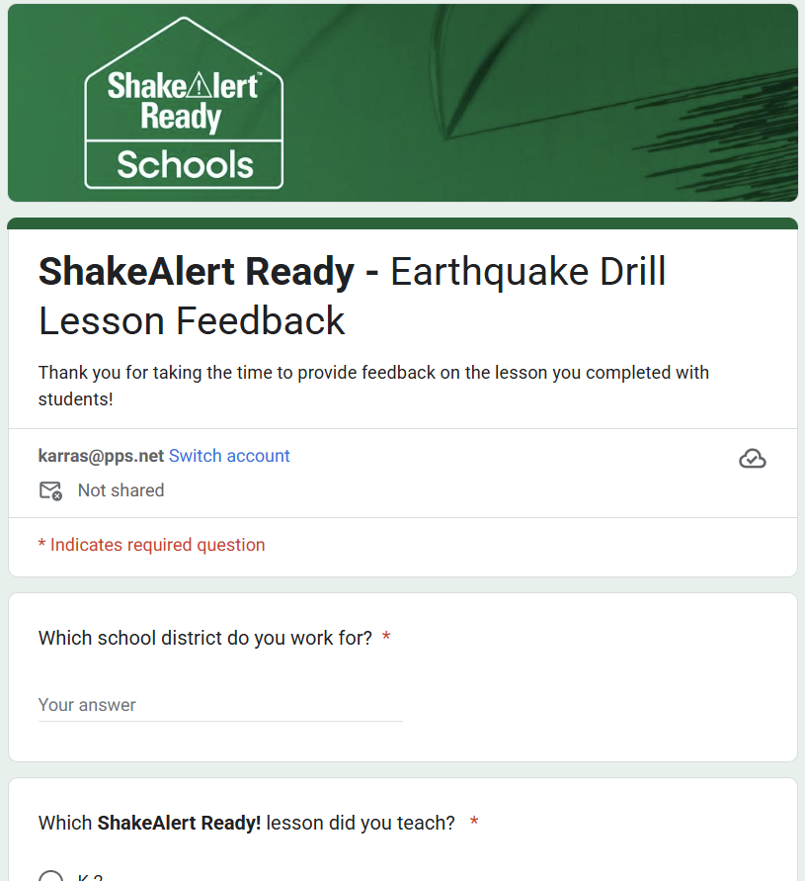
Teachers, share your feedback, please!
Please complete the short and anonymous feedback form and help us to improve our ShakeAlert Ready lessons.
Notes:
LINK: https://docs.google.com/forms/d/e/1FAIpQLSeNHAr45fDTztflhJJD3_JVS8p0RiV1MW9sKyQgFucGJyKcCA/viewform?usp=sf_link

Slide 38
Content Standards: Kindergarten
Common Core English Language Arts | CA, OR, WA | Common Core CCSS.ELA-Literacy.SL.K.1 | Participate in collaborative conversations with diverse partners about kindergarten topics and texts with peers and adults in small and larger groups.
 |  | Common Core CCSS.ELA-LITERACY.SL.K.3 | Ask and answer questions in order to seek help, get information, or clarify something that is not understood.

Slide 39
Content Standards: First Grade
Common Core English Language Arts | CA, OR, WA | Common Core CCSS.ELA-Literacy.SL.1.1 | Participate in collaborative conversations with diverse partners about grade 1 topics and texts with peers and adults in small and larger groups.
 |  | Common Core CCSS.ELA-LITERACY.SL.1.3 | Ask and answer questions about what a speaker says in order to gather additional information or clarify something that is not understood.
Health | OR | 1.SFA.2 | List the steps to identify and respond to emergency situations.
 | WA | H1.Sa1.1a | Identify safety hazards in the school.
 | CA | 1.2.S | Identify emergency situations.
 |  | 7.1.S | Practice ways to stay safe at home, at school, and in the community.
 |  | 7.2.S | Practice emergency, fire, and safety plans at home and at school.
 |  | 1.9.P | Identify emergency situations (e.g., injuries, abductions, fires, floods, earthquakes)
 |  | 4.2.P | Demonstrate effective communication skills in an emergency situation.
 |  | 7.4.P | Demonstrate appropriate behaviors during fire drills, earthquake drills, and other disaster drills.

Slide 40
Content Standards: Kindergarten & First Grade
English Language Proficiency | OR |  | An ELL can construct meaning from oral presentations and literary and informational text through grade-appropriate listening, reading, and viewing.
 | WA | ELD-SI.K-3.Narrate | Share ideas about one’s own and others’ lived experiences and previous learning Connect stories with images and representations to add meaning | Ask questions about what others have shared Recount and restate ideas
 |  | ELD-SI.K-3.Inform | Describe characteristics, patterns, or behavior Summarize information from interaction with others and from learning experiences | Sort, clarify, and summarize ideas Describe parts and wholes
 | CA | Bridging Proficiency Levels | Exchanging information and ideas: Contribute to class, group, and partner discussions, including sustained dialogue by listening attentively, following turn-taking rules, asking relevant questions, affirming others, adding pertinent information, building on responses, and providing useful feedback. 3. Offering opinions: Offer opinions and negotiate with others in conversations using a variety of learned phrases (e.g., That’s a good idea, but X), as well as open responses in order to gain and/or hold the floor, provide counterarguments, elaborate on an idea, and the like. | 5. Listening actively: Demonstrate active listening to read-alouds and oral presentations by asking and answering detailed questions, with minimal prompting and light support.
Transformative Social Emotional Learning Competencies | CA | Self-Awareness | Identifying one’s emotions
 |  | Relationship Skills | Listening actively, communicating effectively, and self-advocating
 |  | Responsible Decision Making | Reflecting on one’s role to promote personal, family, and community well-being Considering personal and collective safety concerns

Slide 41
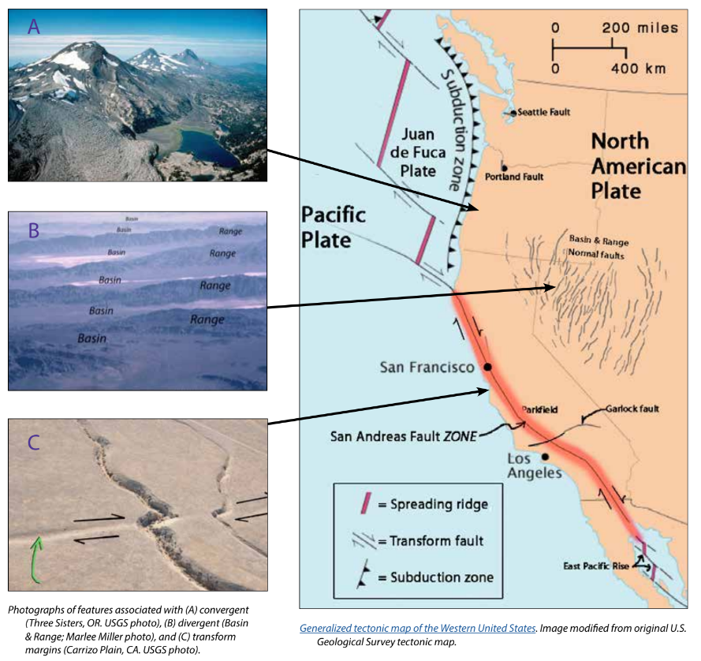
Background - Earthquake Hazard
California, Oregon, and Washington all face earthquake hazards because of the underlying tectonic plates, which constantly grind against each other. This friction creates "faults," lines of weakness in the Earth's tectonic plates (lithosphere) where earthquakes are most likely to occur.
California's San Andreas Fault is one example. Another example is the Cascadia Subduction Zone, which threatens all three states and British Columbia, Canada. This giant fault lies offshore, where the Juan de Fuca Plate dives beneath the North American Plate. This type of motion on other subduction zones can cause massive earthquakes, like the one that struck Japan in 2011.
While smaller earthquakes happen often, scientists think a major earthquake could happen any time, so it's important to be prepared.
For more information: Faults, Plate Tectonics & Earthquake Hazards - Animations / Videos
Notes:
IMAGE: https://www.iris.edu/hq/inclass/activities/introduction_to_faults_and_plate_tectonics
SOURCE: https://www.usgs.gov/programs/earthquake-hazards/science/pacific-northwest-hazards
https://www.usgs.gov/programs/earthquake-hazards/science/southern-california-earthquake-hazards

Slide 42
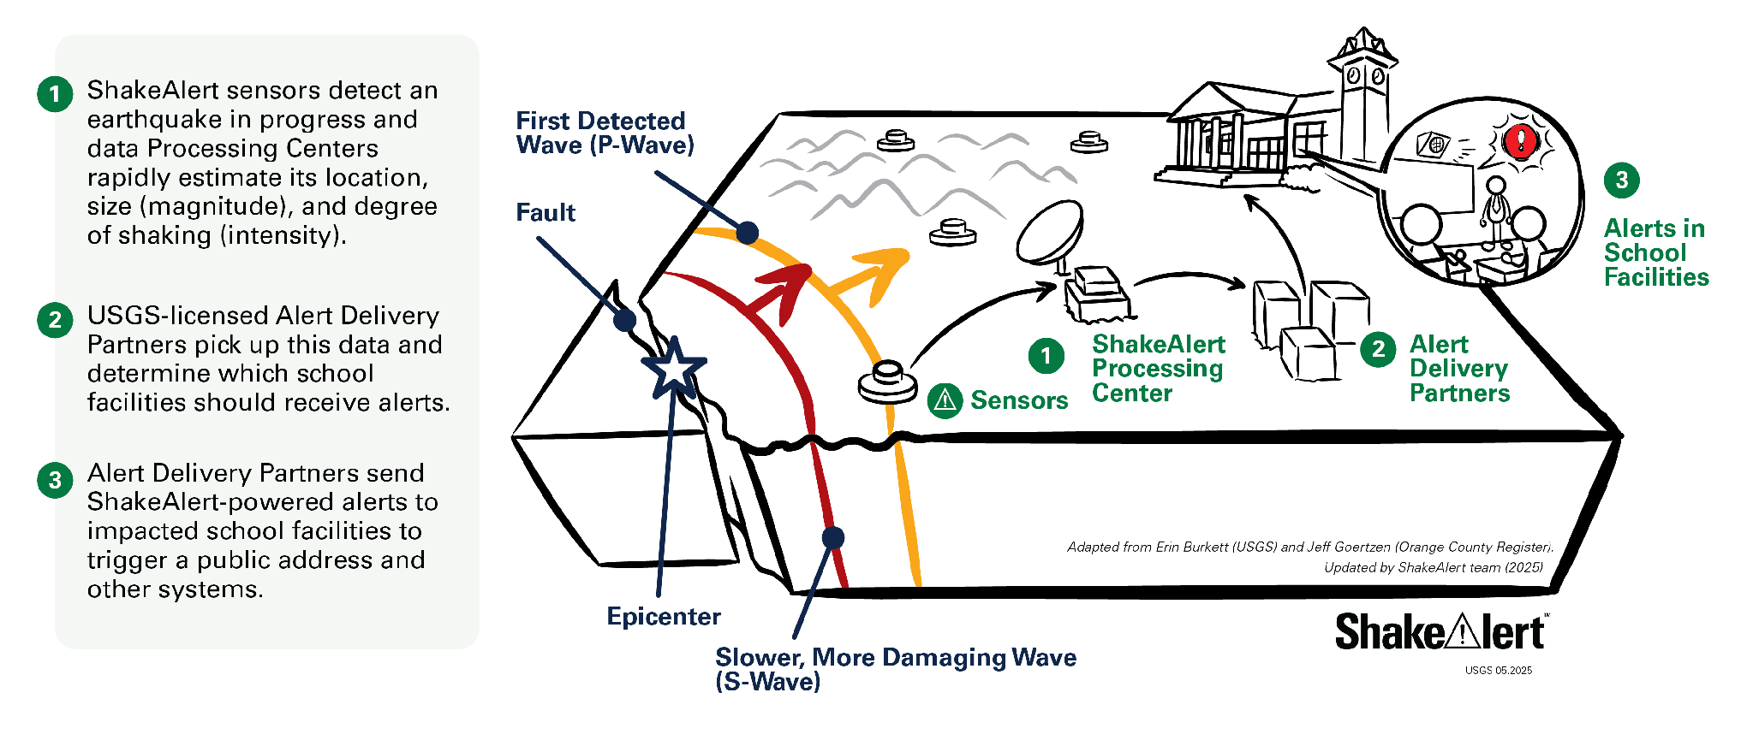
Background - How ShakeAlertⓇ Earthquake Early Warning System Works
42
Notes:
For more information on Earthquake Early Warning, go to: https://www.iris.edu/hq/inclass/sequences/earthquake_early_warning
IMAGE: Image courtesy of the USGS

Slide 43
Background - Effective Protective Actions
Most earthquake-related injuries and deaths are caused by collapsing walls and roofs, flying glass and falling objects.
If you are inside a building, move no more than a few steps, then Drop, Cover, and Hold On.
If you are outdoors when the shaking starts, you should find a clear spot away from buildings, trees, streetlights, and power lines, then Drop, Cover, and Hold On. Stay there until the shaking stops.
For protective actions in various settings (descriptions and gifs), go to https://www.earthquakecountry.org/step5/
Notes:
SOURCE: https://www.shakeout.org/whyparticipate/
IMAGE: Image courtesy of the USGS

Slide 44
Rationale
Why do we practice earthquake drills?
To react quickly you must practice often. You may only have seconds to protect yourself in an earthquake, before strong shaking knocks you down--or drops something on you.
Social science research has long shown that people who practice actions are more likely to take those actions when a safety- threatening event occurs, such as an earthquake or fire. Tests, drills, and exercises that repeat concepts build “muscle memory” of procedural knowledge and timely reaction. The more frequently a person practices a procedure or self-protective action, such as Drop, Cover, and Hold On, the more likely they will employ it— almost without thinking—when they receive an alert or feel shaking.
Why share the Family Engagement Letter?
While schools practice earthquake drills regularly, most other locations do not. Some students’ family members may not have practiced earthquake drills since they were in school.
Family members may have outdated information about how to stay safe in an earthquake, such as the incorrect belief that standing in doorways or “the triangle of life” will keep one safe in an earthquake. Students will be able to share correct protective actions (Drop, Cover, and Hold On) with their family and community members.
Students spend more time at home than at school. Therefore, educating families will help keep students and our community safe. Additionally, families are more likely to understand their family and community members’ needs. This communication can prompt families to ensure they’re prepared to protect all members of their families in case of an earthquake.
In Oregon and Washington where earthquakes are less frequent, people might be unaware of the risk of an earthquake.
The Family Engagement Letter has links for family members to learn more about earthquakes and protective actions.
44
Notes:
SOURCE: https://www.shakeout.org/whyparticipate/ , https://www.shakealert.org/toolkit/introduction/

Slide 45
Additional Resources
State Emergency Management Departments
ShakeAlert Website
ShakeAlert Ready Schools
ShakeAlert Messaging Toolkit (Videos, Graphics, Factsheets)
The Hero in You Foundation (PK-5 Educational Resources in Multiple Languages)
Great ShakeOut Educational Resources
Earthquake Country Alliance
(Earthquake Resources in Multiple Languages)
California Governor's Office of Emergency Services
Oregon Department of Emergency Management
Washington Emergency Management Division
45

