Slide 1
ShakeAlert® Earthquake Early Warning
Presentation to Parents and Guardians
Understanding the ShakeAlertⓇ Earthquake Early Warning (EEW) System
What to expect and how to respond
Using ShakeAlert resources to educate the school community

Slide 2
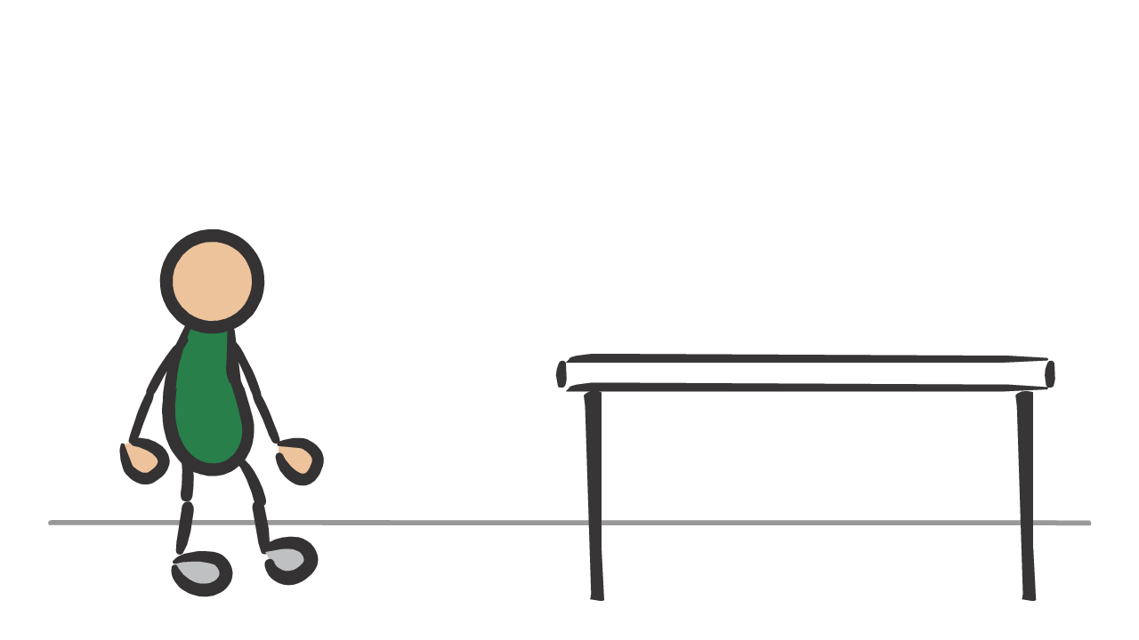
The ShakeAlertⓇ Earthquake Early Warning System
provides potential seconds of warning to take protective action before strong shaking arrives.
Image courtesy of USGS
Notes:
The ShakeAlert Earthquake Early Warning System can students and staff with potential seconds of warning to take protective action before strong ground shaking arrives. There are many ways to get alerts, including but not limited to via cell phones and digital devices, over public address systems, and more! Much like other alarms and drills, the ShakeAlert-powered technology in many schools helps to keep people safe when strong shaking is expected at their location.

Slide 3
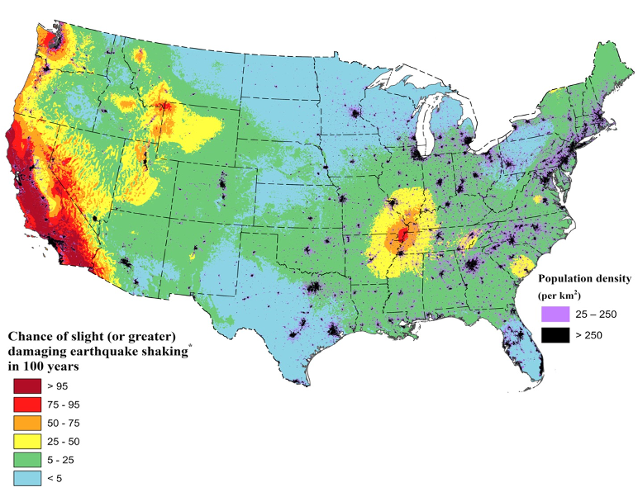
You Live in
Earthquake Country!
Areas in red have a more than 75% chance of a damaging earthquake in the next 100 years.
Image courtesy of USGS
Notes:
Did you know that much of California and some areas in Oregon and Washington have a more than 75% chance of experience a damaging earthquake in the next 100 years? This U.S. Geological Survey (USGS) graphic shows areas in red have a greater than 75% chance of experiencing an earthquake with strong to extreme shaking in the next 100 years (Modified Mercalli Intensity of 6 or greater).
An MMI of 6 on the 10-point scale will be felt by everyone and may be frightening and cause slight damage. Increasing intensity will result in a range of damage from overturned furniture to partial or complete building collapse. Because of this risk, it is important to prepare your staff and students to respond safely to an earthquake. That’s why the school district has ShakeAlert-powered earthquake early warning at your school.
In case there’s a question regarding MMI scale, show this scale and explain briefly.

Slide 4
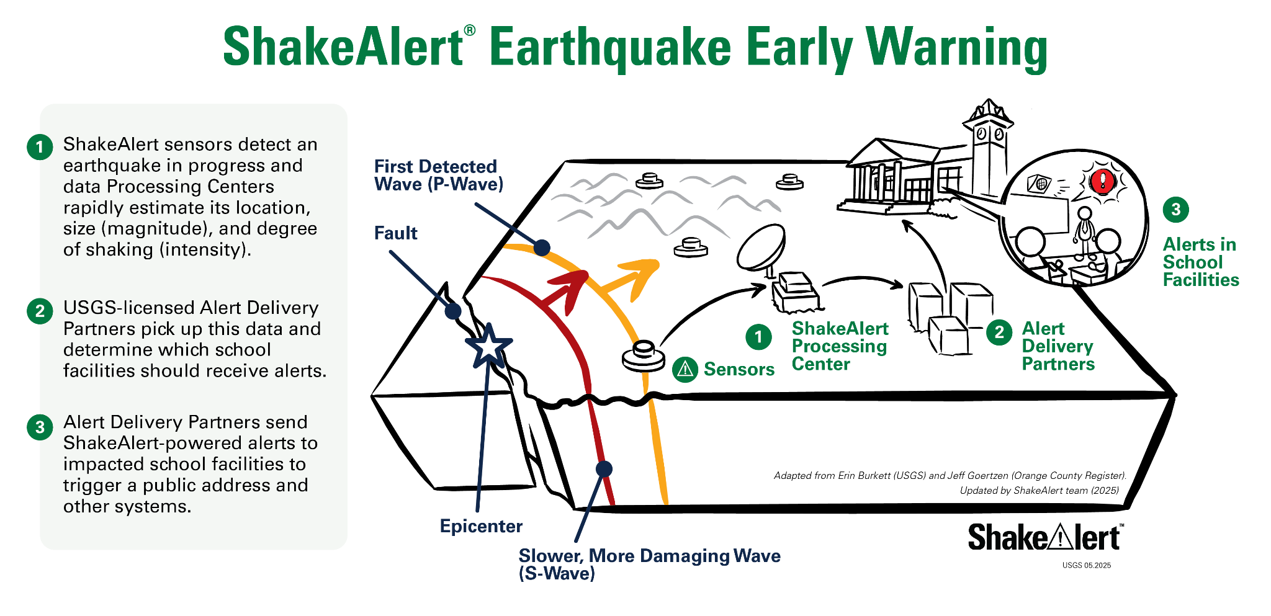
Image courtesy of USGS
‹#›
Notes:
It is important to note that ShakeAlert does not predict earthquakes. When an earthquake is detected by sensors in the U.S. Geological Survey's seismic network, a message is sent to Alert Delivery Partners who rapidly determine which school facilities should get alerts and deliver alerts through the public address or other systems—all in a matter of seconds. Alerts can potentially provide seconds of time for our school community to Drop, Cover and Hold On before strong shaking arrives!

Slide 5
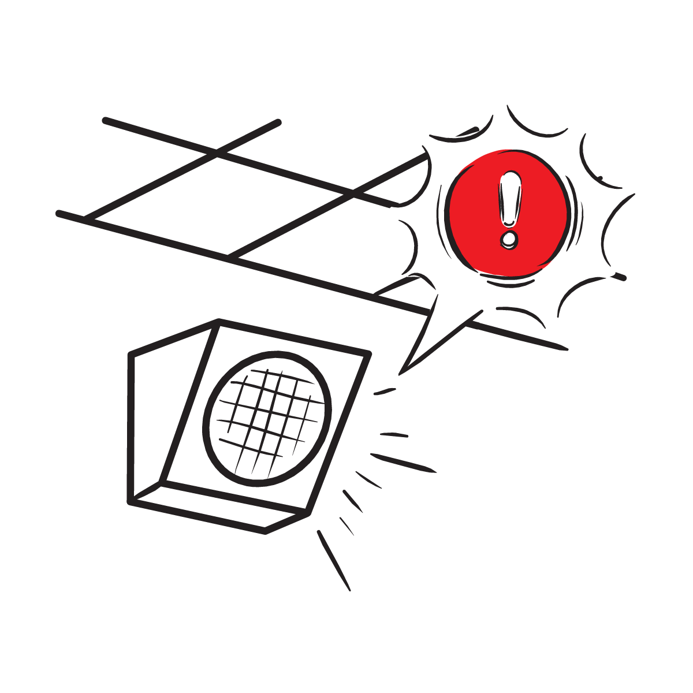

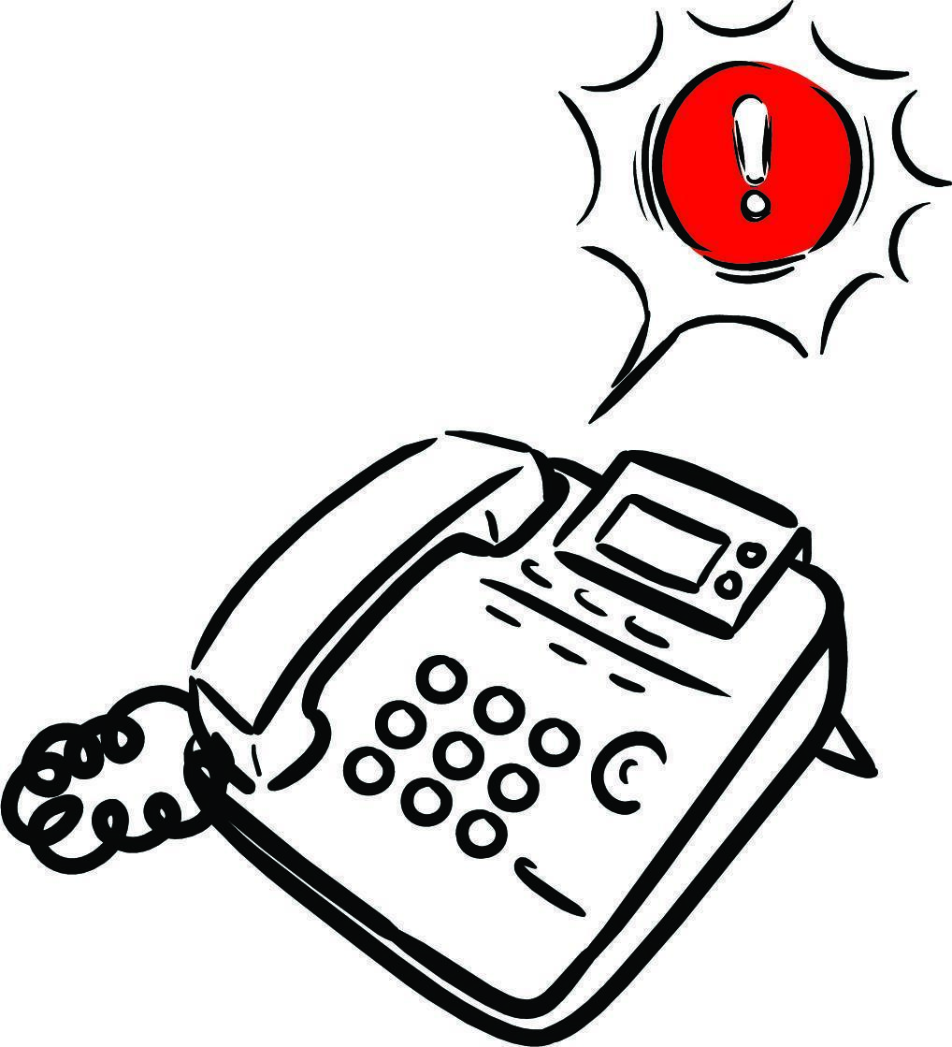

What to Expect from an Alert
Alerts can look and sound differently on different devices and among different Alert Delivery Partners.
Image courtesy of USGS
Notes:
There are many ways of getting an alert. Alerts in your child’s school may sound similar to this if they have integrated ShakeAlert-powered alerts into their public address system (click to play alert sound). In some instances, people may feel shaking without getting an alert. Whatever the case, the most recommended protective action is to Drop, Cover, and Hold On. The alert at your school may look and sound differently.
NOTE: Before presenting the webinar, insert the alert audio and any alert visuals that apply to your particular school. If this webinar is presented to schools who work with multiple Alert Delivery Partners, use the general ShakeAlert alert tone found here: https://drive.google.com/drive/folders/12Z0jGCIHnErxaLXU_82m2mMNtJd7EePD

Slide 6
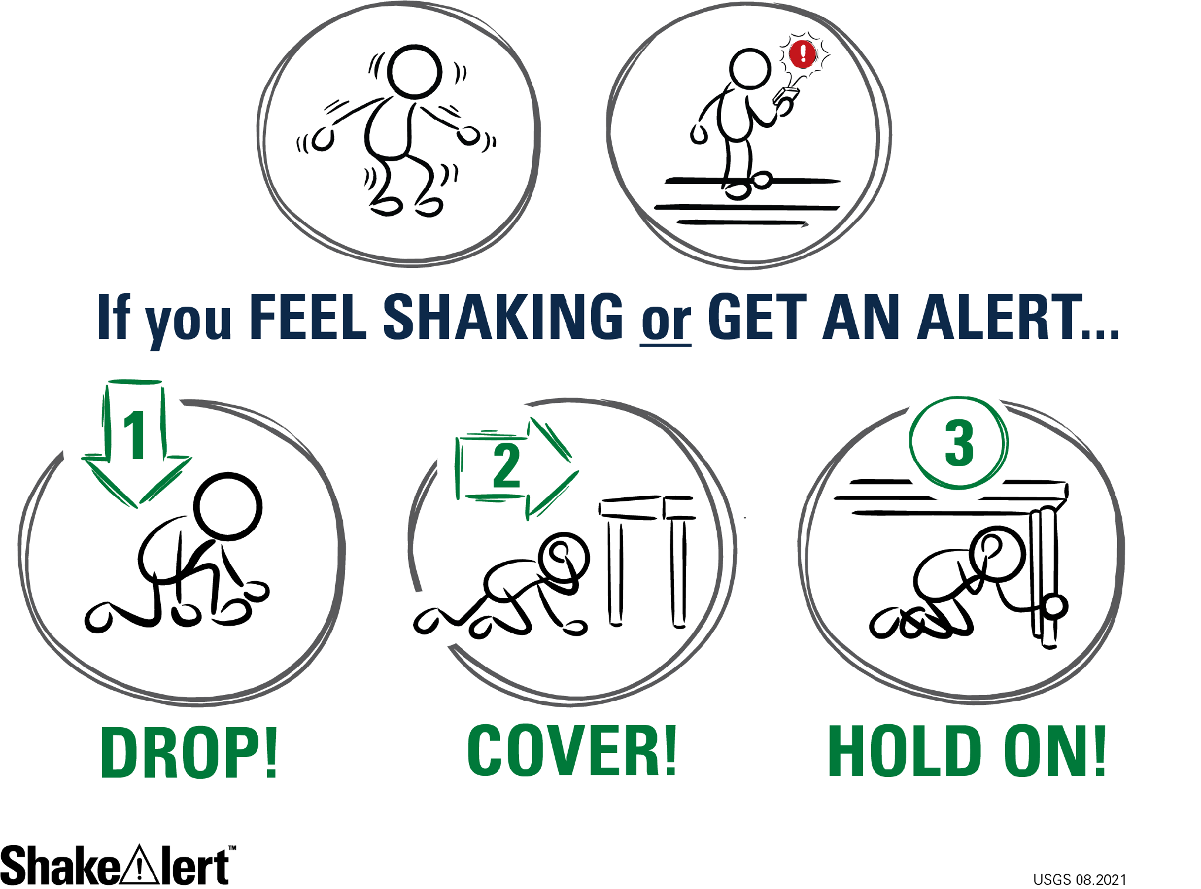
Image courtesy of USGS
Notes:
Most earthquake injuries are a result of people trying to move, falling, and/or being hit by falling objects. Therefore, when you feel shaking or get an alert, immediately Drop, Cover, and Hold On or take another protective action that is appropriate to your situation. Typically, this means dropping to your hands and knees (not your bottom) so you don’t fall. Cover your neck and head with your hands, and get under a table or desk, if possible. Using one hand, hold onto the leg of the table. Intentional training and practice is necessary to ensure everyone is ready to take an immediate protective action.

Slide 7
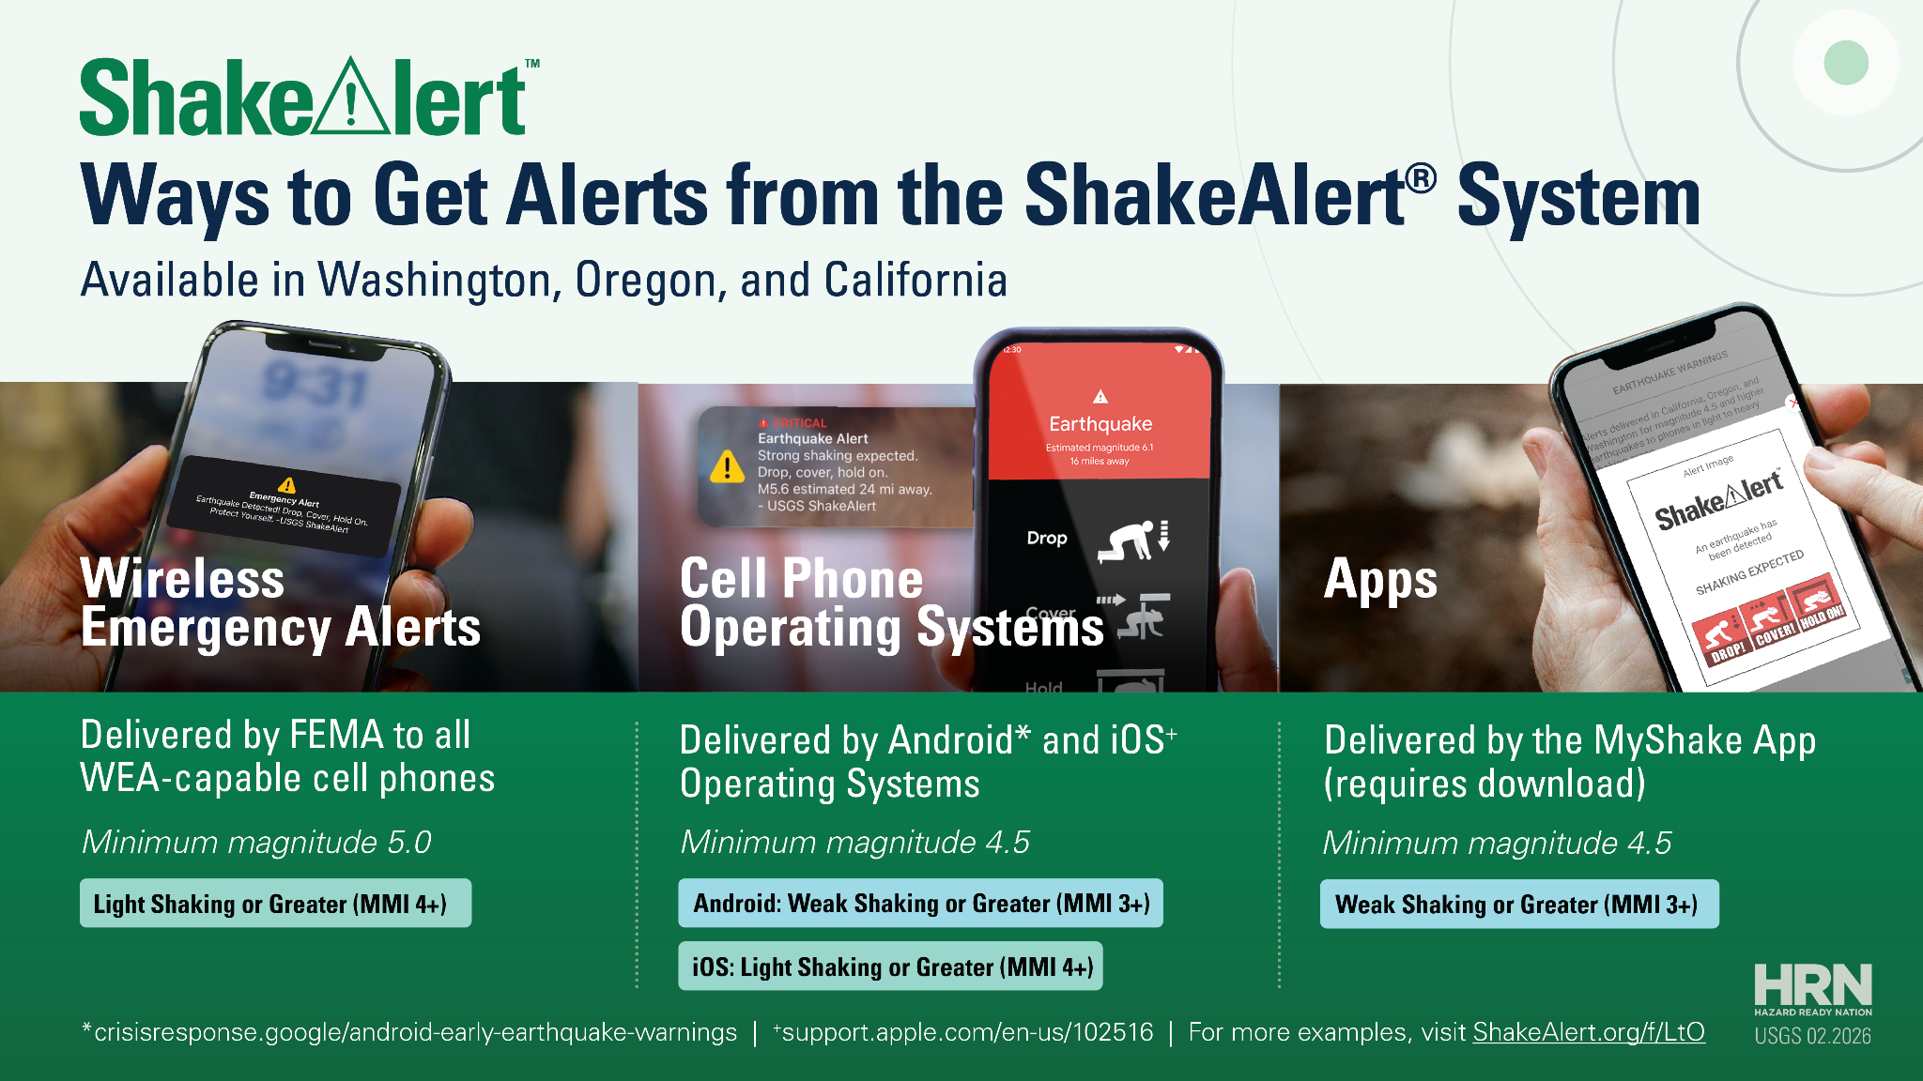
Notes:
Be sure you can get ShakeAlert-powered earthquake early warning alerts on your cell phone. Be sure to get alerts in many ways to increase your chance of being alerted.
https://www.usgs.gov/faqs/how-do-i-sign-shakealertr-earthquake-early-warning-system

Slide 8

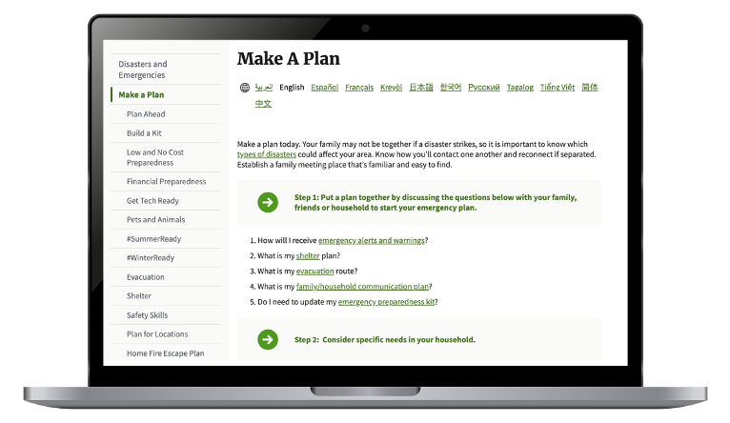
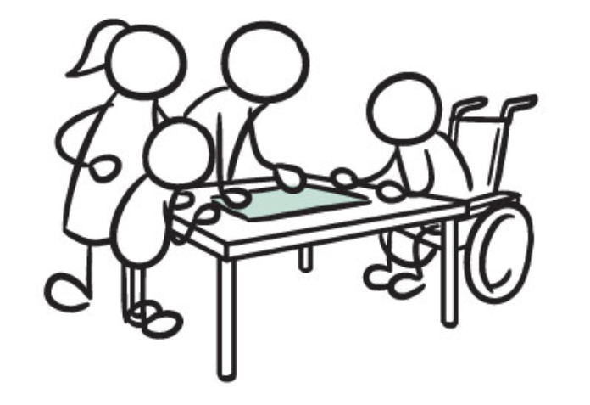
Make A Plan
Image courtesy of Ready.gov
Image courtesy of USGS
‹#›
Notes:
NOTE: Clicking on the image on the left will take you to Ready.gov.
Talk with your family about your plan to stay safe during an earthquake. Decide where to meet if you’re not together. Discuss evacuation routes. Make sure all family members have access to each other's’ contact information. Be sure to consider any of your family’s specific dietary or medical needs when planning. Ready.gov has checklists and other resources to help you create your family’s emergency plan. https://www.ready.gov/plan

Slide 9
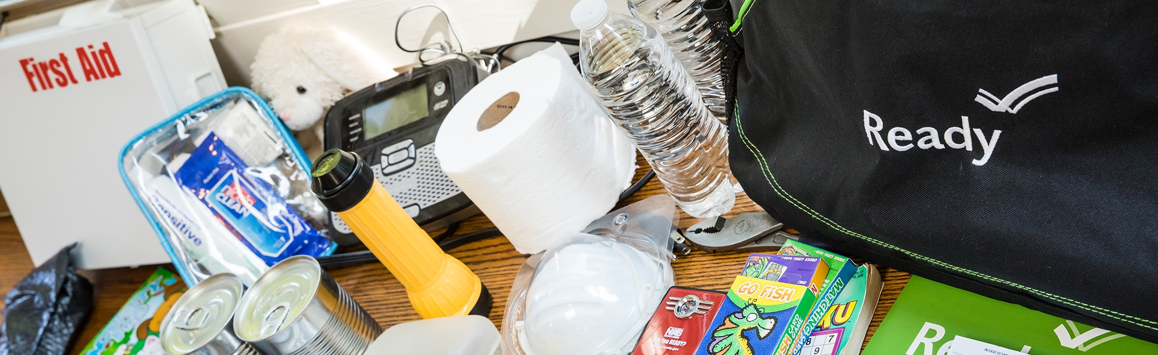

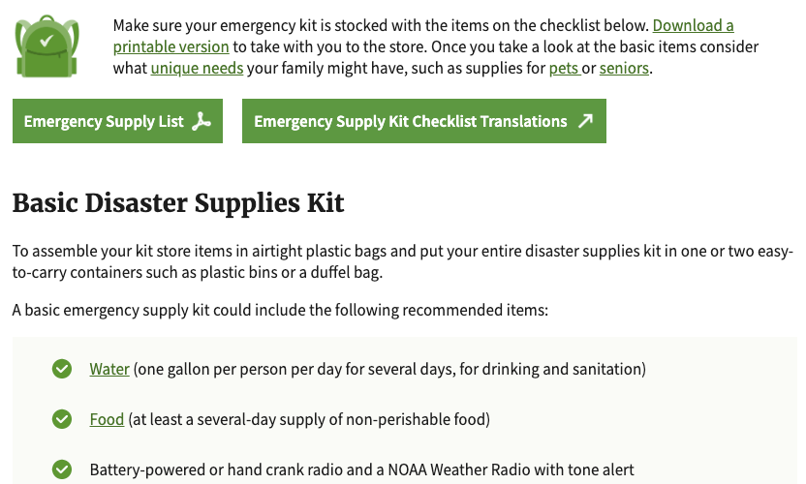
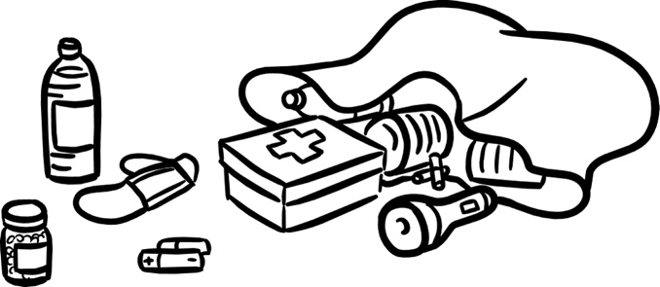
Make An Emergency Supply Kit
Image courtesy of Ready.gov
Image courtesy of USGS
‹#›
Notes:
NOTE: Clicking on the image on the left will take you to Ready.gov.
Build an emergency supply kit with enough water, food and other supplies for your family to survive for up to two weeks after an earthquake. Ready.gov has a list of what you may need, as well as low-cost and cost-free ideas on how to prepare. https://www.ready.gov/kit

Slide 10
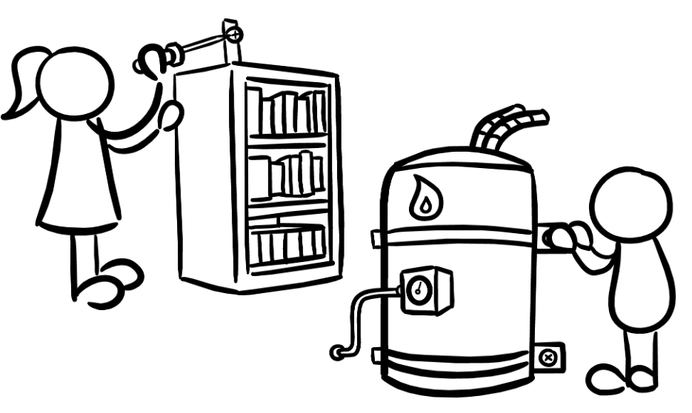
Secure Your Space
Image courtesy of USGS
‹#›
Notes:
NOTE: Clicking on the image on the left will take you to the Earthquake Country Alliance website, where you can learn how to secure your space.
During an earthquake injuries can occur as objects fall on people. Take action to prevent injuries by moving heavy objects to lower shelves, and moving beds and couches where people sleep or sit away from windows (which could break) and shelves or other heavy objects (that could fall during ground shaking).
The Earthquake Country Alliance has no-cost and low-cost ideas on how to get started. https://www.earthquakecountry.org/step1/

Slide 11
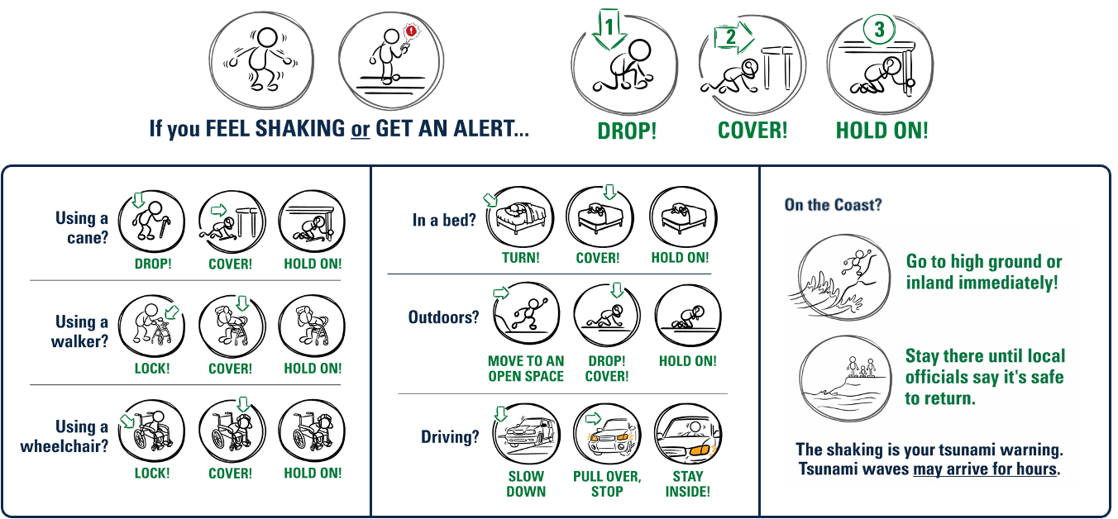
Image courtesy of USGS
‹#›
Notes:
Practice earthquake drills with your family. Research has shown that family members will instinctively try to get to each other during an earthquake, even though they are more likely to be injured while moving around. It is important to practice Drop, Cover, and Hold On with your family and discuss protective actions in various situations. The more you practice, the more automatic your family members’ responses will be.
The Earthquake Country Alliance has detailed information about how all bodies can protect themselves, as well as the best protective actions in a variety of settings, such as what to do if you hear an alert or feel shaking while you’re in bed, in a store, outside, or in a car. https://www.earthquakecountry.org/step5/

Slide 12
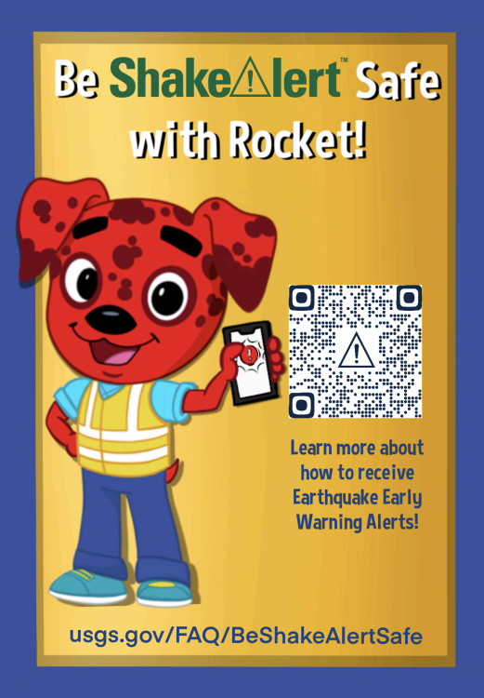
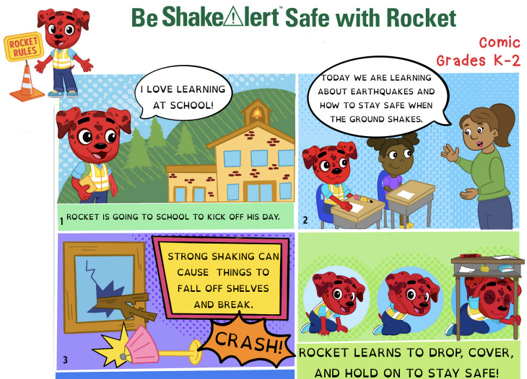
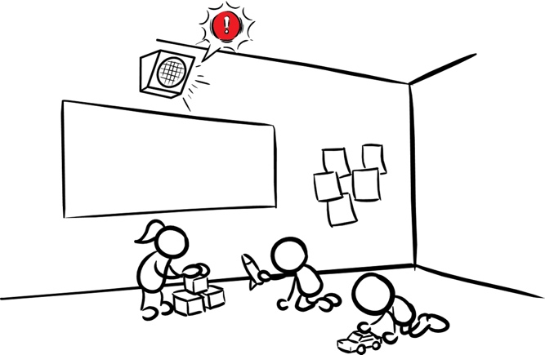
Talk to Children About Earthquake Safety
It’s ok to be scared, but it’s better to be prepared!
Image courtesy of USGS
Images courtesy of The Hero in You Foundation
‹#›
Notes:
Talk to your children about earthquakes and other hazards. They may be afraid or anxious about an earthquake. Assure them that your family has a plan, that you are prepared, and that it’s ok to be afraid. If your children are in kindergarten through 5th grade, consider visiting RocketRules.org/ShakeAlert for videos, comic books, and coloring sheets about how to stay safe in an earthquake.

Slide 13
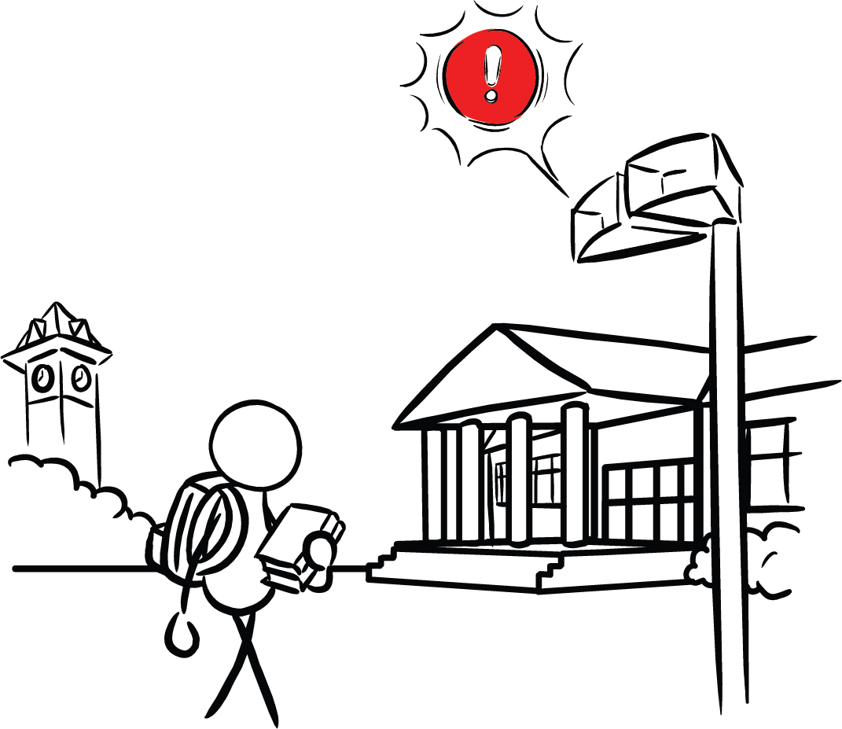
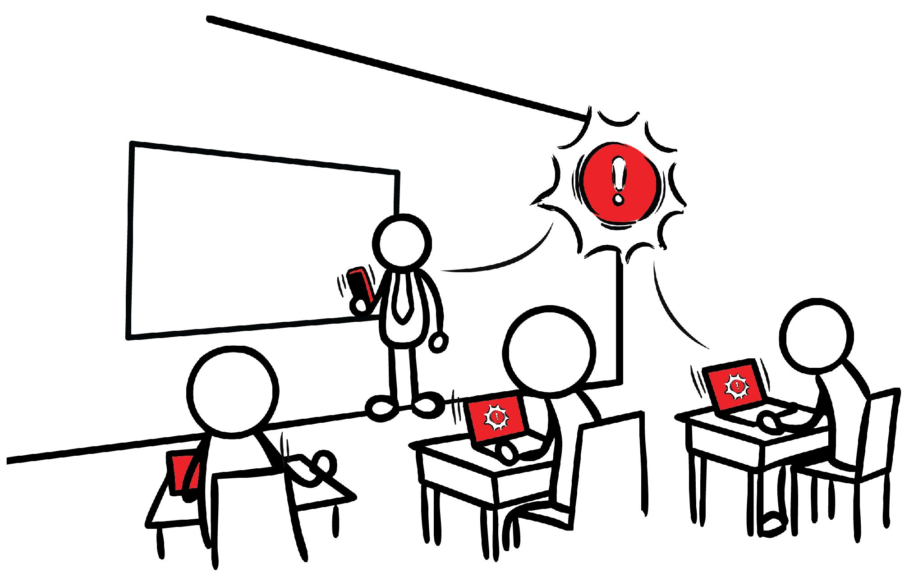
Talk to Older Students About Earthquake Safety
Consider working with older students to create a plan.
Images courtesy of USGS
‹#›
Notes:
Talk to your kids about earthquakes and other hazards. Older students may also be afraid or anxious about an earthquake. Consider working with older students to create a plan. Earthquake Country Alliance has many resources designed to help California’s prepare, survive, and recover from an earthquake. https://www.earthquakecountry.org/ Check out this comic about earthquakes, called “Without Warning,” available for free at https://digital.darkhorse.com/books/99762a678d1c41f8889eac6318f674d9/without-warning .

Slide 14

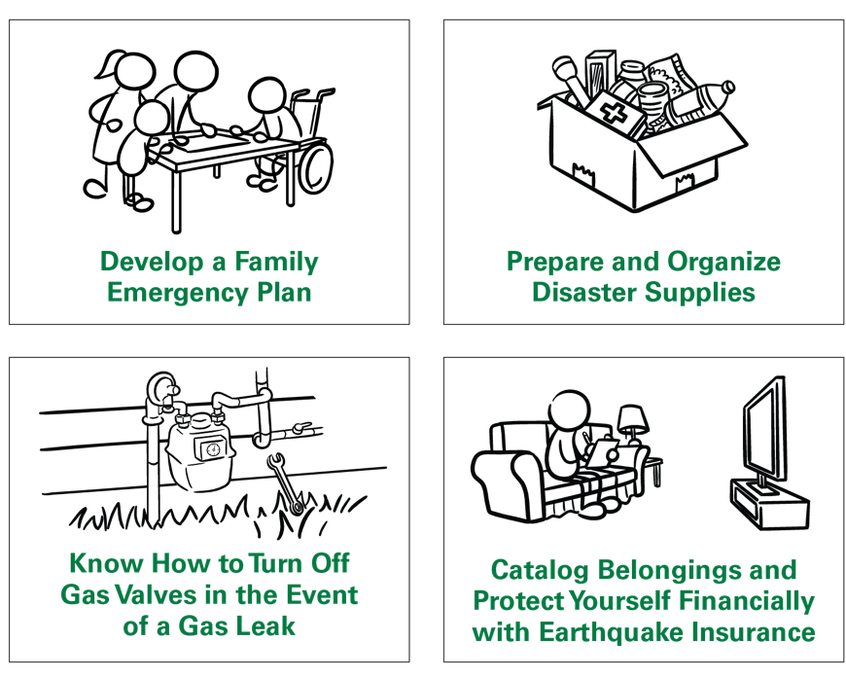
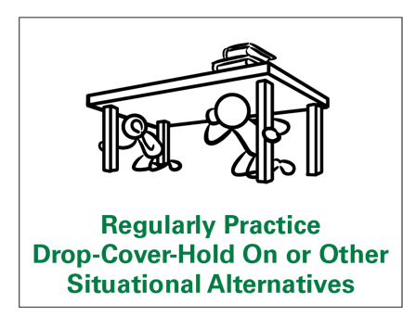

Connect with Your Community
Image courtesy of ShakeOut
Image courtesy of USGS
‹#›
Notes:
Consider sharing information with your community members about earthquake preparedness. Remember, most adults haven’t participated in an earthquake drill since they were in school. They may have incorrect ideas about how to protect themselves in an earthquake.
Conduct an earthquake drill at your workplace, house of worship, or other organization after reviewing correct protective actions. Include information about how to protect all bodies, including those that use a wheelchair, cane, or walker. Consider participating in the Great ShakeOut, an international earthquake drill that happens on the 3rd Thursday every October.

Slide 15

ShakeAlert Ready Schools | 7.2026
‹#›
Notes:
There are lots of great resources out there about earthquake preparedness. It can feel overwhelming to start preparing. Consider setting a reminder on your phone once a month to conduct an earthquake drill with your family, and complete one preparedness task. Anything you can do to prepare for an earthquake makes you and your family safer!

Slide 16

Thank you

