Slide 1

ShakeAlert® Earthquake Early Warning
Teacher Professional Development for
K-12 Lessons
OBJECTIVE: Prepare teachers to use ShakeAlert educational materials to conduct a ShakeAlert-powered Great ShakeOut drill.
Notes:
Welcome back to school from the US Geological Survey (USGS) and ShakeAlert. Schools are increasingly installing the ShakeAlert® Earthquake Early Warning System (EEW) into public address systems and on digital devices to potentially provide seconds of warning before strong shaking arrives. Being ShakeAlert ready is a true safety bonus!

Slide 2
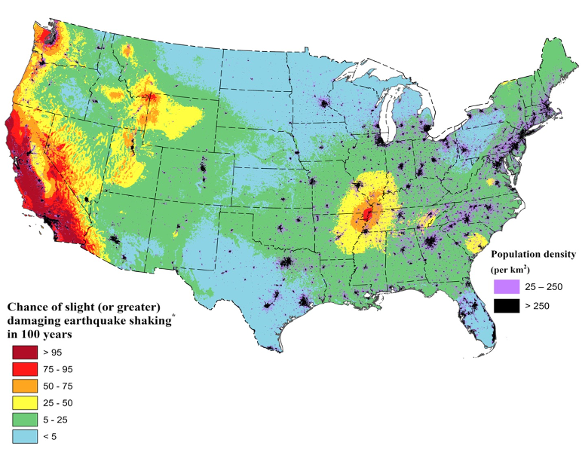
You Live in
Earthquake Country!
Areas in red have a more than 75% chance of a damaging earthquake in the next 100 years.
Image courtesy of USGS
‹#›
Notes:
NOTE: This slide is optional and can be skipped if you viewed the ShakeAlert Ready Staff Back-to-School Presentation.
Did you know that much of California, and some areas in Oregon and Washington have a more than 75% chance of experience a damaging earthquake in the next 100 years? This USGS graphic shows areas in red have a greater than 75% chance of experiencing an earthquake with strong to extreme shaking in the next 100 years. This means an earthquake with a Modified Mercalli Intensity of 6 or greater.
An MMI of 6 on the 10-point scale will be felt by everyone and may be frightening and cause slight damage. Increasing intensity will result in a range of damage from overturned furniture to partial or complete building collapse. Because of this risk, it is important to prepare your staff and students to respond safely to an earthquake. That’s why the school district has ShakeAlert-powered earthquake early warning at your school.
In case there’s a question regarding MMI scale, show this scale and explain briefly.

Slide 3
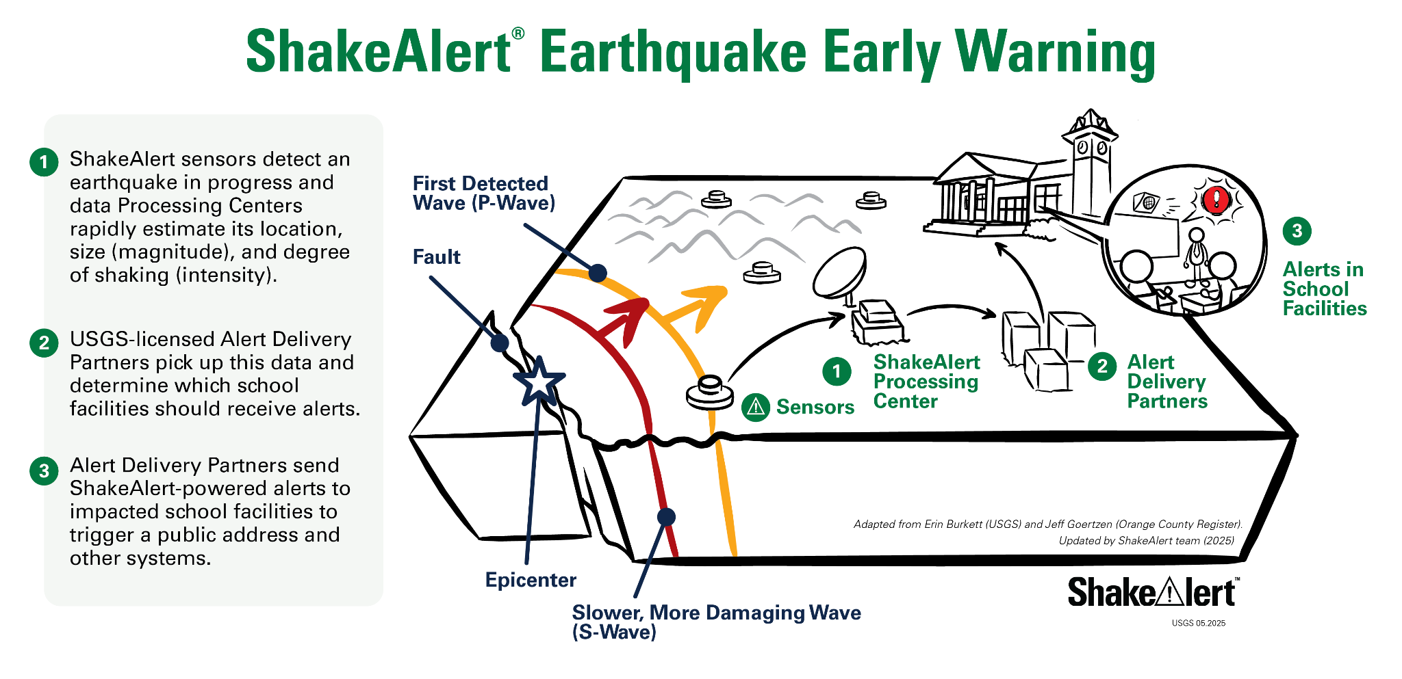
Image courtesy of USGS
‹#›
Notes:
NOTE: This slide is optional and can be skipped if you viewed the ShakeAlert Ready Staff Back to School Presentation.
It is important to note that ShakeAlert does not predict earthquakes. When an earthquake is detected by sensors in the US Geological Survey's seismic network, a message is sent to Alert Delivery Partners who automatically push that information to users like your school, which can deliver it through the PA or other systems—all in a matter of seconds. Alerts can provide seconds of extra time for our school community to Drop, Cover and Hold On before the strongest shaking arrives!

Slide 4
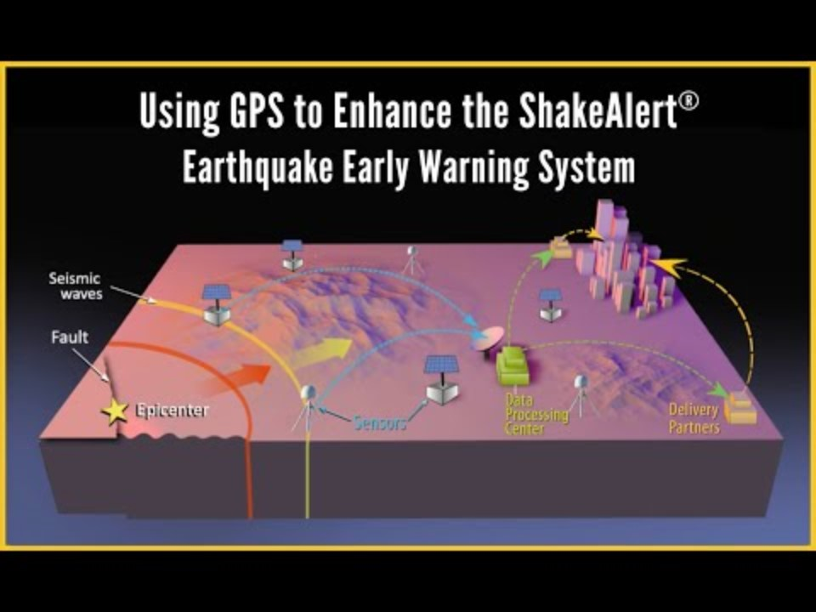
How Does ShakeAlertⓇ Earthquake Early Warning Work?
Video courtesy of Earthscope Consortium
‹#›
Notes:
NOTE: This slide is optional and can be skipped if you viewed the ShakeAlert Ready Staff Back to School Presentation.
Show video. The most important part is the first 1:26. You can stop video at that point. Otherwise, play the whole thing. ShakeAlert can give your students seconds of time to Drop, Cover and Hold On before the dangerous shaking arrives. For the ShakeAlert system to be effective, it is important students practice responding to alerts.
For more information and animations, please visit EarthScope.

Slide 5

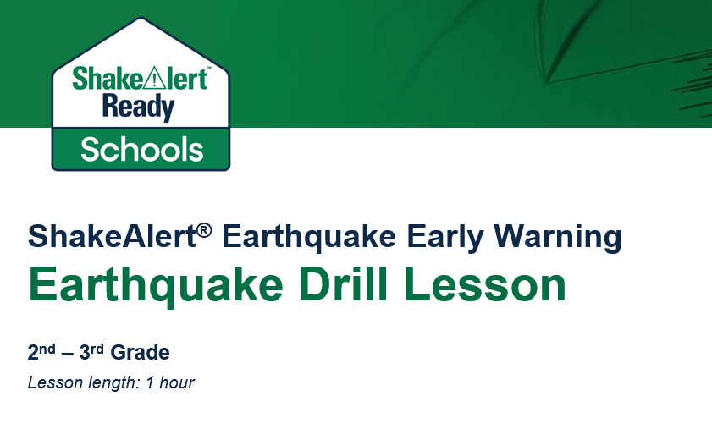
Prepare Your Students
Image courtesy of ShakeOut
Image courtesy of USGS
‹#›
Notes:
To prepare students to respond automatically to ShakeAlert-powered alerts, we will conduct a ShakeAlert-powered earthquake drill. Your school might choose to do this in conjunction with the Great ShakeOut, in which millions of people around the world participate in an earthquake drill on the third Thursday of October each year. ShakeAlert provides grade-specific lessons that will help you lead your students through the drill. Lessons are grade-appropriate and standards-aligned.

Slide 6
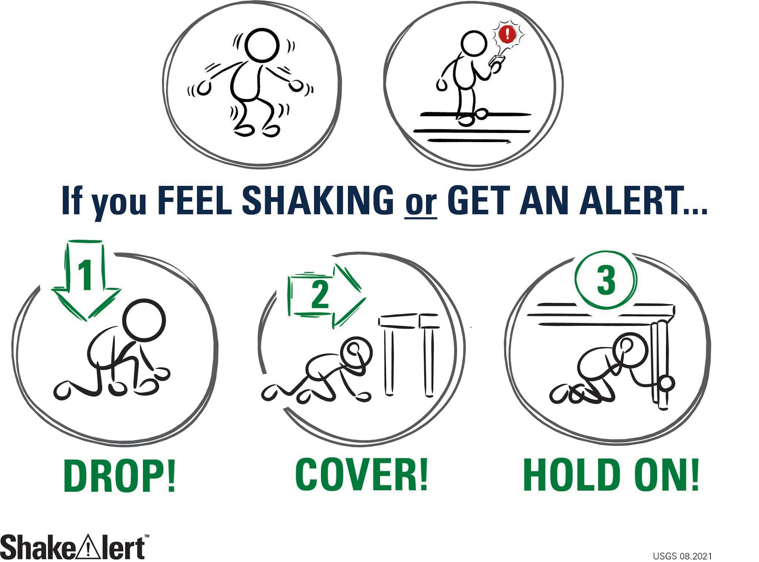
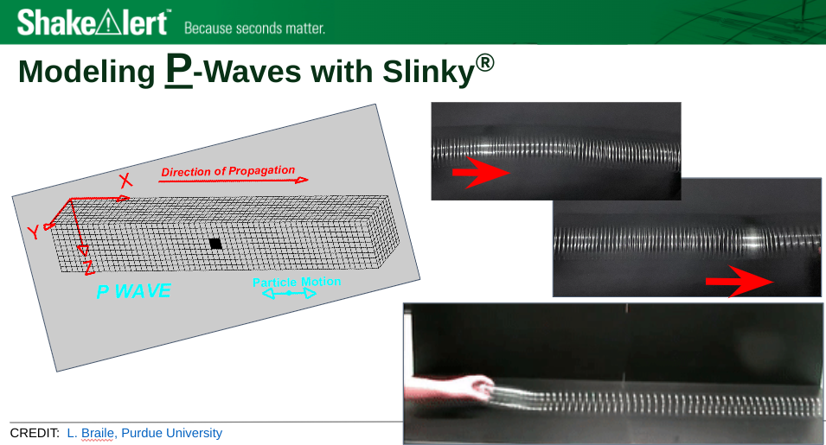
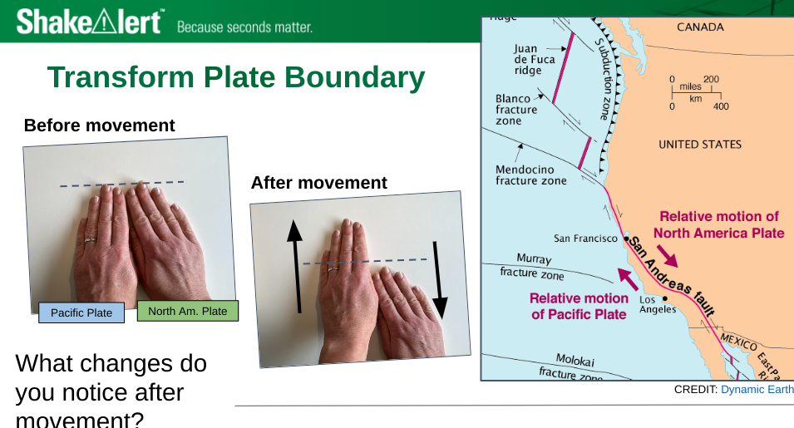
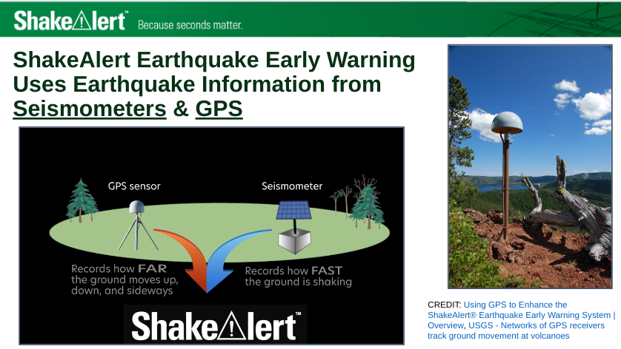
Lesson Goals
Images courtesy of USGS
‹#›
Notes:
The lesson you’ll teach will provide students with an opportunity to practice responding to an earthquake early warning or ground shaking by taking protective actions, such as Drop, Cover and Hold On. The lessons are aligned to Next Generation Science Standards and contain grade-level appropriate science content. For example, the 4th to 5th grade lesson uses models of seismic waves moving houses to connect to 4-PS4-1; the middle school lesson models plate boundaries and faults which supports MS-ESS2-2; and the high school lesson describes how the ShakeAlert System utilizes seismic waves and radio waves in its earthquake early warning system, which is related to HS-PS4-5.

Slide 7
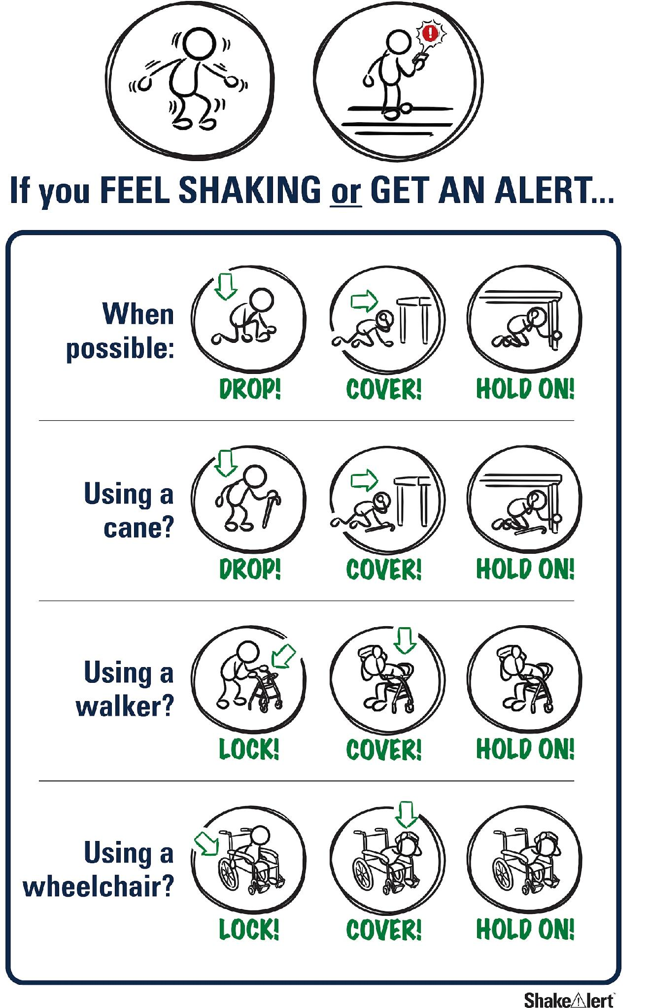
Image courtesy of USGS
‹#›
Notes:
Lessons and materials provide protective actions for all bodies. Through practicing Drop, Cover, and Hold On (DCHO), we build students’ muscle memories and increase the likelihood that they will act automatically to take correct protective actions even when emotions are heightened during an actual earthquake!

Slide 8

Why Drop, Cover, and Hold On?
You're twice as likely to be injured while moving.
Many injuries occur while exiting or moving away from buildings.
Fifty percent of earthquake injuries are caused by falls and falling hazards.
Seconds of warning—along with taking action, such as
Drop, Cover, and Hold On—can potentially reduce injuries by 50 percent.
‹#›
Notes:
In the United States—where most structures are required to meet building codes for safety—Drop, Cover and Hold on is usually the best action to take. Taking refuge in doorways, which were once considered a safe zone, is no longer recommended. In fact, you could be injured while trying to reach a doorway.
As early as 1998, researchers found that people were twice as likely to be injured while trying to move during ground shaking and that many injuries were caused by falling debris they encountered while trying to flee or move to safer locations within building. A 2016 study by Berkeley researchers Jennifer Strauss and Richard Allen conclude that, "If everyone received a few seconds of warning, and if everyone dropped, took cover, and held on, then early warning could reduce the number of injuries by more than 50% in future earthquakes.”
Although ShakeAlert-powered earthquake early warning system can provide seconds of warning, it cannot tell you how much time you have before before shaking arrives. It is highly unlikely that you could evacuate a school before dangerous shaking arrives, which would expose students to additional risk.

Slide 9
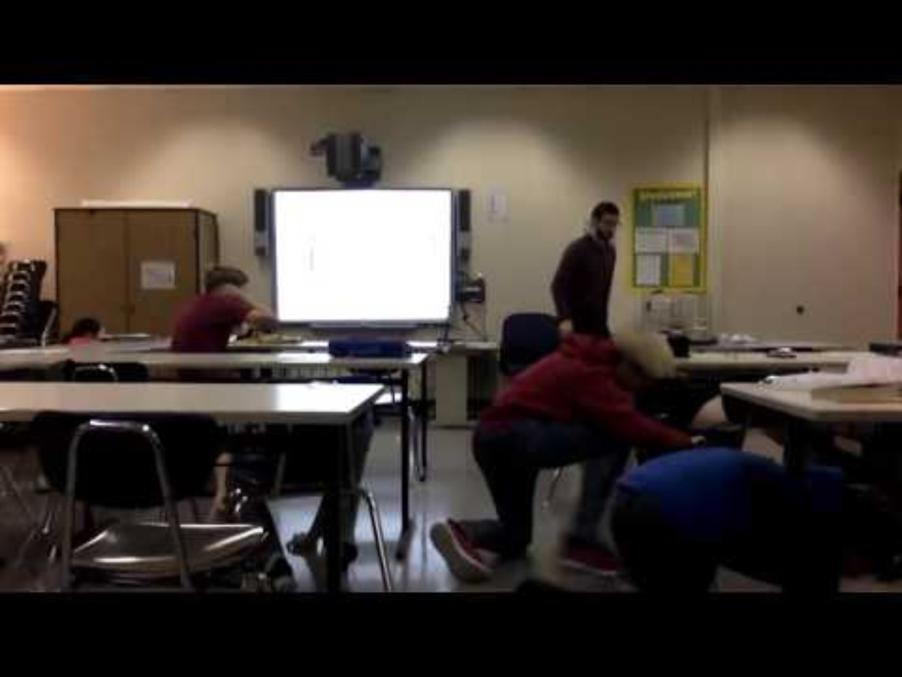
2018 Magnitude 7.1 Anchorage, Alaska Earthquake
Watch initial jolt and almost immediate action of class.
Video courtesy of Anchorage School District
‹#›
Notes:
This video shows why immediate action is imperative when you feel ground shaking or get an alert. Here you see students react immediately and appropriately to the first jolt of ground shaking as they Drop, Cover, and Hold On. Therefore, when the slower more damaging energy from the earthquake arrives, they are protected.
VIDEO: Video courtesy of the Anchorage School District

Slide 10
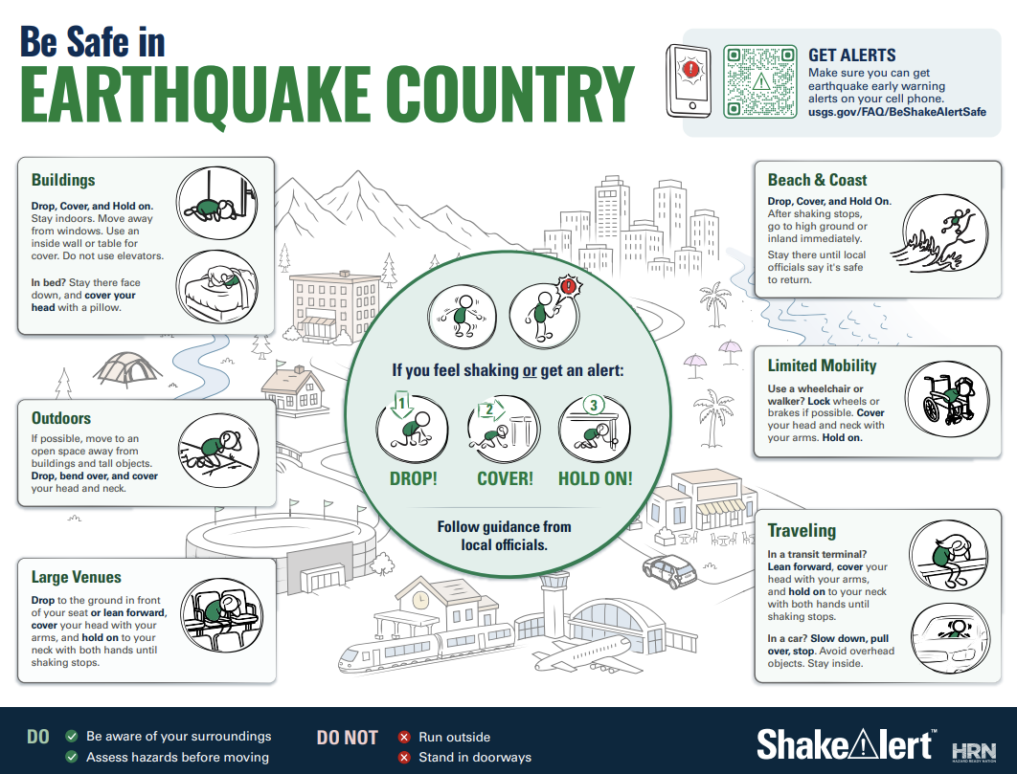
Situational Awareness is Key Wherever You Are!
Image courtesy of USGS
‹#›
Notes:
Your students will undoubtedly wonder how to protect themselves in a variety of situations. It’s important to stress situational awareness and ask students to discuss different scenarios with their families. There are many resources available to help on ShakeAlert.org.

Slide 11
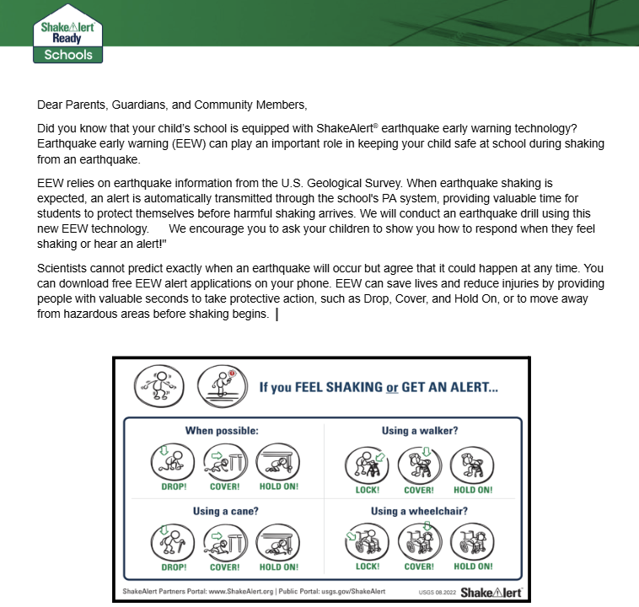

Engage Parents and Guardians
Image courtesy of Ready.gov
Image courtesy of USGS
‹#›
Notes:
In addition to preparing students for an earthquake, you can leverage ShakeAlert Ready resources to connect with parents and guardians. Take an opportunity to tell them about the steps your school is taking to prepare their children and to encourage them to prepare, as well.
Many adults haven’t participated in an earthquake drill since they were children or don’t know the current protective actions to take in an earthquake. After completing our first ShakeAlert-powered earthquake drill, teachers can share information about ShakeAlert and about how families can prepare for and protect themselves during an earthquake. There is a customizable family engagement letter in English and Spanish that can be emailed or sent with students, as well as a family engagement website that has no- and low-cost ideas on how families can prepare. There’s also a PTA/Parent Community presentation available. Again, these resources are customizable, and you can present this information from the speaker notes, or we can make a video presentation for you on request.

Slide 12
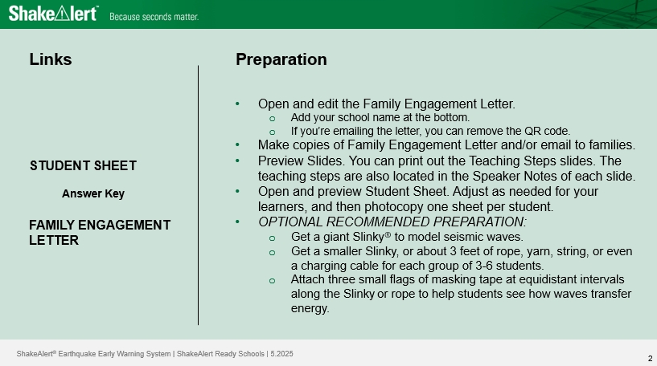
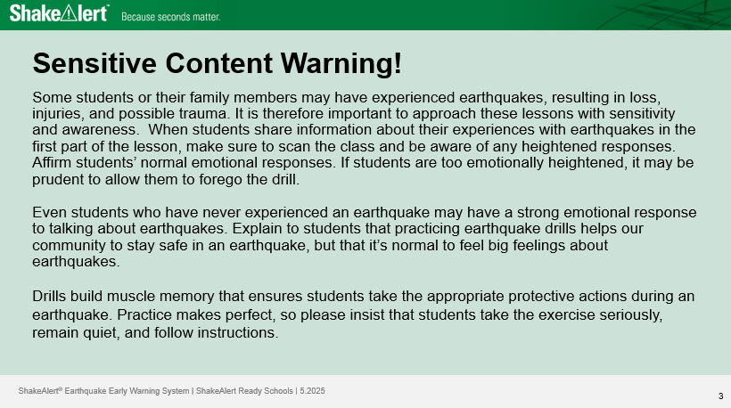
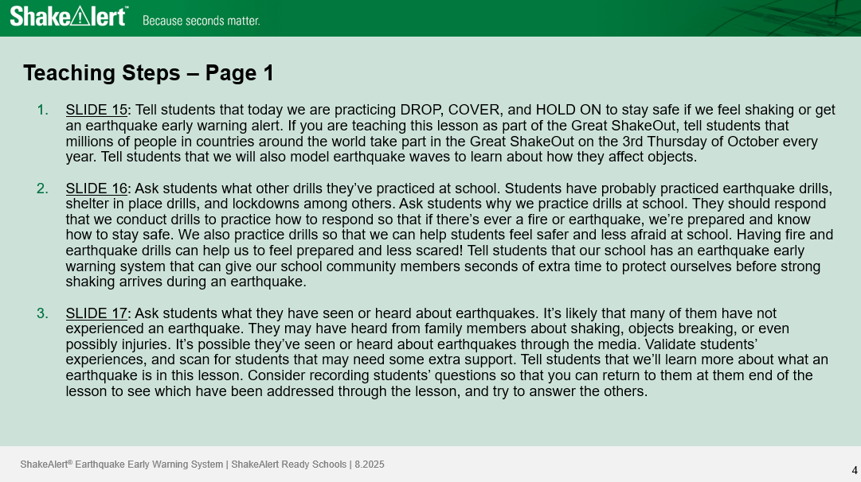
Before the Lesson
‹#›
Notes:
Green slides are teacher-facing, white slides are student-facing.
Before the lesson:
Prep - 15 minutes or less - some have optional student sheets.
Sensitive content warning - Be sure to read and consider your school community. Is there someone who may need extra sensitivity or an advanced warning?
Teaching steps - Consider printing these steps or printing the student-facing slides with speaker notes.

Slide 13
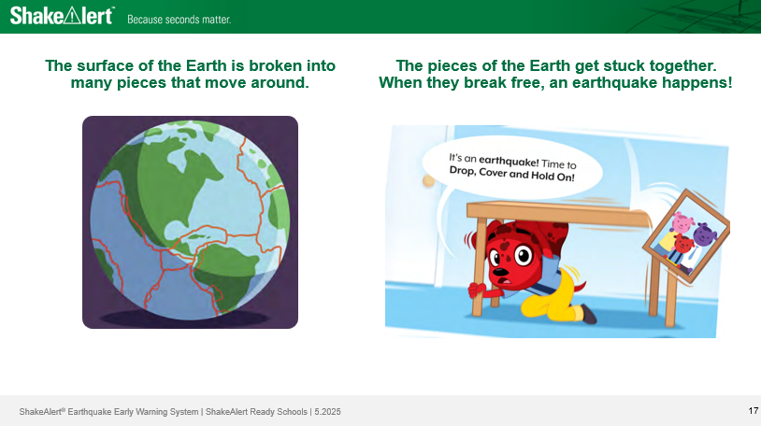
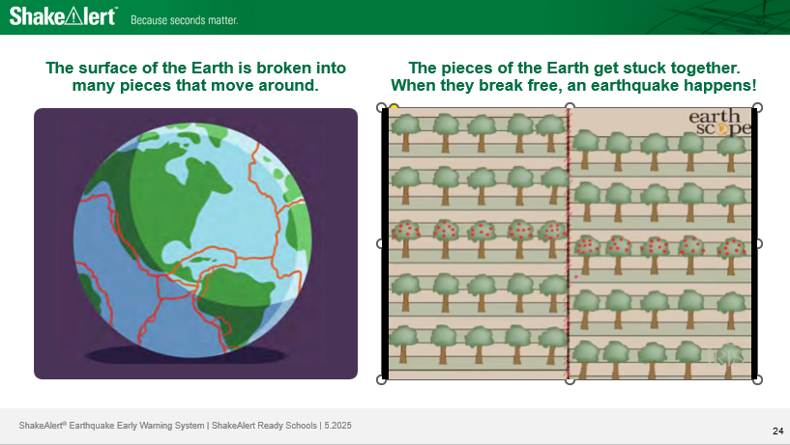
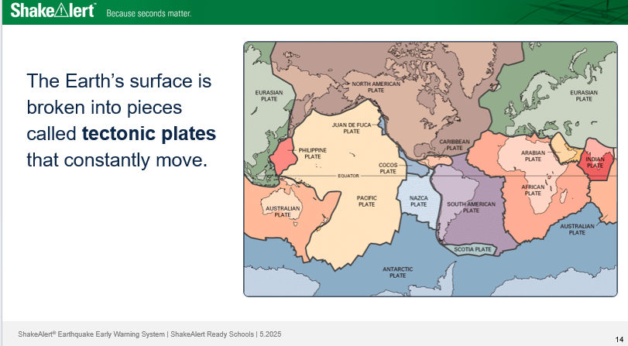
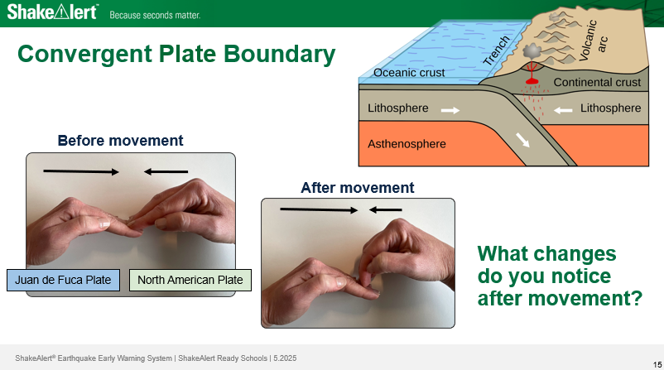
Lessons are Grade-Appropriate & Standards-Aligned
‹#›
Notes:
Lessons are available for Kindergarten to 1st grade, 2nd to 3rd grade, 4th to 5th grade, 6th to 8th grade, and high school.
Here’s an example of how science content is handled in early elementary school versus middle school.
In the kindergarten and first grade lesson, there’s a picture of Earth’s surface broken into pieces, and a GIF (short video) of a cartoon dog taking cover and hold on under a table during ground shaking.
In the fourth and fifth grade lesson, the same picture of Earth’s surface broken into pieces is used, along with a GIF of friction between moving pieces of earth and the earthquake when friction is overcome.
In the middle school lesson, there’s a detailed map of tectonic plates and specific examples of different plate boundaries, as well as the geological processes and landforms at each.
The teaching steps are in the speaker notes of each slide.

Slide 14
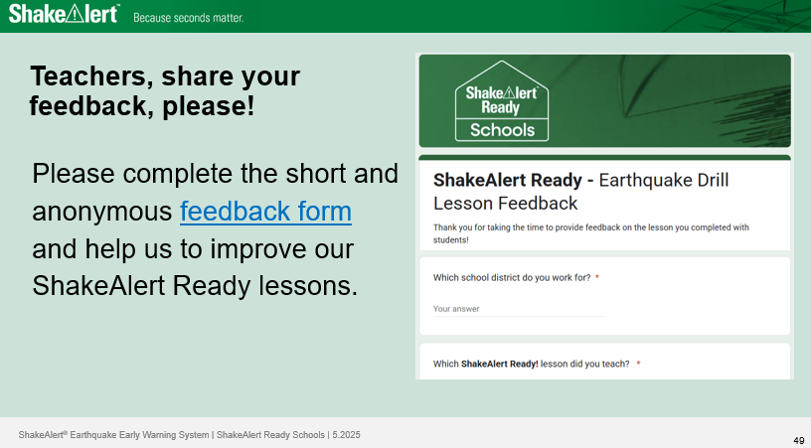
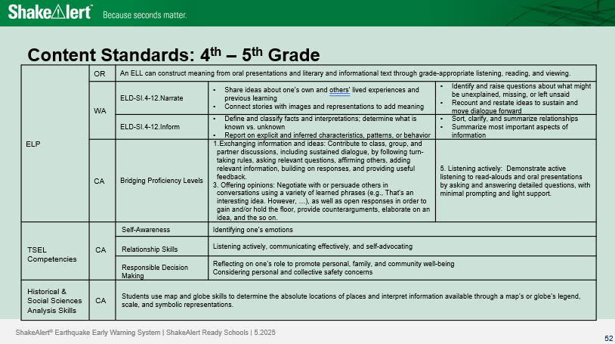
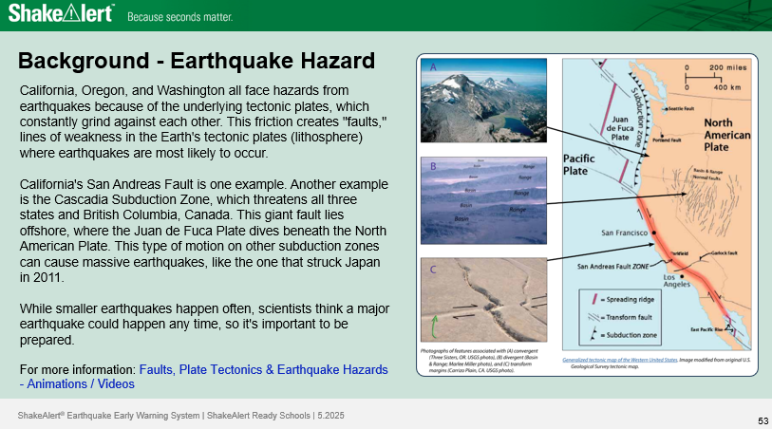
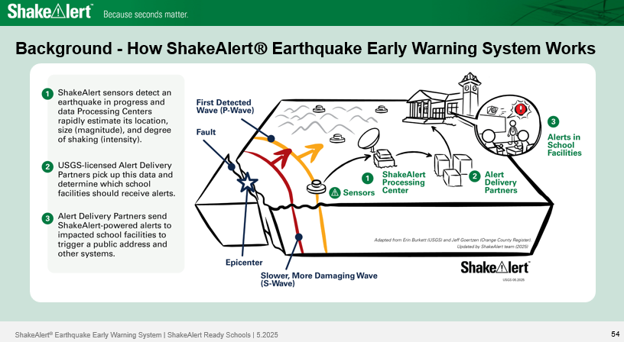
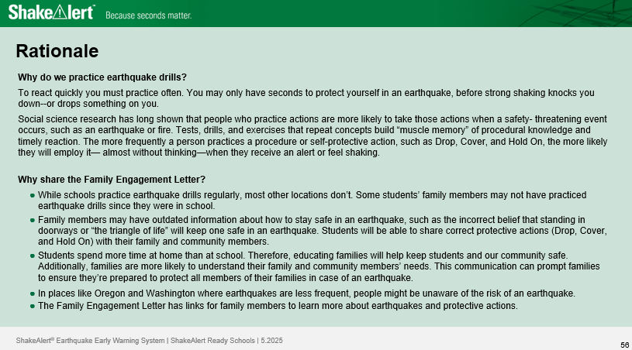
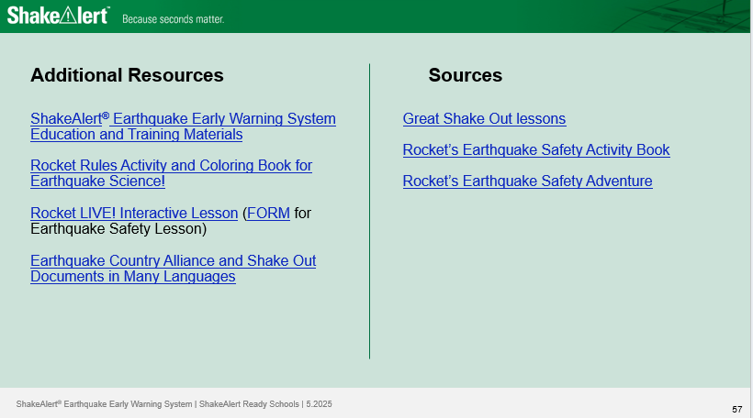
Each Lesson Also Includes …
feedback survey
content standards
background on hazards
how EEW works
rationale for drills
additional resources
‹#›
Notes:
At the end of the lesson, you will find:
Feedback survey
Content standards
Background on nearby earthquake hazards
How ShakeAlert earthquake early warning works.
Rationale for conducting drills and communicating with students’ adult caregivers
Additional resources

Slide 15
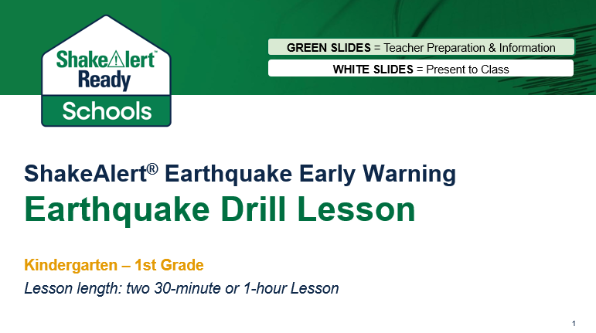
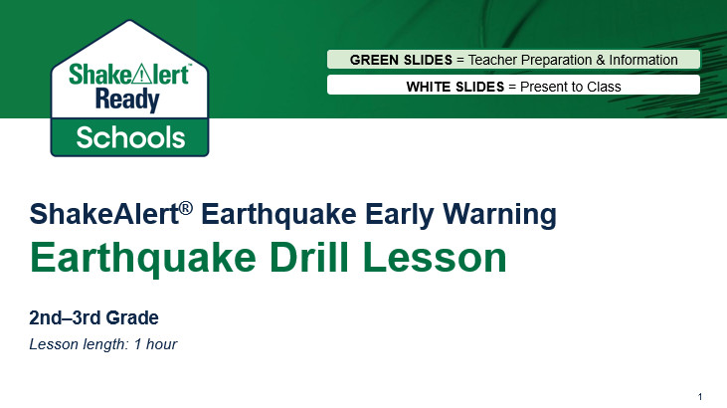
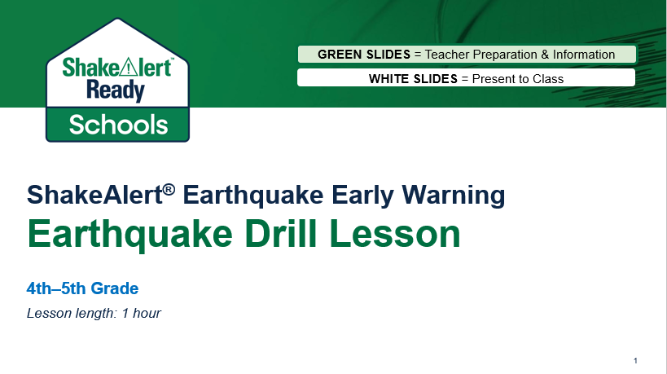
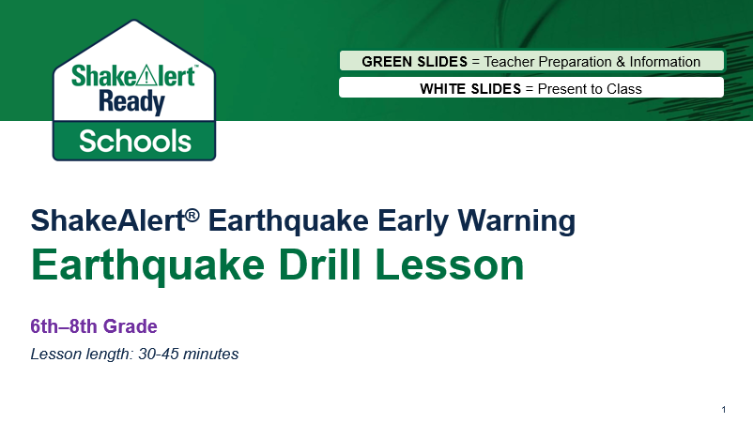
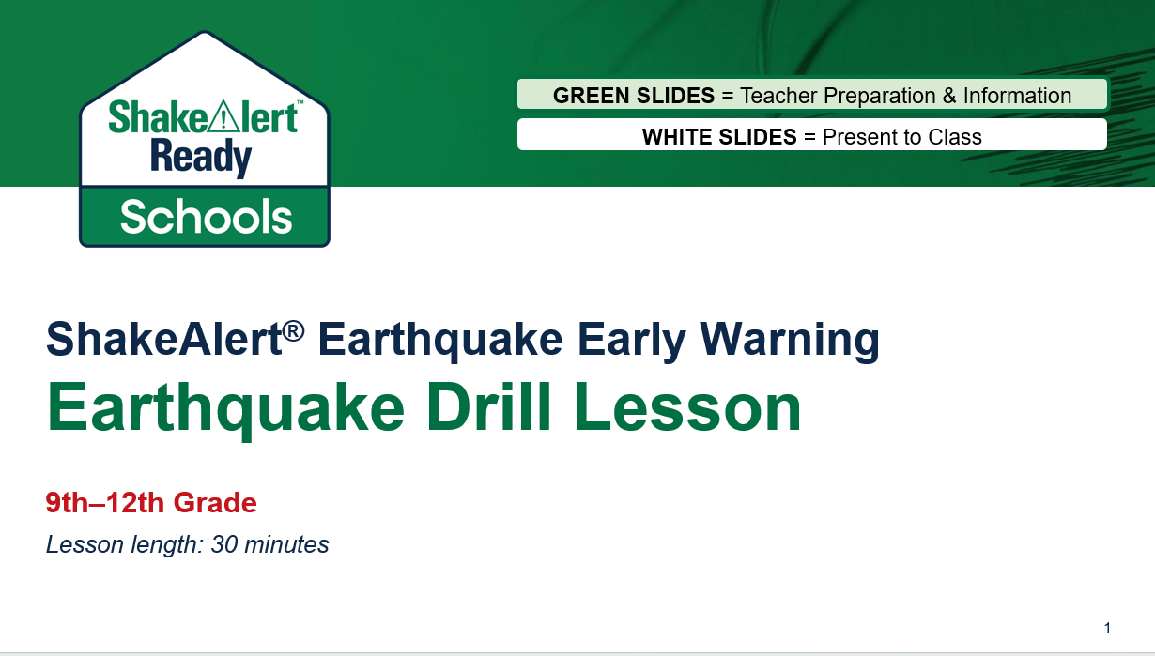
Review Your Grade-level Lesson
‹#›
Notes:
This completes the introductory training on the layout, resources and purpose of the ShakeAlert-powered Great ShakeOut lessons.
Open the lesson for your grade level.
Take time now to read the Sensitive Content Warning.
Preview the slides and the teacher notes.
Prepare the Family Engagement Letter to share with your adult caregivers.
Print out the teaching steps slides and student sheets.

Slide 16
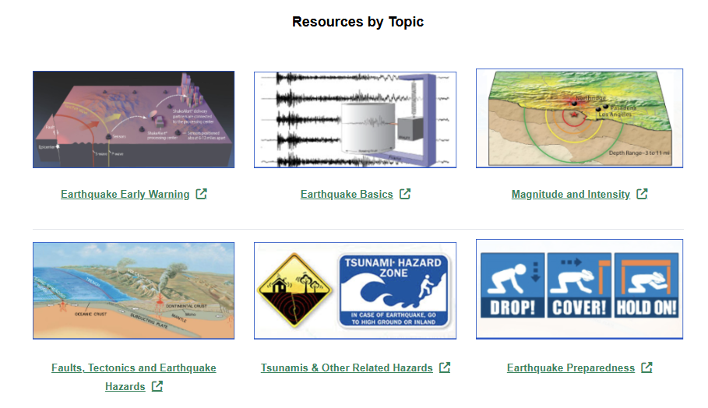
Leverage ShakeAlert.org to Enhance STEAM Education!
Image courtesy of ShakeAlert
‹#›
Notes:
Leverage ShakeAlert to enhance STEAM education. ShakeAlert.org has interactive activities, animations, and videos that are standards-aligned, vetted by teachers and geologists, and designed to fit within 5-, 15-, or 45-minutes.

Slide 17

For More Information
USGS ShakeAlert www.ShakeAlert.org
Ready.gov https://www.ready.gov/earthquakes
Earthquake Country Alliance https://www.earthquakecountry.org/
California Governor's Office of Emergency Services https://www.caloes.ca.gov/
Oregon Department of Emergency Management https://www.oregon.gov/oem/Pages/default.aspx
Washington Emergency Management Division https://mil.wa.gov/emergency-management-division
@USGS_ShakeAlert
‹#›

Slide 18

Thank you

