Slide 1
ShakeAlert® Earthquake Early Warning System
Staff Back-to-School Presentation
What is the ShakeAlertⓇ Earthquake Early Warning System?
What to expect and how to respond
Educating the school community about earthquake safety
Notes:
Welcome to a new school year from the U.S. Geological Survey and ShakeAlert!

Slide 2
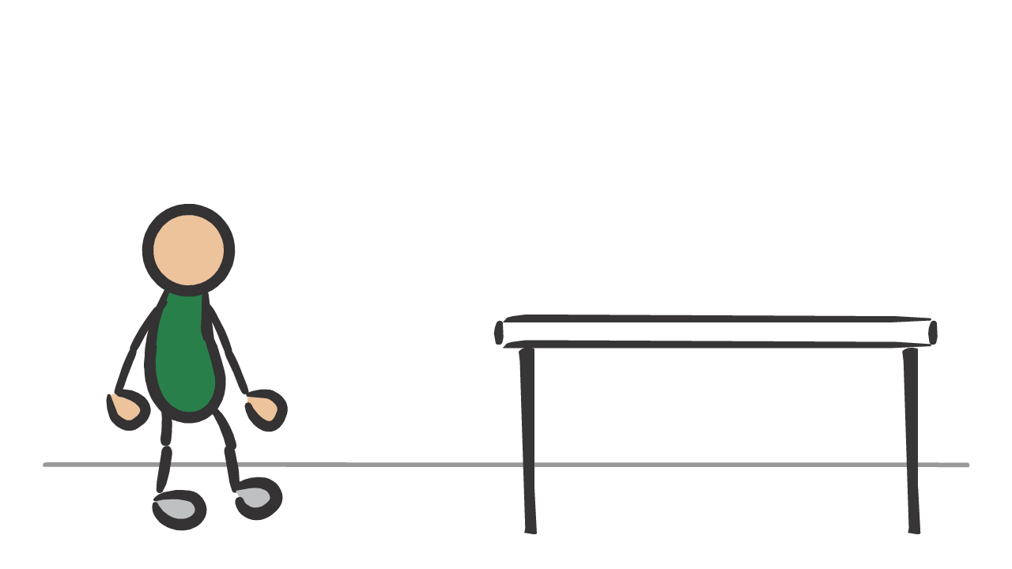
The ShakeAlert Earthquake Early Warning System
provides potential seconds of warning to take protective action before strong shaking arrives.
Image courtesy of USGS
2
Notes:
Schools protected by the ShakeAlert Earthquake Early Warning System can provide school community members with potential seconds of warning before strong ground shaking arrives. This could provide enough time to allow students and staff to take protective action. Much like other alarms and drills, the ShakeAlert-powered technology in your school helps students and teachers know what to do when an earthquake strikes.

Slide 3
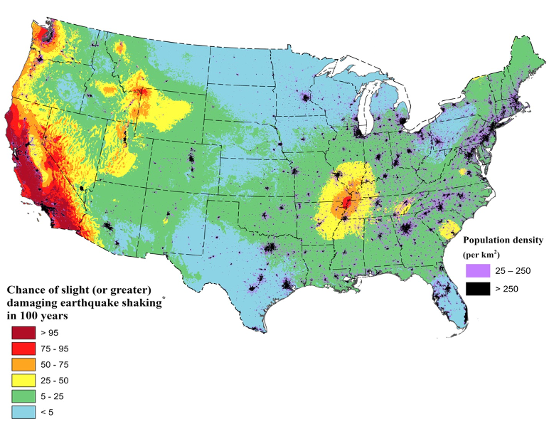
You Live in
Earthquake Country!
Areas in red have a more than 75% chance of a damaging earthquake in the next 100 years.
Image courtesy of USGS
3
Notes:
Did you know that much of California, and some areas in Oregon and Washington, have a more than 75% chance of experience a damaging earthquake in the next 100 years? This U.S. Geological Survey (USGS) graphic shows areas in red that have a greater than 75% chance of experiencing an earthquake with strong to extreme shaking in the next 100 years. This means an earthquake with a Modified Mercalli Intensity of 6 or greater.
An MMI of 6 on the 10-point scale will be felt by everyone and may be frightening and cause slight damage. Increasing intensity will result in a range of damage from overturned furniture to partial or complete building collapse. Because of this risk, it is important to prepare your staff and students to respond safely to an earthquake. That’s why the school district has ShakeAlert-powered earthquake early warning at your school.
In case there’s a question regarding MMI scale, show this scale and explain briefly.

Slide 4
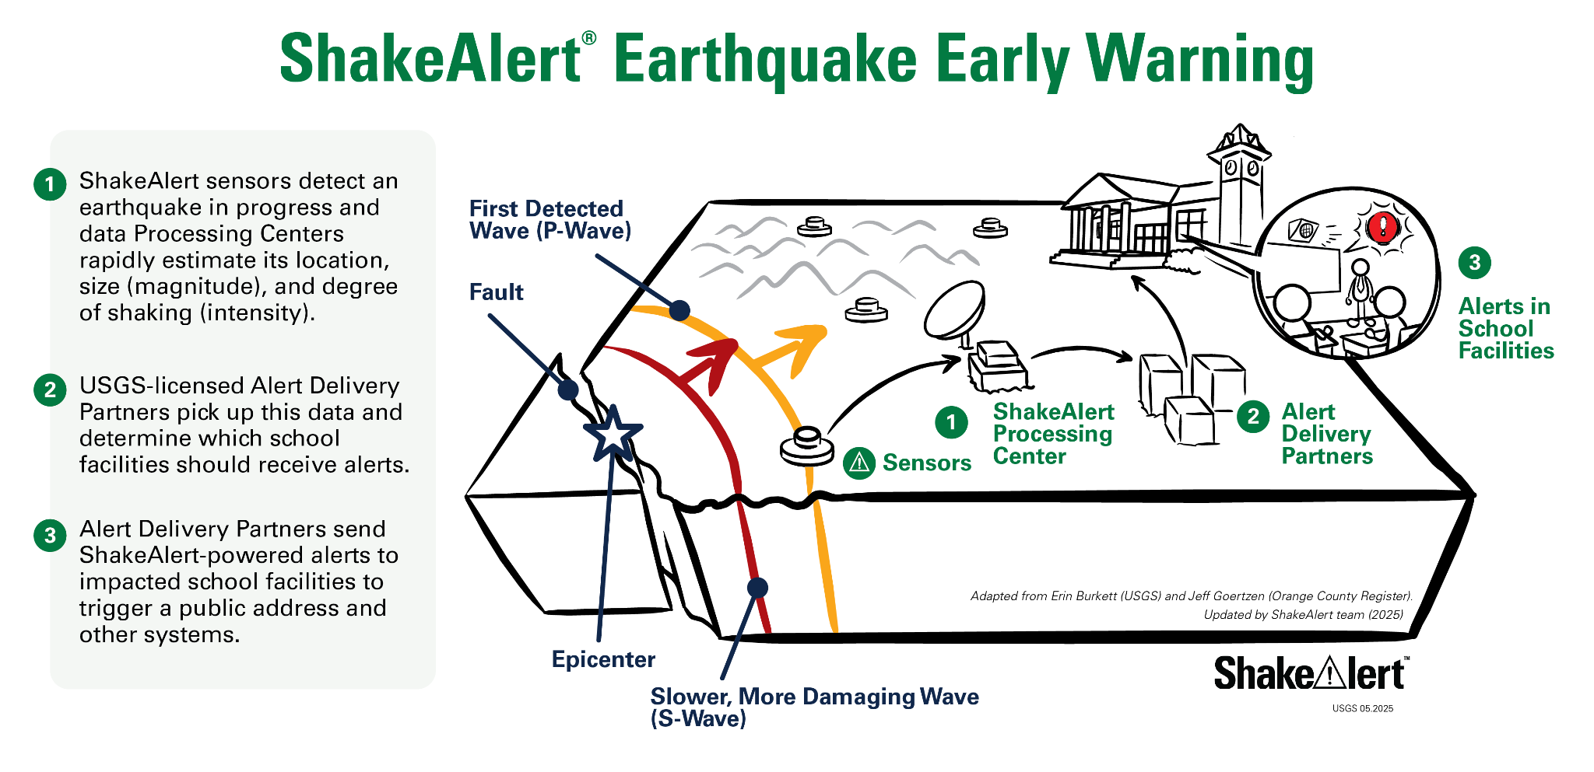
Image courtesy of USGS
4
Notes:
It is important to note that ShakeAlert does not predict earthquakes. When an earthquake is detected by sensors in the U.S. Geological Survey's seismic network, a message is sent to Alert Delivery Partners who rapidly determine which school facilities should get alerts and deliver alerts through the public address or other systems—all in a matter of seconds. Alerts can potentially provide seconds of time for our school community to Drop, Cover and Hold On before strong shaking arrives!

Slide 5
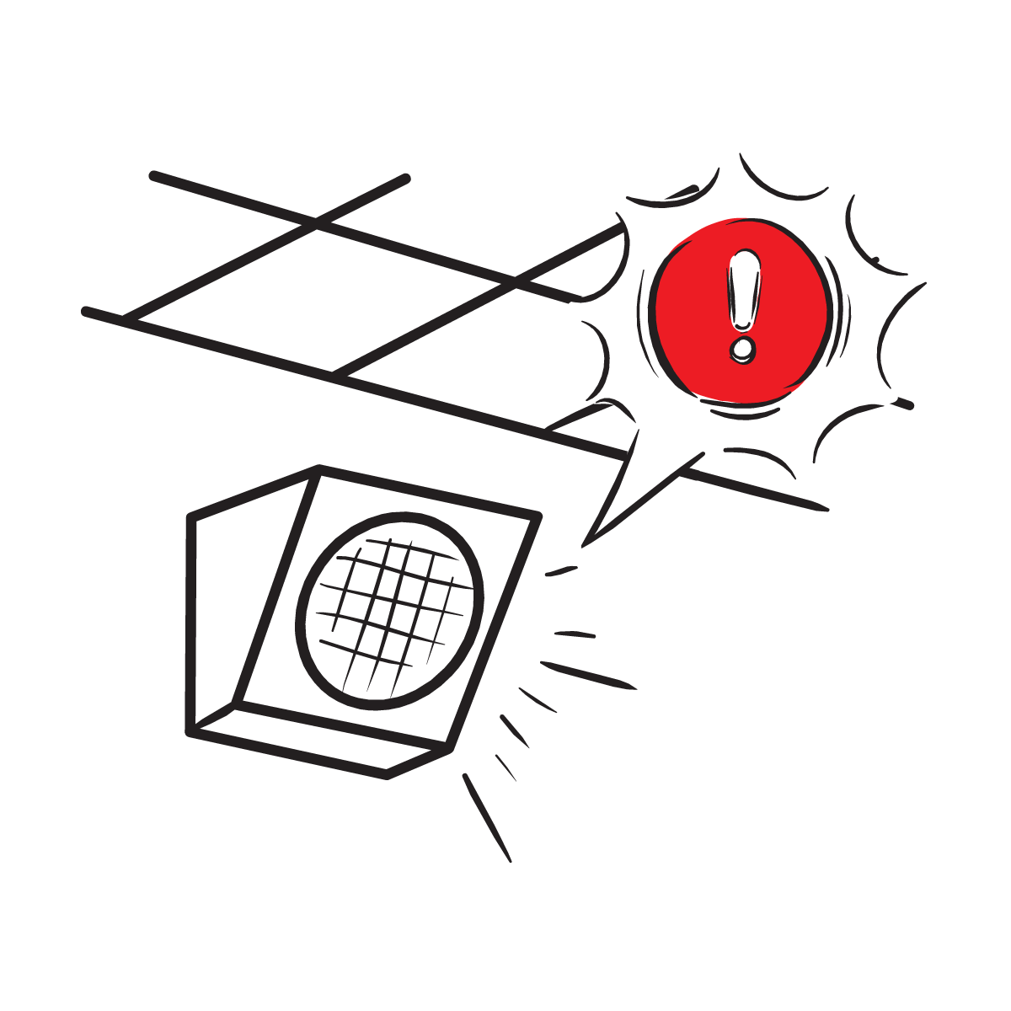
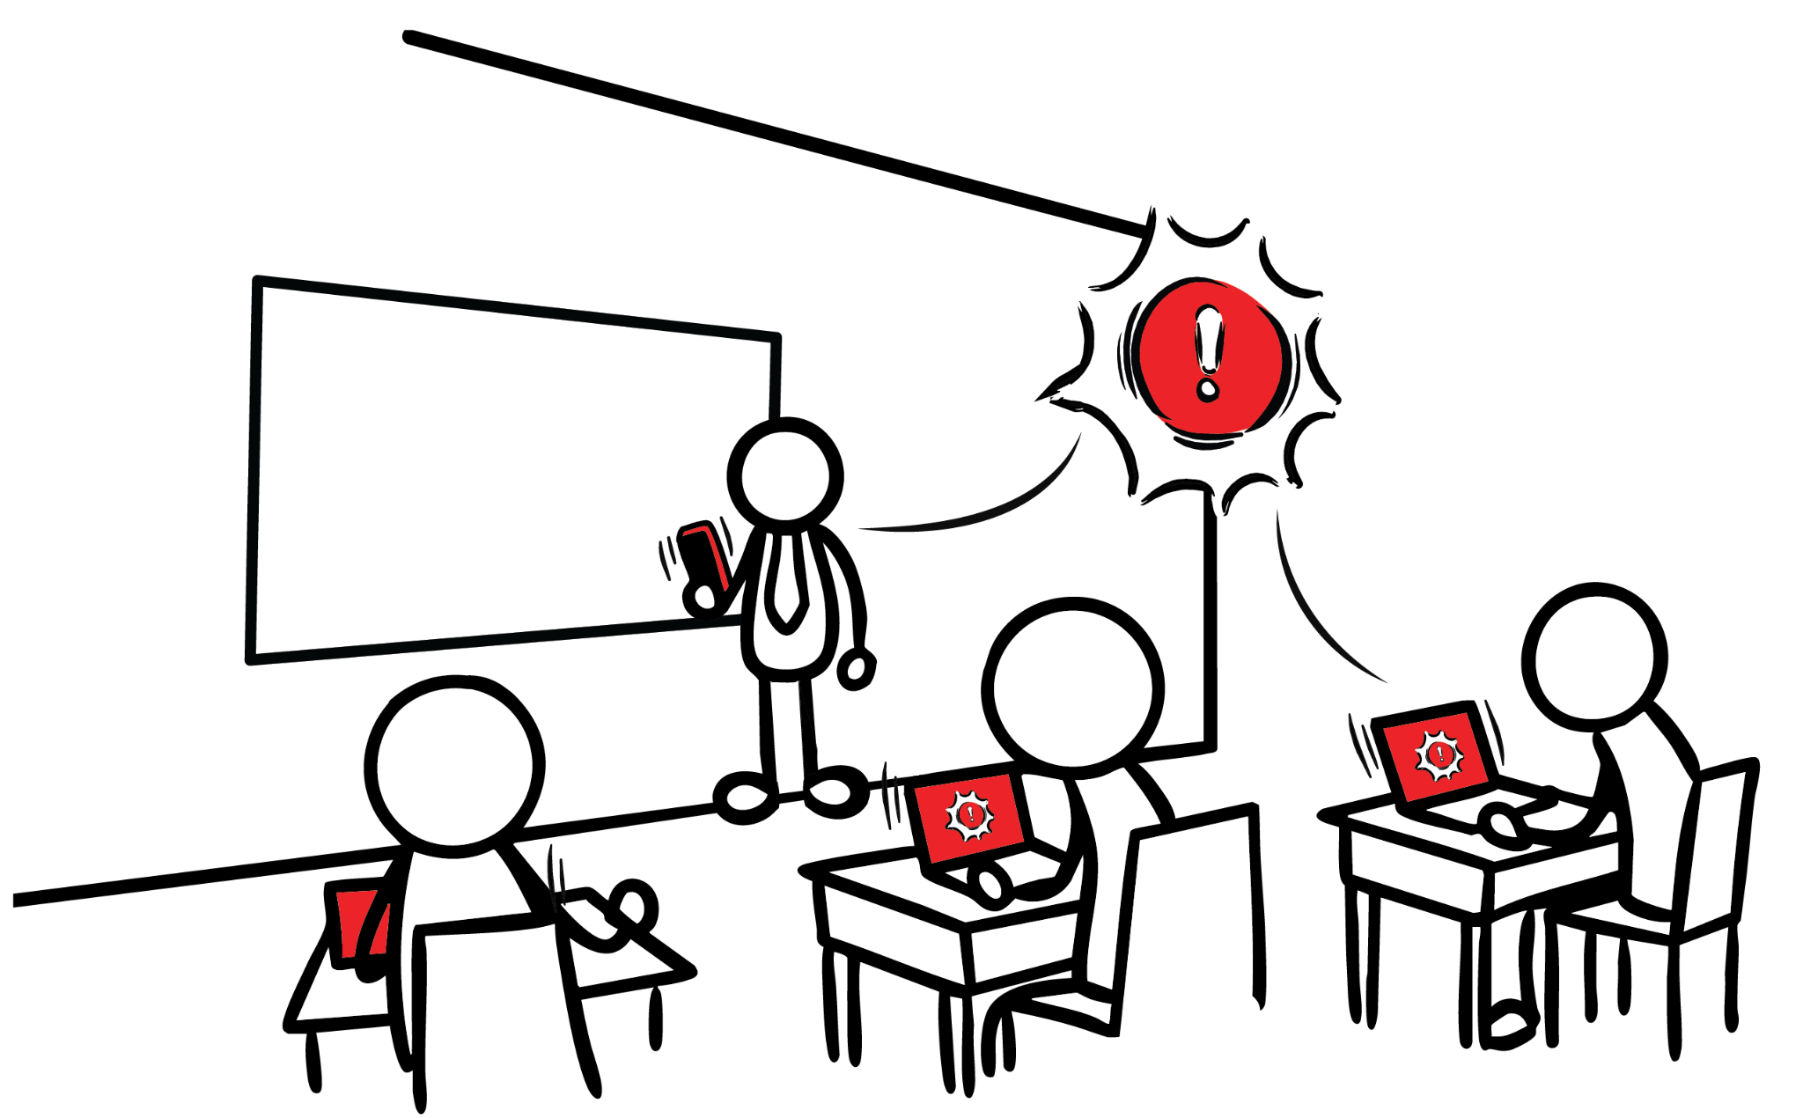
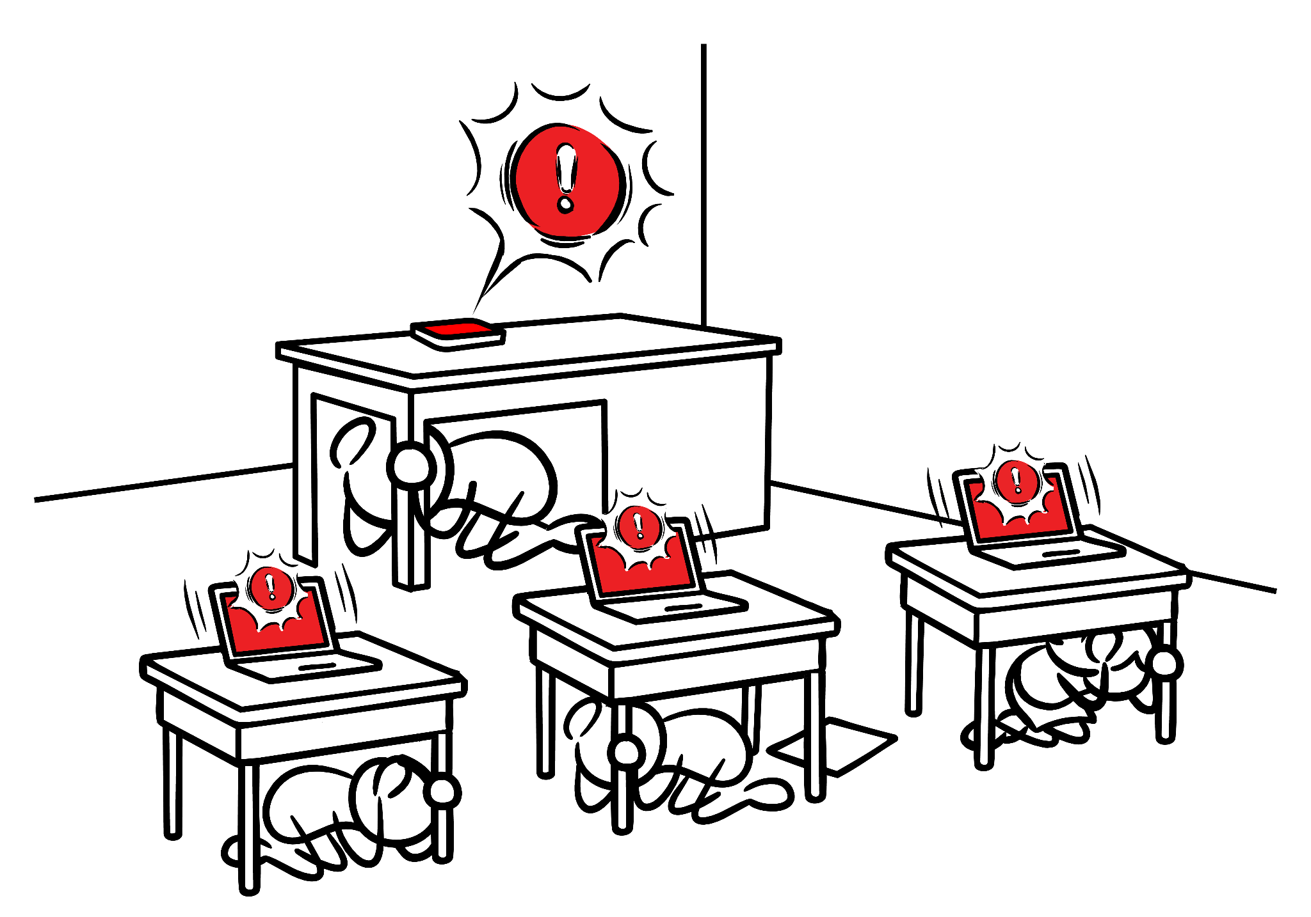

What to Expect from an Alert at School
Image courtesy of USGS
5
Notes:
In the case of an earthquake at school, you may get an alert on your phone or other devices, or hear it over the public address system if your school has integrated ShakeAlert-powered alerts. If so, the alert in your school will sound similar to this (click to play alert sound). In some instances, you may feel shaking without getting an alert. Whenever you feel shaking or get an alert, you should immediately drop, cover, and hold on.
NOTE: It is preferable to insert the alert audio and visuals your school community can expect so they are familiar with the exact alerts they may get.

Slide 6
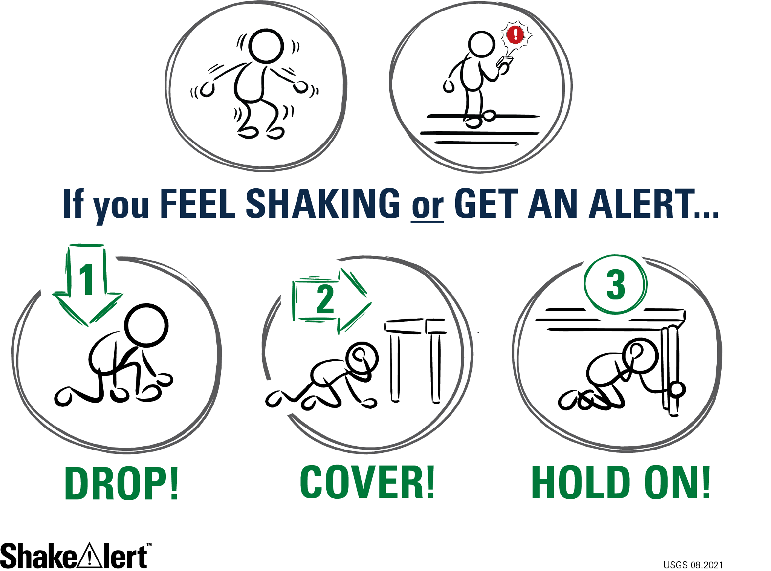
Image courtesy of USGS
6
Notes:
Most earthquake injuries are a result of people falling or being hit by falling objects while trying to move. Therefore, when you feel shaking or get an alert, you should immediately Drop, Cover, and Hold On or take another appropriate protective action that suits your situation. In most instances, that means dropping to your hands and knees (not your bottom) so you don’t fall. Cover your neck and head with your arms and hands and get under a table or desk, if possible. Use one hand to hold onto the leg of the table. Intentional training and practice are necessary to ensure everyone is ready to Drop, Cover, and Hold On immediately or take another protective action appropriate to the situation!

Slide 7
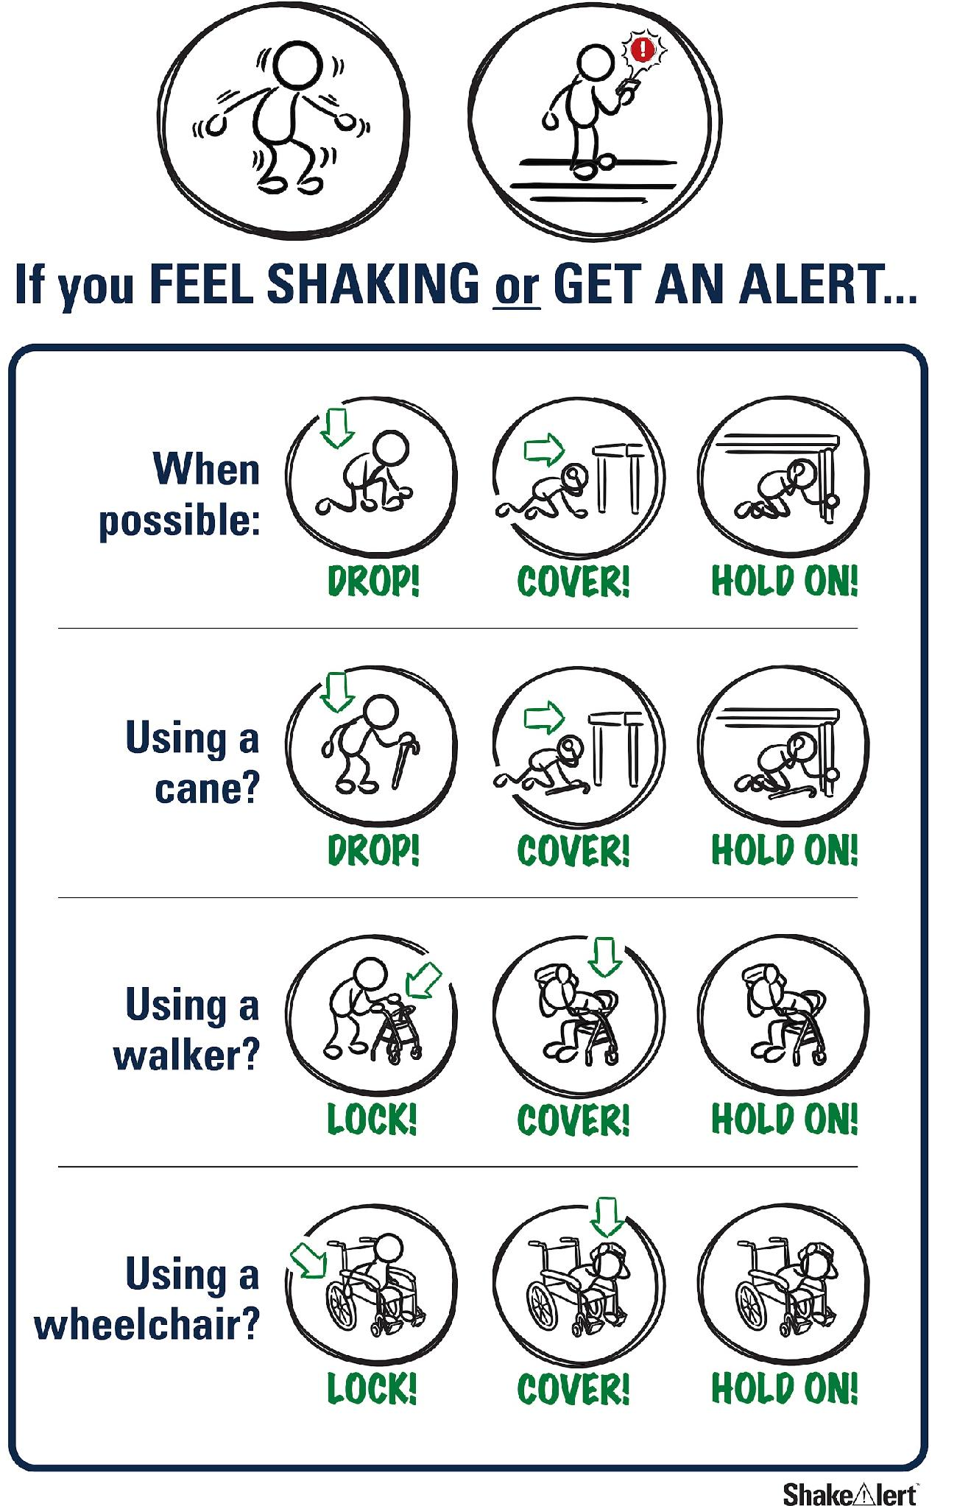
Image courtesy of USGS
7
Notes:
Everybody can take a protective action to make themselves safer in an earthquake. ShakeAlert Ready Schools has created lessons and materials that provide protective actions for all bodies. By practicing Drop, Cover and Hold On, students build “muscle memory” that increases the likelihood that they can act immediately to take correct protective actions, even when emotions are heightened during an actual earthquake.

Slide 8

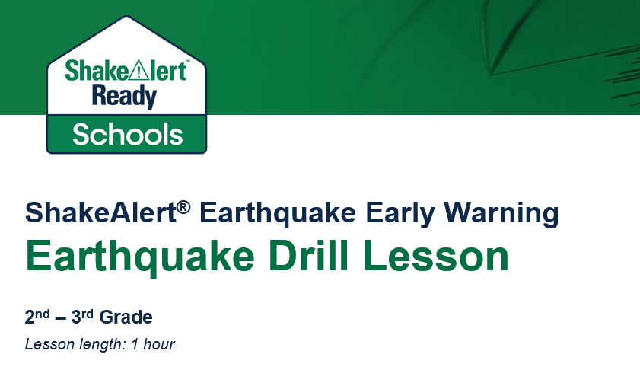

Prepare Your Students
Image courtesy of ShakeOut
Image courtesy of USGS
8
Notes:
To prepare students to respond automatically when they feel shaking or get an alert, we will conduct a ShakeAlert-powered earthquake drill. Your school might choose to do this in conjunction with the Great ShakeOut, in which millions of people around the world participate in an earthquake drill on the third Thursday of October each year. ShakeAlert provides grade-specific lessons that will help you lead your students through the drill. Lessons are grade-appropriate and standards-aligned.

Slide 9
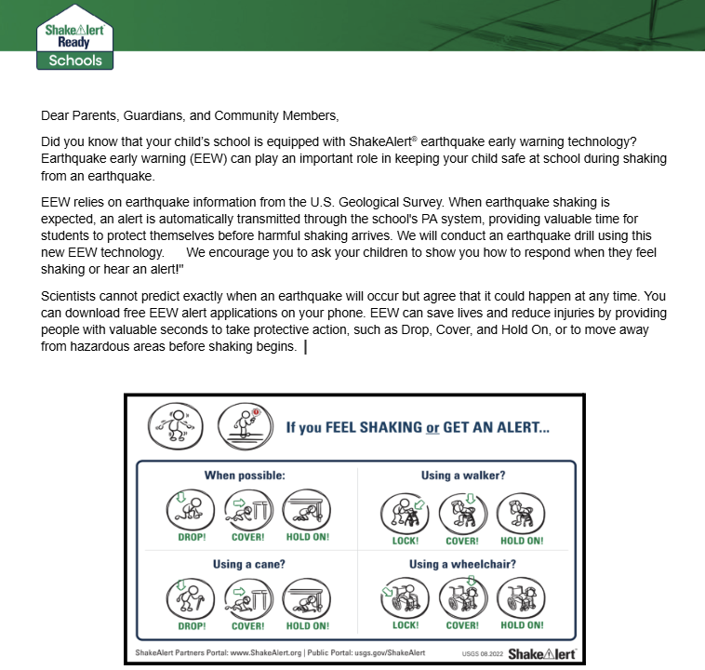

Engage Parents and Guardians
Image courtesy of Ready.gov
Image courtesy of USGS
9
Notes:
We’ll also take this opportunity to help our families prepare. Most adults haven’t participated in an earthquake drill since they were in school. They may have incorrect ideas about how to protect themselves in an earthquake. After completing the ShakeAlert-powered earthquake drill, teachers will share information about the ShakeAlert Earthquake Early Warning System, and about how families can prepare for an earthquake.

Slide 10
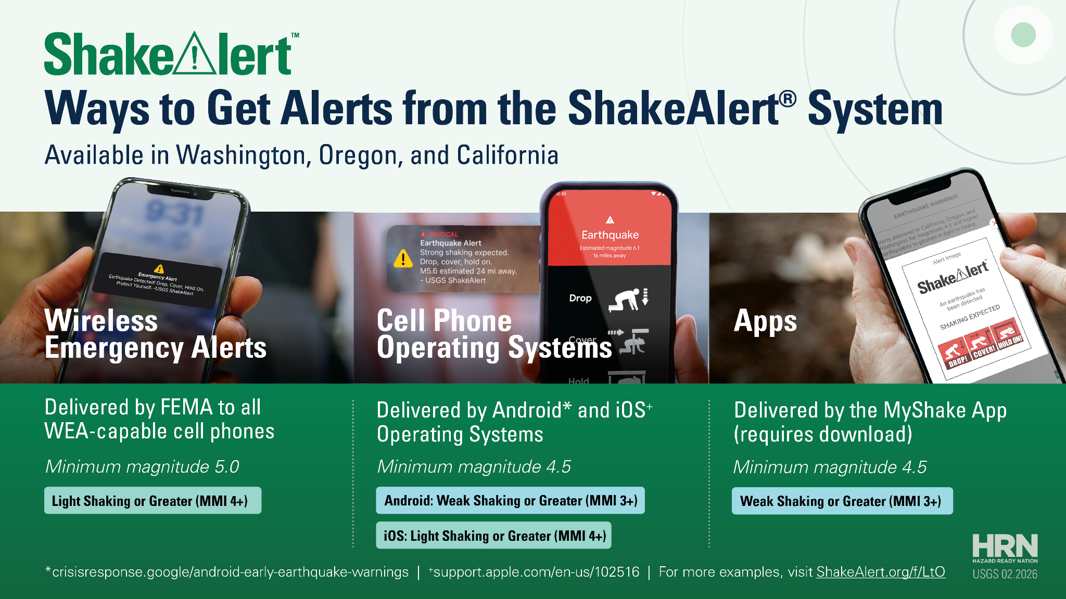
Notes:
Be sure you can get ShakeAlert-powered earthquake early warning alerts on your cell phone. Be sure to get alerts in many ways to increase your chance of being alerted.
https://www.usgs.gov/faqs/how-do-i-sign-shakealertr-earthquake-early-warning-system

Slide 11
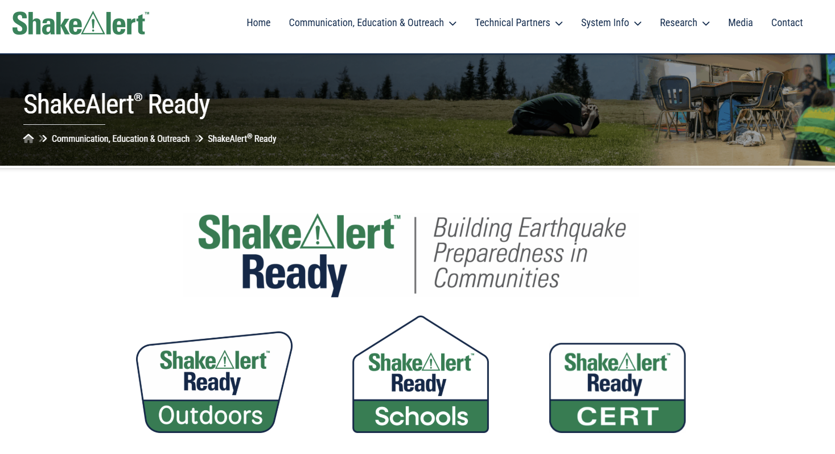
Plan to be ShakeAlert Ready!
11
Notes:
There are many ways to get alerts. Your school may have already installed equipment that enables staff and students to get alerts via the public address system or on digital devices. Make the most of the variety of alerting methods by ensuring everyone in your school community is prepared to respond to an alert or ground shaking with ShakeAlert Ready Schools educational resources!

Slide 12

For More Information
USGS ShakeAlert www.ShakeAlert.org
Ready.gov https://www.ready.gov/earthquakes
Earthquake Country Alliance https://www.earthquakecountry.org/
California Governor's Office of Emergency Services https://www.caloes.ca.gov/
Oregon Department of Emergency Management https://www.oregon.gov/oem/Pages/default.aspx
Washington Emergency Management Division https://mil.wa.gov/emergency-management-division
@USGS_ShakeAlert
12

Slide 13

Thank you

