Slide 1
ShakeAlert® Earthquake Early Warning Earthquake Drill Lesson
GREEN SLIDES = Teacher Preparation & Information
WHITE SLIDES = Present to Class
9th – 12 Grade
Lesson length: 30 minutes
11/2024

Slide 2
Links for Printing
Preparation
FAMILY ENGAGEMENT LETTER
Family Engagement Letter (English & Spanish)
Open and edit your state’s Family Engagement Letter.
Add your school name at the bottom.
If you’re emailing the letter, you can remove the QR code.
If you’re in California, you can delete the OR/WA optional paragraph.
Make copies of Family Engagement Letter and/or email to families.
Preview Slides. You can print out the Teaching Steps slides. The teaching steps are also located in the Speaker Notes of each slide.
11/2024
2

Slide 3
Sensitive Content Warning
Some students or their family members may have experienced earthquakes, resulting in loss, injuries, and possible trauma. It is therefore important to approach these lessons with sensitivity and awareness. When students share information about their experiences with earthquakes in the first part of the lesson, make sure to scan the class and be aware of any heightened responses. Affirm students’ normal emotional responses. If students are too emotionally heightened, it may be prudent to allow them to forego the drill.
Even students who have never experienced an earthquake may have a strong emotional response to talking about earthquakes. Explain to students that practicing earthquake drills helps our community to stay safe in an earthquake, but that it’s normal to feel strong feelings, such as fear, about earthquakes.
The purpose of drills is to build muscle memory so that in a heightened emotional state students are still able to take appropriate protective action. Therefore, it is important to take drills seriously. To the extent you can, please insist on students remaining quiet and following instructions.
11/2024
3

Slide 4
Teaching Steps - page 1
SLIDE 10 -Tell students that today they are taking part in an earthquake drill and will practice how to protect themselves during an earthquake. If you are teaching this lesson as part of the Great ShakeOut, tell students that millions of people in countries around the world take part in the Great ShakeOut on the 3rd Thursday of October every year.
SLIDE 11 - Ask students what other drills they’ve practiced at school. Students have probably practiced earthquake drills, shelter in place drills, and lockdowns among others. Ask students why we practice drills at school. They should respond that we conduct drills to practice how to respond so that if there’s ever a fire or earthquake, we’re prepared and know how to stay safe. We also practice drills so that we can help students feel safer and less afraid at school. Having fire and earthquake drills can help us to feel prepared and less scared! Tell students that our school has an earthquake early warning system that can give our school community members seconds of extra time to protect ourselves before damaging shaking arrives during an earthquake.
SLIDE 12 - Ask students what they already know about earthquakes, including what they are, causes and effects
SLIDE 13 - This map shows the chance of a damaging earthquake in the next 100 years. In this case, damaging means an earthquake felt by all that frightens many, and moves heavy furniture, creating slight damage. Ask students to use the key to assess the chance of a damaging earthquake in the next 100 years where they live.
11/2024
4

Slide 5
Teaching Steps - page 2
SLIDE 14 - Ask students to point out where they live on the map. Ask them what kind of plate boundary is nearby. Students in California will note that they live near a transform boundary, where the North American and Pacific Plates slide past each other. Students in Washington, Oregon and Northern California will see they live near a subduction zone, which is a convergent boundary in which the denser plate (in this case the Juan de Fuca Plate) slides beneath the less dense plate (in this case the North American Plate). If you live in Southern California, point out the Salton Sea, which is part of the Salton Trough formed at the divergent plate boundary (that is on land) between the North American and Pacific Plates.
SLIDE 15 - Tell students that faults are cracks in Earth’s surface created at and around tectonic plate boundaries as the brittle earth material is deformed. Remind students that faults form at and around each kind of boundary, and that earthquakes can occur along faults including plate boundaries. Ask students to compare the locations of plate boundaries and faults to the risk of earthquakes.
SLIDE 16 - Remind students that because of the area’s chance of experiencing a damaging earthquake, their school has ShakeAlert-powered earthquake early warning. Tell students that ShakeAlert uses information from two kinds of sensors: seismometers and GPS. Seismometers record how fast the ground is shaking, and GPS records how far the ground moves up, down, and sideways. Both sensors utilize waves; seismometers measure seismic waves, and GPS uses radio waves to send information.
11/2024
5

Slide 6
Teaching Steps - page 3
SLIDE 17 - Tell students that earthquakes generate seismic waves. We can model an earthquake with a snap of a finger. When we press our two fingers together, there is friction between them which prevents them from moving in the direction of the force, creating a build up of stored potential energy. When friction is overcome, the potential energy is transformed into kinetic energy, or movement, much like an earthquake. Earthquakes can happen at faults, including plate boundaries. Ask students to share their observations of the earthquake animation.
SLIDE 18 - Show the videos about different types of seismic waves. Ask students what they observe about how the distance between waves changes as they travel away from where the earthquake started. They should notice that when the earthquake starts, the waves are right on top of each other. As the waves travel through the earth, the distance between them grows.
SLIDE 19 - Tell students that seismic waves can affect people long distances from where they begin. Remind students that the p-waves move the fastest, but are less damaging, whereas s-waves and surface waves are slower but are more damaging. Tell students that as soon as the first wave is detected, alerts are sent to areas that may experience damaging shaking. Therefore, as soon as you get an alert, you should Drop, Cover, and Hold On.
SLIDE 20 - Remind students that in addition to utilizing seismometers, ShakeAlert uses GPS during an earthquake to measure how far the ground moves. This helps to determine how large the intensity of an earthquake will be.
11/2024
6

Slide 7
Teaching Steps - page 4
SLIDE 21 - Remind students that ShakeAlert also uses GPS, which stands for Global Positioning System. GPS uses a network of satellites that orbit the Earth twice a day. They continuously send radio waves to the ground with atomic clock-generated time, and the satellite’s position. Radio waves are a type of electromagnetic radiation, so they travel through the vacuum of space at the speed of light, which is 300,000 km per second. Each GPS receiver uses messages sent from more than 4 satellites to determine its position on Earth. It needs at least 4 to get a position, but it needs more than four to produce an accurate position. That’s because data is noisy; the radio waves are distorted by variations in the atmosphere (for instance pockets of hot and cold air) as they pass from the satellite to the receiver. Having more data overcomes this noise. The accuracy of GPS is oftentimes to 5 mm, or ¼ inch.
SLIDE 22 - Tell students that this video describes how ShakeAlert uses seismometers and GPS to send earthquake early warning alerts. Read the two questions on the slide to students before showing the video so that students know what to focus on (This video (2:17) describes the USGS-managed ShakeAlert System, which senses earthquakes as soon as they begin, and sends alerts to buildings and schools like yours. These alerts can give people seconds of time to Drop, Cover, and Hold On before dangerous ground shaking occurs).
SLIDE 23 - Ask students what we do when there’s an earthquake or we hear an alert. They may know about Drop, Cover, and Hold On.
SLIDE 24 & 25 - Tell students that Drop, Cover, and Hold On looks different for different bodies. Review modified protective actions for people who use wheelchairs, walkers or canes. While you may not have students who use wheelchairs, walkers, or canes in your class, it is likely that there are members of your community who do.
11/2024
7

Slide 8
Teaching Steps - page 5
SLIDE 26 - Ask students why we Drop, Cover, and Hold On if there’s ground shaking or we receive an alert. This slide is animated and the ‘Cover’ and ‘Hold On’ will appear individually so you can discuss each action in turn.
DROP: Dropping to your knees protects you from falling during ground shaking.
COVER: We cover our neck and head to protect them from becoming injured if something falls.
HOLD ON: We hold on to a table leg once we’re beneath a table so that the earthquake doesn’t move us out.
SLIDE 27 - Tell students that they should take these protective actions when the ground shakes, if there’s an earthquake alert, or if they’re doing an earthquake drill, which we’ll do now. Tell students that it’s vital they Drop, Cover, and Hold On immediately and without hesitation. They can be a leader in their community by immediately taking protective actions.
SLIDE 28 - Play the ShakeAlert alert message. Have all students Drop, Cover, and Hold On. Ask students to stay in their protective positions while the teacher observes and offers corrections if necessary. Once the teacher has checked in with each student, ask them to return to their seats.
NOTE: Your EEW alert may sound and look different than the one pictures on the slide!
SLIDE 29 - Reflect on your earthquake drill by asking students how they did, and if they have questions. After reflecting, remind students of the key takeaways to stay safe during an earthquake, including: immediately dropping to your knees, moving away from glass or heavy objects that could fall, etc.
11/2024
8

Slide 9
Teaching Steps - page 6
SLIDE 30 - Ask students what else they can do to prepare for an earthquake. This slide is animated. Elicit student responses first. The slide contains some ideas. Validate/discuss other student ideas. “Practice” means to practice earthquake drills in multiple settings, and practice reunification with family after an earthquake.
SLIDE 31 - Tell students that most of the adults they know have probably not taken part in an earthquake drill since they were students, and may have incorrect ideas about how to protect themselves in an earthquake. They can help their family and community members prepare by teaching them about Drop, Cover, and Hold On, and informing them about ways to prepare, such as signing up for ShakeAlert-powered alerts and preparing an emergency kit and plan.
SLIDE 32 - Ask students to share any details about their experience sharing what they learned with their families.
SLIDE 33 - OPTIONAL - Please complete the ShakeAlert Ready! Earthquake Drill Lesson Feedback Form.
11/2024
9

Slide 10


Learning Targets:
I can explain how ShakeAlert uses information carried by waves (including seismic and radio waves) to deliver earthquake early warning alerts.
I know to Drop, Cover, and Hold On if the ground shakes or if I get an earthquake early warning alert.
CREDIT: Great ShakeOut, ShakeAlert Circle Magnet
11/2024
10
Notes:
Teacher Notes: Tell students that today they are taking part in an earthquake drill and will practice how to protect themselves during an earthquake. If you are teaching this lesson as part of the Great ShakeOut, tell students that millions of people in countries around the world take part in the Great ShakeOut on the 3rd Thursday of October every year.
IMAGES: https://www.shakeout.org/, https://drive.google.com/file/d/1_6K4HftZApOSYdEueUChXVud-rwsoZhf/view

Slide 11
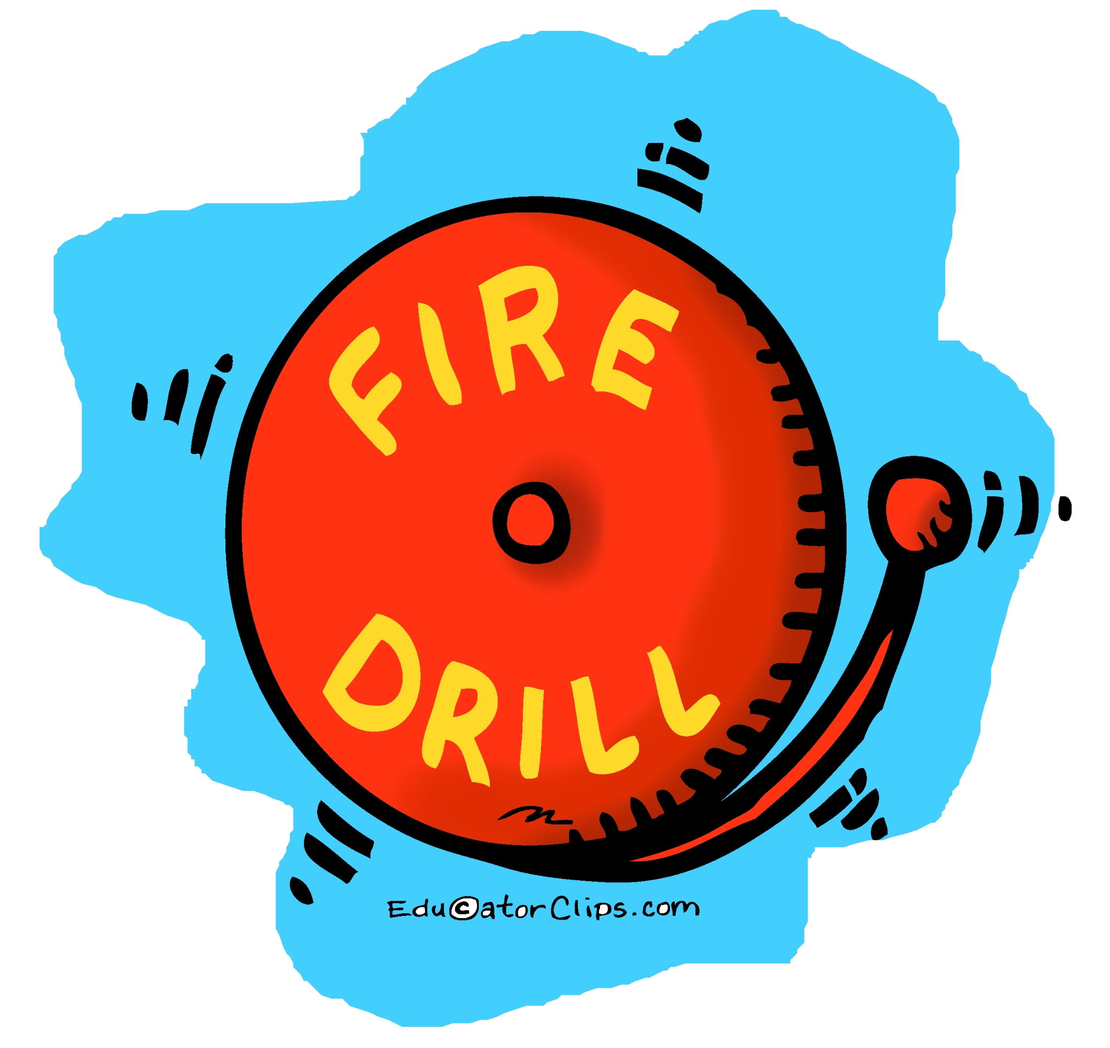

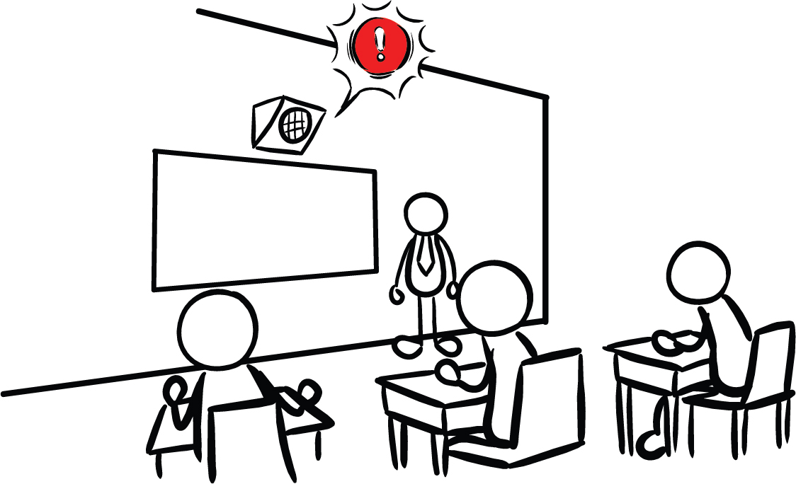
What other safety drills have we had at school?
Why do we have drills at school?
Our school has Earthquake Early Warning!
CREDIT: Educator Clips, Mark A. Hicks, Olympia CUSD 16, and Education_9_PA_V03.jpg
11
Notes:
Teacher Notes: This slide is animated so the questions appear one at a time. Ask students what other drills they’ve practiced at school. Students have probably practiced earthquake drills, shelter in place drills, and lockdowns among others.
Ask students why we practice drills at school. They should respond that we conduct drills to practice how to respond so that if there’s ever a fire or earthquake, we’re prepared and know how to stay safe. We also practice drills so that we can help students feel safer and less afraid at school. Having fire and earthquake drills can help us to feel prepared and less scared!
Tell students that our school has an earthquake early warning system that can give our school community members seconds of extra time to protect ourselves before damaging shaking arrives during an earthquake.
IMAGES: https://teachingiselementary.blogspot.com/2011/11/fire-drills-safety-is-free.html, https://www.olympia.org/o/oms/article/136094, https://drive.google.com/file/d/1bey_N-Kk5RGJhFgTLFIgTZLeorlPEFIm/view?usp=drive_link

Slide 12
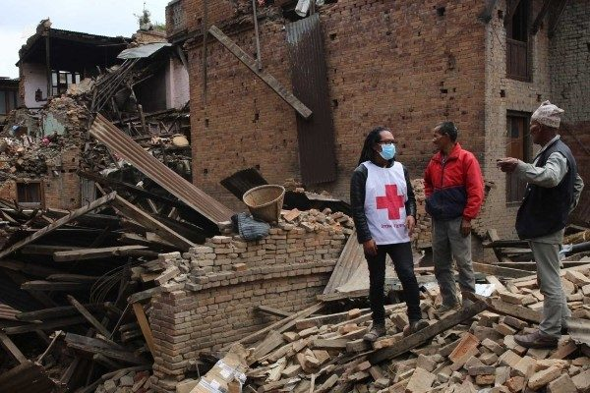
What is an earthquake?
Why do they happen?
What are some things that happen when there is an earthquake?
CREDIT: Red Cross Earthquake Safety
12
Notes:
Teacher Note: Students will likely have a lot of background knowledge about plate boundaries and earthquakes.
Sample Student Response: An earthquake is a sudden release of energy in the form of seismic waves that travel away from the earthquake focus. An earthquake occurs when the friction between pieces of earth is overcome, and elastic potential energy on a fault (including a tectonic plate boundary) is transformed into kinetic energy, along with sound and thermal energy. Earthquakes can cause ground shaking, tsunamis, as well as injuries and destruction of property.
IMAGES: https://www.redcross.org/get-help/how-to-prepare-for-emergencies/types-of-emergencies/earthquake.html

Slide 13
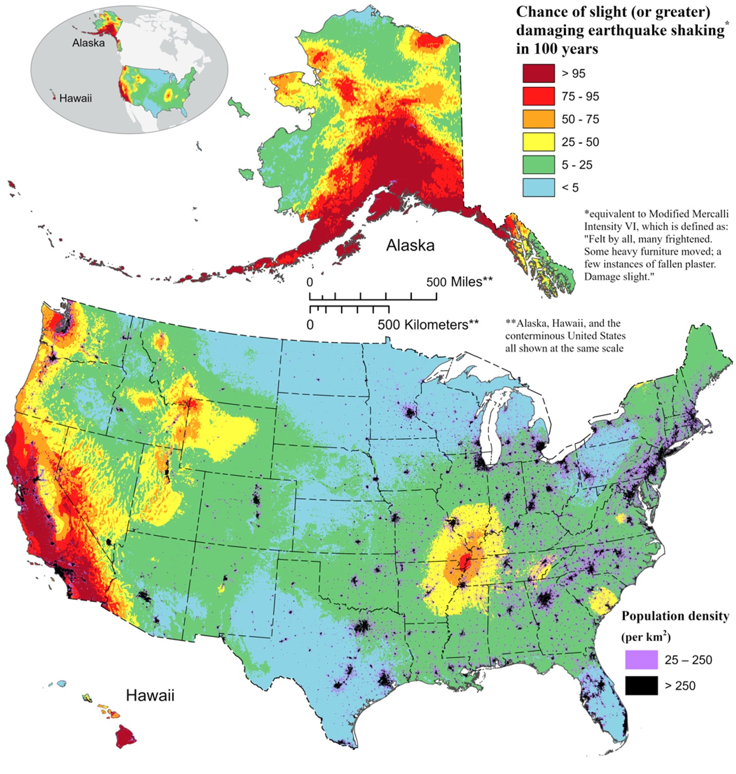
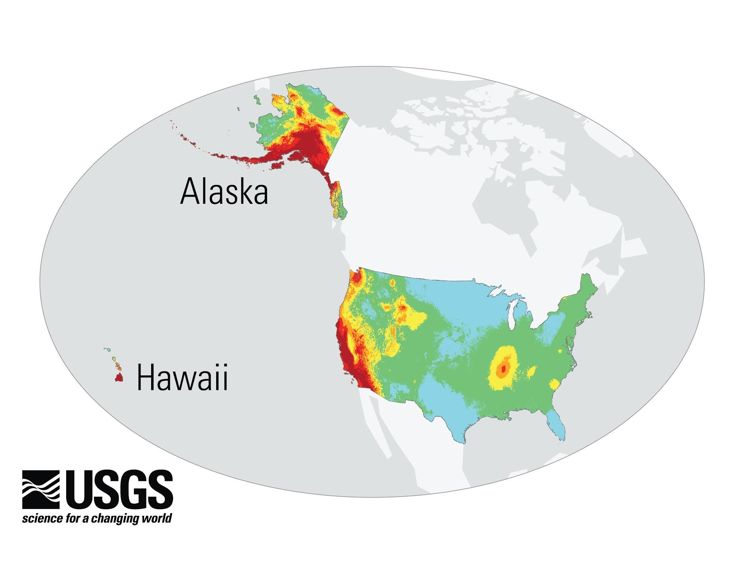
We Live in Earthquake Country!
This map shows the chance of a damaging earthquake in the next 100 years.
Where are we located?
What is the chance in our area?
CREDIT: 2023 50-State Long-term National Seismic Hazard Model
13
Notes:
Teacher Note: This slide is animated. It has two layers starting with a map of the globe, and zooming in to the United States. This map shows the chance of a damaging earthquake in the next 100 years. In this case, damaging means an earthquake felt by all that frightens many, and moves heavy furniture, creating slight damage. Ask students to use the key to assess the chance of a damaging earthquake in the next 100 years where they live.
IMAGE: 2023 50-State Long-term National Seismic Hazard Model | U.S. Geological Survey

Slide 14
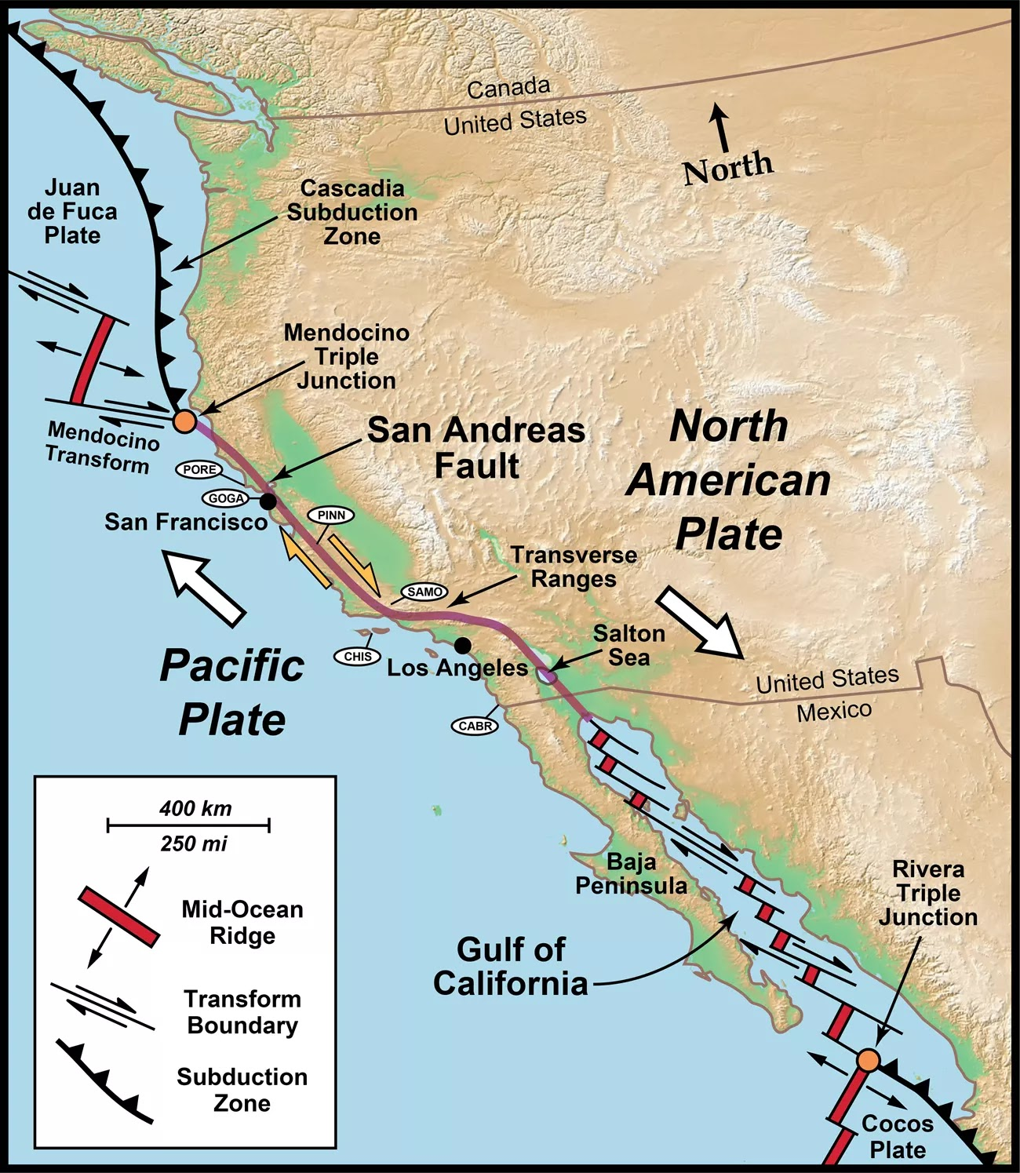
We Live Near a Tectonic Plate Boundary!
Where are we located?
What kind of plate boundary is nearby?
CREDIT: NPS, San Andreas Transform Plate Boundary
14
Notes:
Teacher Note: Ask students to point out where they live on the map. Ask them what kind of plate boundary is nearby. Students in California will note that they live near a transform boundary, where the North American and Pacific Plates slide past each other. Students in Northern California will see they live near a subduction zone, which is a convergent boundary in which the denser plate (in this case the Juan de Fuca Plate) slides beneath the less dense plate (in this case the North American Plate). If you live in Southern California, point out the Salton Sea, which is part of the Salton Trough formed at the divergent plate boundary (that is on land) between the North American and Pacific Plates.
IMAGE: https://www.nps.gov/media/photo/gallery-item.htm?pg=6323516&id=7c979cd9-db8e-4d44-a3c5-2ff61669f470&gid=A83922BE-6F3D-45B7-889F-7051CD4FC3C9

Slide 15
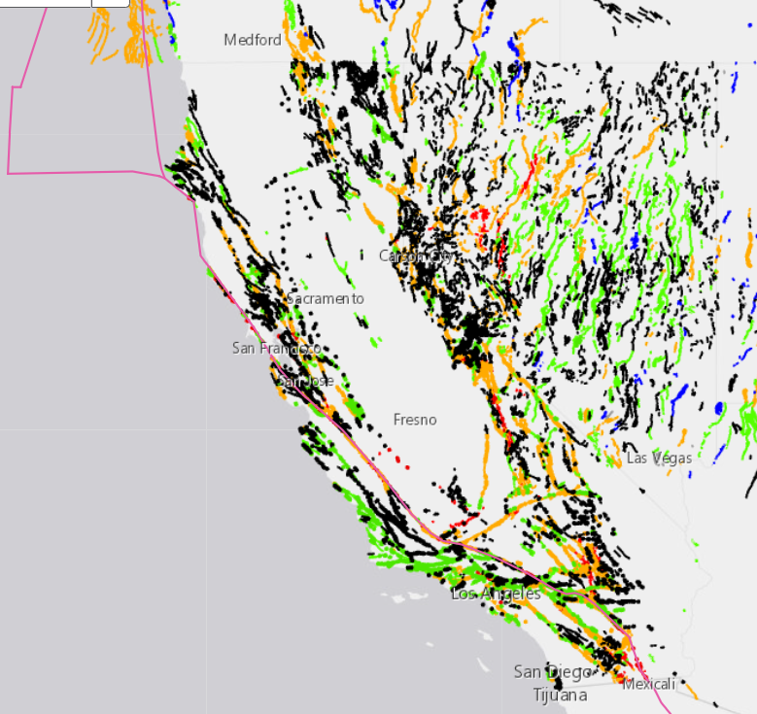
What relationship can you infer about the location of plate boundaries, faults, and the chance of damaging earthquake shaking occurring in 100 years?
CREDIT: USGS Interactive Fault Map
CREDIT: 2023 50-State Long-term National Seismic Hazard Model
15
Notes:
Teacher Note: Tell students that faults are cracks in Earth’s surface created at and around tectonic plate boundaries as the brittle earth material is deformed. Remind students that faults form at and around each kind of boundary, and that earthquakes can occur along faults including plate boundaries. Ask students to compare the locations of plate boundaries and faults to the risk of earthquakes. They should notice that there is a higher risk of earthquakes in areas that have many faults, and that there are many faults near plate boundaries. Students may need to be reminded that an observation is something you see, hear, smell, etc., whereas an inference is a reasonable deduction based on observations.
IMAGE: https://doi.org/10.5066/F7S75FJM, 2023 50-State Long-term National Seismic Hazard Model | U.S. Geological Survey

Slide 16
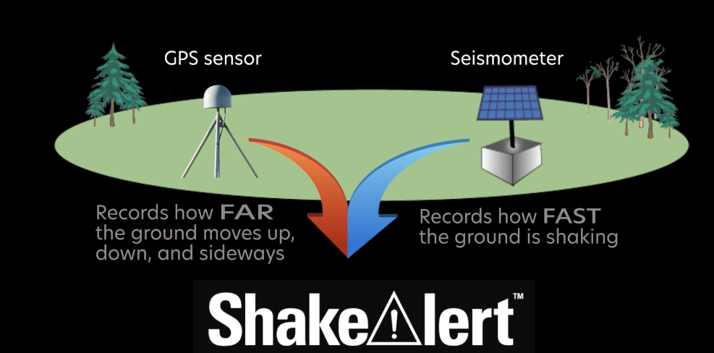
ShakeAlert Earthquake Early Warning Uses Earthquake Information from Seismometers & GPS
CREDIT:
Using GPS to Enhance the ShakeAlert® Earthquake Early Warning System | Overview
16
Notes:
Teacher Notes: Remind students that because of the area’s chance of experiencing a damaging earthquake, their school has ShakeAlert-powered earthquake early warning. Tell students that ShakeAlert uses information from two kinds of sensors: seismometers and GPS. Seismometers record how fast the ground is shaking, and GPS records how far the ground moves up, down, and sideways. Both sensors utilize waves; seismometers measure seismic waves, and GPS uses radio waves to send information.
IMAGE: https://www.youtube.com/watch?v=grmBDsBQJ64

Slide 17


Earthquakes Generate Seismic Waves
What observations do you have of the animation?
CREDIT: SAGE Fault: Strike-slip -- High Friction with Elastic Rebound
17
Notes:
TEACHER NOTE: This slide is animated. The snap is a gif, which will play on a loop. Clicking will play the apple tree animation.
We can model an earthquake with a snap of a finger. When we press our two fingers together, there is friction between them which prevents them from moving in the direction of the force, creating a build up of stored potential energy. When friction is overcome, the potential energy is transformed into kinetic energy, or movement, much like an earthquake. Earthquakes can happen at faults, including plate boundaries. Ask students to share their observations of the earthquake animation. In the animation, they should observe a buildup of potential energy, and then sudden, lurching motion, which sends seismic waves (earthquake waves) away from the fault in both directions.
VIDEO: https://www.iris.edu/hq/inclass/animation/elastic_rebound_on_highfriction_strikeslip_fault
IMAGE: GIF made from: https://www.youtube.com/watch?v=cFy3uJYctZs

Slide 18
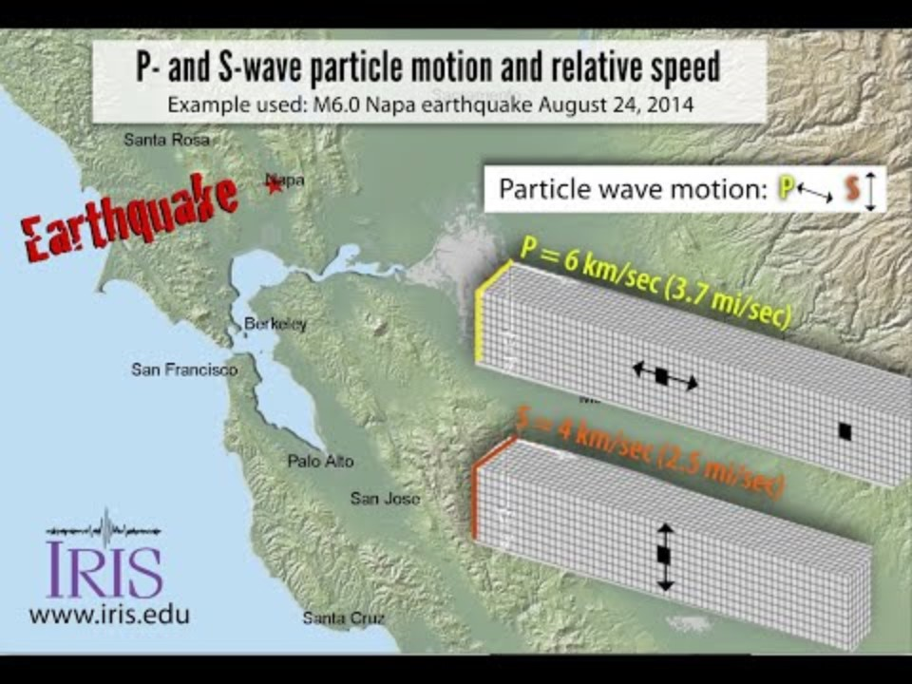
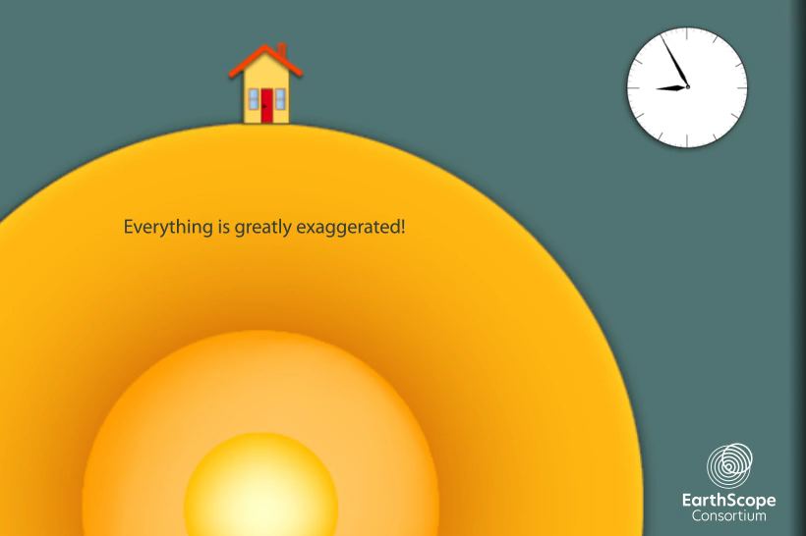
Different Kinds of Seismic Waves
How do the speeds of the three types of waves compare?
How does each type of wave affect the building?
CREDIT: IRIS Seismic Waves—P- and S-wave particle motion and relative wave-front speeds
CREDIT: IRIS: 1-Component Seismogram
18
Notes:
Teacher Notes: The videos will play automatically after each question appears. To play either video again, click the white play button. NOTE: when bringing in the second question, click on the white space on the slide, not on the video.
Ask students what they observe about how the distance between waves changes as they travel away from where the earthquake started. They should notice that when the earthquake starts, the waves are right on top of each other. As the waves travel through the earth, the distance between them grows.
CREDIT: https://www.youtube.com/watch?v=Y5xbgsPVfsA, https://www.iris.edu/hq/inclass/animation/1component_seismogram_building_responds_to_p_s_surface_waves

Slide 19
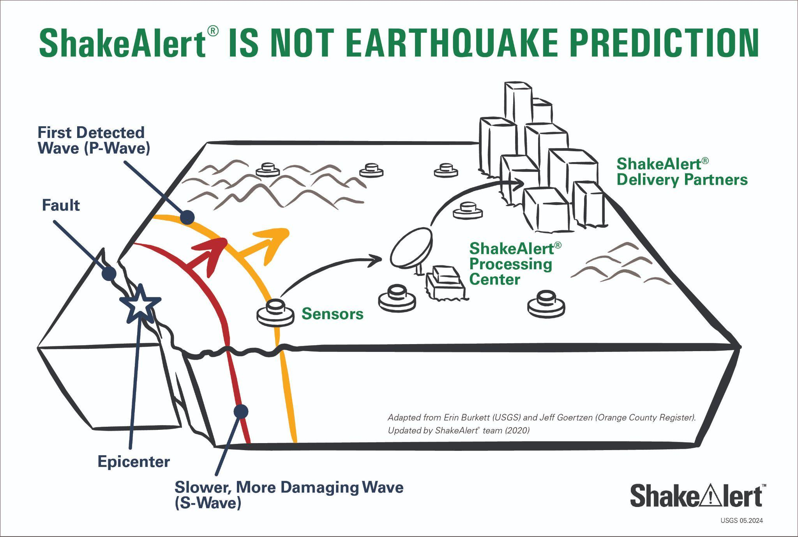
Earthquake Early Warning Uses Seismic Waves
p-waves - faster & less damaging
surface and s-waves - slower & more damaging
Alerts - delivered soon after first earthquake waves (P) detected by sensors.
CREDIT: ShakeAlert Is Not Earthquake Prediction
19
Notes:
Teacher Notes: The slide is animated. Point out the p-wave and s-wave in the diagram as the words appear.
Tell students that seismic waves can affect people long distances from where they begin. Remind students that the p-waves move the fastest, but are less damaging, whereas s-waves and surface waves are slower but are more damaging. Tell students that as soon as the first wave is detected, alerts are sent to areas that may experience damaging shaking. Therefore, as soon as you get an alert, you should Drop, Cover, and Hold On.
CREDIT: https://drive.google.com/file/d/1wl-DjZ9fmVTTFuUtAVhcseaE5UpkkGdk/view?usp=drive_link

Slide 20
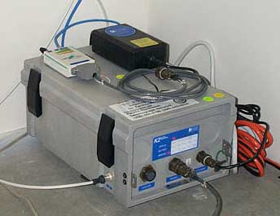
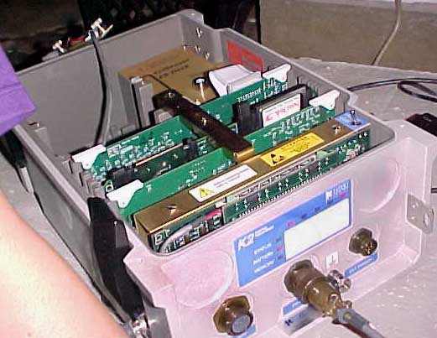
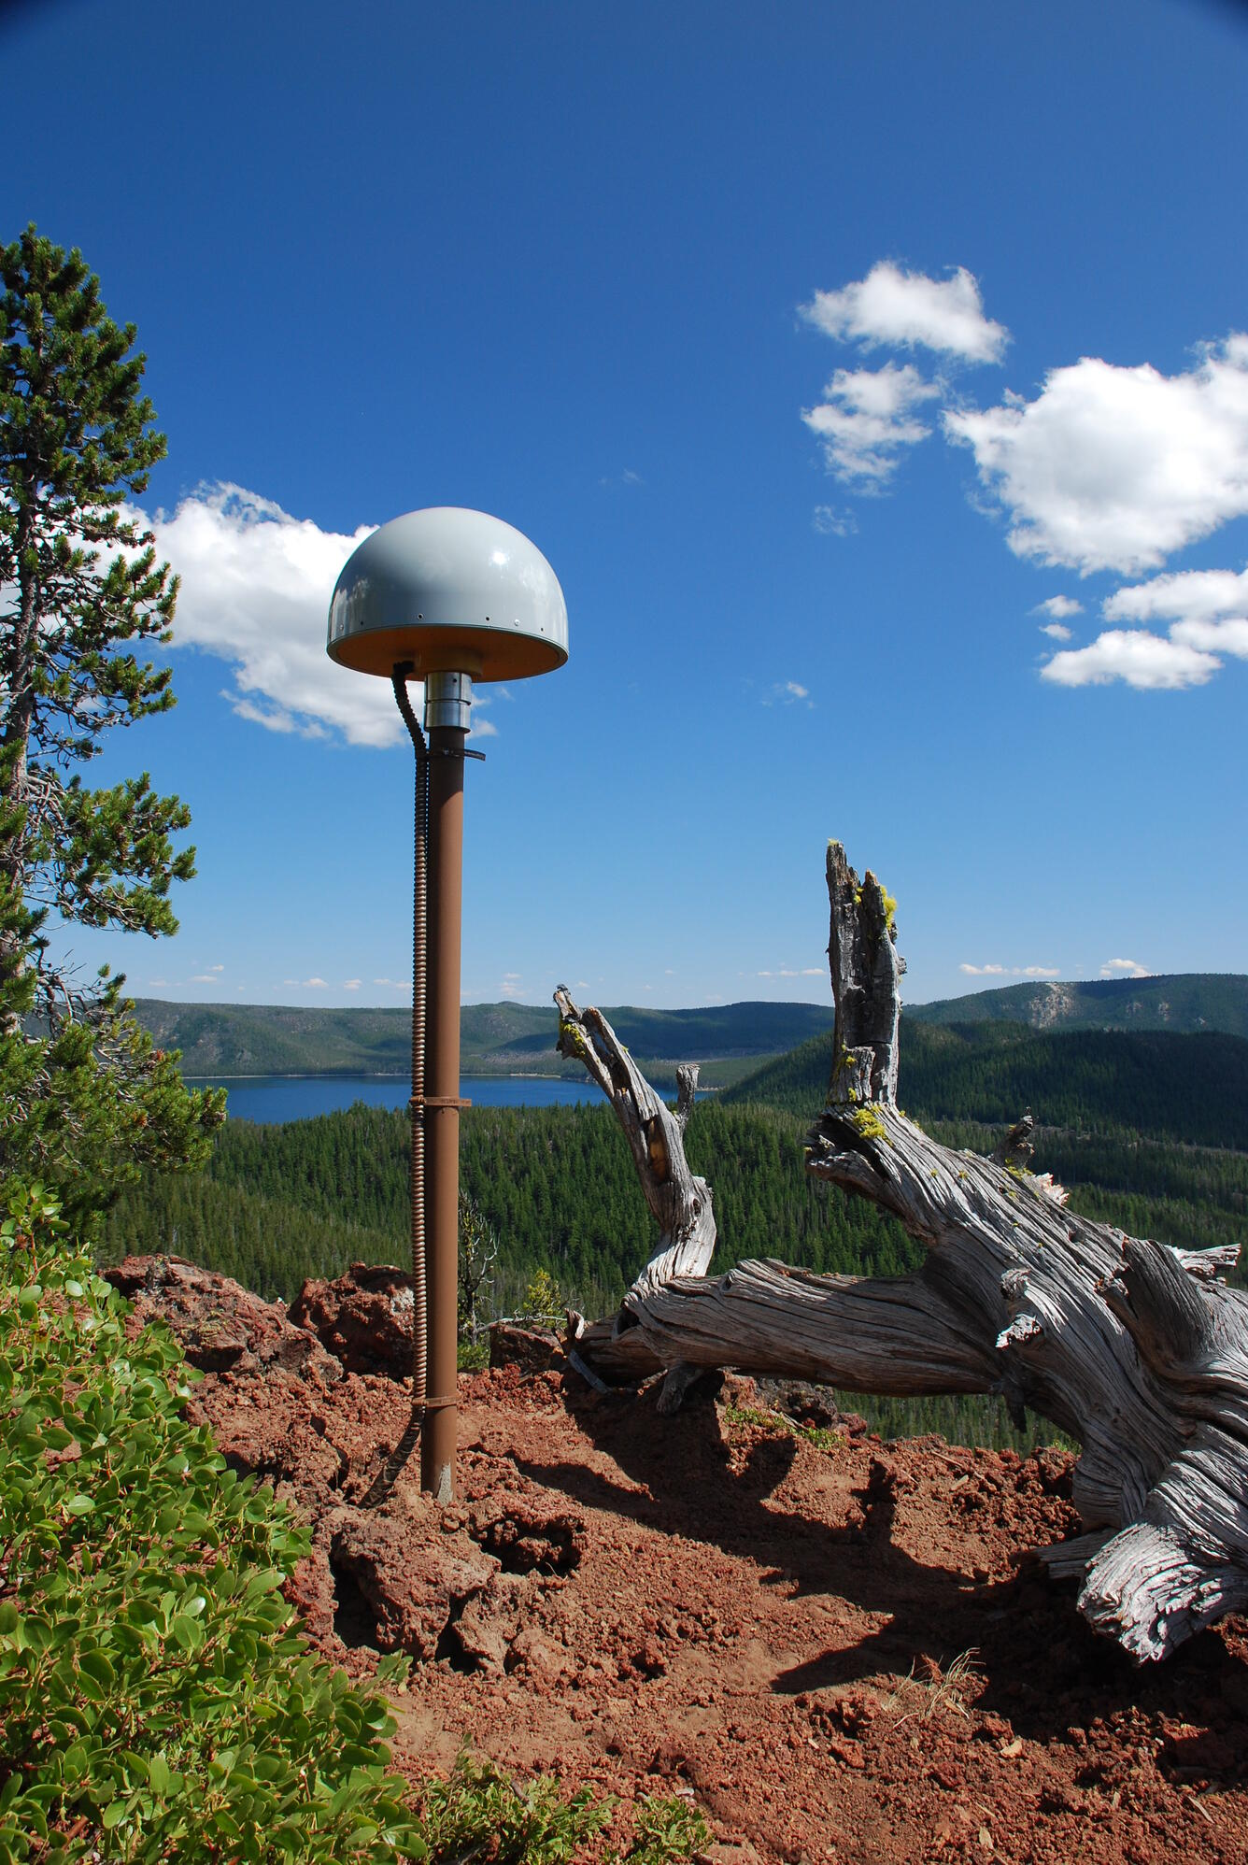
Example of Seismometer and GPS station used for the ShakeAlert system
Example of seismometer, inside and out
CREDIT: USGS - Networks of GPS receivers track ground movement at volcanoes, PNSN Seismometers
20
Notes:
Teacher Notes: In addition to utilizing seismometers, ShakeAlert uses GPS during an earthquake to measure how far the ground moves. This helps to determine how large the intensity of an earthquake will be.
Source: https://earthquake.usgs.gov/monitoring/gps/about.php
IMAGE: https://assets.pnsn.org/OUTED/VIRTTOURS/seismometers.html, Global Positioning System receiver (called a GPS monument) at North Rim Station, a monitoring location at Newberry volcano, Oregon.

Slide 21
GPS (Global Positioning System)
Uses Radio Waves
Sent continuously from satellites to GPS receivers
Signal from >4 satellites - latitude, longitude, elevation & time check
CREDIT: Networks of GPS receivers track ground movement at volcanoes
21
Notes:
Teacher Notes: The slide is animated so that the text comes in one point at a time.
Remind students that ShakeAlert also uses GPS, which stands for Global Positioning System. GPS uses a network of satellites that orbit the Earth twice a day. They continuously send radio waves to the ground with atomic clock-generated time, and the satellite’s position. Radio waves are a type of electromagnetic radiation, so they travel through the vacuum of space at the speed of light, which is 300,000 km per second. Each GPS receiver uses messages sent from more than 4 satellites to determine its position on Earth. It needs at least 4 to get a position, but it needs more than four to produce an accurate position. That’s because data is noisy; the radio waves are distorted by variations in the atmosphere (for instance pockets of hot and cold air) as they pass from the satellite to the receiver. Having more data overcomes this noise. The accuracy of GPS is oftentimes to 5 mm, or ¼ inch.
Source: https://earthquake.usgs.gov/monitoring/gps/about.php
IMAGE: https://earthquake.usgs.gov/monitoring/gps/about.php Global Positioning System receiver (called a GPS monument) at North Rim Station, a monitoring location at Newberry volcano, Oregon.

Slide 22
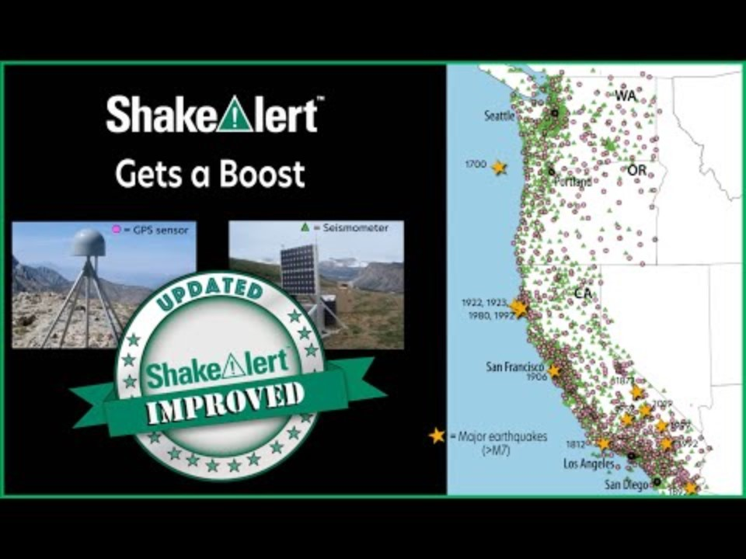
As you watch:
How does ShakeAlert utilize p- and s-wave behavior?
How does GPS contribute to ShakeAlert alerting?
CREDIT: ShakeAlert® Gets a Boost with GPS Technology
22
Notes:
Teacher Note: Tell students that this video describes how ShakeAlert uses seismometers and GPS to send earthquake early warning alerts. Read the two questions on the slide to students before showing the video so that students know what to focus on. (This video (2:17) describes the USGS-managed ShakeAlert System, which senses earthquakes as soon as they begin, and sends alerts to buildings and schools like yours. These alerts can give people seconds of time to Drop, Cover, and Hold On before dangerous ground shaking occurs.) Students should notice that ShakeAlert takes advantage of seismic wave behaviors by sending alerts as soon as faster-moving but less damaging p-waves are detected. This can give people further away from the earthquake focus time to Drop, Cover and Hold On before the slower and more damaging s-waves arrive. GPS helps to more accurately estimate the magnitude of the earthquake by measuring ground displacement during an earthquake.
VIDEO: https://www.youtube.com/watch?v=A_zQKW8ipL4

Slide 23
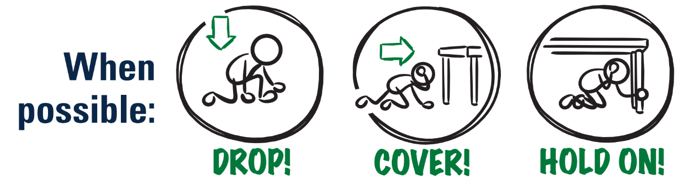
What do you do if you feel shaking or get an alert?
CREDIT: ShakeAlert Infographic Modified Protective Actions
23
Notes:
Teacher Note: This is animated. Ask the question first to elicit student responses.
Review and model correct protective actions - Drop, Cover, and Hold On. Make sure students know they should drop to their knees (not their bottoms), have one hand over their necks, and try to get away from glass or any other objects that could fall on them. If they’re able to get under a table or desk while staying on their knees, they should. Once there, they should hold on to the leg of the table.
IMAGE: https://drive.google.com/file/d/1KaHNTj7_C1NvRDFZE3jWW-6g2K4I_Q4h/view

Slide 24

If you or someone you know uses a wheelchair:
CREDIT: ShakeAlert Infographic Modified Protective Actions
24
Notes:
Teacher Notes: Tell students that Drop, Cover, and Hold On looks different for different bodies. Review modified protective actions for people who use wheelchairs. While you may not have students who use wheelchairs in your class, it is likely that there are members of your community who do. Ask students to help their family members or friends who use a wheelchair by sharing that “Lock, Cover, and Hold On” is how they can protect themselves during an earthquake. Have students repeat the phrase, “Lock, Cover, and Hold On” after you’ve said it.
IMAGE: https://drive.google.com/file/d/1KaHNTj7_C1NvRDFZE3jWW-6g2K4I_Q4h/view

Slide 25


If you or someone you know uses a cane or walker:
CREDIT: ShakeAlert Infographic Modified Protective Actions
25
Notes:
Teacher Notes: Slide is animated so images come in when you click. Tell students that Drop, Cover, and Hold On looks different for different bodies. Review modified protective actions for people who use a cane or walker. While you may not have students who use a cane or walker in your class, it is likely that there are members of your community who do. Ask students to help their family members or friends who use a cane or walker by sharing the correct protective actions. Have students repeat the phrase, “Drop, Cover, and Hold On” and then “Lock, Cover, and Hold On” after you’ve said it.
IMAGE: https://drive.google.com/file/d/1KaHNTj7_C1NvRDFZE3jWW-6g2K4I_Q4h/view

Slide 26
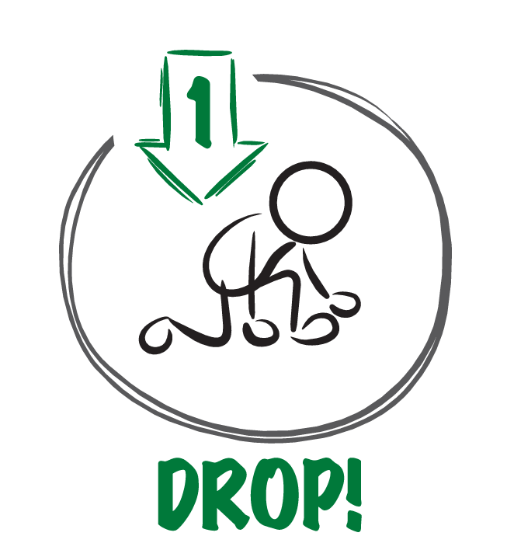


When the ground shakes or you get an alert,
why is it important to . . .?
CREDIT: ShakeAlert Infographic Modified Protective Actions
26
Notes:
TEACHER NOTE: This slide is animated and the ‘Cover’ and ‘Hold On’ appear individually so you can discuss each action in turn. Begin by eliciting student responses for each. Add on to student responses as necessary.
DROP: Dropping to your knees protects you from falling during ground shaking.
COVER: We cover our neck and head to protect them from becoming injured if something falls.
HOLD ON: We hold on to a table leg once we’re beneath a table so that the earthquake doesn’t move us out from underneath the table that is protecting us.
IMAGE: https://drive.google.com/file/d/1ZSnjJY34GVvTJCyYB908pbDSXBC5F_cZ/view?usp=sharing

Slide 27
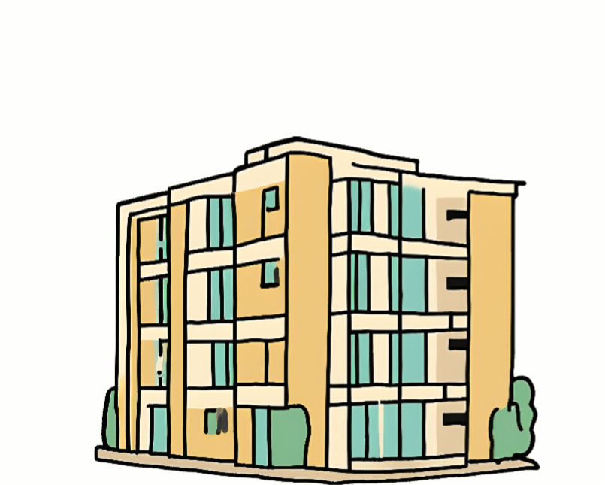

Protect yourself when there is . . .
ground shaking
an earthquake drill
an earthquake early warning alert
27
Notes:
Teacher Notes: Slide is animated so images come in when you click. Tell students that they should take these protective actions when the ground shakes, if there’s an earthquake early warning alert, or if they’re doing an earthquake drill, which we’ll do now. Tell students that it’s vital they Drop, Cover, and Hold On immediately and without hesitation. They can be a leader in their community by immediately taking protective actions!
IMAGES: https://rocketrules.org/wp-content/uploads/2020/08/Earthquake_Cont_English_072720.pdf
https://www.shakeout.org/

Slide 28
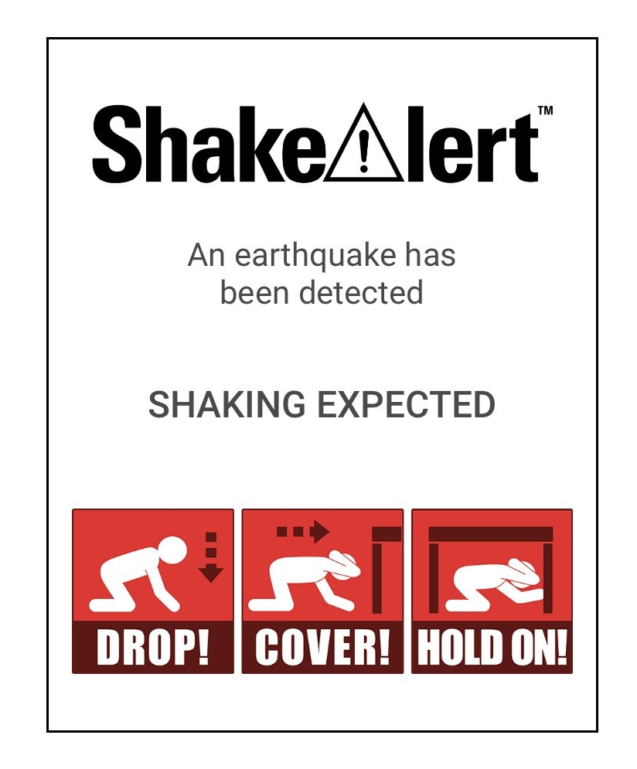

What to Expect from an Alert
28
Notes:
Teacher Notes: Play the ShakeAlert alert. Have all students Drop, Cover, and Hold On. Ask students to stay in their protective positions while the teacher observes and offers corrections if necessary. Once the teacher has checked in with each student, ask them to return to their seats.
NOTE: Your EEW alert may sound and look different than the one pictures on the slide!

Slide 29

Let’s reflect!
How did we do?
Questions?
Key things to remember?
29
Notes:
Teacher Notes: Ask students to turn and talk to reflect on the earthquake drill to discuss how they did, if they have questions, and what they think the key things to remember are. After reflecting, remind students of the key takeaways to stay safe during an earthquake, including: immediately dropping to your knees, moving away from glass or heavy objects that could fall, etc.

Slide 30
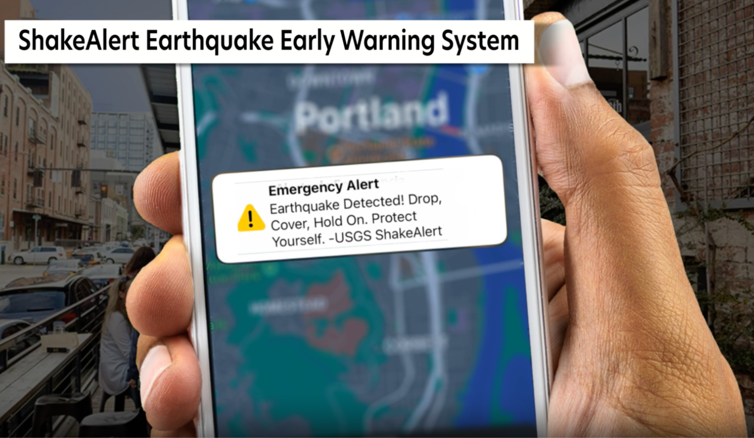
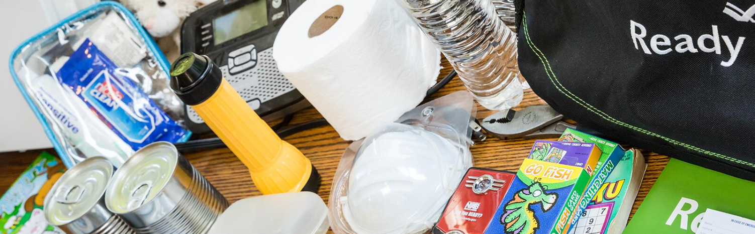
What else can you, the people you live with, and community do to prepare for an earthquake?
Sign up for ShakeAlert EEW
Emergency Plan
Practice
Emergency Supply Kit
CREDIT: Ready.gov/kit and MyShake
30
Notes:
Teacher Notes: This slide is animated. Elicit student responses first. This is not a complete list. Validate / discuss other student ideas. Practice means to practice earthquake drills in multiple settings, and practice reunification with family after an earthquake.
IMAGE: https://www.ready.gov/kit
https://myshake.berkeley.edu/

Slide 31
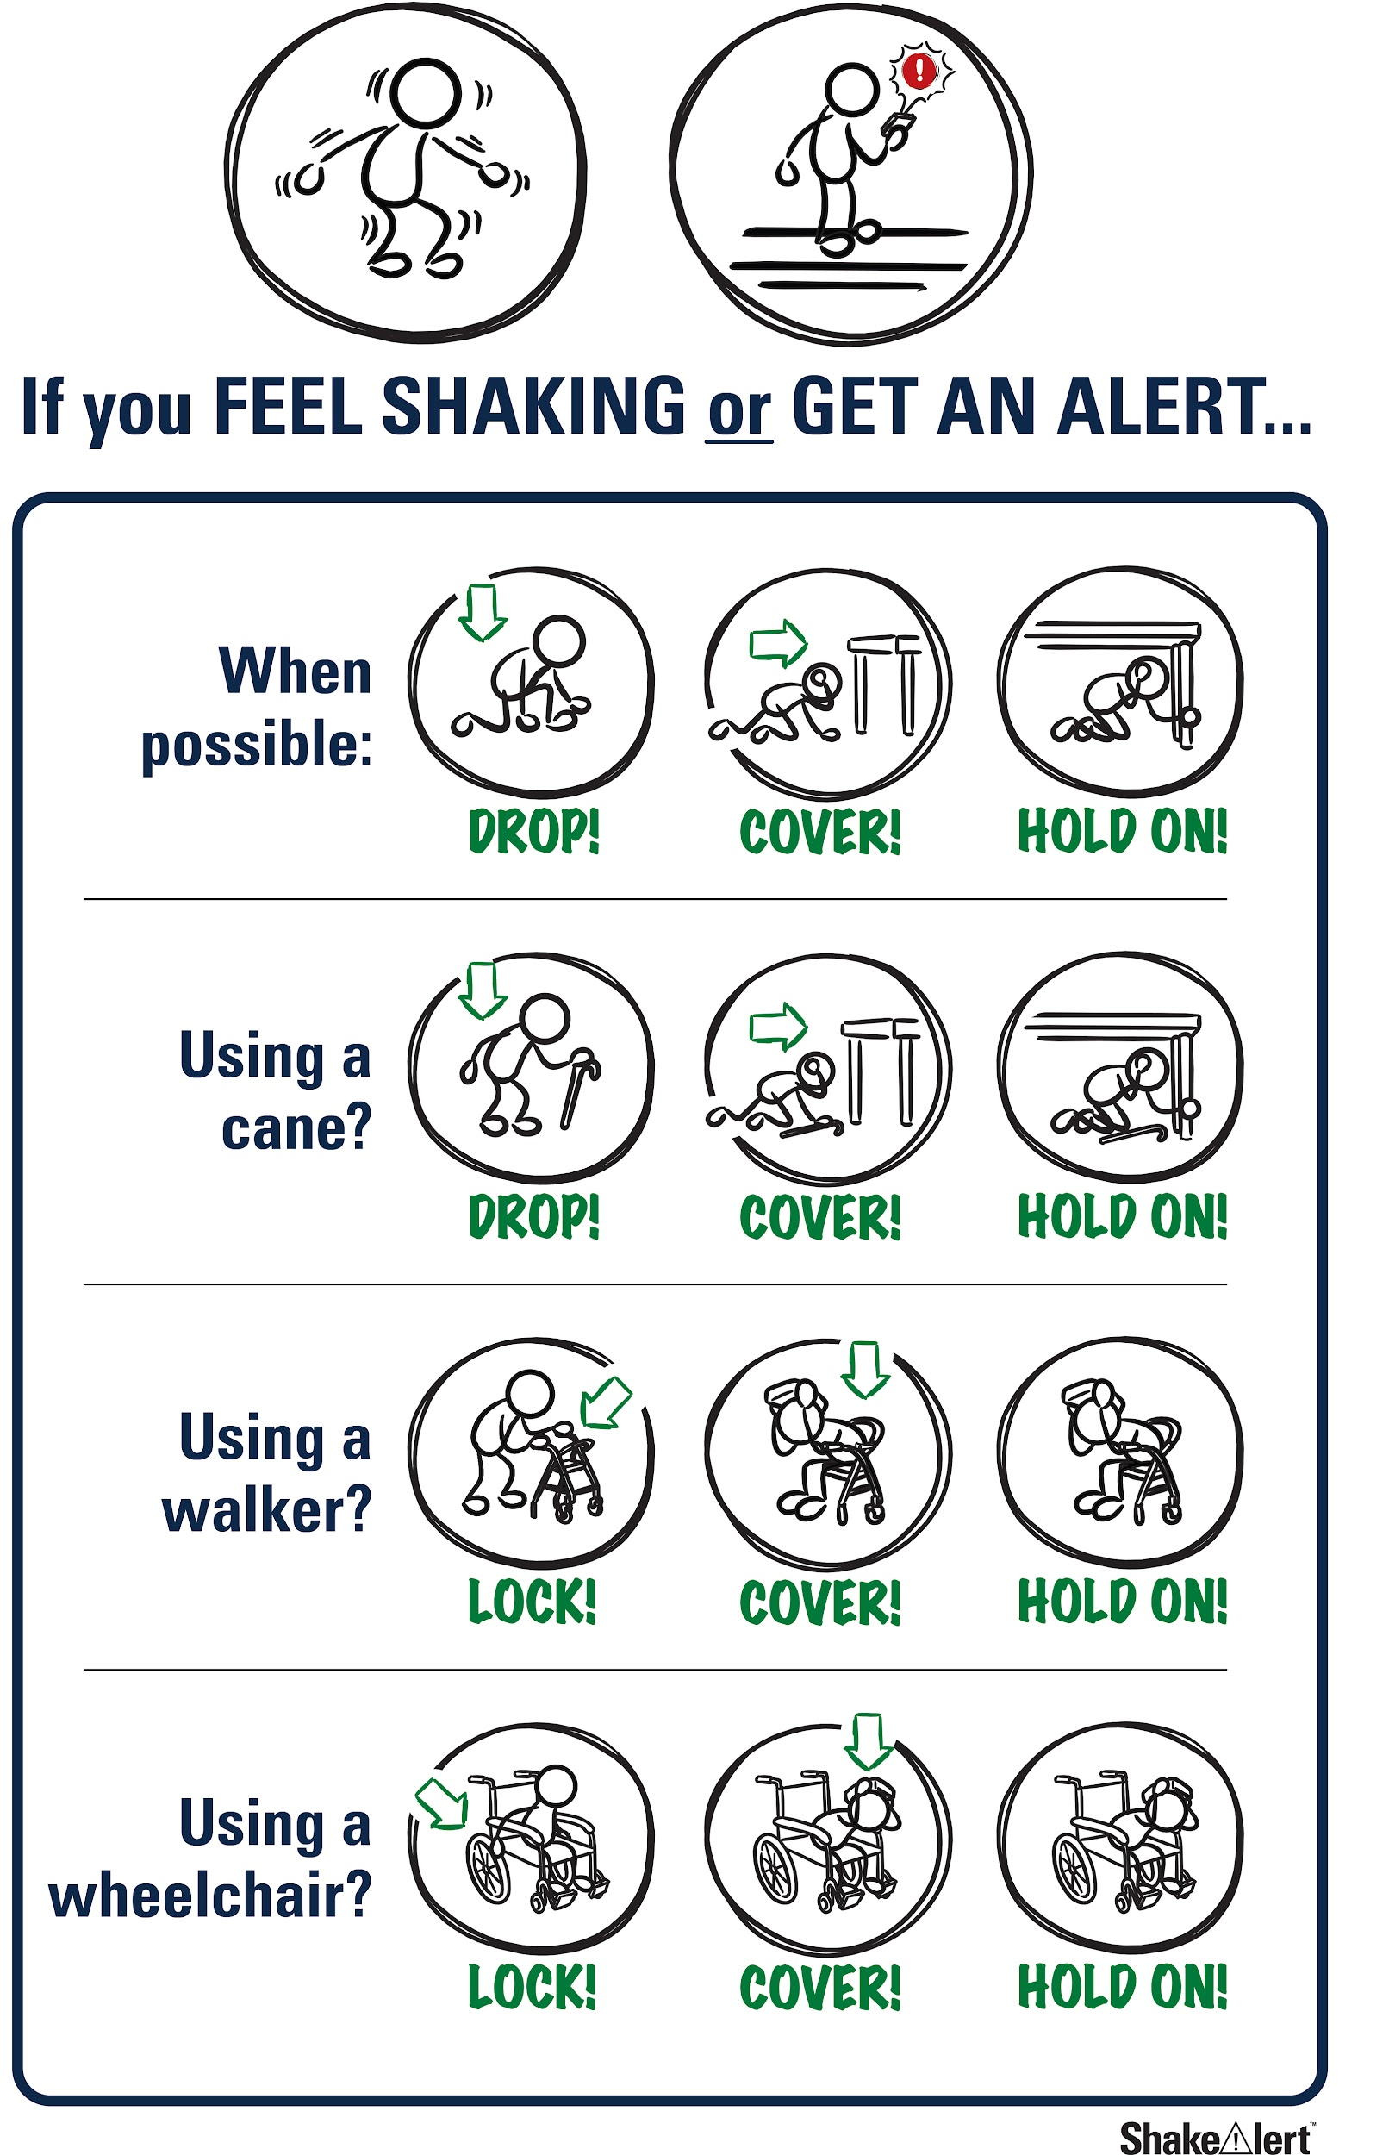
Help the people you live with and community prepare!
Spread the word! Tell your family and community what you learned about protecting yourself during an earthquake.
Practice tonight!
CREDIT: Sign up for ShakeAlert
31
Notes:
Teacher Note: Tell students that most of the adults they know have probably not taken part in an earthquake drill since they were students, and may have incorrect ideas about how to protect themselves in an earthquake. They can help the people they live with and community members prepare by teaching them about Drop, Cover, and Hold On, and informing them about ways to prepare, such as signing up for ShakeAlert-powered alerts and preparing an emergency kit and plan. Ask them to share the Family Engagement Letter with their families tonight.
IMAGE: https://drive.google.com/drive/folders/1Jt3m3AuHWwSDYJPZOj5FJqj626gyI7Ek

Slide 32

Welcome Back!
How did your discussions with your families go?
Did you show your families how to Drop, Cover, and Hold On during an earthquake?
CREDIT: Great ShakeOut
32
Notes:
Teacher Notes: NEXT DAY: Ask students how their conversations with their families went. Did their family members know that Drop, Cover, and Hold On are the correct protective actions? Did they talk about an emergency plan?
IMAGE:https://www.shakeout.org/

Slide 33
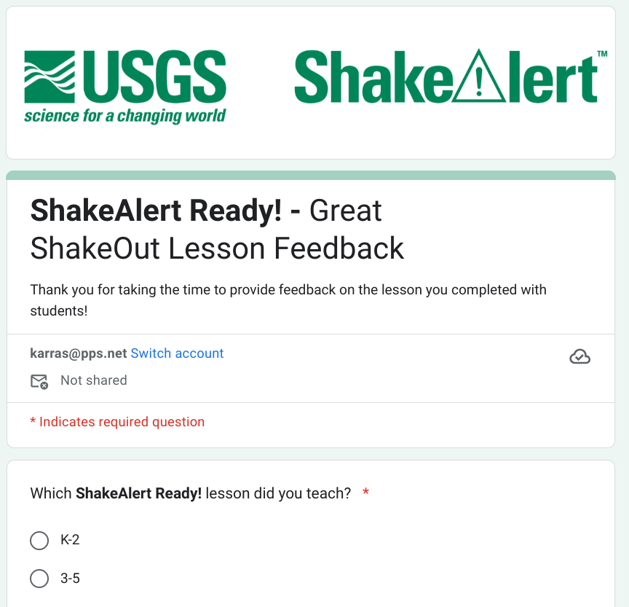
Teachers: Share your feedback, please!
Please complete the short and anonymous feedback form and help us to improve our ShakeAlert Ready lessons.
11/2024
33
Notes:
LINK: https://docs.google.com/forms/d/e/1FAIpQLSeNHAr45fDTztflhJJD3_JVS8p0RiV1MW9sKyQgFucGJyKcCA/viewform?usp=sf_link

Slide 34
Content Standards
Common Core ELA
CCSS.ELA-LITERACY.RST.9-10.7
Translate quantitative or technical information expressed in words in a text into visual form (e.g., a table or chart) and translate information expressed visually or mathematically (e.g., in an equation) into words.
CCSS.ELA-LITERACY.RST.11-12.7
Integrate and evaluate multiple sources of information presented in diverse formats and media (e.g., quantitative data, video, multimedia) in order to address a question or solve a problem.
ELP (OR)
9-12.2 An ELL can participate in grade-appropriate oral and written exchanges of information, ideas, and analyses, responding to peer, audience, or reader comments and questions.
9-12.9 An ELL can create clear and coherent grade-appropriate speech and text.
9-12.10 An ELL can make accurate use of standard English to communicate in grade-appropriate speech and writing
ELP (WA)
ELD-SI 4-12 Narrate
Share ideas about one’s own and others’ lived experiences and previous learning
Connect stories with images and representations to add meaning
Identify and raise questions about what might be unexplained, missing, or left unsaid
ELD-SI 4-12 Inform
Report on explicit and inferred characteristics, patterns, or behavior
Describe the parts and wholes of a system
Summarize most important aspects of information
Science
HS-PS4-5. Communicate technical information about how some technological devices use the principles of wave behavior and wave interactions with matter to transmit and capture information and energy.*
Social Sciences (OR)
HS.G.GR.1 Use geographic tools, various kinds of maps, and geospatial technologies to examine geographic components of past and current world events or to solve geographic problems.
Social Emotional Learning (OR)
Standard 5: Demonstrate curiosity and analysis of oneself and society in order to make caring choices that impact personal, social, and collective well-being across situations and environments.
Health (OR)
HS.SFA.6 Analyze community and individual preparation and emergency response in case of natural disasters, including wildfires and earthquakes, and acts of violence.
Health Education (CA)
1.3.S Analyze emergency preparedness plans for the home, the school, and the community.
1.11.S Identify ways to stay safe during natural disasters and emergency situations (e.g., landslides, floods, earthquakes, wildfires, electrical storms, winter storms, and terrorist attacks).
3.2.S Analyze community resources for disaster preparedness.
6.1.S Develop a plan to prevent injuries during emergencies and natural disasters.
ELP (CA) - 6 (Bridging Proficiency Levels)
1. 1. Exchanging information/ideas: Contribute to class, group, and partner discussions, sustaining conversations on a variety of age and grade-appropriate academic topics by following turn-taking rules, asking and answering relevant, on-topic questions, affirming others, and providing coherent and well-articulated comments and additional information.
3. Supporting opinions and persuading others: Negotiate with or persuade others in conversations in appropriate registers (e.g., to acknowledge new information in an academic conversation but then politely offer a counterpoint) using a variety of learned phrases, indirect reported speech (e.g., I heard you say X, and I haven’t thought about that before. However, ... ), and open responses to express and defend nuanced opinions.
5. Listening actively: Demonstrate comprehension of oral presentations and discussions on a variety of social and academic topics by asking and answering detailed and complex questions that show thoughtful consideration of the ideas and arguments, with light support.
11/2024
34

Slide 35
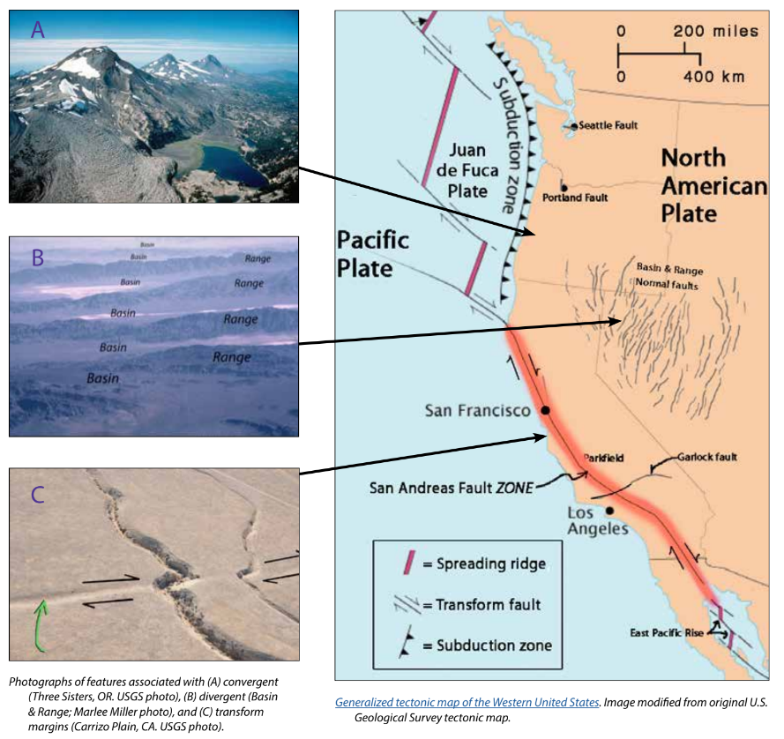
Background - Earthquake Hazard
California, Oregon, and Washington all face hazards from earthquakes because of the underlying tectonic plates, which constantly grind against each other. This friction creates "faults," lines of weakness in the Earth's tectonic plates (lithosphere) where earthquakes are most likely to occur.
California's San Andreas Fault is one example. Another example is the Cascadia Subduction Zone, which threatens all three states and British Columbia, Canada. This giant fault lies offshore, where the Juan de Fuca Plate dives beneath the North American Plate. This type of motion on other subduction zones can cause massive earthquakes, like the one that struck Japan in 2011.
While smaller earthquakes happen often, scientists think a major earthquake could happen any time, so it's important to be prepared.
For more information: Faults, Plate Tectonics & Earthquake Hazards - Animations / Videos
11/2024
35
Notes:
IMAGE: https://www.iris.edu/hq/inclass/activities/introduction_to_faults_and_plate_tectonics
SOURCE: https://www.usgs.gov/programs/earthquake-hazards/science/pacific-northwest-hazards
https://www.usgs.gov/programs/earthquake-hazards/science/southern-california-earthquake-hazards

Slide 36
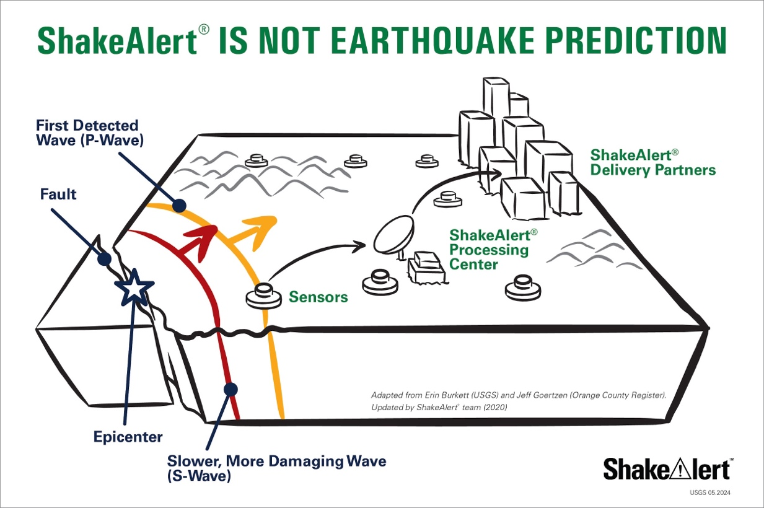
Background - How ShakeAlertⓇ Earthquake Early Warning System Works
During an earthquake, a rupturing fault sends out different types of waves. The fast-moving P-wave is first to arrive, followed by the slower S-wave and later-arriving surface waves.​
Sensors detect the P-wave and immediately transmit data to a ShakeAlert processing center where the location, size, and estimated shaking of the quake are determined. If the earthquake fits the right profile a ShakeAlert Message is issued by the USGS.​
A ShakeAlert Message is then picked up by delivery partners (such as a transportation agency) that could be used to produce an alert to notify people to take a protective action such as Drop, Cover, and Hold On and/or trigger an automated action such as slowing a train.​
11/2024
36
Notes:
https://drive.google.com/drive/folders/1oQOHup9P_p3DUkyIOi9DwqAlLgzdY45A?usp=drive_link
For more information on Earthquake Early Warning, go to: https://www.iris.edu/hq/inclass/sequences/earthquake_early_warning

Slide 37
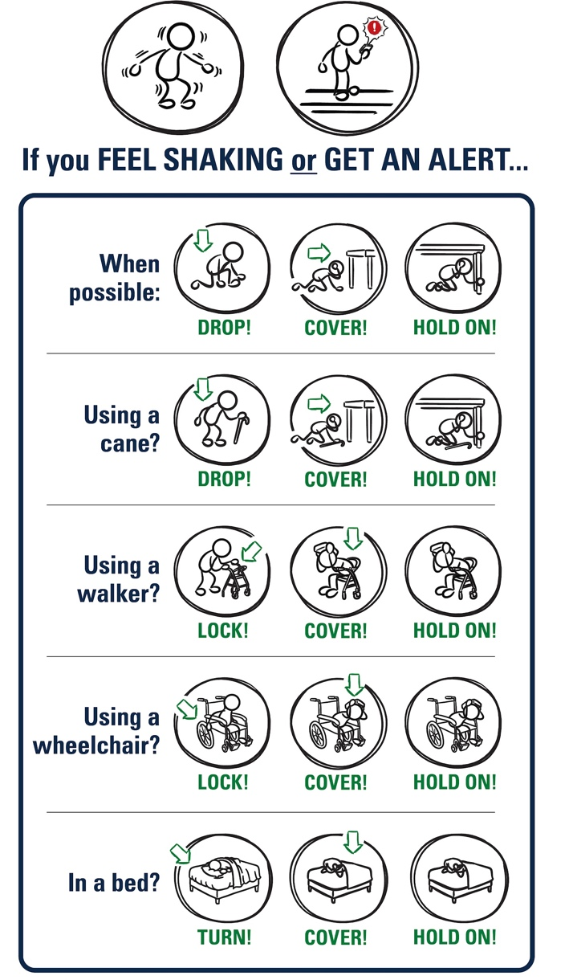
Background - Effective Protective Actions
Most earthquake-related injuries and deaths are caused by collapsing walls and roofs, flying glass and falling objects.
If you are inside a building, move no more than a few steps, then Drop, Cover, and Hold On.
If you are outdoors when the shaking starts, you should find a clear spot away from buildings, trees, streetlights, and power lines, then Drop, Cover, and Hold On. Stay there until the shaking stops.
For protective actions in various settings (descriptions and gifs), go to https://www.earthquakecountry.org/step5/
11/2024
37
Notes:
SOURCE: https://www.shakeout.org/whyparticipate/
IMAGE: https://drive.google.com/file/d/1KaHNTj7_C1NvRDFZE3jWW-6g2K4I_Q4h/view

Slide 38
Rationale
Why do we practice earthquake drills?
To react quickly you must practice often. You may only have seconds to protect yourself in an earthquake, before strong shaking knocks you down--or drops something on you.
Social science research has long shown that people who practice actions are more likely to take those actions when a safety- threatening event occurs, such as an earthquake or fire. Tests, drills, and exercises that repeat concepts build “muscle memory” of procedural knowledge and timely reaction. The more frequently a person practices a procedure or self-protective action, such as Drop, Cover, and Hold On, the more likely they will employ it— almost without thinking—when they receive an alert or feel shaking.
Why share the Family Engagement Letter?
While schools practice earthquake drills regularly, most other locations don’t. Some students’ family members may not have practiced earthquake drills since they were in school.
Family members may have outdated information about how to stay safe in an earthquake, such as the incorrect belief that standing in doorways or “the triangle of life” will keep one safe in an earthquake. Students will be able to share correct protective actions (Drop, Cover, and Hold On) with their family and community members.
Students spend more time at home than at school. Therefore, educating families will help keep students and our community safe. Additionally, families are more likely to understand their family and community members’ needs. This communication can prompt families to ensure they’re prepared to protect all members of their families in case of an earthquake.
Because earthquakes are infrequent in Oregon and Washington, people may be unaware of the risk of an earthquake.
The Family Engagement Letter has links for family members to learn more about earthquakes and protective actions.
11/2024
38
Notes:
SOURCE: https://www.shakeout.org/whyparticipate/ , https://www.shakealert.org/toolkit/introduction/

Slide 39
Additional Resources
ShakeAlert® Earthquake Early Warning System Education and Training Materials
Great ShakeOut Lessons
Earthquake Country Alliance and Shake Out Documents in Many Languages
EarthScope Consortium Education Resources
11/2024
39

