Slide 1
ShakeAlert® Earthquake Early Warning Earthquake Drill Lesson
GREEN SLIDES = Teacher Preparation & Information
WHITE SLIDES = Present to Class
Kindergarten - 2nd Grade
Lesson length: 2 30-minute or 1 hour Lesson
11/2024

Slide 2
Links for Printing
Preparation
Student Sheets
Student Sheet - Kindergarten
Student Sheet - 1st Grade
Student Sheet - 2nd Grade
Family Engagement Letters
Family Engagement Letter (English & Spanish)
Open and edit your state’s Family Engagement Letter.
Add your school name at the bottom.
If you’re emailing the letter, you can remove the QR code.
Make copies of Family Engagement Sheet and/or email to families.
Preview Slides. You can print out the Teaching Steps slides. The teaching steps are also located in the Speaker Notes of each slide.
Copy Student Sheet or go to the Rocket Rules website to find additional student sheets, including some in Spanish.
OPTIONAL (FREE): Go to the Rocket Rules website to sign up for Rocket Live!, a 20 minute cost-free live Zoom interactive lesson.
11/2024

Slide 3
Sensitive Content Warning
Some students or their family members may have experienced earthquakes, resulting in loss, injuries, and possible trauma. It is therefore important to approach these lessons with sensitivity and awareness. When students share information about their experiences with earthquakes in the first part of the lesson, make sure to scan the class and be aware of any heightened responses. Affirm students’ normal emotional responses. If students are too emotionally heightened, it may be prudent to allow them to forego the drill.
Even students who have never experienced an earthquake may have a strong emotional response to talking about earthquakes. Explain to students that practicing earthquake drills helps our community to stay safe in an earthquake, but that it’s normal to feel strong feelings, such as fear, about earthquakes.
The purpose of drills is to build muscle memory so that in a heightened emotional state students are still able to take appropriate protective action. Therefore, it is important to take drills seriously. To the extent you can, please insist on students remaining quiet and following instructions.
11/2024

Slide 4
Teaching Steps - page 1
SLIDE 10: Tell students that today they are taking part in the Great ShakeOut. They’re practicing protecting themselves during an earthquake with millions of people all around the world. The Great ShakeOut is practiced in countries all around the world on the 3rd Thursday of October every year but can be done anytime.
SLIDE 11: Ask students what other drills they’ve practiced at school. Kindergarten students may only have have fire drills at this point in the year, but older students have probably practiced earthquake drills, shelter in place drills, and lockdowns among others. Ask students why we practice drills at school. They should respond that we conduct drills to practice how to respond so that if there’s ever a fire or earthquake, we’re prepared and know how to stay safe. We also practice drills so that we can help students feel safer and less afraid at school. Having fire and earthquake drills can help us to feel prepared and less scared!
SLIDE 12: Tell students that our school has an earthquake early warning system that can give our school community members seconds of extra time to protect ourselves before damaging shaking arrives during an earthquake.
SLIDE 13: Sometimes drills can be scary because we don't know what to do or what is happening around us. During these lessons you will practice the drill many times. After practicing, you should feel more confident and hopefully less scared or nervous. When thinking about earthquake drills, how do you feel right now? Turn to a student sitting next to you and talk about where you’re at.
11/2024

Slide 5
Teaching Steps - page 2
SLIDE 14: Ask students what they’ve seen and heard about earthquakes. They may have seen images of people or buildings shaking. They may have seen a cartoon in which a giant fissure opens up in Earth’s surface (which is incorrect). Tell students that we’ll learn more about what an earthquake is in this lesson. Consider recording students’ questions so that you can return to them at them end of the lesson to see which have been addressed through the lesson, and try to answer the others.
SLIDE 15: Ask students if they or family members have ever experienced an earthquake. If they have, what did they see, hear, and feel?
It’s likely that students have not experienced an earthquake, but have heard family members discuss their experiences. Validate students’ experiences, and scan for students who may need some extra support.
SLIDE 16: Ask students where they are located, starting with the school they’re in, and then progressively zooming out.
SLIDE 17: Explain to students that the Earth’s surface is broken into many pieces that move around. Most of the time we don’t feel the movement, but sometimes we do. As the pieces of the Earth move, they can become stuck because of friction similar to how if you slide your tennis shoe across a floor, it can get stuck. An earthquake occurs when the moving pieces of Earth overcome friction and move suddenly. You can demonstrate this by snapping your fingers. Your thumb and finger model the pieces of Earth. At first when you press them together, they’re stuck because of friction. This models the friction between the pieces of Earth. When your finger snaps into the base of your thumb, that’s the earthquake.
11/2024

Slide 6
Teaching Steps - page 3
SLIDE 18: Review and model correct protective actions - Drop, Cover, and Hold On. Make sure students know they should drop to their knees (not their bottoms), have one hand over their necks, and try to get away from glass or any other objects that could fall on them. If they’re able to get under a table or desk while staying on their knees, they should. Once there, they should hold on to the leg of the table.
SLIDE 19: Tell students that Drop, Cover, and Hold On looks different for different bodies. Review modified protective actions for people who use wheelchairs.
While you may not have students who use wheelchairs in your class, it is likely that there are members of your community who do. Have students repeat the phrase, “Drop, Cover, and Hold On” and then “Lock, Cover, and Hold On” after you’ve said it.
SLIDE 20: Tell students that Drop, Cover, and Hold On looks different for different bodies. Review modified protective actions for people who use a cane or walker.
While you may not have students who use a cane or walker in your class, it is likely that there are members of your community who do. Ask students to help their family members or friends who use a cane or walker by sharing the correct protective actions. Have students repeat the phrase, “Drop, Cover, and Hold On” and then “Lock, Cover, and Hold On” after you’ve said it.
SLIDE 21: Tell students that they should take these protective actions when the ground shakes, if there’s an earthquake early warning alert, or if they’re doing an earthquake drill, which we’ll do now.
11/2024

Slide 7
Teaching Steps - page 4
SLIDE 22: Play the ShakeAlert message. Have all students Drop, Cover, and Hold On. Ask students to stay in their protective positions while the teacher observes and offers corrections if necessary. Once the teacher has checked in with each student, ask them to return to their seats.
SLIDE 23: Reflect with students on how they did, and give them a chance to ask questions. Address students’ questions as they come up if you can, and record the rest of their questions to respond to later.
SLIDE 24: Tell students that they will be sharing information about how to stay safe in earthquakes with the adults in their homes. Provide students with the Family Engagement letter, and/or copies of the Rocket’s Earthquake Safety Activity Book to share with their family.
SLIDE 25: LESSON BREAK - If you haven’t already, please send the family engagement letter home, and photocopy the student sheet for use tomorrow. If you have extra time, consider reading the green teacher-facing slides at the end to learn more about earthquake risk in your area, how earthquake early warning works, and the rationale for teaching this lesson and sharing family engagement materials.
SLIDE 26: NEXT DAY - Ask students how their conversations with the people in their homes went. Ask students to give you a thumbs up if they showed their families how to Drop, Cover, and Hold On. Did the people in their homes know that Drop, Cover, and Hold On are the correct protective actions? Did they talk about an emergency plan?
11/2024

Slide 8
Teaching Steps - page 5
SLIDE 27: Review with students what to do if there’s an earthquake while they’re at school. They should remember Drop, Cover, and Hold On.
SLIDE 28: Review with students why each protective action is important during an earthquake. DROP: Dropping to your knees protects you from falling during ground shaking. COVER: We cover our neck and head to protect them from becoming injured if something falls. HOLD ON: We hold on to a table leg once we’re beneath a table so that the earthquake doesn’t move us out from underneath the table that is protecting us.
SLIDE 29: Remind students that they should drop, cover, and hold on if they get an alert, or if there’s ground shaking. Tell students that they will hear sound effects like earthquake shaking. This is just pretend! But it is similar to what you might hear in a real earthquake. Play the ground shaking noises, and practice Drop, Cover, and Hold On.
SLIDE 30: Students may wonder what to do if they’re outside when they feel shaking or get an alert. Tell them to find a clear spot away from buildings, trees, streetlights, and power lines, then Drop, Cover, and Hold On. Stay there until the shaking stops.
11/2024

Slide 9
Teaching Steps - page 6
SLIDE 31: Ask students to turn and talk to a student nearby, and then share out with the entire class. Reflect with students on how taking protective actions during an earthquake will help us protect ourselves as well as our community. Students may note that they now know how to stay safe if there is ground shaking or an alert, and that they can tell others in their communities how to stay safe as well.
SLIDE 32: Ask students, “now that you've learned how to protect yourself if we have an earthquake, how do you feel? Are your feelings different than yesterday when we began? Turn and Talk.
SLIDE 33: Provide students with the student sheet to give them the chance to review the correct protective actions if there is ground shaking or if they get an EEW alert.
SLIDE 34: OPTIONAL - Please complete the ShakeAlert Ready! Earthquake Drill Lesson Feedback Form.
11/2024

Slide 10
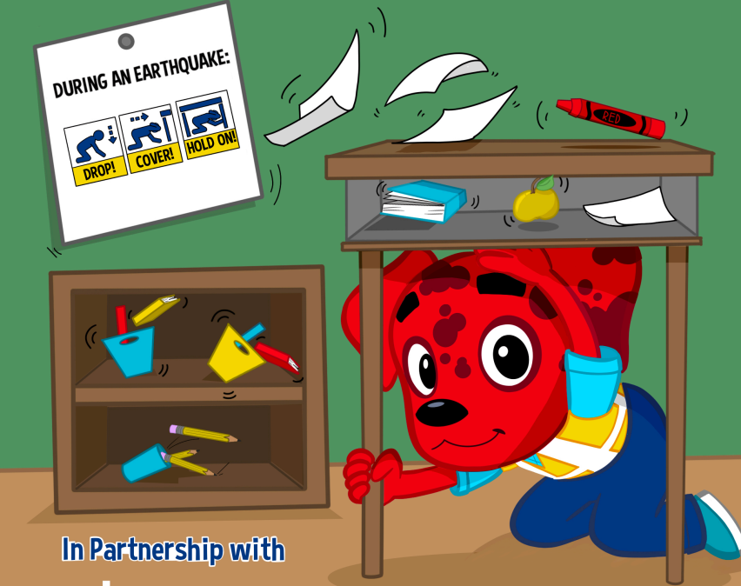
LEARNING TARGET
I can Drop, Cover, and Hold On if there’s ground shaking or if there is an alert.
CREDIT: Rocket’s Earthquake Safety Activity Book
11/2024

Slide 11


What other safety drills have we had at school?
Why do we have drills at school?
CREDIT: Educator Clips, Mark A. Hicks
CREDIT: Olympia CUSD 16
Notes:
Teacher Notes: Ask students what other drills they’ve practiced at school. Kindergarten students may only have have fire drills at this point in the year, but older students have probably practiced earthquake drills, shelter in place drills, and lockdowns among others.
Ask students why we practice drills at school. They should respond that we conduct drills to practice how to respond so that if there’s ever a fire or earthquake, we’re prepared and know how to stay safe. We also practice drills so that we can help students feel safer and less afraid at school. Having fire and earthquake drills can help us to feel prepared and less scared!
IMAGES: https://educatorclips.com/fire_drill.html , https://www.olympia.org/o/oms/article/136094

Slide 12
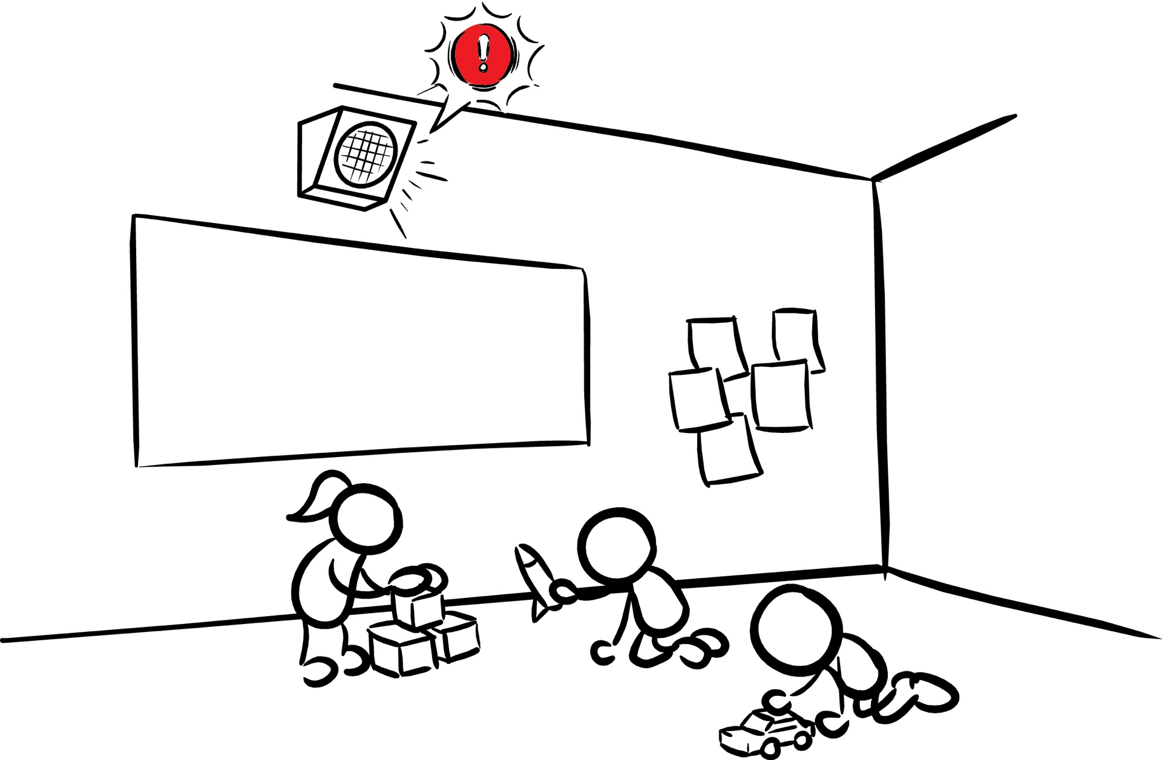
Our school has Earthquake Early Warning!
CREDIT: Education_15_SmallKids_V01.jpg
Notes:
Teacher Notes: Tell students that our school has an earthquake early warning system that can give our school community members seconds of extra time to protect ourselves before damaging shaking arrives during an earthquake.
IMAGES: https://drive.google.com/file/d/1c-wx46pgNeN2sBWM51xPwq0eLwnvT8jU/view?usp=drive_link

Slide 13
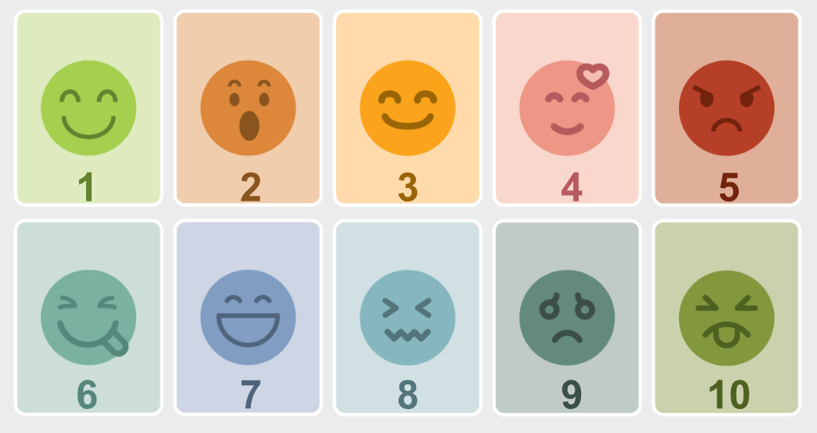
How do you feel? Turn and talk to a partner!
CREDIT: Nebraska Department of Education
Notes:
Teacher Notes: Sometimes drills can be scary because we don't know what to do or what is happening around us. During these lessons you will practice the drill many times. After practicing, you should feel more confident and hopefully less scared or nervous. When thinking about earthquake drills, how do you feel right now? Turn to a student sitting next to you and talk about where you’re at.
IMAGE: https://www.education.ne.gov/wp-content/uploads/2021/12/6185-21-STQ-Emotions-Blog-Images.jpg

Slide 14
What are some things you have seen or heard about earthquakes?
What do you wonder about earthquakes?
CREDIT: Rocket’s Earthquake Safety Activity Book
Notes:
Teacher Notes: Ask students what they’ve seen and heard about earthquakes. They may have seen images of people or buildings shaking. They may have seen a cartoon in which a giant fissure opens up in Earth’s surface (which is incorrect). Tell students that we’ll learn more about what an earthquake is in this lesson. Consider recording students’ questions so that you can return to them at them end of the lesson to see which have been addressed through the lesson, and try to answer the others.
IMAGES: https://rocketrules.org/wp-content/uploads/2020/08/Earthquake_Cont_English_072720.pdf

Slide 15

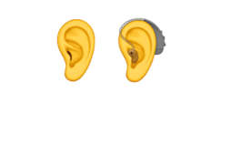
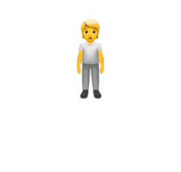
Have you experienced an earthquake? What about your family members?
What did you or family members:
SEE?
HEAR?
FEEL?
CREDIT: Rocket’s Earthquake Safety Activity Book
Notes:
Teacher Notes: Ask students if they or their family members have experienced an earthquake. It’s likely that many of them have not experienced an earthquake. They may have heard from family members about shaking, objects breaking, or even possibly injuries. Validate students’ experiences, and scan for students that may need some extra support.
IMAGES: https://rocketrules.org/wp-content/uploads/2020/08/Earthquake_Cont_English_072720.pdf

Slide 16
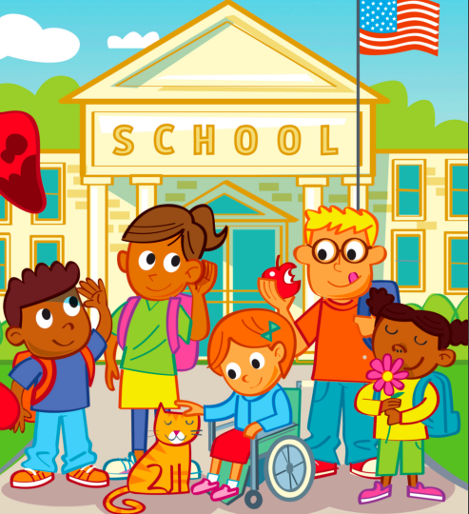
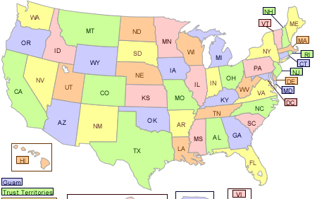

Where are we?
School
City
State
Country
Planet
CREDIT: Rocket’s Sense of Safety, USGS Soil Lead Safety Data, NASA A Guide to Climate Change for Kids
Notes:
Teacher Notes: This slide is animated so pictures and prompts come in when you click starting with the school, and then zooming out to planet Earth. Ask students where they are located, starting with the school they’re in, and then progressively zooming out.
IMAGES: Rocket’s Sense of Safety https://rocketrules.org/wp-content/uploads/2024/01/Sos-English-v2.pdf, USGS Soil Lead Safety Data https://www.epa.gov/superfund/usgs-background-soil-lead-survey-state-data , NASA: A Guide to Climate Change for Kids https://climatekids.nasa.gov/kids-guide-to-climate-change/

Slide 17
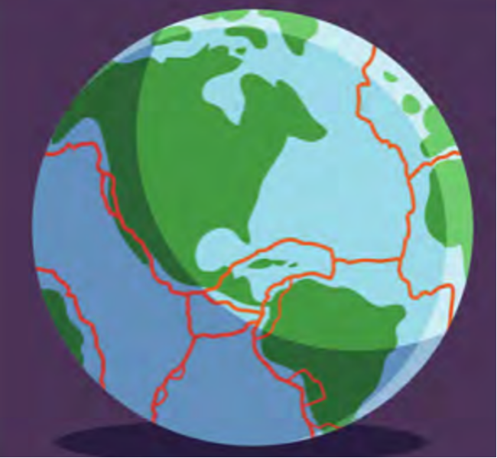
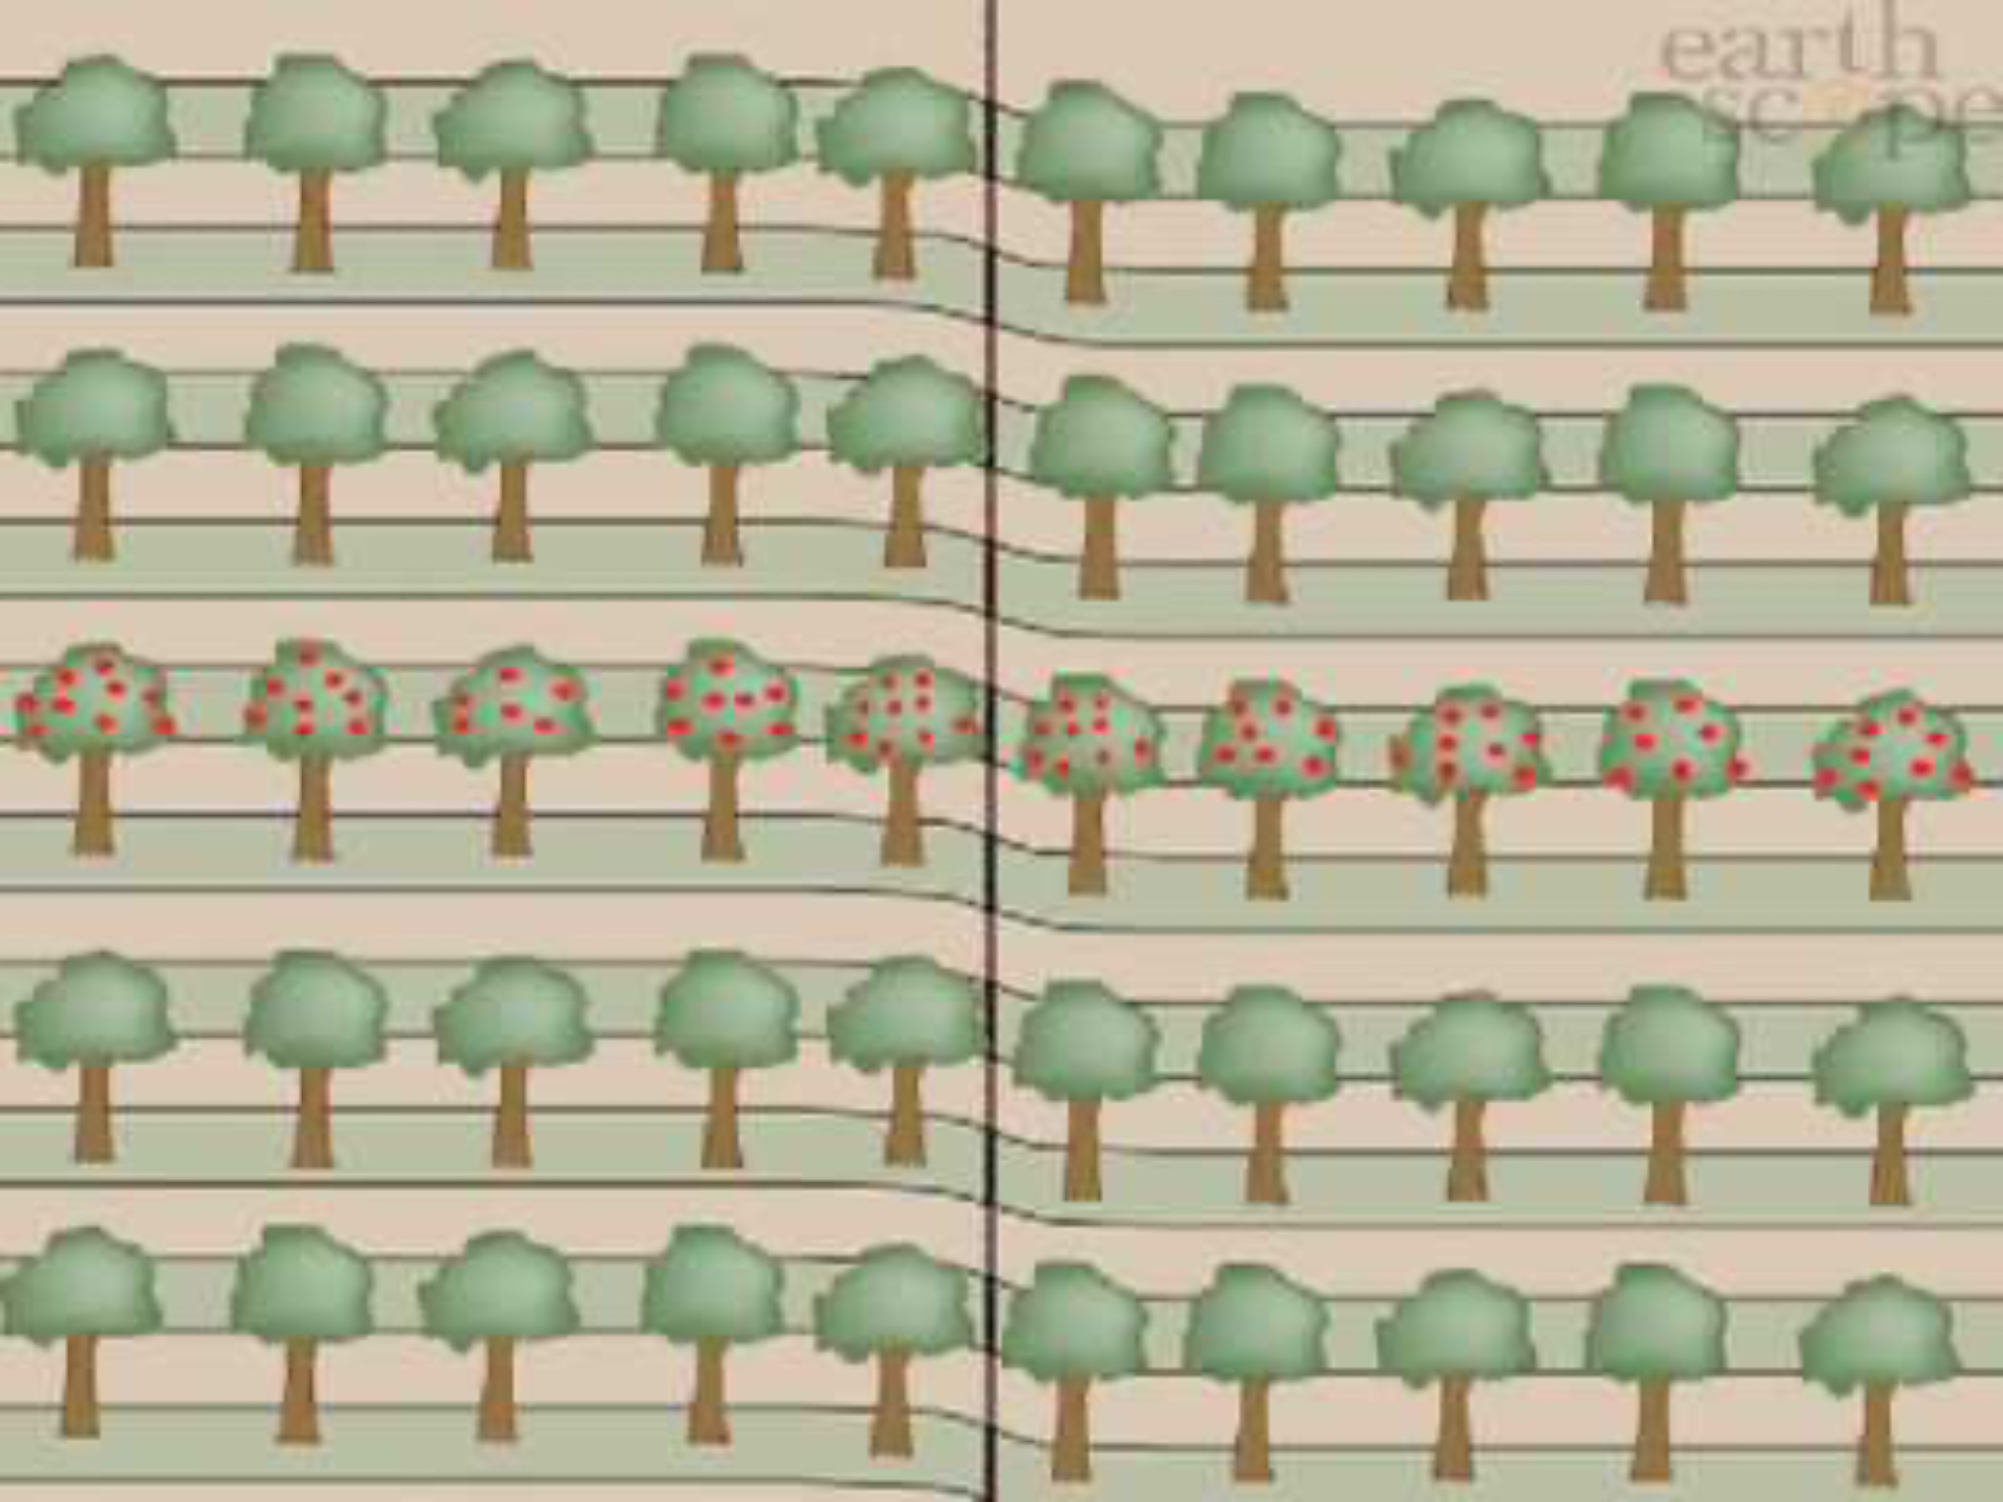
The surface of the Earth is broken into many pieces that move around.
The pieces of the Earth get stuck together. When they break free, an earthquake happens!
CREDIT: Rocket’s Earthquake Safety Adventure
CREDIT: Earthscope YouTube
Notes:
Teacher Notes: Slide is animated so images come in when you click. Animation plays when clicked.
Explain to students that the Earth’s surface is broken into many pieces that move around. Most of the time we don’t feel the movement, but sometimes we do. As the pieces of the Earth move, they can become stuck because of friction similar to how if you slide your tennis shoe across a floor, it can get stuck. An earthquake occurs when the moving pieces of Earth overcome friction and move suddenly. You can demonstrate this by snapping your fingers. Your thumb and finger model the pieces of Earth. At first when you press them together, they’re stuck because of friction. This models the friction between the pieces of Earth. When your finger snaps into the base of your thumb, that’s the earthquake.
IMAGES: https://rocketrules.org/wp-content/uploads/2020/09/Earthquake_Story_Full_optimized.pdf
VIDEO: https://www.youtube.com/watch?v=-5BgKKutxBs

Slide 18
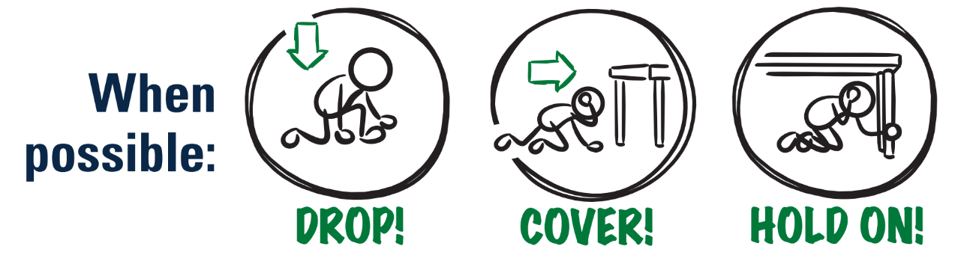
What do you do if you feel shaking or get an alert?
CREDIT: ShakeAlert Infographic Modified Protective Actions
Notes:
Teacher Note: This is animated. Ask the question first to elicit student responses.
Review and model correct protective actions - Drop, Cover, and Hold On. Make sure students know they should drop to their knees (not their bottoms), have one hand over their necks, and try to get away from glass or any other objects that could fall on them. If they’re able to get under a table or desk while staying on their knees, they should. Once there, they should hold on to the leg of the table.
IMAGE: https://drive.google.com/file/d/1KaHNTj7_C1NvRDFZE3jWW-6g2K4I_Q4h/view

Slide 19
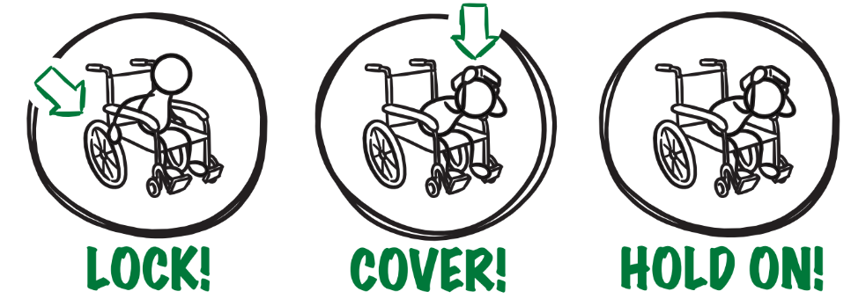
If you or someone you know uses a wheelchair:
CREDIT: ShakeAlert Infographic Modified Protective Actions
Notes:
Teacher Notes: Tell students that Drop, Cover, and Hold On looks different for different bodies. Review modified protective actions for people who use wheelchairs. While you may not have students who use wheelchairs in your class, it is likely that there are members of your community who do. Ask students to help their family members or friends who use a wheelchair by sharing that “Lock, Cover, and Hold On” is how they can protect themselves during an earthquake. Have students repeat the phrase, “Lock, Cover, and Hold On” after you’ve said it.
IMAGE: https://drive.google.com/file/d/1KaHNTj7_C1NvRDFZE3jWW-6g2K4I_Q4h/view

Slide 20


If you or someone you know uses a cane or walker:
CREDIT: ShakeAlert Infographic Modified Protective Actions
Notes:
Teacher Notes: Slide is animated so images come in when you click. Tell students that Drop, Cover, and Hold On looks different for different bodies. Review modified protective actions for people who use a cane or walker. While you may not have students who use a cane or walker in your class, it is likely that there are members of your community who do. Ask students to help their family members or friends who use a cane or walker by sharing the correct protective actions. Have students repeat the phrase, “Drop, Cover, and Hold On” and then “Lock, Cover, and Hold On” after you’ve said it.
IMAGE: https://drive.google.com/file/d/1KaHNTj7_C1NvRDFZE3jWW-6g2K4I_Q4h/view

Slide 21
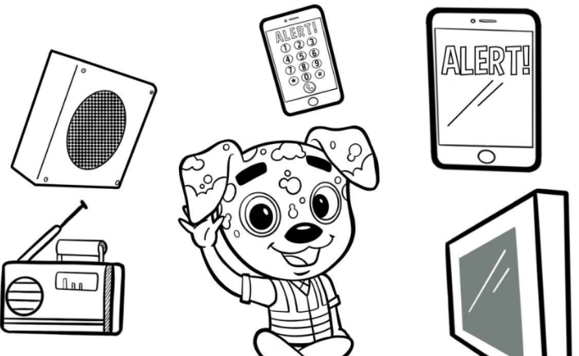
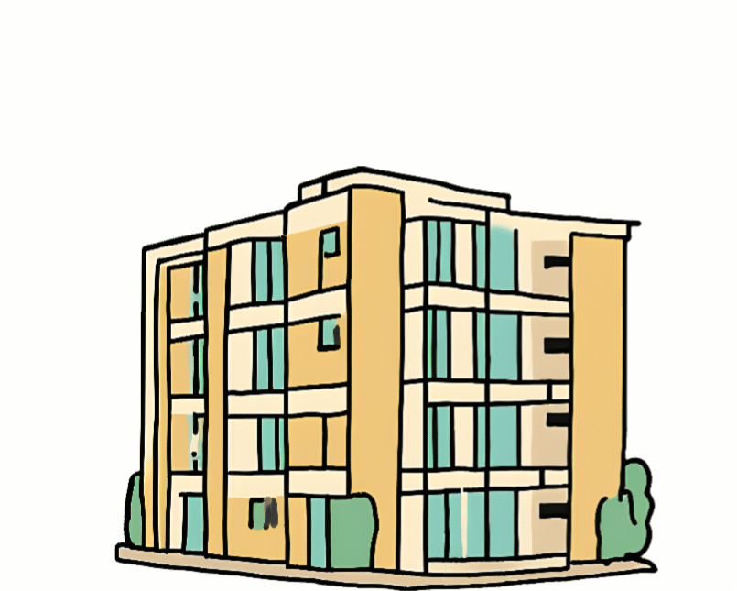

Protect yourself when there is . . .
ground shaking
an earthquake drill
an earthquake early warning alert
Notes:
Teacher Notes: Slide is animated so images come in when you click. Tell students that they should take these protective actions when the ground shakes, if there’s an earthquake early warning alert, or if they’re doing an earthquake drill, which we’ll do now. Tell students that it’s vital they Drop, Cover, and Hold On immediately and without hesitation. They can be a leader in their community by immediately taking protective actions!
IMAGES: https://rocketrules.org/wp-content/uploads/2020/08/Earthquake_Cont_English_072720.pdf
https://www.shakeout.org/

Slide 22
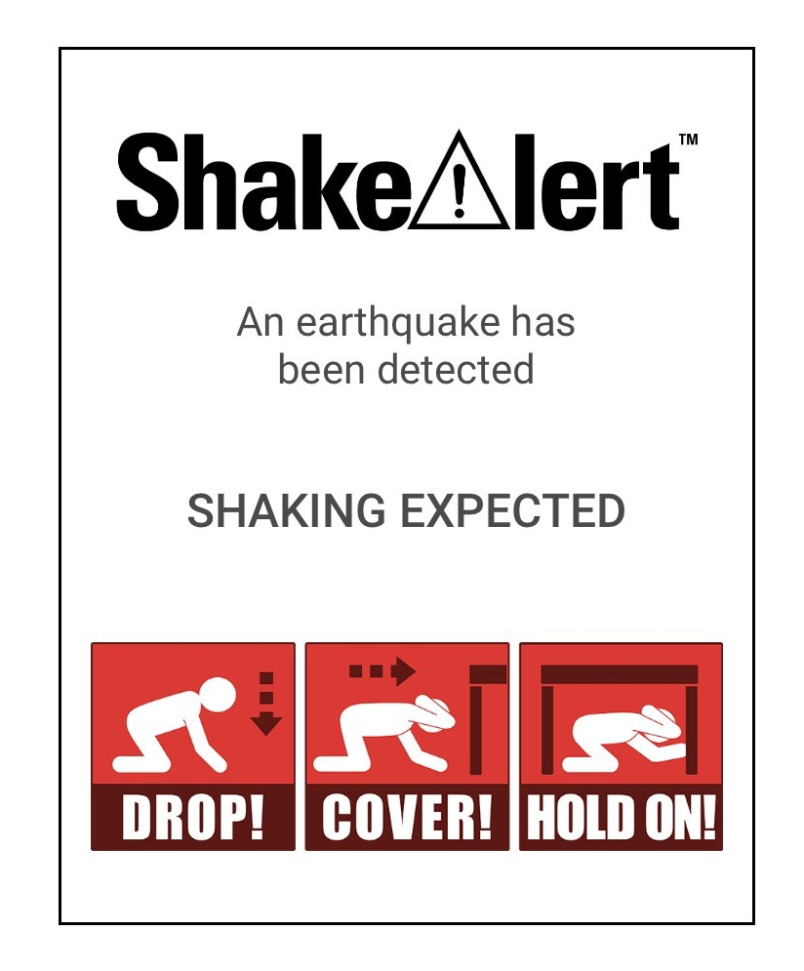

What to Expect from an Alert
Notes:
Teacher Notes: Play the ShakeAlert alert. Have all students Drop, Cover, and Hold On. Ask students to stay in their protective positions while the teacher observes and offers corrections if necessary. Once the teacher has checked in with each student, ask them to return to their seats.
NOTE: Your EEW alert may sound and look different than the one pictures on the slide!

Slide 23

LET’S REFLECT!
How did we do?
Questions?
Key things to remember?
Notes:
Teacher Notes: Ask students to turn and talk to reflect on the earthquake drill to discuss how they did, if they have questions, and what they think the key things to remember are. After reflecting, remind students of the key takeaways to stay safe during an earthquake, including: immediately dropping to your knees, moving away from glass or heavy objects that could fall, etc.

Slide 24
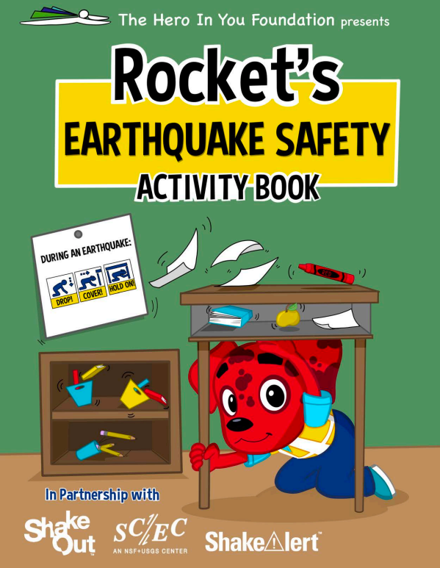
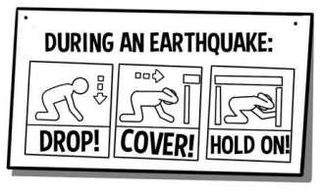
Help the people in your home prepare!
Tell the people in your home what you learned about protecting yourself in an earthquake.
Learn more with Rocket!
CREDIT: Rocket’s Earthquake Safety Activity Book
Notes:
Teacher Notes: Tell students that they will be sharing information about how to stay safe in earthquakes with the adults in their homes. Provide students with the Family Engagement letter, and/or copies of the Rocket’s Earthquake Safety Activity Book to share with their family. You could also share a student sheet from the Rocket Rules website that families can complete with their student.
IMAGES: https://rocketrules.org/wp-content/uploads/2020/08/Earthquake_Cont_English_072720.pdf

Slide 25
Lesson Break
Advanced Preparation
Send Family Engagement letter home with students.
Photocopy student sheet (if you’re using it).
11/2024

Slide 26

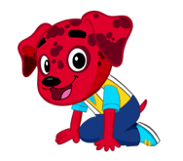

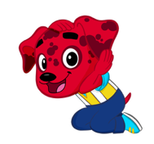

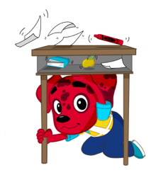
Welcome Back!
👍Thumbs up if you demonstrated how to stay safe during an earthquake by…
Did the people in your house know that Drop, Cover, and Hold On are the correct protective actions?
CREDIT: Rocket’s Earthquake Safety Adventure Story Book
Notes:
Teacher Notes: This slide is animated. Drop, Cover, and Hold On come in on each click. Ask students how their conversations with the people in their homes went. Ask students to give you a thumbs up if they showed their families how to Drop, Cover, and Hold On. Did the people in their homes know that Drop, Cover, and Hold On are the correct protective actions? Did they talk about an emergency plan?
IMAGE: https://rocketrules.org/wp-content/uploads/2020/09/Earthquake_Story_Full_optimized.pdf

Slide 27


What do we do at school if there’s an earthquake?
CREDIT: Great ShakeOut and Cybersecurity & Infrastructure Security Agency
Notes:
Teacher Notes: This slide is animated - the “Drop, Cover, Hold On“ image comes in on a click. Review with students what to do if there’s an earthquake while they’re at school.They should remember Drop, Cover, and Hold On.
IMAGES: https://www.shakeout.org/dropcoverholdon/
https://www.cisa.gov/audiences/educational-institutions

Slide 28



When the ground shakes, or you get an alert, why is it important to . . .?
CREDIT: Rocket’s Earthquake Safety Adventure Story Book
Notes:
Teacher Notes: Slide is animated so images appear individually when you click. Review with students why each protective action is important during an earthquake. Begin by eliciting student responses for each. Add on to student responses as necessary.
DROP: Dropping to your knees protects you from falling during ground shaking.
COVER: We cover our neck and head to protect them from becoming injured if something falls.
HOLD ON: We hold on to a table leg once we’re beneath a table so that the earthquake doesn’t move us out from underneath the table that is protecting us.
IMAGE: https://rocketrules.org/wp-content/uploads/2020/08/Earthquake_Cont_English_072720.pdf

Slide 29
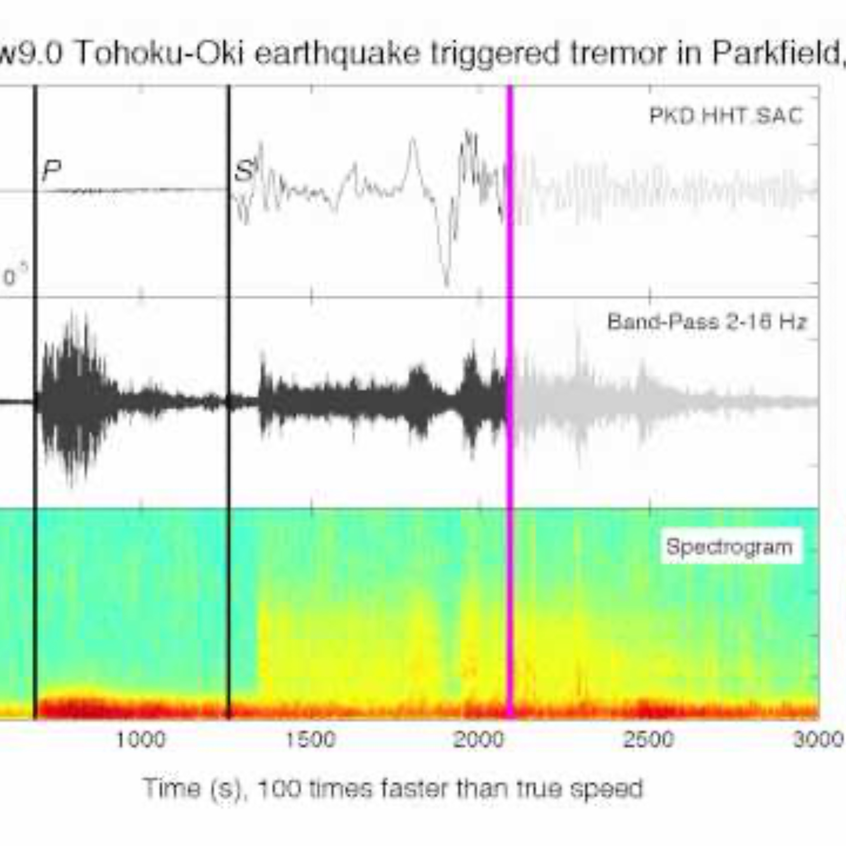
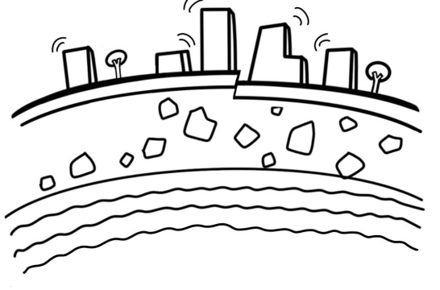
LET’S PRACTICE!
If you experience ground shaking:
DROP
COVER
HOLD ON
CREDIT: Rocket’s Earthquake Safety Activity Book
Notes:
Teacher Notes: Remind students that they should drop, cover, and hold on if they get an alert, or if there’s ground shaking. Tell students that they will hear sound effects like earthquake shaking. This is just pretend! But it is similar to what you might hear in a real earthquake. Click to play the ground shaking noises, and practice Drop, Cover, and Hold On.
IMAGE: https://rocketrules.org/wp-content/uploads/2020/08/Earthquake_Cont_English_072720.pdf
SOUND: https://www.youtube.com/watch?v=q1wg2IbA0oo Georgia Tech - Hearing the Japanese Earthquake - Clip 3

Slide 30
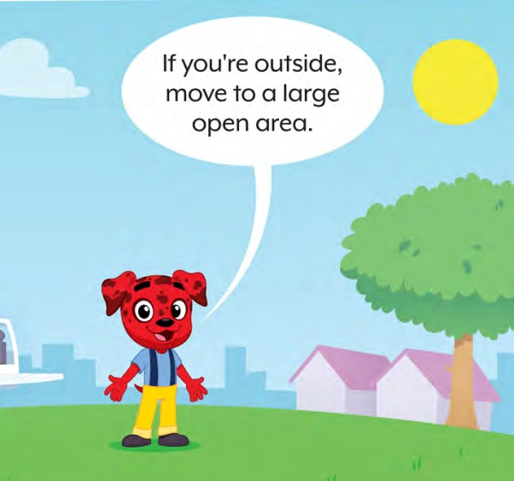
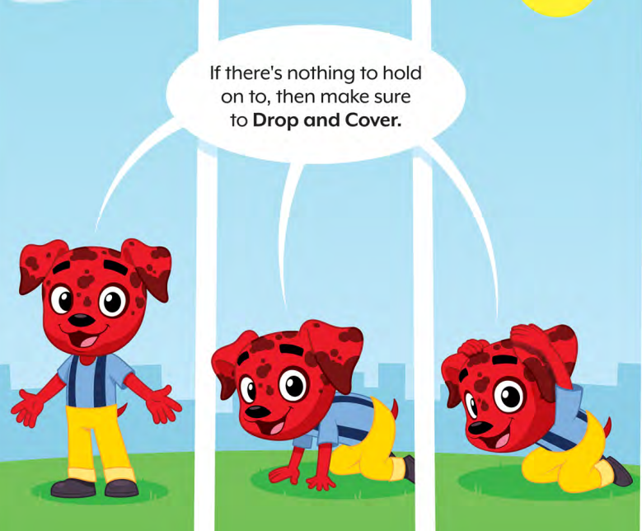
What if you’re outside when you get an alert or feel shaking?
CREDIT: Rocket’s Earthquake Safety Adventure Story Book
Notes:
Teacher Notes: Students may wonder what to do if they’re outside when they feel shaking or get an alert. Tell them to find a clear spot away from buildings, trees, streetlights, and power lines, then Drop, Cover, and Hold On. Stay there until the shaking stops.
IMAGE: https://rocketrules.org/wp-content/uploads/2020/09/Earthquake_Story_Full_optimized.pdf

Slide 31


Keeping Our Community Safe
How does practicing staying safe in an earthquake help to keep you safe?
How does it help your community stay safe?
CREDIT: Ready.gov
Notes:
Teacher Notes: Ask students to turn and talk to a student nearby, and then share out with the entire class. Reflect with students on how taking protective actions during an earthquake will help us protect ourselves as well as our community. Students may note that they now know how to stay safe if there is ground shaking or an alert, and that they can tell others in their communities how to stay safe as well.
IMAGE / RESOURCE: https://www.ready.gov/kids/curriculum
RESOURCE: Red Cross Building Resilience in Children

Slide 32
How do you feel? Turn and talk!
CREDIT: Nebraska Department of Education
Notes:
Teacher Notes: Ask students, “now that you've learned how to protect yourself if we have an earthquake, how do you feel? Are your feelings different than yesterday when we began? Turn and Talk.
IMAGE: https://www.education.ne.gov/wp-content/uploads/2021/12/6185-21-STQ-Emotions-Blog-Images.jpg

Slide 33
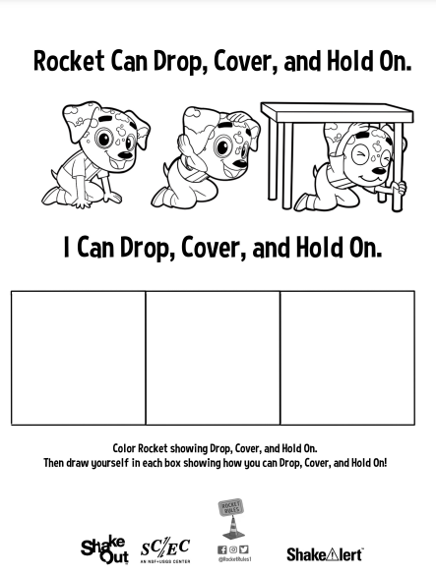
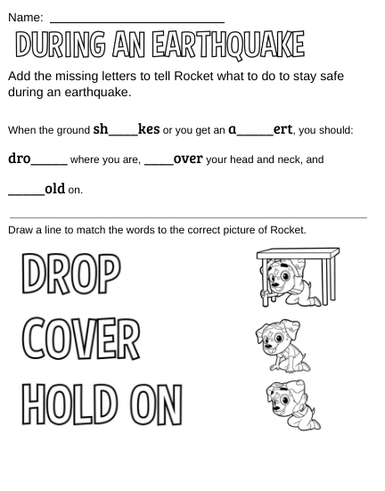
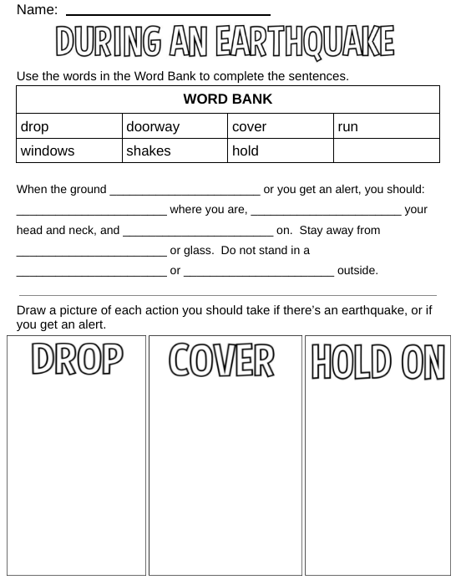
Review
Notes:
Teacher Notes: Provide students with the student sheet to give them the chance to review the correct protective actions if there is ground shaking or if they get an EEW alert.

Slide 34
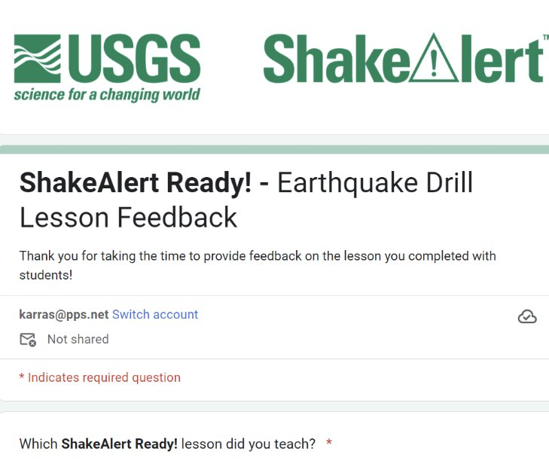
Teachers, share your feedback, please!
Please complete the short and anonymous feedback form and help us to improve our ShakeAlert Ready lessons.
11/2024
Notes:
LINK: https://docs.google.com/forms/d/e/1FAIpQLSeNHAr45fDTztflhJJD3_JVS8p0RiV1MW9sKyQgFucGJyKcCA/viewform?usp=sf_link

Slide 35
Content Standards: Kindergarten
ELA | CA, OR, WA | Common Core CCSS.ELA-Literacy.SL.K.1 | Participate in collaborative conversations with diverse partners about kindergarten topics and texts with peers and adults in small and larger groups.
 |  | Common Core CCSS.ELA-LITERACY.SL.K.3 | Ask and answer questions in order to seek help, get information, or clarify something that is not understood.
ELP | OR |  | An ELL can construct meaning from oral presentations and literary and informational text through grade-appropriate listening, reading, and viewing.
 | WA | ELD-SI.K-3.Narrate | Share ideas about one’s own and others’ lived experiences and previous learning Connect stories with images and representations to add meaning | Ask questions about what others have shared Recount and restate ideas
 |  | ELD-SI.K-3.Inform | Describe characteristics, patterns, or behavior Summarize information from interaction with others and from learning experiences | Sort, clarify, and summarize ideas Describe parts and wholes
 | CA | Bridging Proficiency Levels | Exchanging information and ideas: Contribute to class, group, and partner discussions, including sustained dialogue by listening attentively, following turn-taking rules, asking relevant questions, affirming others, adding pertinent information, building on responses, and providing useful feedback. 3. Offering opinions: Offer opinions and negotiate with others in conversations using a variety of learned phrases (e.g., That’s a good idea, but X), as well as open responses in order to gain and/or hold the floor, provide counterarguments, elaborate on an idea, and the like. | 5. Listening actively: Demonstrate active listening to read-alouds and oral presentations by asking and answering detailed questions, with minimal prompting and light support.
11/2024

Slide 36
Content Standards: 1st Grade
ELA | CA, OR, WA | Common Core CCSS.ELA-Literacy.SL.1.1 | Participate in collaborative conversations with diverse partners about grade 1 topics and texts with peers and adults in small and larger groups.
 |  | Common Core CCSS.ELA-LITERACY.SL.1.3 | Ask and answer questions about what a speaker says in order to gather additional information or clarify something that is not understood.
Health | OR | 1.SFA.2 | List the steps to identify and respond to emergency situations.
 | WA | H1.Sa1.1a | Identify safety hazards in the school.
 | CA | 1.2.S | Identify emergency situations.
 |  | 7.1.S | Practice ways to stay safe at home, at school, and in the community.
 |  | 7.2.S | Practice emergency, fire, and safety plans at home and at school.
 |  | 1.9.P | Identify emergency situations (e.g., injuries, abductions, fires, floods, earthquakes)
 |  | 4.2.P | Demonstrate effective communication skills in an emergency situation.
 |  | 7.4.P | Demonstrate appropriate behaviors during fire drills, earthquake drills, and other disaster drills.
ELP | OR |  | An ELL can construct meaning from oral presentations and literary and informational text through grade-appropriate listening, reading, and viewing.
 | WA | ELD-SI.K-3.Narrate | Share ideas about one’s own and others’ lived experiences and previous learning Connect stories with images and representations to add meaning | Ask questions about what others have shared Recount and restate ideas
 |  | ELD-SI.K-3.Inform | Describe characteristics, patterns, or behavior Summarize information from interaction with others and from learning experiences | Sort, clarify, and summarize ideas Describe parts and wholes
 | CA | Bridging Proficiency Levels | 1. Exchanging information and ideas: Contribute to class, group, and partner discussions by listening attentively, following turn-taking rules, and asking and answering questions 3. Offering opinions: Offer opinions and negotiate with others in conversations using an expanded set of learned phrases (e.g., I think/don’t think X. I agree with X), and open responses in order to gain and/or hold the for, elaborate on an idea, provide different opinions, and so on. | 5. Listening actively: Demonstrate active listening to read-alouds and oral presentations by asking and answering detailed questions, with minimal prompting and light support
11/2024

Slide 37
Content Standards: 2nd Grade
Science | CA, OR, WA | NGSS 2-ESS1-1 | Use information from several sources to provide evidence that Earth events can happen quickly or slowly.
ELA | CA, OR, WA | Common Core CCSS.ELA-Literacy.SL.2.1 | Participate in collaborative conversations with diverse partners about grade 2 topics and texts with peers and adults in small and larger groups.
 |  | Common Core CCSS.ELA-LITERACY.SL.2.3 | Ask and answer questions about what a speaker says in order to clarify comprehension, gather additional information, or deepen understanding of a topic or issue.
Health | WA | H1.Sa1.2c | Describe emergency, fire, and safety plans at home and at school.
 |  | H1.Sa2.2a | Recognize local emergency alert systems.
ELP | OR |  | An ELL can construct meaning from oral presentations and literary and informational text through grade-appropriate listening, reading, and viewing.
 | WA | ELD-SI.K-3.Narrate | Share ideas about one’s own and others’ lived experiences and previous learning Connect stories with images and representations to add meaning | Ask questions about what others have shared Recount and restate ideas
 |  | ELD-SI.K-3.Inform | Describe characteristics, patterns, or behavior Summarize information from interaction with others and from learning experiences | Sort, clarify, and summarize ideas Describe parts and wholes
 | CA | Bridging Proficiency Levels | Exchanging information and ideas: Contribute to class, group, and partner discussions, including sustained dialogue by listening attentively, following turn-taking rules, asking relevant questions, affirming others, adding pertinent information, building on responses, and providing useful feedback. 3. Offering opinions: Offer opinions and negotiate with others in conversations using a variety of learned phrases (e.g., That’s a good idea, but X), as well as open responses in order to gain and/or hold the floor, provide counterarguments, elaborate on an idea, and the like. | 5. Listening actively: Demonstrate active listening to read-alouds and oral presentations by asking and answering detailed questions, with minimal prompting and light support.
11/2024

Slide 38
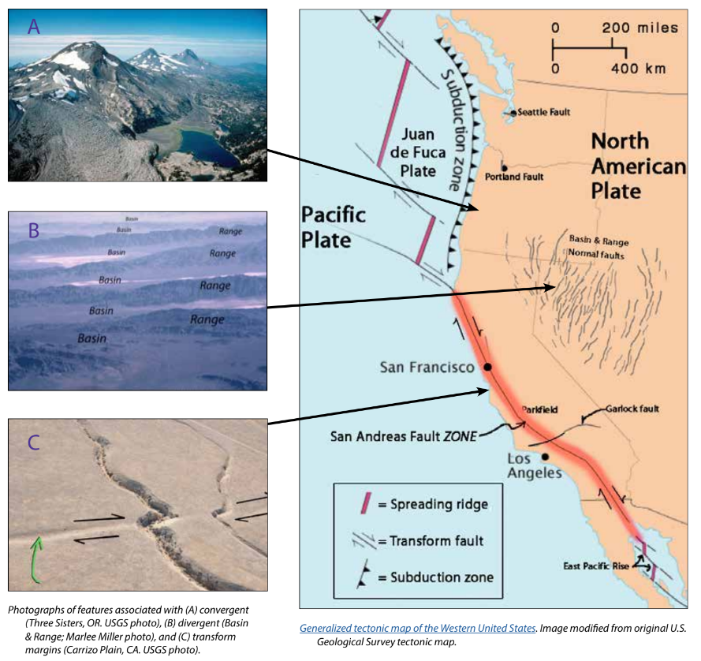
Background - Earthquake Hazard
California, Oregon, and Washington all face hazards from earthquakes because of the underlying tectonic plates, which constantly grind against each other. This friction creates "faults," lines of weakness in the Earth's tectonic plates (lithosphere) where earthquakes are most likely to occur.
California's San Andreas Fault is one example. Another example is the Cascadia Subduction Zone, which threatens all three states and British Columbia, Canada. This giant fault lies offshore, where the Juan de Fuca Plate dives beneath the North American Plate. This type of motion on other subduction zones can cause massive earthquakes, like the one that struck Japan in 2011.
While smaller earthquakes happen often, scientists think a major earthquake could happen any time, so it's important to be prepared.
For more information: Faults, Plate Tectonics & Earthquake Hazards - Animations / Videos
11/2024
Notes:
IMAGE: https://www.iris.edu/hq/inclass/activities/introduction_to_faults_and_plate_tectonics
SOURCE: https://www.usgs.gov/programs/earthquake-hazards/science/pacific-northwest-hazards
https://www.usgs.gov/programs/earthquake-hazards/science/southern-california-earthquake-hazards

Slide 39
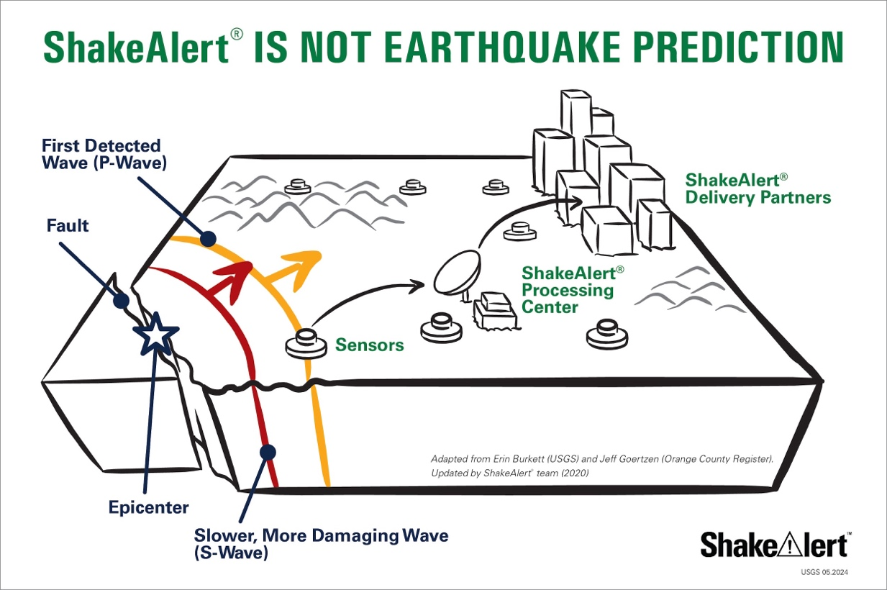
Background - How ShakeAlertⓇ Earthquake Early Warning System Works
During an earthquake, a rupturing fault sends out different types of waves. The fast-moving P-wave is first to arrive, followed by the slower S-wave and later-arriving surface waves.
Sensors detect the P-wave and immediately transmit data to a ShakeAlert processing center where the location, size, and estimated shaking of the quake are determined. If the earthquake fits the right profile a ShakeAlert Message is issued by the USGS.
A ShakeAlert Message is then picked up by delivery partners (such as a transportation agency) that could be used to produce an alert to notify people to take a protective action such as Drop, Cover, and Hold On and/or trigger an automated action such as slowing a train.
11/2024
Notes:
https://drive.google.com/drive/folders/1oQOHup9P_p3DUkyIOi9DwqAlLgzdY45A?usp=drive_link
For more information on Earthquake Early Warning, go to: https://www.iris.edu/hq/inclass/sequences/earthquake_early_warning

Slide 40
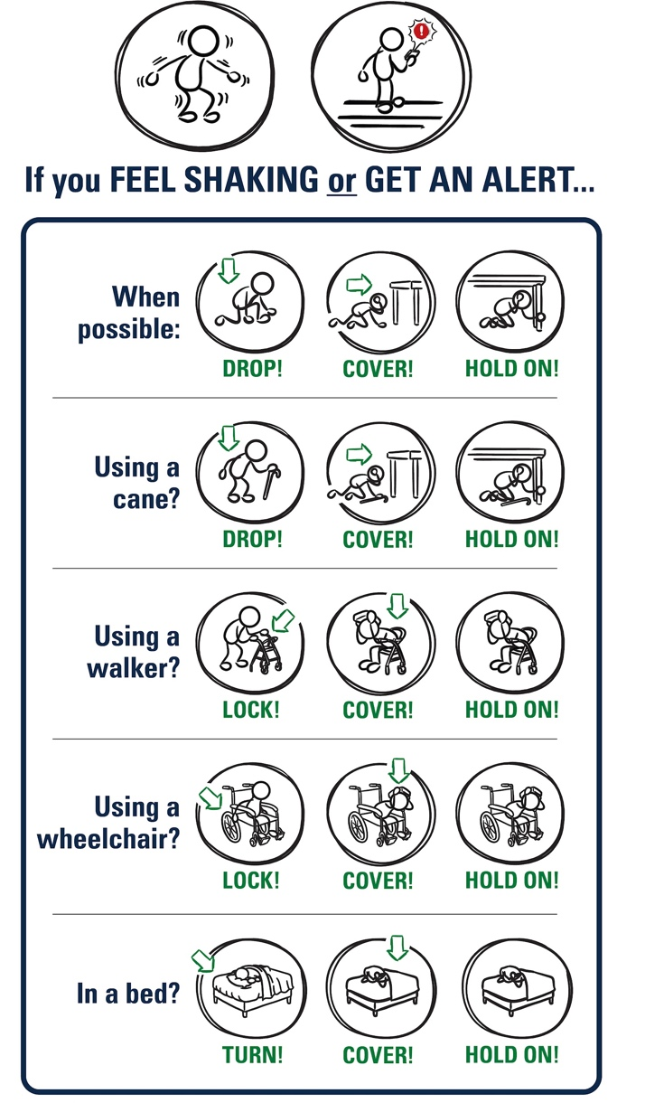
Background - Effective Protective Actions
Most earthquake-related injuries and deaths are caused by collapsing walls and roofs, flying glass and falling objects.
If you are inside a building, move no more than a few steps, then Drop, Cover, and Hold On.
If you are outdoors when the shaking starts, you should find a clear spot away from buildings, trees, streetlights, and power lines, then Drop, Cover, and Hold On. Stay there until the shaking stops.
For protective actions in various settings (descriptions and gifs), go to https://www.earthquakecountry.org/step5/
11/2024
Notes:
SOURCE: https://www.shakeout.org/whyparticipate/
IMAGE: https://drive.google.com/file/d/1KaHNTj7_C1NvRDFZE3jWW-6g2K4I_Q4h/view

Slide 41
Rationale
Why do we practice earthquake drills?
To react quickly you must practice often. You may only have seconds to protect yourself in an earthquake, before strong shaking knocks you down--or drops something on you.
Social science research has long shown that people who practice actions are more likely to take those actions when a safety- threatening event occurs, such as an earthquake or fire. Tests, drills, and exercises that repeat concepts build “muscle memory” of procedural knowledge and timely reaction. The more frequently a person practices a procedure or self-protective action, such as Drop, Cover, and Hold On, the more likely they will employ it— almost without thinking—when they receive an alert or feel shaking.
Why share the Family Engagement Letter?
While schools practice earthquake drills regularly, most other locations don’t. Some students’ family members may not have practiced earthquake drills since they were in school.
Family members may have outdated information about how to stay safe in an earthquake, such as the incorrect belief that standing in doorways or “the triangle of life” will keep one safe in an earthquake. Students will be able to share correct protective actions (Drop, Cover, and Hold On) with their family and community members.
Students spend more time at home than at school. Therefore, educating families will help keep students and our community safe. Additionally, families are more likely to understand their family and community members’ needs. This communication can prompt families to ensure they’re prepared to protect all members of their families in case of an earthquake.
Because earthquakes are infrequent in Oregon and Washington, people may be unaware of the risk of an earthquake.
The Family Engagement Letter has links for family members to learn more about earthquakes and protective actions.
11/2024
Notes:
SOURCE: https://www.shakeout.org/whyparticipate/ , https://www.shakealert.org/toolkit/introduction/

Slide 42
Additional Resources
Sources
ShakeAlert® Earthquake Early Warning System Education and Training Materials
Rocket Rules Activity and Coloring Book for Earthquake Science!
Rocket LIVE! Interactive Lesson (FORM for Earthquake Safety Lesson)
Earthquake Country Alliance and Shake Out Documents in Many Languages
Great Shake Out lessons
Rocket’s Earthquake Safety Activity Book
Rocket’s Earthquake Safety Adventure
11/2024

