Slide 1
ShakeAlert® Earthquake Early Warning
Earthquake Drill Lesson
GREEN SLIDES = Teacher Preparation & Information
WHITE SLIDES = Present to Class
3rd – 5th Grade
Lesson length: 1 hour
11/2024

Slide 2
Links for Printing
Preparation
STUDENT SHEET
3rd Grade Student Sheet (ANSWER KEY)
4th - 5th Grade Student Sheet (ANSWER KEY)
FAMILY ENGAGEMENT LETTER
Family Engagement Letter (English & Spanish)
Open and edit your state’s Family Engagement Letter.
  Add your school name at the bottom.
  If you’re emailing the letter, you can remove the QR code.
Make copies of Family Engagement Letter and/or email to families.
Preview Slides. You can print out the Teaching Steps slides. The teaching steps are also located in the Speaker Notes of each slide.
Open and preview Student Sheet. Adjust as needed for your learners, and then photocopy one sheet per student.
OPTIONAL RECOMMENDED PREPARATION:
  Get a giant SlinkyⓇ to model seismic waves.
  Get a smaller Slinky, or about 3 feet of rope, yarn, string, or even a charging cable for each group of 3-6 students.
  Attach three small flags of masking tape at equidistant intervals along the Slinky or rope to help students see how waves transfer energy.
11/2024
2

Slide 3
Sensitive Content Warning!
Some students or their family members may have experienced earthquakes, resulting in loss, injuries, and possible trauma. It is therefore important to approach these lessons with sensitivity and awareness. When students share information about their experiences with earthquakes in the first part of the lesson, make sure to scan the class and be aware of any heightened responses. Affirm students’ normal emotional responses. If students are too emotionally heightened, it may be prudent to allow them to forego the drill.
Even students who have never experienced an earthquake may have a strong emotional response to talking about earthquakes. Explain to students that practicing earthquake drills helps our community to stay safe in an earthquake, but that it’s normal to feel big feelings about earthquakes.
The purpose of drills is to build muscle memory so that in a heightened emotional state students are still able to take appropriate protective action. Therefore, it is important to take drills seriously. To the extent you can, please insist on students remaining quiet and following instructions.
11/2024
3

Slide 4
Teaching Steps - page 1
SLIDE 13 - Tell students that today they are taking part in an earthquake drill and will practice how to protect themselves during an earthquake. If you are teaching this lesson as part of the Great ShakeOut, tell students that millions of people in countries around the world take part in the Great ShakeOut on the 3rd Thursday of October every year.
SLIDE 14 - Ask students what other drills they’ve practiced at school. Students have probably practiced earthquake drills, shelter in place drills, and lockdowns among others. Ask students why we practice drills at school. They should respond that we conduct drills to practice how to respond so that if there’s ever a fire or earthquake, we’re prepared and know how to stay safe. We also practice drills so that we can help students feel safer and less afraid at school. Having fire and earthquake drills can help us to feel prepared and less scared! Tell students that our school has an earthquake early warning system that can give our school community members seconds of extra time to protect ourselves before damaging shaking arrives during an earthquake.
SLIDE 15 - Sometimes drills can be scary because we don't know what to do or what is happening around us. During these lessons you will practice the drill many times. After practicing, you should feel more confident and hopefully less scared or nervous. When thinking about earthquake drills, how do you feel right now? Turn to a student sitting next to you and talk about where you’re at.
11/2024
4

Slide 5
Teaching Steps - page 2
SLIDE 16 - Tell students that before we start our earthquake drill, we’ll see what they already know about earthquakes. Tell them you’ll read a statement, and give them 15 seconds to discuss with their elbow partner. Set a timer if you’d like. When the timer goes off, they will put their thumbs up if they think the statement is true, and their thumbs down if they think the statement is false. Once students have responded, go to the next slide to reveal the answer. Read, “An earthquake will happen somewhere today.” Hit down or enter to start the timer.
SLIDE 17 - Audio will automatically play on the slide. AUDIO SCRIPT: TRUE. Earthquakes are happening all over the world, and all the time. There’s likely one happening right now somewhere. Most of them might be too small for us to feel, but specialized machines are always recording seismic waves under the Earth’s surface.
SLIDE 18 - Read, “Scientists can predict when an earthquake will happen,” and start the 15 second timer for student discussion. When the timer goes off, students should put their thumbs up if they think the statement is true, and their thumbs down if they think the statement is false. Once students have responded, go to the next slide to reveal the answer.
SLIDE 19 - Audio will automatically play on the slide. AUDIO SCRIPT: FALSE. Scientists cannot predict exactly when an earthquake will happen. However, recent technology can send out alerts to people once the earthquake starts that may arrive to certain people before strong shaking happens in their area. Your school has the ShakeAlertⓇ Earthquake Early Warning system installed.
11/2024
5

Slide 6
Teaching Steps - page 3
SLIDE 20 - Read, “During an earthquake, you should run outside,” and start the 15 second timer for student discussion. When the timer goes off, students should put their thumbs up if they think the statement is true, and their thumbs down if they think the statement is false. Once students have responded, go to the next slide to reveal the answer.
SLIDE 21 - Audio will automatically play on the slide. AUDIO SCRIPT: FALSE. The most common causes of injury in earthquakes include people falling down and/or getting hit by falling debris. In the US, where buildings meet basic building standards, staying inside the building (preferably under a table) is actually safer than trying to exit. If no table is available, simply crouch on the floor and cover your head and neck with your hands.
SLIDE 22 - Ask students what they have seen or heard about earthquakes. It’s likely that many of them have not experienced an earthquake. They may have heard from family members about shaking, objects breaking, or even possibly injuries. It’s possible they’ve seen or heard about earthquakes through the media. Validate students’ experiences, and scan for students that may need some extra support. Tell students that we’ll learn more about what an earthquake is in this lesson. Consider recording students’ questions so that you can return to them at them end of the lesson to see which have been addressed through the lesson, and try to answer the others.
11/2024
6

Slide 7
Teaching Steps - page 4
SLIDE 23 - Explain to students that the Earth’s surface is broken into many pieces that move around. Most of the time we don’t feel the movement, but sometimes we do. As the pieces of the Earth move, they can become stuck because of friction similar to how if you slide your tennis shoe across a floor, it can get stuck. An earthquake occurs when the moving pieces of Earth overcome friction and move suddenly. You can demonstrate this by snapping your fingers. Your thumb and finger model the pieces of Earth. At first when you press them together, they’re stuck because of friction. This models the friction between the pieces of Earth. When your finger snaps into the base of your thumb, that’s the earthquake.
SLIDE 24 - Tell students that earthquakes release waves of energy, which we will learn more about next. Ask students to turn and talk with their elbow partner about what they think a wave is, and what kinds of waves they’ve heard of.
  Students may say that a wave is moving water. They may mention ocean waves, sound waves, heat waves, or a flag or person’s hand waving.
SLIDE 25- Tell students that waves of energy are released during an earthquake, which we call seismic waves. There are different kinds of seismic waves. Students should observe that the p-wave arrives first and moves the house up and down, the s-wave is second and moves the house side to side, and the surface wave arrives last, and moves the house in an undulating motion. The waves are similar because they all move the house. They are different in the time it takes for them to arrive at the house, whether they move through the earth or across its surface, and in how they move the house. Point out to students that seismic waves transfer energy and not matter. The house moved because energy was transferred from the earthquake to the house, not because matter was transferred from the earthquake to the house.
11/2024
7

Slide 8
Teaching Steps - page 5
SLIDE 26 - Tell students that we can model seismic waves using a SlinkyⓇ. A giant Slinky works best for this. If you have one, have two students hold either end and stretch it out between them on the floor. If you don’t have a Slinky, just show and discuss the animations on the following two slides. Model a p-wave with the Slinky by having the student on one end of the Slinky push it toward the other student. Instruct other students to observe. Repeat this step a few times as students share their observations.
SLIDE 27 - Model an s-wave with the Slinky by having the student on one end of the Slinky move it back and forth. Instruct other students to observe. Repeat this step a few times as students share their observations.
SLIDE 28 - This slide is optional for teachers who are providing small groups of students with a rope or Slinky to experiment with. This slide contains a video with images to demonstrate how to experiment safely with the rope of Slinky. If you are providing students with a Slinky, rope, yarn, etc. to model waves, go over the safety guidelines, and give them time to discover ways to send energy through the material. Consider setting a 4 minute timer for students to experiment, and ask students to be ready to share their observations with the class once time’s up!
SUGGESTED SAFETY GUIDELINES:
Someone needs to hold the rope on each side at all times.
Stay seated on your bottom or knees the entire time.
The rope or Slinky shouldn’t go higher than stomach-height.
11/2024
8

Slide 9
Teaching Steps - page 6
SLIDE 29 - This slide is optional. If you are modeling waves using a SlinkyⓇ or section of rope, use this slide to guide your demonstration. To start, explain to students that amplitude is one way we can describe the energy in a wave. Point out that amplitude is the distance from the midpoint of the wave to the furthest point from the midpoint, called the crest or trough. Model a wave with a higher amplitude with the Slinky or rope. Then model a wave with a lower amplitude. Ask students to observe the differences in how the tape moves with a high vs a lower amplitude wave. They should notice that the higher the amplitude, the more the tape moves. Ask students to notice what happens to the amplitude of the wave as it travels down the Slinky or rope. They should notice that the amplitude decreases as the wave travels, as they observe the tape closest to the source of the wave moving more, and the tape furthest from the source of the wave moving less. They may also note that the amplitude changes direction back and forth across the midpoint as it travels. Point out to students again that seismic waves transfer energy, not matter. If you’re using a section of rope to model waves, point out that while the tape moves back and forth, it doesn’t actually move down the rope.
SLIDE 30 - Watch the video of seismic waves traveling through the Earth again. Ask students what they observe about how the distance between waves changes as they travel away from where the earthquake started. They should notice that when the earthquake starts, the waves are right on top of each other. As the waves travel through the earth, the distance between them grows.
SLIDE 31 - Point out the p-wave and s-wave in the diagram as the words appear. Remind students that seismic waves can affect people long distances from where they begin. Tell students that the p-waves move the fastest, but are less damaging, whereas s-waves are slower but are more damaging. Tell students that as soon as the first wave is detected, alerts are sent to areas that may experience damaging shaking. Therefore, as soon as you get an alert, you should Drop, Cover, and Hold On.
11/2024
9

Slide 10
Teaching Steps - page 7
SLIDE 32 - Ask students to discuss whether they think there could be an earthquake where they live. Students in California will probably know that there are earthquakes nearby, but students in Oregon and Washington may not be aware that there is a risk of earthquakes.
SLIDES 33 - 35 are optional, and are skipped in the slidedeck. To unskip them, right click and click on “Unskip.”
  SLIDE 33 - Tell students that this map shows the chance of experiencing a damaging earthquake in the next 100 years. Point out that the red areas have a greater than 95% chance of experiencing a damaging earthquake in the next 100 years, whereas the blue areas have a less than 5% chance. Ask a student to come up and point to the area where you live on the map. Work with students to determine the earthquake risk where you live using the key.
  SLIDE 34 - This map also shows population density. Tell students that the black areas have lots of people living closer together, and light purple areas have a moderate amount of people living closer together. Again ask a student to come up and point to the area where you live on the map.
  SLIDE 35 - Ask students what patterns they see in this map. What does this map show us about the area we live? Students should notice that California has the highest chance of experiencing a damaging earthquake in the next 100 years, with many areas having a >95% chance. Areas in Oregon and Washington near the Pacific Ocean have a 50-95% chance of experiencing a damaging earthquake in the next 100 years.
SLIDE 36 - Review and model correct protective actions - Drop, Cover, and Hold On. Make sure students know they should drop to their knees (not their bottoms), have one hand over their necks, and try to get away from glass or any other objects that could fall on them. If they’re able to get under a table or desk while staying on their knees, they should. Once there, they should hold on to the leg of the table.
11/2024
10

Slide 11
Teaching Steps - page 8
SLIDE 37 - Tell students that Drop, Cover, and Hold On looks different for different bodies. Review modified protective actions for people who use wheelchairs. While you may not have students who use wheelchairs in your class, it is likely that there are members of your community who do. Ask students to help their family members or friends who use a wheelchair by sharing that “Lock, Cover, and Hold On” is how they can protect themselves during an earthquake. Have students repeat the phrase, “Lock, Cover, and Hold On” after you’ve said it.
SLIDE 38 - Review protective actions for people who use a cane or walker.
SLIDE 39 - This slide is animated and the ‘Cover’ and ‘Hold On’ appear individually when you click enter or down so you can discuss why each protective action is important in turn. Begin by asking students why each protective action is important. Add on to student responses as necessary.
DROP: Dropping to your knees protects you from falling during ground shaking.
COVER: We cover our neck and head to protect them from becoming injured if something falls.
HOLD ON: We hold on to a table leg once we’re beneath a table so that the earthquake doesn’t move us out from underneath the table that is protecting us.
SLIDE 40 - Tell students that they should take protective actions when the ground shakes, if there’s an earthquake alert, or if they’re doing an earthquake drill, which we’ll do now. Tell students that it’s vital they Drop, Cover, and Hold On immediately and without hesitation. They can be a leader in their community by immediately taking protective actions!
11/2024
11

Slide 12
Teaching Steps - page 9
SLIDE 41 - Play the ShakeAlertⓇ message. Have all students Drop, Cover, and Hold On. Ask students to stay in their protective positions while the teacher observes and offers corrections if necessary. Once the teacher has checked in with each student, ask them to return to their seats. NOTE: Your EEW alert may sound and look different than the one pictured on the slide!
SLIDE 42 - Reflect on your earthquake drill by asking students how they did, and if they have questions. After reflecting, remind students of the key lesson takeaways. 1) To stay safe if you get an alert or feel shaking, immediately drop to your knees, move away from glass or heavy objects that could fall, and cover your head and neck. 2) Seismic waves travel at different speeds, with less damaging p-waves travelling faster than more damaging s-waves.
SLIDE 43 - Tell students that most of the adults they know have probably not taken part in an earthquake drill since they were students, and may have incorrect ideas about how to protect themselves in an earthquake. They can help their family and community members by teaching them about Drop, Cover, and Hold On, and informing them about ways to prepare, such as signing up for ShakeAlert and preparing an emergency kit and plan. Ask them to share the Family Engagement Letter with their families tonight.
SLIDE 44: If you’re providing students with the student sheet to review their learning, do so now. There is a 3rd grade student sheet, and a 4th-5th grade student sheet.
SLIDE 45: Ask students, “Now that you've learned about how and why earthquakes occur, as well as how you can protect yourself and others, have your feelings changed?" Turn and talk: Yes or No and why?
SLIDE 46 - NEXT DAY: Ask students how their conversations with their families went. Did their family members know that Drop, Cover, and Hold On are the correct protective actions? Did they talk about an emergency plan?
SLIDE 47: OPTIONAL - Please complete the ShakeAlert Ready! Earthquake Drill Lesson Feedback Form.
11/2024
12

Slide 13

Learning Targets
I can Drop, Cover, and Hold On if there’s shaking or I get an alert.
I can use a model to describe how waves of energy from an earthquake affect objects at various distances from where the earthquake starts.
CREDIT: Great ShakeOut
13
Notes:
Teacher Notes: Tell students that today they are taking part in an earthquake drill and will practice how to protect themselves during an earthquake. If you are teaching this lesson as part of the Great ShakeOut, tell students that millions of people in countries around the world take part in the Great ShakeOut on the 3rd Thursday of October every ye
IMAGES: https://www.shakeout.org/resources/nodate/index.html

Slide 14


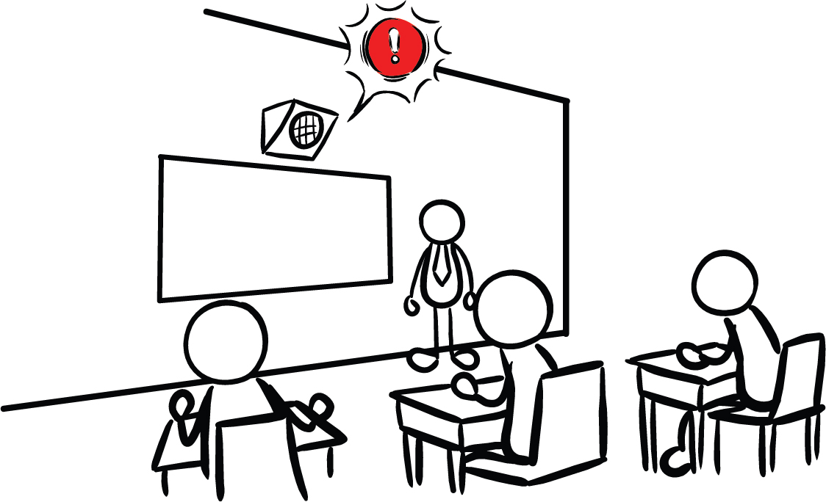
What other safety drills have we had at school?
Why do we have drills at school?
Our school has Earthquake Early Warning!
CREDIT: Educator Clips, Mark A. Hicks, Olympia CUSD 16, and Education_9_PA_V03.jpg
14
Notes:
Teacher Notes: This slide is animated so the questions appear one at a time. Ask students what other drills they’ve practiced at school. Students have probably practiced earthquake drills, shelter in place drills, and lockdowns among others.
Ask students why we practice drills at school. They should respond that we conduct drills to practice how to respond so that if there’s ever a fire or earthquake, we’re prepared and know how to stay safe. We also practice drills so that we can help students feel safer and less afraid at school. Having fire and earthquake drills can help us to feel prepared and less scared!
Tell students that our school has an earthquake early warning system that can give our school community members seconds of extra time to protect ourselves before damaging shaking arrives during an earthquake.
IMAGES: https://teachingiselementary.blogspot.com/2011/11/fire-drills-safety-is-free.html, https://www.olympia.org/o/oms/article/136094, https://drive.google.com/file/d/1bey_N-Kk5RGJhFgTLFIgTZLeorlPEFIm/view?usp=drive_link

Slide 15
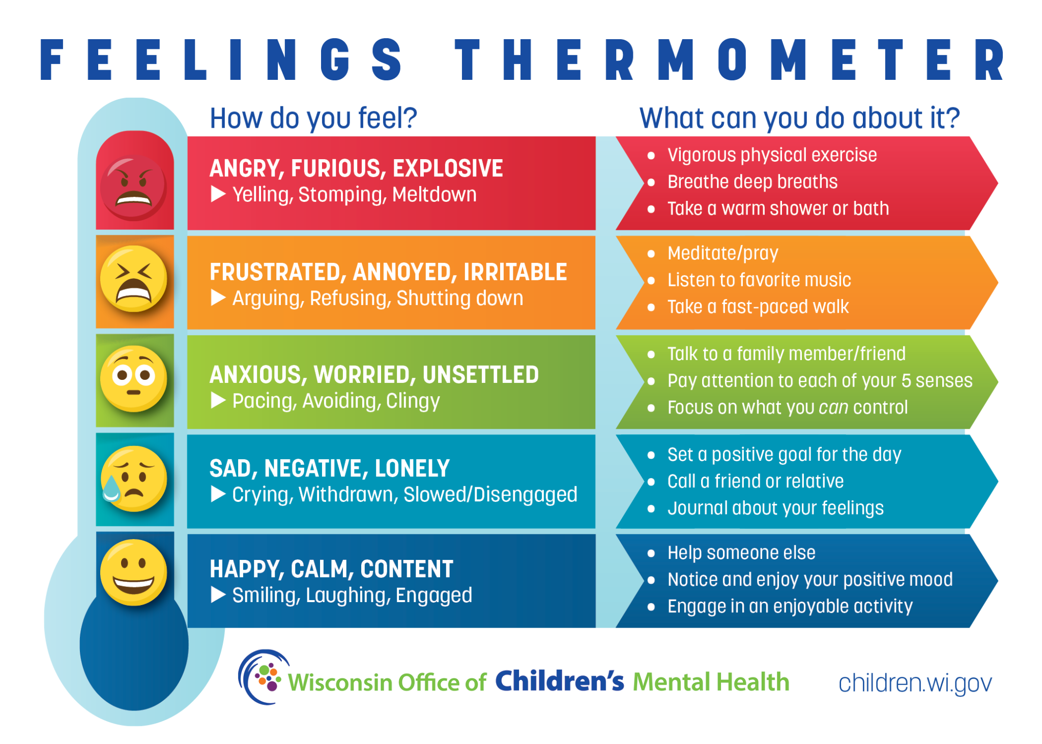
How do you feel?
Turn and talk to a partner!
CREDIT: Wisconsin Office of Children’s Mental Health
15
Notes:
Teacher Notes: Sometimes drills can be scary because we don't know what to do or what is happening around us. During these lessons you will practice the drill many times. After practicing, you should feel more confident and hopefully less scared or nervous. When thinking about earthquake drills, how do you feel right now? Turn to a student sitting next to you and talk about where you’re at.
IMAGE / RESOURCE: https://children.wi.gov/Pages/FeelingsThermometer.aspx

Slide 16


True or False?
An earthquake will happen somewhere today.
OR
16
Notes:
Teacher Notes: Tell students that before we start our earthquake drill, we’ll see what they already know about earthquakes. Tell them you’ll read a statement, and give them 15 seconds to discuss with their elbow partner. Set a timer if you’d like. When the timer goes off, they will put their thumbs up if they think the statement is true, and their thumbs down if they think the statement is false. Once students have responded, go to the next slide to reveal the answer.
CREDIT: https://omsi.edu/wp-content/uploads/2023/07/ShakeAlert-Interactive-Demos-v.-Jul-2023.pdf

Slide 17

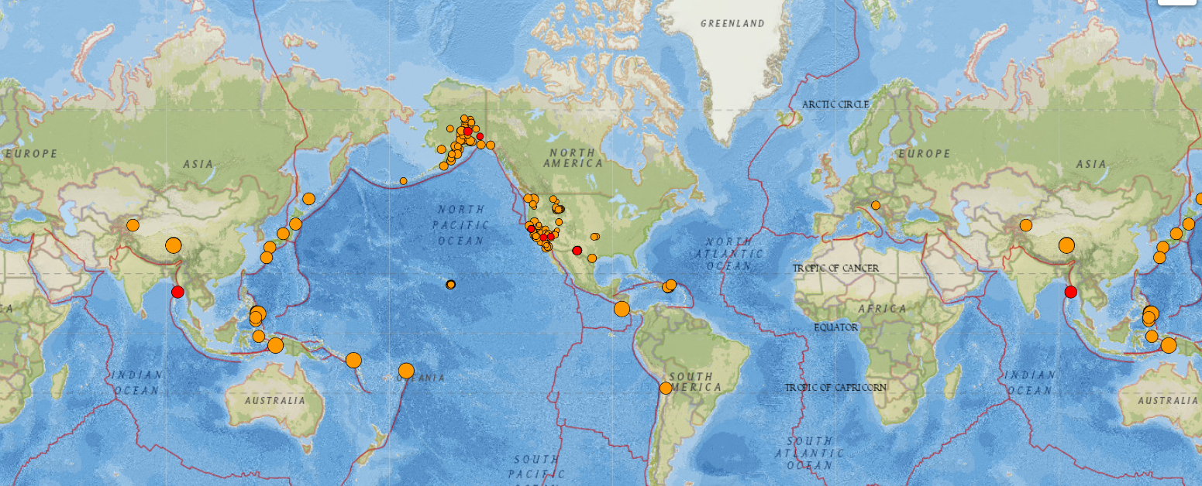
TRUE
CREDIT: USGS Latest Earthquakes
17
Notes:
Teacher Notes: Audio will automatically play on the slide. This image from USGS shows magnitude 2.5 and higher earthquakes that occurred on 3/6/24 (one day). Red dots indicate earthquakes that happened within the past hour, whereas orange dots indicate earthquakes that happened within the last week. To create a more recent map, go to: https://earthquake.usgs.gov/earthquakes/map/?extent=-65.94647,-394.80469&extent=84.30218,204.96094&list=false
AUDIO SCRIPT: TRUE. Earthquakes are happening all over the world, and all the time. There’s likely one happening right now somewhere. Most of them might be too small for us to feel, but specialized machines are always recording seismic waves under the Earth’s surface.
CREDIT: https://omsi.edu/wp-content/uploads/2023/07/ShakeAlert-Interactive-Demos-v.-Jul-2023.pdf

Slide 18
True or False?
Scientists can predict when an earthquake will happen.
OR
18
Notes:
Teacher Notes: Read the statement, and give students 15 seconds to discuss with their team whether they think the statement is true or false. When the timer goes off, they will put their thumbs up if they think the statement is true, and their thumbs down if they think the statement is false. Once students have responded, go to the next slide to reveal the answer. NOTE: The answer audio will play automatically when you move to the next slide.
CREDIT: https://omsi.edu/wp-content/uploads/2023/07/ShakeAlert-Interactive-Demos-v.-Jul-2023.pdf

Slide 19
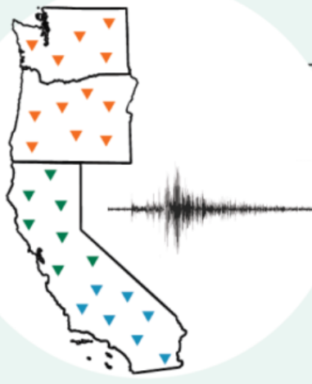
FALSE
ShakeAlertⓇ is not earthquake prediction.
Constant Monitoring
Earthquake Early Warnings
CREDIT: Who Does What in the ShakeAlert System? and : Edcation_9_PA_V03
19
Notes:
Teacher Notes: Audio will automatically play on the slide.
AUDIO SCRIPT: FALSE. Scientists cannot predict exactly when earthquakes will happen. However, recent technology constantly monitors the ground for shaking or movement, and can send out alerts to people once the earthquake starts that may arrive to certain people before strong shaking begins in their area. Because earthquakes can occur in our area, our school has the ShakeAlert earthquake early warning system installed!
IMAGE: https://drive.google.com/file/d/18WPnYQ4nZ_8fVGnnklmQhZj-2-odHxrD/view?usp=sharing https://drive.google.com/file/d/1bey_N-Kk5RGJhFgTLFIgTZLeorlPEFIm/view?usp=drive_link
CREDIT: https://omsi.edu/wp-content/uploads/2023/07/ShakeAlert-Interactive-Demos-v.-Jul-2023.pdf

Slide 20
True or False?
During an earthquake, you should run outside.
OR
20
Notes:
Teacher Notes: Tell students that you will be reading statements, and they will have to discuss with their team whether they think the statement is true or false. When the timer goes off, they will put their thumbs up if they think the statement is true, and their thumbs down if they think the statement is false. Once students have responded, go to the next slide to reveal the answer. NOTE: The answer audio will play automatically when you move to the next slide.
CREDIT: https://omsi.edu/wp-content/uploads/2023/07/ShakeAlert-Interactive-Demos-v.-Jul-2023.pdf

Slide 21
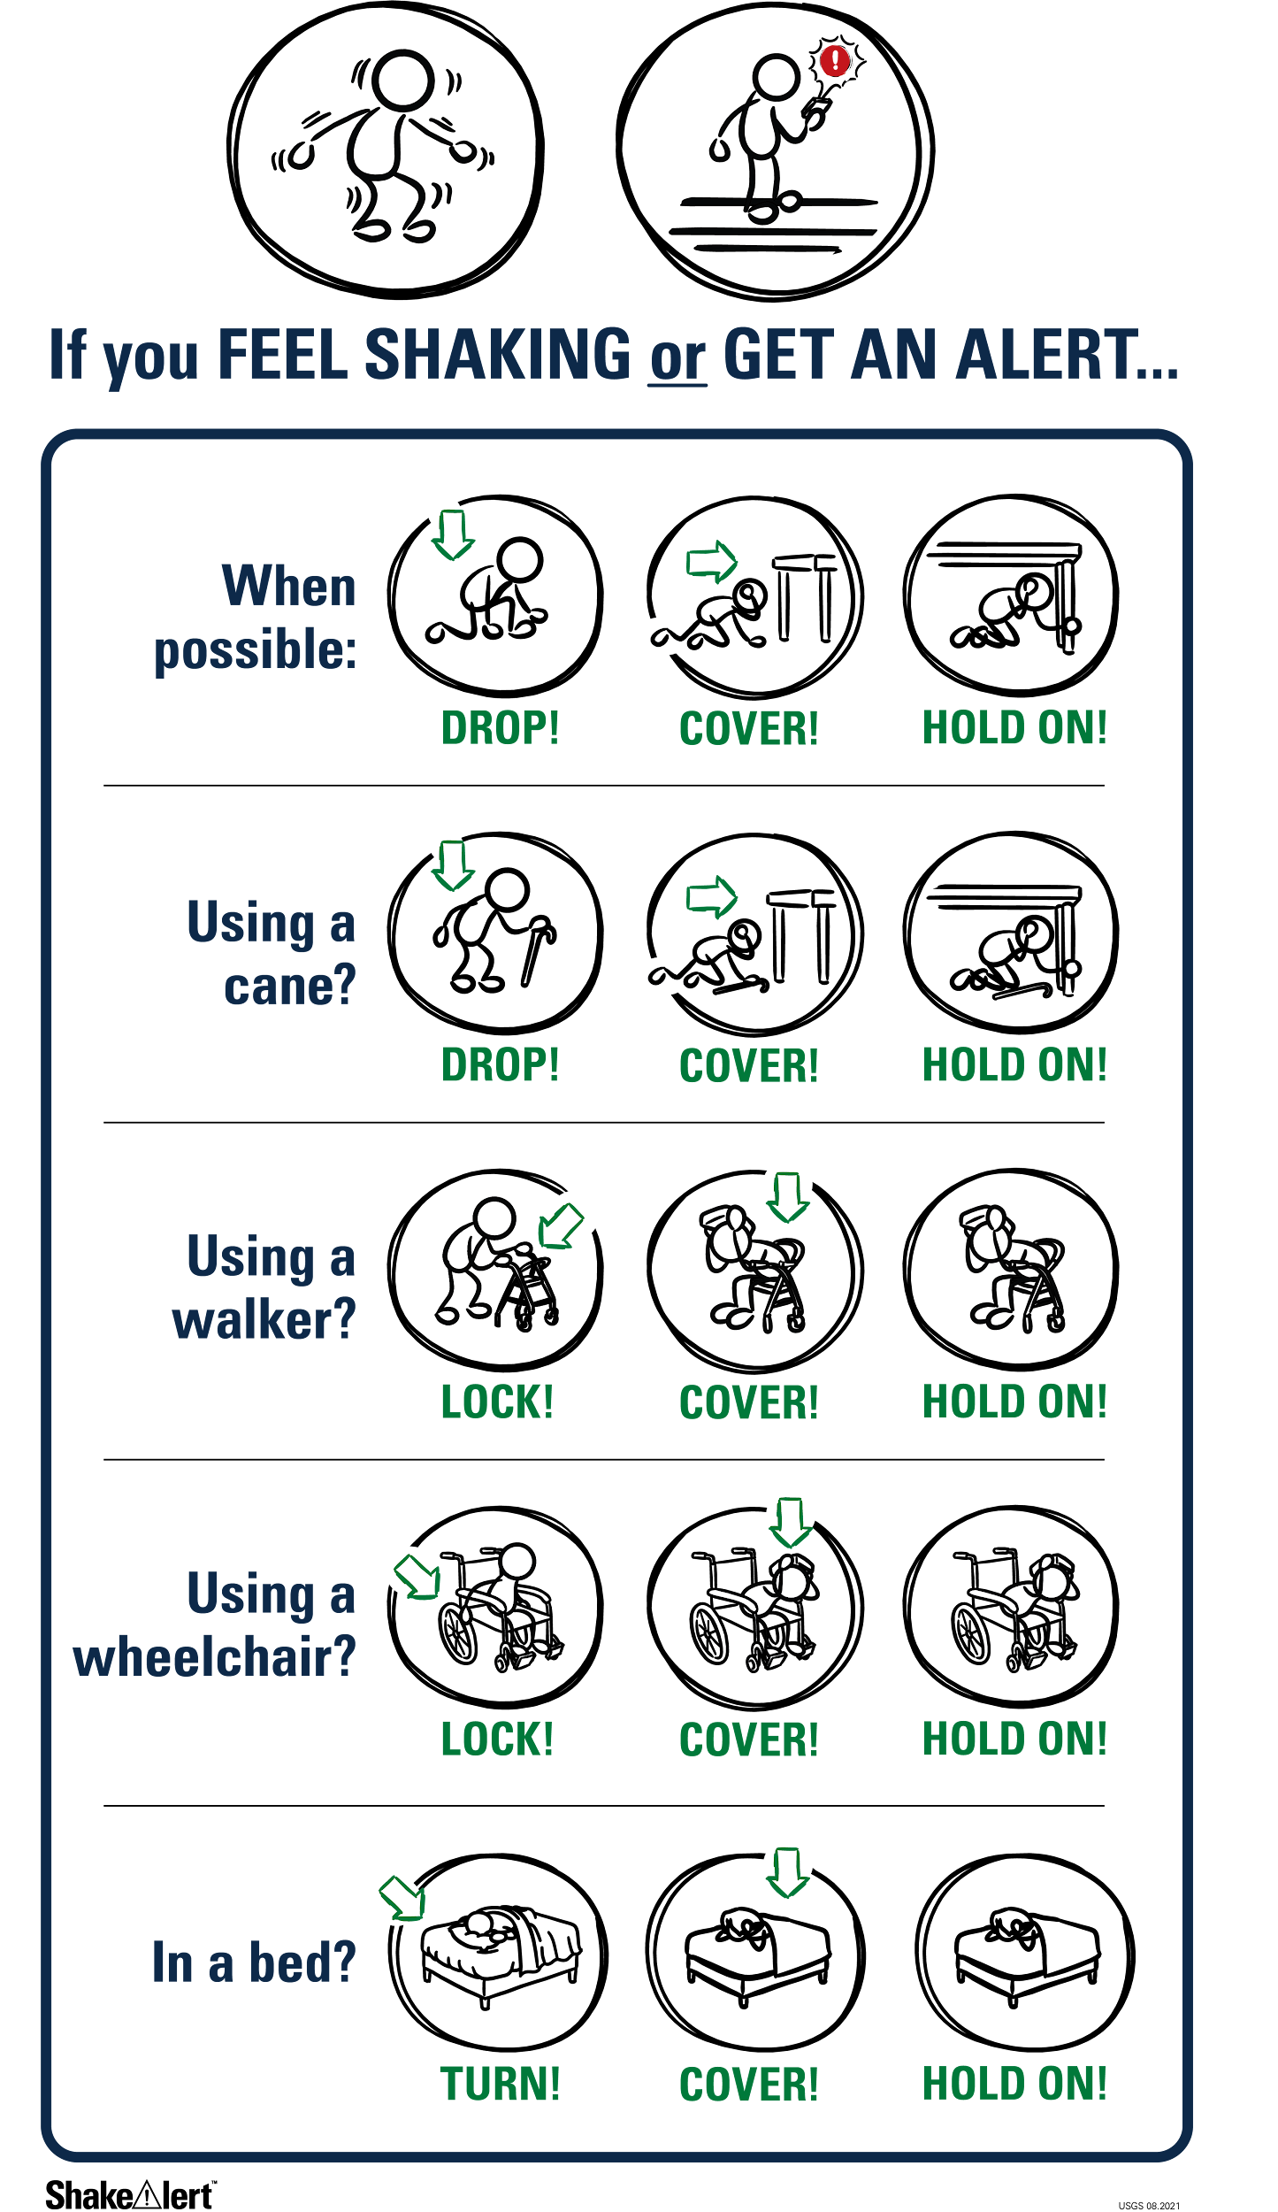
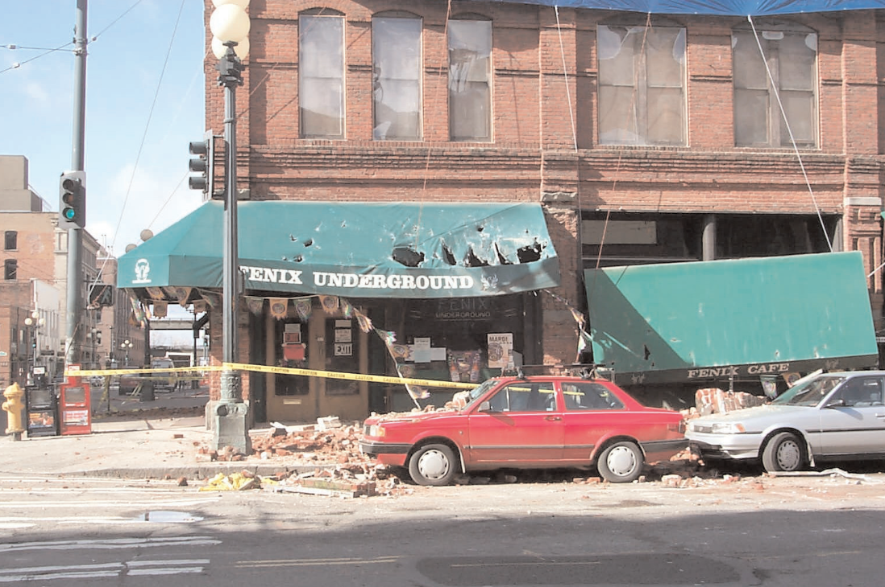
FALSE
CREDIT: ShakeAlert DCHO_Infographic and DOGAMI, The Nisqually, Washington, Earthquake of February 28, 2001
21
Notes:
Teacher Notes: Audio will automatically play on the slide.
AUDIO SCRIPT: FALSE. The most common causes of injury in earthquakes include people falling down and/or getting hit by falling debris. In the US, where buildings meet basic building standards, staying inside the building (preferably under a table) is actually safer than trying to exit. If no table is available, simply crouch on the floor and cover your head and neck with your hands.
IMAGE：https://drive.google.com/file/d/1fgu1qEMsOpWoAKCjCzmeu0ugLZ5Cy4tw/view?usp=drive_link, https://pubs.oregon.gov/dogami/ofr/O-01-02.pdf
CREDIT: https://omsi.edu/wp-content/uploads/2023/07/ShakeAlert-Interactive-Demos-v.-Jul-2023.pdf

Slide 22
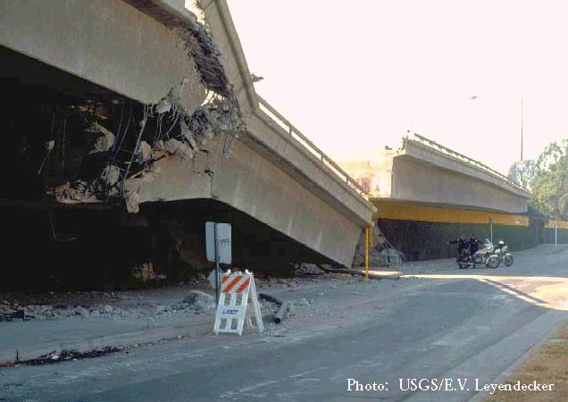
What are some things you have seen or heard about earthquakes?
What do you wonder about earthquakes?
CREDIT: USGS Response to an Urban Earthquake: Northridge ‘94
22
Notes:
Teacher Note: Ask students what they have seen or heard about earthquakes. It’s likely that many of them have not experienced an earthquake. They may have heard from family members about shaking, objects breaking, or even possibly injuries. It’s possible they’ve seen or heard about earthquakes through the media. Validate students’ experiences, and scan for students that may need some extra support. Tell students that we’ll learn more about what an earthquake is in this lesson. Consider recording students’ questions so that you can return to them at them end of the lesson to see which have been addressed through the lesson, and try to answer the others.
IMAGE: https://pubs.usgs.gov/of/1996/ofr-96-0263/p29study.jpg
This image shows a bridge that collapsed during the Northridge earthquake

Slide 23

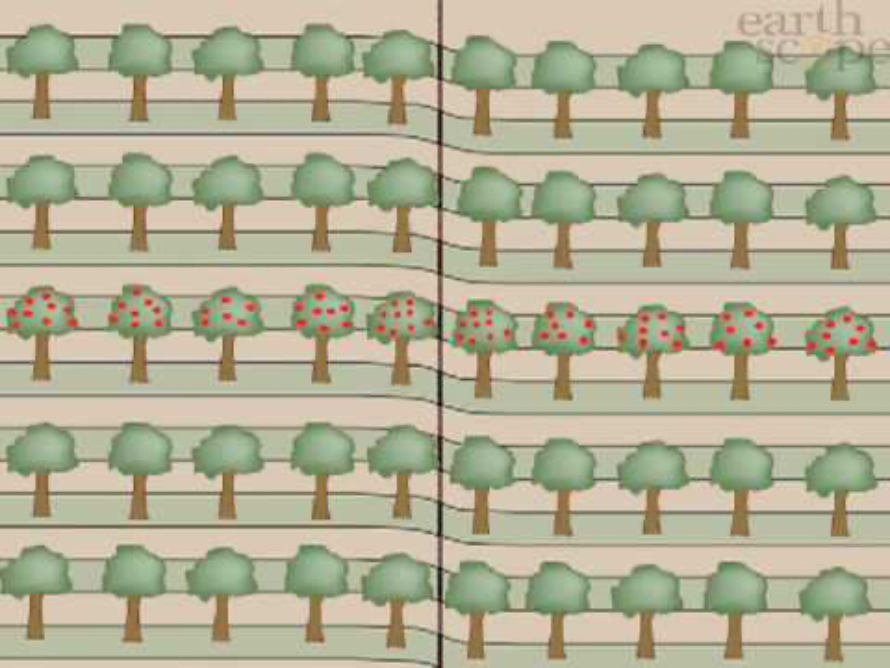
The surface of the Earth is broken into many pieces that move around.
The pieces of the Earth get stuck together. When they break free, an earthquake happens!
CREDIT: Rocket’s Earthquake Safety Adventure
CREDIT: Earthscope YouTube
23
Notes:
Teacher Notes: Slide is animated so images come in when you click.
Explain to students that the Earth’s surface is broken into many pieces that move around. Most of the time we don’t feel the movement, but sometimes we do. As the pieces of the Earth move, they can become stuck because of friction similar to how if you slide your tennis shoe across a floor, it can get stuck. An earthquake occurs when the moving pieces of Earth overcome friction and move suddenly. You can demonstrate this by snapping your fingers. Your thumb and finger model the pieces of Earth. At first when you press them together, they’re stuck because of friction. This models the friction between the pieces of Earth. When your finger snaps into the base of your thumb, that’s the earthquake.
IMAGES: https://rocketrules.org/wp-content/uploads/2020/09/Earthquake_Story_Full_optimized.pdf
VIDEO: https://www.youtube.com/watch?v=-5BgKKutxBs

Slide 24

Waves in Our Lives － Turn and Talk
What is a wave?
What are some different kinds of waves?
CREDIT: National Science Foundation, Andrew Schmidt
24
Notes:
Teacher Notes: Tell students that earthquakes release waves of energy, which we will learn more about next. Ask students to turn and talk with their elbow partner about what they think a wave is, and what kinds of waves they’ve heard of.
Students may say that a wave is moving water. They may mention ocean waves, sound waves, heat waves, or a flag or person’s hand waving.
IMAGE: https://www.nsf.gov/news/mmg/mmg_disp.jsp?med_id=77253&from=

Slide 25
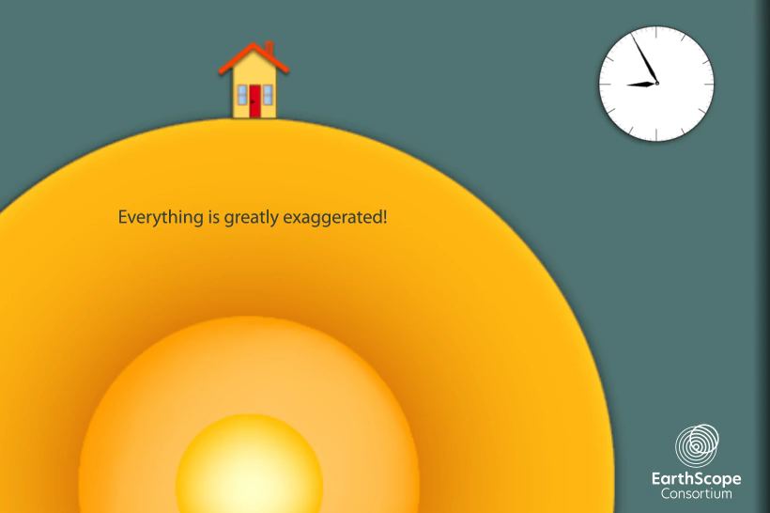
Earthquake Waves are called Seismic Waves
How does each type of wave affect the building?
How are the waves of energy SIMILAR?
How are they DIFFERENT?
25
Notes:
Teacher Notes: The slide is animated so that the questions appear one at a time. The video will play automatically when you open the slide. To play the video again, click the white play button.
Tell students that waves of energy are released during an earthquake, which we call seismic waves. There are different kinds of seismic waves. Students should observe that the p-wave arrives first and moves the house up and down, the s-wave is second and moves the house side to side, and the surface wave arrives last, and moves the house in an undulating motion. The waves are similar because they all move the house. They are different in the time it takes for them to arrive at the house, whether they move through the earth or across its surface, and in how they move the house. Point out to students that seismic waves transfer energy and not matter. The house moved because energy was transferred from the earthquake to the house, not because matter was transferred from the earthquake to the house.
To view a more detailed model of seismic waves, go to: https://www.iris.edu/hq/inclass/animation/1component_seismogram_building_responds_to_p_s_surface_waves

Slide 26
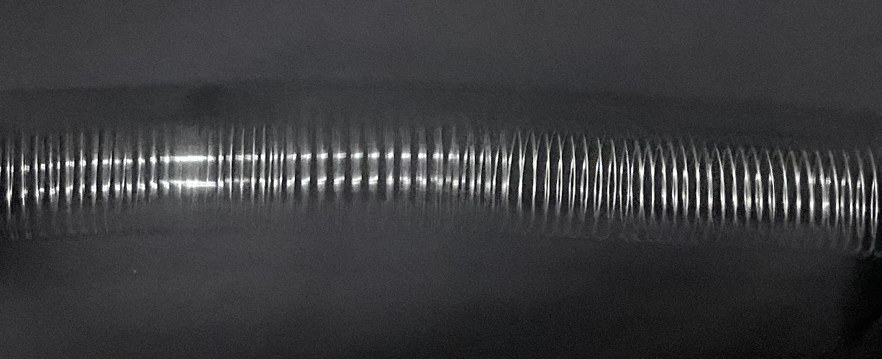
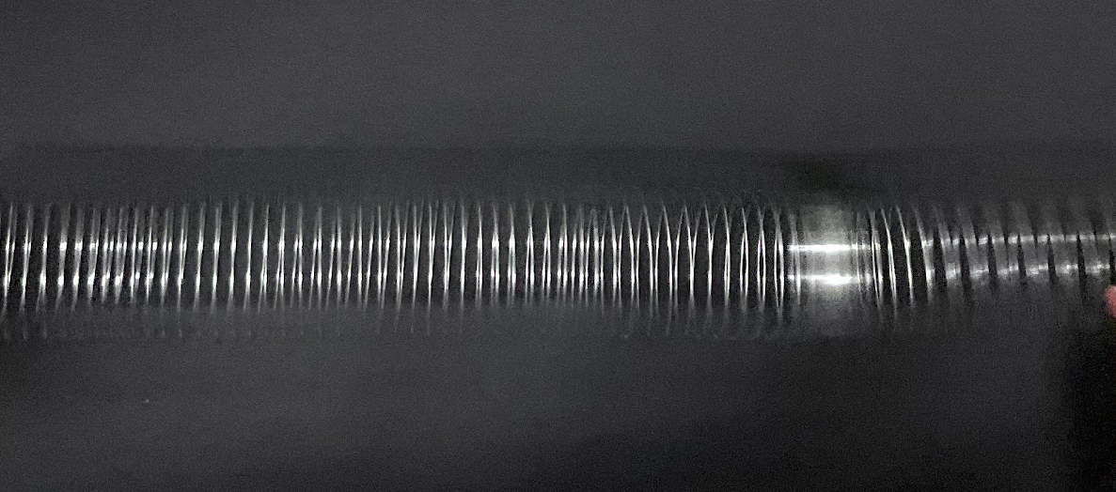
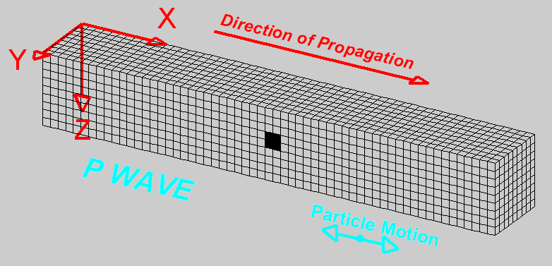
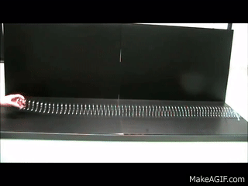
Modeling P-Waves with SlinkyⓇ
CREDIT: L. Braile, Purdue University
26
Notes:
Teacher Notes: Tell students that we can model seismic waves using a Slinky. A giant Slinky works best for this. If you have one, have two students hold either end and stretch it out between them on the floor. If you don’t have a Slinky, just show and discuss the animations on the following two slides. Model a p-wave with the Slinky by having the student on one end of the Slinky push it toward the other student. Instruct other students to observe. Repeat this step a few times as students share their observations.
SOURCE: Seismic Slinky https://www.iris.edu/hq/inclass/lesson/seismic_slinkymodeling_p_and_s_waves
GIF: https://makeagif.com/gif/longitudinal-waves-on-a-slinky-ZChjoc, L. Braile, Purdue University
VIDEO: To watch a video of a teacher demonstrating modeling seismic waves with a Slinky, go to https://www.iris.edu/hq/inclass/video/seismic_slinky_modeling_p_and_s_waves_in_the_classroom

Slide 27
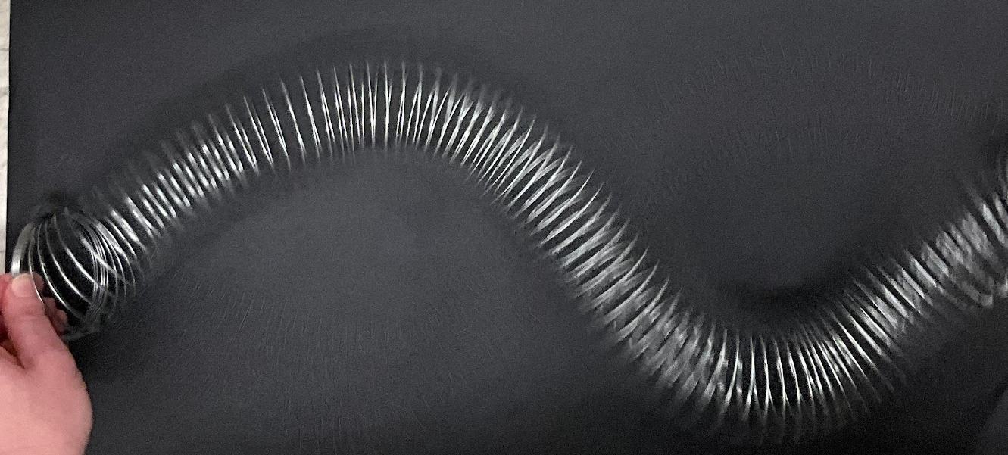
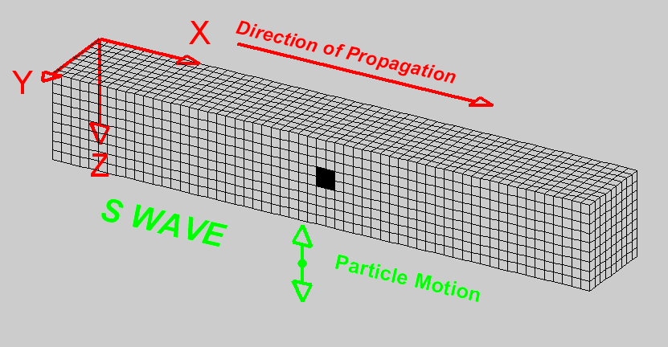
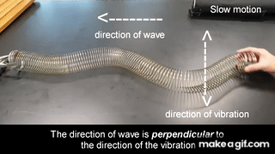
Modeling S-Waves with SlinkyⓇ
CREDIT: L. Braile, Purdue University
27
Notes:
Teacher Notes: Model an s-wave with the Slinky by having the student on one end of the Slinky move it back and forth. Instruct other students to observe. Repeat this step a few times as students share their observations.
SOURCE: Seismic Slinky https://www.iris.edu/hq/inclass/lesson/seismic_slinkymodeling_p_and_s_waves
GIF: L. Braile, Purdue University, https://makeagif.com/gif/transverse-wave-using-slinky-coil-UJEhkl

Slide 28
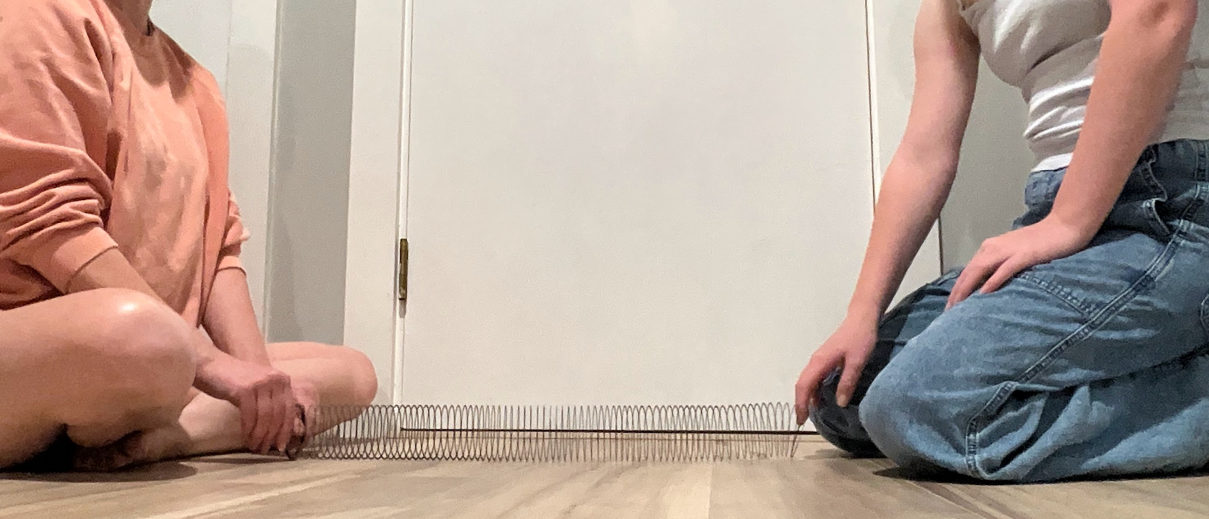
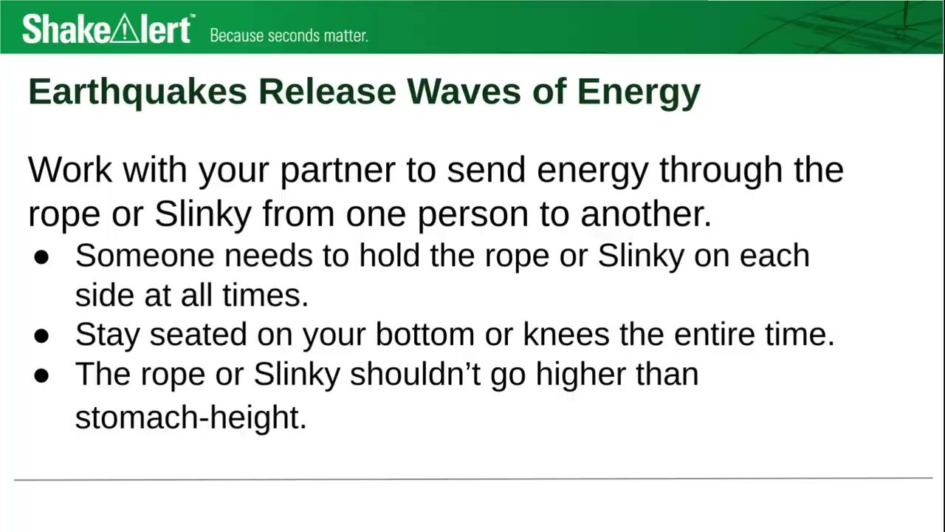
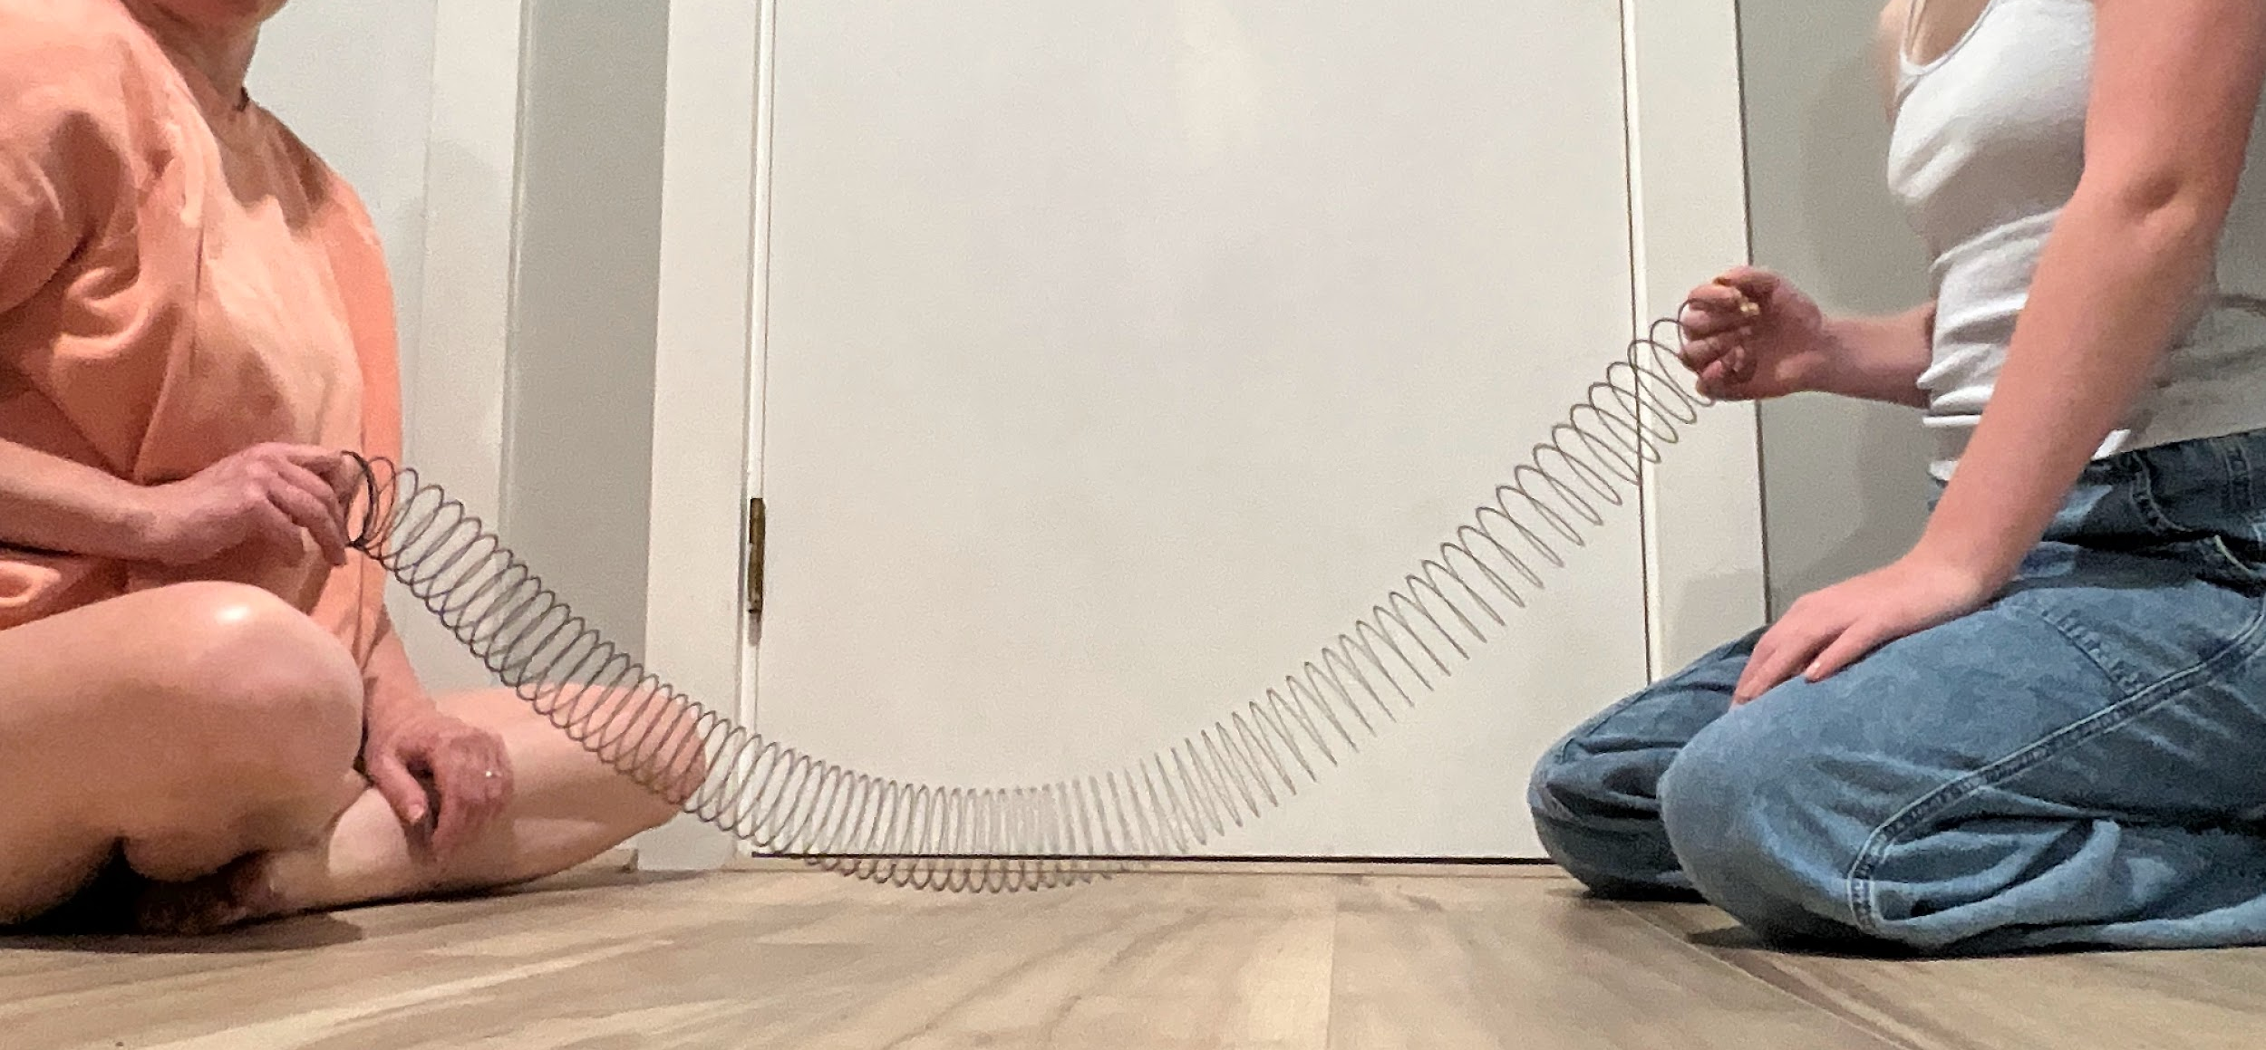
Earthquakes Release Waves of Energy
28
Notes:
Teacher Notes: This slide is optional for teachers who are providing small groups of students with a rope or SlinkyⓇto experiment with. This slide contains a video with images to demonstrate how to experiment safely with the rope of Slinky. To play the video, press the white triangle. To make the video full screen, click the small box in the lower right corner.
If you are providing students with a Slinky, rope, yarn, etc. to model waves, go over the safety guidelines, and give them time to discover ways to send energy through the material. Consider setting a 4 minute timer for students to experiment, and ask students to be ready to share their observations with the class once time’s up!
SUGGESTED SAFETY GUIDELINES:
Someone needs to hold the rope or Slinky on each side at all times.
Stay seated on your bottom or knees the entire time.
The rope or Slinky shouldn’t go higher than stomach-height.

Slide 29
Seismic Waves with Different Amounts of Energy
Model s-waves with different amounts of energy.
How does the amplitude of the wave affect the amount of shaking?
How does the amplitude of the wave change as the wave travels away from its starting point?
Amplitude
29
Notes:
Teacher Notes: This slide is optional. If you are modeling waves using a SlinkyⓇ or section of rope, use this slide to guide your demonstration.
To start, explain to students that amplitude is one way we can describe the energy in a wave. Point out that amplitude is the distance from the midline of the wave to the furthest point from the midpoint, called the crest or trough. Model a wave with a higher amplitude with the Slinky or rope. Then model a wave with a lower amplitude. Ask students to observe the differences in how the tape moves with a high vs a lower amplitude wave. They should notice that the higher the amplitude, the more the tape moves. Ask students to notice what happens to the amplitude of the wave as it travels down the Slinky or rope. They should notice that the amplitude decreases as the wave travels, as they observe the tape closest to the source of the wave moving more, and the tape furthest from the source of the wave moving less. They may also note that the amplitude changes direction back and forth across the midpoint as it travels. Point out to students again that seismic waves transfer energy, not matter. If you’re using a section of rope to model waves, point out that while the tape moves back and forth, it doesn’t actually move down the rope.

Slide 30
Earthquakes Waves Behave Differently
Watch again!
Pay close attention to the different speeds of the three types of waves.
30
Notes:
Teacher Notes: To play the video again, click the white play button. It may help to play the video again and pause it right before the seismic waves reach the house (around 0:10).
Ask students what they observe about how the distance between waves changes as they travel away from where the earthquake started. They should notice that when the earthquake starts, the waves are right on top of each other. As the waves travel through the earth, the distance between them grows.
To view a more detailed model of seismic waves, go to: https://www.iris.edu/hq/inclass/animation/1component_seismogram_building_responds_to_p_s_surface_waves

Slide 31
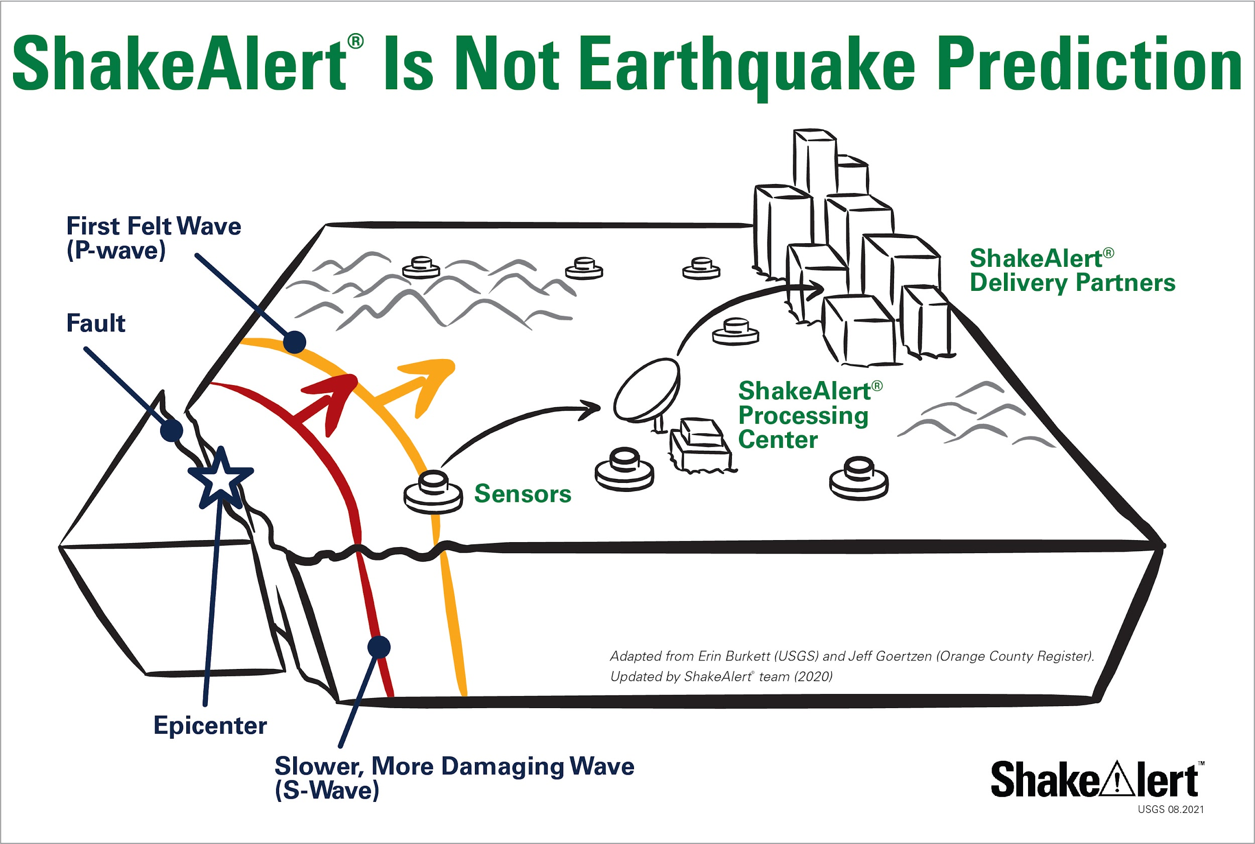
Earthquake Early Warning
P-waves: faster & less damaging
S-waves: slower & more damaging
Alerts: delivered as soon as first earthquake wave detected.
CREDIT: ShakeAlert Is Not Earthquake Prediction
31
Notes:
Teacher Notes: The slide is animated. Point out the p-wave and s-wave in the diagram as the words appear.
Remind students that seismic waves can affect people long distances from where they begin. Tell students that the p-waves move the fastest, but are less damaging, whereas s-waves are slower but are more damaging. Tell students that as soon as the first wave is detected, alerts are sent to areas that may experience damaging shaking. Therefore, as soon as you get an alert, you should Drop, Cover, and Hold On.
CREDIT: https://drive.google.com/file/d/1wl-DjZ9fmVTTFuUtAVhcseaE5UpkkGdk/view?usp=drive_link

Slide 32

Earthquakes Near Us?
Could there be an earthquake near us?
32
Notes:
Teacher Notes: Ask students to discuss whether they think there could be an earthquake where they live. Students in California will probably know that there are earthquakes nearby, but students in Oregon and Washington may not be aware that there is a risk of earthquakes.
If you would like, you can visit the USGS Latest Earthquakes website and show students the earthquakes that have happened in the last day, last 7 days, or last 30 days in the US. (https://earthquake.usgs.gov/earthquakes/map)

Slide 33
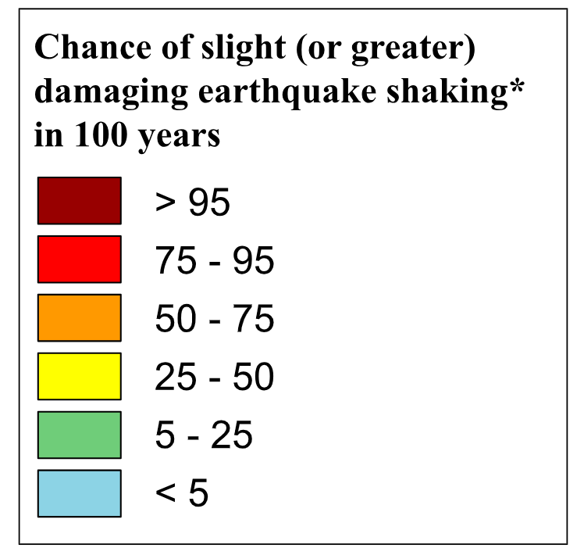
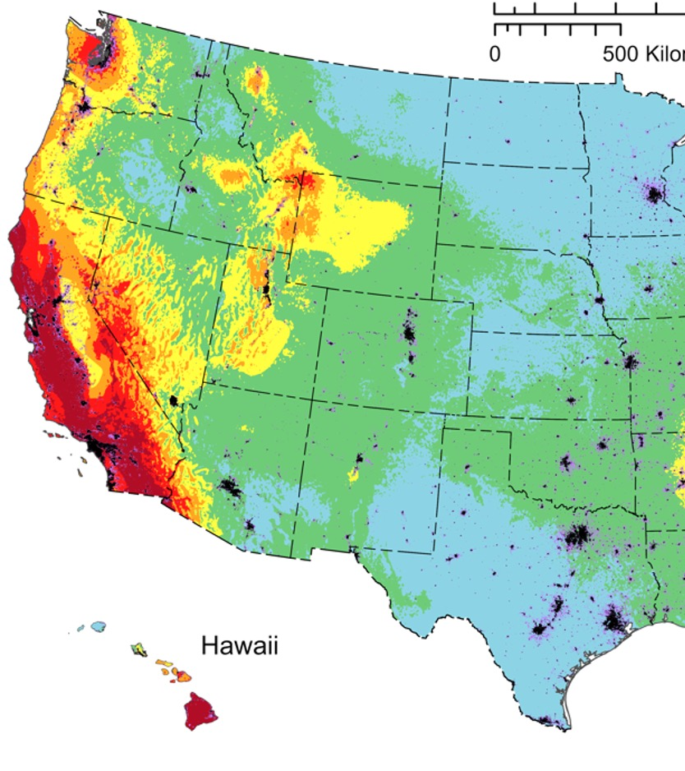
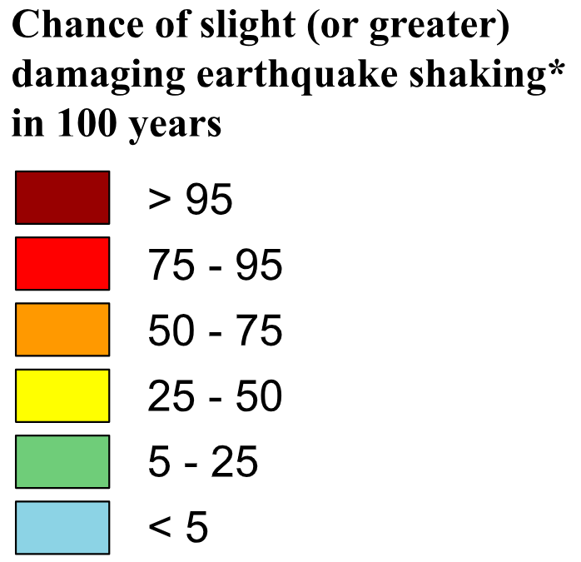
Examine the key . . .
CREDIT: National Seismic Hazard Model (2023) - Chance of Damaging Earthquake Shaking
33
Notes:
Teacher Notes: This slide is optional.
Tell students that this map shows the chance of experiencing a damaging earthquake in the next 100 years. Point out that the red areas have a greater than 95% chance of experiencing a damaging earthquake in the next 100 years, whereas the blue areas have a less than 5% chance. Ask a student to come up and point to the area where you live on the map. Work with students to determine the earthquake risk where you live using the key.
IMAGE: https://www.usgs.gov/media/images/national-seismic-hazard-model-2023-chance-damaging-earthquake-shaking

Slide 34
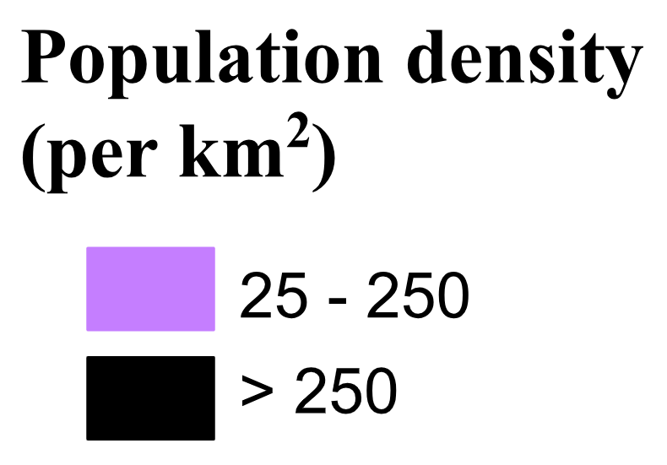
And this key . . .
CREDIT: National Seismic Hazard Model (2023) - Chance of Damaging Earthquake Shaking
34
Notes:
Teacher Notes: This slide is optional.
This map also shows population density. Tell students that the black areas have lots of people living closer together, and light purple areas have a moderate amount of people living closer together. Again ask a student to come up and point to the area where you live on the map.
IMAGE: https://www.usgs.gov/media/images/national-seismic-hazard-model-2023-chance-damaging-earthquake-shaking

Slide 35
Putting it together . . .
CREDIT: National Seismic Hazard Model (2023) - Chance of Damaging Earthquake Shaking
35
Notes:
Teacher Notes: This slide is optional.
Ask students what patterns they see in this map. What does this map show us about the area we live? Students should notice that California has the highest chance of experiencing a damaging earthquake in the next 100 years, with many areas having a >95% chance. Areas in Oregon and Washington near the Pacific Ocean have a 50-95% chance of experiencing a damaging earthquake in the next 100 years.
IMAGE: https://www.usgs.gov/media/images/national-seismic-hazard-model-2023-chance-damaging-earthquake-shaking

Slide 36

What do you do if you feel shaking or get an alert?
CREDIT: ShakeAlert Infographic Modified Protective Actions
36
Notes:
Teacher Note: This is animated. Ask the question first to elicit student responses.
Review and model correct protective actions - Drop, Cover, and Hold On. Make sure students know they should drop to their knees (not their bottoms), have one hand over their necks, and try to get away from glass or any other objects that could fall on them. If they’re able to get under a table or desk while staying on their knees, they should. Once there, they should hold on to the leg of the table.
IMAGE: https://drive.google.com/file/d/1KaHNTj7_C1NvRDFZE3jWW-6g2K4I_Q4h/view

Slide 37

If you or someone you know uses a wheelchair:
CREDIT: ShakeAlert Infographic Modified Protective Actions
37
Notes:
Teacher Notes: Tell students that Drop, Cover, and Hold On looks different for different bodies. Review modified protective actions for people who use wheelchairs. While you may not have students who use wheelchairs in your class, it is likely that there are members of your community who do. Ask students to help their family members or friends who use a wheelchair by sharing that “Lock, Cover, and Hold On” is how they can protect themselves during an earthquake. Have students repeat the phrase, “Lock, Cover, and Hold On” after you’ve said it.
IMAGE: https://drive.google.com/file/d/1KaHNTj7_C1NvRDFZE3jWW-6g2K4I_Q4h/view

Slide 38


If you or someone you know uses a cane or walker:
CREDIT: ShakeAlert Infographic Modified Protective Actions
38
Notes:
Teacher Notes: Slide is animated so images come in when you click. Tell students that Drop, Cover, and Hold On looks different for different bodies. Review modified protective actions for people who use a cane or walker. While you may not have students who use a cane or walker in your class, it is likely that there are members of your community who do. Ask students to help their family members or friends who use a cane or walker by sharing the correct protective actions. Have students repeat the phrase, “Drop, Cover, and Hold On” and then “Lock, Cover, and Hold On” after you’ve said it.
IMAGE: https://drive.google.com/file/d/1KaHNTj7_C1NvRDFZE3jWW-6g2K4I_Q4h/view

Slide 39
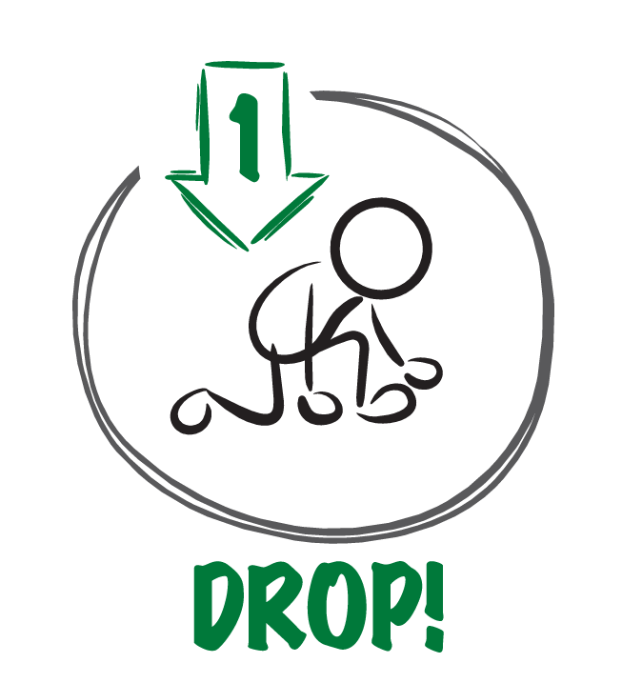


When the ground shakes or you get an alert,
why is it important to . . .?
CREDIT: ShakeAlert Infographic Modified Protective Actions
39
Notes:
TEACHER NOTE: This slide is animated and the ‘Cover’ and ‘Hold On’ appear individually so you can discuss each action in turn. Begin by eliciting student responses for each. Add on to student responses as necessary.
DROP: Dropping to your knees protects you from falling during ground shaking.
COVER: We cover our neck and head to protect them from becoming injured if something falls.
HOLD ON: We hold on to a table leg once we’re beneath a table so that the earthquake doesn’t move us out from underneath the table that is protecting us.
IMAGE: https://drive.google.com/file/d/1ZSnjJY34GVvTJCyYB908pbDSXBC5F_cZ/view?usp=sharing

Slide 40
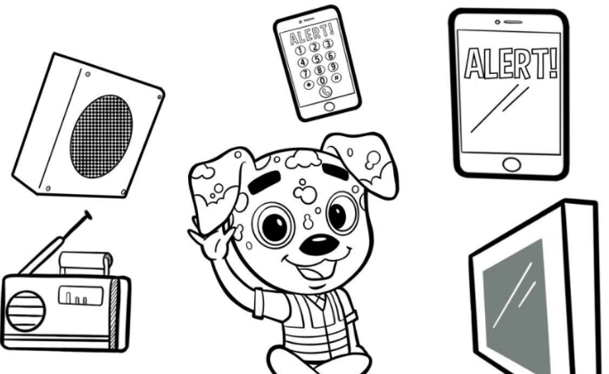
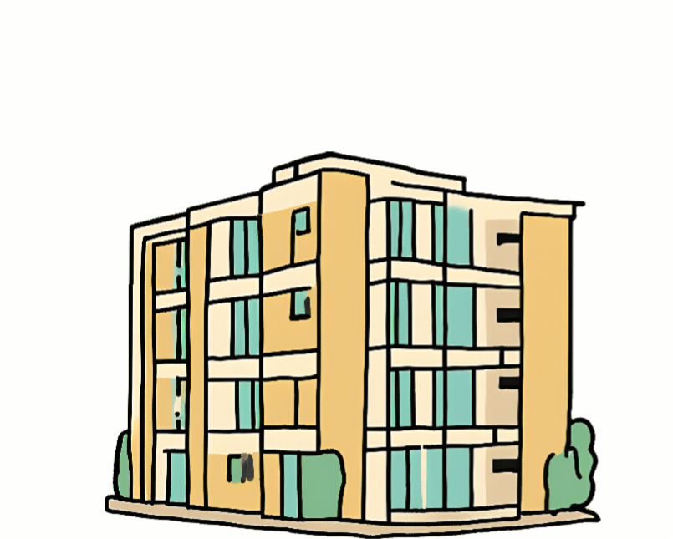

Protect yourself when there is . . .
ground shaking
an earthquake drill
an earthquake early warning alert
40
Notes:
Teacher Notes: Slide is animated so images come in when you click. Tell students that they should take these protective actions when the ground shakes, if there’s an earthquake early warning alert, or if they’re doing an earthquake drill, which we’ll do now. Tell students that it’s vital they Drop, Cover, and Hold On immediately and without hesitation. They can be a leader in their community by immediately taking protective actions!
IMAGES: https://rocketrules.org/wp-content/uploads/2020/08/Earthquake_Cont_English_072720.pdf
https://www.shakeout.org/

Slide 41
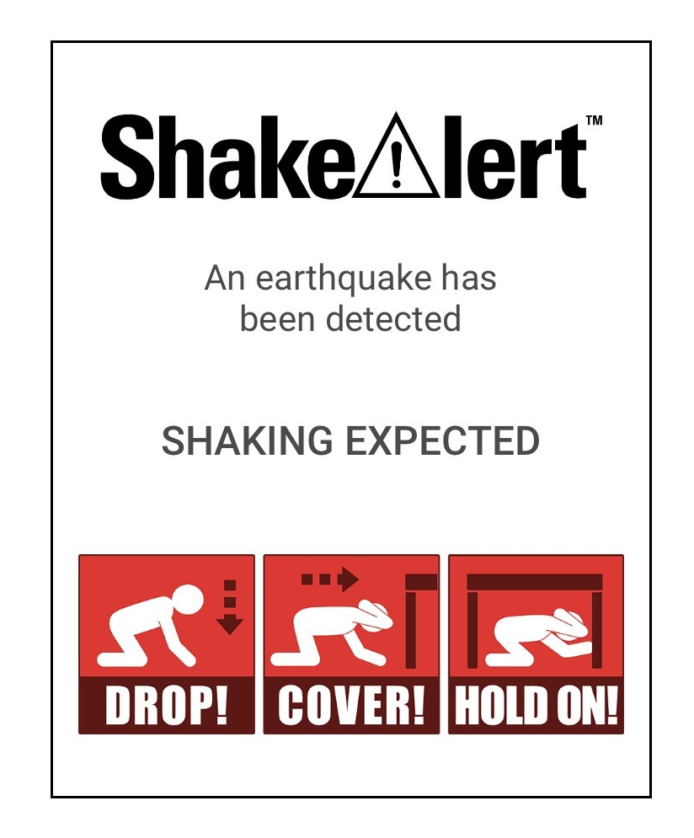
What to Expect from an Alert
41
Notes:
Teacher Notes: Play the ShakeAlert alert. Have all students Drop, Cover, and Hold On. Ask students to stay in their protective positions while the teacher observes and offers corrections if necessary. Once the teacher has checked in with each student, ask them to return to their seats.
NOTE: Your EEW alert may sound and look different than the one pictures on the slide!

Slide 42

Let’s reflect!
How did we do?
Questions?
Key things to remember?
42
Notes:
Teacher Notes: Ask students to turn and talk to reflect on the earthquake drill to discuss how they did, if they have questions, and what they think the key things to remember are. After reflecting, remind students of the key takeaways to stay safe during an earthquake, including: immediately dropping to your knees, moving away from glass or heavy objects that could fall, etc.

Slide 43
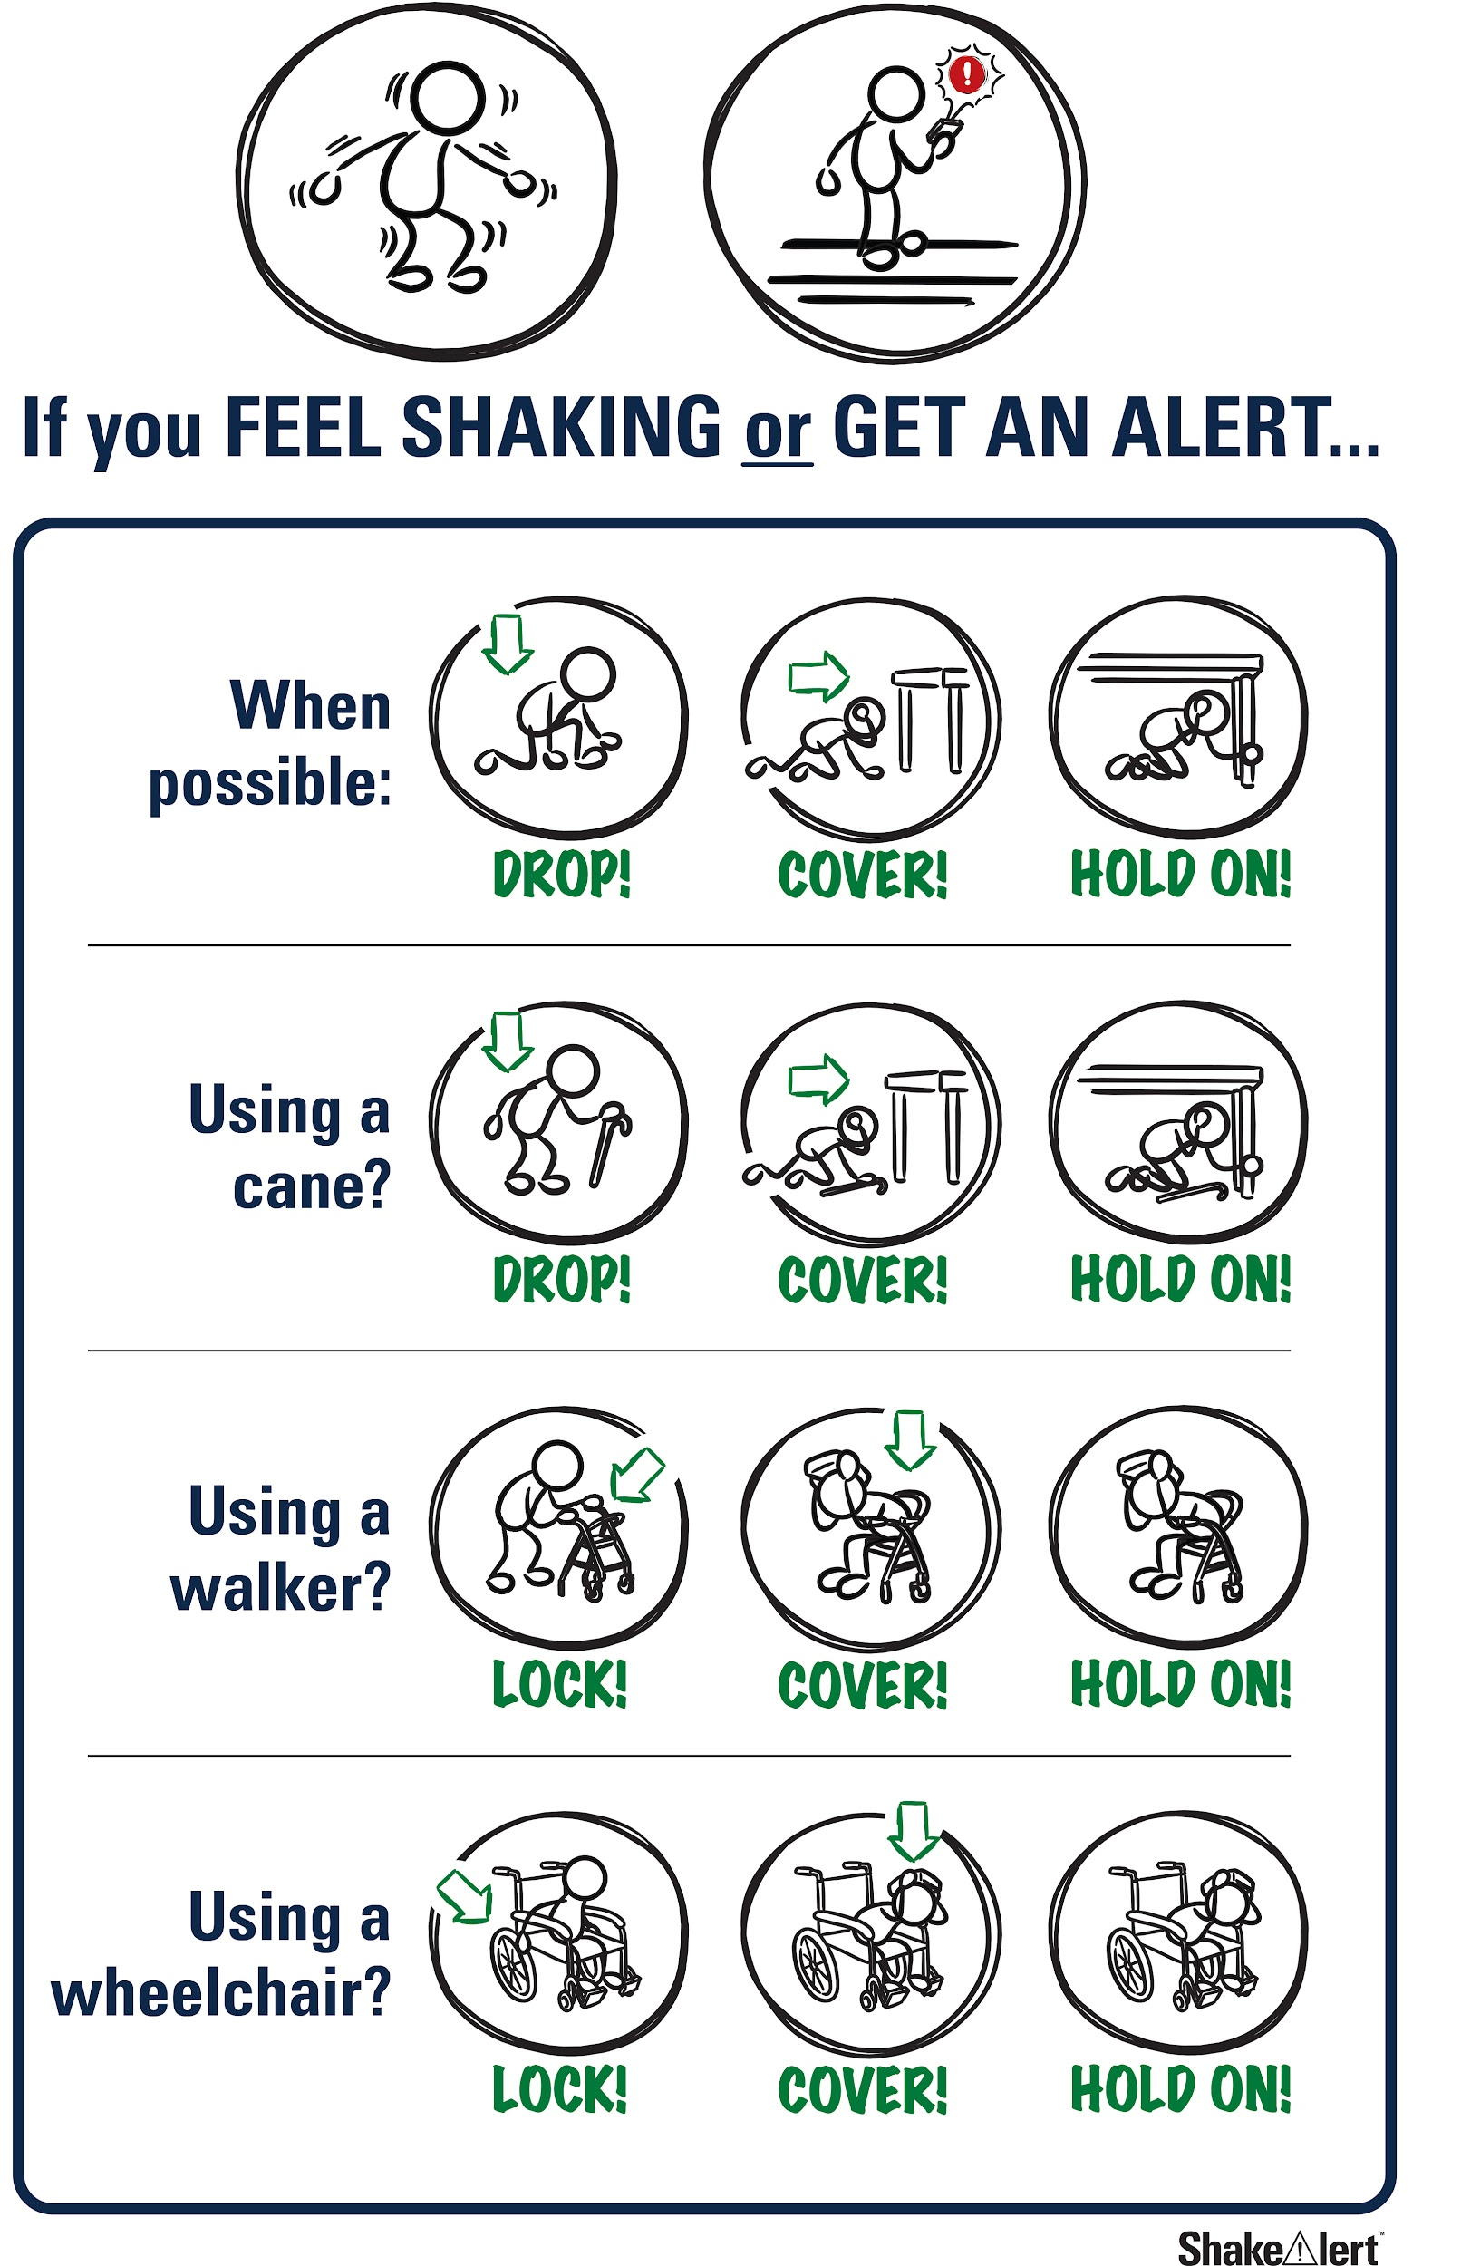
Help the people you live with and community prepare!
Spread the word! Tell your family and community what you learned about protecting yourself during an earthquake.
Practice tonight!
CREDIT: Sign up for ShakeAlert
43
Notes:
Teacher Note: Tell students that most of the adults they know have probably not taken part in an earthquake drill since they were students, and may have incorrect ideas about how to protect themselves in an earthquake. They can help the people they live with and community members prepare by teaching them about Drop, Cover, and Hold On, and informing them about ways to prepare, such as signing up for ShakeAlert-powered alerts and preparing an emergency kit and plan. Ask them to share the Family Engagement Letter with their families tonight.
IMAGE: https://drive.google.com/drive/folders/1Jt3m3AuHWwSDYJPZOj5FJqj626gyI7Ek

Slide 44
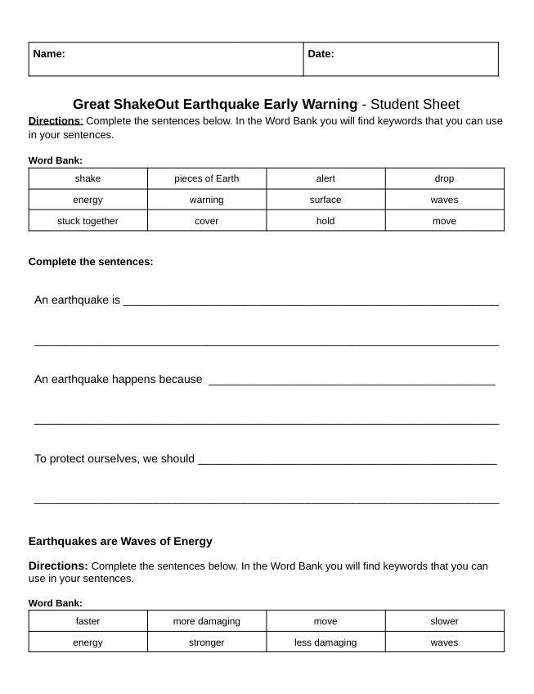
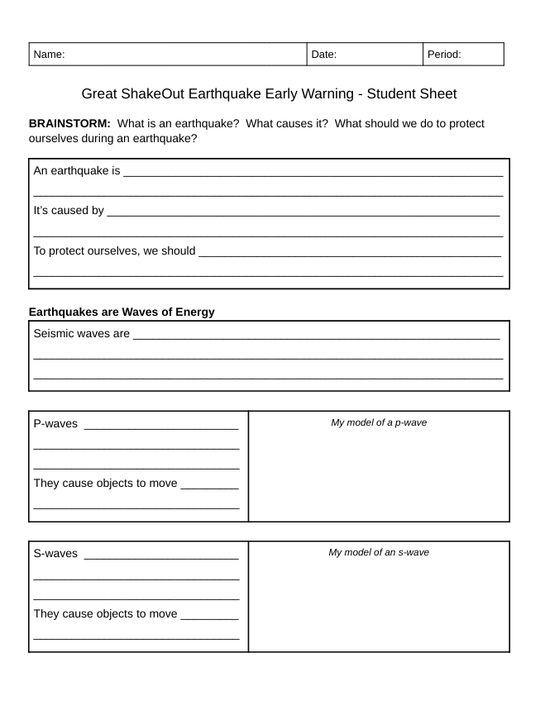
Let’s review what we’ve learned!
44
Notes:
Teacher Note: If you’re providing students with the student sheet to review their learning, do so now. There is a 3rd grade student sheet, and a 4th-5th grade student sheet.

Slide 45
How do you feel?
Turn and talk to a partner!
CREDIT: Wisconsin Office of Children’s Mental Health
45
Notes:
Teacher Notes: Ask students, “Now that you've learned about how and why earthquakes occur, as well as how you can protect yourself and others, have your feelings changed?" Turn and talk: Yes or No and why?
IMAGE / RESOURCE:https://children.wi.gov/Pages/FeelingsThermometer.aspx

Slide 46

Welcome Back!
How did your discussions with your families go?
Did you show your families how to Drop, Cover, and Hold On during an earthquake?
CREDIT: Great ShakeOut
46
Notes:
Teacher Notes: NEXT DAY: Ask students how their conversations with their families went. Did their family members know that Drop, Cover, and Hold On are the correct protective actions? Did they talk about an emergency plan?
IMAGE:https://www.shakeout.org/

Slide 47
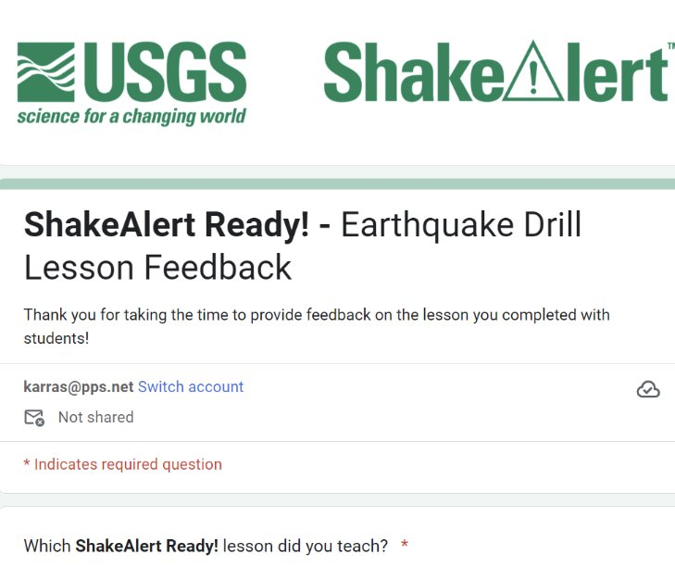
Teachers, share your feedback, please!
Please complete the short and anonymous feedback form and help us to improve our ShakeAlert Ready lessons.
11/2024
47
Notes:
LINK: https://docs.google.com/forms/d/e/1FAIpQLSeNHAr45fDTztflhJJD3_JVS8p0RiV1MW9sKyQgFucGJyKcCA/viewform?usp=sf_link

Slide 48
Content Standards - 3rd Grade
CC Writing | CCSS.ELA-LITERACY.W.3.8 | Recall information from experiences or gather information from print and digital sources; take brief notes on sources and sort evidence into provided categories.
CC Speaking & Listening | CCSS.ELA-LITERACY.SL.3.1 | Engage effectively in a range of collaborative discussions (one-on-one, in groups, and teacher-led) with diverse partners on grade 3 topics and texts, building on others' ideas and expressing their own clearly.
 | CCSS.ELA-LITERACY.SL.3.3 | Ask and answer questions about information from a speaker, offering appropriate elaboration and detail.
Historical & Social Sciences Analysis Skills (CA, K-5) |  | Students use map and globe skills to determine the absolute locations of places and interpret information available through a map’s or globe’s legend, scale, and symbolic representations.
Health (OR) | 3.SFA.4 | Describe how to identify and respond to emergency situations.
 | 3.SFA.5 | Describe safety procedures for responding to natural disasters.
Health (WA) | H1.Sa1.3a | Identify ways to prevent injuries at home, at school, and in the community.
 | H1.Sa1.3b | Create emergency, fire, and safety plans for home.
 | H1.Sa2.3a | Describe safety rules to follow in a disaster.
11/2024
48

Slide 49
Content Standards - 4th Grade
Science | 4-PS4.1 | Develop a model of waves to describe patterns in terms of amplitude and wavelength and that waves can cause objects to move.
CC Writing | CCSS.ELA-LITERACY.W.4.8 | Recall relevant information from experiences or gather relevant information from print and digital sources; take notes and categorize information, and provide a list of sources
CC Speaking & Listening | CCSS.ELA-LITERACY.SL.4.1 | Engage effectively in a range of collaborative discussions (one-on-one, in groups, and teacher-led) with diverse partners on grade 4 topics and texts, building on others' ideas and expressing their own clearly.
 | CCSS.ELA-LITERACY.SL.4.3 | Identify the reasons and evidence a speaker provides to support particular points.
Historical & Social Sciences Analysis Skills (CA, K-5) |  | Students use map and globe skills to determine the absolute locations of places and interpret information available through a map’s or globe’s legend, scale, and symbolic representations.
Health (CA) | 1.1.S | Describe safety hazards, including those related to fire, water, dangerous objects, being home alone, and using the Internet.
 | 1.5.S | Identify basic safety guidelines associated with weather-related emergencies and natural disasters (e.g., floods, earthquakes, and tsunamis).
 | 1.6.S | Identify disaster preparedness procedures at home, at school, and in the community
 | 7.2.S | Practice disaster preparedness procedures at home and at school.
 | 7.6.S | Demonstrate the ability to execute an escape plan for incidents of fires, floods, earthquakes, and other natural disasters.
Health (WA) | H1.Sa2.4a | Describe how to prepare for an emergency.
11/2024
49

Slide 50
Content Standards - 5th Grade
CC Writing | CCSS.ELA-LITERACY.W.5.8 | Recall relevant information from experiences or gather relevant information from print and digital sources; summarize or paraphrase information in notes and finished work, and provide a list of sources.
CC Speaking & Listening | CCSS.ELA-LITERACY.SL.5.1 | Engage effectively in a range of collaborative discussions (one-on-one, in groups, and teacher-led) with diverse partners on grade 5 topics and texts, building on others' ideas and expressing their own clearly.
 | CCSS.ELA-LITERACY.SL.5.3 | Summarize the points a speaker makes and explain how each claim is supported by reasons and evidence.
Historical & Social Sciences Analysis Skills (CA, K-5) |  | Students use map and globe skills to determine the absolute locations of places and interpret information available through a map’s or globe’s legend, scale, and symbolic representations.
Health (OR) | 5.SFA.6 | Discuss steps to take to prepare for natural disasters.
Health (WA) | H1.Sa2.5 | Explain how to respond to emergency situations.
11/2024
50

Slide 51
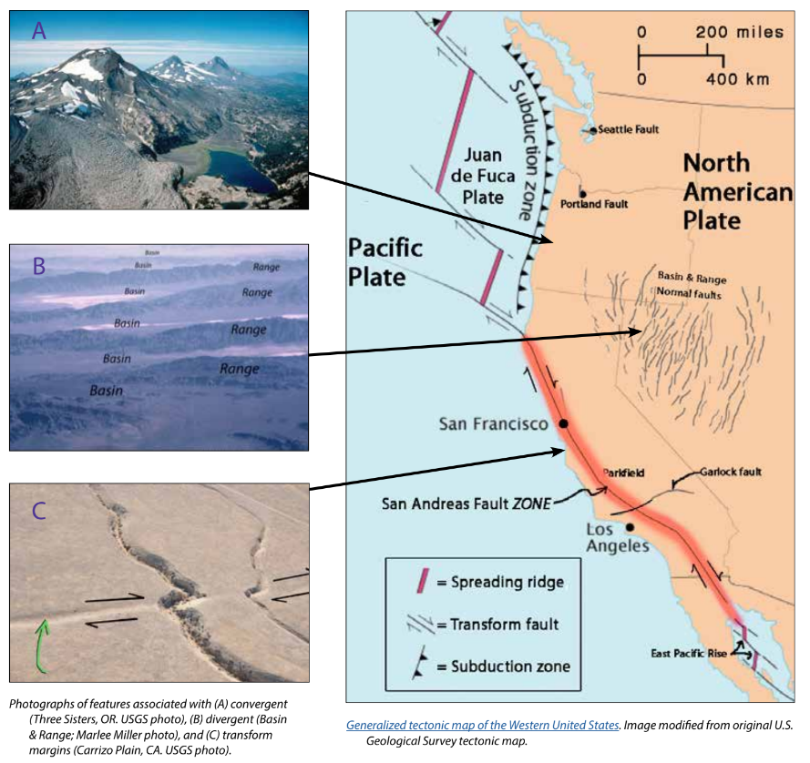
Background - Earthquake Hazard
California, Oregon, and Washington all face hazards from earthquakes because of the underlying tectonic plates, which constantly grind against each other. This friction creates "faults," lines of weakness in the Earth's tectonic plates (lithosphere) where earthquakes are most likely to occur.
California's San Andreas Fault is one example. Another example is the Cascadia Subduction Zone, which threatens all three states and British Columbia, Canada. This giant fault lies offshore, where the Juan de Fuca Plate dives beneath the North American Plate. This type of motion on other subduction zones can cause massive earthquakes, like the one that struck Japan in 2011.
While smaller earthquakes happen often, scientists think a major earthquake could happen any time, so it's important to be prepared.
For more information: Faults, Plate Tectonics & Earthquake Hazards - Animations / Videos
11/2024
51
Notes:
IMAGE: https://www.iris.edu/hq/inclass/activities/introduction_to_faults_and_plate_tectonics
SOURCE: https://www.usgs.gov/programs/earthquake-hazards/science/pacific-northwest-hazards
https://www.usgs.gov/programs/earthquake-hazards/science/southern-california-earthquake-hazards

Slide 52
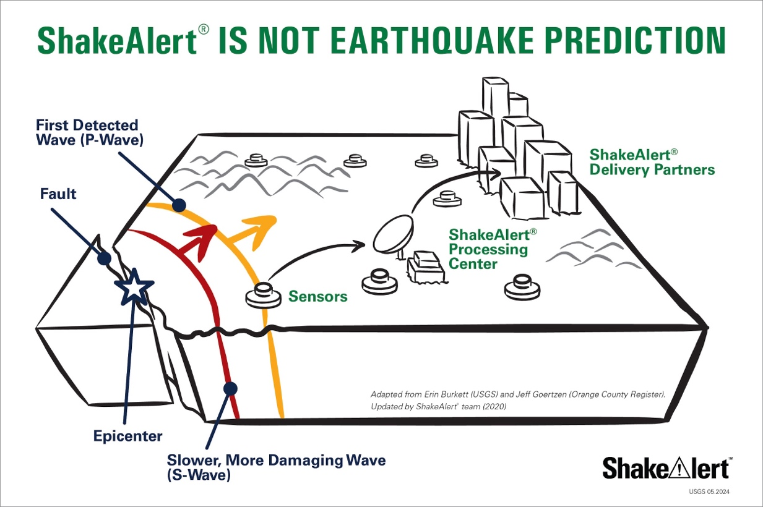
Background - How ShakeAlertⓇ Earthquake Early Warning System Works
During an earthquake, a rupturing fault sends out different types of waves. The fast-moving P-wave is first to arrive, followed by the slower S-wave and later-arriving surface waves.​
Sensors detect the P-wave and immediately transmit data to a ShakeAlert processing center where the location, size, and estimated shaking of the quake are determined. If the earthquake fits the right profile a ShakeAlert Message is issued by the USGS.​
A ShakeAlert Message is then picked up by delivery partners (such as a transportation agency) that could be used to produce an alert to notify people to take a protective action such as Drop, Cover, and Hold On and/or trigger an automated action such as slowing a train.​
11/2024
52
Notes:
https://drive.google.com/drive/folders/1oQOHup9P_p3DUkyIOi9DwqAlLgzdY45A?usp=drive_link
For more information on Earthquake Early Warning, go to: https://www.iris.edu/hq/inclass/sequences/earthquake_early_warning

Slide 53
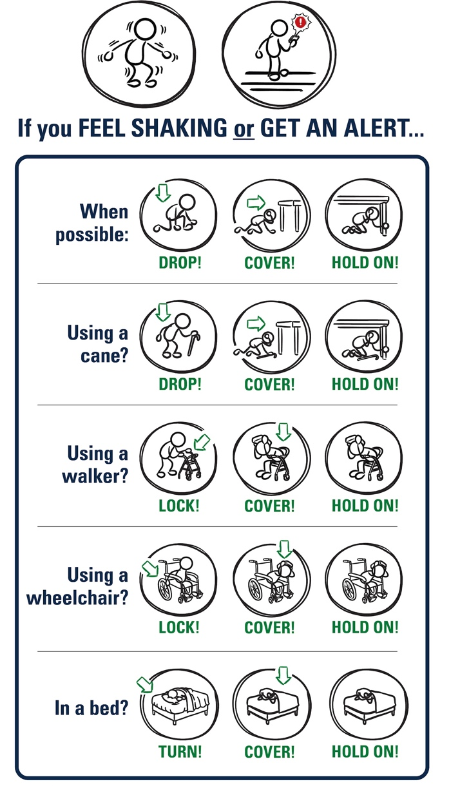
Background - Effective Protective Actions
Most earthquake-related injuries and deaths are caused by collapsing walls and roofs, flying glass and falling objects.
If you are inside a building, move no more than a few steps, then Drop, Cover, and Hold On.
If you are outdoors when the shaking starts, you should find a clear spot away from buildings, trees, streetlights, and power lines, then Drop, Cover, and Hold On. Stay there until the shaking stops.
For protective actions in various settings (descriptions and gifs), go to https://www.earthquakecountry.org/step5/
11/2024
53
Notes:
SOURCE: https://www.shakeout.org/whyparticipate/
IMAGE: https://drive.google.com/file/d/1KaHNTj7_C1NvRDFZE3jWW-6g2K4I_Q4h/view

Slide 54
Rationale
Why do we practice earthquake drills?
To react quickly you must practice often. You may only have seconds to protect yourself in an earthquake, before strong shaking knocks you down--or drops something on you.
Social science research has long shown that people who practice actions are more likely to take those actions when a safety- threatening event occurs, such as an earthquake or fire. Tests, drills, and exercises that repeat concepts build “muscle memory” of procedural knowledge and timely reaction. The more frequently a person practices a procedure or self-protective action, such as Drop, Cover, and Hold On, the more likely they will employ it— almost without thinking—when they receive an alert or feel shaking.
Why share the Family Engagement Letter?
While schools practice earthquake drills regularly, most other locations don’t. Some students’ family members may not have practiced earthquake drills since they were in school.
Family members may have outdated information about how to stay safe in an earthquake, such as the incorrect belief that standing in doorways or “the triangle of life” will keep one safe in an earthquake. Students will be able to share correct protective actions (Drop, Cover, and Hold On) with their family and community members.
Students spend more time at home than at school. Therefore, educating families will help keep students and our community safe. Additionally, families are more likely to understand their family and community members’ needs. This communication can prompt families to ensure they’re prepared to protect all members of their families in case of an earthquake.
Because earthquakes are infrequent in Oregon and Washington, people may be unaware of the risk of an earthquake.
The Family Engagement Letter has links for family members to learn more about earthquakes and protective actions.
11/2024
54
Notes:
SOURCE: https://www.shakeout.org/whyparticipate/ , https://www.shakealert.org/toolkit/introduction/

Slide 55
Additional Resources
Sources
ShakeAlert® Earthquake Early Warning System
Education and Training Materials
Rocket Rules Activity and Coloring Book for Earthquake Science!
Rocket LIVE! Interactive Lesson (FORM for Earthquake Safety Lesson)
Earthquake Country Alliance and Shake Out Documents in Many Languages
Great Shake Out lessons
Rocket’s Earthquake Safety Activity Book
Rocket’s Earthquake Safety Adventure
11/2024
55

