Slide 1
ShakeAlert® Earthquake Early Warning TEACHER PROFESSIONAL DEVELOPMENT FOR GREAT SHAKEOUT K-12 LESSON
OBJECTIVE: Prepare teachers to use ShakeAlert educational materials to conduct a ShakeAlert-powered Great ShakeOut drill.
09/2024
Notes:
Welcome back to school from US Geological Survey and ShakeAlert. Your school has taken the critical step to protect your community by installing the ShakeAlert® Earthquake Early Warning System (EEW). Your school is now Powered by ShakeAlert! It could give your staff and students seconds of warning so you can Drop, Cover, and Hold On before damaging shaking from an earthquake reaches you.

Slide 2
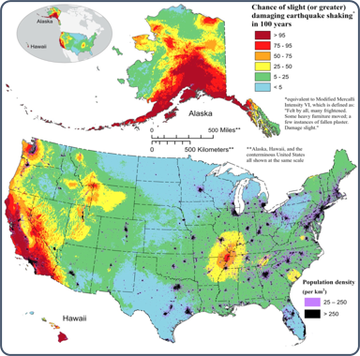
You Live in Earthquake Country
This map shows areas with a >75% chance of a damaging earthquake in the next 100 years in CA.
CREDIT: 2023 50-State Long-term National Seismic Hazard Model
09/2024
Notes:
NOTE: This slide is optional, and can be skipped if you viewed the ShakeAlert Ready Staff Preservice Presentation.
You already know that there are earthquakes in California. While Oregon and Washington have earthquakes less frequently, there are crustal and deep quakes, and a large megathrust earthquake will also occur at some point. This graphic from a recent USGS publication shows that there are areas in California, Oregon and Washington with a high chance of experiencing an earthquake with damaging shaking in the next 100 years. In this case, damaging means an earthquake felt by all that frightens many, and moves heavy furniture, creating slight damage or more. Because of this risk, it is important for us to prepare ourselves and our students to respond safely to an earthquake. Your district has taken extra steps to protect you from an earthquake by installing a ShakeAlert-powered earthquake early warning system.

Slide 3
Your School Has Earthquake Early Warning!
CREDIT: ShakeAlert
09/2024
Notes:
NOTE: This slide is optional, and can be skipped if you viewed the ShakeAlert Ready Staff Preservice Presentation.
Your school has installed ShakeAlert-powered earthquake early warning system. Earthquake Early Warning is not earthquake prediction, as earthquakes can’t be predicted. Instead, it is rapid detection and information processing of earthquakes that have already begun. Using earthquake information provided by the USGS, alerts are delivered to your school so that people can have time to Drop, Cover, and Hold On (DCHO) before the strongest shaking arrives. Alerts can provide seconds of extra time for our school community to prepare!

Slide 4
How does ShakeAlertⓇ EEW work?
ShakeAlert EEW is available in CA, OR, & WA
CREDIT: Using GPS to Enhance the ShakeAlert EEW System
09/2024
Notes:
NOTE: This slide is optional, and can be skipped if you viewed the ShakeAlert Ready Staff Preservice Presentation.
Show video. The most important part is the first 1:26. You can stop video at that point. Otherwise, play the whole thing. ShakeAlert can give your students seconds of time to Drop, Cover and Hold On before the dangerous shaking arrives. For the ShakeAlert system to be effective, it is important students practice responding to alerts.
For more information and animations, please visit the Earthscope Using GPS to Enhance the ShakeAleret EEW System site.

Slide 5
Prepare Your Students
09/2024
Notes:
To prepare students to respond automatically to ShakeAlert-powered alerts, you will conduct a ShakeAlert-powered earthquake drill as part of the Great ShakeOut. Millions of people from around the world participate in an earthquake drill on the third Thursday of October each year, known as the Great ShakeOut Earthquake Drill.

Slide 6
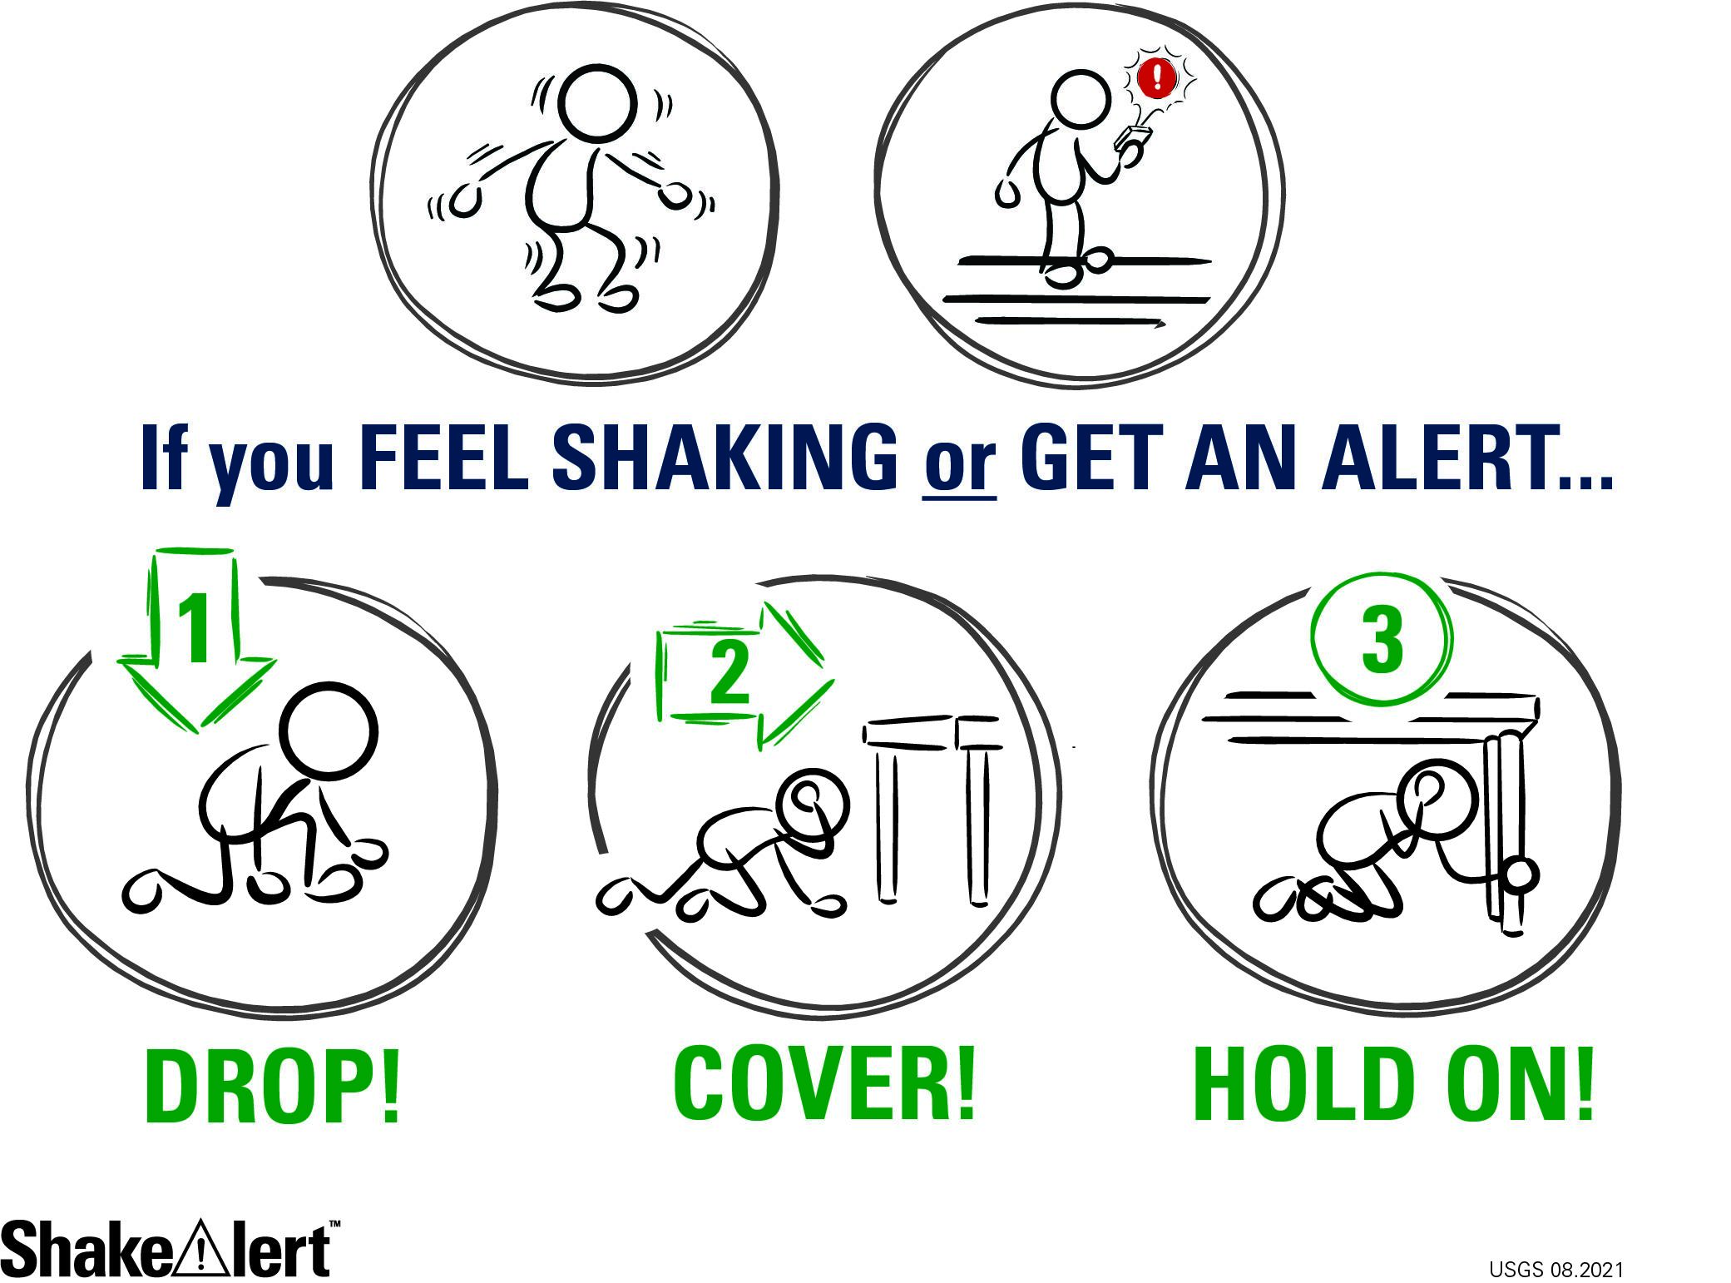
Lesson Goals
09/2024
Notes:
These lessons provide students with an opportunity to practice responding to an earthquake early warning or ground shaking by taking protective measures - Drop, Cover and Hold On. Each lesson also has NGSS-aligned grade-level appropriate science content. 3-5 lesson uses models of seismic waves moving houses to connect to 4-PS4-1, the middle school lesson models plate boundaries and faults which supports MS-ESS2-2, and the high school lesson describes how the ShakeAlert system utilizes seismic waves and radio waves in its earthquake early warning system, which is related to HS-PS4-5.

Slide 7
09/2024
Notes:
Protective actions. Lessons and materials are inclusive, providing protective actions for all bodies. Through practicing DCHO, we build students’ muscle memories and increase the likelihood that they will act automatically to take correct protective actions even when emotions are heightened during an actual earthquake!

Slide 8
Why Drop, Cover, and Hold On (DCHO)?
From “Evidence-based guidelines for protective actions and earthquake early warning systems:”
2x more likely to be injured when moving
Many injuries occur while exiting or moving away from buildings
From “Benefits and Costs of Earthquake Early Warning:”
50% of injuries caused by falls and falling hazards.
Seconds of warning + DCHO → 50% reduction in injuries
09/2024
Notes:
In the US where buildings meet certain building standards, drop, cover and hold on is safest. Doorways are not any safer than the rest of the building.
In, “Evidence-based guidelines for protective actions and earthquake early warning systems” by Sara McBride et al, “Close examination of injury data of relevant earthquakes experienced in California, from the 1989 M6.9 Loma Prieta and 1994 M6.7 Northridge earthquakes (Shoaf et al., 1998), found that people were twice as likely to be injured when moving during shaking. Kano (2005) finds that a large portion of injuries occurred while people were exiting or moving away from buildings, with bricks and other material falling on them as they fled.”
In Benefits and Costs of Earthquake Early Warning (Jennifer A. Strauss and Richard M. Allen) they found, “In both the 1989 Loma Prieta and 1994 Northridge earthquakes, more than 50% of the injuries were caused by falls and falling hazards (Shoaf et al., 1998). This includes all the injuries caused by non-structural hazards such as falling ceiling tiles, lighting fixtures, bookcases, and so on. If everyone received a few seconds of warning, and if everyone dropped, took cover, and held on, then early warning could reduce the number of injuries by more than 50% in future earthquakes.”
Lastly, consider that the ShakeAlert powered earthquake early warning system can provide you with seconds of warning before dangerous shaking arrives, but it cannot tell you have much time. It is highly unlikely that you could evacuate a school before dangerous shaking arrives, and instead will expose students to additional risk.

Slide 9
2018 Magnitude 7.1 Anchorage, Alaska earthquake
Watch initial jolt and almost immediate action of class.
CREDIT: Earthquake Classroom Video, Anchorage School District
09/2024
Notes:
This video shows why immediate action is imperative when you feel ground shaking or get an alert. Here you see students react immediately and appropriately to the first jolt of ground shaking as they Drop, Cover, and Hold On. Therefore, when the slower more damaging energy from the earthquake arrives, they are protected.
VIDEO: https://www.youtube.com/watch?v=NJZqREPc9k0&t=225s from Anchorage School District

Slide 10
Situational Awareness is Key!
CREDIT: Earthquake Country Alliance
09/2024
Notes:
Your students will undoubtedly wonder how to protect themselves in a variety of situations. It’s important to stress situational awareness, and ask students to discuss this with their families. There are many resources available to help, including gifs like those on this slide from the Earthquake Country Alliance, and the Washington Emergency Management Division’s “When an Earthquake Strikes: Where Will You Be? What Will You Do?” poster.
Gifs: https://www.earthquakecountry.org/step5/

Slide 11
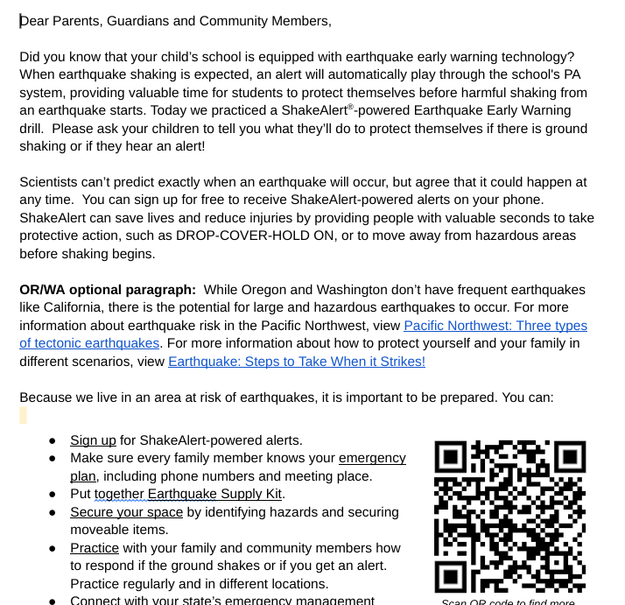
Engage your Adult Caregivers and Community
09/2024
Notes:
In addition to preparing students for an earthquake, you can leverage the Great ShakeOut lessons to connect with adult caregivers and the community. Take this opportunity to tell them about the steps your school is taking to protect their children, and to encourage them to prepare. Most adults haven’t participated in an earthquake drill since they were in school. They may have incorrect ideas about how to protect themselves in an earthquake. After completing our first ShakeAlert powered earthquake drill, teachers will share information about the Earthquake Early Warning system, and about how families can prepare for an earthquake. There is a customizable family engagement letter in English and Spanish that can be emailed or sent with students, and a family engagement website that has no cost and low cost ideas on how families can prepare for an earthquake or other emergency.

Slide 12
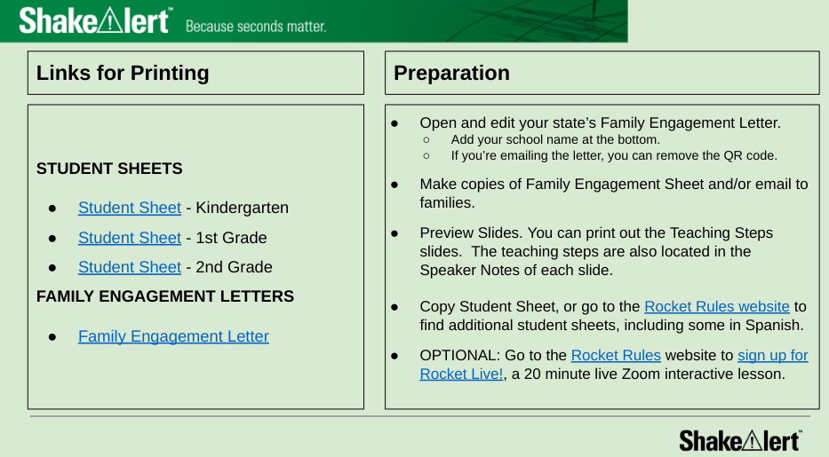
Before the Lesson
09/2024
Notes:
Green slides are teacher-facing, white slides are student-facing.
Before the lesson:
prep - 15 minutes or less - some have optional student sheets.
sensitive content warning - be sure to read, and consider your school community. Who may need extra sensitivity or an advanced warning?
teaching steps - consider printing these steps, or printing the student facing slides with speaker notes.

Slide 13
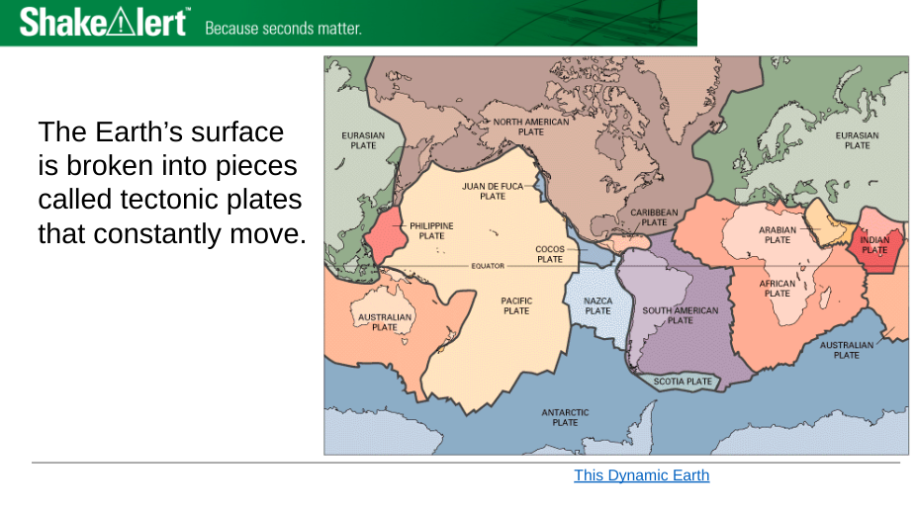
Lessons are Age-Appropriate & Standards-Aligned
09/2024
Notes:
There are K-2, 3-5, 6-8 and high school lessons.
Here’s an example of how science content is handled in K-2 vs 6-8.
In K-2 there’s a picture of Earth’s surface broken into pieces, and a cartoon of an earthquake.
In 6-8 there’s a more detailed map of tectonic plates, and specific examples of different kinds of plate boundaries as well as the geological processes and landforms they cause.
The teaching steps are in the speaker notes of each slide.

Slide 14
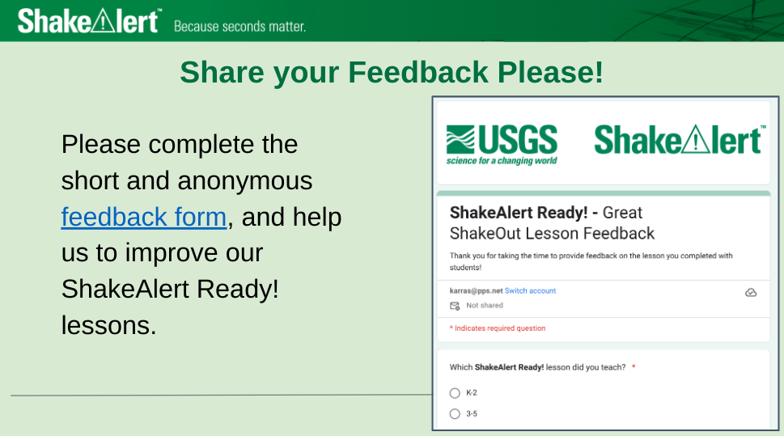
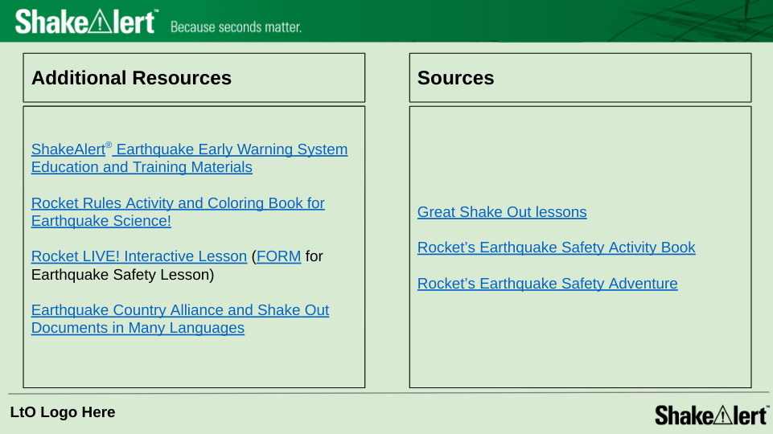
Also with the Lesson . . .
feedback survey
content standards
background on hazards
how EEW works
rationale for drills
additional resources
09/2024
Notes:
Also with the lesson:
Feedback survey
content standards
background on nearby earthquake hazards
how ShakeAlert earthquake early warning works.
rationale for conducting drills and communicating with students’ adult caregivers
additional resources
Specific lesson professional development to follow!

Slide 15
Leverage ShakeAlert to Enhance STEAM Education!
LINK: ShakeAlert Educational Resources
09/2024
Notes:
Leverage ShakeAlert to enhance STEAM education. ShakeAlert has interactive activities, animations, and videos that are standards-aligned, vetted by teachers and geologists, and designed to fit within 5-, 15-, or 45-minutes.

Slide 16
Contact Information
Coordinators for K-12 School Communities
Katrina Arras (karras@pps.net)
Roger Groom (rgroom@pps.net)
For more resources: www.ShakeAlert.org
Follow @USGS_ShakeAlert
09/2024
Notes:
If you have any questions or would like help with educational materials or setting up for your ShakeAlert-powered earthquake drill, please contact…

Slide 17
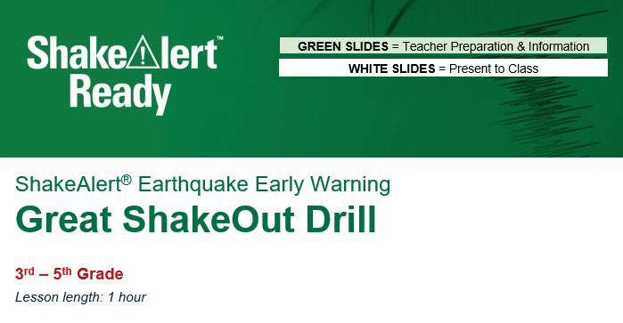
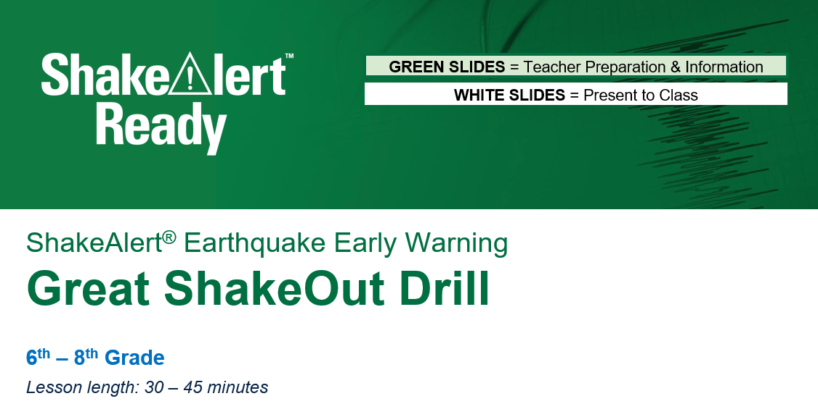
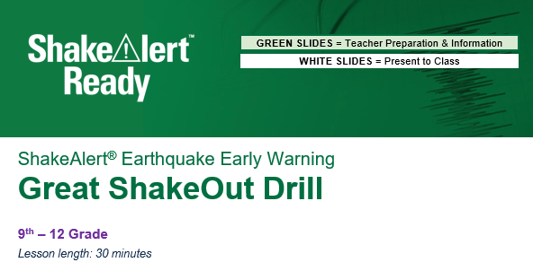
This completes the introductory training on the layout, resources and purpose of the ShakeAlert-powered Great ShakeOut lessons.
Next please review your grade-level lesson
09/2024
Notes:
Open the lesson for your grade band. Take time now to read the Sensitive Content Warning. Preview the slides with the teacher notes. Prepare the Family Engagement Letter to share with your adult caregivers. If you have any questions or need help, please reach out to Katrina Arras (karras@pps.net) or Roger Groom (rgroom@pps.net).

