Slide 1
ShakeAlert® Earthquake Early Warning
GREEN SLIDES = Teacher Preparation & Information
WHITE SLIDES = Present to Class
ShakeAlert Drill Essentials
Kindergarten to Fifth Grade
Lesson Length: 15 Minutes

Slide 2
Links for Printing
Preparation
Family Engagement Letters
Open the Family Engagement Letter.
Add your school’s name at the bottom.
If you’re emailing the letter, you can remove the QR code.
Make a copy of the Family Engagement Letter for each student and/or email to families.
Preview Slides. You can print out the Teaching Steps slides. The teaching steps are also located in the Speaker Notes of each slide.
2

Slide 3
Sensitive Content Warning
Some students or their family members may have experienced earthquakes, resulting in loss, injuries, and possible trauma. It is therefore important to approach these lessons with sensitivity and awareness. When students share information about their experiences with earthquakes in the first part of the lesson, make sure to scan the class and be aware of any heightened responses. Affirm students’ normal emotional responses. If students are too emotionally heightened, it may be prudent to allow them to forego the drill.
Even students who have never experienced an earthquake may have a strong emotional response to talking about earthquakes. Explain to students that practicing earthquake drills helps our community to stay safe in an earthquake, but that it’s normal to feel strong feelings, such as fear, about earthquakes.
Drills build muscle memory that ensures students take the appropriate protective actions during an earthquake. Practice makes perfect, so please insist that students take the exercise seriously, remain quiet, and follow instructions.
3

Slide 4
Teaching Steps - Page 1
SLIDE 8: Tell students that today they are learning about how to react when there is an earthquake or earthquake early warning alert, which could happen anytime.
SLIDE 9: Ask students why we practice drills at school. They should respond that we conduct drills to practice how to respond so that if there’s ever a fire or earthquake, we’re prepared and know how to stay safe. We also practice drills so that we can help students feel safer and less afraid at school. Having fire and earthquake drills can help us to feel prepared.
SLIDE 10: Tell students that our school has an earthquake early warning system that can give our school community members seconds of extra time to protect ourselves before ground shaking arrives during an earthquake.
SLIDE 11: Ask students what they’ve seen and heard about earthquakes. They may have seen images of people or buildings shaking. They may have seen a cartoon in which a giant fissure opens on Earth’s surface (which is incorrect). Ask students if they or their family members have ever experienced an earthquake*. If they have, what did they see, hear, and feel? Tell students that we’ll learn a bit about what an earthquake is in this lesson. Keep this conversation brief.
*It’s likely that students have not experienced an earthquake but they may have heard others discuss their experiences. Validate their feelings, and scan for students who may need some extra support.
4

Slide 5
Teaching Steps - Page 2
SLIDE 12: Explain to students that the Earth’s surface is broken into many pieces that move around. Most of the time we don’t feel the movement, but sometimes we do. As the pieces of the Earth move, they can become stuck because of friction. An earthquake occurs when the moving pieces of Earth overcome friction and move suddenly. You can demonstrate this by snapping your fingers. Your thumb and finger model the pieces of Earth. At first when you press them together, they’re stuck because of friction. This models the friction between the pieces of Earth. When your finger snaps into the base of your thumb, that’s the earthquake.
SLIDE 13: Review and model Drop, Cover, and Hold On. Make sure students know they should drop to their knees (not their bottoms), have one hand over their necks, and get under a table or desk. Once there, they should hold on to the leg of the table so that if the table moves, they will move with it. If they can't get under a table, they should try to get away from glass or any other objects that could fall on them while still staying on their knees.
SLIDE 14: Tell students that they will hear sound effects like earthquake shaking. This is just pretend! But it is similar to what you might hear in a real earthquake. Click to play the ground shaking noises and animation, and practice Drop, Cover, and Hold On. Ask students to stay in their protective positions while you observe and offer corrections if necessary. Once you’ve checked each student, ask them to return to their seats.
SLIDE 15: Students may wonder what to do if they’re outside when they feel shaking or get an alert. Tell them to find a clear spot away from buildings, trees, streetlights, and power lines if it’s safe to do so, then Drop, Cover, and Hold On. Stay there until the shaking stops.
5

Slide 6
Teaching Steps - Page 3
SLIDE 16: Tell students that Drop, Cover, and Hold On looks different for different bodies. Review modified protective actions for people who use wheelchairs.
While you may not have students who use wheelchairs in your class, some members of your community who might. Have students repeat the phrase, “Drop, Cover, and Hold On” and then “Lock, Cover, and Hold On” after you’ve said it.
SLIDE 17: Review modified protective actions for people who use a cane or walker.
While you may not have students who use a cane or walker in your class, some members of your community might. Ask students to help their family members or friends who use a cane or walker by sharing the correct protective actions. Have students repeat the phrase, “Drop, Cover, and Hold On” and then “Lock, Cover, and Hold On” after you’ve said it.
SLIDE 18: Tell students that they should take these protective actions when the ground shakes, if there’s an earthquake early warning alert, or if they’re doing an earthquake drill.
SLIDE 19: Tell students that as part of the Earthquake Early Warning system they will hear the alert coming over the intercom. Click to play the alert. Students should practice Drop, Cover, Hold On again.
6

Slide 7
Teaching Steps - Page 4
SLIDE 20: Some students may be concerned about earthquakes, so check in with their feelings by having them turn and talk with a partner about how they are feeling now that they’ve learned how to protect themselves and have practiced Drop, Cover, and Hold On. Address any concerns that come up.
SLIDE 21: Reflect with students on how they did during the drill and give them a chance to ask questions. Address student questions as they come up if you can and review the key points—the need to immediately drop to your knees, get under a table or desk if you can and hold on to what you’re under. Remind them to face away from glass or heavy objects that could fall, cover their head and neck, remain silent so they can hear teacher instructions, and hold their position until shaking stops.
SLIDE 22: Encourage students to share information about how to stay safe in earthquakes with the adults in their homes. Provide students with the Family Engagement letter.
SLIDE 23: Teachers, please complete the optional ShakeAlert Ready Earthquake Drill Lesson Feedback Form so we can continue to provide you with the resources you need.
NOTE: Please see the green slides at the end of this deck for information on earthquakes and how earthquake early warning works.
7

Slide 8
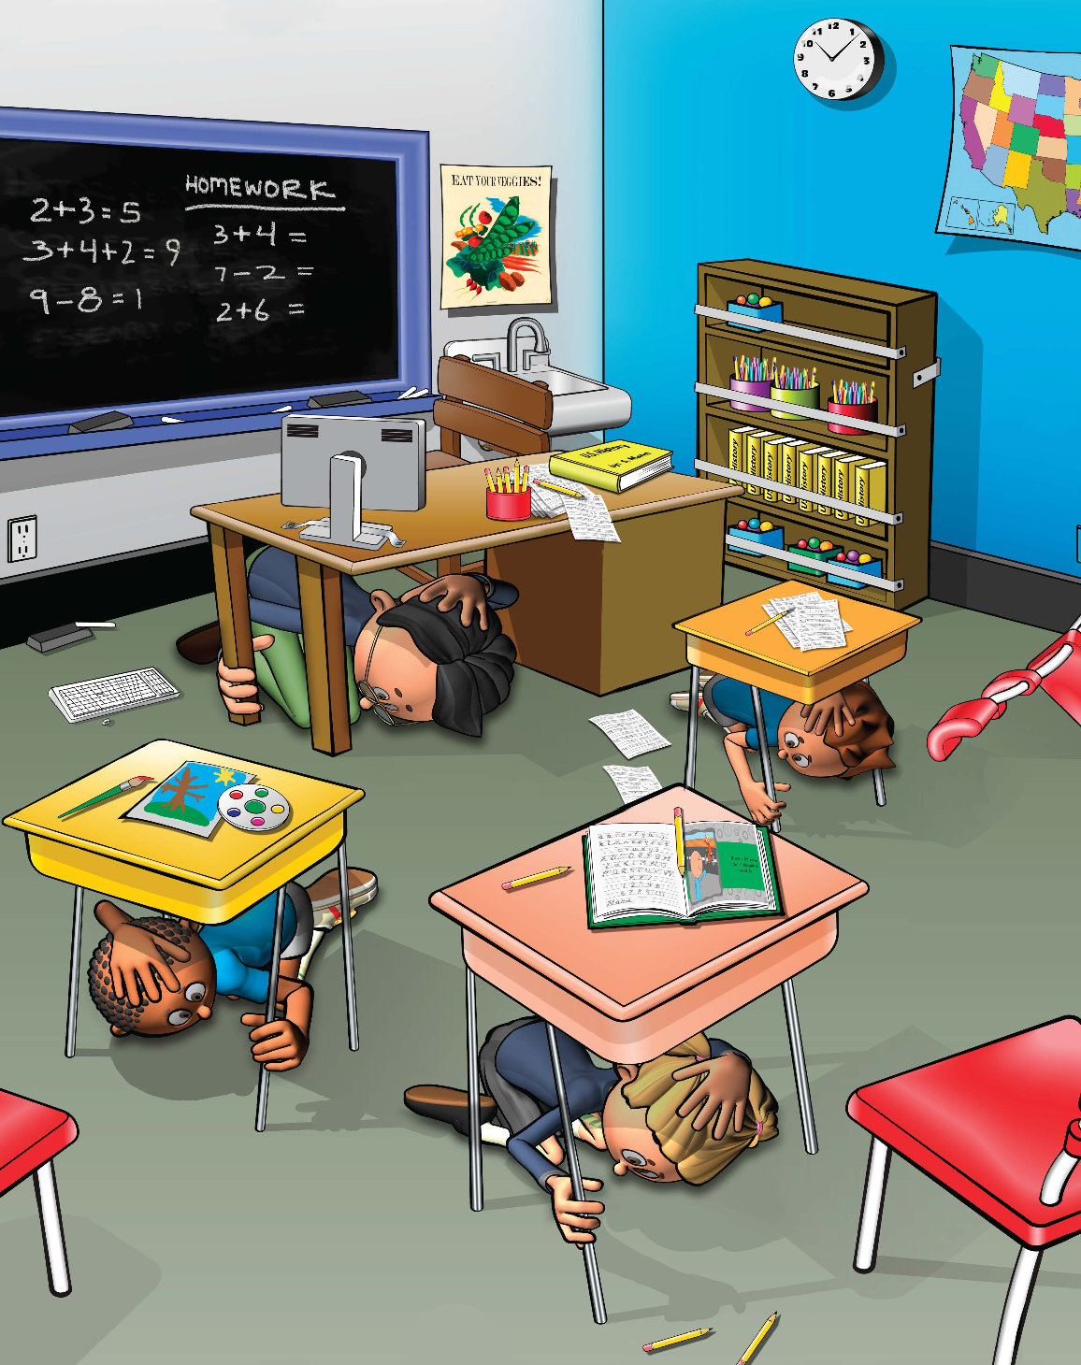
LEARNING TARGET
I can Drop, Cover, and Hold On if there’s ground shaking or if there is an alert.
8
Notes:
Teacher Notes: Tell students that today they are learning about how to react when there is an earthquake or earthquake early warning alert, which could happen anytime.
IMAGE: https://www.fema.gov/emergency-managers/risk-management/building-science/publications?name=&field_keywords_target_id=49441&field_document_type_target_id=All&field_audience_target_id=50525

Slide 9
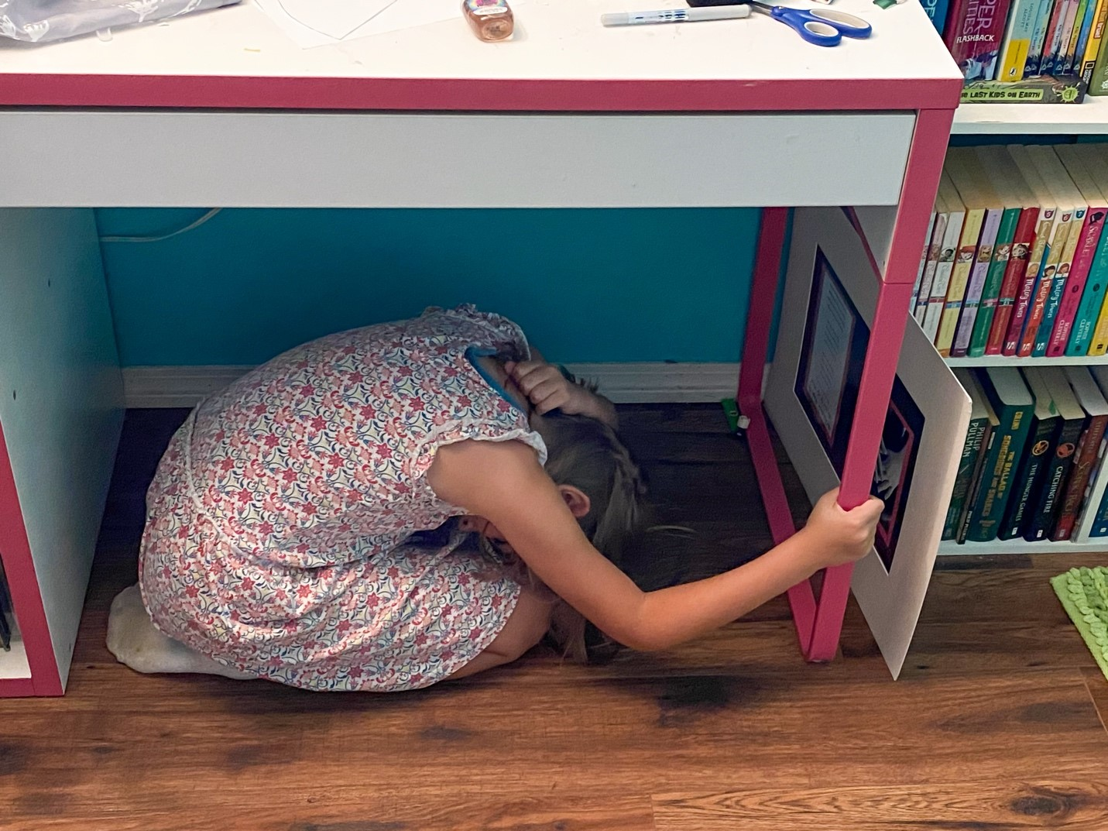
Why do we have drills at school?
9
Notes:
Teacher Notes: Ask students what other drills they’ve practiced at school. Kindergarten students may only have had fire drills at this point in the year, but older students have probably practiced earthquake drills, shelter in place drills, and lockdowns, among others.
Ask students why we practice drills at school. They should respond that we conduct drills to practice how to respond so that if there’s ever a fire or earthquake, we’re prepared and know how to stay safe. We also practice drills so that we can help students feel safer and less afraid at school. Having fire and earthquake drills can help us to feel prepared and less scared!
IMAGE: https://www.usgs.gov/media/images/drop-cover-and-hold-2021-great-hawaii-shakeout

Slide 10
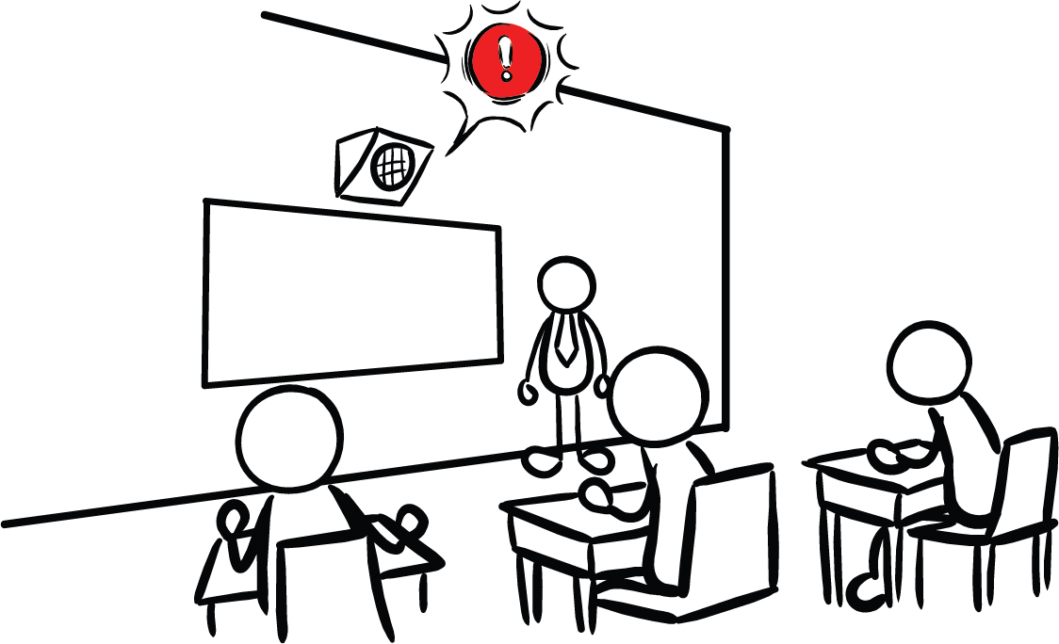
Our school has Earthquake Early Warning!
10
Notes:
Teacher Notes: Tell students that our school has an earthquake early warning system that can give our school community members seconds of extra time to protect ourselves before ground shaking arrives during an earthquake.
IMAGE: https://drive.google.com/file/d/1bey_N-Kk5RGJhFgTLFIgTZLeorlPEFIm/view

Slide 11
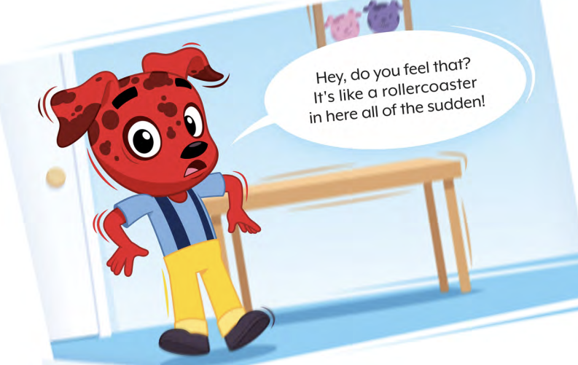
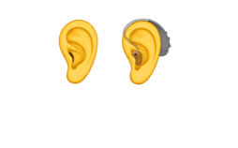
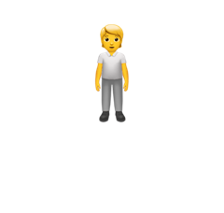
Have you experienced an earthquake? What about your family members?
What did you or family members
SEE?
HEAR?
FEEL?
CREDIT: Rocket’s Earthquake Safety Adventure
11
Notes:
Teacher Notes: Ask students if they or their family members have experienced an earthquake. They may have seen images of people or buildings shaking. They may have seen a cartoon in which a giant fissure opens in Earth’s surface (which is incorrect). They may have heard from family members talk about shaking, objects breaking, or even injuries. Tell students that we’ll learn a little bit about what an earthquake is in this lesson. Validate their feelings, and scan for students that may need some extra support. Keep this conversation brief!
IMAGES: https://rocketrules.org/wp-content/uploads/2020/09/Earthquake_Story_Full_optimized.pdf

Slide 12
The surface of the Earth is broken up into big pieces.
These pieces get stuck together and when they break free, an earthquake happens!
CREDIT: IRIS Earthquake Science YouTube
12
Notes:
Teacher Notes: Slide is animated so video plays when you click anywhere. A second click will move you to the next slide. If you want to start and pause the video, click on the red video play button instead. When done, click anywhere else on slide to advance to the next slide.
Explain to students that the Earth’s surface is broken into many pieces that move around. Most of the time we don’t feel the movement, but sometimes we do. As the pieces of the Earth move, they can become stuck because of friction. An earthquake occurs when the moving pieces of Earth overcome friction and move suddenly. You can demonstrate this by snapping your fingers. Your thumb and finger model the pieces of Earth. At first when you press them together, they’re stuck because of friction. This models the friction between the pieces of Earth. When your finger snaps into the base of your thumb, that’s the earthquake.
VIDEO: https://www.youtube.com/watch?v=-5BgKKutxBs (IRIS Earthquake Science)

Slide 13
What do we do at school if there’s an earthquake?
13
Notes:
Teacher Notes: This slide is animated - the “Drop, Cover, Hold On“ image comes in one image at a time. Review with students what to do if there’s an earthquake while they’re at school. They should remember Drop, Cover, and Hold On. Reinforce the importance of:
getting on knees, and not bottoms
having one hand over the neck
head facing away from glass or any large objects that could fall
hold on to leg of whatever they’re under
IMAGES: https://www.shakeout.org/dropcoverholdon/
https://www.cisa.gov/audiences/educational-institutions

Slide 14
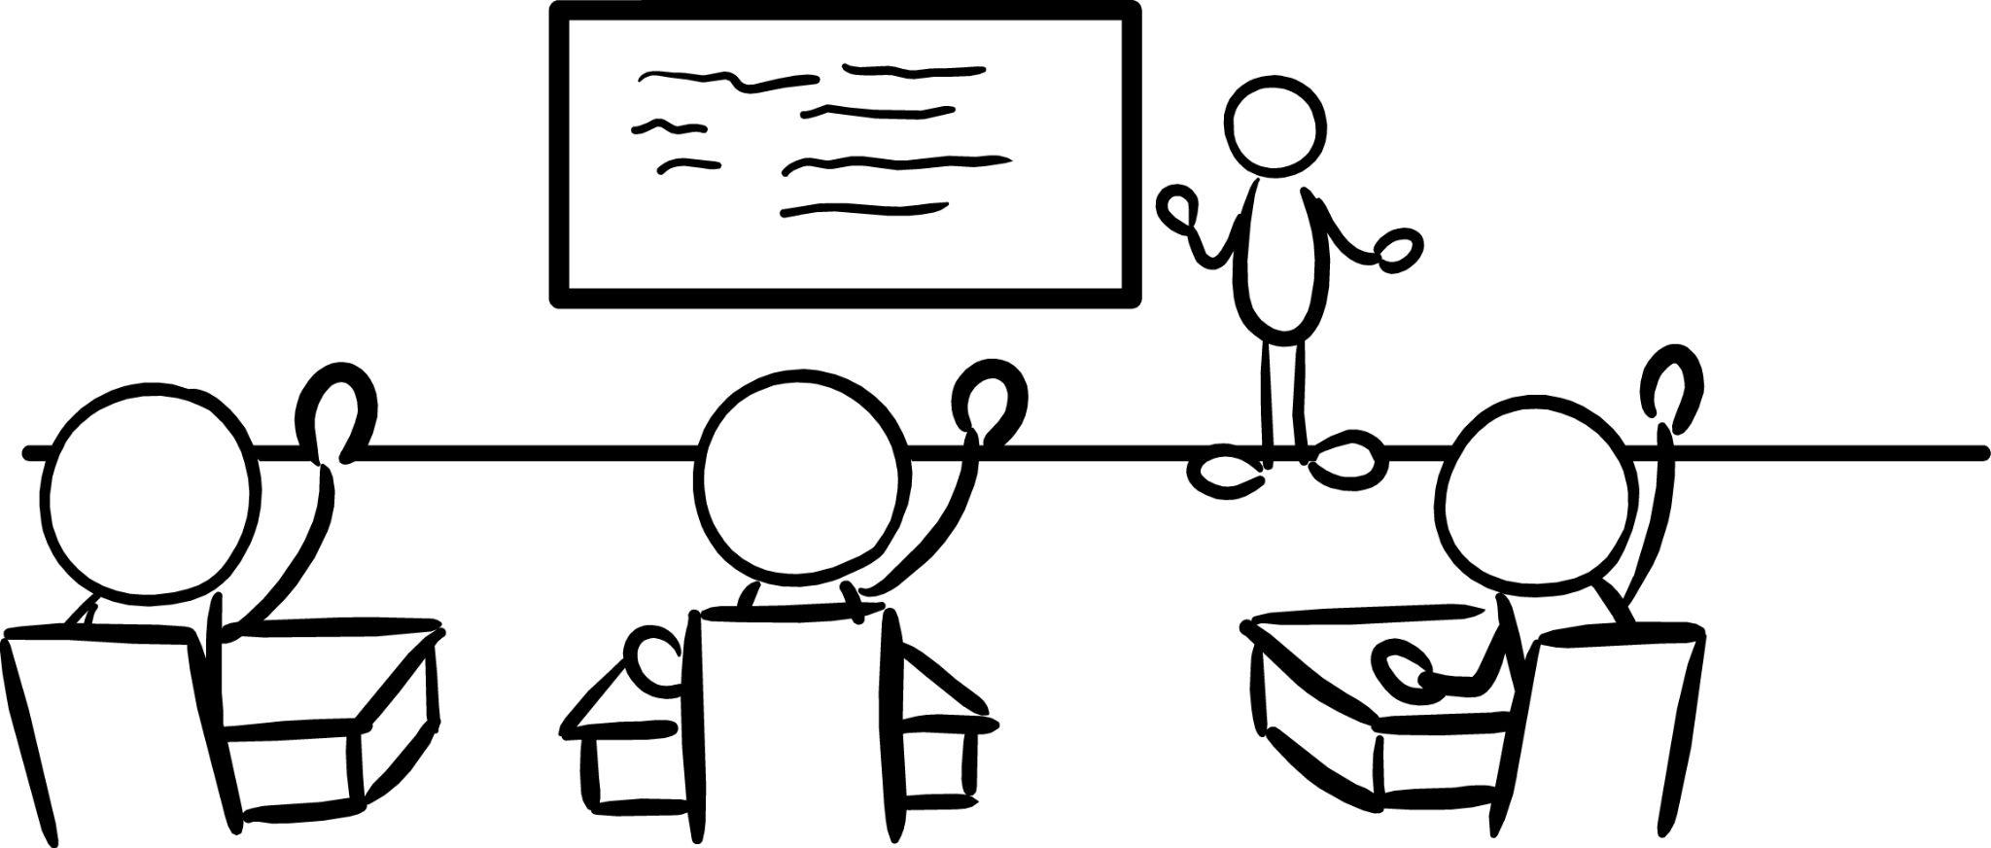
LET’S PRACTICE!
If you experience ground shaking:
DROP
COVER
HOLD ON
14
Notes:
Animation Note: Click anywhere will do two things—the audio will play and the building image will start shaking. The audio and shaking will continue until you click to the next slide.
Teacher Notes: Remind students that they should drop, cover, and hold on if they hear an alert or if there’s ground shaking. Tell students that they will hear sound effects like earthquake shaking. This is just pretend! But it is similar to what you might hear in a real earthquake. Click to play the ground shaking noises and animation, and practice Drop, Cover, and Hold On. Ask students to stay in their protective positions while you observe and offer corrections if necessary. Once you’ve checked each student, ask them to return to their seats.
SOUND: https://www.youtube.com/watch?v=q1wg2IbA0oo Georgia Tech - Hearing the Japanese Earthquake - Clip 3

Slide 15
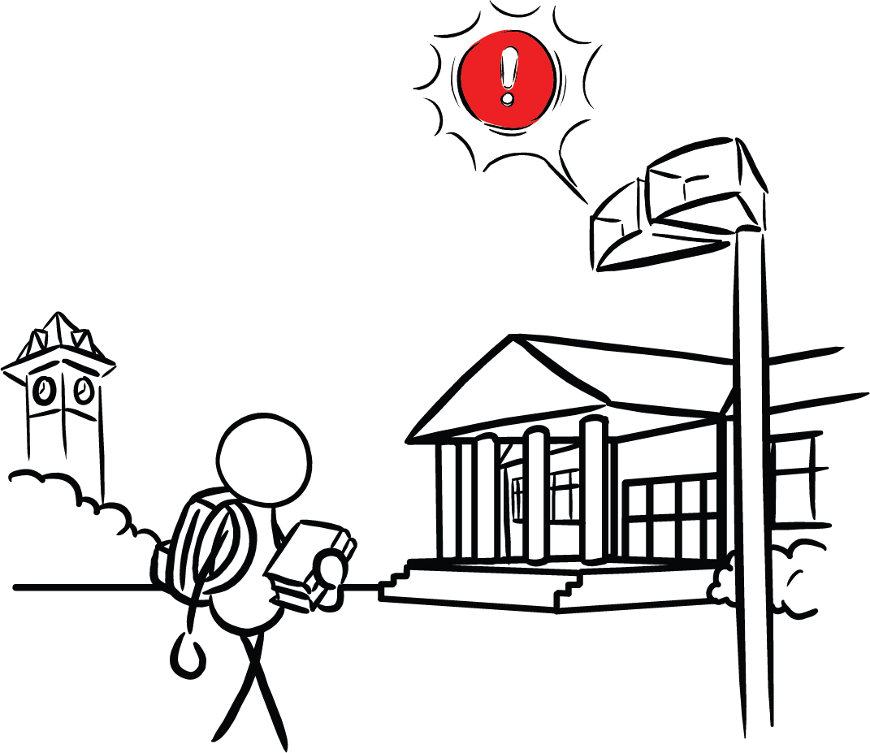
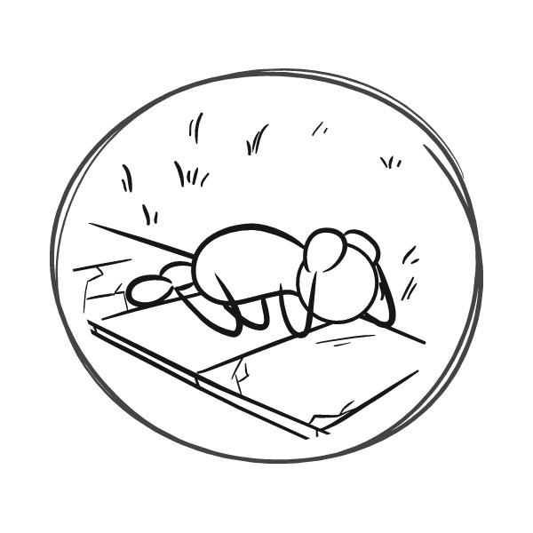
What if you’re outside when you get an alert or feel shaking?
15
Notes:
Teacher Notes: Students may wonder what to do if they’re outside when they feel shaking or get an alert. Tell them to find a clear spot away from buildings, trees, streetlights, and power lines, then Drop, Cover, and Hold On. Stay there until the shaking stops.
IMAGE: https://drive.google.com/drive/folders/1XHxYpX_KrqQc74yKs9rieTcI66z-tMmt

Slide 16
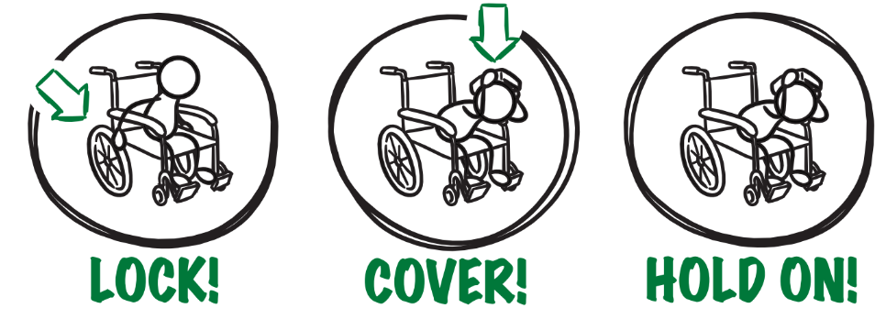
If you or someone you know uses a wheelchair:
16
Notes:
Teacher Notes: Tell students that Drop, Cover, and Hold On looks different for different bodies. Review modified protective actions for people who use wheelchairs. While you may not have students who use wheelchairs in your class, some members of your community might. Ask students to help their family members or friends who use a wheelchair by sharing that “Lock, Cover, and Hold On” is how they can protect themselves during an earthquake. Have students repeat the phrase, “Lock, Cover, and Hold On” after you’ve said it.
IMAGE: https://drive.google.com/file/d/1KaHNTj7_C1NvRDFZE3jWW-6g2K4I_Q4h/view

Slide 17
If you or someone you know uses a cane or walker:
17
Notes:
Teacher Notes: Slide is animated, so images come in when you click.
Review modified protective actions for people who use a cane or walker. While you may not have students who use a cane or walker in your class, some members of your community might. Ask students to help their family members or friends who use a cane or walker by sharing the correct protective actions. Have students repeat the phrase, “Drop, Cover, and Hold On” and then “Lock, Cover, and Hold On” after you’ve said it.
IMAGE: https://drive.google.com/file/d/1KaHNTj7_C1NvRDFZE3jWW-6g2K4I_Q4h/view

Slide 18
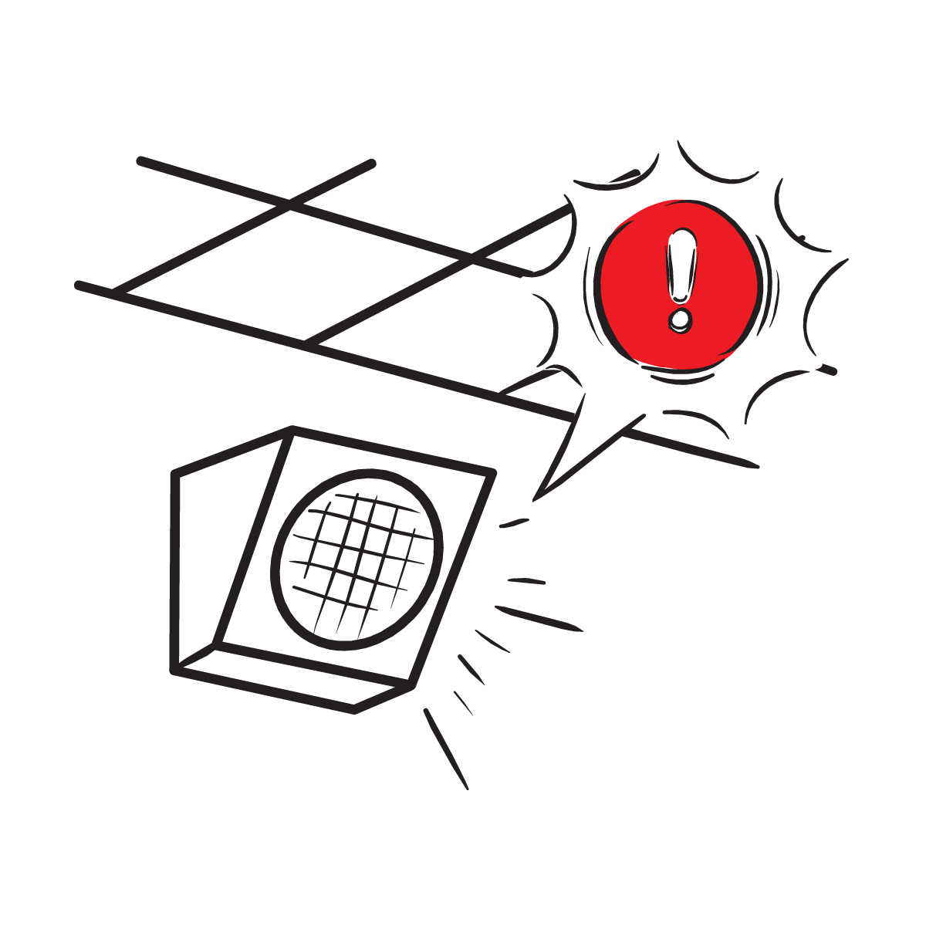
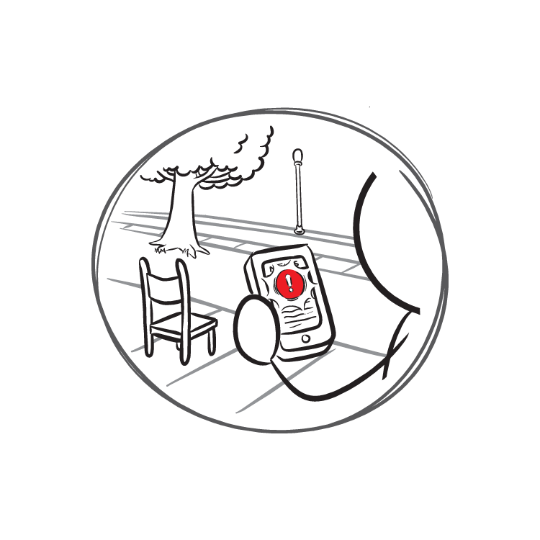
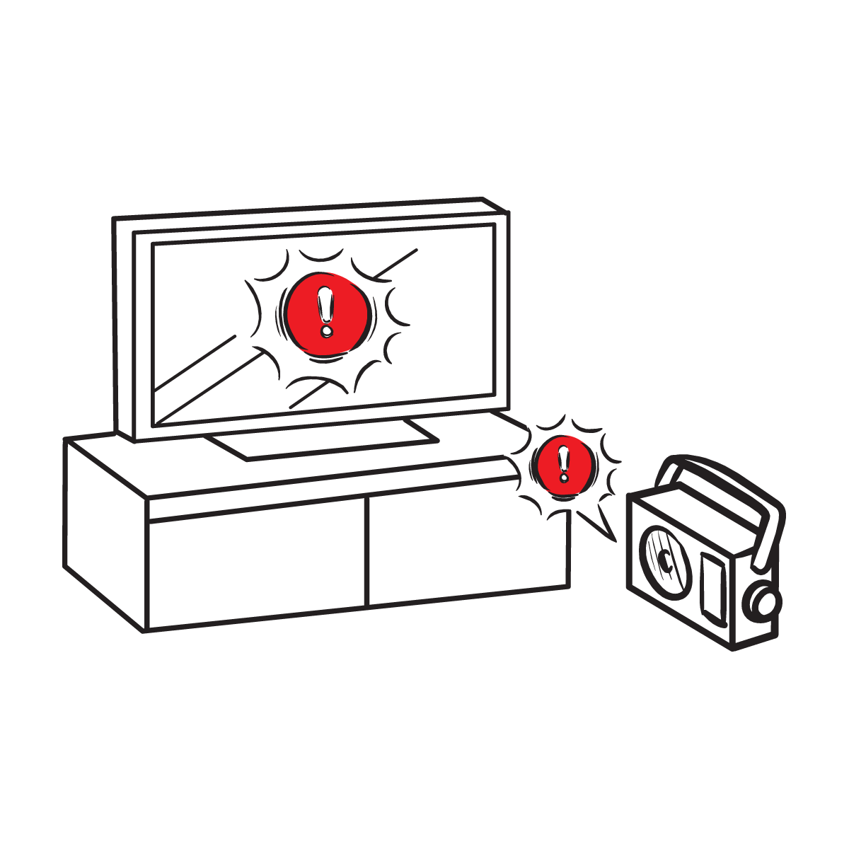
Protect yourself when there is . . .
ground shaking
an earthquake drill
an earthquake early warning alert
18
Notes:
Teacher Notes: Slide is animated, so images come in when you click.
Tell students that they should take these protective actions when the ground shakes, if there’s an earthquake early warning alert, or if they’re doing an earthquake drill, which we’ll do now. Tell students that it’s important that they Drop, Cover, and Hold On immediately and without hesitation.
IMAGES: https://drive.google.com/file/d/1wQ8vlM3KebN_mcLluX37N9BgF1n6ZNB9/view?usp=drive_link, https://www.shakeout.org/

Slide 19
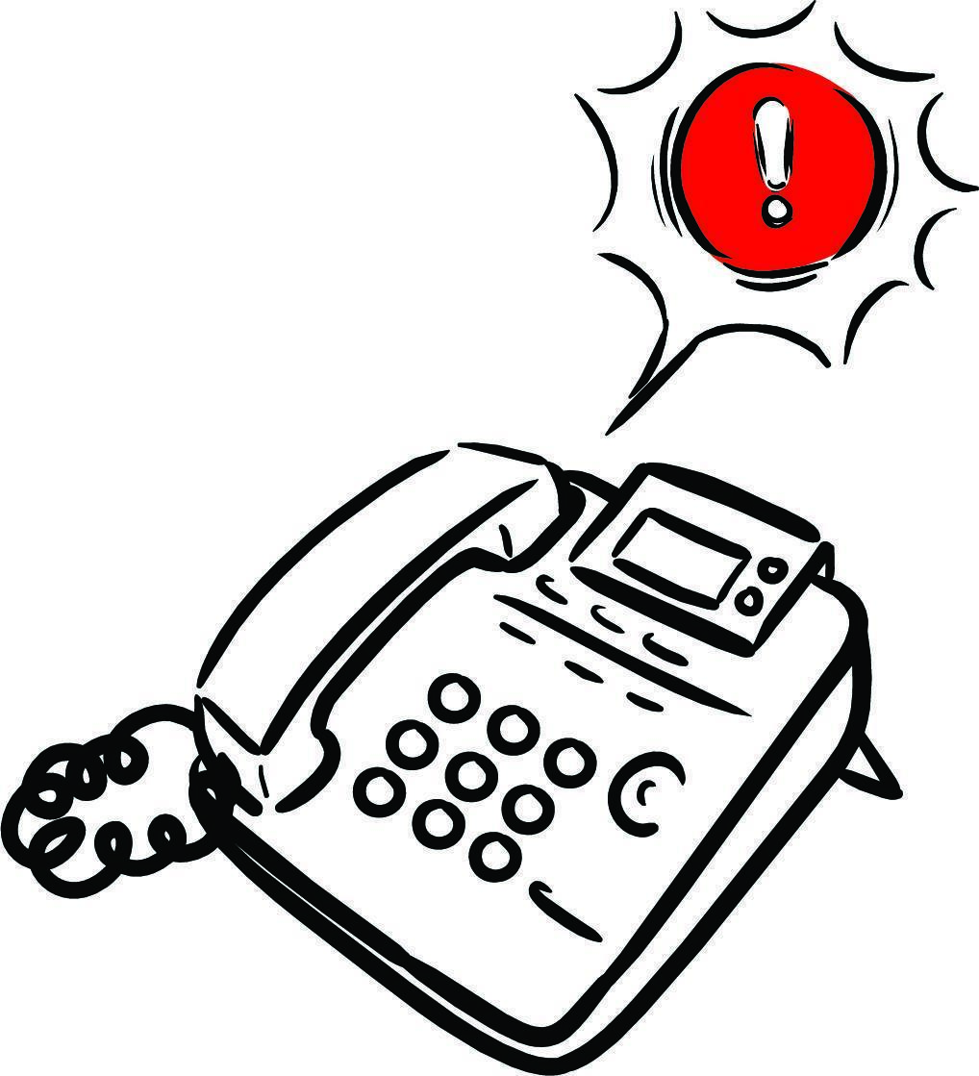
What to Expect from an Alert
19
Notes:
Animation Note: When the slide is clicked once, the audio will start along with the pulsing icon. There is a brief introduction to the alert, and then the alert starts and repeats that shaking is expected twice. Then, there is a seven-second delay before an imitation of an earthquake sound starts with concurrent audio about what to do.
Teacher Notes: Inform students that when you click on the slide that, after a brief introduction, an alert will sound and students should practice Drop, Cover, and Hold On immediately with the alert. Remind students this is only a drill. Play the ShakeAlert alert by clicking anywhere on the slide. Have all students Drop, Cover, and Hold On. Ask students to stay in their protective positions while the teacher observes and offers corrections if necessary. Once the teacher has checked in with each student, ask them to return to their seats.
NOTE: Your EEW alert may sound and look different than the one pictured on the slide!

Slide 20
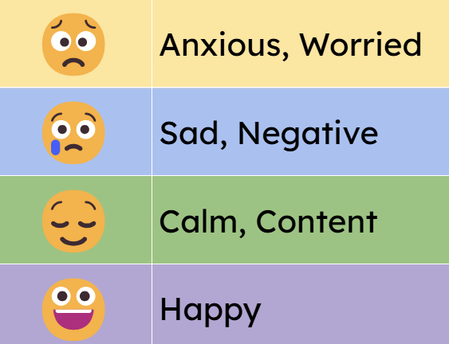
How do you feel?
Turn and talk to a partner!
20
Notes:
Teacher Notes: Sometimes drills can be scary because we don't know what to do or what is happening around us. During these lessons you will practice the drill many times. After practicing, you should feel more confident and hopefully less scared or nervous. When thinking about earthquake drills, how do you feel right now? Turn to a student sitting next to you and talk about where you’re at.

Slide 21
LET’S REFLECT!
How did we do on the drill?
Questions?
Key things to remember?
21
Notes:
Teacher Notes: Ask students to turn and talk to each other about the earthquake drill, how they did, if they have questions, and what they think important things to remember are. After reflecting, remind students of the key takeaways to stay safe during an earthquake, including immediately dropping to your knees, getting under a table if you can and holding on to the table leg, facing away from glass or heavy objects that could fall, covering your head and neck, remaining silent in order to hear teacher instructions, and holding this position until shaking stops.

Slide 22
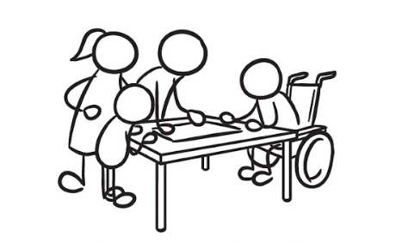
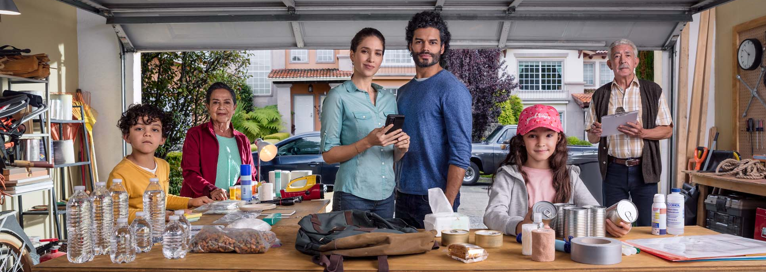
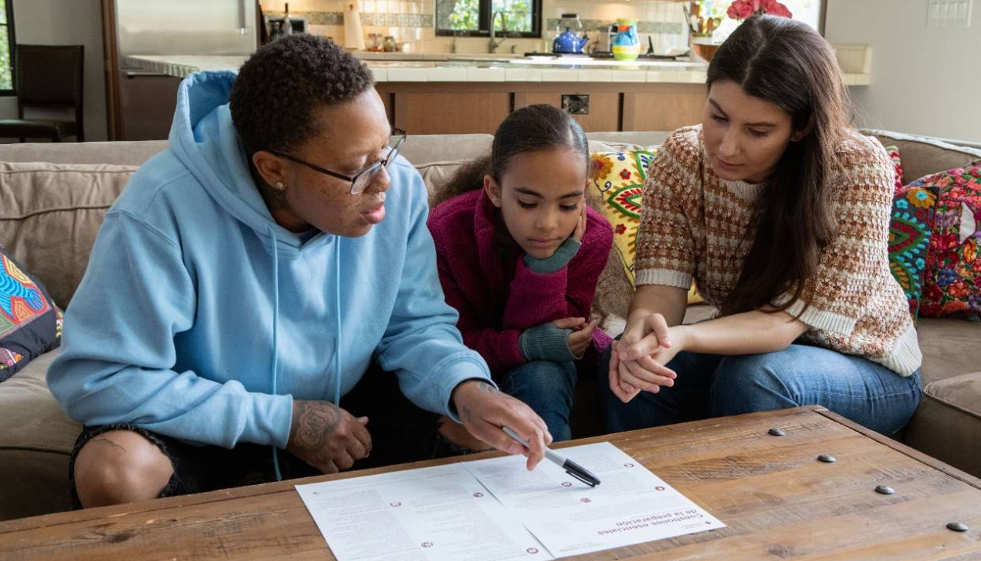
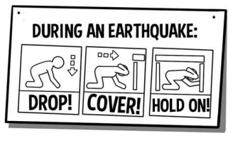
Help the people in your home prepare!
Tell the people in your home what you learned about protecting yourself in an earthquake.
CREDIT: American Red Cross North Texas Region
22
Notes:
Teacher Notes: Regardless of whether you are sending the Family Engagement letter or email home before or after the lesson, tell students to talk with their families about how to stay safe in earthquakes with the adults in their homes. Provide students with the Family Engagement letter if you haven’t already done so.
Image Credit: https://www.redcross.org/local/texas/north-texas/about-us/news-and-events/news/national-preparedness-month--how-to-make-a-plan-and-build-an-eme.html

Slide 23
Teachers, share your feedback, please!
Please complete this brief, anonymous feedback form to help us to improve our ShakeAlert Ready lessons.
23
Notes:
LINK: https://docs.google.com/forms/d/e/1FAIpQLSeNHAr45fDTztflhJJD3_JVS8p0RiV1MW9sKyQgFucGJyKcCA/viewform?usp=sf_link

Slide 24
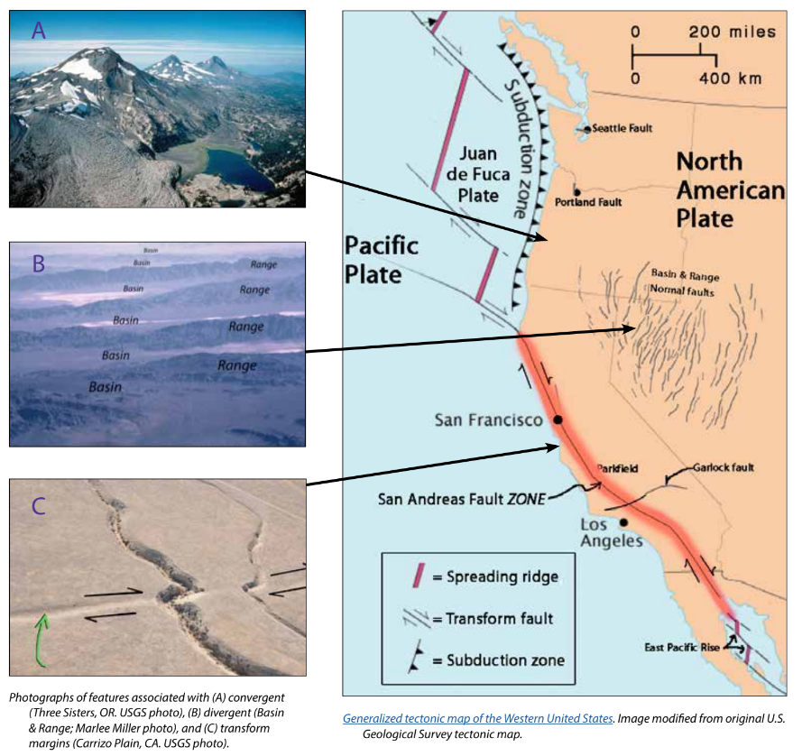
Background - Earthquake Hazards
California, Oregon, and Washington all face hazards from earthquakes because of the underlying tectonic plates, which constantly grind against each other. This friction creates "faults," lines of weakness in the Earth's tectonic plates (lithosphere) where earthquakes are most likely to occur.
California's San Andreas Fault is one example. Another example is the Cascadia Subduction Zone, which threatens all three states and British Columbia, Canada. This giant fault lies offshore, where the Juan de Fuca Plate dives beneath the North American Plate. This type of motion on other subduction zones can cause massive earthquakes, like the one that struck Japan in 2011.
While smaller earthquakes happen often, scientists think a major earthquake could happen any time, so it's important to be prepared.
For more information: Faults, Plate Tectonics & Earthquake Hazards - Animations / Videos
24
Notes:
IMAGE: https://www.iris.edu/hq/inclass/activities/introduction_to_faults_and_plate_tectonics
SOURCE: https://www.usgs.gov/programs/earthquake-hazards/science/pacific-northwest-hazards
https://www.usgs.gov/programs/earthquake-hazards/science/southern-california-earthquake-hazards

Slide 25
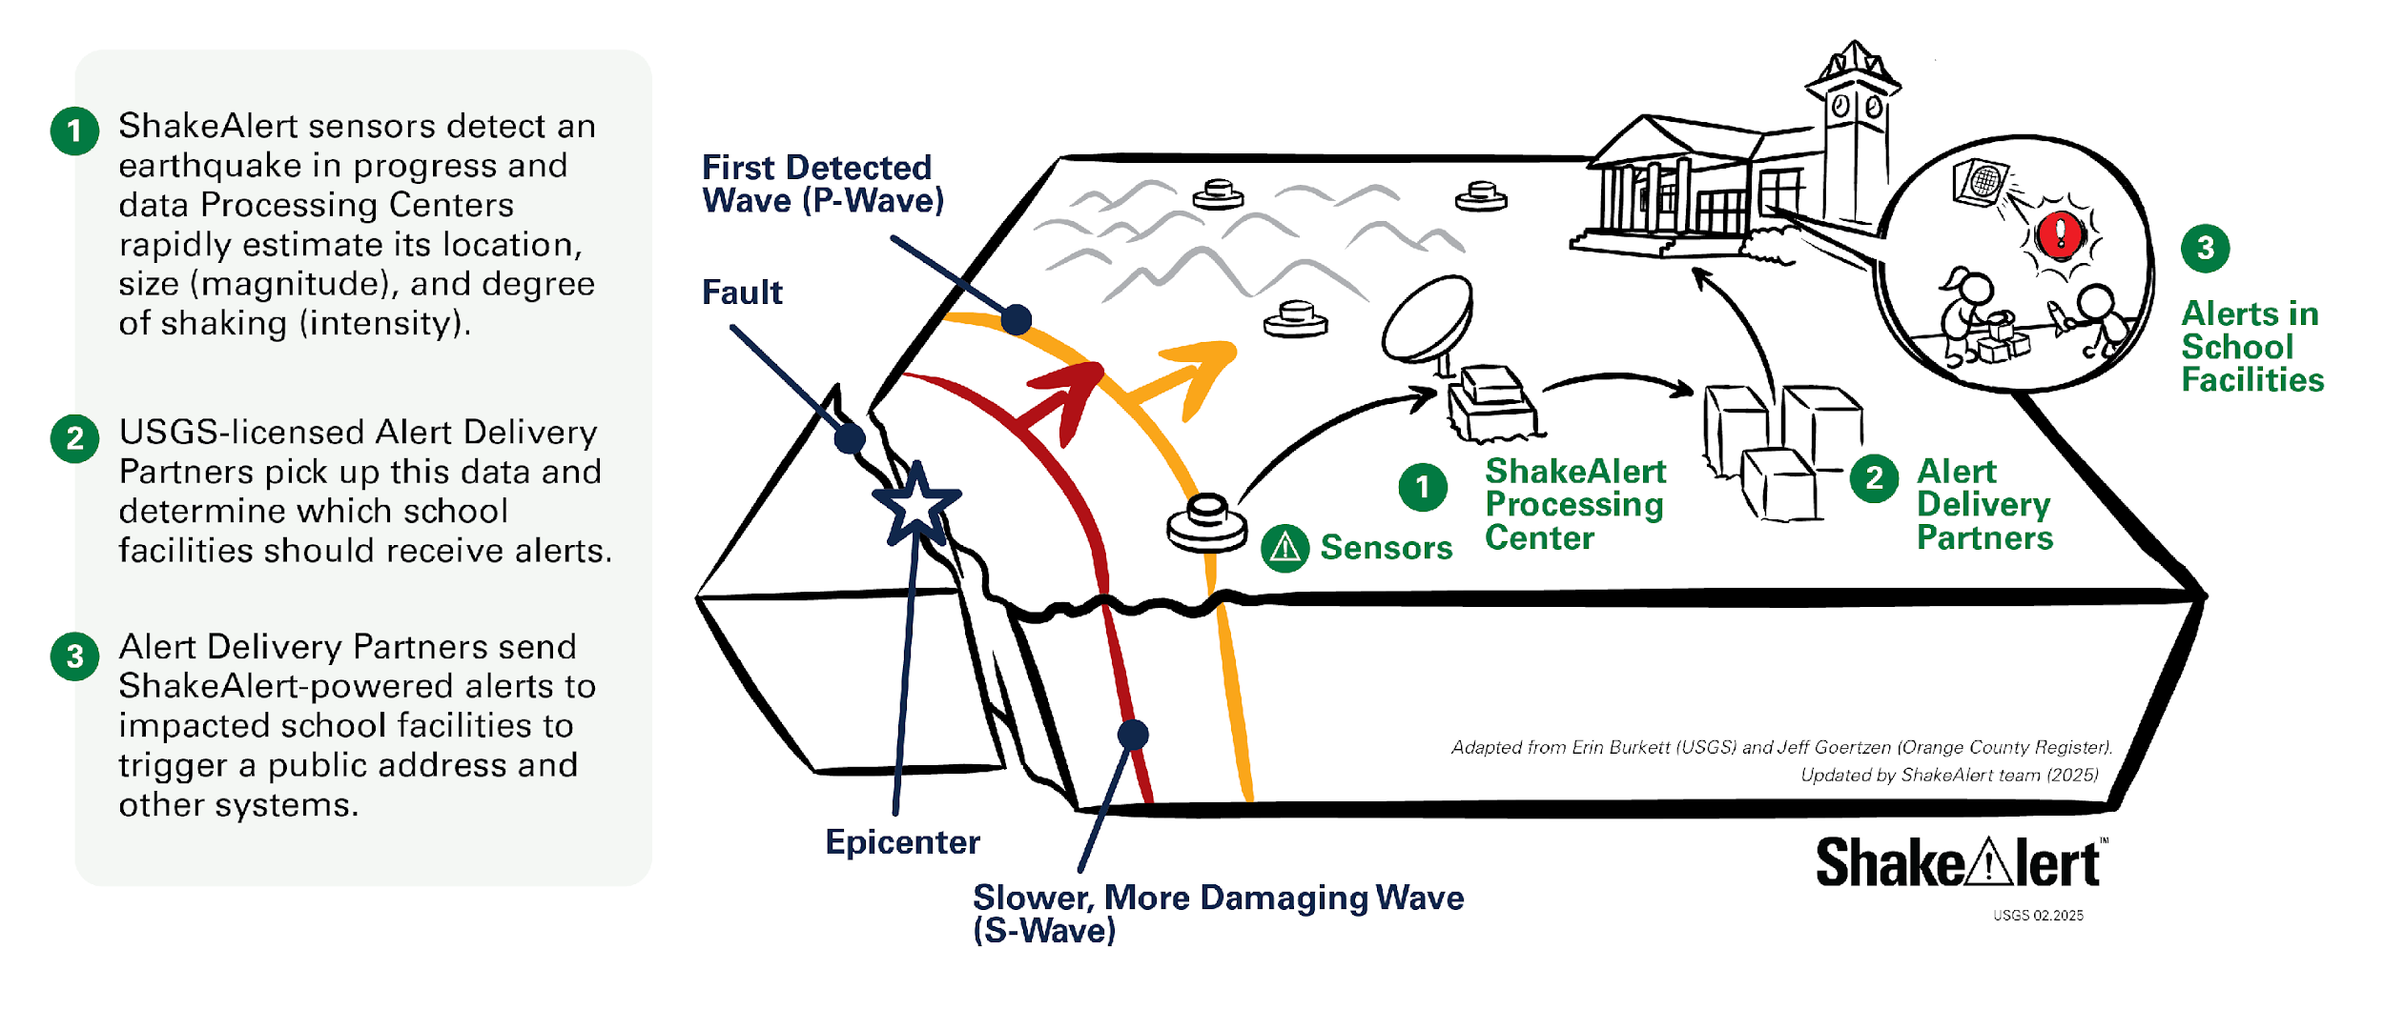
Background - How ShakeAlertⓇ Earthquake Early Warning System Works
25
Notes:
https://drive.google.com/drive/folders/1oQOHup9P_p3DUkyIOi9DwqAlLgzdY45A?usp=drive_link
For more information on Earthquake Early Warning, go to: https://www.iris.edu/hq/inclass/sequences/earthquake_early_warning

Slide 26
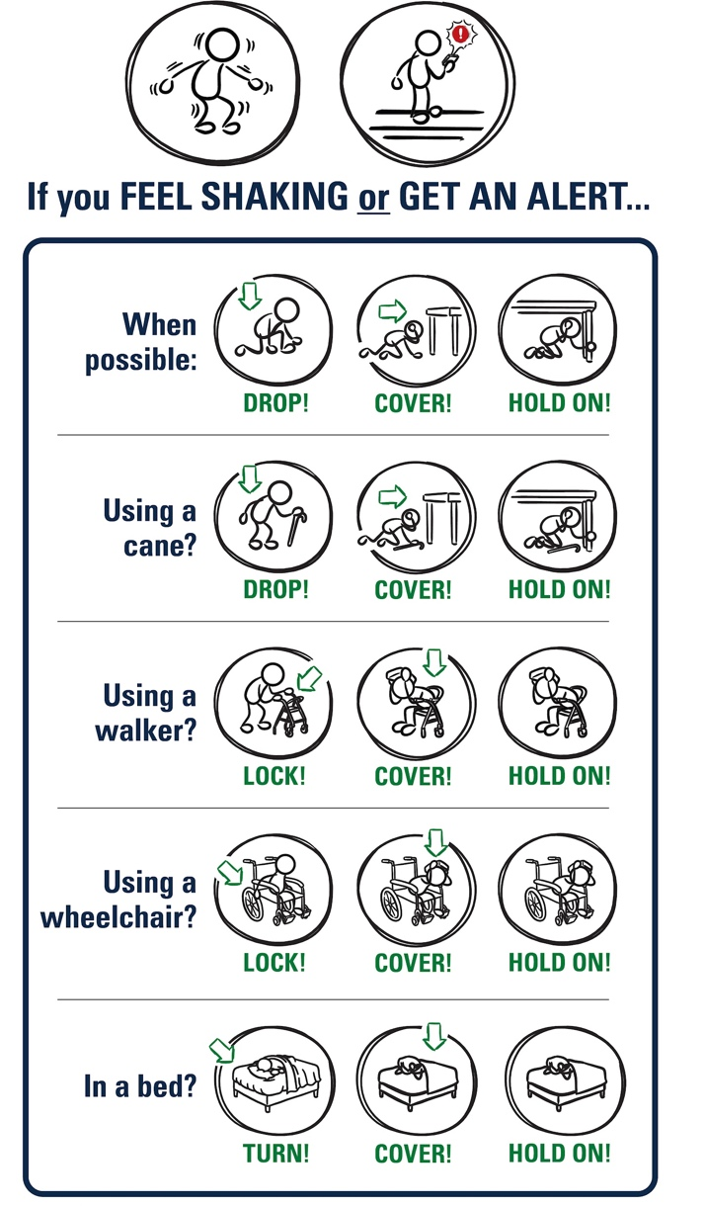
Background - Effective Protective Actions
Most earthquake-related injuries and deaths are caused by collapsing walls and roofs, flying glass and falling objects.
If you are inside a building, move no more than a few steps, then Drop, Cover, and Hold On.
If you are outdoors when the shaking starts, you should find a clear spot away from buildings, trees, streetlights, and power lines, then Drop, Cover, and Hold On. Stay there until the shaking stops.
For protective actions in various settings (descriptions and gifs), go to https://www.earthquakecountry.org/step5/
26
Notes:
SOURCE: https://www.shakeout.org/whyparticipate/
IMAGE: https://drive.google.com/file/d/1KaHNTj7_C1NvRDFZE3jWW-6g2K4I_Q4h/view

Slide 27
Rationale
Why do we practice earthquake drills?
To react quickly you must practice often. You may only have seconds to protect yourself in an earthquake, before strong shaking knocks you down—or knocks something down on you.
Social science research has long shown that people who practice protective actions are more likely to take those actions when a safety- threatening event occurs, such as an earthquake or fire. Tests, drills, and exercises that repeat concepts build “muscle memory” of procedural knowledge and timely reaction. The more frequently a person practices a procedure or self-protective action, such as Drop, Cover, and Hold On, the more likely they will employ it— almost without thinking—when they receive an alert or feel shaking.
Why share the Family Engagement Letter?
While schools practice earthquake drills regularly, most other locations don’t. Some students’ family members may not have practiced earthquake drills since they were in school.
Family members may have outdated information about how to stay safe in an earthquake, such as the incorrect belief that standing in doorways or “the triangle of life” will keep one safe in an earthquake. Students will be able to share correct protective actions (Drop, Cover, and Hold On) with their family and community members.
Students spend more time at home than at school. Therefore, educating families will help more people know what to do when an earthquake strikes. Additionally, families are more likely to understand their family and community members’ needs. This communication can prompt families to ensure they’re prepared to protect all members of their families in case of an earthquake.
In places like Oregon and Washington where earthquakes are less frequent, people might be unaware of the risk of an earthquake.
The Family Engagement Letter has links for family members to learn more about earthquakes and protective actions.
27
Notes:
SOURCE: https://www.shakeout.org/whyparticipate/ , https://www.shakealert.org/toolkit/introduction/

Slide 28
Additional Resources
Sources
ShakeAlert.org
ShakeAlert® Earthquake Early Warning System Education and Training Materials
Earthquake Safety and Preparedness Resources in Multiple Languages
Great ShakeOut Lessons
28

