Slide 1
ShakeAlert® Earthquake Early Warning
Earthquake Drill Lesson
GREEN SLIDES = Teacher Preparation & Information
WHITE SLIDES = Present to Class
Fourth to Fifth Grade
Lesson Length: 1 Hour

Slide 2
Links
Preparation
STUDENT SHEET
  Answer Key
FAMILY ENGAGEMENT LETTER
Open and edit the Family Engagement Letter.
  Add your school name at the bottom.
  If you’re emailing the letter, you can remove the QR code.
Make copies of Family Engagement Letter and/or email to families.
Preview Slides. You can print out the Teaching Steps slides. The teaching steps are also located in the Speaker Notes of each slide.
Open and preview Student Sheet. Adjust as needed for your learners, and then photocopy one sheet per student.
OPTIONAL RECOMMENDED PREPARATION:
  Get a giant SlinkyⓇ to model seismic waves.
  Get a smaller Slinky, or about 3 feet of rope, yarn, string, or even a charging cable for each group of 3-6 students.
  Attach three small flags of masking tape at equidistant intervals along the Slinky or rope to help students see how waves transfer energy.
2

Slide 3
Sensitive Content Warning!
Some students or their family members may have experienced earthquakes, resulting in loss, injuries, and possible trauma. It is therefore important to approach these lessons with sensitivity and awareness. When students share information about their experiences with earthquakes in the first part of the lesson, make sure to scan the class and be aware of any heightened responses. Affirm students’ normal emotional responses. If students are too emotionally heightened, it may be prudent to allow them to forego the drill.
Even students who have never experienced an earthquake may have a strong emotional response to talking about earthquakes. Explain to students that practicing earthquake drills helps our community to stay safe in an earthquake, but that it’s normal to feel big feelings about earthquakes.
Drills build muscle memory that ensures students take the appropriate protective actions during an earthquake. Practice makes perfect, so please insist that students take the exercise seriously, remain quiet, and follow instructions.
3

Slide 4
Teaching Steps – Page 1
SLIDE 14 - Tell students that today we are practicing DROP, COVER, and HOLD ON to stay safe if we feel shaking or get an earthquake early warning alert. If you are teaching this lesson as part of the Great ShakeOut, tell students that millions of people in countries around the world take part in the Great ShakeOut on the 3rd Thursday of October every year.​ Tell students that we will also model earthquake waves to learn about how they affect objects.
SLIDE 15 - Ask students what other drills they’ve practiced at school. Students have probably practiced earthquake drills, shelter in place drills, and lockdowns among others. Ask students why we practice drills at school. They should respond that we conduct drills to practice how to respond so that if there’s ever a fire or earthquake, we’re prepared and know how to stay safe. We also practice drills so that we can help students feel safer and less afraid at school. Having fire and earthquake drills can help us to feel prepared and less scared! Tell students that our school has an earthquake early warning system that can give our school community members seconds of extra time to protect ourselves before strong shaking arrives during an earthquake.
SLIDE 16 - Ask students what they have seen or heard about earthquakes. It’s likely that many of them have not experienced an earthquake. They may have heard from family members about shaking, objects breaking, or even possibly injuries. It’s possible they’ve seen or heard about earthquakes through the media. Validate students’ experiences, and scan for students that may need some extra support. Tell students that we’ll learn more about what an earthquake is in this lesson. Consider recording students’ questions so that you can return to them at them end of the lesson to see which have been addressed through the lesson, and try to answer the others.
4

Slide 5
Teaching Steps – Page 2
SLIDE 17 - Sometimes drills can be scary because we don't know what to do or what is happening around us. During this lessons you will practice DROP, COVER, and HOLD ON. After practicing, you should feel more confident and hopefully less scared or nervous. When thinking about earthquake drills, how do you feel right now? Turn to a student sitting next to you and talk about where you’re at.
SLIDE 18 - Tell students that next they will consider three statements about earthquakes and decide whether they think the statements are True or False. Tell them you’ll read a statement, and give them 15 seconds to discuss with their elbow partner. Set a timer if you’d like. When the timer goes off, they will put their thumbs up if they think the statement is true, and their thumbs down if they think the statement is false. Once students have responded, go to the next slide to reveal the answer.
SLIDE 19 - Audio will automatically play on the slide. AUDIO SCRIPT: TRUE. Earthquakes are happening all over the world, and all the time. There’s likely one happening right now somewhere. Most of them might be too small for us to feel, but specialized machines are always recording seismic waves under the Earth’s surface.
SLIDE 20 - Read, “Scientists can predict when an earthquake will happen,” and start a 15 second timer for student discussion. When the timer goes off, students should put their thumbs up if they think the statement is true, and their thumbs down if they think the statement is false. Once students have responded, go to the next slide to reveal the answer.
5

Slide 6
Teaching Steps – Page 3
SLIDE 21 - Audio will automatically play on the slide. AUDIO SCRIPT: FALSE. Scientists cannot predict exactly when an earthquake will happen. However, recent technology can send out alerts to people once the earthquake starts that may arrive to certain people before strong shaking happens in their area. Your school has the ShakeAlertⓇ Earthquake Early Warning system installed.
SLIDE 22 - Read, “During an earthquake, you should run outside,” and start a 15 second timer for student discussion. When the timer goes off, students should put their thumbs up if they think the statement is true, and their thumbs down if they think the statement is false. Once students have responded, go to the next slide to reveal the answer.
SLIDE 23 - Audio will automatically play on the slide. AUDIO SCRIPT: FALSE. The most common causes of injury in earthquakes include people falling down and/or getting hit by falling debris. In the US, where buildings meet basic building standards, staying inside the building (preferably under a table) is actually safer than trying to exit. If no table is available, simply crouch on the floor and cover your head and neck with your hands.
SLIDE 24 - Explain to students that the Earth’s surface is broken into many pieces that move around. Most of the time we don’t feel the movement, but sometimes we do. As the pieces of the Earth move, they can become stuck because of friction like when you slide your tennis shoe across a floor, and it gets stuck. An earthquake occurs when the moving pieces of Earth overcome friction and move suddenly. You can demonstrate this by snapping your fingers. Your thumb and finger model the pieces of Earth. At first when you press them together, they’re stuck because of friction. This models the friction between the pieces of Earth. When your finger snaps into the base of your thumb, that’s the earthquake
6

Slide 7
Teaching Steps – Page 4
SLIDE 25 -Tell students that earthquakes release waves of energy, which we will learn more about next. Ask students to turn and talk with their elbow partner about what they think a wave is, and what kinds of waves they’ve heard of.
  Students may say that a wave is moving water. They may mention ocean waves, sound waves, heat waves, or a flag or person’s hand waving.
SLIDE 26 - Tell students that waves of energy are released during an earthquake, which we call seismic waves. There are different kinds of seismic waves. Students should observe that the p-wave arrives first and moves the house up and down, the s-wave is second and moves the house side to side, and the surface wave arrives last, and moves the house in an undulating motion. The waves are similar because they all move the house. They are different in the time it takes for them to arrive at the house, whether they move through the earth or across its surface, and in how they move the house. Point out to students that seismic waves transfer energy and not matter. The house moved because energy was transferred from the earthquake to the house, not because matter was transferred from the earthquake to the house.
SLIDE 27 - Tell students that we can model seismic waves using a SlinkyⓇ. A giant Slinky works best for this. If you have one, have two students hold either end and stretch it out between them on the floor. If you don’t have a Slinky, just show and discuss the animations on the following two slides. Model a p-wave with the Slinky by having the student on one end of the Slinky push it toward the other student. Instruct other students to observe. Repeat this step a few times as students share their observations.
7

Slide 8
Teaching Steps – Page 5
SLIDE 28 - Model an s-wave with the Slinky by having the student on one end of the Slinky move it back and forth. Instruct other students to observe. Repeat this step a few times as students share their observations.
SLIDE 29 - This slide is optional for teachers who are providing small groups of students with a rope or Slinky to experiment with. This slide contains a video with images to demonstrate how to experiment safely with the rope of Slinky. If you are providing students with a Slinky, rope, yarn, etc. to model waves, go over the safety guidelines, and give them time to discover ways to send energy through the material. Consider setting a four-minute timer for students to experiment, and ask students to be ready to share their observations with the class once time’s up!
SUGGESTED SAFETY GUIDELINES:
Someone needs to hold the rope on each side at all times.
Stay seated on your bottom or knees the entire time.
The rope or Slinky shouldn’t go higher than stomach-height.
8

Slide 9
Teaching Steps – Page 5
SLIDE 30 - This slide is optional. If you are modeling waves using a SlinkyⓇ or section of rope, use this slide to guide your demonstration. To start, explain to students that amplitude is one way we can describe the energy in a wave. Point out that amplitude is the distance from the midpoint of the wave to the furthest point from the midpoint, called the crest or trough. Model a wave with a higher amplitude with the Slinky or rope. Then model a wave with a lower amplitude. Ask students to observe the differences in how the tape moves with a high vs a lower amplitude wave. They should notice that the higher the amplitude, the more the tape moves. Ask students to notice what happens to the amplitude of the wave as it travels down the Slinky or rope. They should notice that the amplitude decreases as the wave travels, as they observe the tape closest to the source of the wave moving more, and the tape furthest from the source of the wave moving less. They may also note that the amplitude changes direction back and forth across the midpoint as it travels. Point out to students again that seismic waves transfer energy, not matter. If you’re using a section of rope to model waves, point out that while the tape moves back and forth, it doesn’t move down the rope.
SLIDE 31 - Watch the video of seismic waves traveling through the Earth again. Ask students what they observe about how the distance between waves changes as they travel away from where the earthquake started. They should notice that when the earthquake starts, the waves are right on top of each other. As the waves travel through the earth, the distance between them grows.
SLIDE 32 - Point out the p-wave and s-wave in the diagram as they appear. Remind students that seismic waves can affect people long distances from where they begin. Tell students that the p-waves move the fastest, but are less damaging, whereas s-waves are slower but are more damaging. Tell students that as soon as the first wave is detected, alerts are sent to areas that may experience strong shaking. Therefore, as soon as you get an alert, you should Drop, Cover, and Hold On.
9

Slide 10
Teaching Steps – Page 8
SLIDE 33 - Ask students to discuss whether they think there could be an earthquake where they live. Students in California will probably know that there are earthquakes nearby, but students in Oregon and Washington may not be aware that there is a risk of earthquakes.
SLIDES 34 - 36 are optional, and are hidden in the slidedeck. To unhide them, right click and click on “Unhide Slide.”
  SLIDE 34 - Tell students that this map shows the chance of experiencing a strong earthquake in the next 100 years. Point out that the red areas have a greater than 95% chance of experiencing a strong earthquake in the next 100 years, whereas the blue areas have a less than 5% chance. Ask a student to come up and point to the area where you live on the map. Work with students to determine the earthquake risk where you live using the key.
  SLIDE 35 - This map also shows population density. Tell students that the black areas have lots of people living closer together, and light purple areas have a moderate amount of people living closer together. Again ask a student to come up and point to the area where you live on the map.
  SLIDE 36 - Ask students what patterns they see in this map. What does this map show us about the area we live? Students should notice that California has the highest chance of experiencing a strong earthquake in the next 100 years, with many areas having a >95% chance. Areas in Oregon and Washington near the Pacific Ocean have a 50-95% chance of experiencing a strong earthquake in the next 100 years.
SLIDE 37 - Review and model correct protective actions - Drop, Cover, and Hold On. Make sure students know they should drop to their knees (not their bottoms), have one hand over their necks, and try to get away from glass or any other objects that could fall on them. If they’re able to get under a table or desk while staying on their knees, they should. Once there, they should hold on to the leg of the table.
10

Slide 11
Teaching Steps – Page 9
SLIDE 38 - Tell students that Drop, Cover, and Hold On looks different for different bodies. Review modified protective actions for people who use wheelchairs. While you may not have students who use wheelchairs in your class, it is likely that there are members of your community who do. Ask students to help their family members or friends who use a wheelchair by sharing that “Lock, Cover, and Hold On” is how they can protect themselves during an earthquake. Have students repeat the phrase, “Lock, Cover, and Hold On” after you’ve said it.
SLIDE 39 - Review protective actions for people who use a cane or walker.
SLIDE 40 - This slide is animated and the “Cover” and "Hold On” appear individually when you click enter or down so you can discuss why each protective action is important in turn. Begin by asking students why each protective action is important. Add on to student responses as necessary.
    DROP: Dropping to your knees protects you from falling or being hit by falling objects during ground shaking.
    COVER: We cover our neck and head with one arm and hand to protect them from becoming injured if something falls. The back of the neck is particularly important to protect because your head has a skull to protect it.
    HOLD ON: We hold on to a table leg once we’re beneath a table so that the earthquake doesn’t move us out from underneath the table that is protecting us.
SLIDE 41 - Tell students that they should take protective actions when the ground shakes, if there’s an earthquake alert, or if they’re doing an earthquake drill, which we’ll do now. Tell students that it’s vital they Drop, Cover, and Hold On immediately and without hesitation.
11

Slide 12
Teaching Steps – Page 9
SLIDE 42 - Play the ShakeAlertⓇ message. Have all students Drop, Cover, and Hold On. Ask students to stay in their protective positions while the teacher observes and offers corrections if necessary. Once the teacher has checked in with each student, ask them to return to their seats. NOTE: Your EEW alert may sound and look different than the one pictured on the slide!
SLIDE 43 - Ask students to turn and talk to each other about the earthquake drill, how they did, if they have questions, and what they think important things to remember are. After reflecting, remind students of the key takeaways to stay safe during an earthquake, including immediately dropping to your knees, getting under a table if you can and holding on to the table leg, facing away from glass or heavy objects that could fall, covering your head and neck, remaining silent so that you can hear teacher instructions, and holding this position until shaking stops.They also learned that seismic waves travel at different speeds, with less damaging p-waves travelling faster than more damaging s-waves.
SLIDE 44 - Sometimes drills can be scary because we don't know what to do or what is happening around us. After practicing, you should feel more confident and hopefully less scared or nervous.
SLIDE 45 - Ask students how they are feeling now that they’ve learned about how and why earthquakes occur, as well as how to protect themselves during an earthquake or if they get an earthquake early warning.
12

Slide 13
Teaching Steps – Page 10
SLIDE 46 - If you’re providing students with the student sheet to review their learning, do so now.
SLIDE 47 - Tell students that most of the adults they know have probably not taken part in an earthquake drill since they were students and may have incorrect ideas about how to protect themselves in an earthquake. They can help the people they live with, and community members prepare by teaching them about Drop, Cover, and Hold On, and informing them about ways to prepare, such as signing up for ShakeAlert-powered alerts and preparing an emergency kit and plan. Ask them to share the Family Engagement Letter with their families tonight.
SLIDE 48 - NEXT DAY: Ask students how their conversations with their families went. Did their family members know that Drop, Cover, and Hold On are the correct protective actions? Did they talk about an emergency plan?
SLIDE 49 - OPTIONAL - Please complete the ShakeAlert Ready! Great ShakeOut Lesson Feedback Form.
NOTE: Please see the green slides at the end of this deck for information on earthquakes and how earthquake early warning works
13

Slide 14
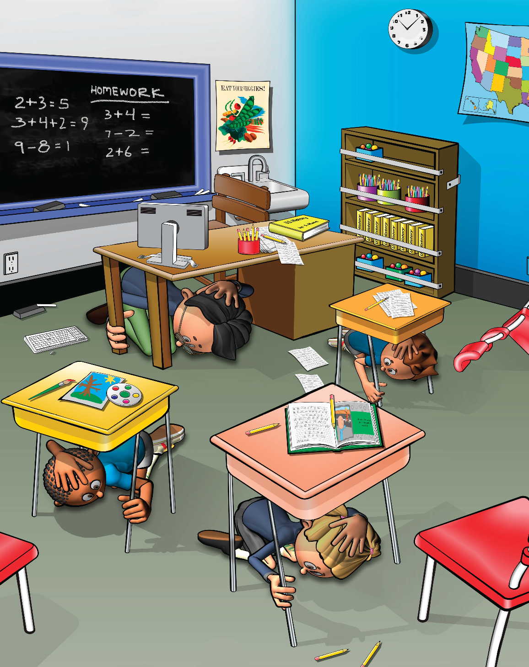
Learning Targets
I can Drop, Cover, and Hold On if there’s shaking or I get an alert.
I can use a model to describe how waves of energy from an earthquake affect objects at various distances from where the earthquake starts.
14
Notes:
Teacher Notes: Tell students that today we are practicing DROP, COVER, and HOLD ON to stay safe if we feel shaking or get an earthquake early warning alert. If you are teaching this lesson as part of the Great ShakeOut, tell students that millions of people in countries around the world take part in the Great ShakeOut on the third Thursday of October every year.​ Tell students that we will also model earthquake waves to learn about how they affect objects.
IMAGE: Image courtesy of FEMA

Slide 15

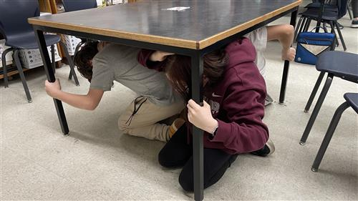
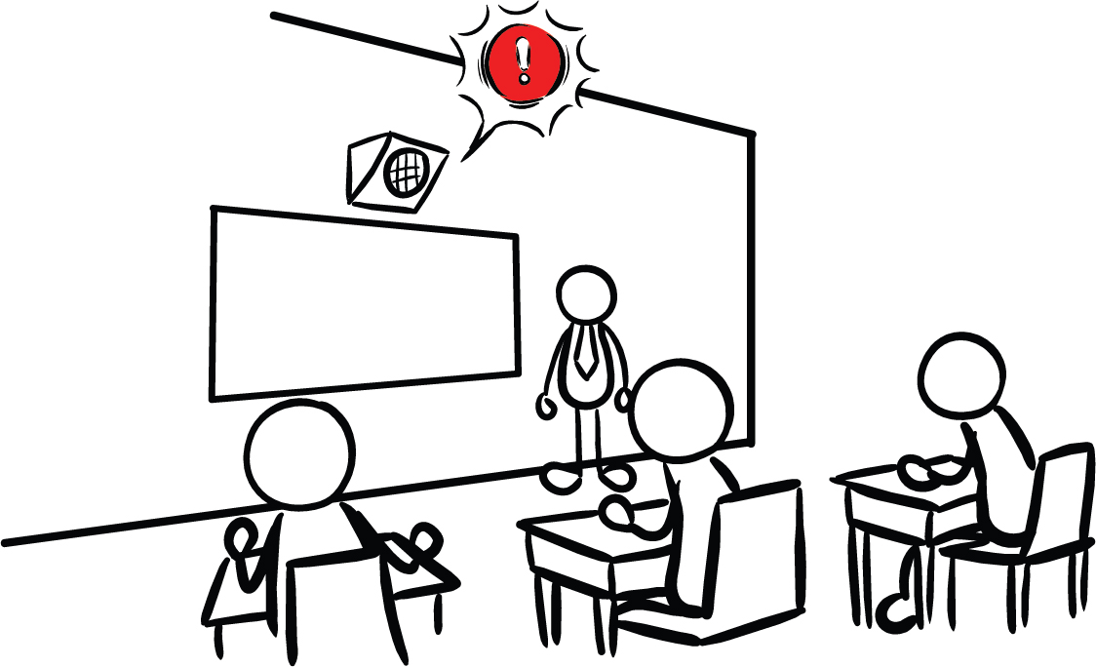
What other safety drills have we had at school?
Why do we have drills at school?
Our school has Earthquake Early Warning!
15
Notes:
Teacher Notes: This slide is animated so the questions appear one at a time. Ask students what other drills they’ve practiced at school. Students have probably practiced earthquake drills, shelter in place drills, and lockdowns among others.
Ask students why we practice drills at school. They should respond that we conduct drills to practice how to respond so that if there’s ever a fire or earthquake, we’re prepared and know how to stay safe. We also practice drills so that we can help students feel safer and less afraid at school. Having fire and earthquake drills can help us to feel prepared and less scared!
Tell students that our school has an earthquake early warning system that can give our school community members seconds of extra time to protect ourselves before strong shaking arrives during an earthquake.
IMAGES: Image credits from left to right. Image courtesy of Educator Clips. Image courtesy of Roger Groom. Used with permission. Image courtesy of USGS.

Slide 16
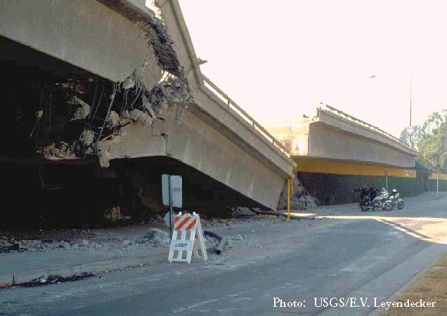
What are some things you have seen or heard about earthquakes?
What do you wonder about earthquakes?
16
Notes:
Teacher Note: Ask students what they have seen or heard about earthquakes. It’s likely that many of them have not experienced an earthquake. They may have heard from family members about shaking, objects breaking, or even possibly injuries. It’s possible they’ve seen or heard about earthquakes through the media. Validate students’ experiences, and scan for students that may need some extra support. Tell students that we’ll learn more about what an earthquake is in this lesson. Consider recording students’ questions so that you can return to them at them end of the lesson to see which have been addressed through the lesson, and try to answer the others.
IMAGE: Image courtesy of USGS
This image shows a bridge that collapsed during the Northridge earthquake

Slide 17
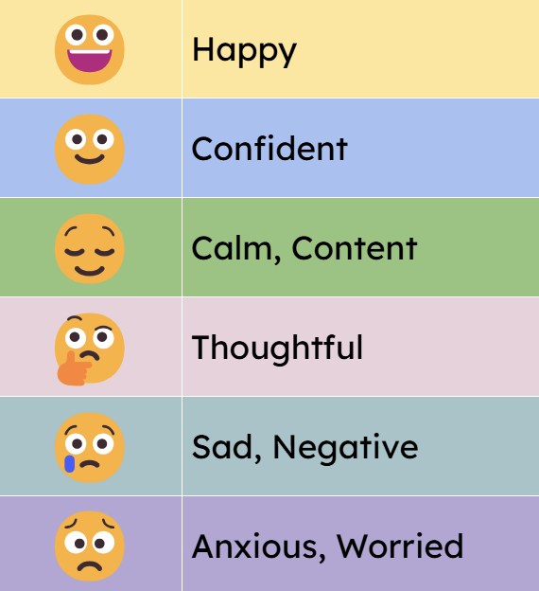
How do you feel?
Turn and talk to a partner!
17
Notes:
Teacher Notes: Sometimes drills can be scary because we don't know what to do or what is happening around us. During this lessons you will practice DROP, COVER, and HOLD ON. After practicing, you should feel more confident and hopefully less scared or nervous. When thinking about earthquake drills, how do you feel right now? Turn to a student sitting next to you and talk about where you’re at.

Slide 18


True or False?
An earthquake will happen somewhere today.
OR
18
Notes:
Teacher Notes: Tell students that next they will consider three statements about earthquakes and decide whether they think the statements are True or False. Tell them you’ll read a statement, and give them 15 seconds to discuss with their elbow partner. Set a timer if you’d like. When the timer goes off, they will put their thumbs up if they think the statement is true, and their thumbs down if they think the statement is false. Once students have responded, go to the next slide to reveal the answer.
CREDIT: https://omsi.edu/wp-content/uploads/2023/07/ShakeAlert-Interactive-Demos-v.-Jul-2023.pdf

Slide 19

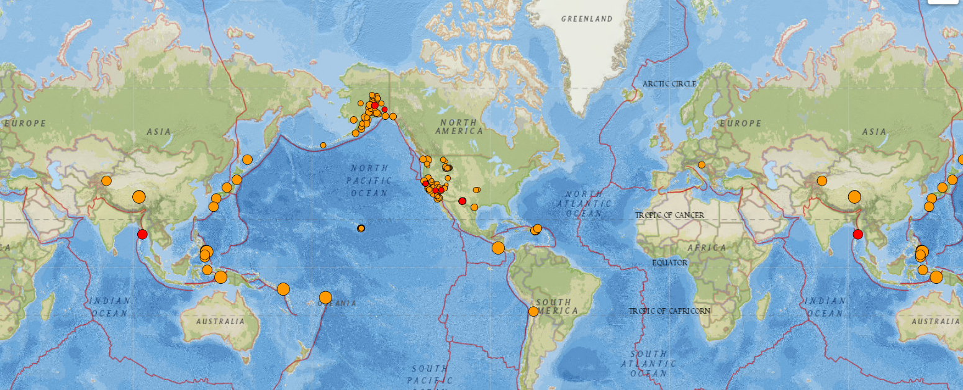
TRUE
19
Notes:
Teacher Notes: Audio will automatically play on the slide. This image from USGS shows magnitude 2.5 and higher earthquakes that occurred on 3/6/24 (one day). Red dots indicate earthquakes that happened within the past hour, whereas orange dots indicate earthquakes that happened within the last week. To create a more recent map, go to: https://earthquake.usgs.gov/earthquakes/map/?extent=-65.94647,-394.80469&extent=84.30218,204.96094&list=false
AUDIO SCRIPT: TRUE. Earthquakes are happening all over the world, and all the time. There’s likely one happening right now somewhere. Most of them might be too small for us to feel, but specialized machines are always recording seismic waves under the Earth’s surface.
CREDIT: https://omsi.edu/wp-content/uploads/2023/07/ShakeAlert-Interactive-Demos-v.-Jul-2023.pdf
IMAGE: . Image courtesy of USGS

Slide 20
True or False?
Scientists can predict when an earthquake will happen.
OR
20
Notes:
Teacher Notes: Read the statement, and give students 15 seconds to discuss with their team whether they think the statement is true or false. When the timer goes off, they will put their thumbs up if they think the statement is true, and their thumbs down if they think the statement is false. Once students have responded, go to the next slide to reveal the answer. NOTE: The answer audio will play automatically when you move to the next slide.
CREDIT: https://omsi.edu/wp-content/uploads/2023/07/ShakeAlert-Interactive-Demos-v.-Jul-2023.pdf

Slide 21
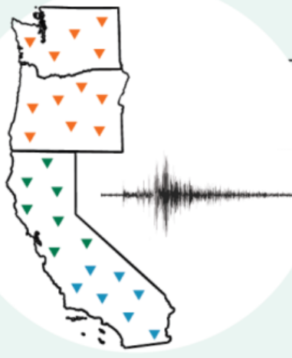
FALSE
ShakeAlertⓇ is not earthquake prediction.
Constant Monitoring
Earthquake Early Warnings
21
Notes:
Teacher Notes: Audio will automatically play on the slide.
AUDIO SCRIPT: FALSE. Scientists cannot predict exactly when earthquakes will happen. However, recent technology constantly monitors the ground for shaking or movement, and can send out alerts to people once the earthquake starts that may arrive to certain people before strong shaking begins in their area. Because earthquakes can occur in our area, our school has the ShakeAlert earthquake early warning system installed!
CREDIT: https://omsi.edu/wp-content/uploads/2023/07/ShakeAlert-Interactive-Demos-v.-Jul-2023.pdf
IMAGE: Image courtesy of USGS

Slide 22
True or False?
During an earthquake, you should run outside.
OR
22
Notes:
Teacher Notes: Tell students that you will be reading statements, and they will have to discuss with their team whether they think the statement is true or false. When the timer goes off, they will put their thumbs up if they think the statement is true, and their thumbs down if they think the statement is false. Once students have responded, go to the next slide to reveal the answer. NOTE: The answer audio will play automatically when you move to the next slide.
CREDIT: https://omsi.edu/wp-content/uploads/2023/07/ShakeAlert-Interactive-Demos-v.-Jul-2023.pdf

Slide 23
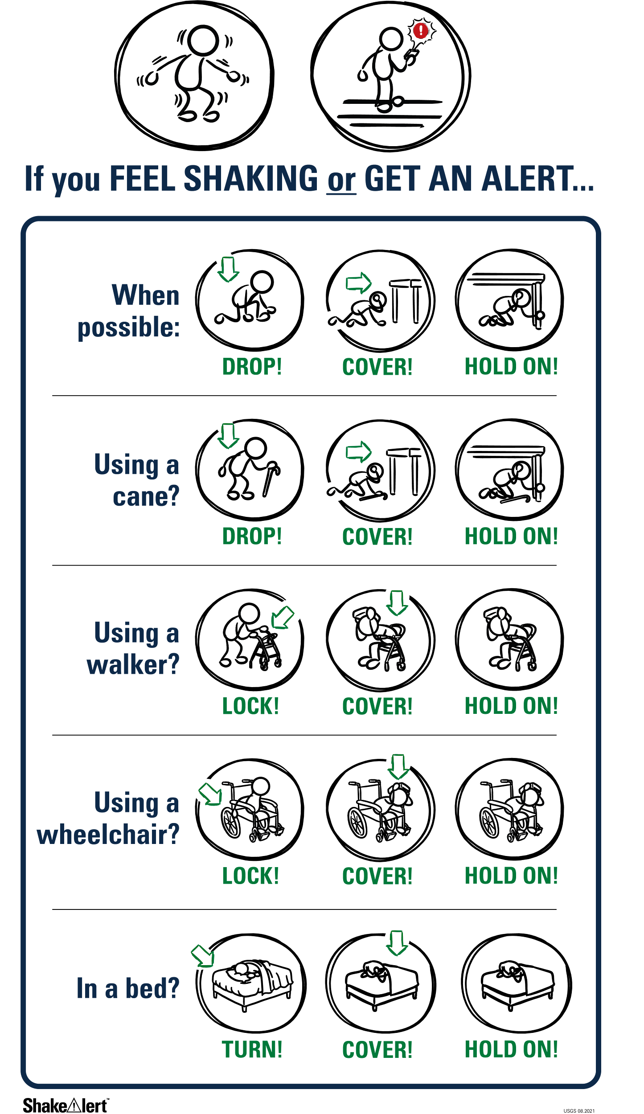
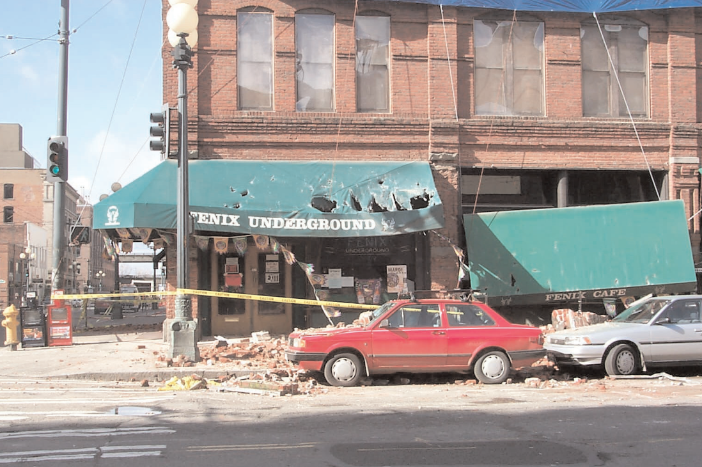
FALSE
23
Notes:
Teacher Notes: Audio will automatically play on the slide.
AUDIO SCRIPT: FALSE. The most common causes of injury in earthquakes include people falling down and/or getting hit by falling debris. In the United States, where buildings meet basic building standards, staying inside the building (preferably under a table) is actually safer than trying to exit. If no table is available, simply crouch on the floor and cover your head and neck with your hands.
IMAGES: Image credits from left to right. Image courtesy of USGS. Image courtesy of Oregon Department of Geology and Mineral Industries.
CREDIT: https://omsi.edu/wp-content/uploads/2023/07/ShakeAlert-Interactive-Demos-v.-Jul-2023.pdf

Slide 24
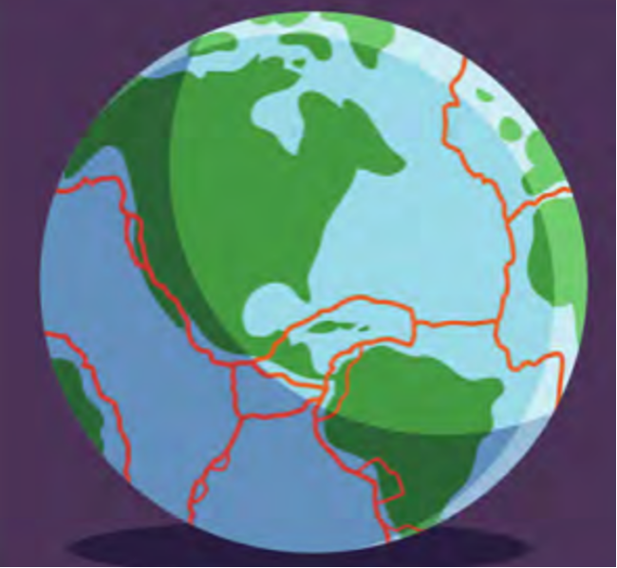
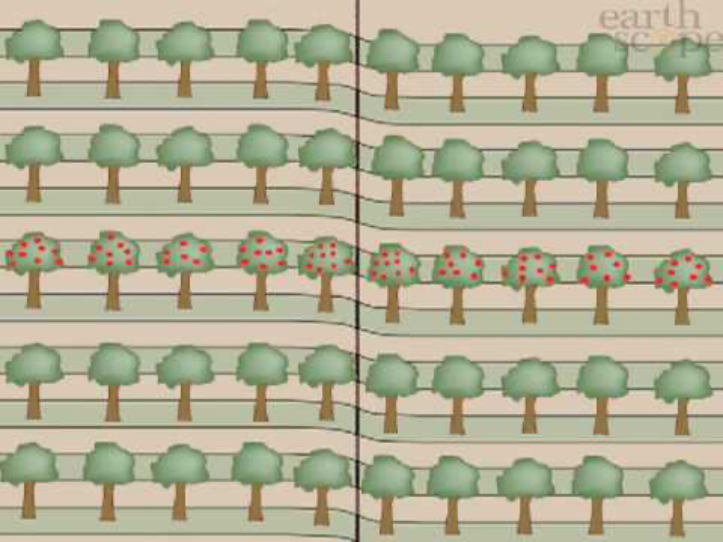
The surface of the Earth is broken into many pieces that move around.
The pieces of the Earth get stuck together. When they break free, an earthquake happens!
24
Notes:
Teacher Notes: Slide is animated so images appear when you click.
Explain to students that the Earth’s surface is broken into many pieces that move around. Most of the time we don’t feel the movement, but sometimes we do. As the pieces of the Earth move, they can become stuck because of friction like when you slide your tennis shoe across a floor, and it gets stuck. An earthquake occurs when the moving pieces of Earth overcome friction and move suddenly. You can demonstrate this by snapping your fingers. Your thumb and finger model the pieces of Earth. At first when you press them together, they’re stuck because of friction. This models the friction between the pieces of Earth. When your finger snaps into the base of your thumb, that’s the earthquake.
IMAGE: Image courtesy of The Hero in You Foundation. Used with permission.
VIDEO: Video courtesy IRIS Earthquake Science

Slide 25

Waves in Our Lives － Turn and Talk
What is a wave?
What are some different kinds of waves?
25
Notes:
Teacher Notes: Tell students that earthquakes release waves of energy, which we will learn more about next. Ask students to turn and talk with their elbow partner about what they think a wave is, and what kinds of waves they’ve heard of.
Students may say that a wave is moving water. They may mention ocean waves, sound waves, heat waves, or a flag or person’s hand waving.
IMAGE: Image couresy of National Science Foundation

Slide 26
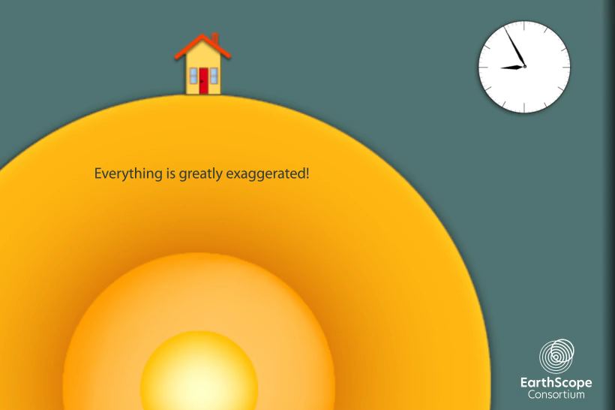
Earthquake Waves are called Seismic Waves
How does each type of wave affect the building?
How are the waves of energy SIMILAR?
How are they DIFFERENT?
26
Notes:
Teacher Notes: The slide is animated so that the questions appear one at a time. The video will play automatically when you open the slide. To play the video again, click the white play button.
Tell students that waves of energy are released during an earthquake, which we call seismic waves. There are different kinds of seismic waves. Students should observe that the p-wave arrives first and moves the house up and down, the s-wave is second and moves the house side to side, and the surface wave arrives last, and moves the house in an undulating motion. The waves are similar because they all move the house. They are different in the time it takes for them to arrive at the house, whether they move through the earth or across its surface, and in how they move the house. Point out to students that seismic waves transfer energy and not matter. The house moved because energy was transferred from the earthquake to the house, not because matter was transferred from the earthquake to the house.
To view a more detailed model of seismic waves, go to: https://www.iris.edu/hq/inclass/animation/1component_seismogram_building_responds_to_p_s_surface_waves
VIDEO: Video courtesy Earthscope Consortium

Slide 27
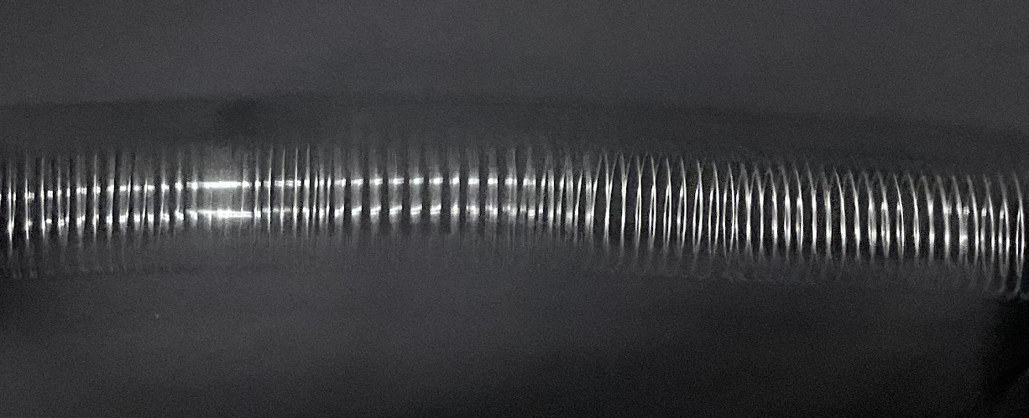
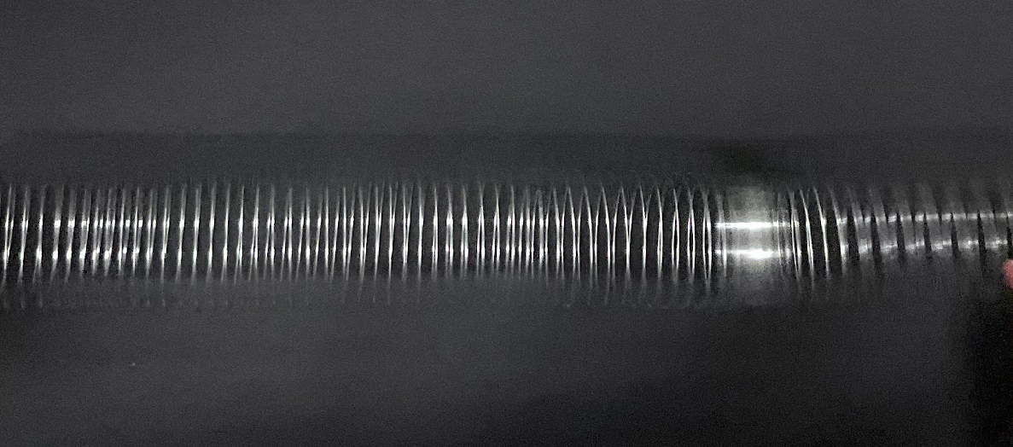
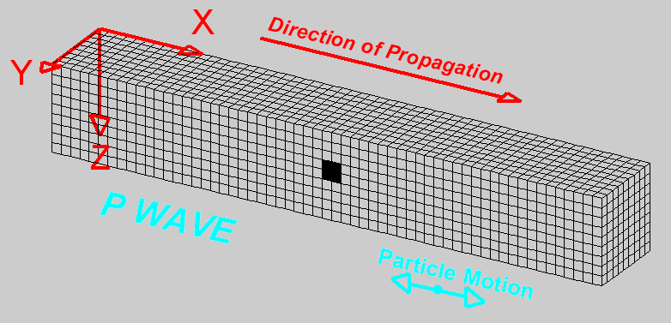
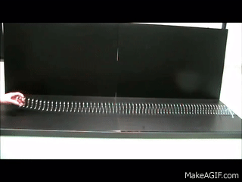
Modeling P-Waves with SlinkyⓇ
27
Notes:
Teacher Notes: Tell students that we can model seismic waves using a Slinky. A giant Slinky works best for this. If you have one, have two students hold either end and stretch it out between them on the floor. If you don’t have a Slinky, just show and discuss the animations on the following two slides. Model a p-wave with the Slinky by having the student on one end of the Slinky push it toward the other student. Instruct other students to observe. Repeat this step a few times as students share their observations.
SOURCE: Seismic Slinky https://www.iris.edu/hq/inclass/lesson/seismic_slinkymodeling_p_and_s_waves
VIDEO: To watch a video of a teacher demonstrating modeling seismic waves with a Slinky, go to https://www.iris.edu/hq/inclass/video/seismic_slinky_modeling_p_and_s_waves_in_the_classroom
GIF: https://makeagif.com/gif/longitudinal-waves-on-a-slinky-ZChjoc, L. Braile, Purdue University

Slide 28
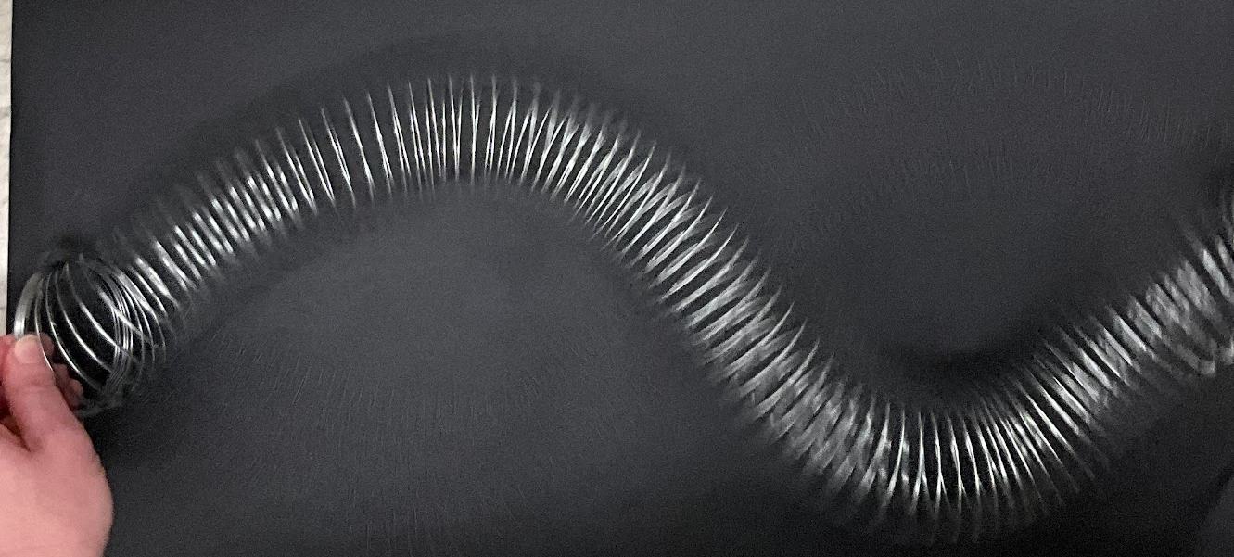
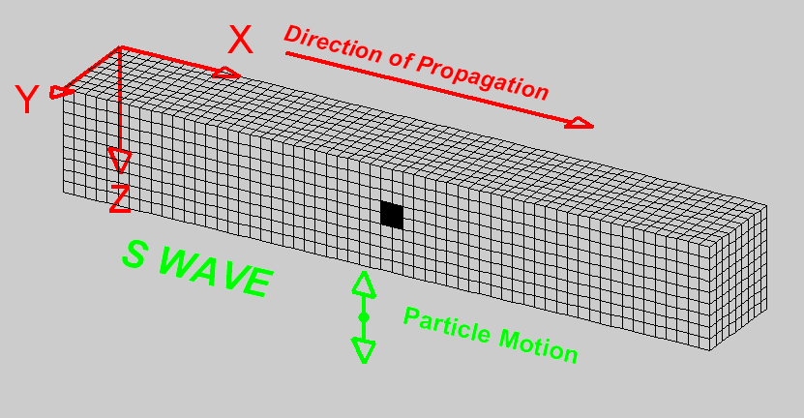
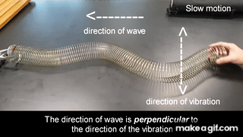
Modeling S-Waves with SlinkyⓇ
28
Notes:
Teacher Notes: Model an s-wave with the Slinky by having the student on one end of the Slinky move it back and forth. Instruct other students to observe. Repeat this step a few times as students share their observations.
SOURCE: Seismic Slinky https://www.iris.edu/hq/inclass/lesson/seismic_slinkymodeling_p_and_s_waves
GIF: L. Braile, Purdue University, https://makeagif.com/gif/transverse-wave-using-slinky-coil-UJEhkl

Slide 29
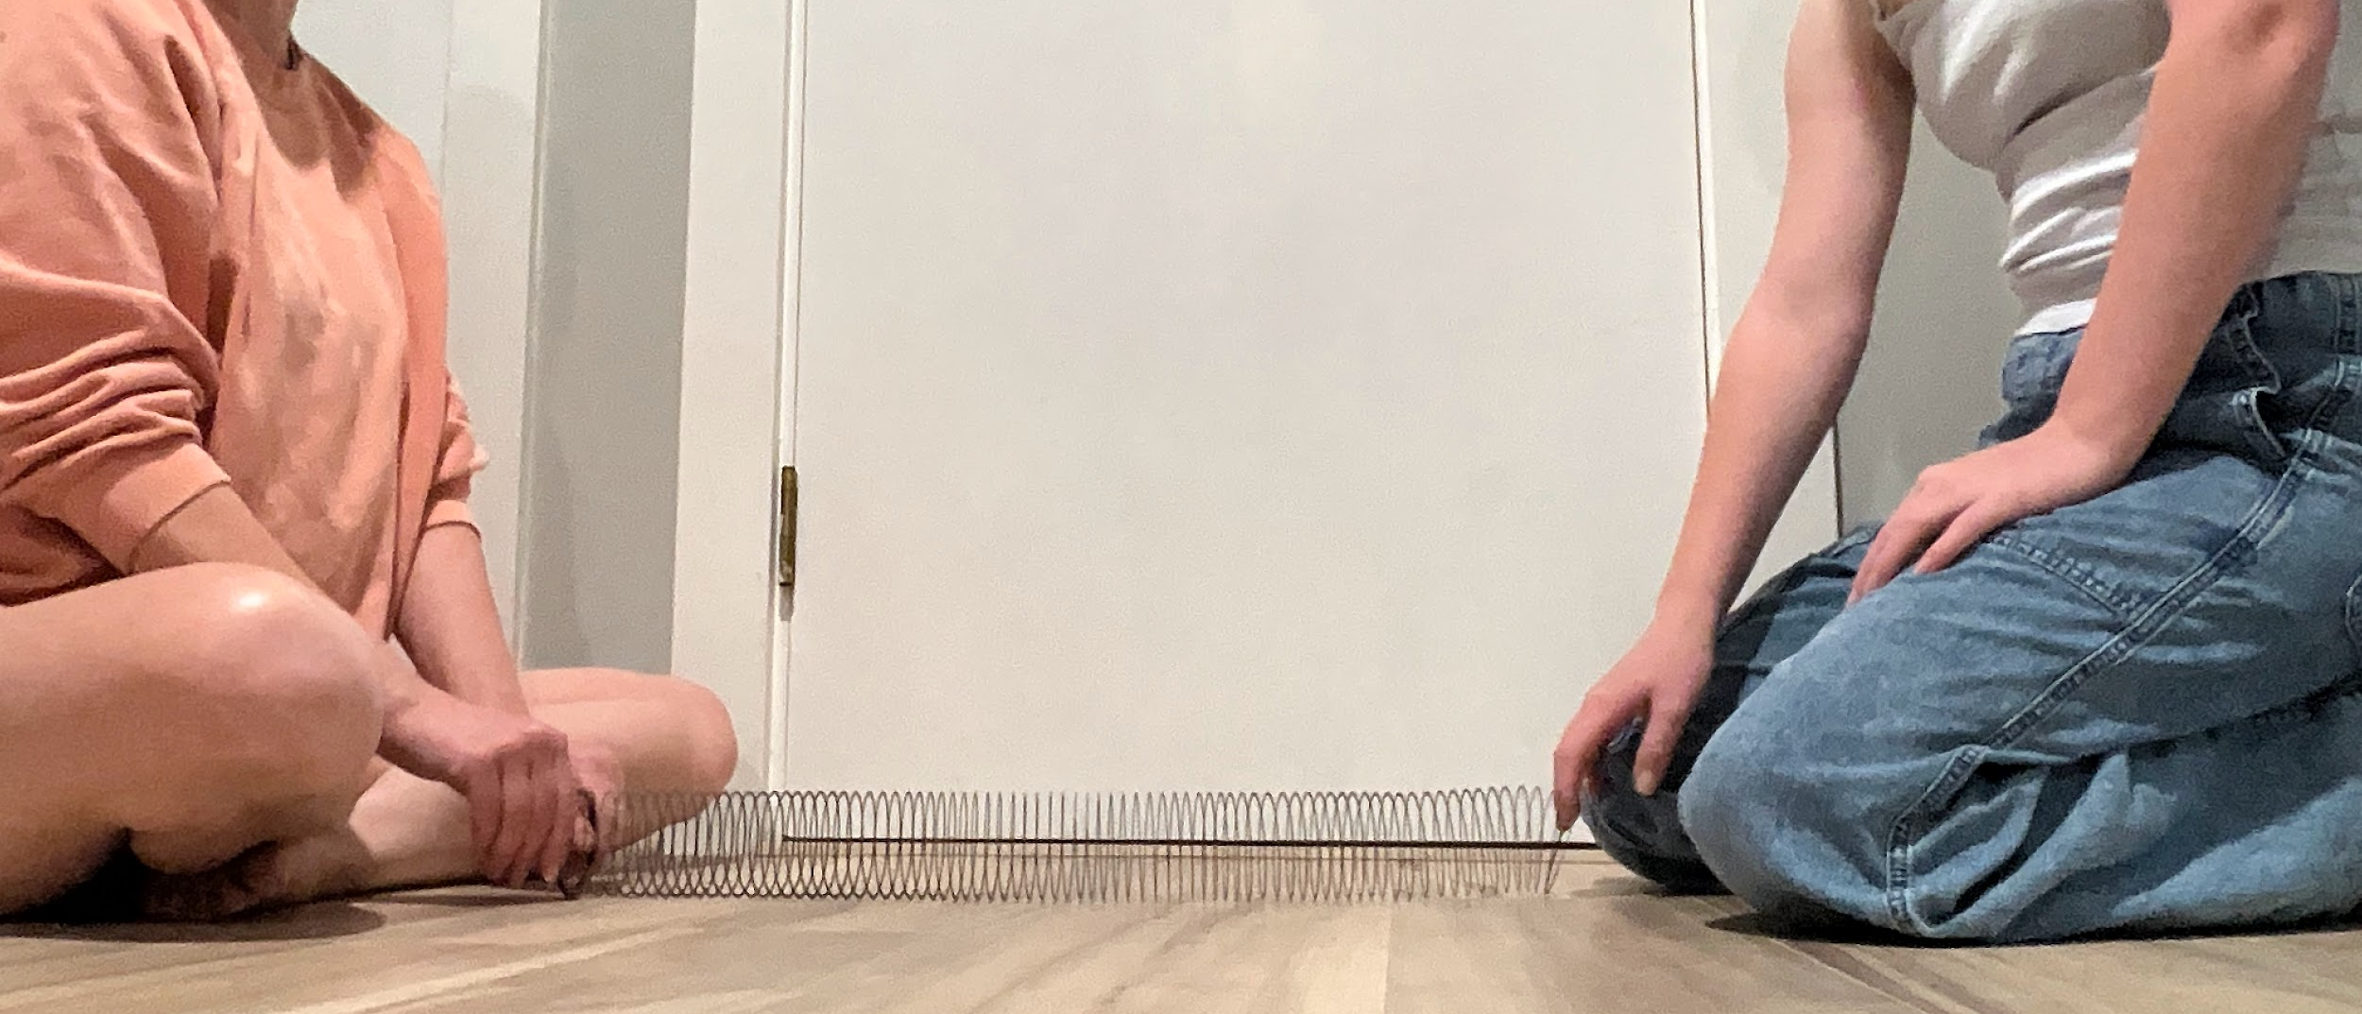
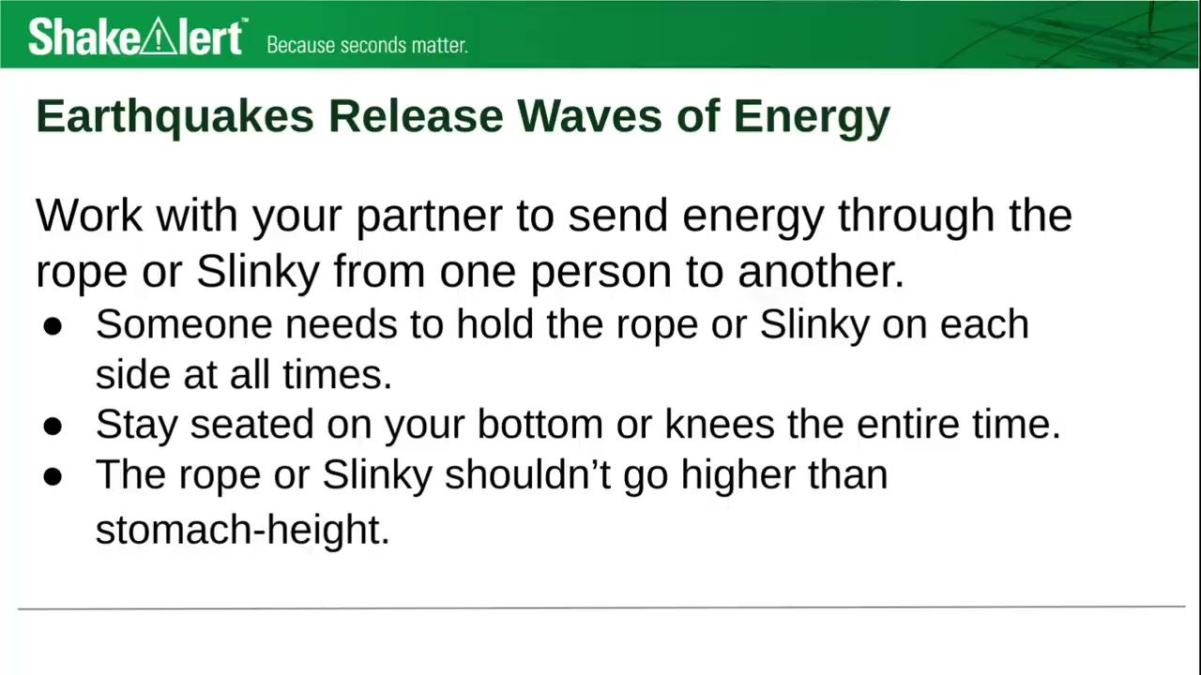
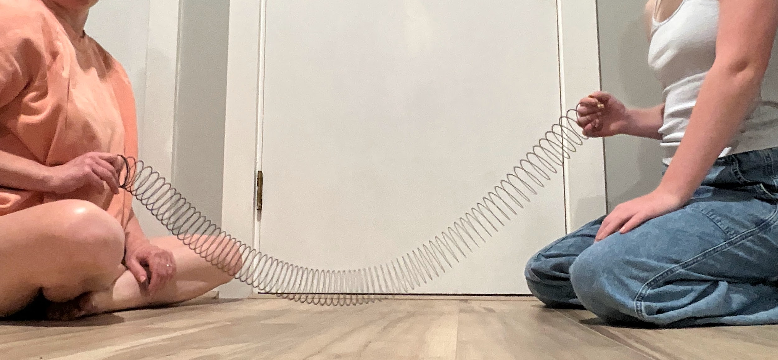
Earthquakes Release Waves of Energy
29
Notes:
Teacher Notes: This slide is optional for teachers who are providing small groups of students with a rope or SlinkyⓇto experiment with. The audio describing how to experiment safely will automatically play.
If you are providing students with a Slinky, rope, yarn, etc. to model waves, go over the safety guidelines, and give them time to discover ways to send energy through the material. Consider setting a 4 minute timer for students to experiment, and ask students to be ready to share their observations with the class once time’s up!
SUGGESTED SAFETY GUIDELINES:
Someone needs to hold the rope or Slinky on each side at all times.
Stay seated on your bottom or knees the entire time.
The rope or Slinky shouldn’t go higher than stomach-height.
IMAGE: Image and video courtesy Katrina Arras. Used with permission.

Slide 30
Seismic Waves with Different Amounts of Energy
Model s-waves with different amounts of energy.
How does the amplitude of the wave affect the amount of shaking?
How does the amplitude of the wave change as the wave travels away from its starting point?
Amplitude
30
Notes:
Teacher Notes: This slide is optional. If you are modeling waves using a SlinkyⓇ or section of rope, use this slide to guide your demonstration.
To start, explain to students that amplitude is one way we can describe the energy in a wave. Point out that amplitude is the distance from the midline of the wave to the furthest point from the midpoint, called the crest or trough. Model a wave with a higher amplitude with the Slinky or rope. Then model a wave with a lower amplitude. Ask students to observe the differences in how the tape moves with a high amplitude wave versus a lower amplitude wave. They should notice that the higher the amplitude, the more the tape moves. Ask students to notice what happens to the amplitude of the wave as it travels down the Slinky or rope. They should notice that the amplitude decreases as the wave travels, as they observe the tape closest to the source of the wave moving more, and the tape furthest from the source of the wave moving less. They may also note that the amplitude changes direction back and forth across the midpoint as it travels. Point out to students again that seismic waves transfer energy, not matter. If you’re using a section of rope to model waves, point out that while the tape moves back and forth, it doesn’t actually move down the rope.

Slide 31
Earthquakes Waves Behave Differently
Watch again!
Pay attention to the different speeds of the three types of waves.
31
Notes:
Teacher Notes: To play the video again, click the white play button. It may help to play the video again and pause it right before the seismic waves reach the house (around 0:10).
Ask students what they observe about how the distance between waves changes as they travel away from where the earthquake started. They should notice that when the earthquake starts, the waves are right on top of each other. As the waves travel through the earth, the distance between them grows.
To view a more detailed model of seismic waves, go to: https://www.iris.edu/hq/inclass/animation/1component_seismogram_building_responds_to_p_s_surface_waves
VIDEO: Video courtesy Earthscope Consortium

Slide 32
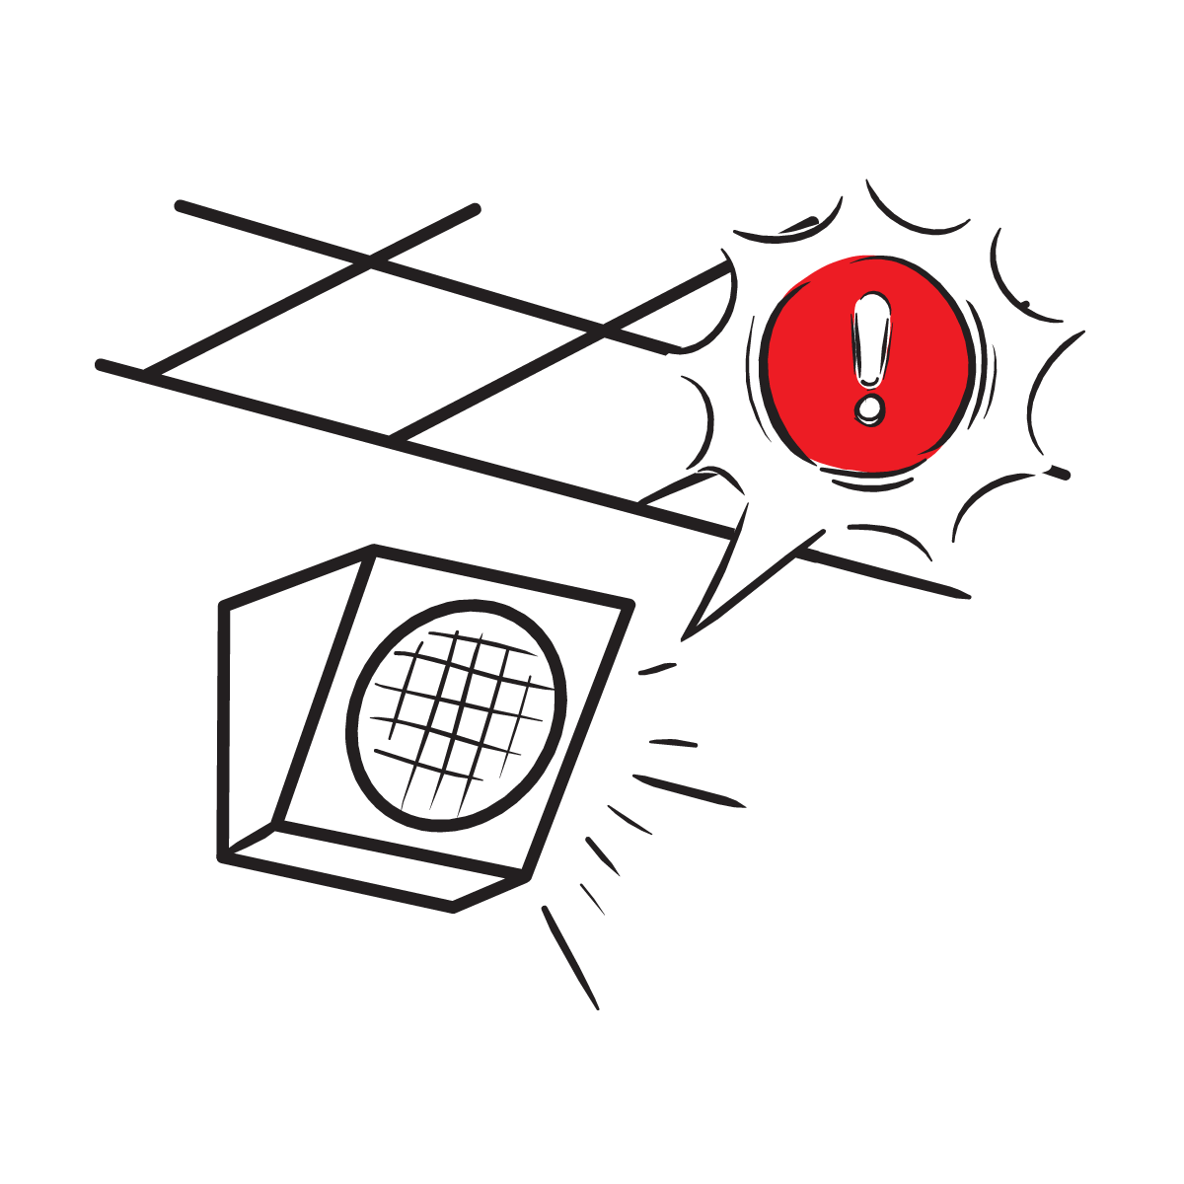
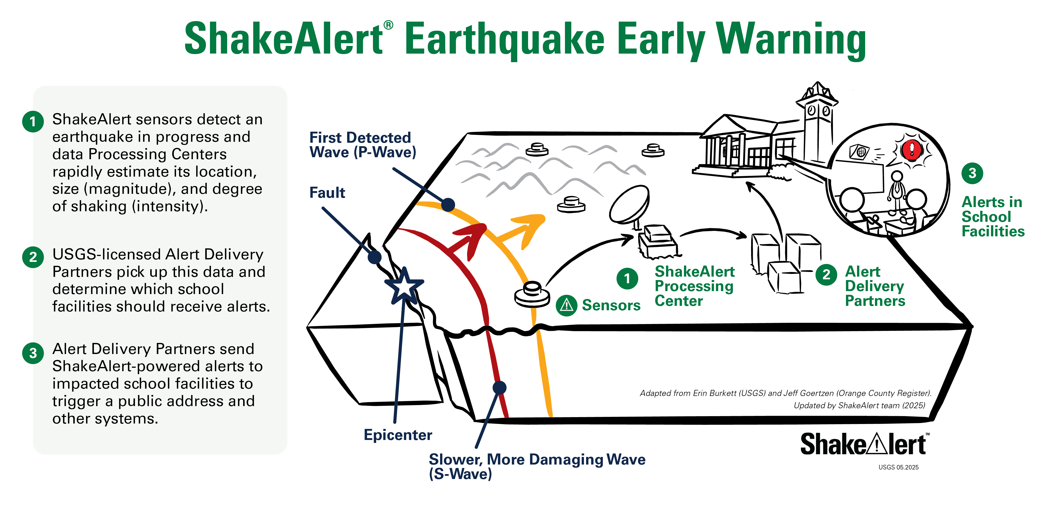
Earthquake Early Warning
P-waves: faster & less damaging
S-waves: slower & more damaging
Alerts: delivered as soon as first earthquake wave detected.
32
Notes:
Teacher Notes: The slide is animated. Point out the p-wave and s-wave in the diagram as the words appear.
Remind students that seismic waves can affect people long distances from where they begin. Tell students that the p-waves move the fastest, but are less damaging, whereas s-waves are slower but are more damaging. Tell students that as soon as the first wave is detected, alerts are sent to areas that may experience damaging shaking. Therefore, as soon as you get an alert, you should Drop, Cover, and Hold On.
IMAGE: Image courtesy of USGS

Slide 33
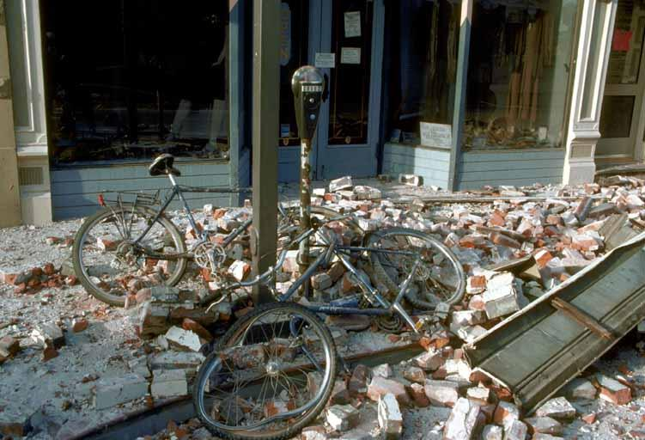
Earthquakes Near Us
Could there be an earthquake near us?
33
Notes:
Teacher Notes: Ask students to discuss whether they think there could be an earthquake where they live. Students in California will probably know that there are earthquakes nearby, but students in Oregon and Washington may not be aware that there is a risk of earthquakes.
If you would like, you can visit the USGS Latest Earthquakes website and show students the earthquakes that have happened in the last day, last seven days, or last 30 days in the United States (https://earthquake.usgs.gov/earthquakes/map)
IMAGE: Image courtesy of USGS.
This picture shows damage from the Loma Prieta 1989 earthquake.

Slide 34
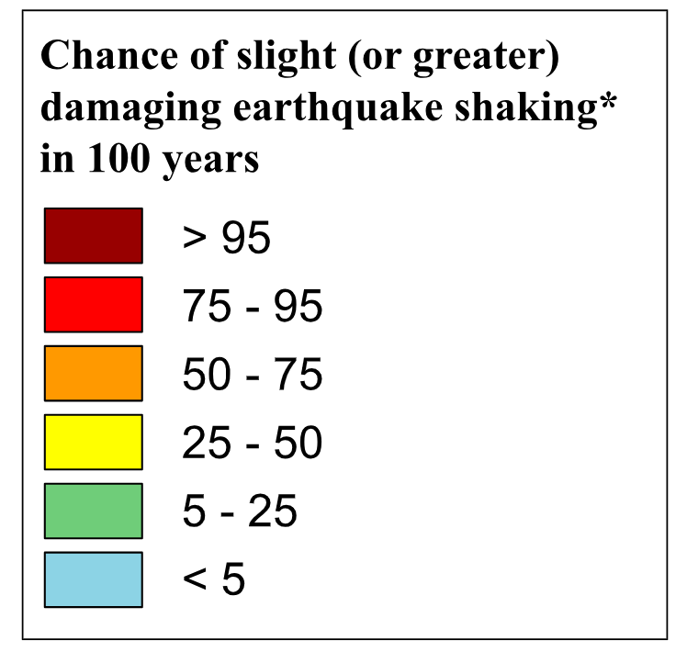
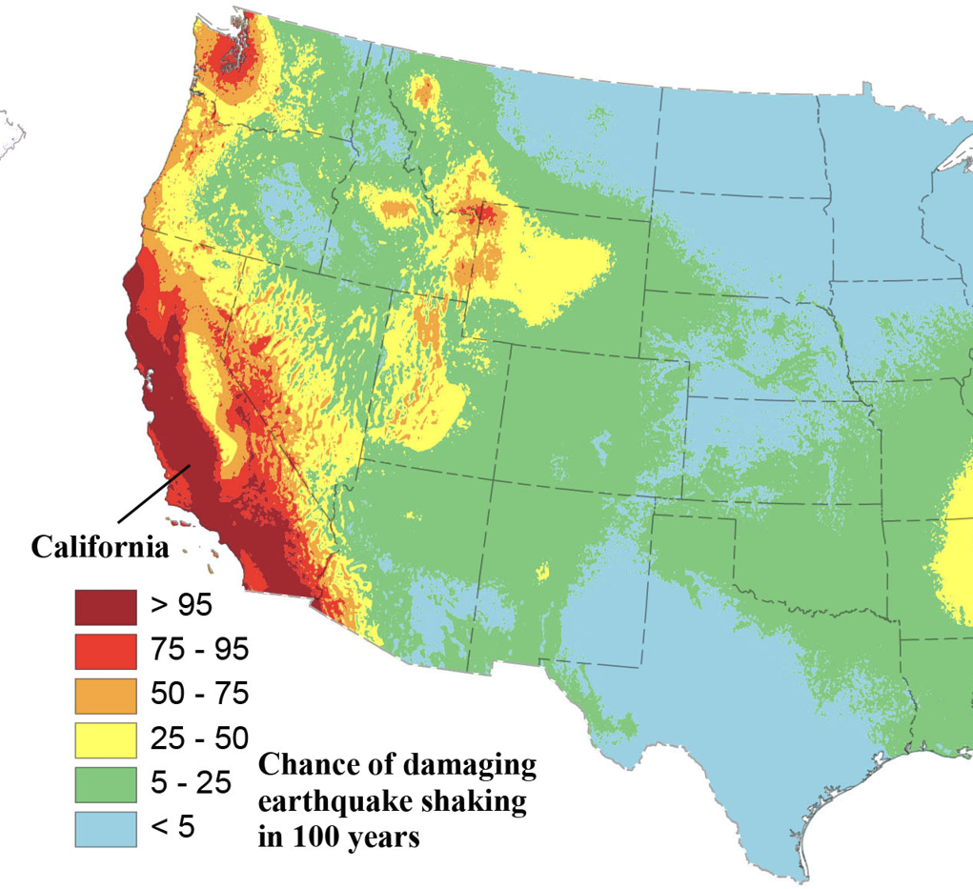
Examine the key . . .
34
Notes:
Teacher Notes: This slide is optional.
Tell students that this map shows the chance of experiencing a strong earthquake in the next 100 years. Point out that the red areas have a greater than 95% chance of experiencing a damaging earthquake in the next 100 years, whereas the blue areas have a less than 5% chance. Ask a student to come up and point to the area where you live on the map. Work with students to determine the earthquake risk where you live using the key.
IMAGE: Image courtesy of USGS
SOURCE: National Seismic Hazard Model (2023) - Chance of Damaging Earthquake Shaking, January 2023

Slide 35
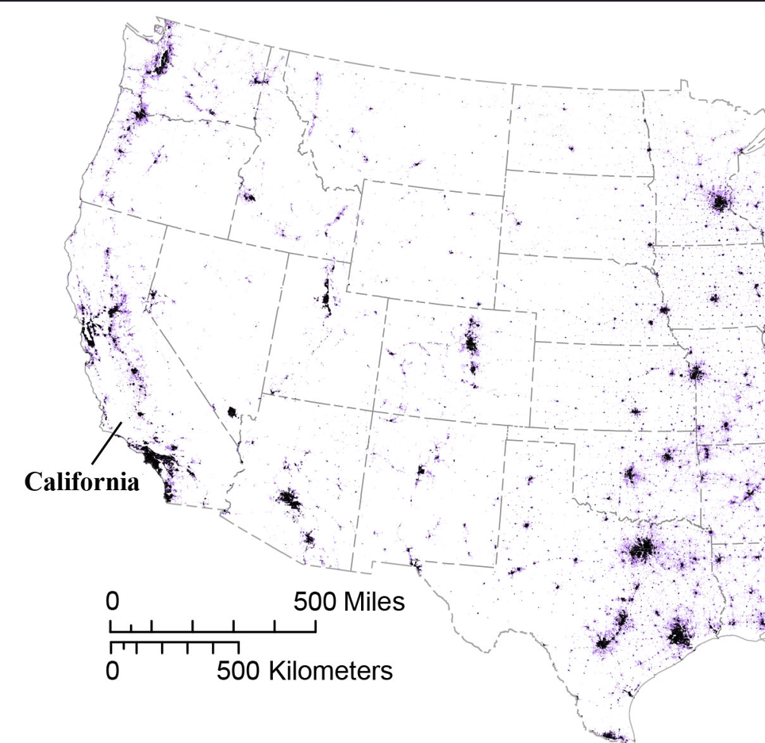
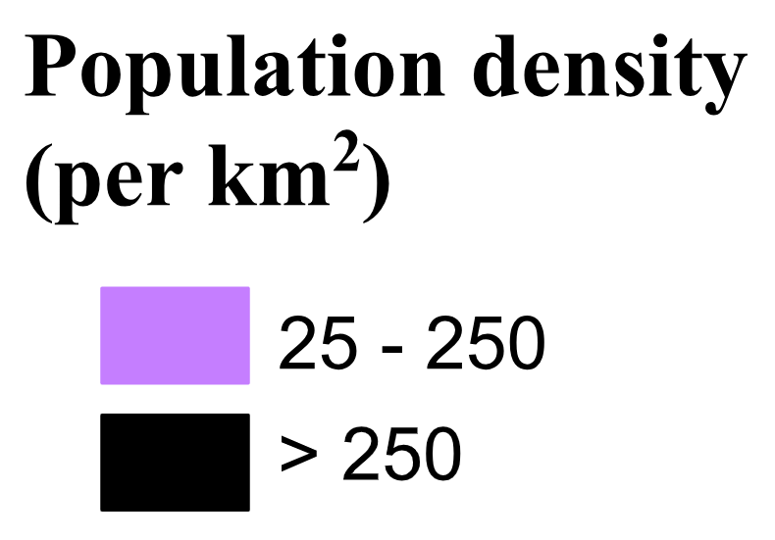
And this key . . .
35
Notes:
Teacher Notes: This slide is optional.
This map also shows population density. Tell students that the black areas have lots of people living closer together, and light purple areas have a moderate amount of people living closer together. Again ask a student to come up and point to the area where you live on the map.
IMAGE: Image courtesy of USGS
SOURCE: National Seismic Hazard Model (2023) - Chance of Damaging Earthquake Shaking, January 2023

Slide 36
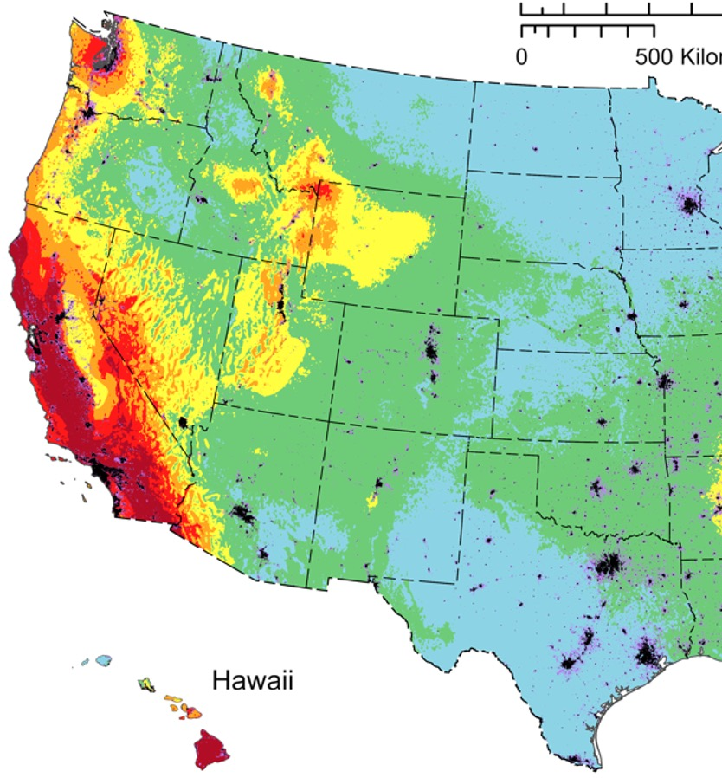
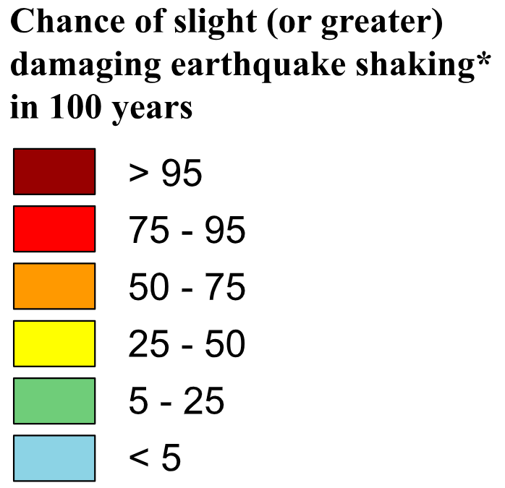
Putting it together . . .
36
Notes:
Teacher Notes: This slide is optional.
Ask students what patterns they see in this map. What does this map show us about the area we live? Students should notice that California has the highest chance of experiencing a damaging earthquake in the next 100 years, with many areas having a >95% chance. Areas in Oregon and Washington near the Pacific Ocean have a 50-95% chance of experiencing a damaging earthquake in the next 100 years.
IMAGE: Image courtesy of USGS
SOURCE: National Seismic Hazard Model (2023) - Chance of Damaging Earthquake Shaking, January 2023

Slide 37

What do you do if you feel shaking or get an alert?
37
Notes:
Teacher Note: This is animated. Ask the question first to elicit student responses.
Review and model correct protective actions - Drop, Cover, and Hold On. Make sure students know they should drop to their knees (not their bottoms), have one hand over their necks, and try to get away from glass or any other objects that could fall on them. If they’re able to get under a table or desk while staying on their knees, they should. Once there, they should hold on to the leg of the table.
IMAGE: Image courtesy of USGS

Slide 38

If you or someone you know uses a wheelchair:
38
Notes:
Teacher Notes: Tell students that Drop, Cover, and Hold On looks different for different bodies. Review modified protective actions for people who use wheelchairs. While you may not have students who use wheelchairs in your class, it is likely that there are members of your community who do. Ask students to help their family members or friends who use a wheelchair by sharing that “Lock, Cover, and Hold On” is how they can protect themselves during an earthquake. Have students repeat the phrase, “Lock, Cover, and Hold On” after you’ve said it.
IMAGE: Image courtesy of USGS

Slide 39


If you or someone you know uses a cane or walker:
39
Notes:
Teacher Notes: Slide is animated, so images appear when you click. Review modified protective actions for people who use a cane or walker. While you may not have students who use a cane or walker in your class, it is likely that there are members of your community who do. Ask students to help their family members or friends who use a cane or walker by sharing the correct protective actions. Have students repeat the phrase, “Drop, Cover, and Hold On” and then “Lock, Cover, and Hold On” after you’ve said it.
IMAGE: Image courtesy of USGS

Slide 40
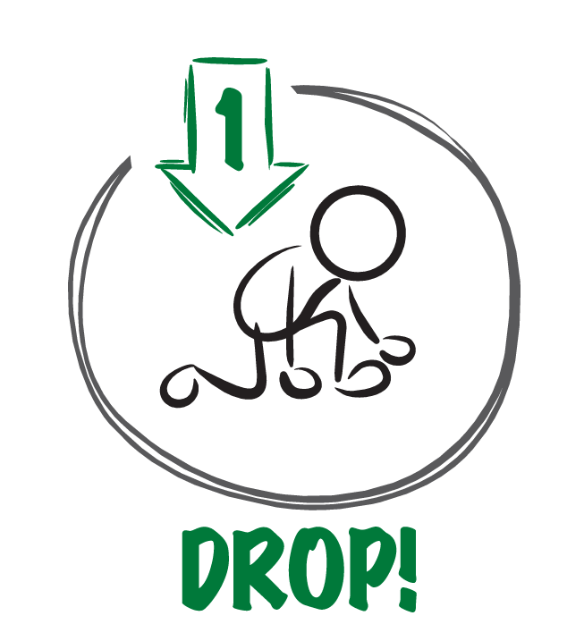


When the ground shakes or you get an alert,
why is it important to . . .?
40
Notes:
TEACHER NOTE: This slide is animated and the ‘Cover’ and ‘Hold On’ appear individually so you can discuss each action in turn. Begin by eliciting student responses for each. Add on to student responses as necessary.
DROP: Dropping to your knees protects you from falling or being hit by falling objects during ground shaking.
COVER: We cover our neck and head with one arm and hand to protect them from becoming injured if something falls. The back of the neck is particularly important to protect because your head has a skull to protect it.
HOLD ON: We hold on to a table leg once we’re beneath a table so that the earthquake doesn’t move us out from underneath the table that is protecting us.
IMAGE: Image courtesy of USGS

Slide 41

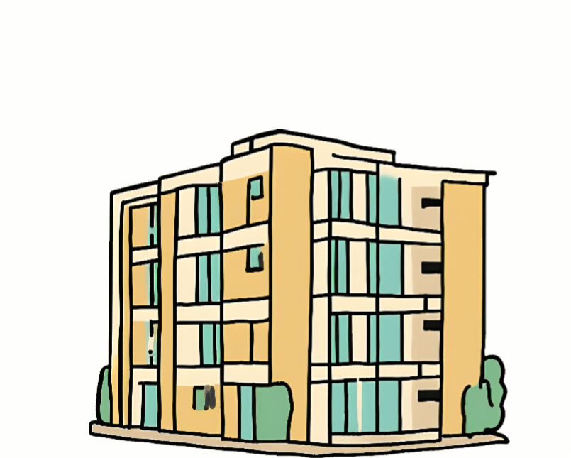
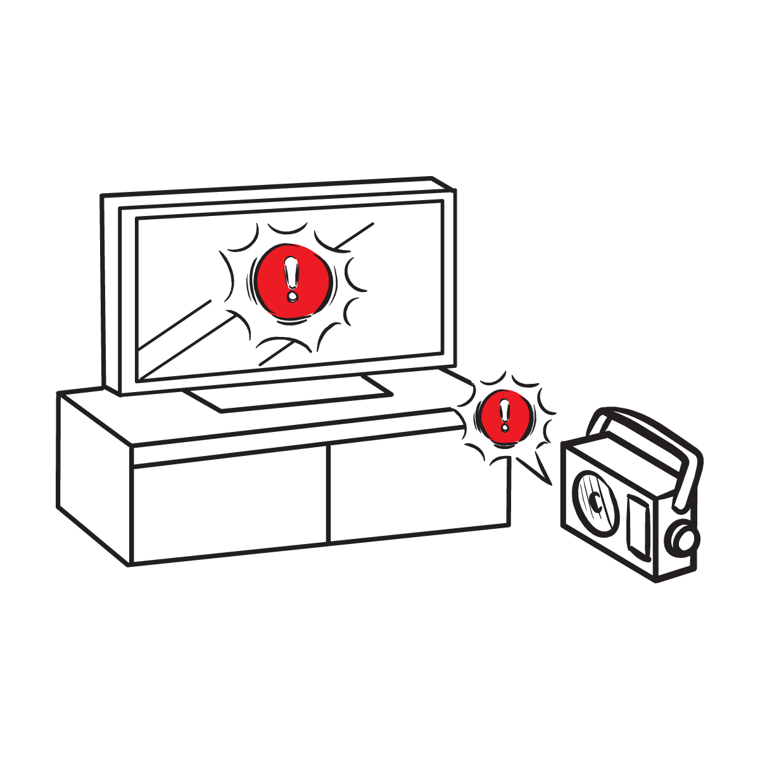

Protect yourself when there is . . .
ground shaking
an earthquake drill
an earthquake early warning alert
Notes:
Teacher Notes: Slide is animated, so images appear when you click. Tell students that they should take these protective actions when the ground shakes, if there’s an earthquake early warning alert, or if they’re participating in an earthquake drill, which we’ll do now. Tell students that it’s vital they Drop, Cover, and Hold On immediately and without hesitation.
IMAGES: Images courtesy of the USGS and the Great ShakeOut. Used with permission.

Slide 42

What to Expect from an Alert
42
Notes:
Teacher Notes: Play the ShakeAlert alert. Have all students Drop, Cover, and Hold On. Ask students to stay in their protective positions while the teacher observes and offers corrections if necessary. Once the teacher has checked in with each student, ask them to return to their seats.
NOTE: Your EEW alert may sound and look different than the one pictures on the slide!
IMAGES: Images courtesy of USGS

Slide 43

Let’s reflect!
How did we do?
Questions?
Key things to remember?
43
Notes:
Teacher Notes: Ask students to turn and talk to each other about the earthquake drill, how they did, if they have questions, and what they think important things to remember are. After reflecting, remind students of the key takeaways to stay safe during an earthquake, including immediately dropping to your knees, getting under a table if you can and holding on to the table leg, facing away from glass or heavy objects that could fall, covering your head and neck, remaining silent so that you can hear teacher instructions, and holding this position until shaking stops. They also learned that seismic waves travel at different speeds, with less damaging p-waves travelling faster than more damaging s-waves.

Slide 44

Let’s Check In
Emergencies are scary.
People react differently, which is normal!
Why do we practice (even though it can be uncomfortable?)
44
Notes:
Teacher Notes: Sometimes drills can be scary because we don't know what to do or what is happening around us. After practicing, you should feel more confident and hopefully less scared or nervous.
IMAGE: Image courtesy Ready.gov

Slide 45
How do you feel?
Turn and talk to a partner!
45
Notes:
Teacher Notes: Ask students how they are feeling now that they’ve learned about how and why earthquakes occur, as well as how to protect themselves during an earthquake or if they get an earthquake early warning.

Slide 46
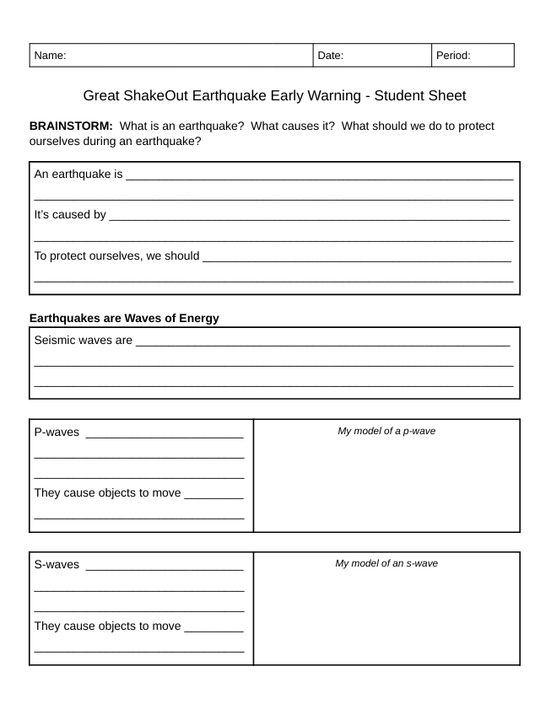
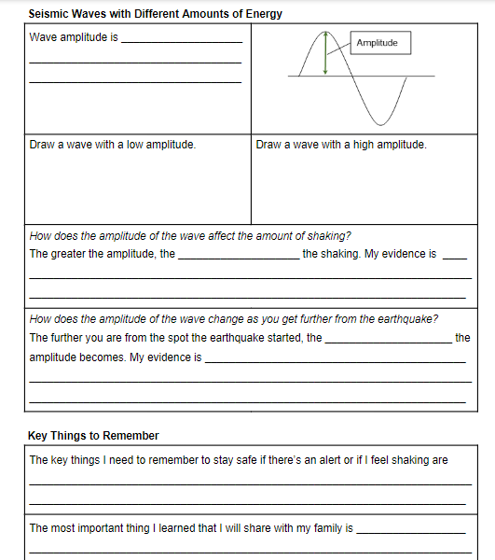
Let’s review what we’ve learned!
46
Notes:
Teacher Note: If you’re providing students with the student sheet to review their learning, do so now.

Slide 47
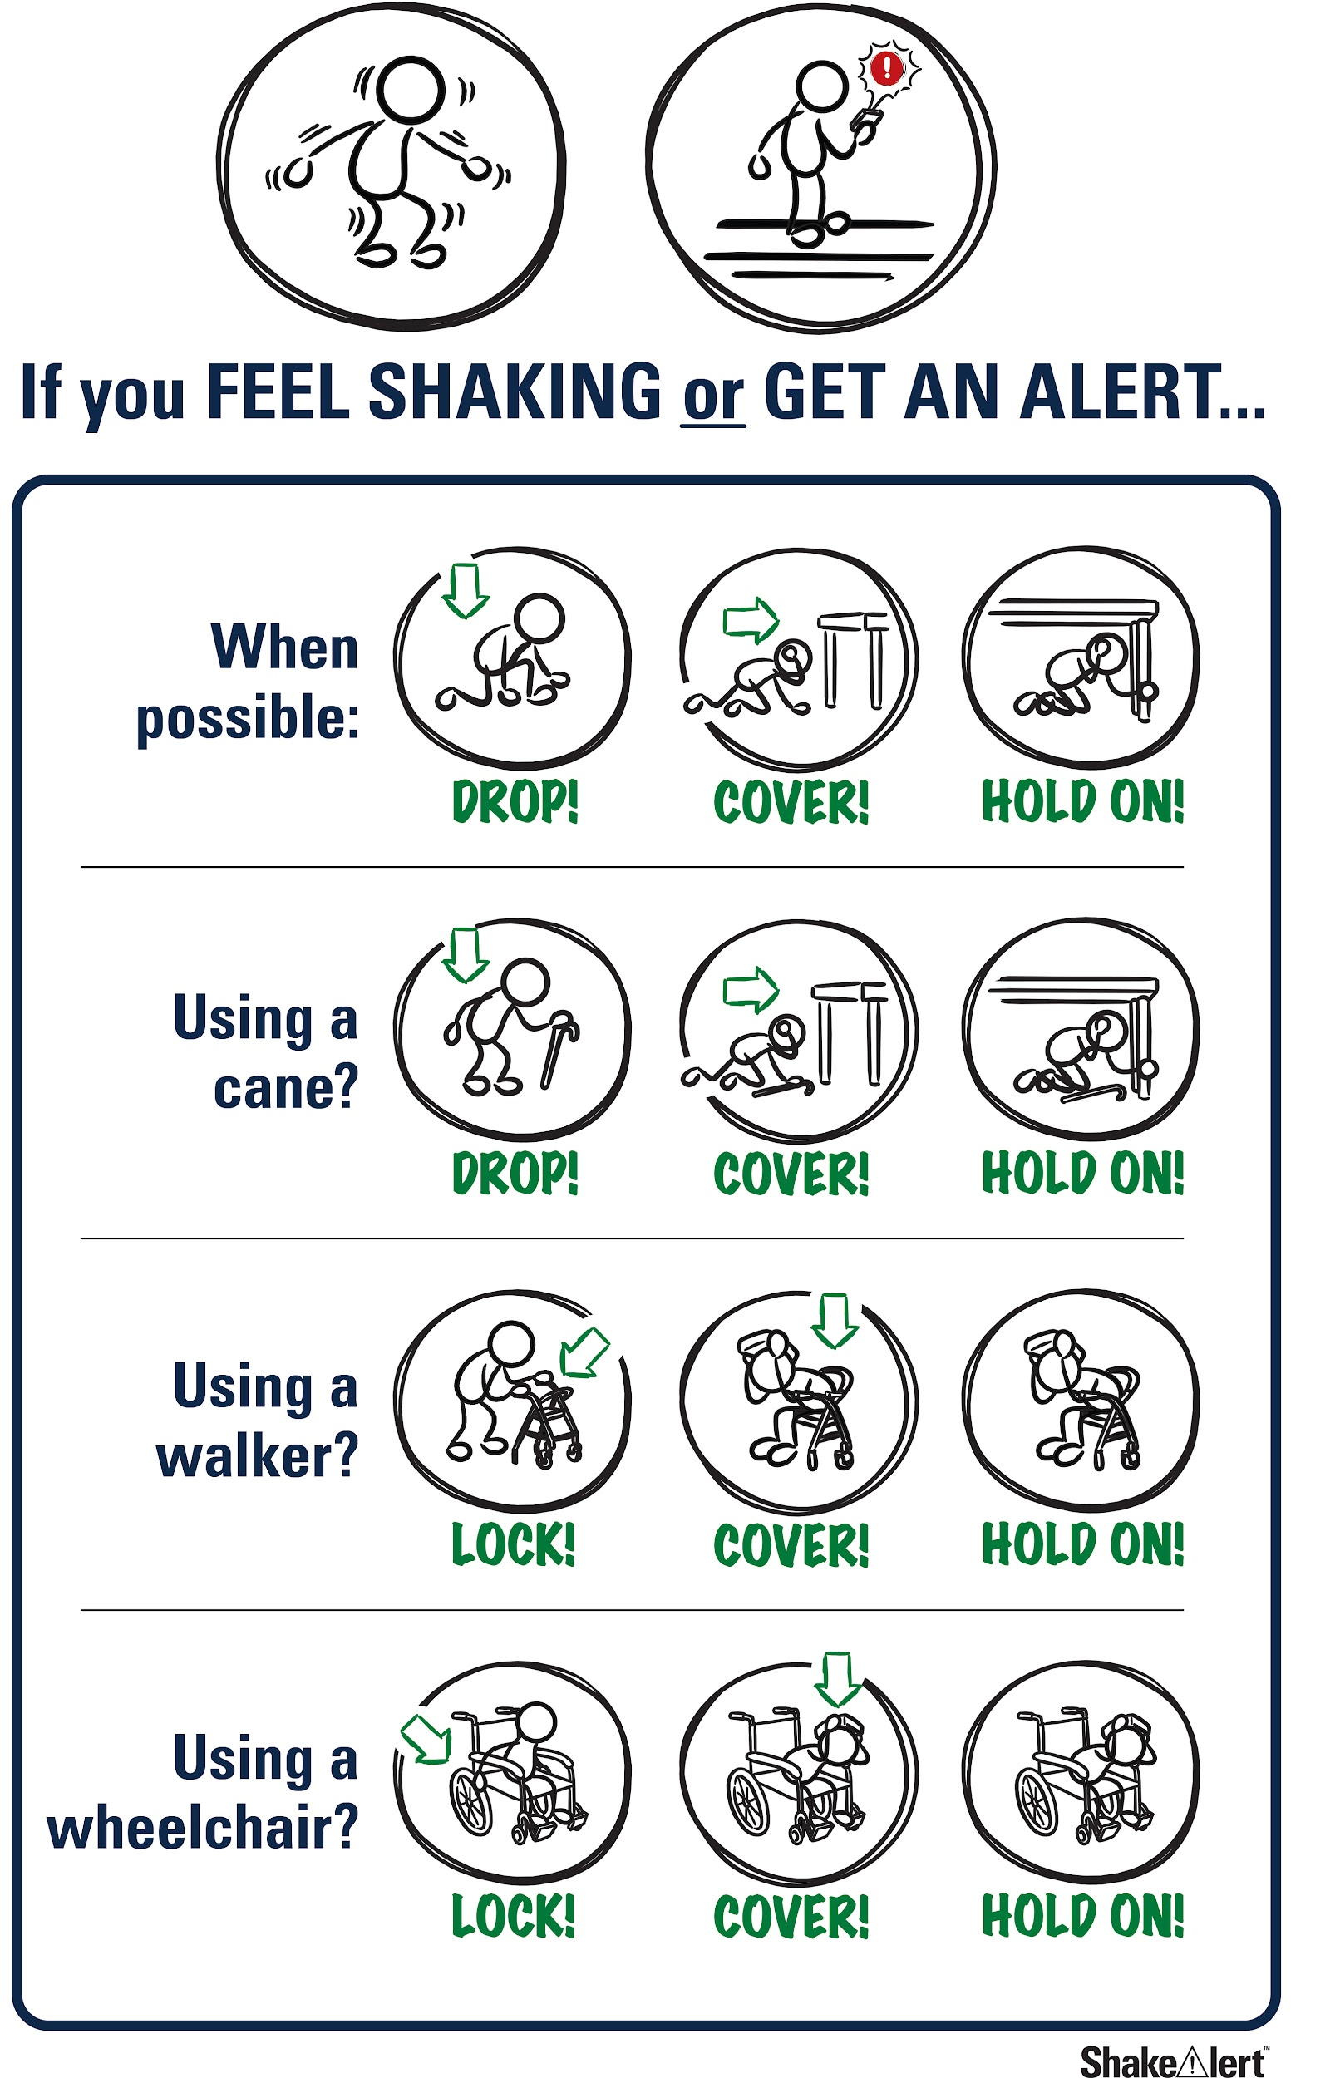
Help the people you live with and community prepare
Spread the word! Tell your family and community what you learned about protecting yourself during an earthquake.
Practice tonight!
47
Notes:
Teacher Note: Tell students that most of the adults they know have probably not taken part in an earthquake drill since they were students, and may have incorrect ideas about how to protect themselves in an earthquake. They can help the people they live with and community members prepare by teaching them about Drop, Cover, and Hold On, and informing them about ways to prepare, such as signing up for ShakeAlert-powered alerts and preparing an emergency kit and plan. Ask them to share the Family Engagement Letter with their families tonight.
IMAGE: Image courtesy of USGS

Slide 48
Welcome Back!
How did your discussions with your families go?
Did you show your families how to Drop, Cover, and Hold On during an earthquake?
48
Notes:
Teacher Notes: NEXT DAY: Ask students how their conversations with their families went. Did their family members know that Drop, Cover, and Hold On are the correct protective actions? Did they talk about an emergency plan?
IMAGE: Image courtesy of USGS

Slide 49
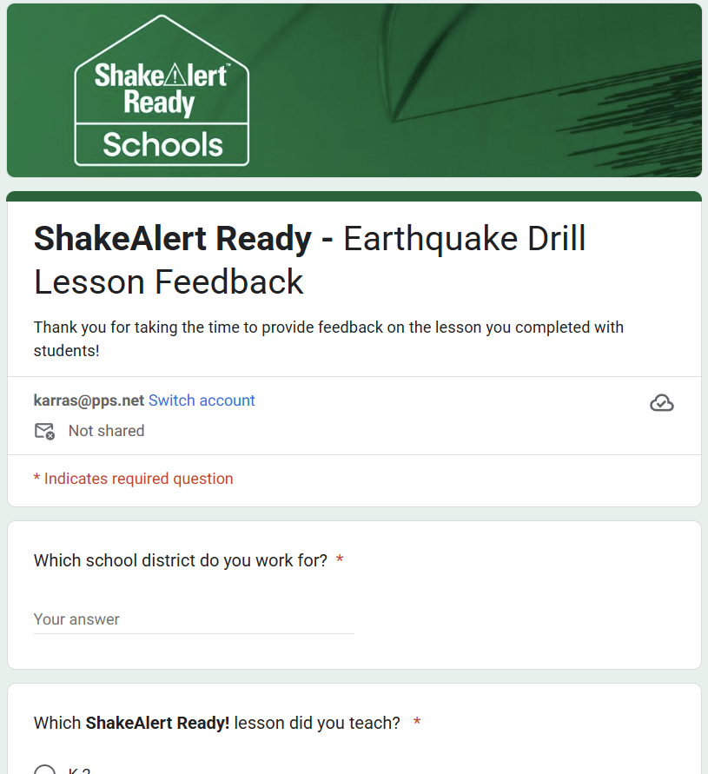
Teachers, share your feedback, please!
Please complete the short and anonymous feedback form and help us to improve our ShakeAlert Ready lessons.
49
Notes:
LINK: https://docs.google.com/forms/d/e/1FAIpQLSeNHAr45fDTztflhJJD3_JVS8p0RiV1MW9sKyQgFucGJyKcCA/viewform?usp=sf_link

Slide 50
Content Standards – Fourth Grade
Science | 4-PS4.1 | Develop a model of waves to describe patterns in terms of amplitude and wavelength and that waves can cause objects to move.
CC Writing | CCSS.ELA-LITERACY.W.4.8 | Recall relevant information from experiences or gather relevant information from print and digital sources; take notes and categorize information, and provide a list of sources
CC Speaking & Listening | CCSS.ELA-LITERACY.SL.4.1 | Engage effectively in a range of collaborative discussions (one-on-one, in groups, and teacher-led) with diverse partners on grade 4 topics and texts, building on others' ideas and expressing their own clearly.
 | CCSS.ELA-LITERACY.SL.4.3 | Identify the reasons and evidence a speaker provides to support particular points.
Health (CA) | 1.1.S | Describe safety hazards, including those related to fire, water, dangerous objects, being home alone, and using the Internet.
 | 1.5.S | Identify basic safety guidelines associated with weather-related emergencies and natural disasters (e.g., floods, earthquakes, and tsunamis).
 | 1.6.S | Identify disaster preparedness procedures at home, at school, and in the community
 | 7.2.S | Practice disaster preparedness procedures at home and at school.
 | 7.6.S | Demonstrate the ability to execute an escape plan for incidents of fires, floods, earthquakes, and other natural disasters.
Health (WA) | H1.Sa2.4a | Describe how to prepare for an emergency.
50

Slide 51
Content Standards – Fifth Grade
CC Writing | CCSS.ELA-LITERACY.W.5.8 | Recall relevant information from experiences or gather relevant information from print and digital sources; summarize or paraphrase information in notes and finished work, and provide a list of sources.
CC Speaking & Listening | CCSS.ELA-LITERACY.SL.5.1 | Engage effectively in a range of collaborative discussions (one-on-one, in groups, and teacher-led) with diverse partners on grade 5 topics and texts, building on others' ideas and expressing their own clearly.
 | CCSS.ELA-LITERACY.SL.5.3 | Summarize the points a speaker makes and explain how each claim is supported by reasons and evidence.
Health (OR) | 5.SFA.6 | Discuss steps to take to prepare for natural disasters.
Health (WA) | H1.Sa2.5 | Explain how to respond to emergency situations.
51

Slide 52
Content Standards – Fourth to Fifth Grade
ELP | OR | An ELL can construct meaning from oral presentations and literary and informational text through grade-appropriate listening, reading, and viewing.
 | WA | ELD-SI.4-12.Narrate | Share ideas about one’s own and others’ lived experiences and previous learning Connect stories with images and representations to add meaning | Identify and raise questions about what might be unexplained, missing, or left unsaid Recount and restate ideas to sustain and move dialogue forward
 |  | ELD-SI.4-12.Inform | Define and classify facts and interpretations; determine what is known vs. unknown Report on explicit and inferred characteristics, patterns, or behavior | Sort, clarify, and summarize relationships Summarize most important aspects of information
 | CA | Bridging Proficiency Levels | Exchanging information and ideas: Contribute to class, group, and partner discussions, including sustained dialogue, by following turn-taking rules, asking relevant questions, affirming others, adding relevant information, building on responses, and providing useful feedback. 3. Offering opinions: Negotiate with or persuade others in conversations using a variety of learned phrases (e.g., That’s an interesting idea. However, …), as well as open responses in order to gain and/or hold the floor, provide counterarguments, elaborate on an idea, and the so on. | 5. Listening actively: Demonstrate active listening to read-alouds and oral presentations by asking and answering detailed questions, with minimal prompting and light support.
TSEL Competencies | CA | Self-Awareness | Identifying one’s emotions
 |  | Relationship Skills | Listening actively, communicating effectively, and self-advocating
 |  | Responsible Decision Making | Reflecting on one’s role to promote personal, family, and community well-being Considering personal and collective safety concerns
Historical & Social Sciences Analysis Skills | CA | Students use map and globe skills to determine the absolute locations of places and interpret information available through a map’s or globe’s legend, scale, and symbolic representations.

Slide 53
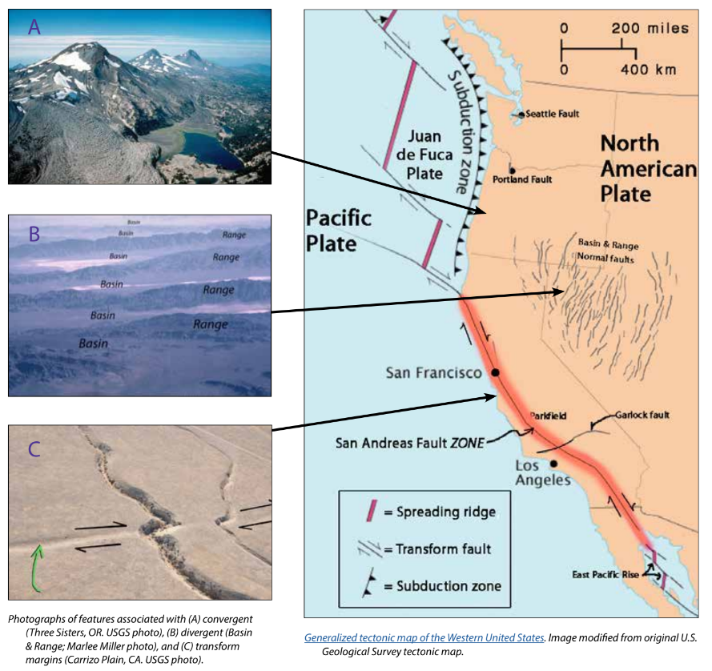
Background - Earthquake Hazard
California, Oregon, and Washington all face hazards from earthquakes because of the underlying tectonic plates, which constantly grind against each other. This friction creates "faults," lines of weakness in the Earth's tectonic plates (lithosphere) where earthquakes are most likely to occur.
California's San Andreas Fault is one example. Another example is the Cascadia Subduction Zone, which threatens all three states and British Columbia, Canada. This giant fault lies offshore, where the Juan de Fuca Plate dives beneath the North American Plate. This type of motion on other subduction zones can cause massive earthquakes, like the one that struck Japan in 2011.
While smaller earthquakes happen often, scientists think a major earthquake could happen any time, so it's important to be prepared.
For more information: Faults, Plate Tectonics & Earthquake Hazards - Animations / Videos
53
Notes:
IMAGE: https://www.iris.edu/hq/inclass/activities/introduction_to_faults_and_plate_tectonics
SOURCE: https://www.usgs.gov/programs/earthquake-hazards/science/pacific-northwest-hazards
https://www.usgs.gov/programs/earthquake-hazards/science/southern-california-earthquake-hazards

Slide 54
Background - How ShakeAlertⓇ Earthquake Early Warning System Works
54
Notes:
For more information on Earthquake Early Warning, go to: https://www.iris.edu/hq/inclass/sequences/earthquake_early_warning
IMAGE: Image courtesy of the USGS

Slide 55
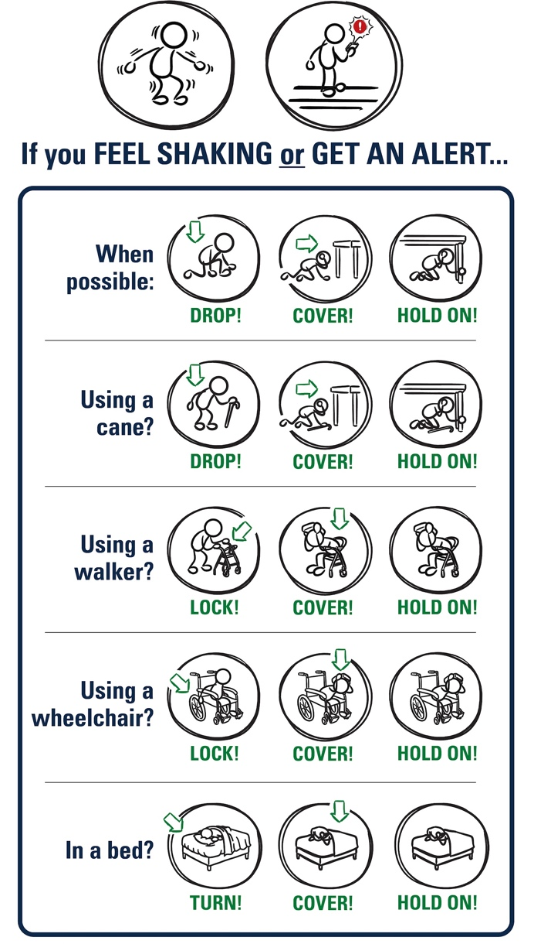
Background - Effective Protective Actions
Most earthquake-related injuries and deaths are caused by collapsing walls and roofs, flying glass and falling objects.
If you are inside a building, move no more than a few steps, then Drop, Cover, and Hold On.
If you are outdoors when the shaking starts, you should find a clear spot away from buildings, trees, streetlights, and power lines, then Drop, Cover, and Hold On. Stay there until the shaking stops.
For protective actions in various settings (descriptions and gifs), go to https://www.earthquakecountry.org/step5/
55
Notes:
SOURCE: https://www.shakeout.org/whyparticipate/
IMAGE: Image courtesy of the USGS

Slide 56
Rationale
Why do we practice earthquake drills?
To react quickly you must practice often. You may only have seconds to protect yourself in an earthquake, before strong shaking knocks you down--or drops something on you.
Social science research has long shown that people who practice actions are more likely to take those actions when a safety- threatening event occurs, such as an earthquake or fire. Tests, drills, and exercises that repeat concepts build “muscle memory” of procedural knowledge and timely reaction. The more frequently a person practices a procedure or self-protective action, such as Drop, Cover, and Hold On, the more likely they will employ it— almost without thinking—when they receive an alert or feel shaking.
Why share the Family Engagement Letter?
While schools practice earthquake drills regularly, most other locations don’t. Some students’ family members may not have practiced earthquake drills since they were in school.
Family members may have outdated information about how to stay safe in an earthquake, such as the incorrect belief that standing in doorways or “the triangle of life” will keep one safe in an earthquake. Students will be able to share correct protective actions (Drop, Cover, and Hold On) with their family and community members.
Students spend more time at home than at school. Therefore, educating families will help keep students and our community safe. Additionally, families are more likely to understand their family and community members’ needs. This communication can prompt families to ensure they’re prepared to protect all members of their families in case of an earthquake.
In places like Oregon and Washington where earthquakes are less frequent, people might be unaware of the risk of an earthquake.
The Family Engagement Letter has links for family members to learn more about earthquakes and protective actions.
56
Notes:
SOURCE: https://www.shakeout.org/whyparticipate/ , https://www.shakealert.org/toolkit/introduction/

Slide 57
Additional Resources
Sources
ShakeAlert® Earthquake Early Warning System
Education and Training Materials
Rocket Rules Activity and Coloring Book for Earthquake Science!
Rocket LIVE! Interactive Lesson (FORM for Earthquake Safety Lesson)
Earthquake Country Alliance and Shake Out Documents in Many Languages
Great Shake Out lessons
Rocket’s Earthquake Safety Activity Book
Rocket’s Earthquake Safety Adventure
57

