Slide 1


ShakeAlert® Earthquake Early Warning
GREEN SLIDES = Teacher Preparation & Information
WHITE SLIDES = Present to Class
ShakeAlert Drill Essentials
9th–12th Grade
Lesson length: 30 minutes
6th-12th Grade
Lesson length: 15 Minutes

Slide 2
To Print
Preparation
Family Engagement Letter
English
Spanish
Open the Family Engagement Letter.
  Add your school’s name at the bottom.
  If you’re emailing the letter, you can remove the QR code.
Make copies of the Family Engagement Letter and/or email to families a week before teaching the lesson. Encourage parents to discuss earthquakes with their kids and to let their teachers know if it might be a difficult topic for their child.
Preview Slides. You can print out the Teaching Steps slides. The teaching steps are also located in the Speaker Notes of each slide.
2

Slide 3
Sensitive Content Warning
Some students or their family members may have experienced earthquakes, resulting in loss, injuries, and possible trauma. It is therefore important to approach these lessons with sensitivity and awareness. When students share information about their experiences with earthquakes in the first part of the lesson, make sure to scan the class and be aware of any heightened responses. Affirm students’ normal emotional responses. If students are too emotionally heightened, it may be prudent to allow them to forego the drill.
Even students who have never experienced an earthquake may have a strong emotional response to talking about earthquakes. Explain to students that practicing earthquake drills helps our community to stay safe in an earthquake, but that it’s normal to feel strong feelings, such as fear, about earthquakes.
Drills build muscle memory that ensures students take the appropriate protective actions during an earthquake. Practice makes perfect, so please insist that students take the exercise seriously, remain quiet, and follow instructions.
3

Slide 4
Teaching Steps - page 1
SLIDE 9: Tell students that today they are learning about how to react when there is an earthquake or earthquake early warning, which could happen anytime.
SLIDE 10: Ask students why we practice drills at school. They should respond that we conduct drills to practice how to respond so that if there’s ever a fire or earthquake, we’re prepared and know how to stay safe. We also practice drills so that we can help students feel safer and less afraid at school. Having fire and earthquake drills can help us to feel prepared.
SLIDE 11: Tell students that your school has an earthquake early warning system that can give school community members seconds of extra time to protect themselves before strong shaking arrives during an earthquake.
SLIDE 12: Ask students what an earthquake is, what causes earthquakes to occur, and what the effects of earthquakes are.
  Sample Student Response: An earthquake is a sudden release of energy in the form of seismic waves that travel away from the earthquake focus. An earthquake occurs when the friction between pieces of earth is overcome, and elastic potential energy on a fault (including a tectonic plate boundary) is transformed into kinetic energy, along with sound and thermal energy. Earthquakes can cause ground shaking and tsunamis, as well as injuries and destruction of property.
4

Slide 5
Teaching Steps - page 2
SLIDE 13: Explain to students that the Earth’s surface is broken into many pieces that move around. Most of the time we don’t feel the movement, but sometimes we do. As the pieces of the Earth move, they can become stuck because of friction. An earthquake occurs when the moving pieces of Earth overcome friction and move suddenly. You can demonstrate this by snapping your fingers. Your thumb and finger model the pieces of Earth. At first when you press them together, they’re stuck because of friction. This models the friction between the pieces of Earth. When your finger snaps into the base of your thumb, that’s the earthquake.
SLIDE 14: Review and model Drop, Cover, and Hold On. Make sure students know they should drop to their knees (not their bottoms), have one hand over their necks, and get under a table or desk. Once there, they should hold on to the leg of the table so that if the table moves, they will move with it. If they can't get under a table, they should try to get away from glass or any other objects that could fall on them while still staying on their knees.
SLIDE 15: Tell students that Drop, Cover, and Hold On looks different for different bodies. Review modified protective actions for people who use wheelchairs.
  While you may not have students who use wheelchairs in your class, it is likely that there are members of your community who do. Have students repeat the phrase, “Drop, Cover, and Hold On” and then “Lock, Cover, and Hold On” after you’ve said it.
5

Slide 6
Teaching Steps - page 3
SLIDE 16: Review modified protective actions for people who use a cane or walker.
  While you may not have students who use a cane or walker in your class, it is likely that there are members of your community who do. Ask students to help their family members or friends who use a cane or walker by sharing the correct protective actions. Have students repeat the phrase, “Drop, Cover, and Hold On” and then “Lock, Cover, and Hold On” after you’ve said it.
SLIDE 17: Tell students that if they are outside when they feel shaking or get an alert, they should immediately move to an open space away from power lines or other objects that could fall on them. They should then drop to their knees and use one arm to cover their head and neck. They should then hold on in that position until the shaking stops.
SLIDE 18: Tell students that if they are visiting the coast, the earthquake could be followed by a tsunami, which is a large wave caused by the earthquake. If they are on the coast when they feel shaking or get an alert, they should wait for shaking to stop, and then immediately go to high ground or inland. They should stay there until local officials say it’s safe to return. Tell students that tsunami waves may arrive for hours after the earthquake.
6

Slide 7
Teaching Steps - page 4
SLIDE 19: Many earthquakes are followed by smaller earthquakes called aftershocks. Aftershocks can happen for even a few weeks after the main earthquake! Even though aftershocks are smaller than the main earthquake, they can still produce strong shaking and cause damage. Ask students what they should do if they feel shaking or get an alert. Remind students that they should stay alert and Drop, Cover, and Hold On if they feel shaking or get an earthquake early warning alert.
SLIDE 20:Tell students that they should take these protective actions when the ground shakes, if there’s an earthquake early warning alert, or if they’re doing an earthquake drill.
SLIDE 21: Tell students that as part of the Earthquake Early Warning system they will hear the alert coming over the intercom. Click to play the alert. Practice Drop, Cover, Hold On. Provide students with feedback on whether their protective actions were correct.
SLIDE 22: Ask students reflect on the earthquake drill with each other and discuss how they did, questions they have, and what things they think are important to remember. After reflecting, remind students of the key ways to stay safe during an earthquake, including immediately dropping to your knees, moving away from glass or heavy objects that could fall, etc.
7

Slide 8
Teaching Steps - page 5
SLIDE 23: Remind students that emergencies are scary, and that people react differently, which is normal. Ask students why we conduct earthquake drills even though they can be uncomfortable. Students should note that practicing can help us to feel more prepared and less afraid.
SLIDE 24: Regardless of whether you are sending the Family Engagement letter or email home before or after the lesson, ask students to talk with their families or caregivers about how to stay safe in earthquakes. Provide students with the Family Engagement letter if you haven’t already done so. Ask students to consider signing up to receive ShakeAlert earthquake early warning alerts on their phones and to show others how to do it, too.
SLIDE 25: OPTIONAL – Teachers, please complete the ShakeAlert Ready! Earthquake Drill Lesson Feedback Form.
NOTE: Please see the green slides at the end of this deck for information on earthquakes and how earthquake early warning works
8

Slide 9
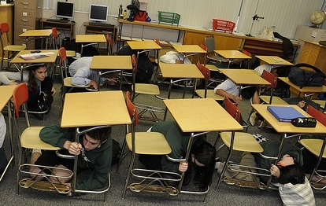
LEARNING TARGET
I can Drop, Cover, and Hold On if there’s ground shaking or if there is an earthquake early warning alert.
9
Notes:
Teacher Notes: Tell students that today they are learning about how to react when there is an earthquake or earthquake early warning alert, which could happen anytime.
IMAGE: Image courtesy of the Red Cross

Slide 10
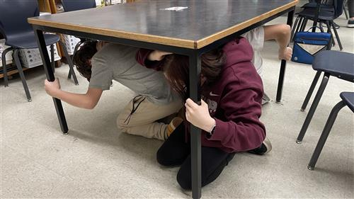
Why do we have drills at school?
10
Notes:
Teacher Notes: Ask students why we practice drills at school. They should respond that we conduct drills to practice how to respond so that if there’s ever a fire or earthquake, we’re prepared and know how to stay safe. We also practice drills so that we can help students feel safer and less afraid at school. Having fire and earthquake drills can help us to feel prepared.
IMAGE: Image courtesy of Roger Groom. Used with permission.

Slide 11
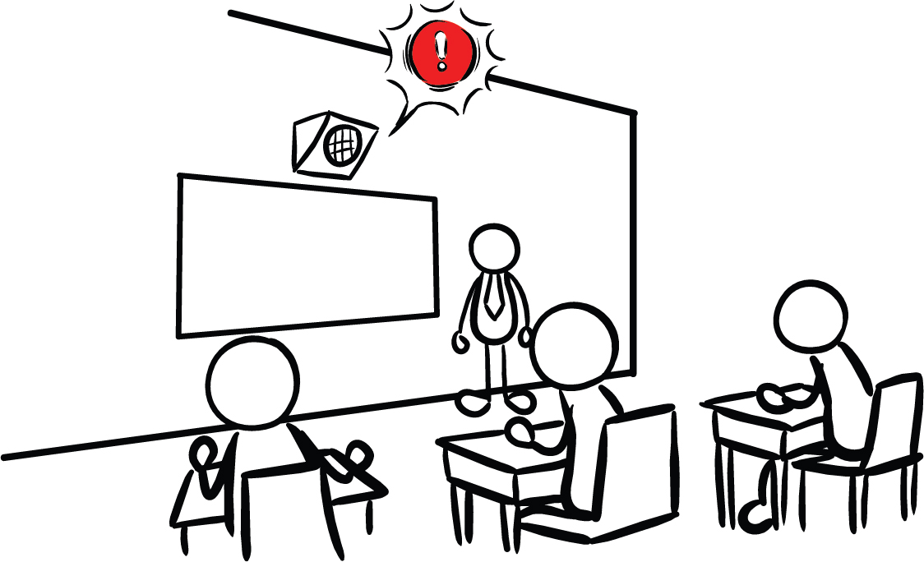
Our school has Earthquake Early Warning!
11
Notes:
Teacher Notes: Tell students that your school has an earthquake early warning system that can give the school community members seconds of extra time to protect themselves before damaging shaking arrives during an earthquake.

Slide 12
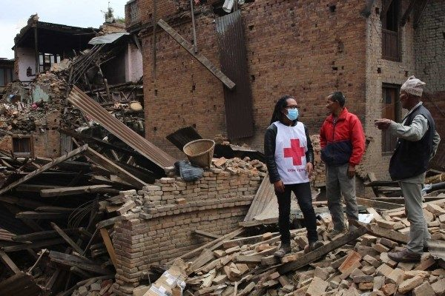
What is an earthquake?
Why do they happen?
What are some things that happen when there is an earthquake?
12
Notes:
Teacher Note: Students may have a lot of background knowledge about plate boundaries and earthquakes.
Sample Student Response: An earthquake is a sudden release of energy in the form of seismic waves that travel away from the earthquake focus. An earthquake occurs when the friction between pieces of earth is overcome, and elastic potential energy on a fault (including a tectonic plate boundary) is transformed into kinetic energy, along with sound and thermal energy. Earthquakes can cause ground shaking, tsunamis, as well as injuries and destruction of property.
IMAGE: Image courtesy of the Red Cross

Slide 13
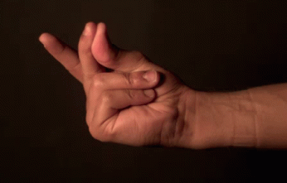
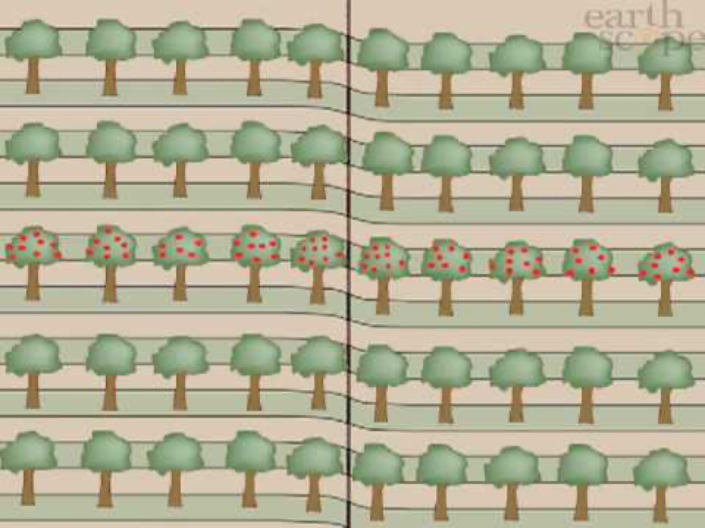
Earthquakes & Friction
What observations do you have of the animation?
13
Notes:
TEACHER NOTE: This slide is animated. The snap is a gif, which will play on a loop. Clicking will play the apple tree animation on the right.
We can model an earthquake with a snap of a finger. When we press our two fingers together, there is friction between them which prevents them from moving in the direction of the force, creating a build up of stored potential energy. When friction is overcome, the potential energy is transformed into kinetic energy, or movement, much like an earthquake. Earthquakes can happen at faults, including plate boundaries.
VIDEO: Video courtesy of Earthscope Consortium
IMAGE: GIF made from: https://www.youtube.com/watch?v=cFy3uJYctZs

Slide 14
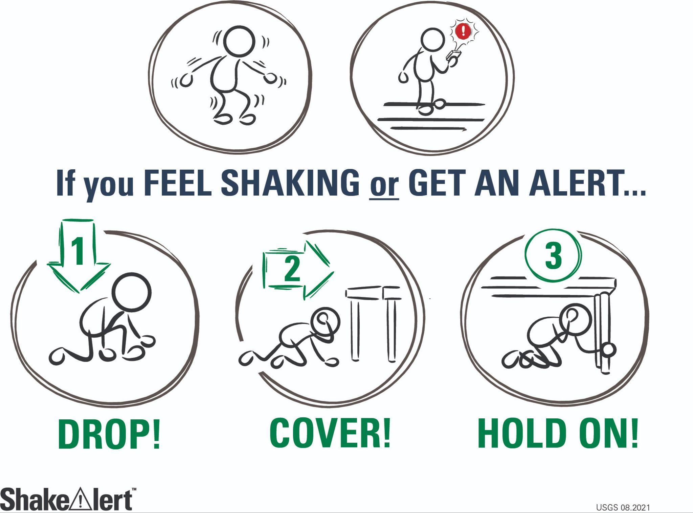
What do we do at school if there’s an earthquake?
14
Notes:
Teacher Notes: This slide is animated - the “Drop, Cover, Hold On“ image comes in one image at a time. Review with students what to do if there’s an earthquake while they’re at school. They should remember Drop, Cover, and Hold On. Reinforce the importance of:
getting on knees, and not bottoms
having one hand over the neck
head facing away from glass or any large objects that could fall
hold on to leg of whatever they’re under
IMAGE: Image courtesy of USGS

Slide 15
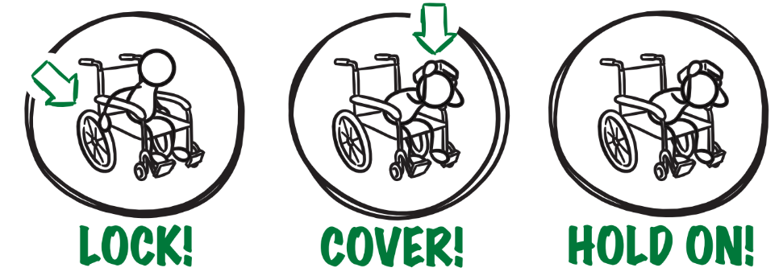
If you or someone you know uses a wheelchair:
15
Notes:
Teacher Notes: Tell students that Drop, Cover, and Hold On looks different for different bodies. Review modified protective actions for people who use wheelchairs. While you may not have students who use wheelchairs in your class, it is likely that there are members of your community who do. Ask students to help their family members or friends who use a wheelchair by sharing that “Lock, Cover, and Hold On” is how they can protect themselves during an earthquake. Have students repeat the phrase, “Lock, Cover, and Hold On” after you’ve said it.
IMAGE: Image courtesy of USGS

Slide 16

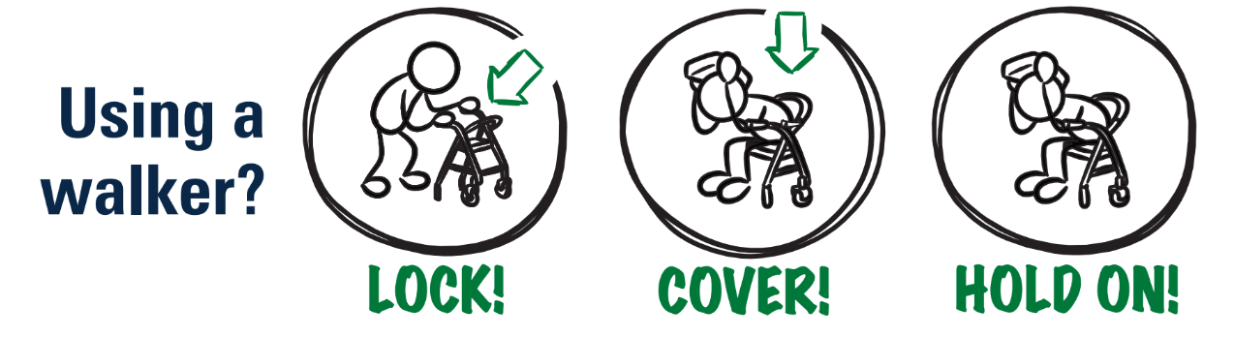
If you or someone you know uses a cane or walker:
16
Notes:
Teacher Notes: Slide is animated, so images come in when you click. Review modified protective actions for people who use a cane or walker. While you may not have students who use a cane or walker in your class, it is likely that there are members of your community who do. Ask students to help their family members or friends who use a cane or walker by sharing the correct protective actions. Have students repeat the phrase, “Drop, Cover, and Hold On” and then “Lock, Cover, and Hold On” after you’ve said it.
IMAGE: Image courtesy of USGS

Slide 17
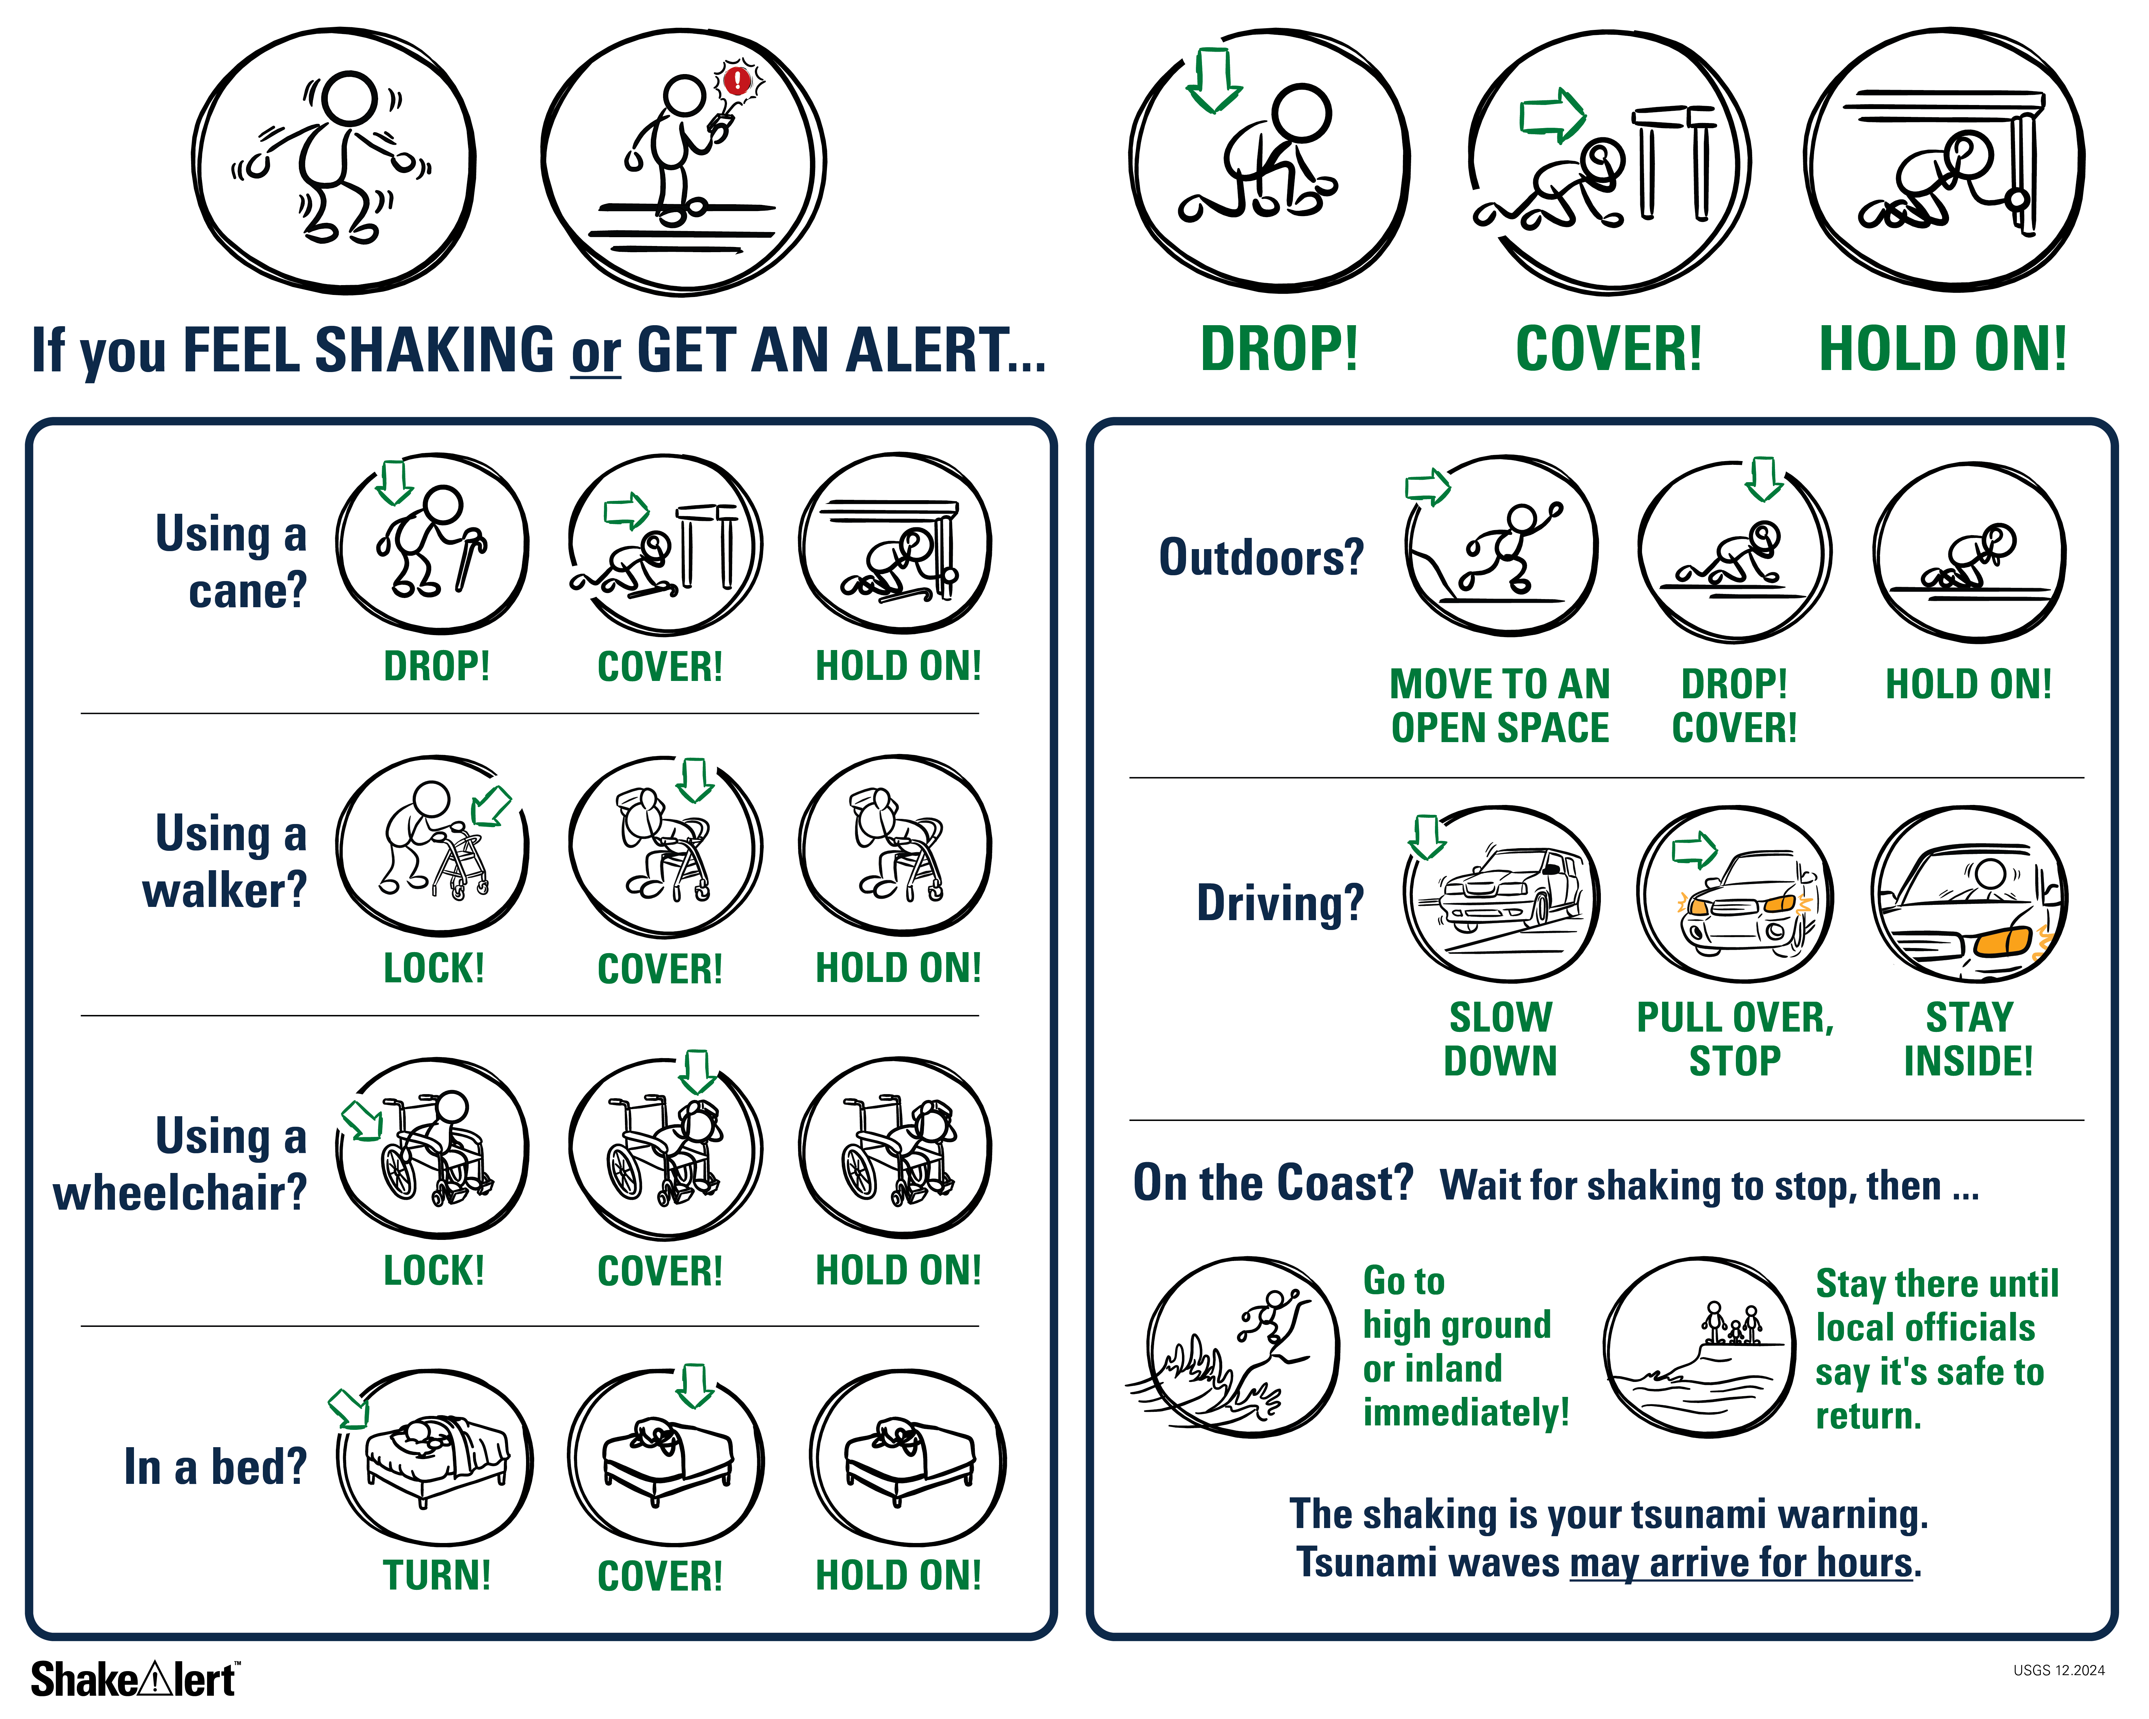
If you are outside when you feeling shaking or get an alert:
17
Notes:
Teacher Notes: Slide is animated so images appear when you click. Tell students that if they are outside when they feel shaking or get an alert, they should immediately move to an open space away from power lines or other objects that could fall on them. They should then drop to their knees and use one arm to cover their head and neck. They should then hold on in that position until the shaking stops.
IMAGE: Image courtesy of USGS

Slide 18
If you are on the coast, wait for shaking to stop, then …
18
Notes:
Teacher Notes: Slide is animated so images appear when you click. Tell students that if they are visiting the coast, the earthquake could be followed by a tsunami, which is a large wave caused by the earthquake. If they are on the coast when they feel shaking or get an alert, they should wait for shaking to stop, and then immediately go to high ground or inland. They should stay there until local officials say it’s safe to return. Tell students that tsunami waves may arrive for hours after the earthquake.
IMAGE: Image courtesy of USGS

Slide 19
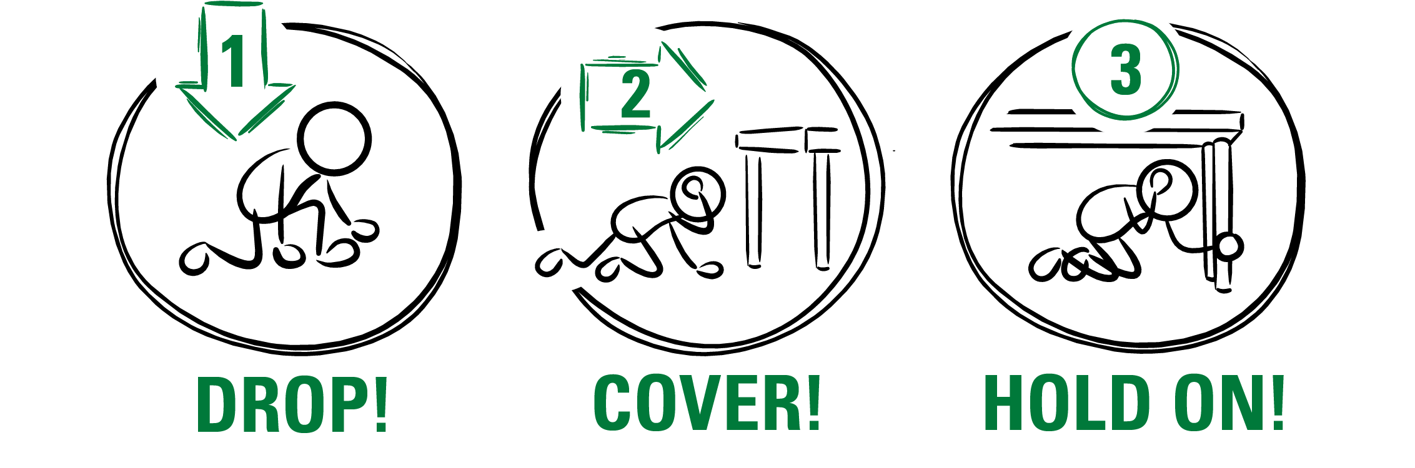

After an earthquake, there can be smaller earthquakes called aftershocks.
What should you do if you feel shaking or get an alert?
Notes:
Teacher Notes: Slide is animated so images appear when you click. Many earthquakes are followed by smaller earthquakes called aftershocks. Aftershocks can happen for even a few weeks after the main earthquake! Even though aftershocks are smaller than the main earthquake, they can still produce strong shaking and cause damage. Ask students what they should do if they feel shaking or get an alert. Remind students that they should stay alert and Drop, Cover, and Hold On if they feel shaking or get an earthquake early warning alert.
SOURCE: earthquake.usgs.gov/data/oaf/overview.php
IMAGE: Image courtesy of U.S. Geological Survey

Slide 20
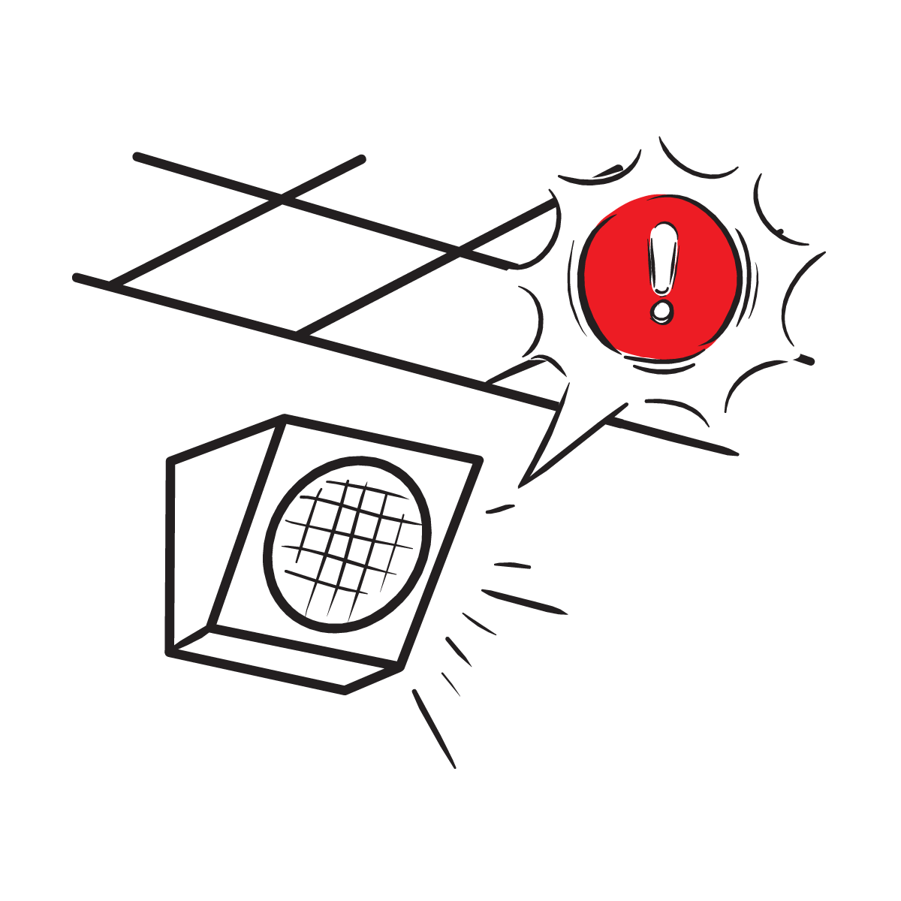
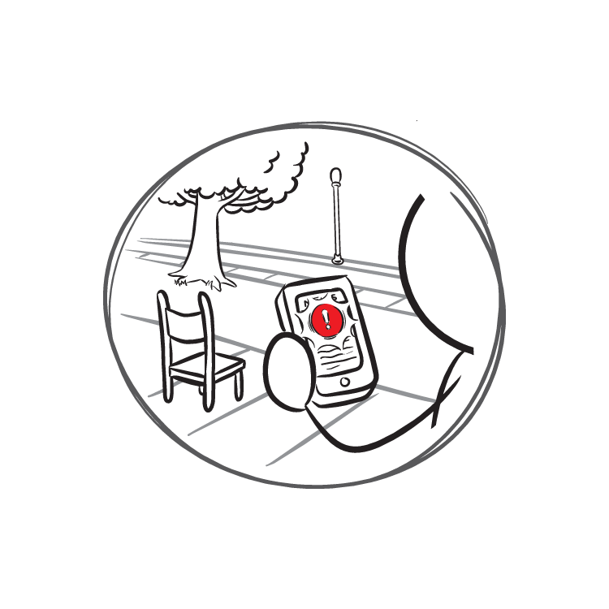
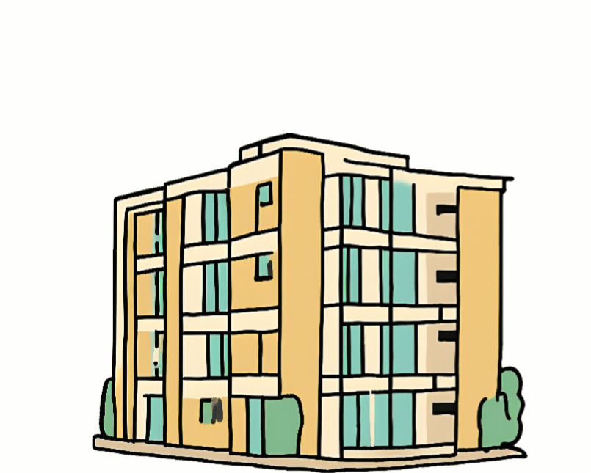
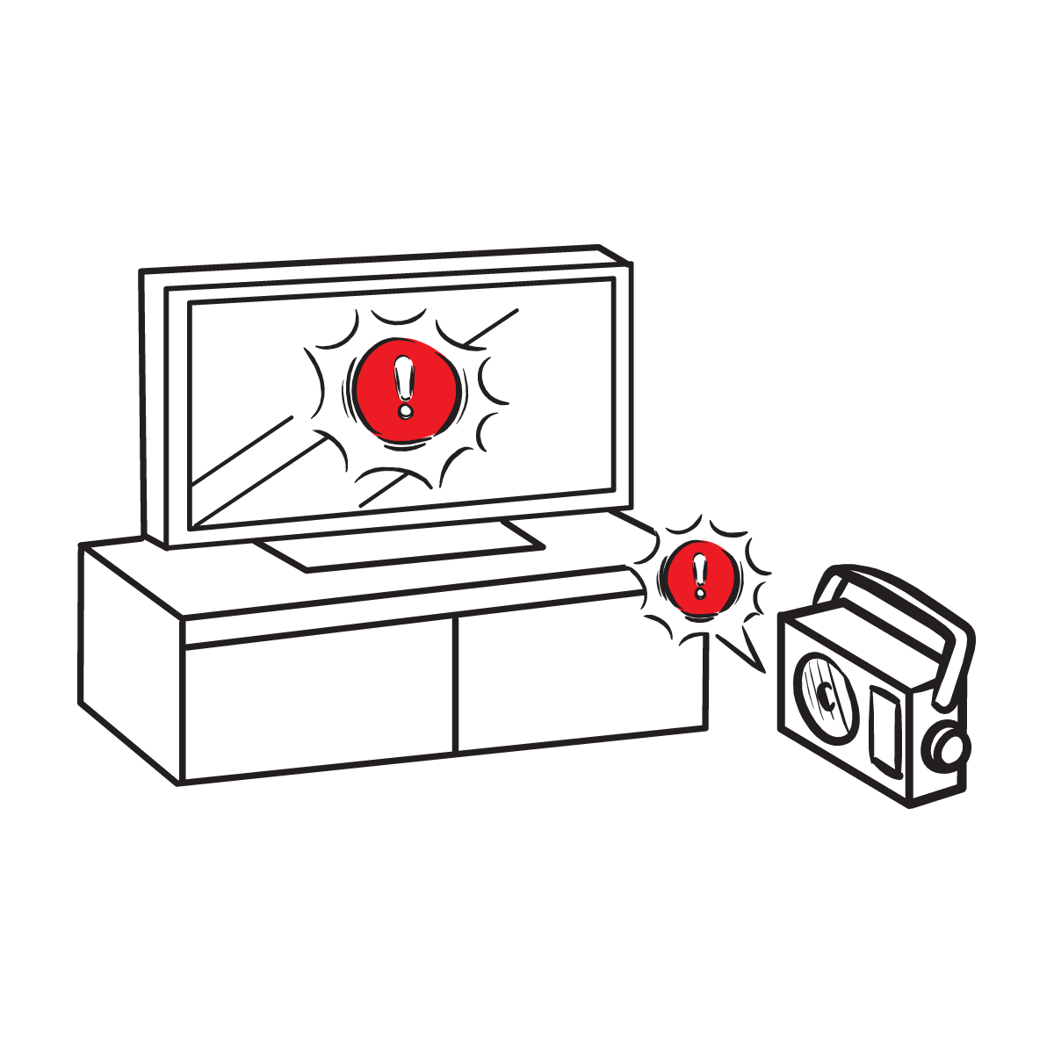

Protect yourself when there is . . .
ground shaking
an earthquake drill
an earthquake early warning alert
20
Notes:
Teacher Notes: Slide is animated, so images appear when you click.
Tell students that they should take protective actions when the ground shakes, if there’s an earthquake early warning alert, or if they’re doing an earthquake drill, which we’ll do now. Tell students that it’s vital they Drop, Cover, and Hold On immediately and without hesitation.
IMAGES: Images courtesy of the USGS and the Great ShakeOut. Used with permission.

Slide 21
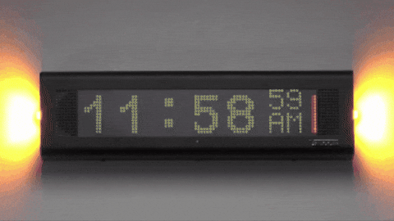

What to Expect from an Alert
21
Notes:
Teacher Notes: Play the ShakeAlert alert. Have all students Drop, Cover, and Hold On. Ask students to stay in their protective positions while the teacher observes and offers corrections if necessary. Once the teacher has checked in with each student, ask them to return to their seats.
NOTE: Your EEW alert may sound and look different than the one pictures on the slide!
SOUND: Valcom VEEWS earthquake early warning alert

Slide 22

LET’S REFLECT!
How did we do on the drill?
Questions?
Key things to remember?
22
Notes:
Teacher Notes: Ask students to turn to their neighbor and reflect on the earthquake drill. Have them discuss how they did, if they have questions, and what they think the key things to remember are. After reflecting, remind students of the key ways to stay safe during an earthquake, including immediately dropping to your knees, moving away from glass or heavy objects that could fall, etc.

Slide 23

Let’s Check In
Emergencies are scary.
People react differently, which is normal!
Why do we practice even though it can be uncomfortable?
23
Notes:
Teacher Notes: Remind students that it’s okay to be scared in an emergency and that different people will react differently, which is normal. Ask students why we conduct earthquake drills even though they can be uncomfortable. Students should note that practicing can help us to feel more prepared and less afraid.
IMAGE: Image courtesy Ready.gov

Slide 24
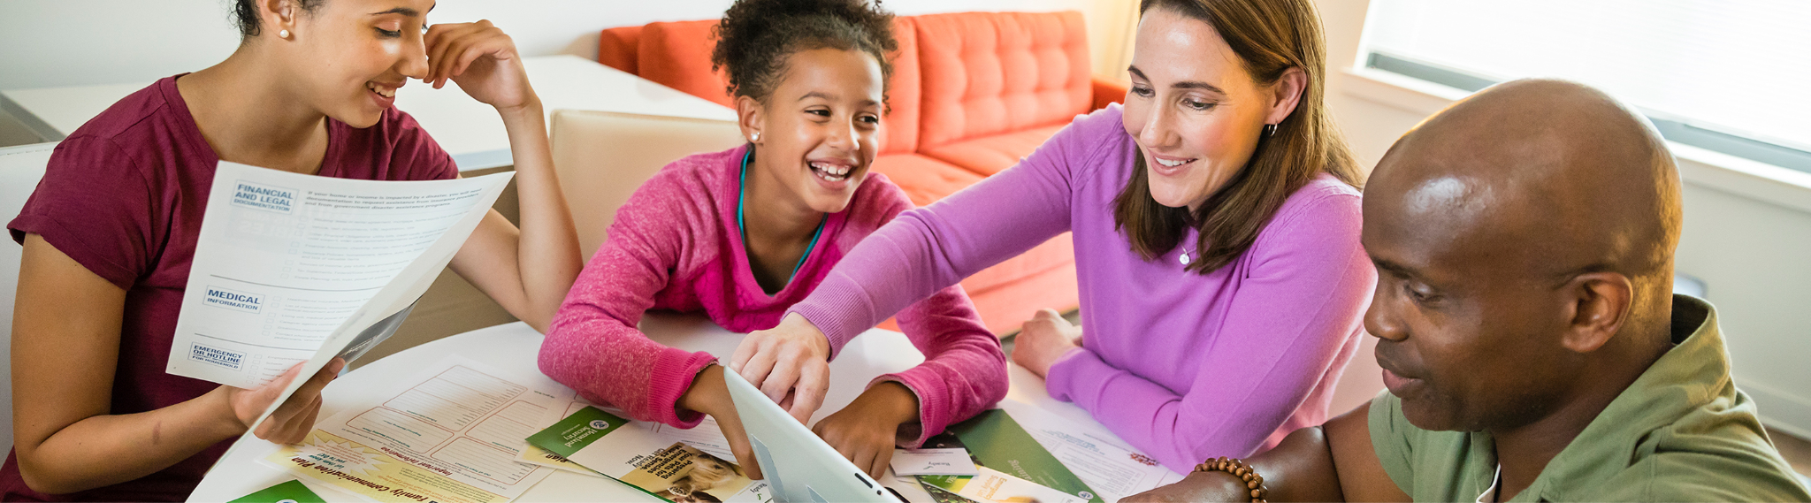
Help the people in your home prepare!
Tell the people in your home what you learned about how to protect yourself in an earthquake.
24
Notes:
Teacher Notes: Regardless of whether you are sending the Family Engagement Letter or email home before or after the lesson, ask students to talk with their families about how to stay safe in earthquakes with the adults in their homes. Provide students with the Family Engagement letter if you haven’t already done so. Ask students to consider signing up to receive ShakeAlert earthquake early warning alerts on their phones and to show others how to do so.
CREDIT: Ready.gov Family Emergency Planning

Slide 25
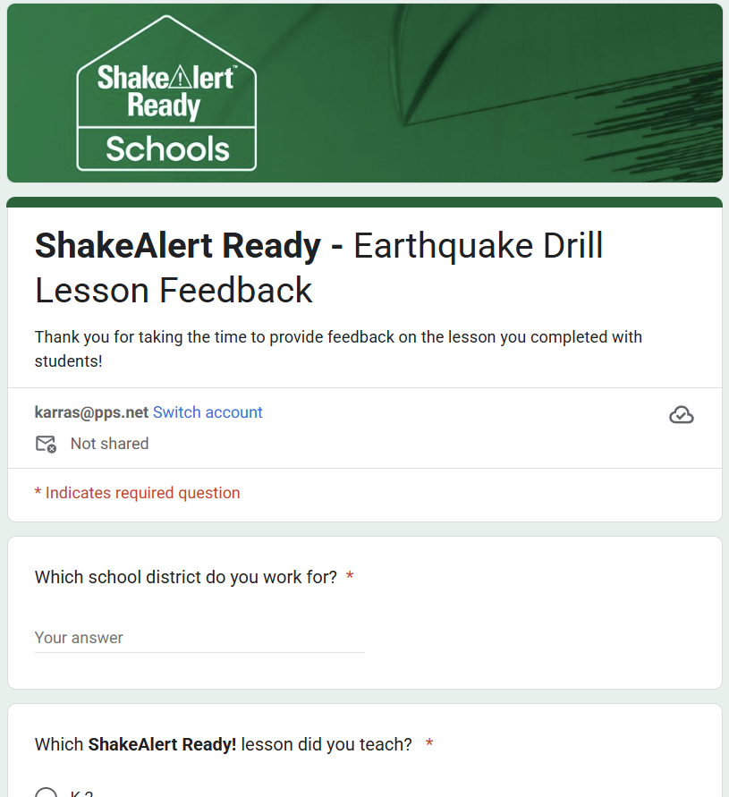
Teachers, please give us your feedback!
Please complete this brief, anonymous feedback form to help us to improve our ShakeAlert Ready lessons.
25
Notes:
LINK: https://docs.google.com/forms/d/e/1FAIpQLSeNHAr45fDTztflhJJD3_JVS8p0RiV1MW9sKyQgFucGJyKcCA/viewform?usp=sf_link

Slide 26
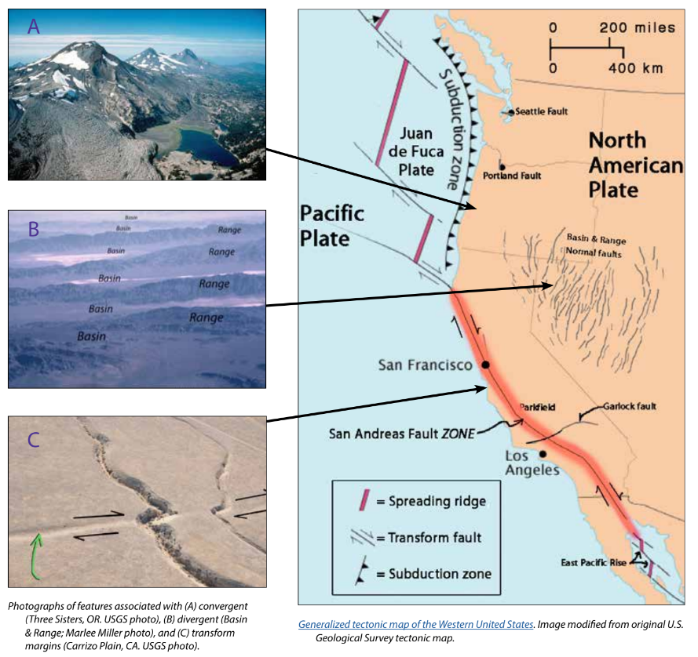
Background - Earthquake Hazard
California, Oregon, and Washington all face hazards from earthquakes because of the underlying tectonic plates, which constantly grind against each other. This friction creates "faults," lines of weakness in the Earth's tectonic plates (lithosphere) where earthquakes are most likely to occur.
California's San Andreas Fault is one example. Another example is the Cascadia Subduction Zone, which threatens all three states and British Columbia, Canada. This giant fault lies offshore, where the Juan de Fuca Plate dives beneath the North American Plate. This type of motion on other subduction zones can cause massive earthquakes, like the one that struck Japan in 2011.
While smaller earthquakes happen often, scientists think a major earthquake could happen any time, so it's important to be prepared.
For more information: Faults, Plate Tectonics & Earthquake Hazards - Animations / Videos
26
Notes:
IMAGE: https://www.iris.edu/hq/inclass/activities/introduction_to_faults_and_plate_tectonics
SOURCE: https://www.usgs.gov/programs/earthquake-hazards/science/pacific-northwest-hazards
https://www.usgs.gov/programs/earthquake-hazards/science/southern-california-earthquake-hazards

Slide 27
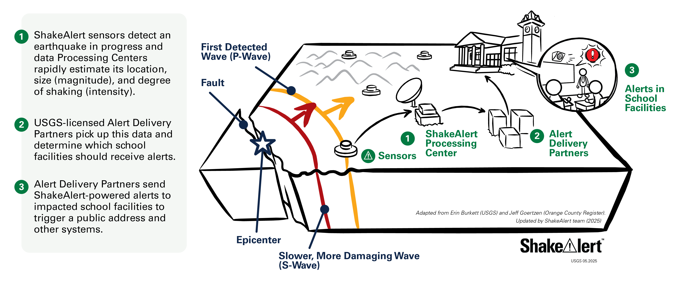
Background - How ShakeAlertⓇ Earthquake Early Warning System Works
27
Notes:
For more information on Earthquake Early Warning, go to: https://www.iris.edu/hq/inclass/sequences/earthquake_early_warning
IMAGE: Image courtesy of the USGS

Slide 28
Background - Effective Protective Actions
Most earthquake-related injuries and deaths are caused by collapsing walls and roofs, flying glass and falling objects.
If you are inside a building, move no more than a few steps, then Drop, Cover, and Hold On.
If you are outdoors when the shaking starts, you should find a clear spot away from buildings, trees, streetlights, and power lines, then Drop, Cover, and Hold On. Stay there until the shaking stops.
For protective actions in various settings (descriptions and gifs), go to https://www.earthquakecountry.org/step5/
Notes:
SOURCE: https://www.shakeout.org/whyparticipate/
IMAGE: Image courtesy of the USGS

Slide 29
Rationale
Why do we practice earthquake drills?
To react quickly you must practice often. You may only have seconds to protect yourself in an earthquake, before strong shaking knocks you down--or drops something on you.
Social science research has long shown that people who practice actions are more likely to take those actions when a safety- threatening event occurs, such as an earthquake or fire. Tests, drills, and exercises that repeat concepts build “muscle memory” of procedural knowledge and timely reaction. The more frequently a person practices a procedure or self-protective action, such as Drop, Cover, and Hold On, the more likely they will employ it— almost without thinking—when they receive an alert or feel shaking.
Why share the Family Engagement Letter?
While schools practice earthquake drills regularly, most other locations don’t. Some students’ family members may not have practiced earthquake drills since they were in school.
Family members may have outdated information about how to stay safe in an earthquake, such as the incorrect belief that standing in doorways or “the triangle of life” will keep one safe in an earthquake. Students will be able to share correct protective actions (Drop, Cover, and Hold On) with their family and community members.
Students spend more time at home than at school. Therefore, educating families will help keep students and our community safe. Additionally, families are more likely to understand their family and community members’ needs. This communication can prompt families to ensure they’re prepared to protect all members of their families in case of an earthquake.
In places like Oregon and Washington where earthquakes are less frequent, people might be unaware of the risk of an earthquake. .
The Family Engagement Letter has links for family members to learn more about earthquakes and protective actions.
29
Notes:
SOURCE: https://www.shakeout.org/whyparticipate/ , https://www.shakealert.org/toolkit/introduction/

Slide 30
Additional Resources
State Emergency Management Departments
ShakeAlert Website
ShakeAlert Ready Schools
ShakeAlert Messaging Toolkit (Videos, Graphics, Factsheets)
The Hero in You Foundation (PK-5 Educational Resources in Multiple Languages)
Great ShakeOut Educational Resources
Earthquake Country Alliance
(Earthquake Resources in Multiple Languages)
Valcom Earthquake Early Warning System - Valcom
California Governor's Office of Emergency Services
Oregon Department of Emergency Management
Washington Emergency Management Division
30

