Slide 1
ShakeAlert® Earthquake Early Warning
Presentation for Parents and Guardians
What is ShakeAlert Earthquake Early Warning (EEW)?
What can we expect from EEW? How should we respond?
How can we leverage ShakeAlert resources to educate our school community?

Slide 2
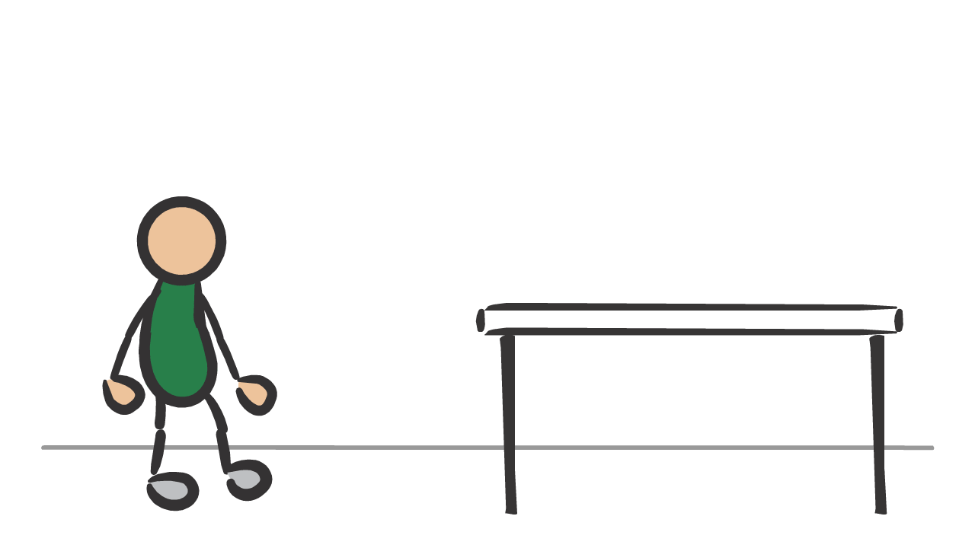
The ShakeAlert Earthquake Early Warning System
can help protect the school community by providing seconds of warning before strong shaking arrives.
2
Notes:
Children in our schools are already protected from fires by mandatory smoke alarms throughout schools, but did you know that there is an alarm system available for schools in Washington, Oregon and California that can provide children with seconds of warning before dangerous ground shaking arrives in an earthquake?

Slide 3
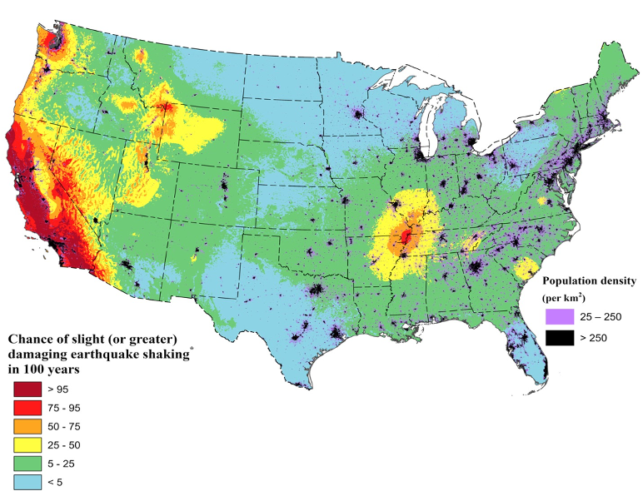
You Live in Earthquake Country!
This map shows areas with a >75% chance of a damaging earthquake in the next 100 years in CA.
3
Notes:
You already know that there are earthquakes in California. This graphic from a recent USGS publication shows that there are areas in California, Oregon and Washington with a greater than 75% chance of experiencing an earthquake with damaging shaking in the next 100 years. In this case, damaging means an earthquake felt by all that frightens many, and moves heavy furniture, creating slight damage. Because of this risk, it is important for us to prepare ourselves and our students to respond safely to an earthquake. That’s why the school district has taken extra steps to protect your child from an earthquake by installing a ShakeAlert-powered earthquake early warning system.

Slide 4
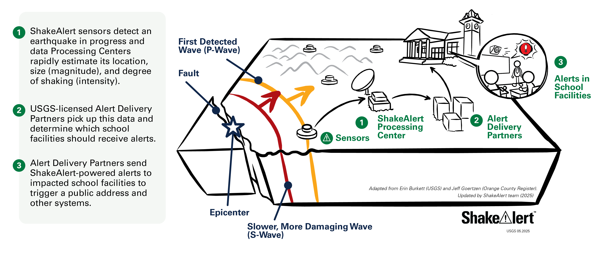
ShakeAlert is Not Earthquake Predication
4
Notes:
ShakeAlert is not earthquake prediction. Instead, there are sensors throughout Washington, Oregon and California that detect an earthquake as soon as it starts. If the earthquake is likely to be damaging enough, alerts are sent out to people and systems in areas that could be affected.

Slide 5
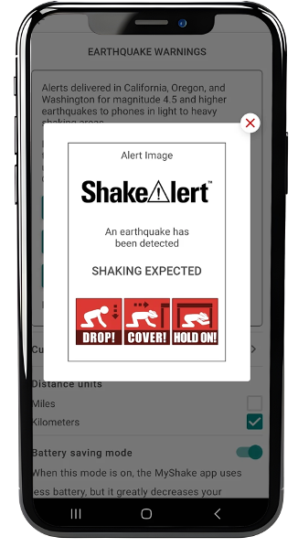



What to Expect from an Alert
5
Notes:
Alert sound will play on click. Alerts at our school will sound like this. Play alert. When we feel shaking or get an alert, we will Drop, Cover, and Hold On.
NOTE: The alert at your school may look and sound different.

Slide 6
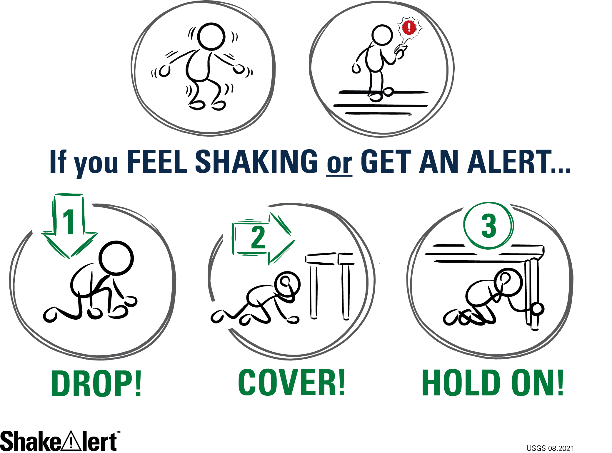
6
Notes:
During an earthquake, most injuries happen as people move around and fall, or have objects fall on them. Therefore, when you feel shaking or get an alert, drop to your hands and knees (not your bottom) so you won’t fall, cover our neck and head with your hand, and get under a table or desk if possible. Hold on to the leg of the table so that the shaking from an earthquake doesn’t jostle you out from under the table.
Credit: https://www.shakealert.org/education-and-outreach/messaging_toolkit/

Slide 7
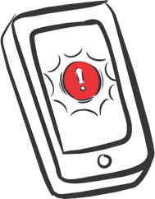






Sign up to Receive Alerts!
PROVIDER | TYPE OF ALERT | HOW TO SIGN UP
 | Wireless Emergency Alerts (WEA) | Most cell phones already access these. Check with your wireless carrier and check your phone’s settings.
 | Android Operating System | Android cell phones can have alerting on their operating system.
 | Mobile App | Available on:
7
Notes:
What else can you do to make sure your family and community is prepared for an earthquake? Sign up to receive ShakeAlert powered earthquake early warning alerts on your personal devices. There are cost-free apps available for Android and Apple devices that could provide you with seconds of warning to drop, cover and hold on before dangerous shaking arrives. https://www.usgs.gov/faqs/how-do-i-sign-shakealertr-earthquake-early-warning-system

Slide 8

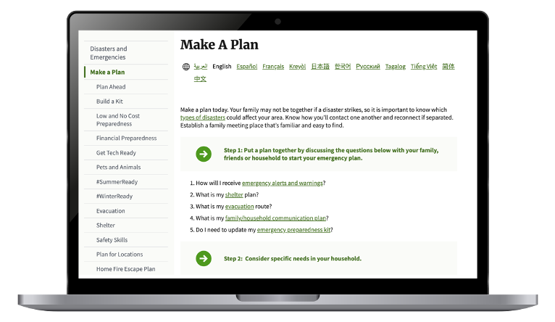
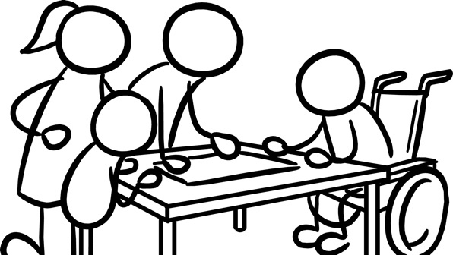
Make A Plan
CREDIT: Ready.gov
8
Notes:
NOTE: Clicking on the image on the left will take you to Ready.gov.
Talk with your family about your plan to stay safe during an earthquake. Decide where zcto meet if you’re not together. Discuss evacuation routes. Make sure all family members have access to each other's’ contact information. Be sure to consider any of your family’s specific dietary or medical needs when planning. Ready.gov has checklists and other resources to help you create your family’s emergency plan. https://www.ready.gov/plan

Slide 9
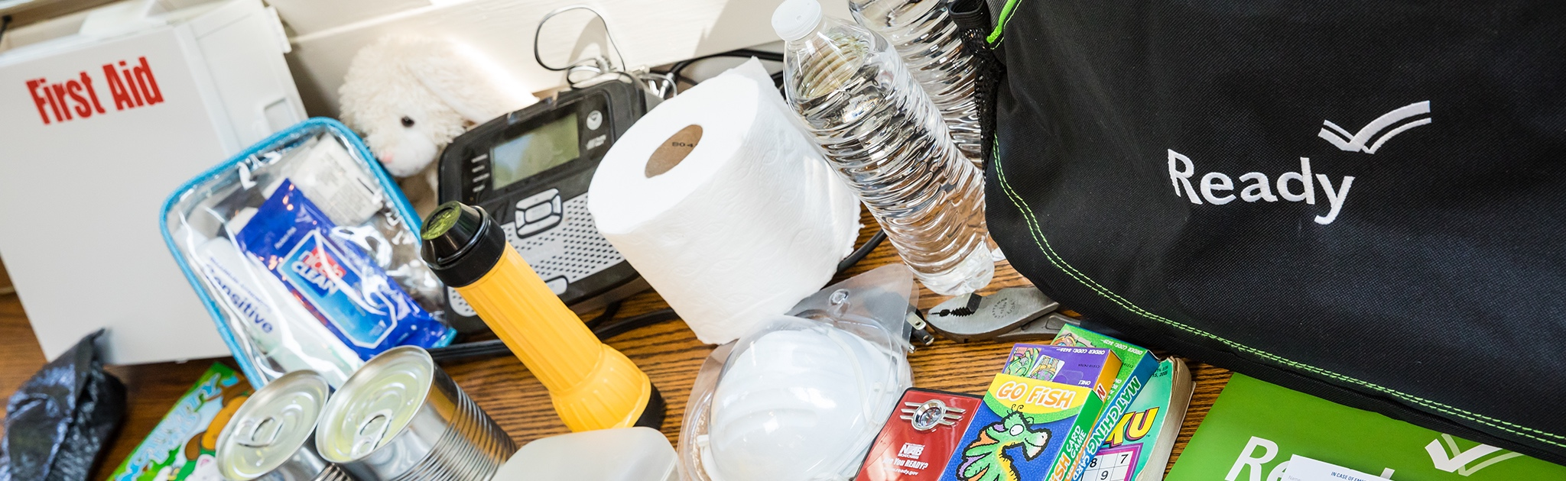

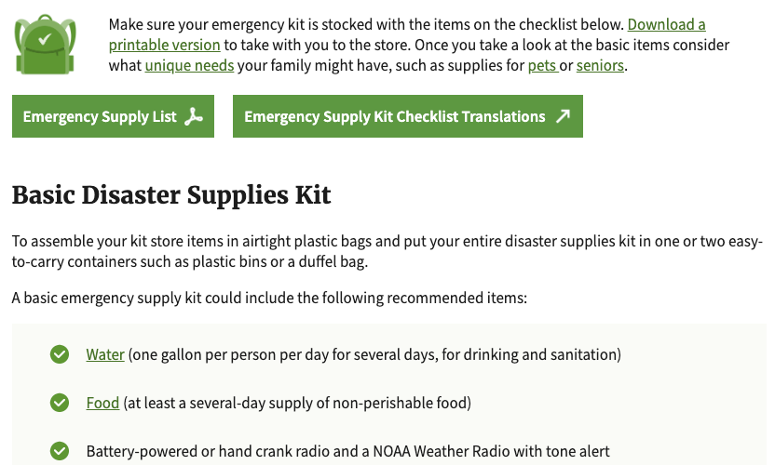
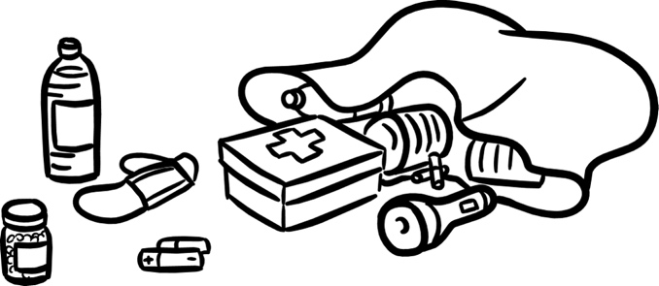
Make An Emergency Supply Kit
CREDIT: Ready.gov
9
Notes:
NOTE: Clicking on the image on the left will take you to Ready.gov.
Build an emergency supply kit with enough water, food and other supplies for your family to survive for a few days after an earthquake. Ready.gov has a list of what you may need, as well as low cost and cost free ideas on how to prepare. https://www.ready.gov/kit

Slide 10
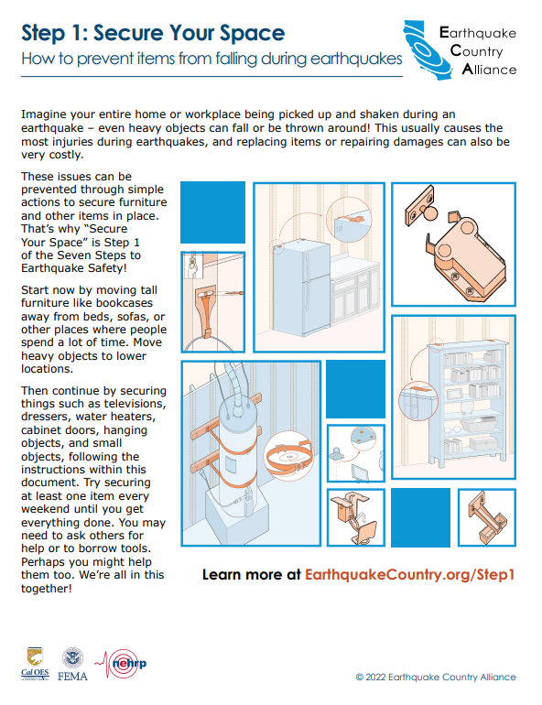
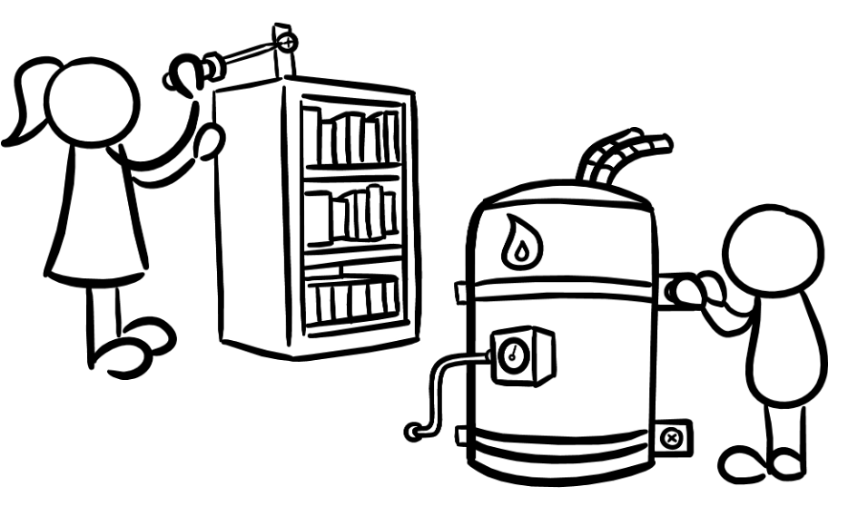

Secure Your Space
CREDIT: Earthquake Country Alliance
10
Notes:
NOTE: Clicking on the image on the left will take you to the Earthquake Country Alliance WEBSITE on how to secure your space. Clicking on the image on the right will take you directly to a pdf that you can download of how to secure your space.
During an earthquake injuries can occur as objects fall on people. Take action to prevent injuries by moving heavy objects to lower shelves, and moving beds and couches where people sleep or sit away from windows (which could break) and shelves or other heavy objects (that could fall during ground shaking).
The Earthquake Country Alliance has no cost and low cost ideas on how to get started. https://www.earthquakecountry.org/step1/

Slide 11
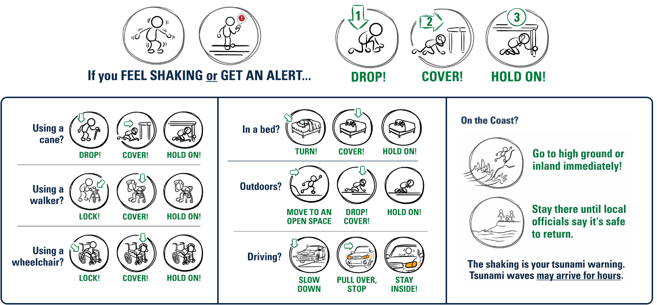
11
Notes:
Practice earthquake drills with your family. Research has shown that family members will instinctually try to get to each other during an earthquake, even though you are more likely to be injured while moving around. It is therefore important to practice Drop Cover and Hold On with your family, and discuss protective actions in various situations. The more you practice, the more automatic your family members’ responses will be. The Earthquake Country Alliance has detailed information about how all bodies can protect themselves, as well as the best protective actions in a variety of settings, such as what to do if you hear an alert or feel shaking while you’re in bed, in a store, outside, or in a car. https://www.earthquakecountry.org/step5/

Slide 12
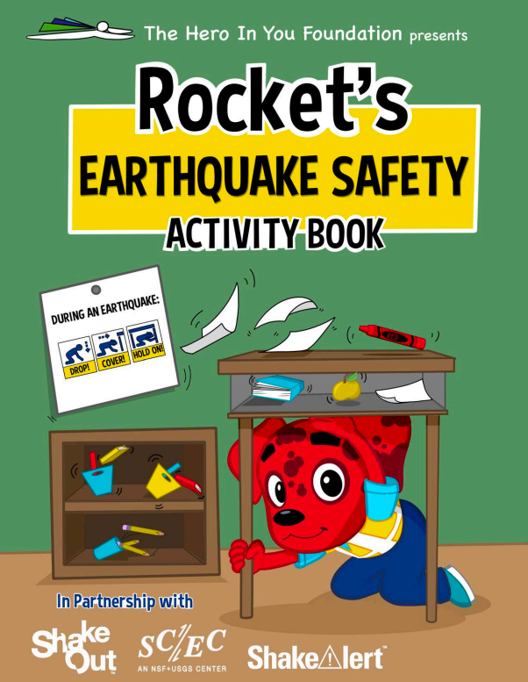
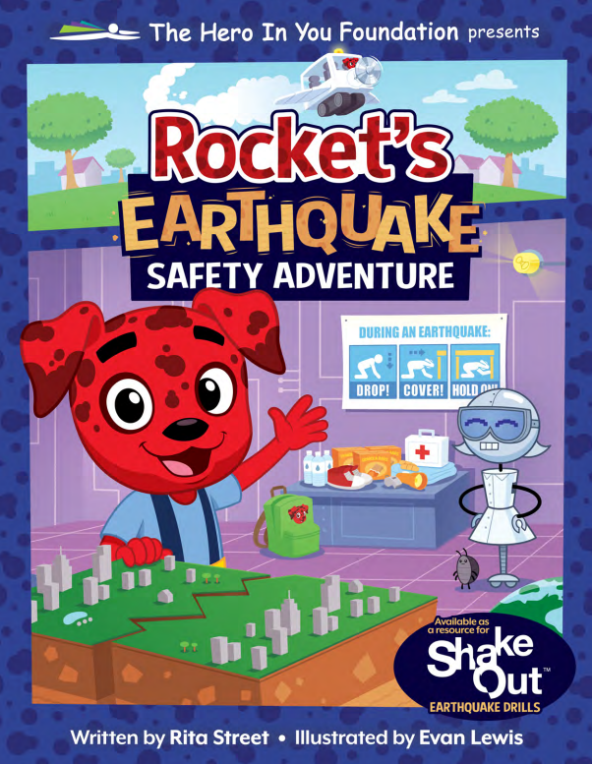
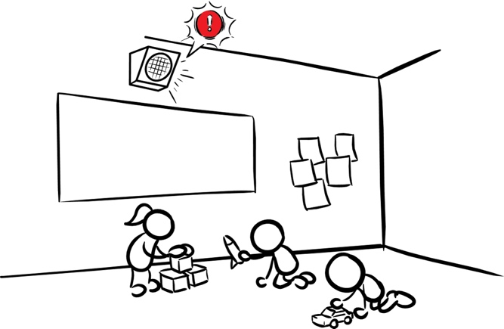

Talk to Children About Earthquake Safety
It’s ok to be scared, but it’s better to be prepared!
CREDIT: Rocket’s Earthquake Safety Activity, Rocket’s Earthquake Safety Adventure
12
Notes:
Talk to your kids about earthquakes and other hazards. They may be afraid or anxious about an earthquake. Assure them that your family has a plan, that you are prepared, and that it’s ok to be afraid. If your children are in kindergarten through 3rd grade, consider reading, “Rocket’s Earthquake Safety Adventure” by The Hero in You Foundation, and working through “Rocket’s Earthquake Safety Activity Book, also by The Hero in You Foundation, which is available in English, Spanish, Chinese, Tagalog, Vietnamese, Armenian, French, Japanese, and Korean.

Slide 13

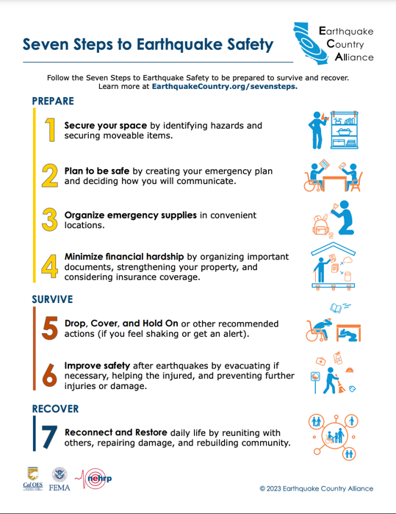
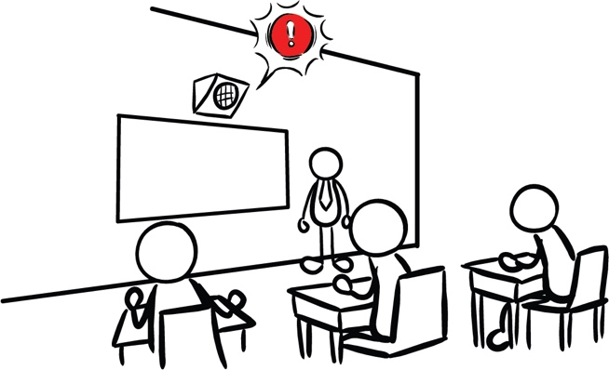
Talk to Older Children About Earthquake Safety
Consider working with your older students to create a plan.
CREDIT: Dark Horse Comics
CREDIT: Earthquake Country Alliance
13
Notes:
NOTE: Clicking on images will take you directly to those resources.
Talk to your kids about earthquakes and other hazards. Older students may also be afraid or anxious about an earthquake. Consider working with your older students to create a plan. Earthquake Country Alliance has many resources designed to help California’s prepare, survive, and recover from an earthquake. https://www.earthquakecountry.org/ Check out this comic about earthquakes, called “Without Warning,” available for free at https://digital.darkhorse.com/books/99762a678d1c41f8889eac6318f674d9/without-warning .

Slide 14

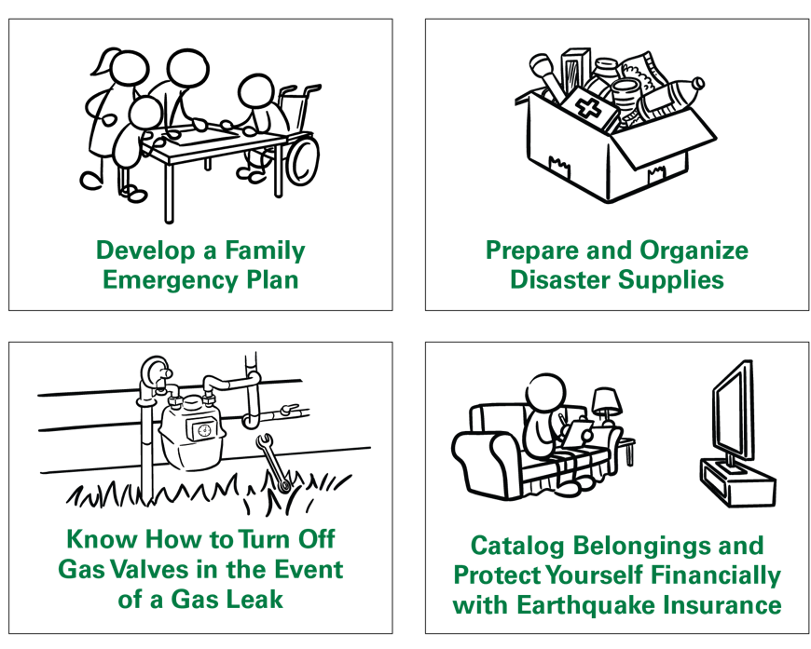
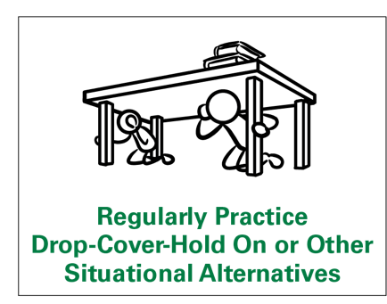

Connect with Your Community
14
Notes:
And lastly, consider sharing information with your community members about earthquake preparedness. Remember, most adults haven’t participated in an earthquake drill since they were in school. They may have incorrect ideas about how to protect themselves in an earthquake.
Conduct an earthquake drill at your workplace, church or other organization after reviewing correct protective actions. Include information about how to protect all bodies, including those that use a wheelchair, cane, or walker. Consider participating in the Great ShakeOut, an international earthquake drill that happens on the 3rd Thursday every October.

Slide 15

For More Information
USGS ShakeAlert www.ShakeAlert.org
Ready.gov https://www.ready.gov/earthquakes
Earthquake Country Alliance https://www.earthquakecountry.org/
California Governor's Office of Emergency Services https://www.caloes.ca.gov/
Oregon Department of Emergency Management https://www.oregon.gov/oem/Pages/default.aspx
Washington Emergency Management Division https://mil.wa.gov/emergency-management-division
@USGS_ShakeAlert
ShakeAlert® Earthquake Early Warning System | ShakeAlert Ready Schools | 12.2024
15
Notes:
There are lots of great resources out there about earthquake preparedness. It can feel overwhelming to start preparing. Consider setting a reminder on your phone once a month to conduct an earthquake drill with your family, and complete one preparedness task. Anything you can do to prepare for an earthquake makes you and your family safer!

