Slide 1
ShakeAlert® Ready: A CERT Guide to Earthquake Early Warning Essentials
What CERT Members Need to Know About Earthquake Early Warning
February 2026 – Version 1.5
Notes:
Welcome everyone to ShakeAlert Ready: A CERT Guide to Earthquake Early Warning Essentials. Explain that this session helps CERT members understand how earthquake early warning works, why it matters, and how to use it as part of their own preparedness and community outreach. ShakeAlert® is the U.S. Geological Survey’s official public earthquake early warning system. It currently operates in California, Oregon, and Washington—the only three states where it is active today—but it may be expanded to other earthquake-prone regions in the future as the system continues to develop. Emphasize that this technology is already saving lives and helping communities act faster when earthquakes strike. By the end of the session, participants should be able to describe ShakeAlert®, know what to do when they get an alert, and share accurate information with neighbors or teammates.
Ask whether anyone has received or heard of a ShakeAlert before, and use a few quick responses to build interest and relevance.

Slide 2
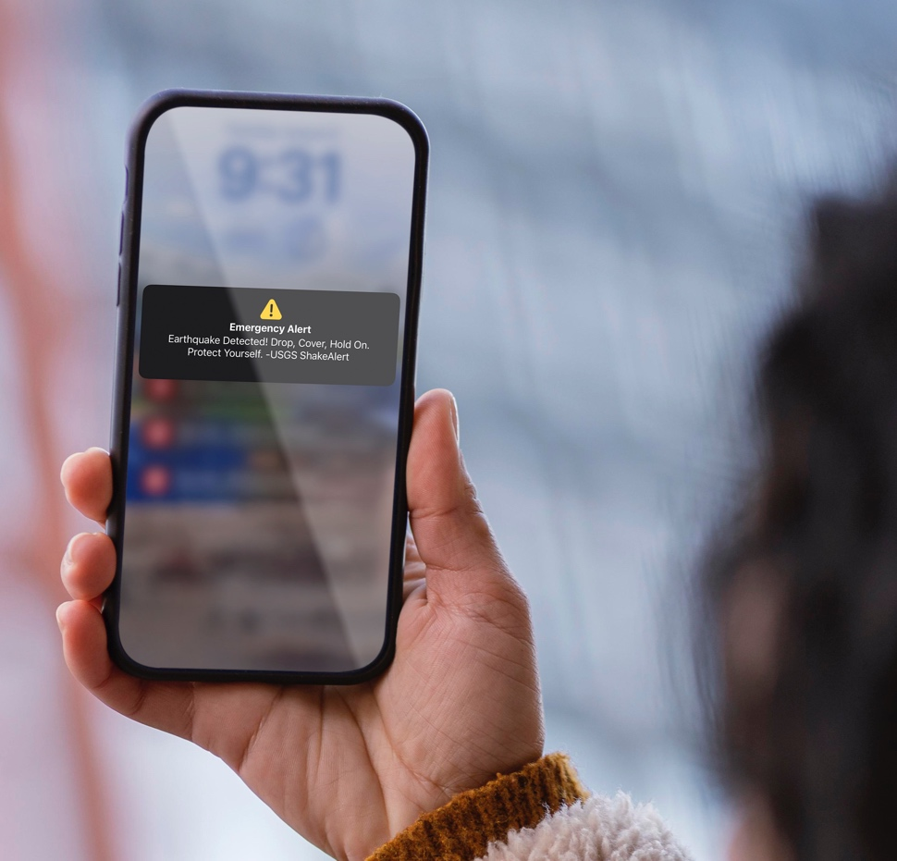
What We Will Cover
ShakeAlert.org
01
Earthquakes and Earthquake Early Warning
02
How ShakeAlert Works
03
Putting ShakeAlert Into Action
Notes:
Explain that this short session has three parts. First, it looks at earthquakes themselves—what happens when the ground shakes and why early warning can make a difference. Next, it explores how the ShakeAlert® system detects and delivers alerts in seconds. Finally, it shows how CERT volunteers can help others understand and use ShakeAlert safely and confidently. Reinforce that this is not a technical briefing; the focus is on gaining a practical understanding and building confidence. CERT members are often the first people their neighbors ask for reliable information, and this module equips them to give clear, trusted answers. Transition by saying, “Let’s start with why this matters—because earthquakes happen where we live.”

Slide 3
Earthquakes and Earthquake Early Warning
Notes:
This is a transition slide. You can say something like, “Let’s start by talking about earthquakes themselves—what happens when the ground starts shaking, and how early warning can help us respond more safely.” Keep it short and conversational to set up the next few slides, which go deeper into earthquake impacts before introducing ShakeAlert®.

Slide 4
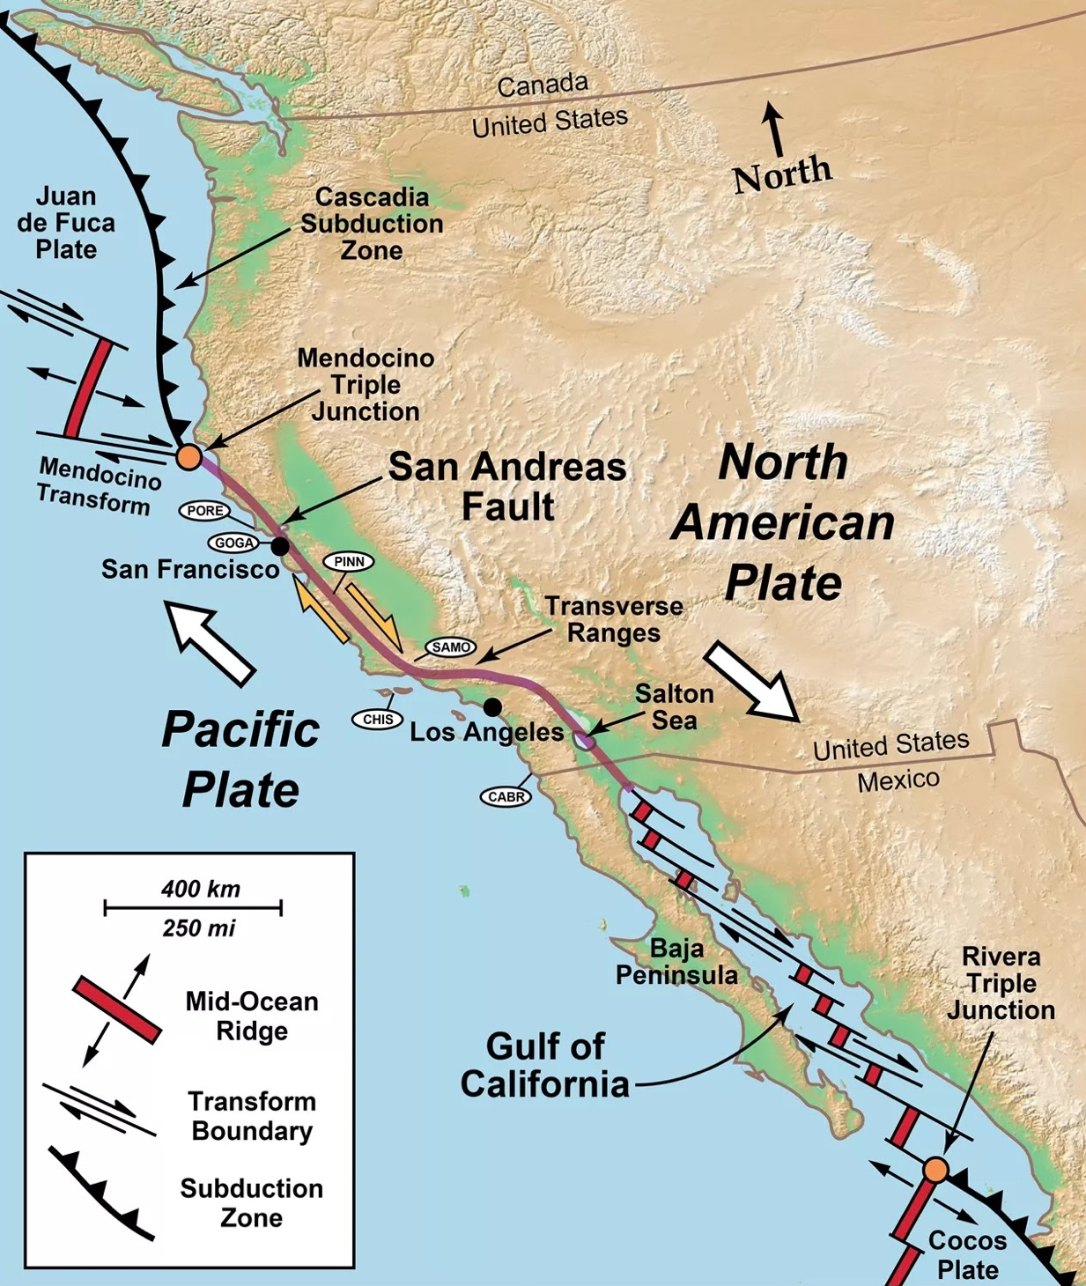
ShakeAlert.org
Earthquakes Happen Here
  California, Oregon, and Washington are home to some of the most active earthquake zones in the United States.
  Large earthquakes have happened before — and they will happen again.
  ShakeAlert® provides early warning so people can take protective action before strong shaking arrives.
Notes:
Use this slide to show that the entire West Coast—California, Oregon, and Washington—sits along the boundary between two massive tectonic plates: the Pacific Plate and the North American Plate. You can say something like, “As you can see, the West Coast lies right on top of major fault systems. This is why earthquakes are a regular part of life in our region.”
Point out a few key features on the map: the Cascadia Subduction Zone off the coasts of Oregon and Washington, where one plate slides beneath another and can produce very large earthquakes; and the San Andreas Fault Zone in California, where the plates slide past each other, generating frequent but usually smaller quakes.
If you feel comfortable, mention a nearby fault or plate boundary relevant to your area to make it local. You don’t need to go into detail—the goal is simply to help participants see that earthquakes are expected here and that early warning is designed specifically for this region.
Wrap up the slide by saying, “Because earthquakes happen here, we need ways to prepare, respond, and act quickly when they start—and that’s where ShakeAlert® comes in.”

Slide 5
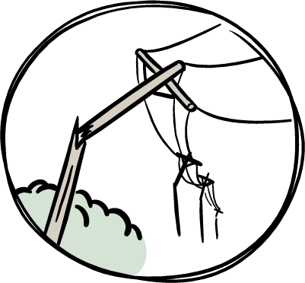
ShakeAlert.org
What Happens During
an Earthquake
  Earthquakes strike suddenly, sometimes with a roar.
  Everything will begin to shake.
  Lights flicker or go out.
  Sprinklers and fire alarms may activate.
  Windows may shatter.
  Objects will fly off shelves and walls, and furniture can move.
  People and animals may react suddenly or panic.
  Trees and telephone poles will rock side to side; some may fall over.
Notes:
Explain that earthquakes strike suddenly and often come with a roar or rumble before the shaking starts. Lights may flicker or go out, alarms might sound, and objects can fall from shelves or walls. The movement can be startling and disorienting, and people’s reactions vary—some freeze, others try to move, and pets may behave strangely or run for cover. Describe that in larger quakes, it’s common for furniture to shift, windows to rattle or break, and for power and communications to fail temporarily.
You can make this slide more engaging by asking participants whether anyone has ever felt an earthquake. Encourage one or two short stories, or share your own experience if appropriate—what it felt like, what people did, or what the environment was like during and after. You can also mention a recent or well-known earthquake that participants may remember and include a local or personal detail to make it relatable. The goal here is to help people visualize what it’s like when an earthquake begins and to remind them that these events are real and unpredictable.
Avoid going into specific protective actions yet—that’s coming later. For now, focus on helping participants connect emotionally to the reality of shaking and think about how disorienting those first moments can be. That connection will make the discussion of protective actions more meaningful when you return to it later.

Slide 6
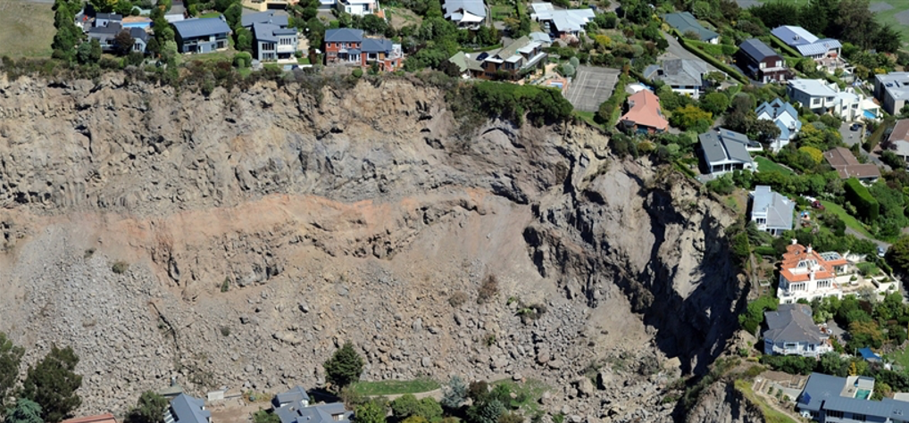
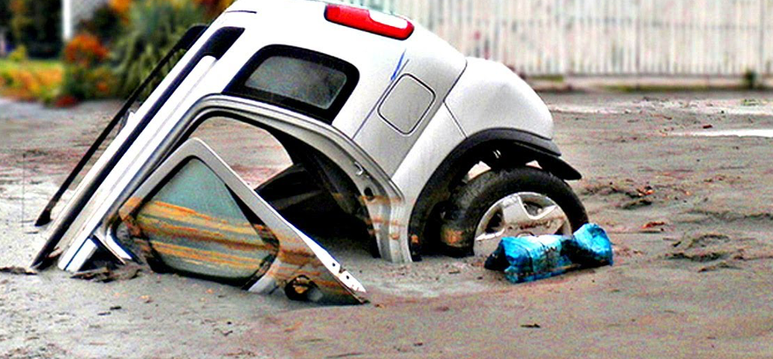
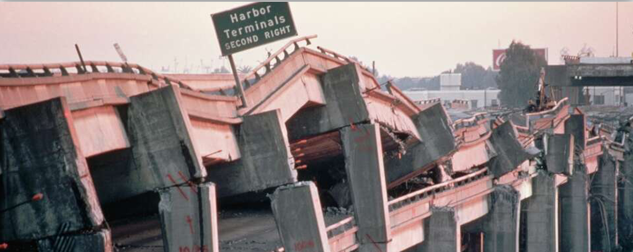
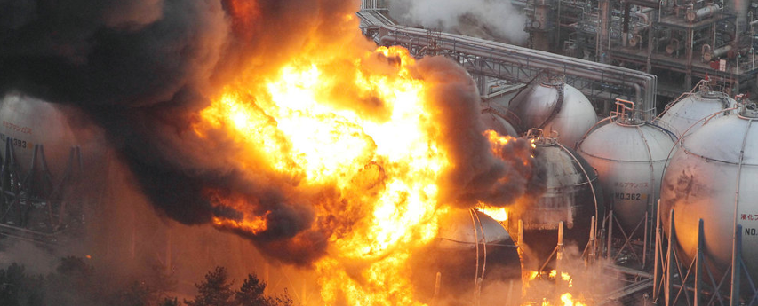
ShakeAlert.org
Earthquake Also Produce Secondary Hazards
LANDSLIDES
GROUND LIQUEFACTION
INFRASTRUCTURE DAMAGE
FIRE
Notes:
Explain that while the shaking itself can cause injuries and damage, earthquakes often trigger a range of secondary hazards that can make the situation worse. Fires may start from broken gas lines or damaged wiring. Power may go out, traffic lights can fail, and water systems may rupture. In some areas, earthquakes can trigger landslides, ground failure, or even tsunamis along the coast.
You can make this slide more relatable by connecting it to familiar examples. If your group is in a hillside area, mention how shaking can loosen slopes or cause retaining walls to fail. If you’re near the coast, talk briefly about the potential for tsunami warnings after major offshore earthquakes. Urban areas might experience transportation disruptions, fires, or hazardous materials spills.
If you feel comfortable, ask participants what secondary hazards might be likely where they live or serve. Encourage them to think beyond the shaking—what else could happen that would affect their neighborhood, their home, or their CERT team’s ability to respond? These examples help people see earthquakes as complex events that can affect many systems at once.

Slide 7
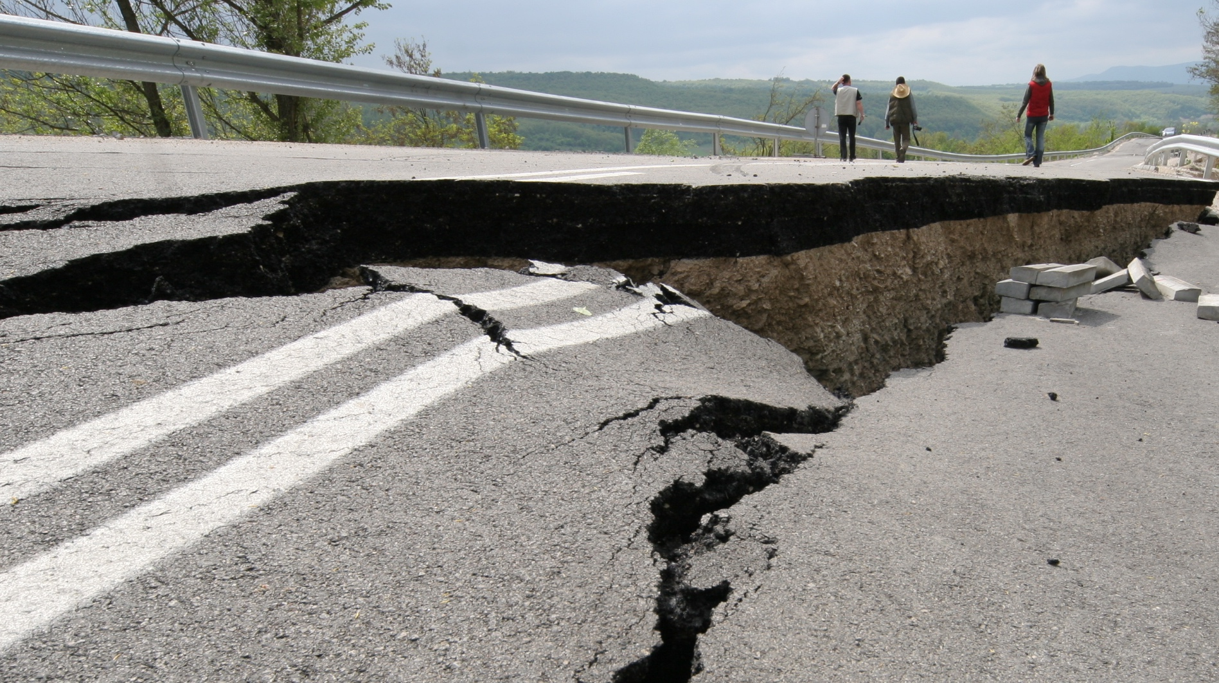
Did you know
you can get an earthquake early warning alert before strong shaking is expected near you?
Notes:
Use this slide to build curiosity and set up the idea of earthquake early warning without going into detail yet. Ask the group, “Did you know that people can actually get a few seconds of warning before strong shaking starts?” Pause to let participants react—some may express surprise or disbelief, which is a good opportunity to affirm that it’s real.
Explain that earthquake early warning gives people advance notice that shaking is on the way. It’s based on science and technology developed by the U.S. Geological Survey and its partners. You don’t need to explain how it works yet—you’ll cover that soon—but let participants know that this system is designed to give them valuable seconds to protect themselves before the shaking reaches them.
If you want to add a quick personal or local touch, you can say something like, “Imagine you’re at work or at home, and your phone buzzes with a short alert—‘Earthquake! Expect shaking.’ That’s the kind of message this system can deliver.” End the slide by saying that next, you’ll look at an earthquake many people remember and imagine how early warning could have made a difference.

Slide 8
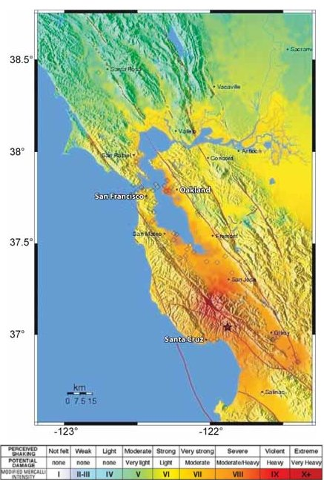
Northern California Loma Prieta Earthquake
M6.9/MMI VIII
October 17, 1989, 5:04 PM
63 deaths
3,757 injuries (400 serious)
Damage to 12,000 homes and 2,600 businesses
US$80 million in damage (equivalent to US$203 million today)
1.4 million people experienced power losses
News stations off air for 15-40 minutes
VIII
Notes:
Use this slide to bring the concept of earthquakes to life with a real and memorable event. Explain that the 1989 Loma Prieta Earthquake struck suddenly at 5:04 p.m. on October 17, during the World Series baseball game between the San Francisco Giants and the Oakland A’s. Because it happened during a nationally televised broadcast, millions of people across the country saw the event unfold almost in real time. You can point out that this earthquake is one many people still remember—especially the dramatic images of the Bay Bridge’s upper deck collapsing, sections of freeway pancaking, and widespread power outages across the Bay Area.
If you’re comfortable doing so, ask if anyone in the group remembers seeing those images or hearing about the quake. You can note that for many Americans, it was the first time they saw the destruction of an urban earthquake on live television. The Loma Prieta earthquake caused 63 deaths, thousands of injuries, and major damage to homes, businesses, and infrastructure.
Share that at the time, there was no early warning system in place—people had no notice that shaking was coming. Encourage participants to think about how unexpected and confusing those first moments must have been. Then, set up the next slide by saying, “Now let’s imagine how things might have been different if ShakeAlert® had existed back then.”

Slide 9
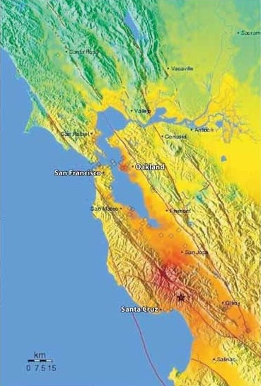
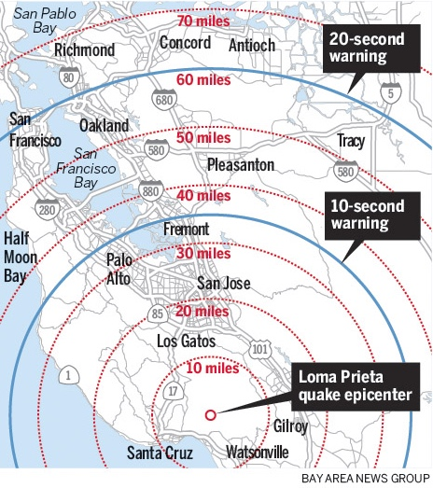
If ShakeAlert Had Been There on October 17, 1989…
Notes:
Now that participants are picturing what the 1989 Loma Prieta earthquake was like, invite them to imagine how things might have been different if ShakeAlert® had existed at that time. Explain that sensors near the earthquake’s epicenter in the Santa Cruz Mountains would have detected the shaking almost instantly. You can point to the map or image on the slide and show that San Francisco is on the west side of the bay and Oakland on the east, connected by the Bay Bridge. If your group includes people unfamiliar with California geography, explain that they can imagine a long bridge linking two major cities across the water—this is the structure where the upper deck collapsed during the quake.
Because the sensors would have been closer to the epicenter, alerts could have reached San Francisco and Oakland about twenty seconds before the strongest shaking arrived. Those twenty seconds might have allowed drivers to slow or stop, broadcasters to stay live on the air, and people to drop, cover, and hold on before the violent shaking began. You can remind participants that twenty seconds may not sound like much, but it can make a huge difference in preventing injuries and saving lives.
At this point, ask the group, “If you had just a few seconds of warning, what could you do?” Encourage short, practical answers—things like taking cover, steadying yourself, warning others, or moving away from hazards. Reinforce that these actions only work if people already know what to do. That’s why early warning doesn’t replace preparedness—it strengthens it by turning awareness into action. End this section by saying, “Let’s look next at how the ShakeAlert® system actually works.”

Slide 10

ShakeAlert.org
ShakeAlert Earthquake Early Warning:
A New Layer of Earthquake Preparedness
Early warning doesn’t replace preparedness — it adds valuable seconds to use the actions you’ve already planned.
When an earthquake begins, seismic waves spread fast — but digital alerts can spread faster.
Earthquake early warning works best when it is built into your overall preparedness plan.
Notes:
Explain that ShakeAlert® adds a new layer of protection to what people already do to prepare for earthquakes. You can say something like, “Early warning works best when it’s built into your overall preparedness plan.” Emphasize that ShakeAlert® doesn’t replace earthquake planning—it enhances it. When people and organizations plan ahead, those extra seconds of warning can help them act faster and more effectively.
Make the point that early warning is most useful for people who already know what to do. The technology gives you a short window of time—but it’s the practice and preparation that make those seconds count. CERT members already think about readiness, communication, and coordination, so ShakeAlert® fits naturally into that mindset. You can give an example: a family that has practiced “Drop, Cover, and Hold On” will automatically take action when an alert sounds, while a business that has trained employees can prevent injuries by doing the same.
Reinforce the key idea that ShakeAlert® strengthens other preparedness—it doesn’t replace it. It gives people time to do what they’ve already planned and practiced, turning those few seconds of warning into protection, calm, and confidence.

Slide 11
How ShakeAlert Works
Notes:
This is a transition slide. Just give a quick overview—something like, “Let’s take a look at how ShakeAlert detects an earthquake and delivers alerts in just seconds.”

Slide 12
ShakeAlert.org
ShakeAlert Earthquake Early Warning Can
Detect: A network of seismic sensors across California, Oregon, and Washington quickly detects shaking when an earthquake begins.
Process: Computers analyze the first data to estimate where the earthquake started, how big it is, and where strong shaking will occur.
Deliver: Alerts are sent to apps, phones, and automated systems, giving people seconds to take protective action before strong shaking arrives.
Protect: Help prompt people and systems to take action like Drop, Cover, and Hold On or trigger automated safety steps.
ShakeAlert is the nation’s only public earthquake early warning system.
Notes:
Use this slide to give participants a simple overview of what the ShakeAlert® system is capable of. You can say something like, “ShakeAlert is designed to detect earthquakes quickly, estimate their size and location, and send alerts that give people and systems a few seconds of warning before strong shaking starts.”
Explain that those alerts can reach phones, apps, and automated systems that trigger protective steps—things like slowing trains, opening fire-station doors, or shutting off gas lines. These automatic actions are important because they can prevent injuries and reduce damage before people even have time to react.
Keep the focus on what the system can do rather than how it works—that comes next. End the slide by saying, “Now let’s look at what happens inside the system—how it detects, processes, and delivers those alerts.”
Note: ShakeAlert® is the USGS-run earthquake early warning system. The alerts people actually receive on their phones are ShakeAlert-powered messages — sent by partner agencies and apps, not directly by USGS. Try to reflect this in the language you use when teaching or answering questions.

Slide 13
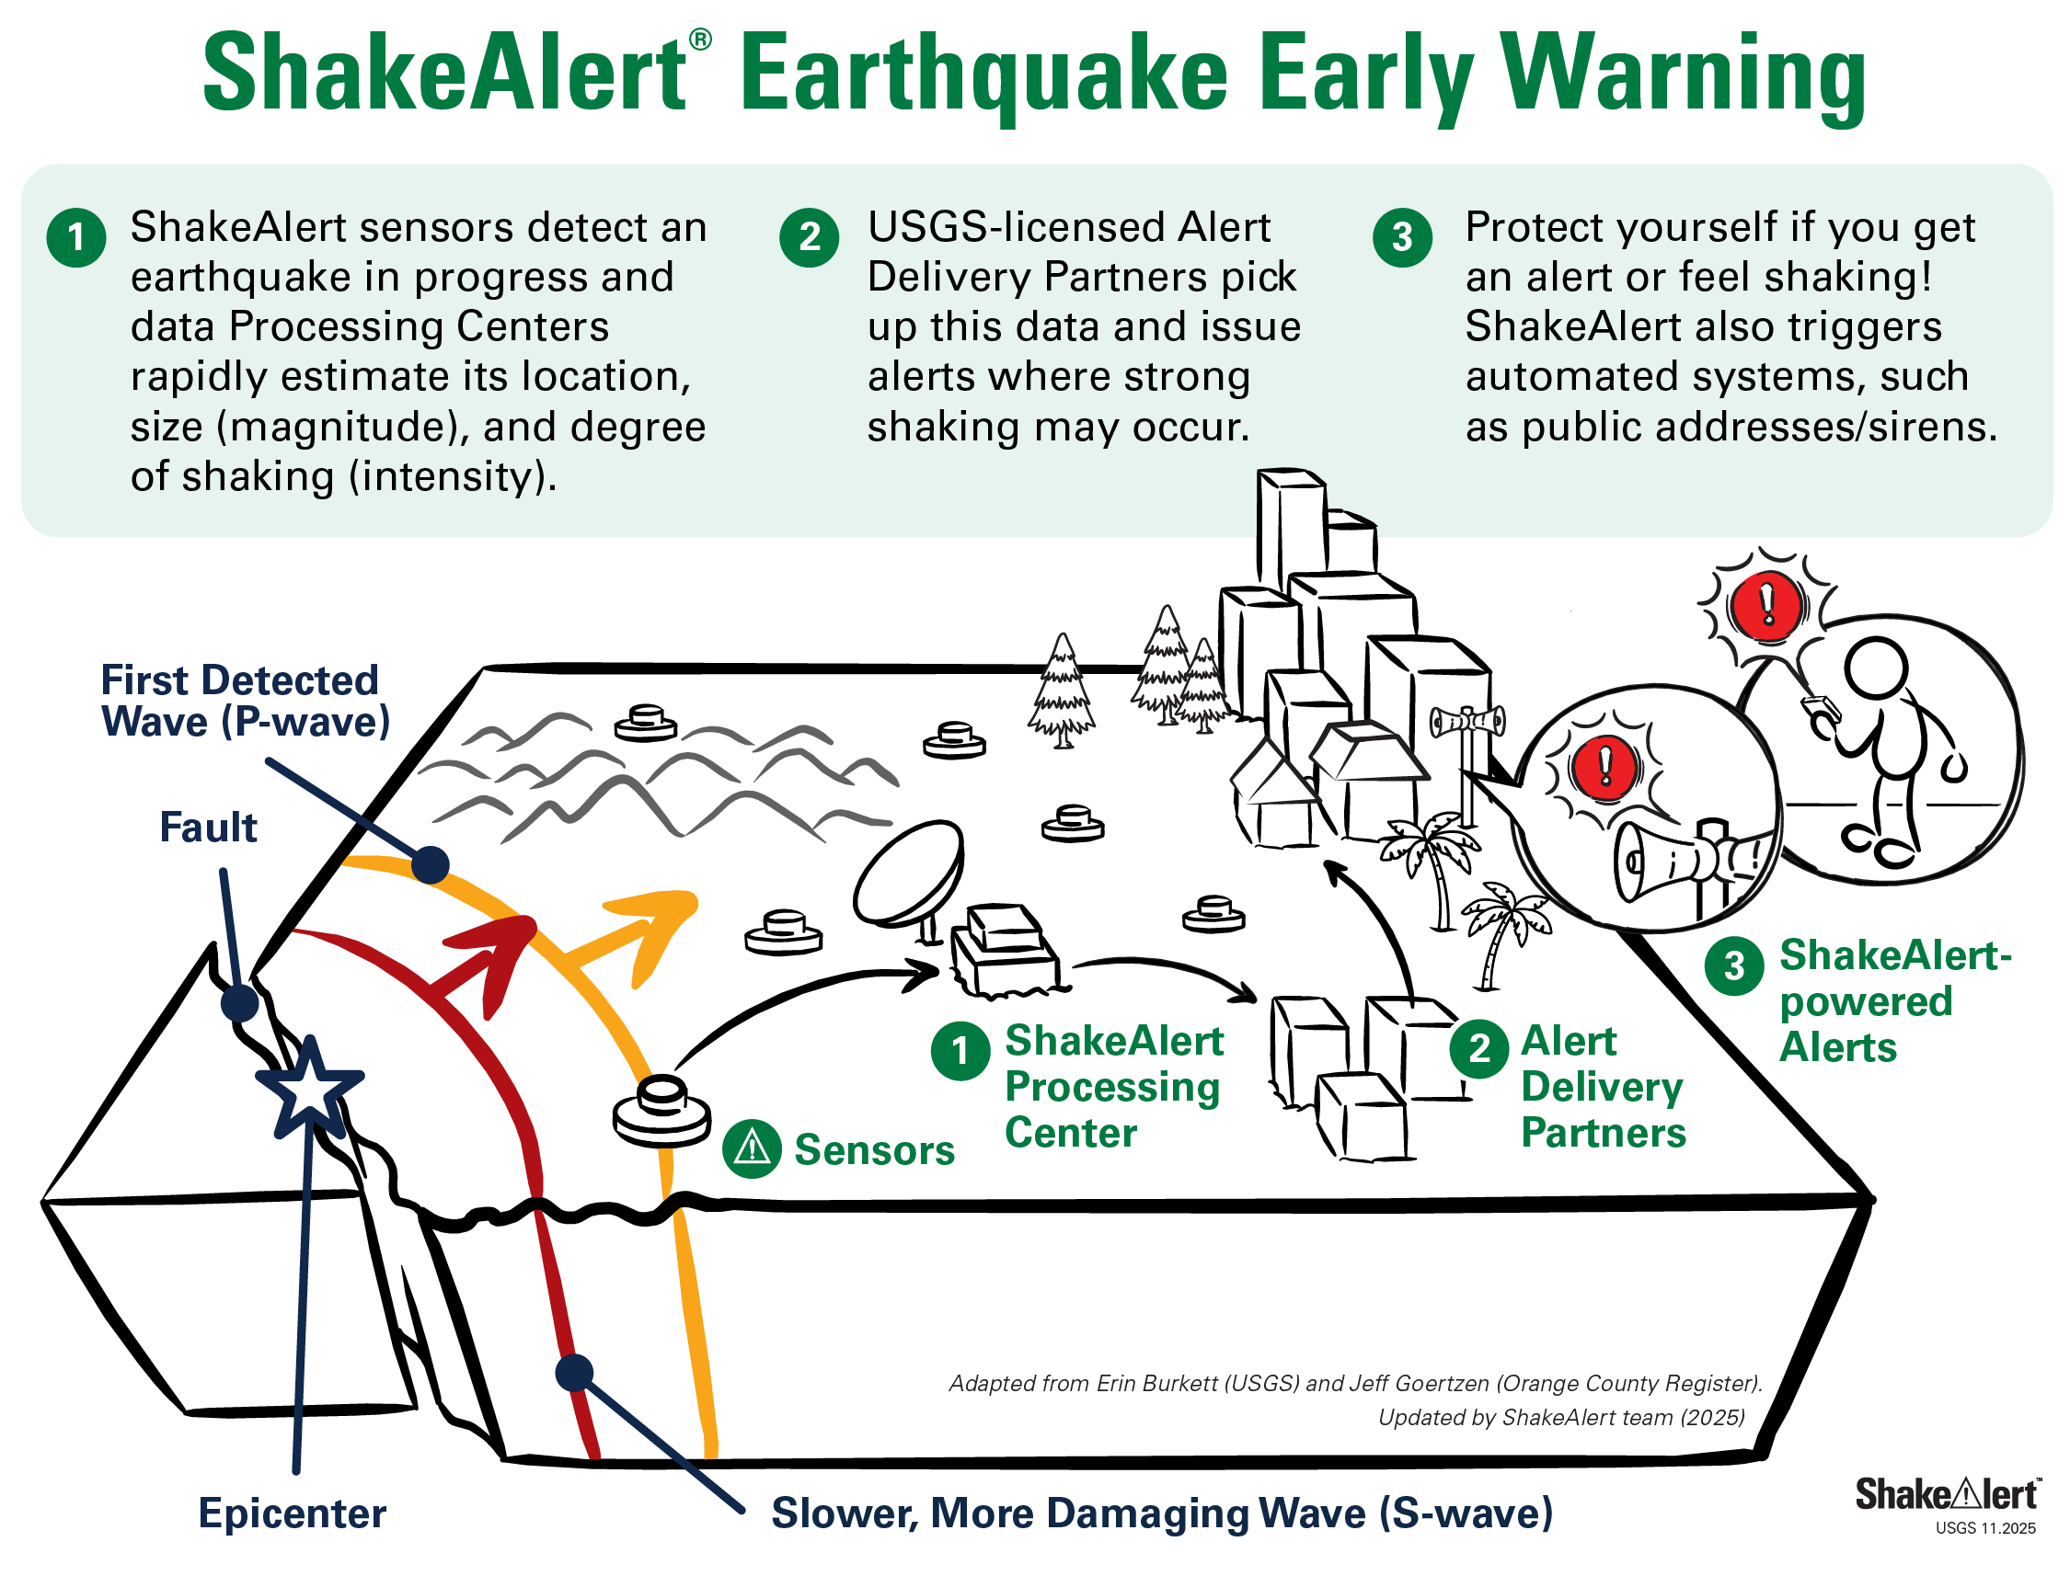
ShakeAlert.org
Detect
Process
Deliver
Notes:
Use this slide to explain how the ShakeAlert® system actually works, step by step. You can say something like, “Here’s what happens behind the scenes when an earthquake begins.”
First, Detect: the system’s network of seismic sensors picks up the very first vibrations—called P-waves—that travel out from the earthquake’s source. These waves move fast and can be detected before the stronger shaking reaches populated areas.
Next, Process: powerful computers instantly analyze the sensor data to estimate where the earthquake started, how large it is, and which areas are likely to feel strong shaking. This all happens automatically within seconds.
Finally, Deliver: once the system has that information, it sends digital alerts to phones, apps, and automated systems. Those alerts can trigger people and technology to take protective action before the strong shaking begins.
You can emphasize that the entire process happens extremely quickly—often faster than people can even realize an earthquake has started. End by saying, “So in just a few seconds, ShakeAlert detects the earthquake, processes the data, and delivers alerts that can help save lives.”

Slide 14
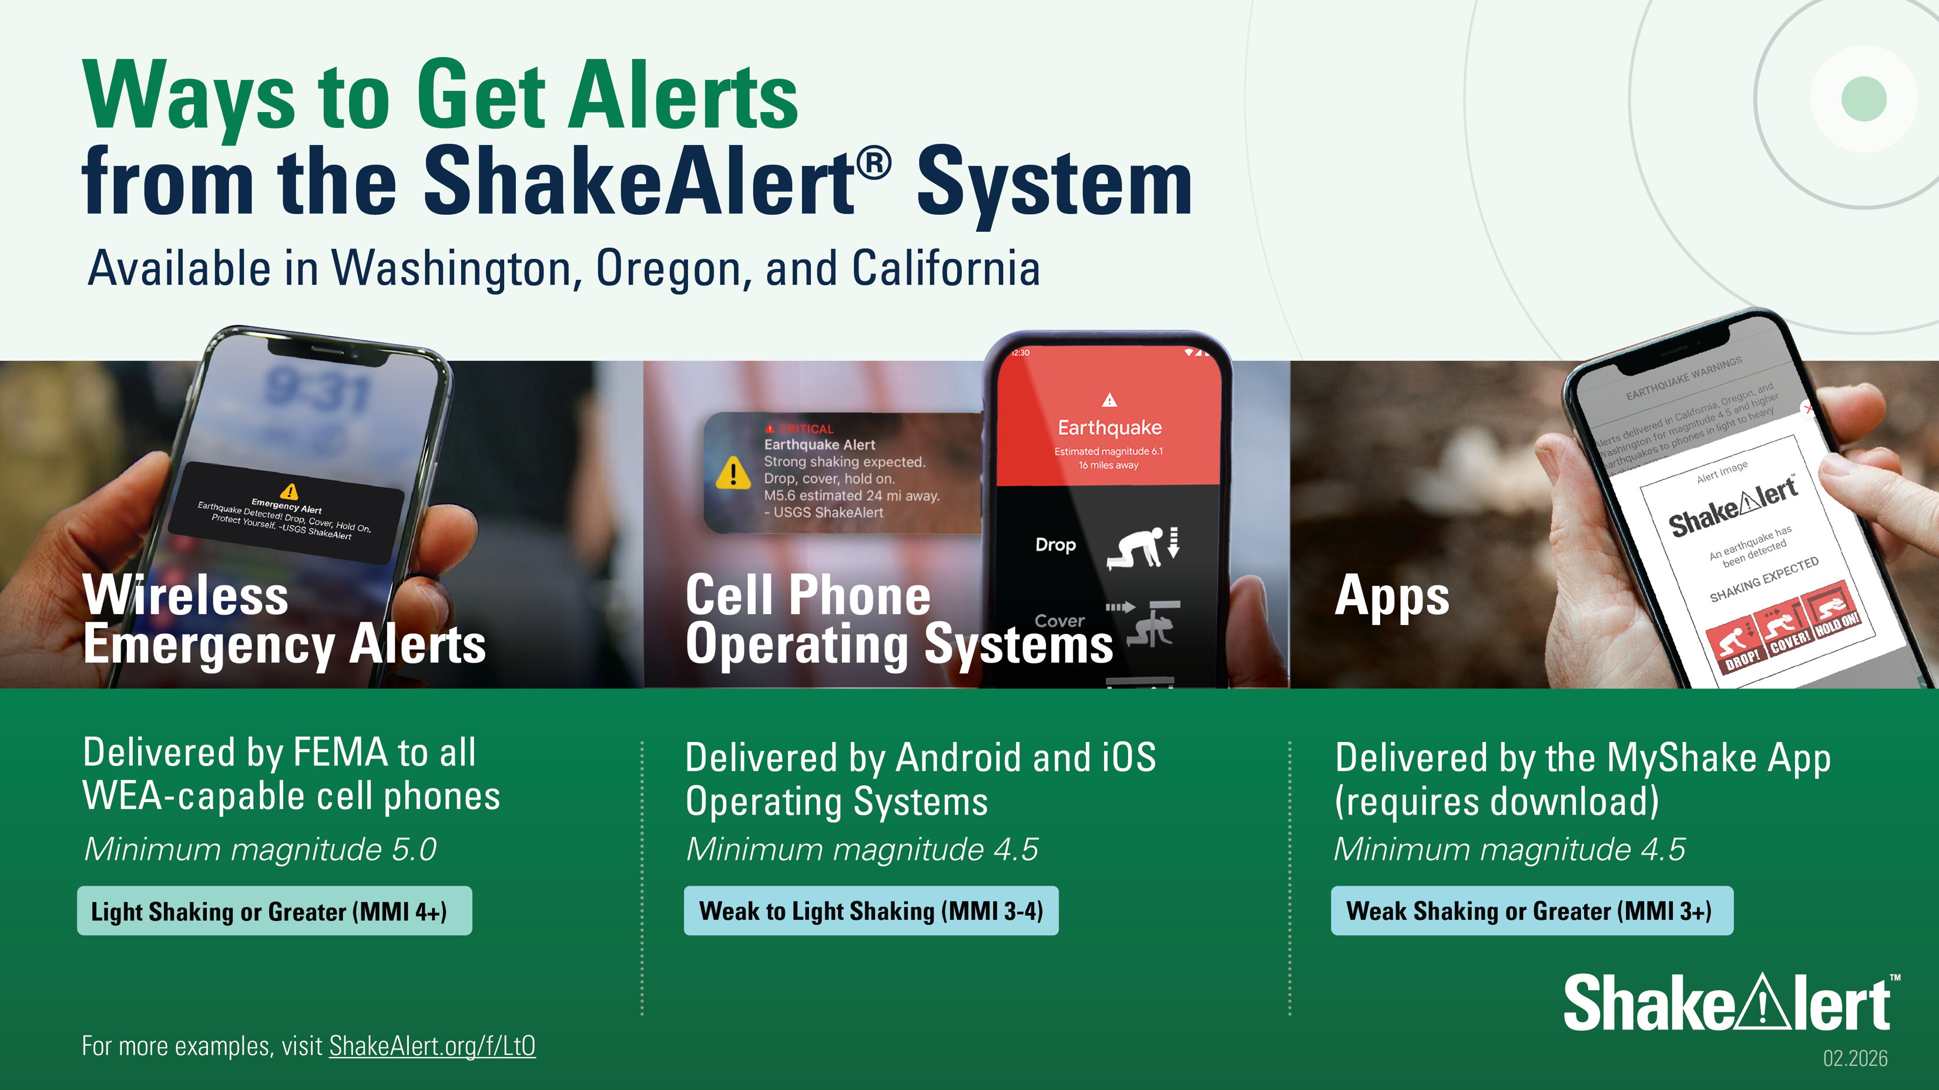
Notes:
Use this slide to explain that ShakeAlert® alerts can reach people through several trusted channels, not just one app or system. You can say something like, “When ShakeAlert sends an alert, it can reach people in a few different ways—through Wireless Emergency Alerts, Android phones, and apps like MyShake.”
Point out that Wireless Emergency Alerts (WEA) are the same system used for AMBER Alerts and other public safety messages, so participants have likely seen one before. Emphasize that most phones receive these WEA messages automatically when strong shaking is expected nearby—there’s no need to download a special app for that.
However, people can also get alerts through the MyShake app, which uses the same ShakeAlert data and can provide additional features or settings. Encourage participants to confirm that their phone’s emergency alerts are turned on and, if they wish, to download the MyShake app for another reliable alert source.
You can mention briefly that some organizations connect directly to ShakeAlert for automated actions—like public address systems or transportation networks—but you’ll go into that later. For now, the key takeaway is that ShakeAlert alerts reach people in multiple reliable ways, and everyone should make sure they can receive at least one of them.

Slide 15
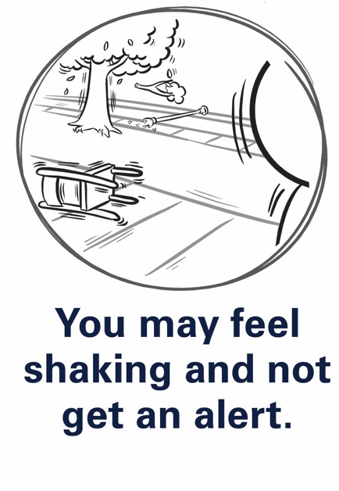
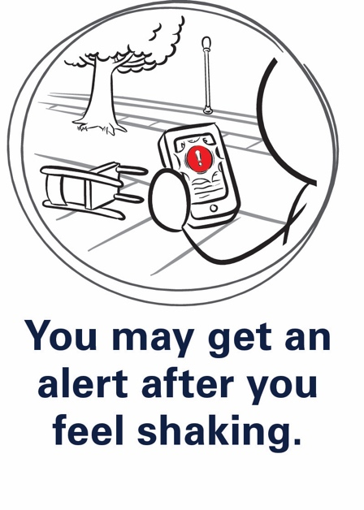
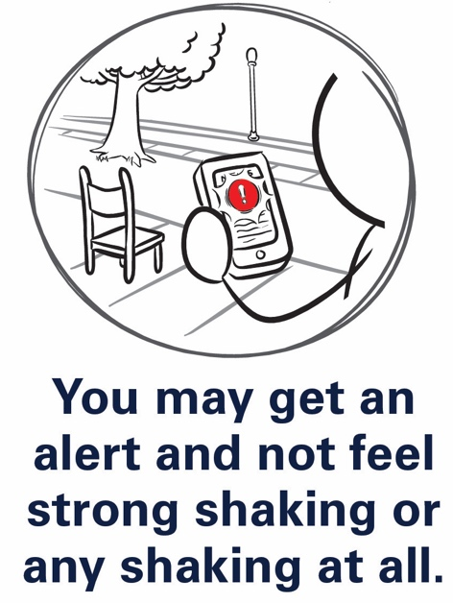
ShakeAlert.org
Warning Time
Warning times vary: 0 seconds to more than a minute.
Late Alert Zone: near the epicenter, shaking may arrive before alerts.
Even a few seconds can save lives — act immediately if you feel shaking or get an alert.
Notes:
Explain that the amount of warning ShakeAlert® can provide depends on how close you are to where the earthquake starts. The system doesn’t predict earthquakes—it detects them as soon as they begin—but it can send alerts faster than the shaking travels. The closer you are to the epicenter, the less time there is between detection and shaking. People farther away might get several seconds—or in some cases, more than a minute—before strong shaking arrives.
You can point to the visual on the slide to show that the areas nearest the epicenter are called the Late Alert Zone, where shaking may arrive before the alert can. Emphasize that even a few seconds of warning can make a big difference. Those seconds can give people time to steady themselves, move away from hazards, or take cover.
To help participants connect this idea, refer back to the Loma Prieta example you discussed earlier. Remind them that if ShakeAlert® had been operating in 1989, people in San Francisco and Oakland could have received about twenty seconds of warning before the strongest shaking hit. Explain that this slide shows why that’s possible—because the sensors near the epicenter detect shaking first and the alert can reach areas farther away before the shaking does.
If you want to make the concept even clearer, you can use a quick analogy: “It’s like seeing lightning before you hear the thunder—ShakeAlert detects the first waves of motion and sends alerts ahead of the stronger shaking.”
End by reinforcing that those seconds of warning are valuable only if people already know what to do with them—and that’s what you’ll cover next.

Slide 16
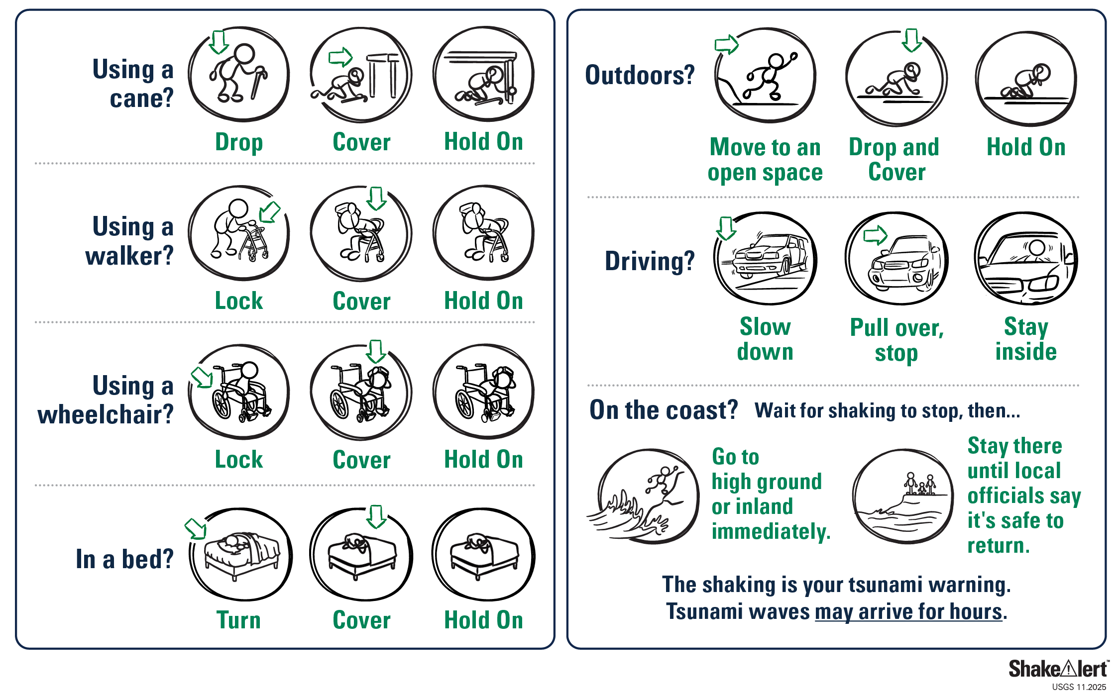
Practice fighting the urge to run!
ShakeAlert.org
Take Protective Action When You Feel Shaking or Get an Alert
Take protective action immediately:
Drop, Cover, and Hold On.
If you can’t get under furniture, protect your head and neck.
Notes:
Now that participants understand how ShakeAlert® works and how much warning it can provide, this is the point to connect it back to what people should actually do when they get an alert—or when shaking begins without one. Explain that the right response is the same in both situations: Drop, Cover, and Hold On. Tell participants that when an alert sounds, they shouldn’t wait to see what happens—they should act immediately.
Encourage them to visualize where they might be when an earthquake starts. At home, that could mean dropping next to a sturdy table; at work, it might mean getting under a desk or beside an interior wall. Emphasize that moving around during shaking is risky—most injuries happen when people try to run or move to another room. The safest choice is to drop low to the ground, protect your head and neck, and hold on until the shaking stops.
If you want to make this slide more interactive, you can invite the group to point out good places to take cover in the room where you’re meeting. This simple discussion helps people remember to look for safe spots wherever they are. End by reinforcing that ShakeAlert® gives people time to act on what they’ve already practiced. Those few seconds can make the difference between being injured and staying safe.

Slide 17
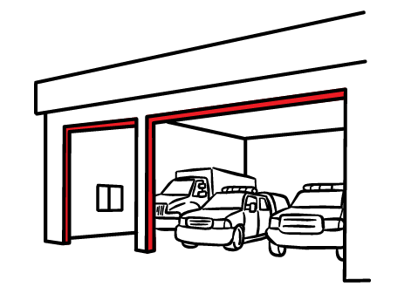
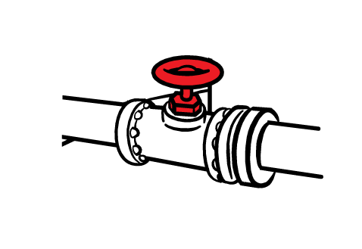
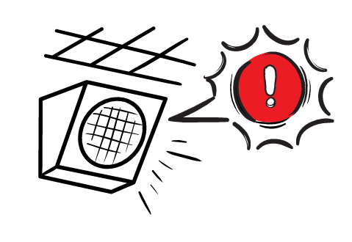
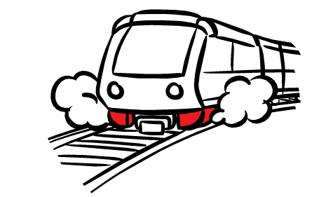
ShakeAlert.org
Automatic Protective Actions Help Keep Systems Safe
Alerts can trigger automatic safety steps, such as:
Issuing audible alerts through a public address system in a school or workplace
Slowing/stopping trains to prevent derailments
Opening firehouse doors for emergency vehicles
Shutting off
gas valves
These actions protect people, infrastructure, and services.
Notes:
Explain that ShakeAlert® isn’t only for individuals—it also helps protect entire systems and communities. When an alert is sent, it can trigger automatic protective actions without waiting for a person to respond. Give a few examples participants can easily picture: trains slowing down to prevent derailments, fire station doors opening so emergency vehicles can get out, elevators stopping at the nearest floor, or gas lines shutting off to prevent fires. These actions happen within seconds of the alert being issued.
You can point out that these automatic responses help protect not only people but also critical services that the community depends on after an earthquake. For example, trains that stop safely can start running again more quickly, and preventing fires or gas leaks reduces damage and makes response and recovery faster.
If you want to make it relatable, you might say something like, “Think about all the systems we rely on every day—transportation, communications, utilities. Early warning helps those systems protect themselves so they can keep serving us when we need them most.” End the slide by reinforcing that ShakeAlert® works at every level—individuals, organizations, and infrastructure—turning seconds of warning into safety and resilience.

Slide 18
Putting ShakeAlert Into Action
Notes:
This is a transition slide. You can say something like, “Now that we’ve talked about what ShakeAlert is and how it works, let’s look at how you can use it—and how CERT volunteers can help others do the same.”

Slide 19


ShakeAlert.org
Myths and Facts About ShakeAlert Earthquake Early Warning
MYTH
FACT
Earthquakes can be predicted.
ShakeAlert does NOT predict earthquakes. It detects shaking quickly after a quake begins and can provide seconds of warning before strong shaking arrives.
Everyone will get an alert.
Not all devices will receive alerts. People close to the epicenter may feel shaking before an alert can be delivered.
All earthquakes trigger alerts.
Only earthquakes meeting certain size and shaking thresholds trigger alerts. Small or distant quakes may not.
Notes:
Explain that this slide helps clear up some common misconceptions about ShakeAlert®. You can introduce it by saying something like, “Let’s take a minute to separate what’s true from what people often think about earthquake early warning.”
Start with the most common myth—that ShakeAlert® predicts earthquakes. Clarify that it does not predict them; it detects the first seismic waves once an earthquake begins and sends alerts ahead of the stronger shaking. The technology can’t tell when or where a future earthquake will happen, only what’s occurring in real time.
Another misconception is that everyone will always get an alert. Explain that’s not the case. People who are very close to the epicenter—the Late Alert Zone—may feel shaking before an alert can arrive because the seismic waves move faster than the notification. Others may not receive an alert if the expected shaking in their area is below the system’s threshold.
A third myth is that every earthquake triggers an alert. Explain that ShakeAlert® is designed to warn only when shaking is expected to be strong enough to cause concern, so smaller or distant earthquakes might not trigger alerts.
You can end the slide by saying, “As CERT volunteers, it’s important that you can explain these facts clearly. Knowing what ShakeAlert can and can’t do helps build trust when you talk about it in your community.”

Slide 20
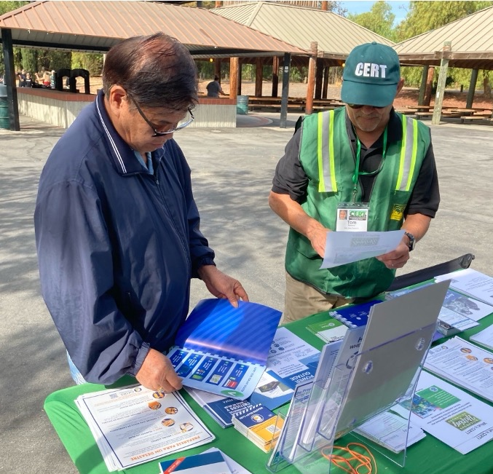
ShakeAlert.org
How CERT Volunteers Can Share ShakeAlert
Protect yourself! Make sure your phone is ShakeAlert Ready and practice what you would do if you get an alert or feel shaking.
Show neighbors, friends, and family how to check phone alert settings and encourage them to download the MyShake app.
Share this message: “Did you know you can get an alert before you feel shaking?”
Encourage multiple ways to receive alerts.
Notes:
Explain that this slide highlights the practical steps CERT volunteers can take to share ShakeAlert® with others. You can say something like, “As CERT volunteers, you already play an important role in helping your neighbors get prepared. Here’s how you can help more people benefit from ShakeAlert.”
Start by emphasizing the first line of the slide: Protect yourself first. Encourage everyone to make sure their own phones are ShakeAlert-ready. That means checking that Wireless Emergency Alerts are turned on and, if they use an Android device or an iPhone, confirming that earthquake alerts are enabled. You can also recommend downloading the MyShake app for an additional way to receive alerts.
Then, talk about helping others do the same. Suggest showing friends, neighbors, and family members how to check their phone settings or install the app. This is something CERT members can easily do during preparedness events, neighborhood walks, or informal conversations.
You can demonstrate the sample message on the slide—“Did you know you can get an alert before you feel shaking?”—and encourage participants to use that phrase to start conversations. Reinforce the idea of encouraging multiple ways to receive alerts, since different people may prefer different tools.
End by reminding participants that these small, simple actions help more people take advantage of ShakeAlert®. By sharing accurate information and demonstrating trusted technology, CERT volunteers can turn awareness into real preparedness in their communities.

Slide 21
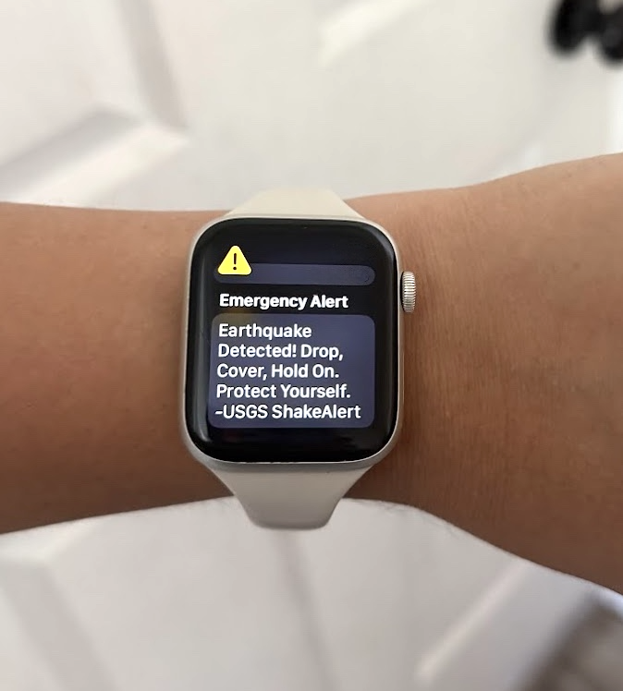
ShakeAlert.org
Be a Trusted Messenger
As CERT volunteers, you can act as trusted messengers for the people around you.
Even if the conversation is informal, it is important to confirm you have trusted information before sharing with anyone.
  Use trusted sources: official government (.gov), education (.edu), CERT channels.
  Verify before sharing to avoid spreading misinformation.
  Be cautious of viral or anonymous posts — they may not be accurate.
  USGS is a trusted source.
Notes:
Explain that this slide is about how to share ShakeAlert® information responsibly. As a CERT volunteer, people already see you as someone who knows where to find reliable information about safety and preparedness. ShakeAlert® is still new to many people, so your role as a trusted messenger is especially important.
You can say something like, “When you talk about ShakeAlert, make sure the information you share is accurate, simple, and comes from a credible source.” Encourage participants to use official sources such as the U.S. Geological Survey (USGS), state emergency management agencies, local CERT program materials, and government (.gov) or education (.edu) websites.
Remind them that before sharing a post, video, or link on social media, it’s always a good idea to verify before sharing. Misinformation spreads easily, especially after a major earthquake, and even well-meaning people can pass along incorrect details.
You can also mention that if participants ever feel unsure about something they’ve heard, they can always check official sources like ShakeAlert.org or USGS.gov before passing it along. Emphasize that being cautious and accurate helps protect their credibility and keeps their community informed.
End by reinforcing that trusted messengers don’t need to know everything—they just need to know where to find the right information and how to share it clearly and calmly.

Slide 22
ShakeAlert.org
Learn, Act, Share
1
2
3
Get alerts on your phone — confirm your WEA settings and download the MyShake app
Act immediately when you feel shaking or get an alert
Share what you know — CERT volunteers are trusted messengers
Learn more: usgs.gov/FAQ/BeShakeAlertSafe | ShakeAlert.org
Notes:
Explain that this slide summarizes the key takeaways from the session—what participants can do right now to make sure they and their communities are ShakeAlert® ready. You can say something like, “We’ve talked about how ShakeAlert works and how it fits into preparedness. Now let’s bring it all together with three simple actions: learn, act, and share.”
Start with Learn. Encourage participants to visit ShakeAlert.org and USGS.gov/BeShakeAlertSafe to get accurate, up-to-date information straight from trusted sources. They can explore videos, FAQs, and local information about how ShakeAlert is being used in their state.
Next, Act. Tell participants to check their phone alert settings right away and make sure they’re ShakeAlert-ready. If they haven’t already, suggest downloading the MyShake app as another way to receive alerts. Emphasize that when they receive an alert—or feel shaking—the most important thing to do is act immediately. Don’t wait. Drop, Cover, and Hold On.
Finally, Share. As CERT volunteers, participants are in a perfect position to spread awareness in their communities. Encourage them to talk with friends, family, and neighbors about ShakeAlert® and show others how to check their phone settings or download the app. They don’t have to be experts—just accurate and enthusiastic trusted messengers.
End the slide by reinforcing that these three steps—learn, act, and share—are what turn technology into real preparedness. The more people understand and use ShakeAlert®, the safer communities will be when the next earthquake strikes.

Slide 23

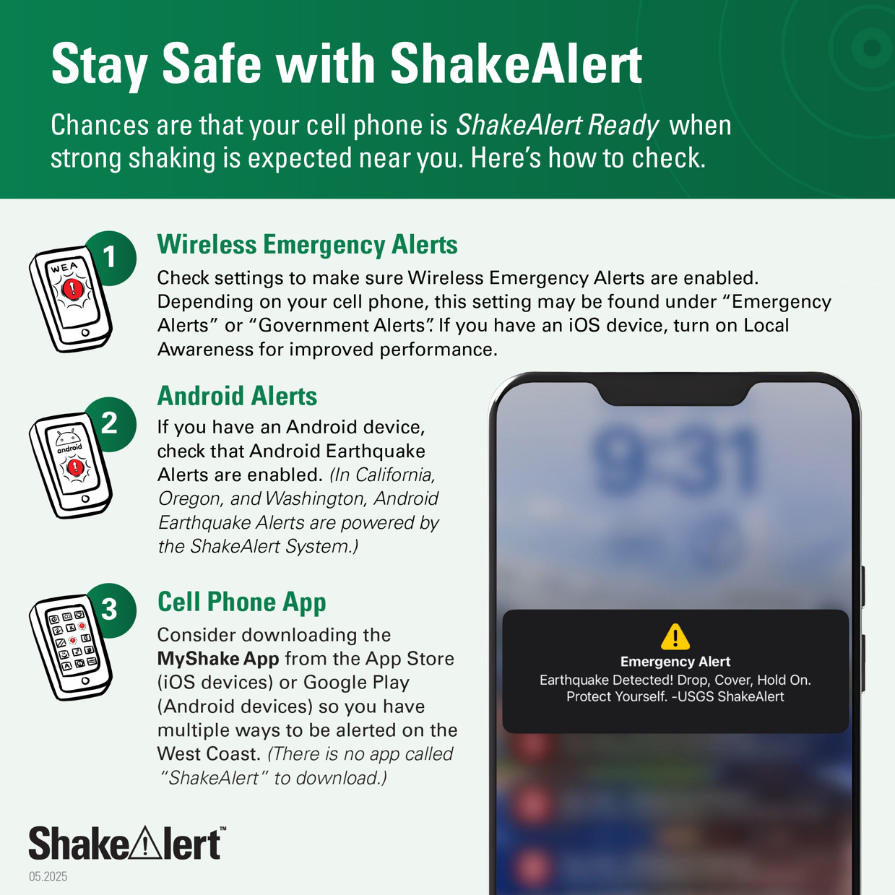
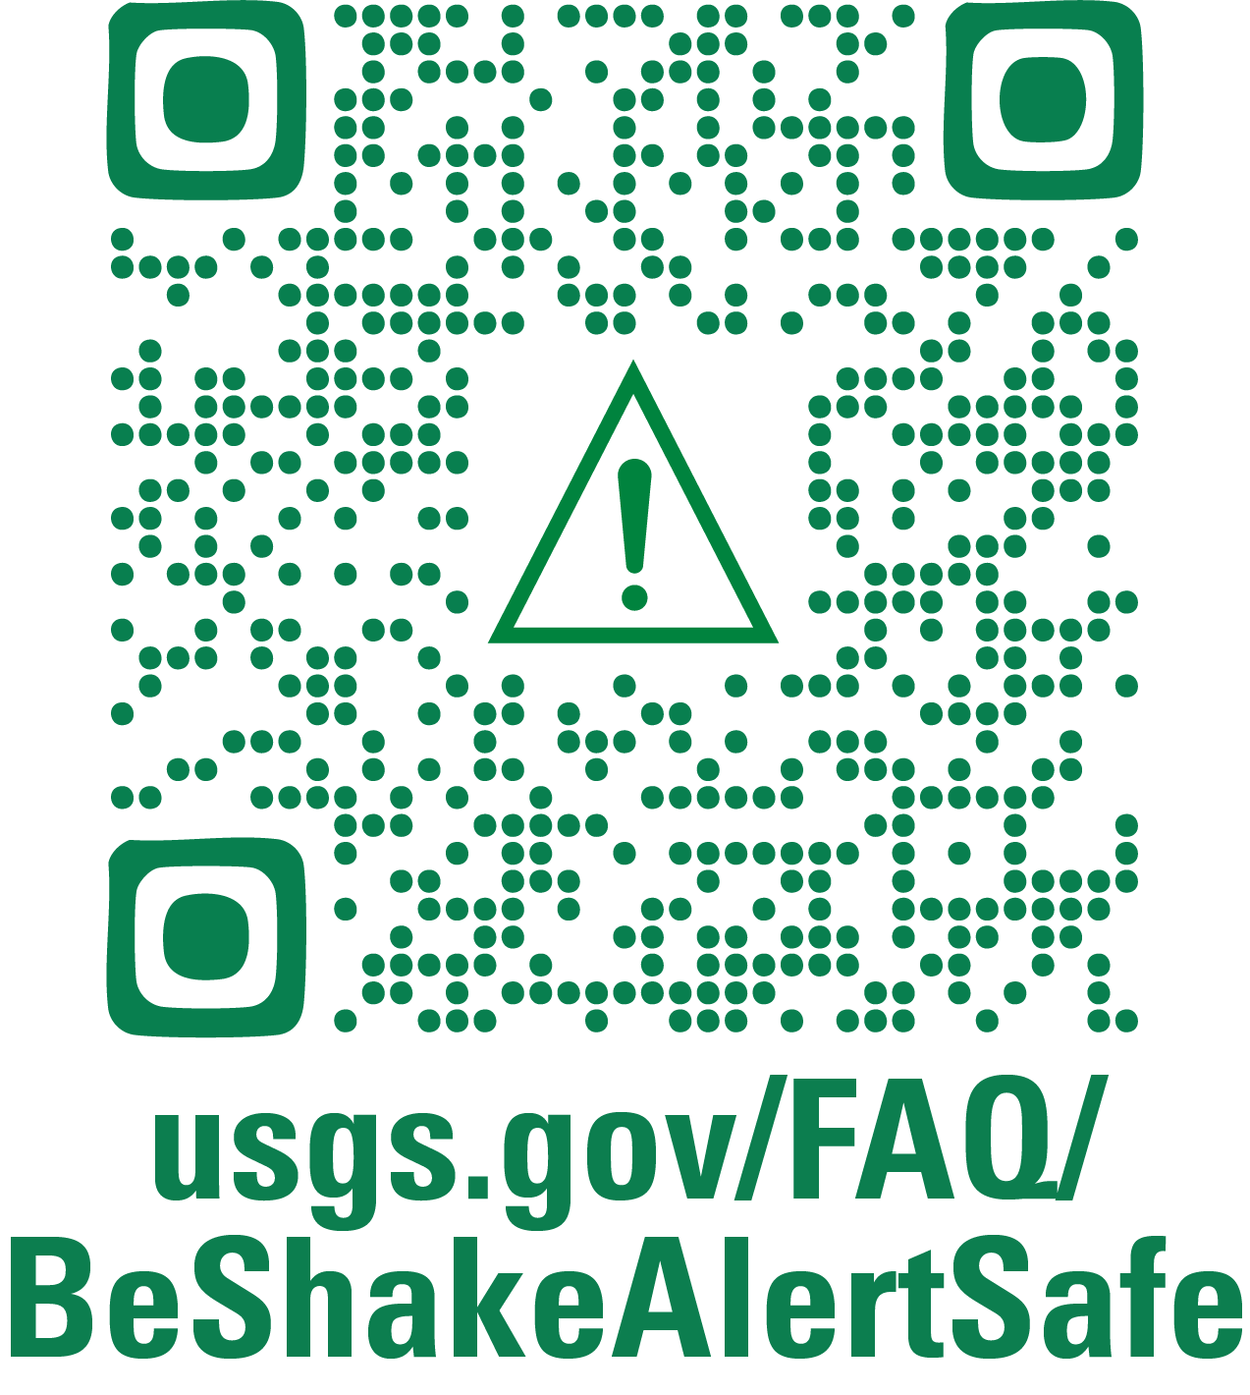
Check Your Settings and Spread the Word!
Notes:
This slide gives participants a chance to take action right away. Encourage everyone to pull out their phones and follow the steps on the screen to make sure they are ShakeAlert Ready. You can say something like, “Let’s take a minute to check our own phones so we can see what this looks like in real life.”
Have participants scan the QR code on the slide or visit usgs.gov/FAQ/BeShakeAlertSafe. The page shows how to confirm that Wireless Emergency Alerts are turned on for both iPhones and Android devices. Remind participants that iPhones receive alerts through the Wireless Emergency Alerts (WEA) system and Android devices also have Android Earthquake Alerts, powered by ShakeAlert®.
Make it clear that as the instructor, you’re not asking to handle anyone’s phone or check settings for them. This is a self-check activity, and if participants want help, they can assist each other. Encourage that—helping a neighbor is great practice for how they can help others in their community after the class.
If time allows, revisit the three main ways alerts can reach them—Wireless Emergency Alerts, Android Earthquake Alerts, and the MyShake app—and encourage everyone to check or download whichever applies to their device. End by saying, “Once your phone is ShakeAlert Ready, show someone else how to do it. That’s how we build awareness—one person at a time.”

Slide 24
Questions?
Notes:
Use this slide to wrap up the session and give participants a chance to ask questions or share final thoughts. You can say something like, “We’ve covered a lot in a short time—about earthquakes, how ShakeAlert® works, and how you can use and share it. What questions do you have?”
If questions come up that you don’t know the answer to, that’s fine—model how to find reliable information by directing participants to ShakeAlert.org or USGS.gov/BeShakeAlertSafe for accurate, up-to-date details. Remind them that information about early warning continues to evolve as the system expands and improves.
Close the session by thanking everyone for participating and reinforcing the three key messages of the training:
Learn how ShakeAlert® works and make sure your phone is alert-ready.
Act when you get an alert or feel shaking—Drop, Cover, and Hold On.
Share what you know with others so more people can use those seconds of warning to stay safe.
You can end by saying something like, “ShakeAlert® gives us time to act—but it’s people like you who turn those few seconds into safety. Thank you for being part of helping your community stay prepared.”

