Slide 1
ShakeAlert® Ready: A CERT Guide to Earthquake Early Warning Course Building CERT Confidence and Community Readiness through Earthquake Early Warning
February 2026 – Version 1.5
Notes:
Welcome participants to ShakeAlert Ready CERT: Full Course — Building CERT Confidence and Community Readiness through Earthquake Early Warning. You can let the group know that this version includes everything from the Essentials course, which is sometimes taught on its own as a short, 15- to 20-minute overview. Explain that today’s session starts with that overview, then takes a deeper dive into the science behind ShakeAlert, how the system works, how alerts are delivered, and how CERT volunteers can share accurate information in their communities.
If you’re co-teaching, you might mention who will lead each section or what to expect with the activities. You can also note that some slides still have placeholders for images, which will be finalized before delivery.

Slide 2
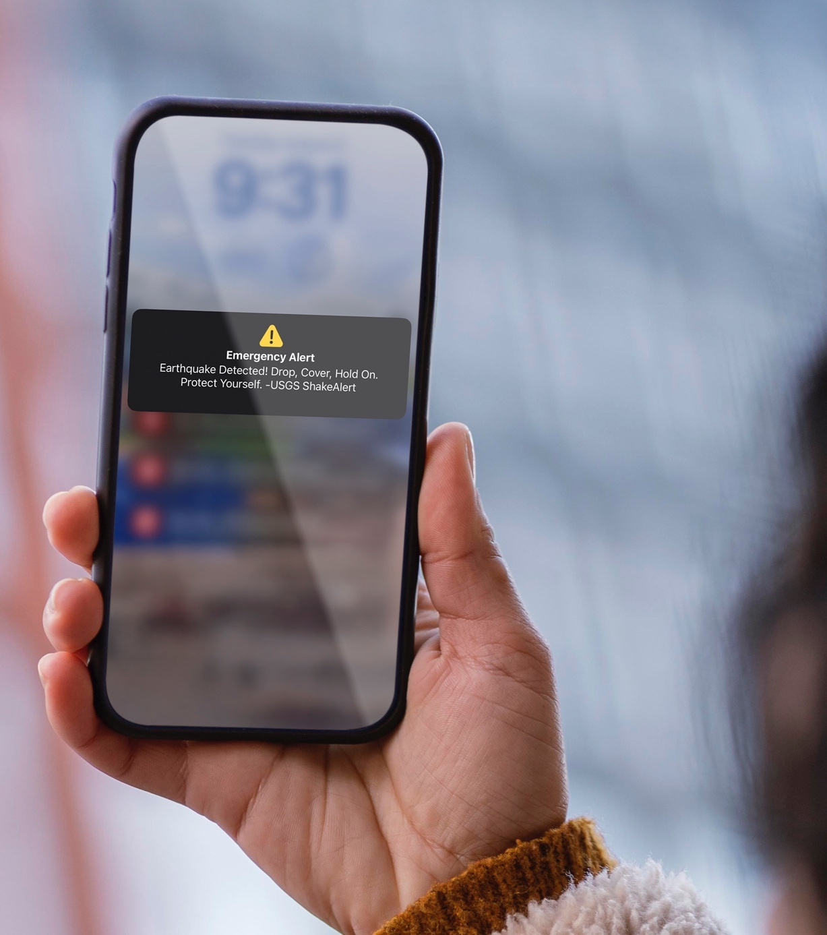
What We Will Cover
ShakeAlert.org
01
ShakeAlert Ready CERT Essentials
02
The Science Behind ShakeAlert
03
Inside the ShakeAlert System
04
Experiencing ShakeAlert
05
Applying Protective Actions
06
The CERT Role in Outreach and Education
Notes:
Walk participants through the six modules shown here. Let them know that Module 1—ShakeAlert Ready CERT Essentials—is the core overview, and that it can also be offered as a stand-alone mini-course if a shorter format is needed.
Explain that the remaining modules are the deep-dive sections that go beyond the basics:
Module 2 covers the science behind ShakeAlert;
Module 3 goes inside the system to show how sensors and partners work together;
Module 4 focuses on how people receive alerts;
Module 5 applies protective actions in different environments; and
Module 6 highlights the CERT role in community outreach and education.
Let participants know that the full session runs about an hour, but you can adjust timing or stop after the Essentials module if your audience only needs the overview.

Slide 3
Module 1: ShakeAlert Ready CERT Essentials
Notes:
This is a transition slide. This first module is the Essentials section—the same short version many CERT programs use as a stand-alone overview. You’ll cover the key points about what ShakeAlert is, how it supports earthquake preparedness, and what to do when an alert arrives.
Let participants know this is the foundation for the rest of the course. After Essentials, you’ll move into the deeper modules that explain the science, the system, and CERT outreach.

Slide 4
Earthquakes and Earthquake Early Warning
Notes:
This is a transition slide. You can say something like, “Let’s start by talking about earthquakes themselves—what happens when the ground starts shaking, and how early warning can help us respond more safely.” Keep it short and conversational to set up the next few slides, which go deeper into earthquake impacts before introducing ShakeAlert®.

Slide 5
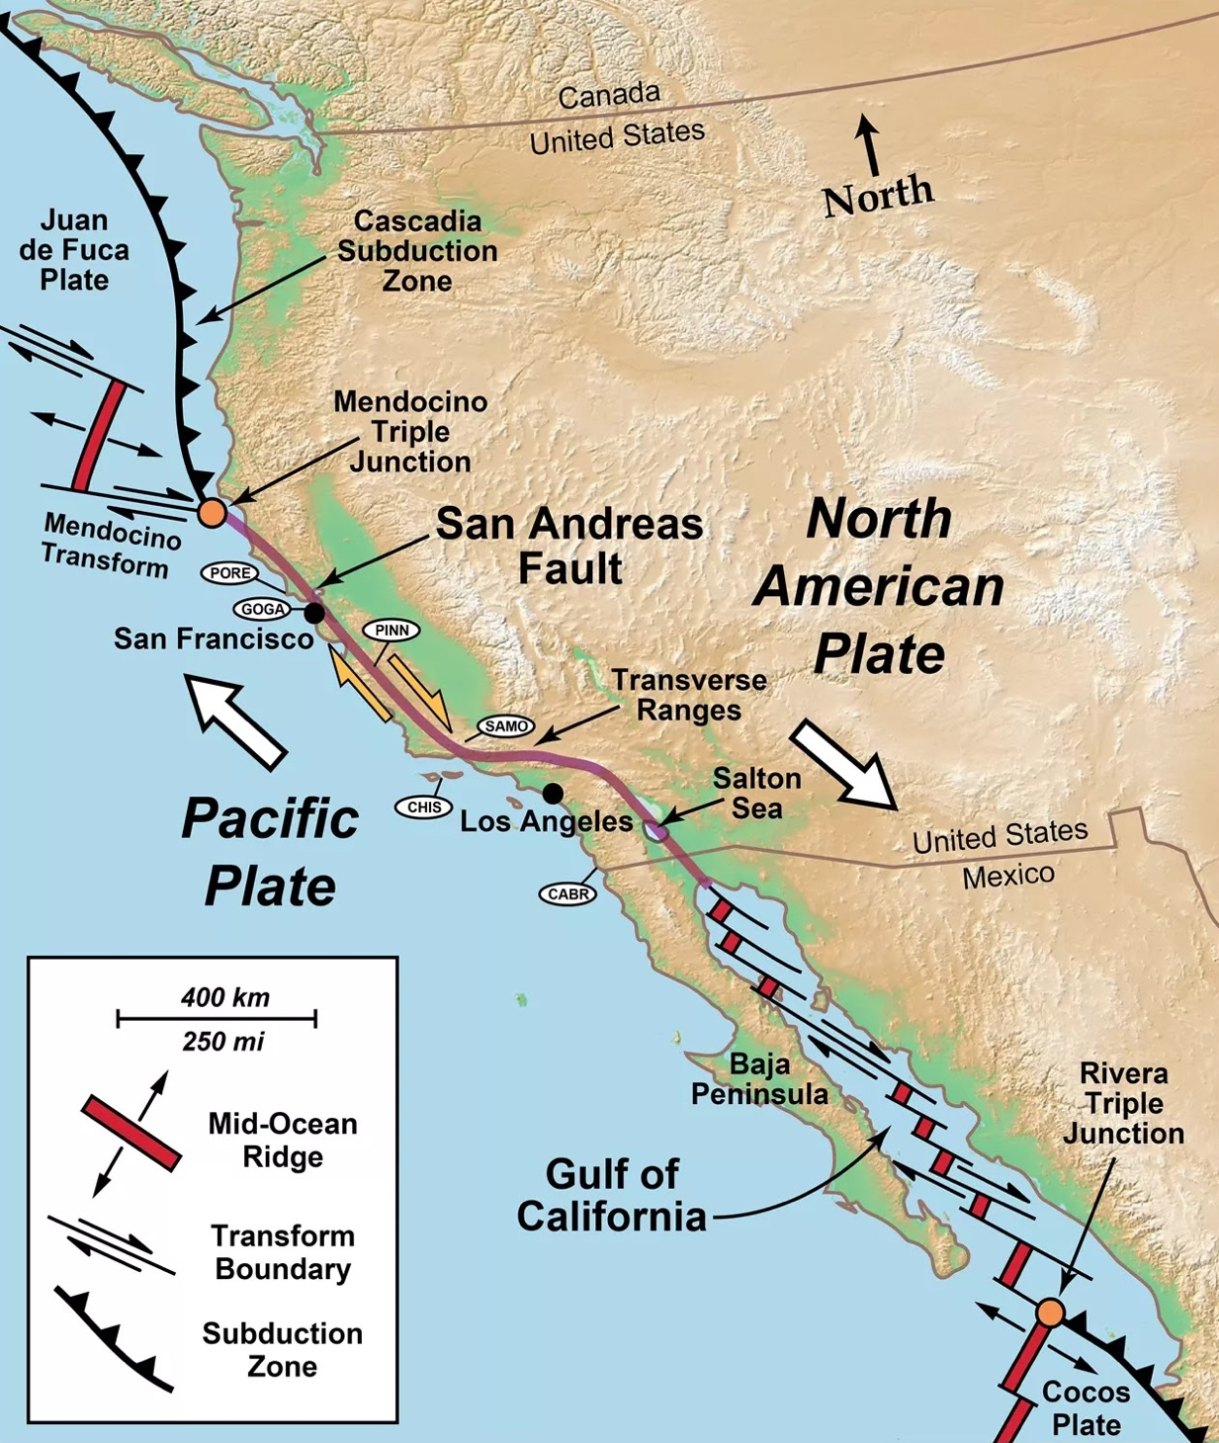
ShakeAlert.org
Earthquakes Happen Here
California, Oregon, and Washington are home to some of the most active earthquake zones in the United States.
Large earthquakes have happened before — and they will happen again.
ShakeAlert® provides early warning so people can take protective action before strong shaking arrives.
Notes:
Use this slide to show that the entire West Coast—California, Oregon, and Washington—sits along the boundary between two massive tectonic plates: the Pacific Plate and the North American Plate. You can say something like, “As you can see, the West Coast lies right on top of major fault systems. This is why earthquakes are a regular part of life in our region.”
Point out a few key features on the map: the Cascadia Subduction Zone off the coasts of Oregon and Washington, where one plate slides beneath another and can produce very large earthquakes; and the San Andreas Fault Zone in California, where the plates slide past each other, generating frequent but usually smaller quakes.
If you feel comfortable, mention a nearby fault or plate boundary relevant to your area to make it local. You don’t need to go into detail—the goal is simply to help participants see that earthquakes are expected here and that early warning is designed specifically for this region.
Wrap up the slide by saying, “Because earthquakes happen here, we need ways to prepare, respond, and act quickly when they start—and that’s where ShakeAlert® comes in.”

Slide 6
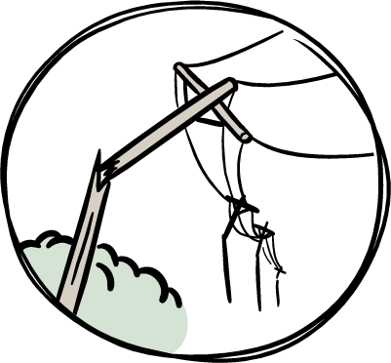
ShakeAlert.org
What Happens During an Earthquake
Earthquakes strike suddenly, sometimes with a roar.
Everything will begin to shake.
Lights flicker or go out.
Sprinklers and fire alarms may activate.
Windows may shatter.
Objects will fly off shelves and walls, and furniture can move.
People and animals may react suddenly or panic.
Trees and telephone poles will rock side to side; some may fall over.
Notes:
Explain that earthquakes strike suddenly and often come with a roar or rumble before the shaking starts. Lights may flicker or go out, alarms might sound, and objects can fall from shelves or walls. The movement can be startling and disorienting, and people’s reactions vary—some freeze, others try to move, and pets may behave strangely or run for cover. Describe that in larger quakes, it’s common for furniture to shift, windows to rattle or break, and for power and communications to fail temporarily.
You can make this slide more engaging by asking participants whether anyone has ever felt an earthquake. Encourage one or two short stories, or share your own experience if appropriate—what it felt like, what people did, or what the environment was like during and after. You can also mention a recent or well-known earthquake that participants may remember and include a local or personal detail to make it relatable. The goal here is to help people visualize what it’s like when an earthquake begins and to remind them that these events are real and unpredictable.
Avoid going into specific protective actions yet—that’s coming later. For now, focus on helping participants connect emotionally to the reality of shaking and think about how disorienting those first moments can be. That connection will make the discussion of protective actions more meaningful when you return to it later.

Slide 7
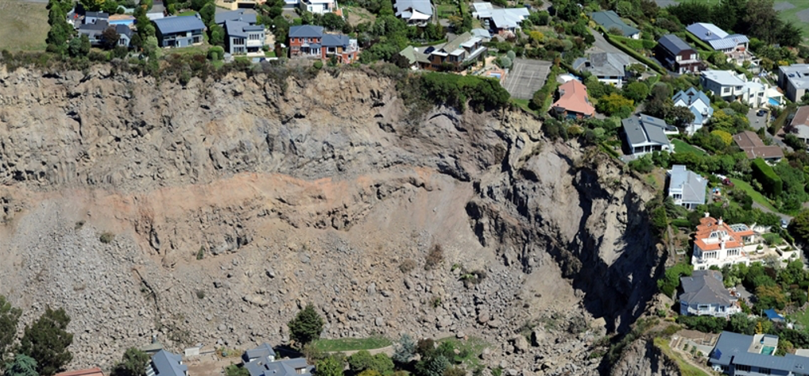
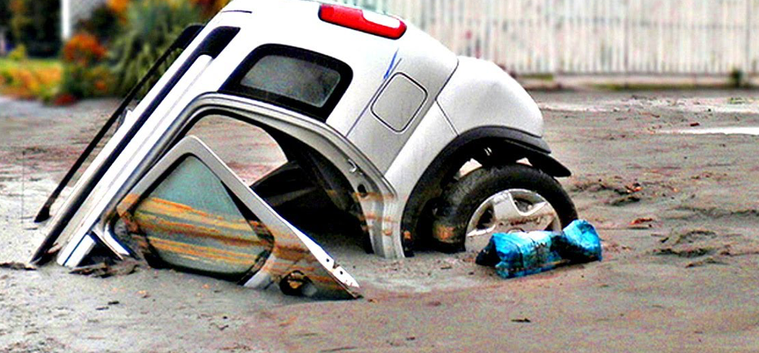
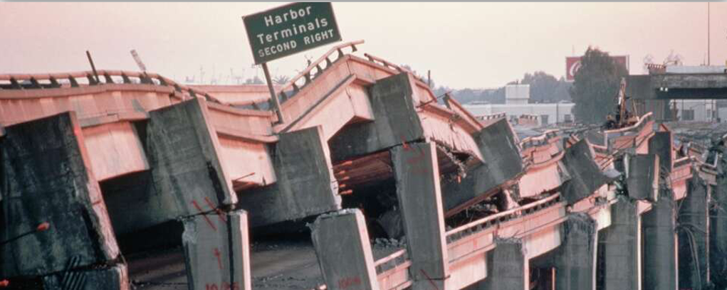
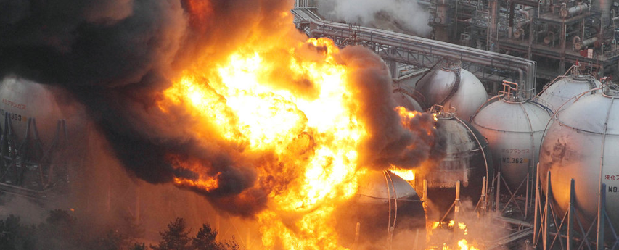
ShakeAlert.org
Earthquake Also Produce Secondary Hazards
LANDSLIDES
GROUND LIQUEFACTION
INFRASTRUCTURE DAMAGE
FIRE
Notes:
Explain that while the shaking itself can cause injuries and damage, earthquakes often trigger a range of secondary hazards that can make the situation worse. Fires may start from broken gas lines or damaged wiring. Power may go out, traffic lights can fail, and water systems may rupture. In some areas, earthquakes can trigger landslides, ground failure, or even tsunamis along the coast.
You can make this slide more relatable by connecting it to familiar examples. If your group is in a hillside area, mention how shaking can loosen slopes or cause retaining walls to fail. If you’re near the coast, talk briefly about the potential for tsunami warnings after major offshore earthquakes. Urban areas might experience transportation disruptions, fires, or hazardous materials spills.
If you feel comfortable, ask participants what secondary hazards might be likely where they live or serve. Encourage them to think beyond the shaking—what else could happen that would affect their neighborhood, their home, or their CERT team’s ability to respond? These examples help people see earthquakes as complex events that can affect many systems at once.

Slide 8
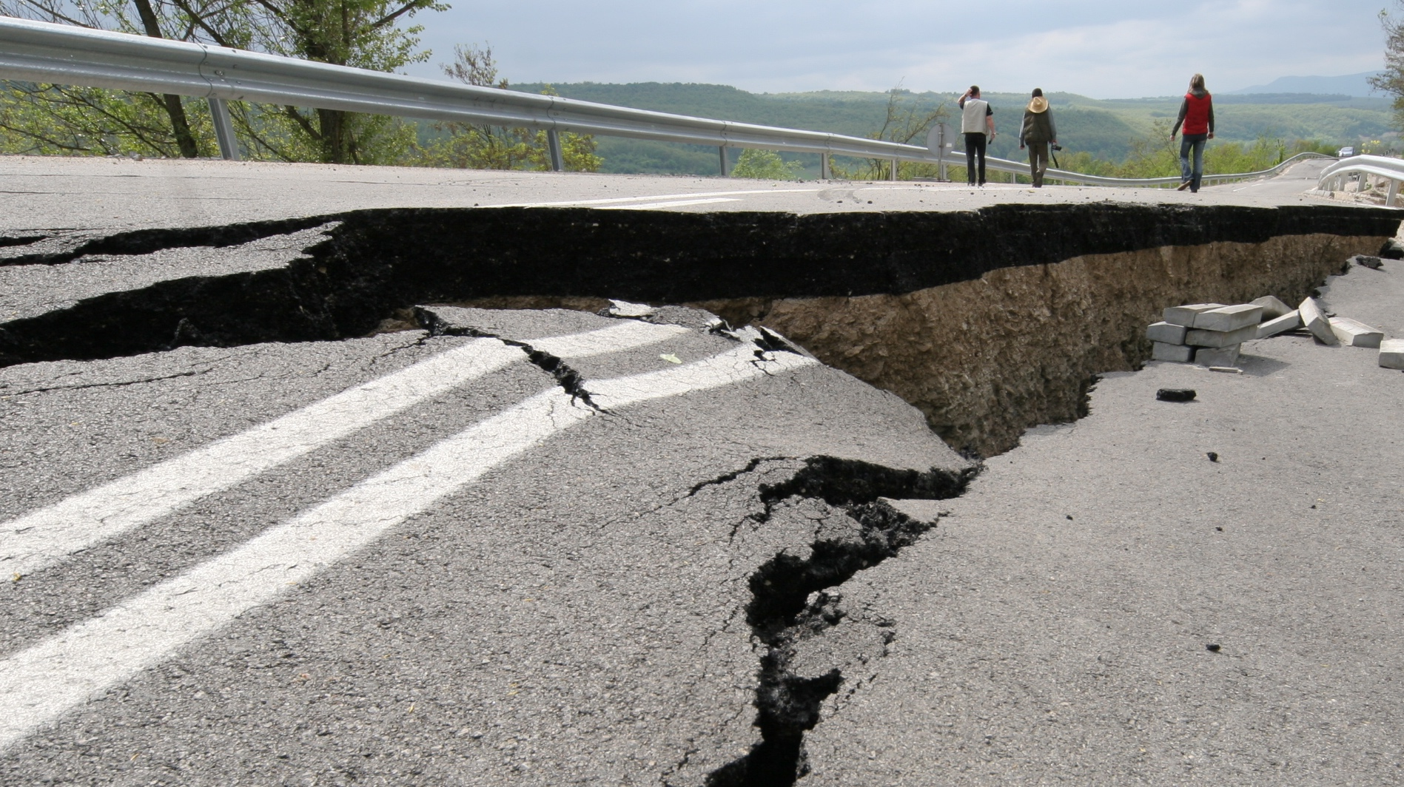
Did you know you can get an earthquake early warning alert before strong shaking is expected near you?
Notes:
Use this slide to build curiosity and set up the idea of earthquake early warning without going into detail yet. Ask the group, “Did you know that people can actually get a few seconds of warning before strong shaking starts?” Pause to let participants react—some may express surprise or disbelief, which is a good opportunity to affirm that it’s real.
Explain that earthquake early warning gives people advance notice that shaking is on the way. It’s based on science and technology developed by the U.S. Geological Survey and its partners. You don’t need to explain how it works yet—you’ll cover that soon—but let participants know that this system is designed to give them valuable seconds to protect themselves before the shaking reaches them.
If you want to add a quick personal or local touch, you can say something like, “Imagine you’re at work or at home, and your phone buzzes with a short alert—‘Earthquake! Expect shaking.’ That’s the kind of message this system can deliver.” End the slide by saying that next, you’ll look at an earthquake many people remember and imagine how early warning could have made a difference.

Slide 9
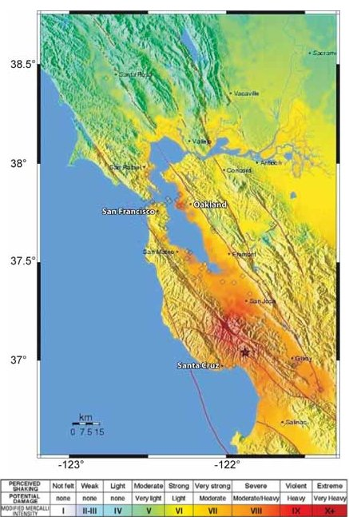
Northern California Loma Prieta Earthquake
M6.9/MMI VIII
October 17, 1989, 5:04 PM
63 deaths
3,757 injuries (400 serious)
Damage to 12,000 homes and 2,600 businesses
US$80 million in damage (equivalent to US$203 million today)
1.4 million people experienced power losses
News stations off air for 15-40 minutes
VIII
Notes:
Use this slide to bring the concept of earthquakes to life with a real and memorable event. Explain that the 1989 Loma Prieta Earthquake struck suddenly at 5:04 p.m. on October 17, during the World Series baseball game between the San Francisco Giants and the Oakland A’s. Because it happened during a nationally televised broadcast, millions of people across the country saw the event unfold almost in real time. You can point out that this earthquake is one many people still remember—especially the dramatic images of the Bay Bridge’s upper deck collapsing, sections of freeway pancaking, and widespread power outages across the Bay Area.
If you’re comfortable doing so, ask if anyone in the group remembers seeing those images or hearing about the quake. You can note that for many Americans, it was the first time they saw the destruction of an urban earthquake on live television. The Loma Prieta earthquake caused 63 deaths, thousands of injuries, and major damage to homes, businesses, and infrastructure.
Share that at the time, there was no early warning system in place—people had no notice that shaking was coming. Encourage participants to think about how unexpected and confusing those first moments must have been. Then, set up the next slide by saying, “Now let’s imagine how things might have been different if ShakeAlert® had existed back then.”

Slide 10
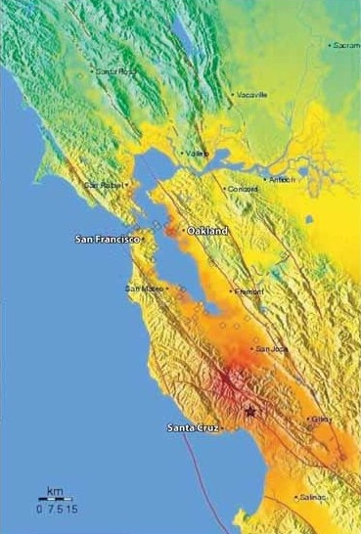
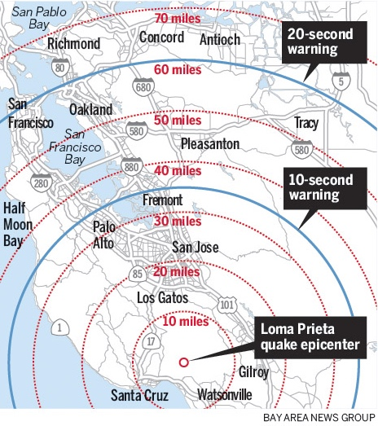
If ShakeAlert Had Been There on October 17, 1989…
Notes:
Now that participants are picturing what the 1989 Loma Prieta earthquake was like, invite them to imagine how things might have been different if ShakeAlert® had existed at that time. Explain that sensors near the earthquake’s epicenter in the Santa Cruz Mountains would have detected the shaking almost instantly. You can point to the map or image on the slide and show that San Francisco is on the west side of the bay and Oakland on the east, connected by the Bay Bridge. If your group includes people unfamiliar with California geography, explain that they can imagine a long bridge linking two major cities across the water—this is the structure where the upper deck collapsed during the quake.
Because the sensors would have been closer to the epicenter, alerts could have reached San Francisco and Oakland about twenty seconds before the strongest shaking arrived. Those twenty seconds might have allowed drivers to slow or stop, broadcasters to stay live on the air, and people to drop, cover, and hold on before the violent shaking began. You can remind participants that twenty seconds may not sound like much, but it can make a huge difference in preventing injuries and saving lives.
At this point, ask the group, “If you had just a few seconds of warning, what could you do?” Encourage short, practical answers—things like taking cover, steadying yourself, warning others, or moving away from hazards. Reinforce that these actions only work if people already know what to do. That’s why early warning doesn’t replace preparedness—it strengthens it by turning awareness into action. End this section by saying, “Let’s look next at how the ShakeAlert® system actually works.”

Slide 11

ShakeAlert.org
ShakeAlert Earthquake Early Warning: A New Layer of Earthquake Preparedness
Early warning doesn’t replace preparedness — it adds valuable seconds to use the actions you’ve already planned.
When an earthquake begins, seismic waves spread fast — but digital alerts can spread faster.
Earthquake early warning works best when it is built into your overall preparedness plan.
Notes:
Explain that ShakeAlert® adds a new layer of protection to what people already do to prepare for earthquakes. You can say something like, “Early warning works best when it’s built into your overall preparedness plan.” Emphasize that ShakeAlert® doesn’t replace earthquake planning—it enhances it. When people and organizations plan ahead, those extra seconds of warning can help them act faster and more effectively.
Make the point that early warning is most useful for people who already know what to do. The technology gives you a short window of time—but it’s the practice and preparation that make those seconds count. CERT members already think about readiness, communication, and coordination, so ShakeAlert® fits naturally into that mindset. You can give an example: a family that has practiced “Drop, Cover, and Hold On” will automatically take action when an alert sounds, while a business that has trained employees can prevent injuries by doing the same.
Reinforce the key idea that ShakeAlert® strengthens other preparedness—it doesn’t replace it. It gives people time to do what they’ve already planned and practiced, turning those few seconds of warning into protection, calm, and confidence.

Slide 12
How ShakeAlert Works
Notes:
This is a transition slide. Just give a quick overview—something like, “Let’s take a look at how ShakeAlert detects an earthquake and delivers alerts in just seconds.”

Slide 13
ShakeAlert.org
ShakeAlert Earthquake Early Warning Can
Detect: A network of seismic sensors across California, Oregon, and Washington quickly detects shaking when an earthquake begins.
Process: Computers analyze the first data to estimate where the earthquake started, how big it is, and where strong shaking will occur.
Deliver: Alerts are sent to apps, phones, and automated systems, giving people seconds to take protective action before strong shaking arrives.
Protect: Help prompt people and systems to take action like Drop, Cover, and Hold On or trigger automated safety steps.
ShakeAlert is the nation’s only public earthquake early warning system.
Notes:
Use this slide to give participants a simple overview of what the ShakeAlert® system is capable of. You can say something like, “ShakeAlert is designed to detect earthquakes quickly, estimate their size and location, and send alerts that give people and systems a few seconds of warning before strong shaking starts.”
Explain that those alerts can reach phones, apps, and automated systems that trigger protective steps—things like slowing trains, opening fire-station doors, or shutting off gas lines. These automatic actions are important because they can prevent injuries and reduce damage before people even have time to react.
Keep the focus on what the system can do rather than how it works—that comes next. End the slide by saying, “Now let’s look at what happens inside the system—how it detects, processes, and delivers those alerts.”
Note: ShakeAlert® is the USGS-run earthquake early warning system. The alerts people actually receive on their phones are ShakeAlert-powered messages — sent by partner agencies and apps, not directly by USGS. Try to reflect this in the language you use when teaching or answering questions.

Slide 14
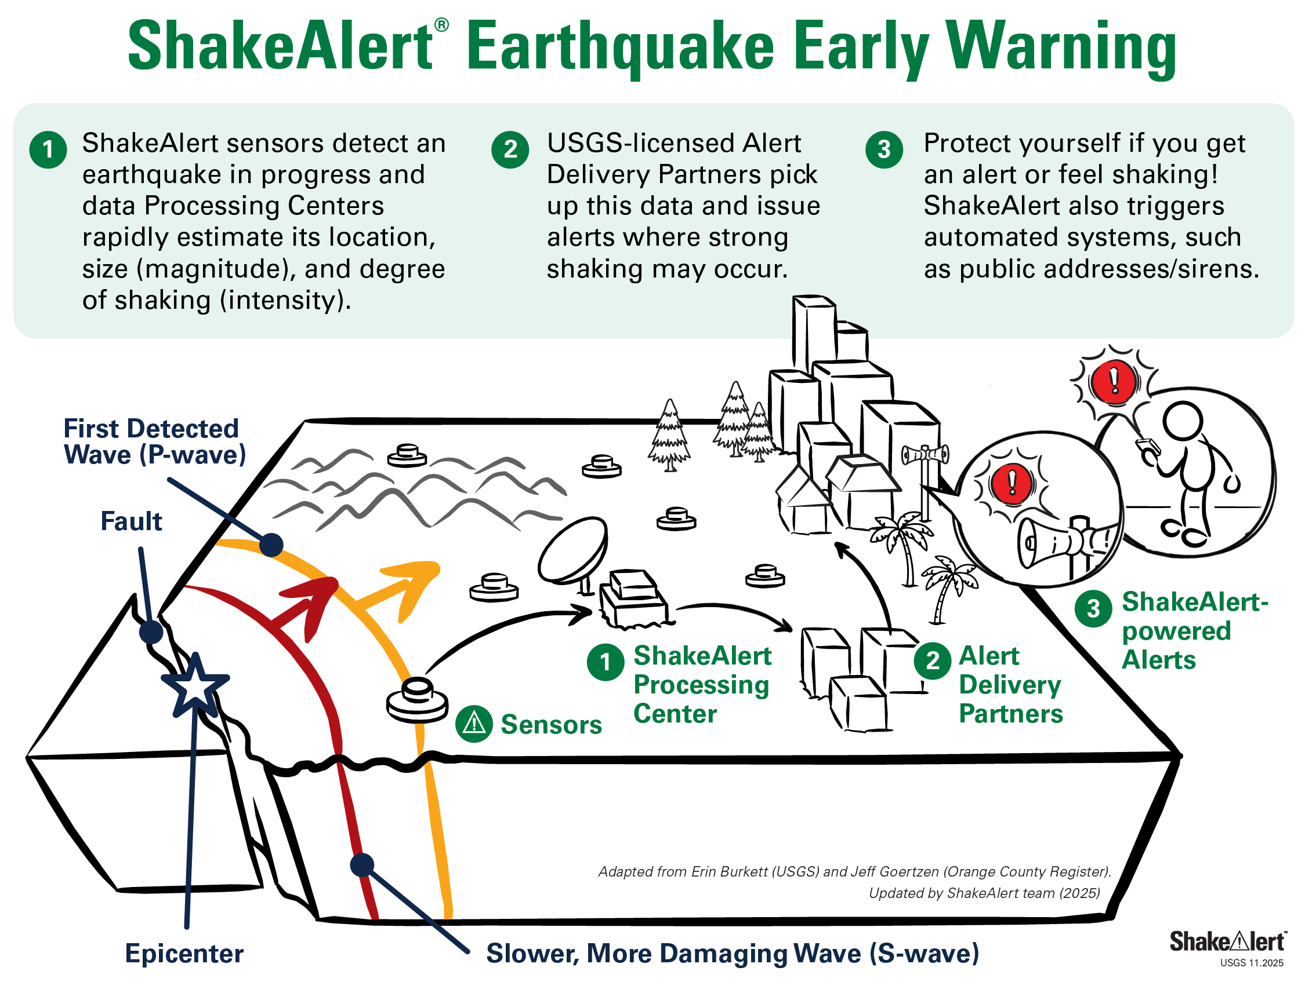
ShakeAlert.org
Detect
Process
Deliver
Notes:
Use this slide to explain how the ShakeAlert® system actually works, step by step. You can say something like, “Here’s what happens behind the scenes when an earthquake begins.”
First, Detect: the system’s network of seismic sensors picks up the very first vibrations—called P-waves—that travel out from the earthquake’s source. These waves move fast and can be detected before the stronger shaking reaches populated areas.
Next, Process: powerful computers instantly analyze the sensor data to estimate where the earthquake started, how large it is, and which areas are likely to feel strong shaking. This all happens automatically within seconds.
Finally, Deliver: once the system has that information, it sends digital alerts to phones, apps, and automated systems. Those alerts can trigger people and technology to take protective action before the strong shaking begins.
You can emphasize that the entire process happens extremely quickly—often faster than people can even realize an earthquake has started. End by saying, “So in just a few seconds, ShakeAlert detects the earthquake, processes the data, and delivers alerts that can help save lives.”

Slide 15
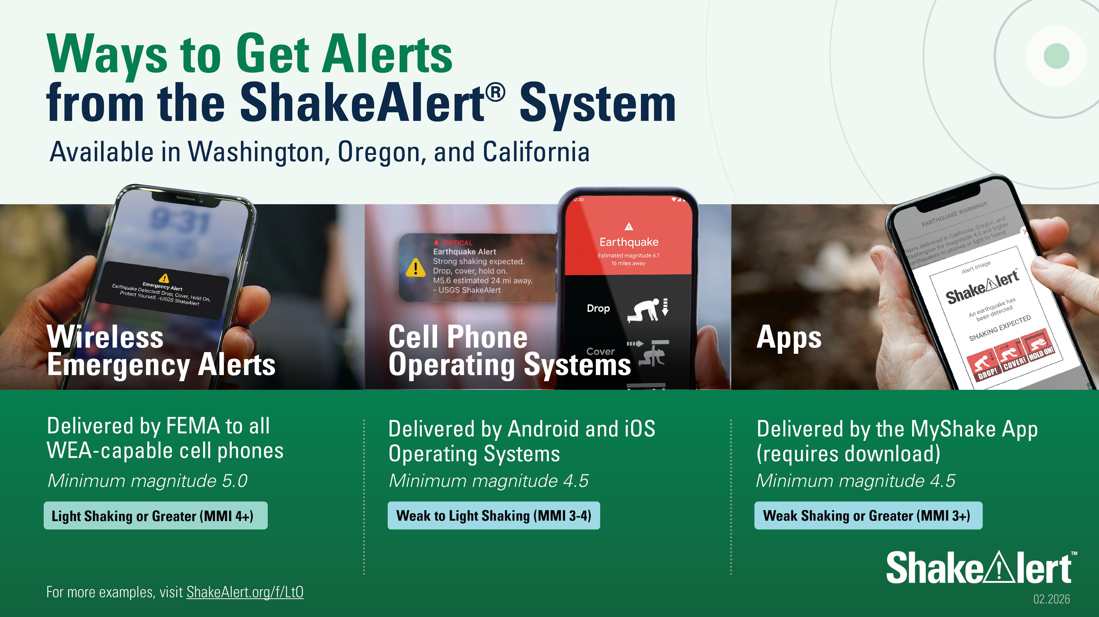
Notes:
Use this slide to explain that ShakeAlert® alerts can reach people through several trusted channels, not just one app or system. You can say something like, “When ShakeAlert sends an alert, it can reach people in a few different ways—through Wireless Emergency Alerts, cell phone operating systems, and apps like MyShake.”
Point out that Wireless Emergency Alerts (WEA) are the same system used for AMBER Alerts and other public safety messages, so participants have likely seen one before. Emphasize that most phones receive these WEA messages automatically when strong shaking is expected nearby—there’s no need to download a special app for that.
However, people can also get alerts through the MyShake app, which uses the same ShakeAlert data and can provide additional features or settings. Encourage participants to confirm that their phone’s emergency alerts are turned on and, if they wish, to download the MyShake app for another reliable alert source.
You can mention briefly that some organizations connect directly to ShakeAlert for automated actions—like public address systems or transportation networks—but you’ll go into that later. For now, the key takeaway is that ShakeAlert alerts reach people in multiple reliable ways, and everyone should make sure they can receive at least one of them.
You can let participants know that they’ll have a chance to check their phones and make sure they’re ShakeAlert Ready later in the session. For now, ask them to keep phones put away so everyone can focus on understanding how ShakeAlert works and what to do when an alert arrives. The phone activity will happen at the very end of the course, once everyone has the full context and you can walk through it together.

Slide 16
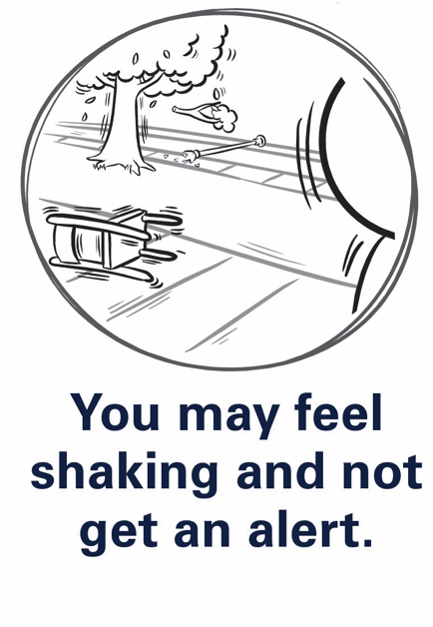
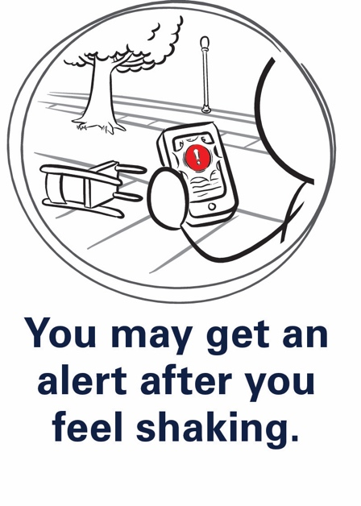
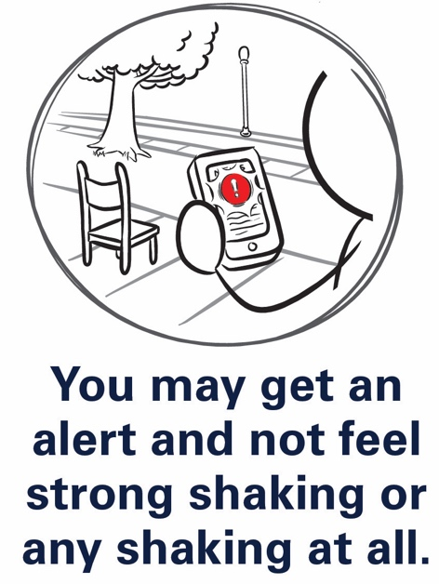
ShakeAlert.org
Warning Time
Warning times vary: 0 seconds to more than a minute.
Late Alert Zone: near the epicenter, shaking may arrive before alerts.
Even a few seconds can save lives — act immediately if you feel shaking or get an alert.
Notes:
Explain that the amount of warning ShakeAlert® can provide depends on how close you are to where the earthquake starts. The system doesn’t predict earthquakes—it detects them as soon as they begin—but it can send alerts faster than the shaking travels. The closer you are to the epicenter, the less time there is between detection and shaking. People farther away might get several seconds—or in some cases, more than a minute—before strong shaking arrives.
You can point to the visual on the slide to show that the areas nearest the epicenter are called the Late Alert Zone, where shaking may arrive before the alert can. Emphasize that even a few seconds of warning can make a big difference. Those seconds can give people time to steady themselves, move away from hazards, or take cover.
To help participants connect this idea, refer back to the Loma Prieta example you discussed earlier. Remind them that if ShakeAlert® had been operating in 1989, people in San Francisco and Oakland could have received about twenty seconds of warning before the strongest shaking hit. Explain that this slide shows why that’s possible—because the sensors near the epicenter detect shaking first and the alert can reach areas farther away before the shaking does.
If you want to make the concept even clearer, you can use a quick analogy: “It’s like seeing lightning before you hear the thunder—ShakeAlert detects the first waves of motion and sends alerts ahead of the stronger shaking.”
End by reinforcing that those seconds of warning are valuable only if people already know what to do with them—and that’s what you’ll cover next.

Slide 17
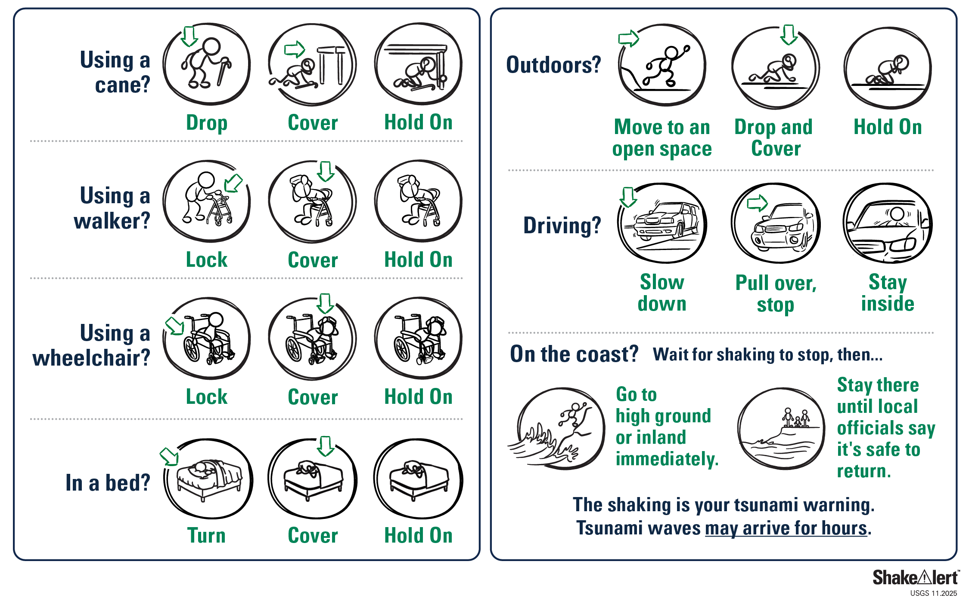
Practice fighting the urge to run!
ShakeAlert.org
Take Protective Action When You Feel Shaking or Get an Alert
Take protective action immediately: Drop, Cover, and Hold On.
If you can’t get under furniture, protect your head and neck.
Notes:
Now that participants understand how ShakeAlert® works and how much warning it can provide, this is the point to connect it back to what people should actually do when they get an alert—or when shaking begins without one. Explain that the right response is the same in both situations: Drop, Cover, and Hold On. Tell participants that when an alert sounds, they shouldn’t wait to see what happens—they should act immediately.
Encourage them to visualize where they might be when an earthquake starts. At home, that could mean dropping next to a sturdy table; at work, it might mean getting under a desk or beside an interior wall. Emphasize that moving around during shaking is risky—most injuries happen when people try to run or move to another room. The safest choice is to drop low to the ground, protect your head and neck, and hold on until the shaking stops.
If you want to make this slide more interactive, you can invite the group to point out good places to take cover in the room where you’re meeting. This simple discussion helps people remember to look for safe spots wherever they are. End by reinforcing that ShakeAlert® gives people time to act on what they’ve already practiced. Those few seconds can make the difference between being injured and staying safe.

Slide 18
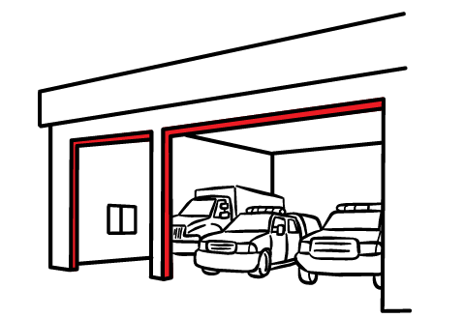
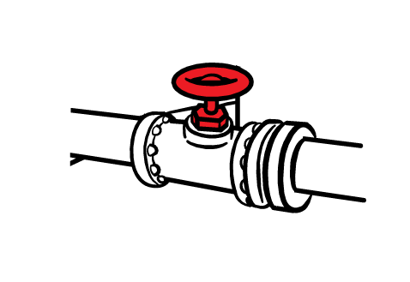
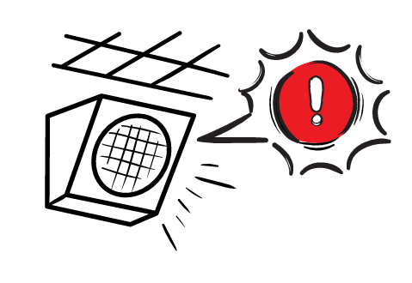
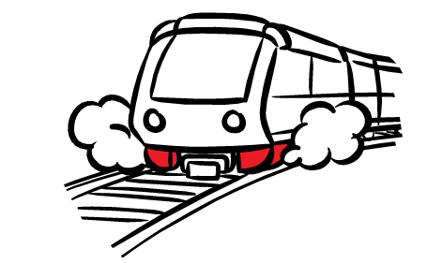
ShakeAlert.org
Automatic Protective Actions Help Keep Systems Safe
Alerts can trigger automatic safety steps, such as:
Issuing audible alerts through a public address system in a school or workplace
Slowing/stopping trains to prevent derailments
Opening firehouse doors for emergency vehicles
Shutting off gas valves
These actions protect people, infrastructure, and services.
Notes:
Explain that ShakeAlert® isn’t only for individuals—it also helps protect entire systems and communities. When an alert is sent, it can trigger automatic protective actions without waiting for a person to respond. Give a few examples participants can easily picture: trains slowing down to prevent derailments, fire station doors opening so emergency vehicles can get out, elevators stopping at the nearest floor, or gas lines shutting off to prevent fires. These actions happen within seconds of the alert being issued.
You can point out that these automatic responses help protect not only people but also critical services that the community depends on after an earthquake. For example, trains that stop safely can start running again more quickly, and preventing fires or gas leaks reduces damage and makes response and recovery faster.
If you want to make it relatable, you might say something like, “Think about all the systems we rely on every day—transportation, communications, utilities. Early warning helps those systems protect themselves so they can keep serving us when we need them most.” End the slide by reinforcing that ShakeAlert® works at every level—individuals, organizations, and infrastructure—turning seconds of warning into safety and resilience.

Slide 19
Putting ShakeAlert Into Action
Notes:
This is a transition slide. You can say something like, “Now that we’ve talked about what ShakeAlert is and how it works, let’s look at how you can use it—and how CERT volunteers can help others do the same.”

Slide 20


ShakeAlert.org
Myths and Facts About ShakeAlert Earthquake Early Warning
MYTH
FACT
Earthquakes can be predicted.
ShakeAlert does NOT predict earthquakes. It detects shaking quickly after a quake begins and can provide seconds of warning before strong shaking arrives.
Everyone will get an alert.
Not all devices will receive alerts. People close to the epicenter may feel shaking before an alert can be delivered.
All earthquakes trigger alerts.
Only earthquakes meeting certain size and shaking thresholds trigger alerts. Small or distant quakes may not.
Notes:
Explain that this slide helps clear up some common misconceptions about ShakeAlert®. You can introduce it by saying something like, “Let’s take a minute to separate what’s true from what people often think about earthquake early warning.”
Start with the most common myth—that ShakeAlert® predicts earthquakes. Clarify that it does not predict them; it detects the first seismic waves once an earthquake begins and sends alerts ahead of the stronger shaking. The technology can’t tell when or where a future earthquake will happen, only what’s occurring in real time.
Another misconception is that everyone will always get an alert. Explain that’s not the case. People who are very close to the epicenter—the Late Alert Zone—may feel shaking before an alert can arrive because the seismic waves move faster than the notification. Others may not receive an alert if the expected shaking in their area is below the system’s threshold.
A third myth is that every earthquake triggers an alert. Explain that ShakeAlert® is designed to warn only when shaking is expected to be strong enough to cause concern, so smaller or distant earthquakes might not trigger alerts.
You can end the slide by saying, “As CERT volunteers, it’s important that you can explain these facts clearly. Knowing what ShakeAlert can and can’t do helps build trust when you talk about it in your community.”

Slide 21
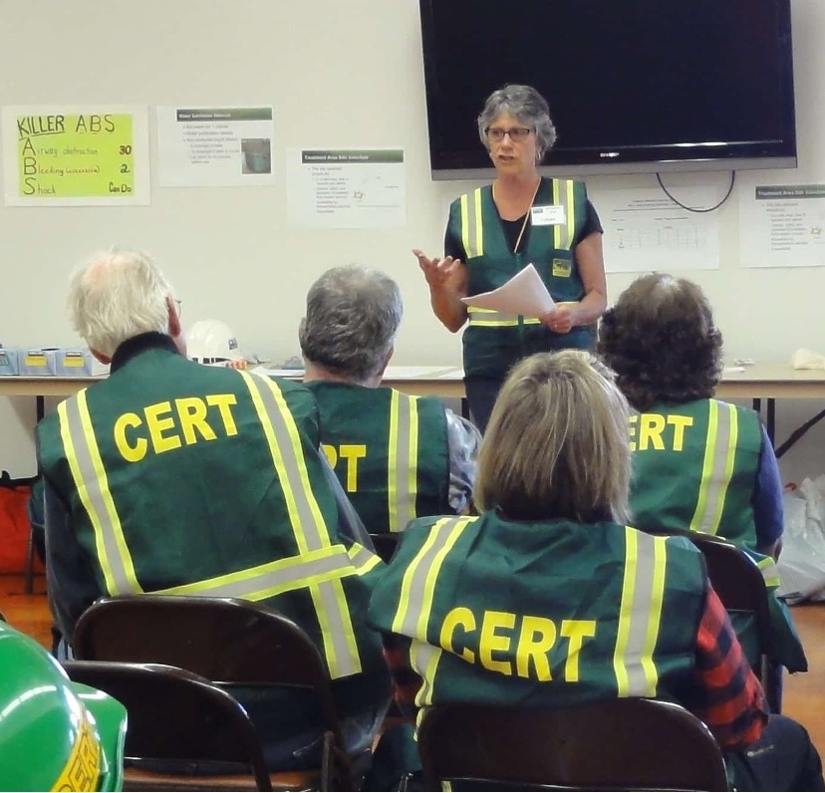
ShakeAlert.org
How CERT Volunteers Can Share ShakeAlert
Protect yourself! Make sure your phone is ShakeAlert Ready and practice what you would do if you get an alert or feel shaking.
Show neighbors, friends, and family how to check phone alert settings and encourage them to download the MyShake app.
Share this message: “Did you know you can get an alert before you feel shaking?”
Encourage multiple ways to receive alerts.
Notes:
Explain that this slide highlights the practical steps CERT volunteers can take to share ShakeAlert® with others. You can say something like, “As CERT volunteers, you already play an important role in helping your neighbors get prepared. Here’s how you can help more people benefit from ShakeAlert.”
Start by emphasizing the first line of the slide: Protect yourself first. Encourage everyone to make sure their own phones are ShakeAlert-ready. That means checking that Wireless Emergency Alerts are turned on and, if they use an Android device or an iPhone, confirming that earthquake alerts are enabled. You can also recommend downloading the MyShake app for an additional way to receive alerts.
Then, talk about helping others do the same. Suggest showing friends, neighbors, and family members how to check their phone settings or install the app. This is something CERT members can easily do during preparedness events, neighborhood walks, or informal conversations.
You can demonstrate the sample message on the slide—“Did you know you can get an alert before you feel shaking?”—and encourage participants to use that phrase to start conversations. Reinforce the idea of encouraging multiple ways to receive alerts, since different people may prefer different tools.
End by reminding participants that these small, simple actions help more people take advantage of ShakeAlert®. By sharing accurate information and demonstrating trusted technology, CERT volunteers can turn awareness into real preparedness in their communities.

Slide 22
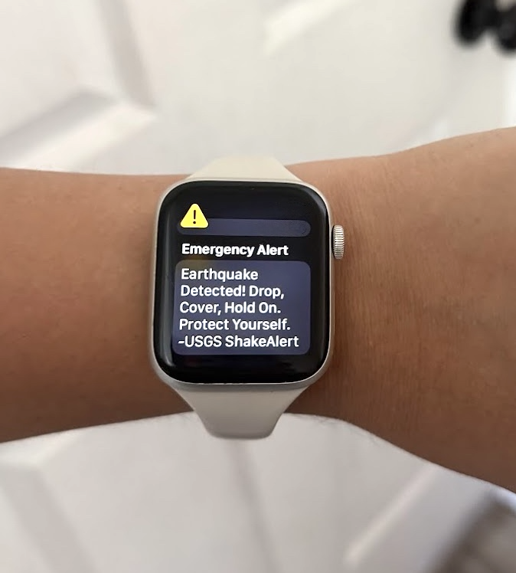
ShakeAlert.org
Be a Trusted Messenger
As CERT volunteers, you can act as trusted messengers for the people around you.
Even if the conversation is informal, it is important to confirm you have trusted information before sharing with anyone.
Use trusted sources: official government (.gov), education (.edu), CERT channels.
Verify before sharing to avoid spreading misinformation.
Be cautious of viral or anonymous posts — they may not be accurate.
USGS is a trusted source.
Notes:
Explain that this slide is about how to share ShakeAlert® information responsibly. As a CERT volunteer, people already see you as someone who knows where to find reliable information about safety and preparedness. ShakeAlert® is still new to many people, so your role as a trusted messenger is especially important.
You can say something like, “When you talk about ShakeAlert, make sure the information you share is accurate, simple, and comes from a credible source.” Encourage participants to use official sources such as the U.S. Geological Survey (USGS), state emergency management agencies, local CERT program materials, and government (.gov) or education (.edu) websites.
Remind them that before sharing a post, video, or link on social media, it’s always a good idea to verify before sharing. Misinformation spreads easily, especially after a major earthquake, and even well-meaning people can pass along incorrect details.
You can also mention that if participants ever feel unsure about something they’ve heard, they can always check official sources like ShakeAlert.org or USGS.gov before passing it along. Emphasize that being cautious and accurate helps protect their credibility and keeps their community informed.
End by reinforcing that trusted messengers don’t need to know everything—they just need to know where to find the right information and how to share it clearly and calmly.

Slide 23
Module 2: The Science Behind ShakeAlert
Notes:
This is a transition slide. Now that participants have the Essentials overview, you’ll start to go a little deeper into the science behind ShakeAlert. Explain that this module helps them understand why the system works — the basics of how earthquakes generate seismic waves, and how those waves relate to magnitude and intensity.
Let participants know that this isn’t a technical lecture; it’s just enough background to help them explain ShakeAlert confidently to others.

Slide 24
Earthquake Science Basics
ShakeAlert.org
Earthquakes send out two main waves.
P-waves (Primary): fastest — usually lighter shaking.
S-waves (Secondary): slower — cause stronger shaking.
ShakeAlert detects P-waves to estimate where and how strong the earthquake is before S-waves arrive.
Notes:
In this slide, you’ll offer more detail about how earthquakes release energy and how that energy travels through the Earth as waves. Explain that when stress builds up between tectonic plates, it eventually releases along a fault line, sending out vibrations—what we feel as an earthquake. The energy moves in several types of waves, but for ShakeAlert, the two we focus on are P-waves and S-waves.
Tell participants that P-waves (Primary waves) are the fastest. They travel through rock at about 3 to 5 miles per second and usually cause lighter shaking—more of a quick bump or thump. S-waves (Secondary waves) move more slowly, about half that speed, but they create stronger side-to-side or up-and-down motion. The S-waves are what cause most of the damage to buildings and infrastructure.
ShakeAlert detects the P-waves first. These arrive seconds before the stronger S-waves, and that brief difference in time is what allows the system to send alerts before the worst shaking begins. You can think of the P-wave as the “heads-up” signal and the S-wave as the damaging wave that follows. If participants seem unsure about the concept, remind them of the example from the CERT Basic Training earthquake section: sometimes you may hear a low rumble or feel a light bump before the heavy shaking starts—that’s the P-wave arriving first.
Wrap up by noting that ShakeAlert’s sensors use those first waves to recognize that an earthquake has begun, but you’ll go into more depth about how the system processes that data in the next module, Inside the ShakeAlert System.

Slide 25
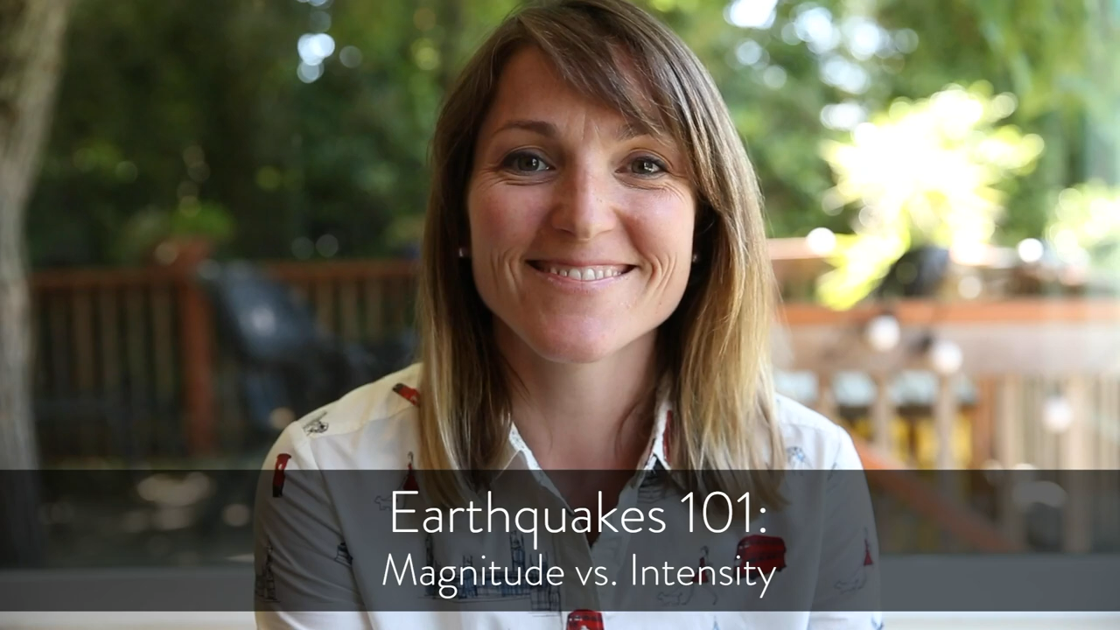
Magnitude and Intensity
ShakeAlert.org
Watch this short video (about 1 minute)
Magnitude = energy released at the source.
Intensity = how strongly shaking is felt in different places.
We’ll look at each next.
Notes:
This slide includes a short video on magnitude and intensity, presented by Angie Lux, PhD, a research scientist at the UC Berkeley Seismology Lab. The video helps participants see how magnitude describes the size of an earthquake and intensity shows how strongly shaking is felt in different places.
Play the video if you have the audio and visual setup to support it. If not, that’s fine — you’ll cover these same ideas in more detail on the next two slides. After the video, briefly summarize that magnitude is about the total energy released at the source, while intensity is about what people actually feel depending on how far they are from the epicenter and what kind of ground or buildings they’re in.

Slide 26
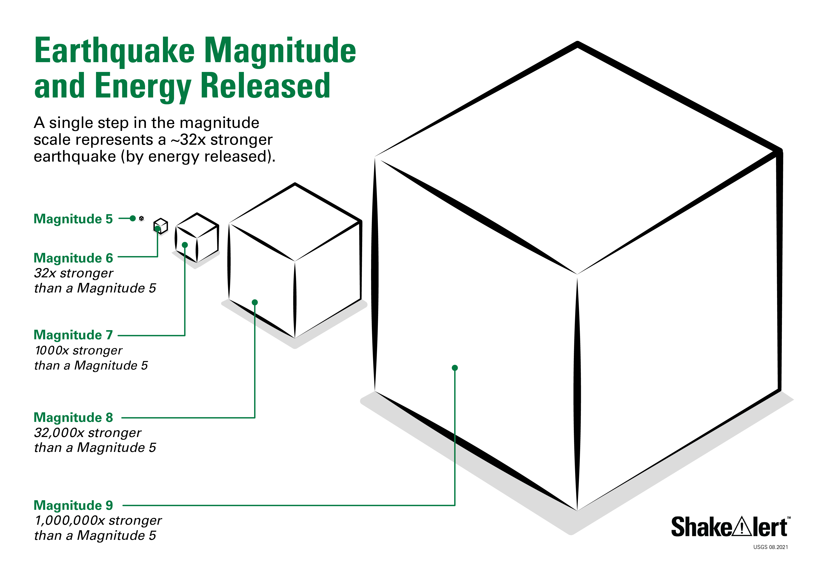
Magnitude
ShakeAlert.org
Magnitude (M) measures the total energy released at the earthquake’s source.
It’s a single number for each event (e.g., M 6.0).
Each step up in magnitude means about 32 times more energy.
Larger magnitudes affect a wider area and can generate longer warning times.
Notes:
On this slide, you’ll explain what magnitude means in earthquake science and how it relates to what ShakeAlert detects. Tell participants that magnitude measures the total energy released at the earthquake’s source. It’s a single value assigned to each earthquake—so a magnitude 6.0 is larger than a 5.0 by a significant amount. Explain that each whole number step on the magnitude scale represents roughly 32 times more energy released. For example, a magnitude 6 earthquake releases about 32 times more energy than a magnitude 5, and more than a thousand times the energy of a magnitude 4.
You can mention that the magnitude is calculated from the size of the seismic waves recorded by many sensors. Those measurements tell scientists—and ShakeAlert’s computers—how much energy is being released and help estimate how large the earthquake might become. Larger magnitudes tend to affect a wider area and can create longer potential warning times because it takes more time for the waves to travel through the ground.
If participants ask about the “Richter scale,” note that while people often use that term, scientists now use more modern versions such as Moment Magnitude (Mw) that measure energy more accurately. You don’t need to go into detail; just clarify that when we say “magnitude,” we mean the overall energy of the earthquake, regardless of which scale is used.
Transition by reminding the group that while magnitude tells us the size of the earthquake, it doesn’t describe what people actually feel. That’s what intensity measures, and that’s what you’ll cover on the next slide.

Slide 27
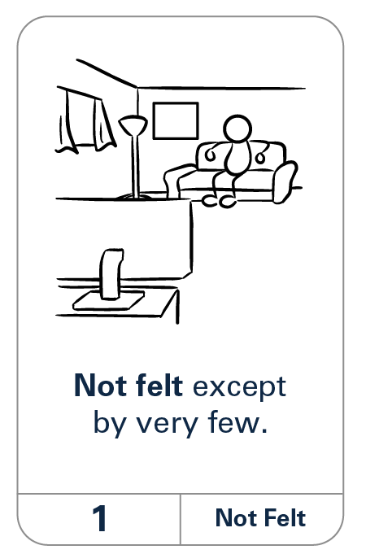
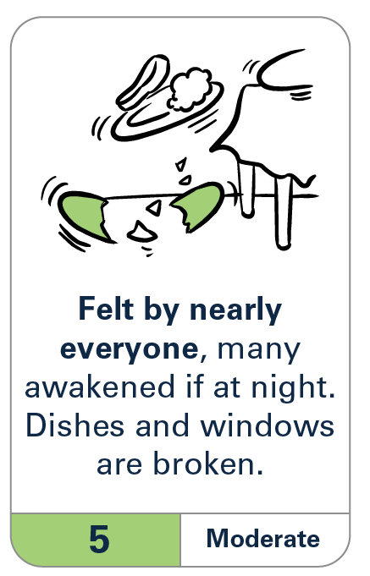
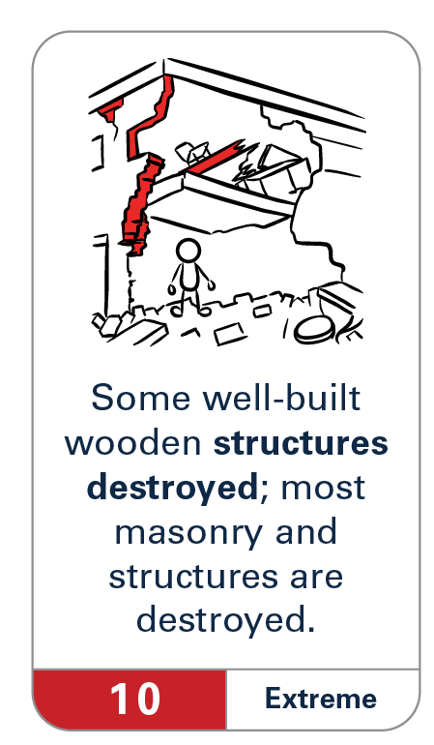
Intensity
ShakeAlert.org
Intensity describes the strength of shaking at a location.
It depends on distance from the epicenter, ground type, and building design.
Measured with the Modified Mercalli Intensity (MMI) Scale.
Intensity can vary greatly — why alerts and shaking feel different in each place.
Notes:
Now you’ll explain what intensity means and how it differs from magnitude. Tell participants that intensity describes the strength of shaking at a specific location—in other words, what people actually feel. While magnitude is a single number for the whole earthquake, intensity varies widely depending on where you are.
Explain that shaking tends to be strongest near the epicenter and weaker farther away. It also depends on local conditions, such as the type of soil or rock and the construction of buildings. For example, soft soils can amplify shaking, while solid bedrock transmits it more efficiently but with less amplification. Building design also matters—older, unreinforced structures may shake more than newer, reinforced ones.
Mention that intensity is measured using the Modified Mercalli Intensity (MMI) Scale, which ranges from I (not felt) to XII (extreme destruction). Show how the images on the slide illustrate what different intensities look like—small tremors in one place, heavy damage in another.
At this point, ask participants a quick question to reinforce the difference between the two concepts: “If an earthquake has a magnitude of 7.0, will everyone feel the same intensity of shaking?” Allow a few answers, then clarify that the magnitude stays the same everywhere—it’s the energy released at the source—but the intensity changes depending on distance, soil, and building type.
Wrap up by emphasizing that this variation in intensity is why ShakeAlert sends alerts based on expected shaking, not just the earthquake’s size. Then transition by saying you’ll connect these concepts to how ShakeAlert actually turns those early wave detections into warnings on the next slide, From Waves to Warning.

Slide 28
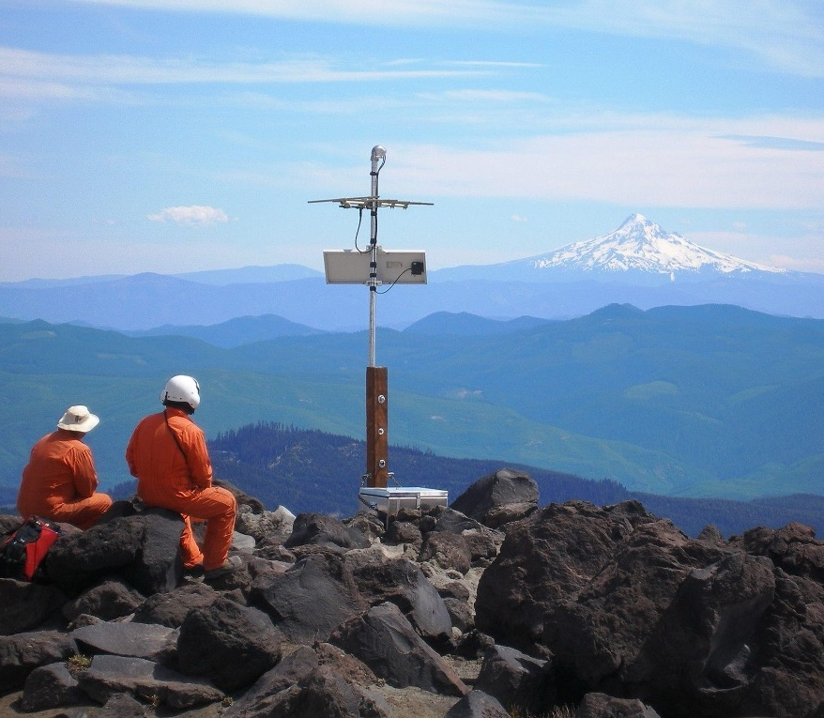
From Waves to Warning
ShakeAlert.org
Sensors across California, Oregon, and Washington detect P-waves within seconds.
Computers estimate location, magnitude, and expected intensity.
Alerts go out before the strong S-waves arrive — giving people seconds to protect themselves.
Those seconds can save lives and reduce damage.
Notes:
On this slide, you’ll connect the earthquake science we just covered to how ShakeAlert actually uses that information. Explain that once an earthquake begins, ShakeAlert’s network of sensors immediately detects the P-waves. Those first data points are analyzed within seconds by computers at the USGS Processing Centers to estimate where the earthquake started, how large it is, and how strong the shaking could be in different areas.
Tell participants that because P-waves travel faster than the damaging S-waves, ShakeAlert can send alerts ahead of the stronger shaking. These alerts give people and systems valuable seconds to act—sometimes just two or three seconds, sometimes twenty or more—depending on how far they are from the epicenter. That brief head start allows people to Drop, Cover, and Hold On, and enables automatic safety actions such as slowing trains or opening firehouse doors.
If participants ask about accuracy, explain that ShakeAlert continually refines its calculations as more sensor data come in. The first estimate might be based on only a few seconds of motion, and then updates follow almost instantly. This helps get alerts out quickly while improving precision as the earthquake unfolds. You can also note that not everyone will receive the same amount of warning. People very close to the epicenter may feel shaking before an alert arrives, while those farther away may have several seconds of notice. This concept—the “late-alert zone”—comes up again in Module 3 when you talk about alert thresholds and delivery.
Finish the slide by reinforcing the key idea: ShakeAlert doesn’t predict earthquakes—it detects them faster than we can feel them, turning the first waves into a few seconds of warning that can save lives.

Slide 29
Module 3: Inside the ShakeAlert System
Notes:
This is a transition slide. Now that participants understand the science behind earthquakes and how ShakeAlert detects the first waves, you’ll shift to what happens next — how that detection becomes an alert. Explain that this module takes a look inside the ShakeAlert system to show how the sensors, data processing, and delivery partners all work together.
Let participants know they don’t need any technical background for this section; you’ll walk through the process step by step. The goal is for them to be able to describe, in plain language, how the system detects shaking, processes information, and sends alerts that reach people and automated systems in seconds.
You can also remind them that this is part of the “deep dive” portion of the course — going beyond the basics covered in the Essentials section to understand how ShakeAlert functions behind the scenes.

Slide 30
Detect → Process → Deliver → Protect
ShakeAlert.org
ShakeAlert uses thousands of sensors across California, Oregon, and Washington.
Computers analyze data within seconds to estimate the earthquake’s size, location, and expected shaking.
Alerts are sent to apps, phones, and automated systems so people and technology can act before strong shaking arrives.
The goal: detect shaking fast enough to deliver alerts faster than the waves travel.
Notes:
This slide gives you the big-picture overview of how ShakeAlert works—from detecting an earthquake to sending out alerts that prompt protective actions.
Explain that ShakeAlert uses thousands of seismic and GPS sensors across California, Oregon, and Washington. You can tell participants that GPS—the Global Positioning System—is one example of a Global Navigation Satellite System, or GNSS. In addition to the U.S. GPS satellites, there are other navigation satellites operated by Europe, Japan, and other countries. Together, these satellite systems allow sensors to measure ground motion with extreme precision. In the ShakeAlert network, GNSS sensors can detect when the ground shifts during an earthquake, while seismic sensors measure the vibrations moving through the Earth. The two types of data work together to make the system more accurate and reliable.
Once the sensors detect motion, that data is transmitted in real time to USGS Processing Centers. Within seconds, specialized computers analyze it to estimate where the earthquake started, how large it is, and what areas are likely to experience the strongest shaking.
As soon as the system has enough information, it issues alerts through multiple delivery paths—phone networks, apps, and automated systems. The goal is to deliver alerts faster than the earthquake’s strongest waves can travel.Emphasize that this all happens automatically and within seconds of the earthquake beginning.
Use the slide to walk through the sequence: Detect → Process → Deliver → Protect. You can describe it as a loop that starts when the ground moves and ends when people and systems take action. The “Protect” step represents both human actions—like Drop, Cover, and Hold On—and automated responses such as trains slowing or firehouse doors opening.
If participants ask about reliability, explain that the system is continuously refined and tested by the USGS and partner institutions. There may still be small differences in timing or coverage, but ShakeAlert prioritizes speed and safety—giving as many people as possible a few seconds to act.
Wrap up by letting the group know that in the next few slides, you’ll take a closer look at the network of sensors, the processing centers, and the partners who send out the alerts.

Slide 31
Sensor Network and Processing
ShakeAlert.org
ShakeAlert’s sensors monitor ground motion 24/7.
Three USGS Processing Centers analyze the data simultaneously for speed and redundancy.
Alerts are issued automatically — there’s no human step in the process.
Continuous updates help refine magnitude and shaking estimates as the quake unfolds.
Notes:
On this slide, you’ll take a closer look at the network that makes ShakeAlert possible. Explain that ShakeAlert is built on a system of seismic and GNSS sensors located all along the West Coast. There are now thousands of these instruments in California, Oregon, and Washington, with new ones added each year. They’re placed in many kinds of locations—hillsides, open fields, near cities, and along known fault zones—to capture ground movement as soon as it begins.
Tell participants that the seismic sensors detect the vibrations caused by earthquakes—the P-waves and S-waves we talked about earlier. The GNSS sensors measure small shifts in the Earth’s surface using satellite signals. Together, these two systems allow scientists and ShakeAlert’s computers to detect both fast vibrations and slower ground movements, giving a fuller picture of what’s happening.
When the sensors pick up shaking, they send that information instantly to one of three USGS Processing Centers—in California, Oregon, and Washington. These centers work together in real time to make sure the system is fast and reliable. The data is analyzed automatically by computers, not people, which is why ShakeAlert can send alerts within seconds.
You can add that this automation is a big part of why early warning works. There’s no time for manual decisions during an earthquake, so the system is designed to recognize patterns in the sensor data, estimate the earthquake’s location, magnitude, and likely intensity, and issue alerts automatically.
If participants are curious, you can mention that ShakeAlert uses a network called the California Integrated Seismic Network (CISN) along with state and university partners such as Caltech, UC Berkeley, and the Pacific Northwest Seismic Network. All of these groups contribute data to make ShakeAlert faster and more accurate.
Wrap up by emphasizing that this sensor network and rapid data processing are what make the early warning possible. The next slide looks at how ShakeAlert’s information reaches the public and automated systems through its delivery partners.

Slide 32
Alert Delivery Partners
ShakeAlert.org
USGS works with Alert Delivery Partners who send alerts to people and systems.
Using multiple delivery methods helps reach more people quickly and reliably.
EXAMPLES:
Wireless Emergency Alerts (WEA) to phones.
Operating system alerts and the MyShake app.
Public address systems, transit, and utility networks.
Notes:
This slide explains how ShakeAlert information reaches people and systems. The USGS does not send alerts directly to the public—instead, it provides alert data to licensed organizations called Alert Delivery Partners. These partners turn that data into messages and deliver them through phone networks, apps, and automated safety systems.
Point out that these partners give ShakeAlert its reach.
The most familiar example is Wireless Emergency Alerts (WEA), which go through FEMA’s Integrated Public Alert and Warning System (IPAWS). Most CERT participants probably know FEMA—the Federal Emergency Management Agency—but you can mention it briefly just in case. FEMA manages the nationwide system that delivers AMBER Alerts, severe-weather warnings, and now ShakeAlert messages. WEA alerts are broadcast from cell towers to nearby phones, so they don’t rely on text messaging or internet connections.
Operating System Alerts are built directly into Android and iOS phones and powered by ShakeAlert data from the USGS. Because the message goes straight through the phone’s operating system, these alerts may look different depending on your phone.
A third example is the MyShake app, available for both Android and iPhone. It’s free to download and uses ShakeAlert data to send location-based alerts. The app can also display educational information and short post-earthquake surveys that help scientists understand shaking impacts.
For participants, the takeaway is that all of these delivery methods use the same ShakeAlert data, but each reaches people slightly differently. Multiple systems create redundancy—if one path fails or a phone is muted, another system may still deliver the alert. This redundancy is intentional and continues to expand as new delivery partners and technologies are added. You can also point out that ShakeAlert data goes beyond phones. Institutional and infrastructure partners use it for automated protective actions—for example, slowing trains, opening firehouse doors, or shutting off gas valves. These actions protect people and critical systems before the strongest shaking arrives.
Finally, remind instructors that this information can change as the program grows. Encourage them to check ShakeAlert.org periodically for the latest list of delivery partners and technologies before teaching this section.
Transition by telling participants that in the next slide, you’ll talk about which earthquakes trigger alerts and why warning time varies from person to person.

Slide 33
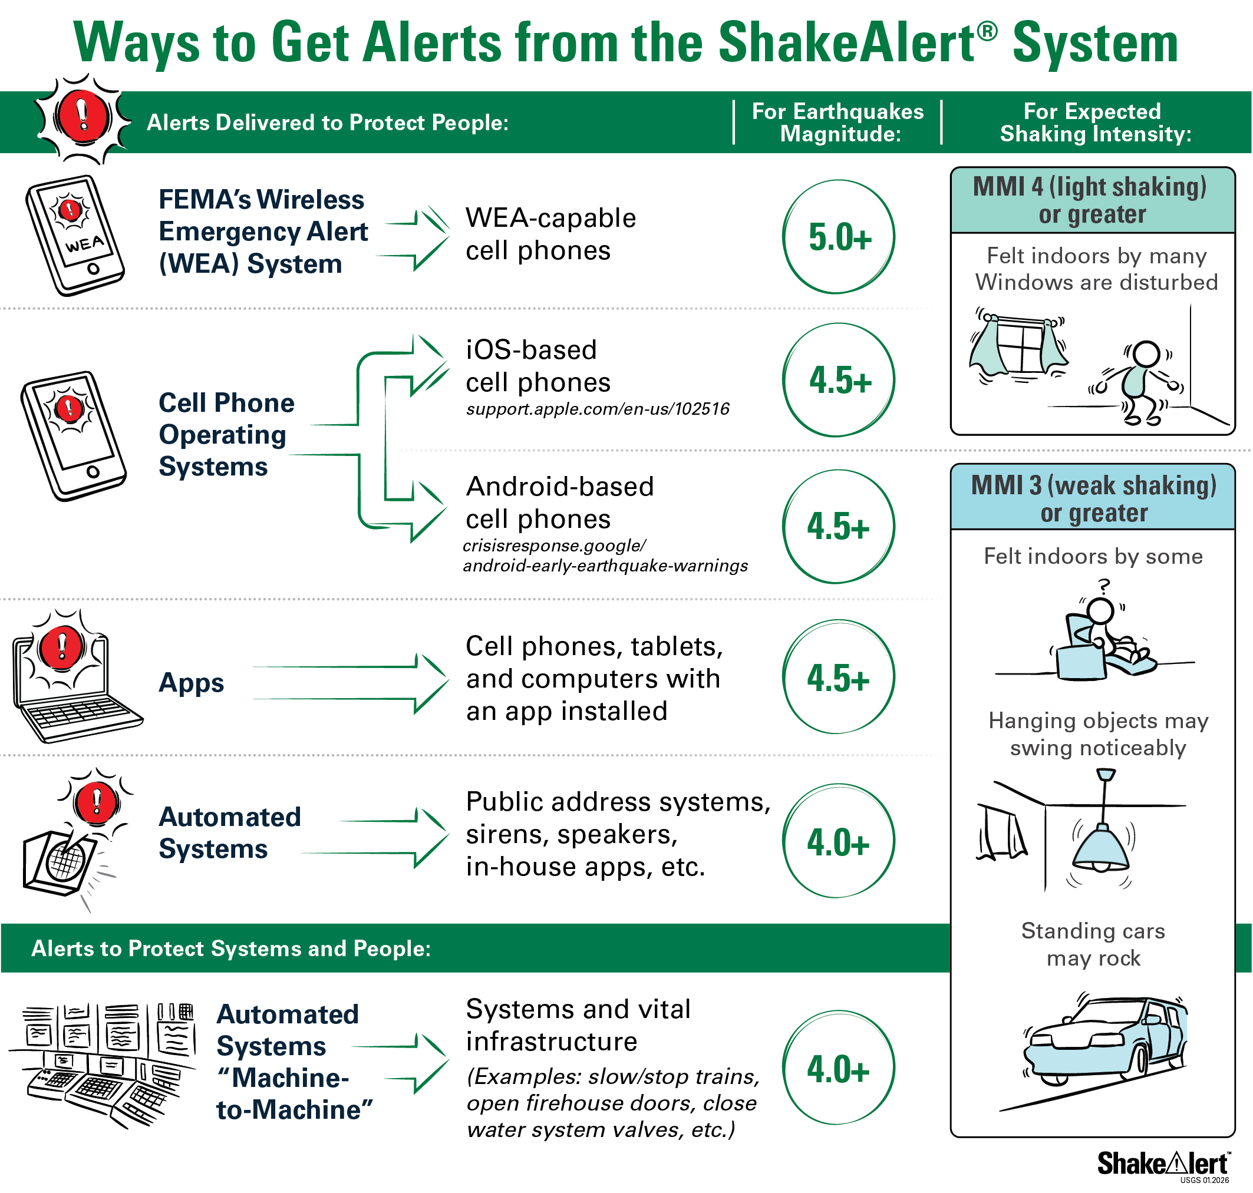
Alert Thresholds and Warning Time
ShakeAlert.org
Only certain earthquakes trigger alerts — based on magnitude and expected shaking.
WEA: M5.0+ and Intensity 4 (light shaking).
Operating system alerts: M4.5+ and either Intensity 3 (Android) or Intensity 4 (iOS).
Apps, like MyShake: M4.5+ and Intensity 3 (weak shaking).
Warning time depends on distance from the epicenter — seconds to over a minute.
Notes:
This slide explains how the system decides which earthquakes trigger alerts and why some people get more warning than others. Start by pointing out that not every earthquake produces a ShakeAlert message. The system has magnitude and intensity thresholds—that means an earthquake has to be large enough, and the expected shaking strong enough, to meet certain criteria before an alert is sent.
Explain that for most people, Wireless Emergency Alerts (WEA) are triggered at about magnitude 5.0 or higher, when the shaking is expected to reach Intensity 4, which feels like light shaking. Alerts from the cell phone Operating Systems system and the MyShake app can trigger at slightly lower levels. Let participants know that warning time depends on distance from the epicenter. People farther away from where the earthquake starts may get anywhere from a few seconds to more than a minute of notice. Those closest to the epicenter may feel shaking before the alert arrives. That’s called the late-alert zone—the area where the earthquake’s S-waves reach people before the alert does.
You can point to the chart on the slide to visualize this. Emphasize that even a few seconds of warning can make a difference. It’s enough time to drop, cover, and protect yourself—or for automated systems to take action.
Remind participants that not everyone in an affected area will receive an alert. The system sends alerts based on the expected intensity of shaking, not just proximity to the earthquake. That’s why two people in the same region might have different experiences—one might get an alert and light shaking, while another closer to the epicenter feels strong shaking before the alert arrives. Also note that ShakeAlert does not send “all-clear” messages. Once someone receives an alert, they should take protective action immediately and stay protected for at least two minutes, even if they don’t feel shaking yet. Aftershocks are possible, so people should be ready for additional shaking and alerts.
You can close by explaining that ShakeAlert’s alert thresholds and coverage will continue to improve as new sensors and technologies are added. Encourage instructors and CERT leaders to check ShakeAlert.org for current information before teaching this topic, since thresholds or alert formats may change in the future.
Transition by saying that in the next module, you’ll move from how the system sends alerts to how people experience and respond to them—what the alerts look like, sound like, and how automated actions help keep people safe.

Slide 34
Module 4: Experiencing ShakeAlert
Notes:
This is a transition slide. Now that participants understand how ShakeAlert detects earthquakes and how alerts are sent out through different partners, you’ll shift to what people actually experience when an alert arrives.
This module focuses on the moment the alert reaches people—what it looks and sounds like on a phone, how people may respond, and examples of automatic safety actions that might happen around them. Let participants know that this section isn’t about the alert systems themselves—that was covered in the last module. Here, you’ll help them recognize what the experience is like for an individual receiving an alert and how that moment can trigger protective action.
You can also remind the group that ShakeAlert is an evolving system. The exact tones, graphics, or display messages may look slightly different depending on the app, phone, or delivery partner, but the message is always the same: act immediately when you get an alert or feel shaking.

Slide 35
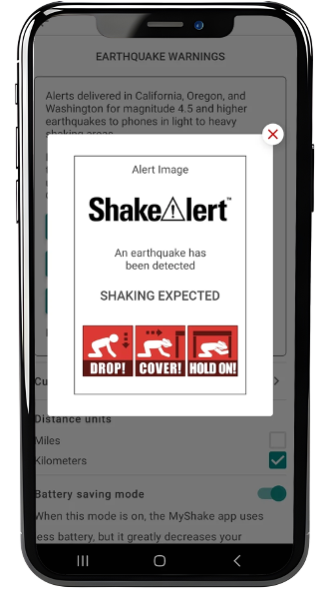



What Alerts Look and Sound Like
ShakeAlert.org
Alerts may appear differently depending on your phone or app.
Most include vibration, sound, and on-screen message such as:
“Earthquake detected! Drop, Cover, and Hold On.”
Don’t wait for the message to finish — take action immediately.
Notes:
This slide helps participants understand what it’s actually like to receive a ShakeAlert-powered alert. You’re not talking about how the alerts are delivered—that was covered earlier—but what people see, hear, and feel in the moment an alert appears. Explain that alerts may look slightly different depending on the system, but they all share the same key elements: a distinct sound, a vibration pattern, and a short, urgent message such as “Earthquake detected! Drop, Cover, and Hold On.” The goal is for the alert to immediately grab attention and prompt action.
Describe the sound: the sound is sharp and unmistakable—louder than a typical notification—and many phones will also flash a message on-screen or vibrate continuously until it’s dismissed. Some apps, such as MyShake, may also display a countdown or an estimated shaking intensity, depending on how close the user is to the source.
You can mention that, from the user’s perspective, alerts often feel abrupt—especially if they come while the person is doing something routine, like working or commuting. People may be startled, confused, or uncertain for a second or two, and that’s normal. ShakeAlert is designed to prompt action, not panic, so this is a good moment to remind participants that training and practice help people respond automatically instead of freezing.
If you want a quick engagement question, ask: “What do you think your first reaction would be if this alert popped up on your phone right now?” A few short answers can help highlight that an alert can feel jarring but also empowering once people know what to do.
Wrap up by emphasizing that no matter what the alert looks or sounds like, the message is always the same: act immediately—Drop, Cover, and Hold On. On the next slide, you’ll show that the same alerts can also trigger automated actions that protect people and infrastructure even faster than we can react.
Note: Alert audio plays in click sequence

Slide 36
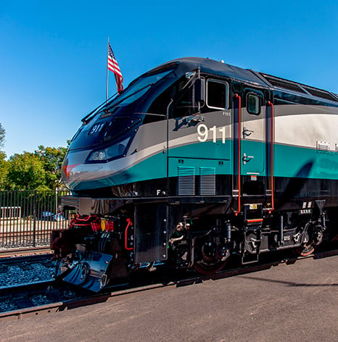
Automated Actions Powered by ShakeAlert
ShakeAlert.org
ShakeAlert can also trigger automatic safety systems to protect people and infrastructure.
Trains slow or stop to prevent derailments.
Firehouse doors open for emergency response.
Gas valves or industrial systems shut off automatically.
These actions help reduce damage and speed up emergency response.
Notes:
This slide focuses on what people might experience when ShakeAlert triggers automatic safety actions around them. Remind participants that ShakeAlert doesn’t just send alerts to phones—it also connects to systems that can act automatically when an earthquake starts. Explain that depending on where they are, people might notice these automated actions before, during, or right after receiving their own alert. For example, trains may slow or stop, public address systems might play an audible warning, or building systems could close valves, open fire doors, or pause elevators. Someone in a school might hear an announcement come over the intercom just before they feel shaking. In an industrial or transportation setting, they might notice equipment shutting down or lights flashing.
Point out the example shown in the slide image: In Southern California, Metrolink uses ShakeAlert-powered technology to automatically slow or stop trains when shaking is expected. This system helps protect passengers and infrastructure by preventing derailments and reducing injuries. (Image courtesy of Metrolink.)
Tell participants that these actions are designed to protect people and critical systems before strong shaking arrives. For most people, the experience is simply that something around them suddenly stops, starts, or makes a loud sound. They don’t need to do anything in response except take their own protective action—Drop, Cover, and Hold On.
You can add that automated systems respond faster than humans can—they act within seconds of detection. The goal is to reduce damage, prevent injuries, and help emergency operations run more smoothly once the shaking ends.
Transition by saying that on the next slide, you’ll look at a few examples of these automated actions in more detail, so participants can picture what’s happening behind the scenes.

Slide 37
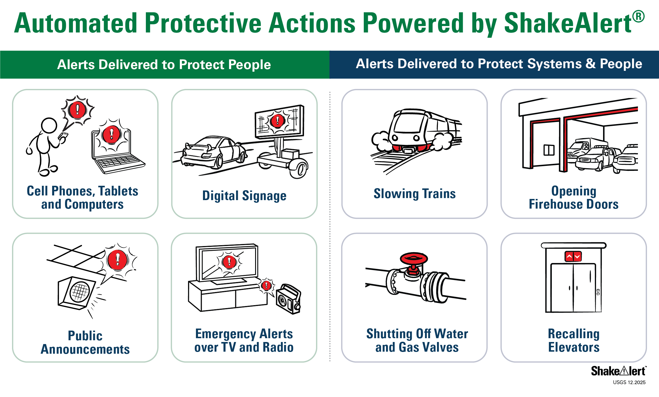
ShakeAlert.org
Notes:
On this slide, you’ll build on the previous discussion by giving a few more examples of what automated actions look like and how they help protect people and critical systems. Keep the focus on what someone might notice or experience during these moments, not the technical details of how it works.
Explain that ShakeAlert data can trigger many types of protective responses. In transportation systems, some California rail networks already use this technology. For example, Metrolink in Southern California and BART—that’s Bay Area Rapid Transit, serving the San Francisco Bay Area—can automatically slow or stop trains when shaking is detected or expected. These systems help protect passengers and infrastructure by preventing derailments.
If you’re teaching in Oregon or Washington, note that there aren’t public rail systems using this automation yet, but similar integrations could happen in the future. ShakeAlert data are already being used in other ways—such as by utilities, emergency operations centers, and universities—to protect facilities and equipment before strong shaking arrives.
You can also mention that other automated actions include fire stations opening bay doors, schools or workplaces using public address systems to announce protective actions, and some utilities shutting off gas valves or protecting sensitive systems. For most people, these actions happen quietly in the background—they may just notice lights dimming, trains slowing, or machines stopping.
Remind participants that all of these measures have the same goal: to use the few seconds of warning ShakeAlert provides to reduce risk and improve safety. And as more organizations adopt the system, people may start noticing ShakeAlert-driven actions in more places.
Wrap up by emphasizing that these automated systems work hand in hand with personal action. While ShakeAlert automation protects people and infrastructure, it’s still up to individuals to Drop, Cover, and Hold On when they get an alert or feel shaking.

Slide 38
Module 5: Applying Protective Actions
Notes:
This is a transition slide. You introduced protective actions briefly in the Essentials section—this module takes that a step further. Here, you’ll help participants think about how and when to act once they receive an alert or feel shaking, and why those actions are so important.
Explain that this section focuses on situational awareness—how to protect yourself wherever you are—and clears up a few common misunderstandings about what’s safe during an earthquake. This is a good moment to remind participants that ShakeAlert gives people a few extra seconds to act, but the key to safety is knowing what to do automatically. The next few slides will show how that looks in different situations.

Slide 39
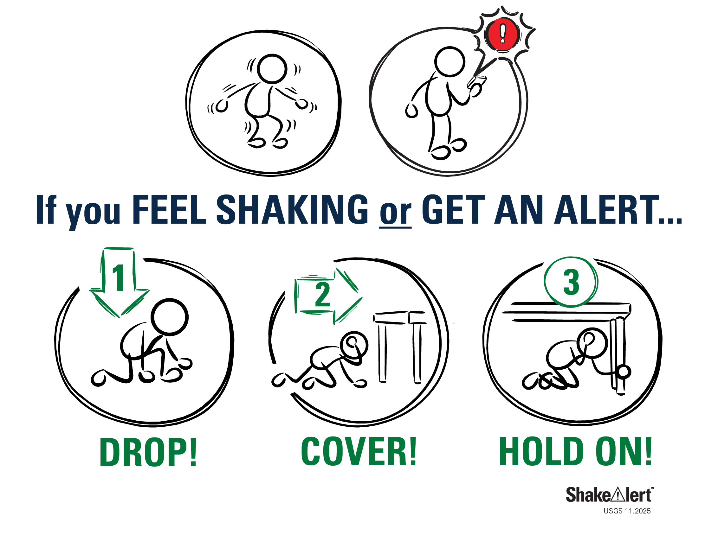
When You First Feel Shaking or Get an Alert
ShakeAlert.org
Act right away — don’t wait to see what happens.
Drop, Cover, Hold On to protect yourself from falling objects.
If you can’t get under sturdy furniture, cover your head and neck where you are.
Practice fighting the urge to run — stay put and protect yourself.
Notes:
This slide builds on what participants already learned in the Essentials section. Remind them that ShakeAlert’s goal is to give people a few seconds of warning so they can take immediate protective action. Whether they get an alert or feel shaking first, the response is the same: Drop, Cover, and Hold On.
Explain that the reason this action is so important is because most injuries in earthquakes come from falling or flying objects, not from collapsing buildings. Getting low, covering your head and neck, and holding on to something sturdy helps protect you from that debris. The few seconds of warning ShakeAlert provides can make the difference between being upright and vulnerable versus already protected when the stronger shaking begins.
You can also mention that protective actions should be automatic—there’s no time to think through options during an earthquake. Practicing this in drills and visualizing what you’d do in different settings helps people respond instinctively.
Connect this back to what participants learned earlier about P-waves and S-waves. The alert is triggered by the faster-moving P-waves, which give a few seconds of notice before the stronger S-waves arrive. The challenge is that you don’t know how large the earthquake will become when the alert appears—so it’s safest to act right away. Those few seconds are your window between the early, lighter shaking and the more damaging waves that follow.
If participants ask whether they should wait to see if the shaking gets worse, be clear: Don’t wait—act immediately. ShakeAlert exists to help people take action before they can even feel the stronger shaking.
Wrap up by emphasizing that practicing this response—both mentally and in drills—helps people react automatically. The next slide looks at how protective actions can vary depending on where you are when shaking starts.

Slide 40
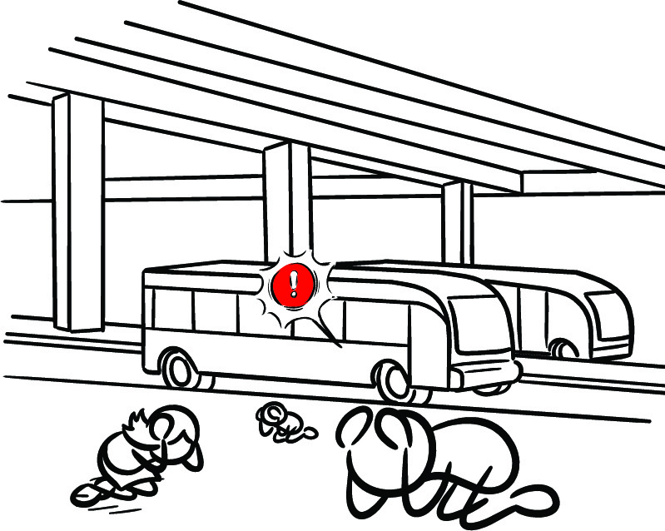
Situational Awareness: Different Environments
ShakeAlert.org
Indoors (home, work, or school): Stay away from windows, glass, and heavy furniture.
In a store or public place: Drop next to a sturdy display or interior wall and protect your head and neck — stay clear of shelves and items that can fall.
Outdoors: Move to an open area — avoid power lines and buildings.
In a vehicle: Pull over safely, set the parking brake, and stay inside.
Near the coast: Strong or long shaking = natural tsunami warning → go to higher ground after shaking stops.
Notes:
This slide helps participants think about how protective actions look in different places. In the Essentials section, you covered the basics—Drop, Cover, and Hold On—but now you’ll guide them through how to apply that in real-world settings where conditions vary.
Start with indoors, such as at home, work, or school. Emphasize staying away from windows, glass, and anything heavy that could fall, like bookshelves or ceiling fixtures. The safest option is to get under a sturdy table or desk and hold on until the shaking stops. If you’re in a store or public place, explain that people may not have sturdy furniture nearby. In that case, drop next to a low display or interior wall and cover your head and neck with your arms. Avoid tall shelving or anything that could topple or send items flying. You can point out that this might feel awkward in public, but the goal is always to protect yourself quickly and safely.
Outdoors, the key is to move to an open area away from buildings, power lines, or trees that could fall. Once in a safe spot, drop to the ground to avoid being knocked over. In a vehicle, tell participants to pull over and stop in a clear area—away from overpasses, power lines, or large signs—and set the parking brake. Stay inside the vehicle until the shaking stops. Explain that the car will shake, but it’s still one of the safer places to be during an earthquake. If you’re near the coast, remind participants that strong or long-lasting shaking is a natural tsunami warning. Once the shaking stops, they should move quickly to higher ground or inland without waiting for an official alert.
Throughout this discussion, remind instructors to keep the focus on thinking ahead rather than memorizing locations. Encourage participants to look around and ask themselves, “What would I do right now if I got an alert?” Practicing that mental awareness builds confidence and helps people act faster during a real event.
Transition by saying that in the next slide, you’ll clear up a few common myths about earthquake safety—ideas many people still believe but that research has proven unsafe.

Slide 41

ShakeAlert.org
Mythbusting: What Not to Do
Doorways aren’t the safest place — modern frames won’t protect you.
“The Triangle of Life” method is not recommended.
Drop, Cover, and Hold On is the tested and proven protective action.
Notes:
This slide helps you address some of the common earthquake safety myths that still circulate in communities. Acknowledge that this guidance has changed over time as scientists and safety experts have learned more about how people get injured during earthquakes. CERT volunteers may encounter these myths when talking with neighbors, so it’s important to know how to explain what’s true and why.
Start with the doorway myth. For many years, people were taught to stand in a doorway because older houses had strong, wood-framed doorways that sometimes survived when walls collapsed. Today’s buildings are constructed differently. Doorways aren’t stronger than other parts of the building, and they often have doors that can swing and hit you. The safer option is to Drop, Cover, and Hold On under sturdy furniture or near an interior wall away from windows.
Next, address the so-called “triangle of life.” This idea came from outdated theories based on building collapses in other countries, but it doesn’t apply to most modern construction in the U.S. Here, buildings are designed to flex rather than completely collapse. Trying to crawl next to furniture or lie beside heavy objects can actually put people in harm’s way. It’s much safer to get low and protect yourself where you are instead of trying to move around during shaking.
You can note that guidance has evolved because we now have decades of data and field research showing which actions reduce injuries. The “Drop, Cover, and Hold On” method has been repeatedly tested in drills, real earthquakes, and building safety studies, and it remains the most effective, simple action for most situations.
Encourage instructors to keep the tone positive when correcting myths. Instead of saying, “That’s wrong,” try framing it as, “That used to be recommended, but here’s what we know now.” This approach helps people update their knowledge without feeling embarrassed or defensive.
Wrap up by emphasizing that earthquake preparedness is like any other safety skill—it improves as we learn more. The next slide will let participants practice thinking through what protective actions look like in different places.

Slide 42
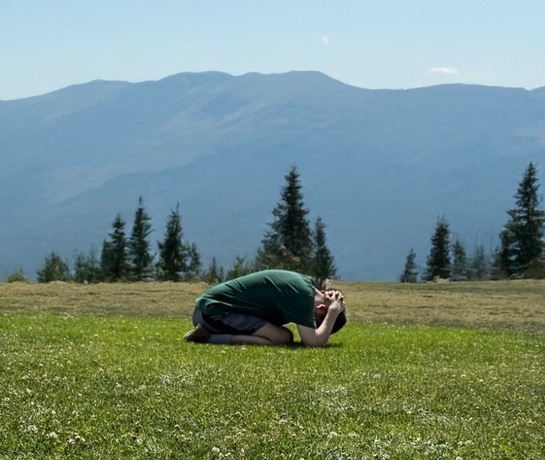
Protective Actions Everywhere
ShakeAlert.org
Quick Scenario: What would you do if you got an alert?
Think about a location you’ve been in sometime over the past week (home, car, work, outside).
What protective action would you take?
Share with a partner or the group.
Notes:
This quick activity helps participants apply what they’ve learned by thinking about real places where they might experience an earthquake. Tell the group this is a short reflection—no need to stand or move around—just a chance to imagine what they would do in a familiar setting.
Say something like: “Think about a place you’ve been in the past week—maybe at home, work, a store, or somewhere outdoors. If you got a ShakeAlert there or suddenly felt shaking, what would you do to protect yourself?” Give participants a minute to think, then invite a few volunteers to share their answers. Encourage a mix of examples so you can talk through different types of environments. Highlight situational awareness—the idea that protective actions may look different depending on where you are, but the principle is always the same: protect your head and neck and stay put until the shaking stops.
If someone suggests an unsafe action, such as running outside, use it as a teachable moment. You might say, “That’s a common instinct, but most injuries happen from falling or being hit by objects. It’s safer to drop where you are and cover your head and neck.” You can also connect the discussion back to ShakeAlert’s purpose. Those few seconds of warning give people a head start—but only if they already know what to do. Activities like this help people think ahead and build confidence so that when an alert happens, their response is automatic.
Wrap up the slide by thanking participants for sharing and reinforcing that situational awareness is one of the most powerful tools CERT volunteers can model and teach. Then transition to the next module, where you’ll talk about how CERT members can share this information in their communities.

Slide 43
Module 6: The CERT Role in Outreach and Education
Notes:
This is a transition slide. Now that participants understand how ShakeAlert works and how to take protective action, this final module focuses on the CERT role—how what they’ve learned fits into community preparedness.
Let participants know this section is about applying their CERT training to help others become ShakeAlert Ready. Some programs have active members who help with community events, while others focus mainly on training individuals who take that knowledge back to their families and neighborhoods. Either way, there’s always a place for CERT-trained people to share clear, accurate information about ShakeAlert.

Slide 44
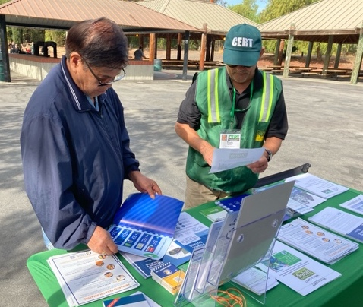
CERT Volunteers as Trusted Messengers
ShakeAlert.org
CERT volunteers help neighbors turn alerts into action.
People trust CERTs during and after emergencies.
Use trusted sources (.gov, .edu, official CERT channels).
Verify before sharing — stop rumors before they spread.
Model good digital preparedness and readiness.
Notes:
This slide highlights why CERT volunteers are such valuable partners in helping communities understand ShakeAlert. You can start by reminding participants that CERT members are already recognized as trusted messengers—neighbors helping neighbors. People are more likely to listen and act on information from someone they know personally or see as part of their community. Reinforce that CERT volunteers don’t need to be scientists or earthquake experts to talk about ShakeAlert. Their role is to help people understand the basics and feel confident about what to do. The key message is simple: When you get an alert or feel shaking, act immediately—Drop, Cover, and Hold On.
You can also mention that after earthquakes, information spreads quickly, and not all of it is accurate. CERT volunteers can play an important role by sharing verified information from official sources such as USGS, FEMA, state emergency management agencies, and local CERT leadership. Keeping messages clear, consistent, and trustworthy helps reduce confusion and prevent rumors.
Make this part conversational. Ask, “Why do you think people trust CERT volunteers as messengers?” Participants will usually say it’s because CERTs are part of the community, not outsiders, and because they lead by example. Reinforce those points—it’s not about having all the answers, it’s about being a calm, credible presence before and after an earthquake.
Wrap up by reminding participants that this trusted role is one of CERT’s strengths. In the next slide, you’ll show how to share ShakeAlert information effectively—keeping it simple, visual, and action-focused.

Slide 45

Let’s Talk ShakeAlert
ShakeAlert.org
Start simple and show how it works.
Begin with: “Did you know you can get an alert before you feel shaking?”
Demonstrate how to check phone settings or download MyShake.
Tie ShakeAlert to existing CERT topics — drills, communications plans, preparedness booths.
Keep messages short, accurate, and action-oriented.
Notes:
On this slide, you’ll share practical ways to talk about ShakeAlert with others. Not every CERT program approaches outreach the same way—some have members who support community events or preparedness fairs, while others focus mainly on training individuals who take this knowledge back to their families and neighborhoods. Whatever the setup, your participants can help others understand ShakeAlert by keeping messages simple, accurate, and confident.
Keep the focus on clear, short messages that people can remember. You can demonstrate how to start a conversation with something like, “Did you know you can get an alert before you feel shaking?” That simple question opens the door to a quick explanation or demonstration of how ShakeAlert works or how to check phone settings.
Remind participants that they don’t need to explain the technology behind ShakeAlert. What matters is that people know what to do when they get an alert: Drop, Cover, and Hold On. Encourage them to connect ShakeAlert to familiar activities—CERT drills, earthquake preparedness month, or community safety events. Sharing it as part of something they already do helps make it feel normal and easy to remember.
Point out that using trusted sources is essential when talking about ShakeAlert, especially after an earthquake when rumors can spread quickly. Encourage participants to rely on official sites like ShakeAlert.org, USGS.gov, and their state or local emergency management agencies.
Wrap up by reminding participants that their confidence and tone matter as much as the information they share. A calm, friendly explanation from a CERT volunteer can make the difference between someone ignoring an alert and someone acting on it. The next slide gives them a chance to practice that in a short think-pair-share activity.
Reminder: When describing alerts to others, use “ShakeAlert-powered alerts” to stay consistent with USGS messaging.

Slide 46
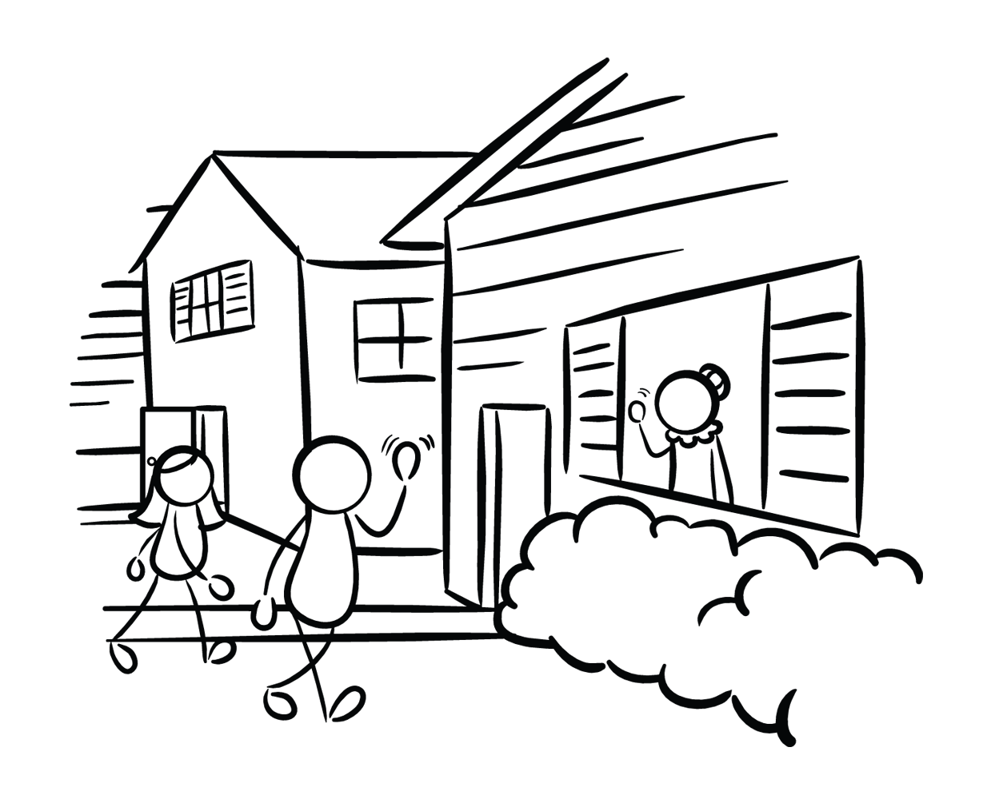
Practicing Outreach (Activity)
ShakeAlert.org
Think → Pair → Share
Think: Imagine a neighbor asks about ShakeAlert. What would you say?
Pair: Share your answer with a partner (1 minute each).
Share: Discuss what worked well — clear, simple, trusted messages.
Notes:
This final activity gives participants a chance to practice how they might talk about ShakeAlert in their own communities. Explain that the goal isn’t to memorize a script, but to feel confident describing ShakeAlert in simple, relatable terms.
Say something like: “Imagine a neighbor or coworker asks you, ‘What’s ShakeAlert?’ How would you explain it?” Give everyone about a minute to think about their answer. Encourage them to focus on keeping it short, clear, and action-oriented—something that feels natural in a real conversation.
Then, have participants pair up and share their answers—about one minute each. Ask them to notice what made explanations easy to understand or engaging. After both partners have shared, bring the group back together and invite a few volunteers to summarize what worked well. Highlight that effective messages are clear, calm, and confident—and come from a trusted voice. Remind participants that every CERT member can help others get ShakeAlert Ready, whether it’s at a community event, during a presentation, or just in an everyday conversation.
If time allows, ask: “What did you hear from your partner that you might borrow for your own message?” This helps participants build on each other’s language and reinforces the idea that everyone can make ShakeAlert outreach personal and approachable.
Wrap up by thanking them for sharing and connecting this activity to the CERT mission: when volunteers communicate preparedness clearly, they help their communities stay safer and more confident before, during, and after emergencies.

Slide 47
Wrap-Up
Notes:
Before moving into the final phone settings activity, take a minute to bring everything together. You can give a short recap of each module—just a sentence or two—to reinforce the main takeaways and show how they connect.
Module 1 – ShakeAlert Ready CERT Essentials: We started with the core messages—the basics of how ShakeAlert works, what to do when you get an alert or feel shaking, and how early warning fits into overall preparedness.
Module 2 – The Science Behind ShakeAlert: We looked at how earthquakes generate P-waves and S-waves, and how ShakeAlert uses those first, faster waves to estimate magnitude and intensity.
Module 3 – Inside the ShakeAlert System: We explored how sensors, processing centers, and alert delivery partners all work together to detect earthquakes and send alerts in seconds.
Module 4 – Experiencing ShakeAlert: We talked about what it’s like to receive an alert—the sounds, visuals, and automatic actions that might happen around people when the system activates.
Module 5 – Applying Protective Actions: We practiced how to adapt Drop, Cover, and Hold On in different environments and discussed why current guidance has changed from older myths.
Module 6 – CERT Role and Outreach: We focused on how CERT volunteers can share clear, trusted messages to help others understand and act on ShakeAlert.
Close the recap by saying something like:
“You’ve seen how ShakeAlert turns a few seconds of warning into action. Now let’s finish with a quick activity to make sure your phone is ShakeAlert Ready—and that you can show others how to check theirs, too.”

Slide 48
ShakeAlert.org
Learn, Act, Share
1
2
3
Get alerts on your phone — confirm your WEA settings and download the MyShake app
Act immediately when you feel shaking or get an alert
Share what you know — CERT volunteers are trusted messengers
Learn more: usgs.gov/FAQ/BeShakeAlertSafe | ShakeAlert.org
Notes:
Explain that this slide summarizes the key takeaways from the session—what participants can do right now to make sure they and their communities are ShakeAlert® ready. You can say something like, “We’ve talked about how ShakeAlert works and how it fits into preparedness. Now let’s bring it all together with three simple actions: learn, act, and share.”
Start with Learn. Encourage participants to visit ShakeAlert.org and USGS.gov/BeShakeAlertSafe to get accurate, up-to-date information straight from trusted sources. They can explore videos, FAQs, and local information about how ShakeAlert is being used in their state.
Next, Act. Tell participants to check their phone alert settings right away and make sure they’re ShakeAlert-ready. If they haven’t already, suggest downloading the MyShake app as another way to receive alerts. Emphasize that when they receive an alert—or feel shaking—the most important thing to do is act immediately. Don’t wait. Drop, Cover, and Hold On.
Finally, Share. As CERT volunteers, participants are in a perfect position to spread awareness in their communities. Encourage them to talk with friends, family, and neighbors about ShakeAlert® and show others how to check their phone settings or download the app. They don’t have to be experts—just accurate and enthusiastic trusted messengers.
End the slide by reinforcing that these three steps—learn, act, and share—are what turn technology into real preparedness. The more people understand and use ShakeAlert®, the safer communities will be when the next earthquake strikes.

Slide 49

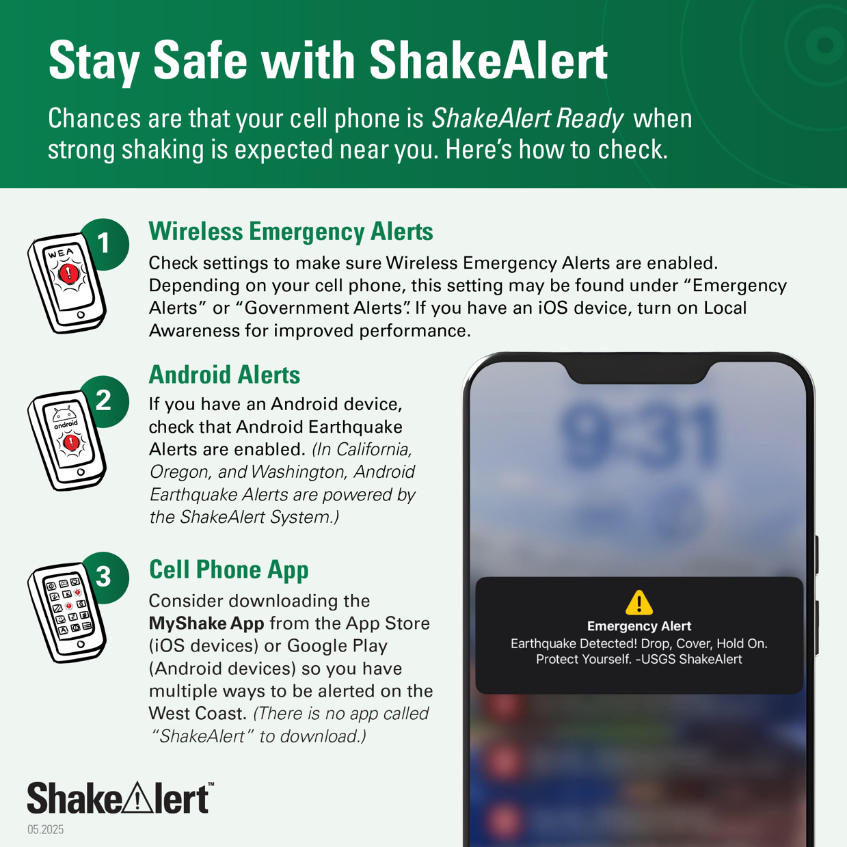
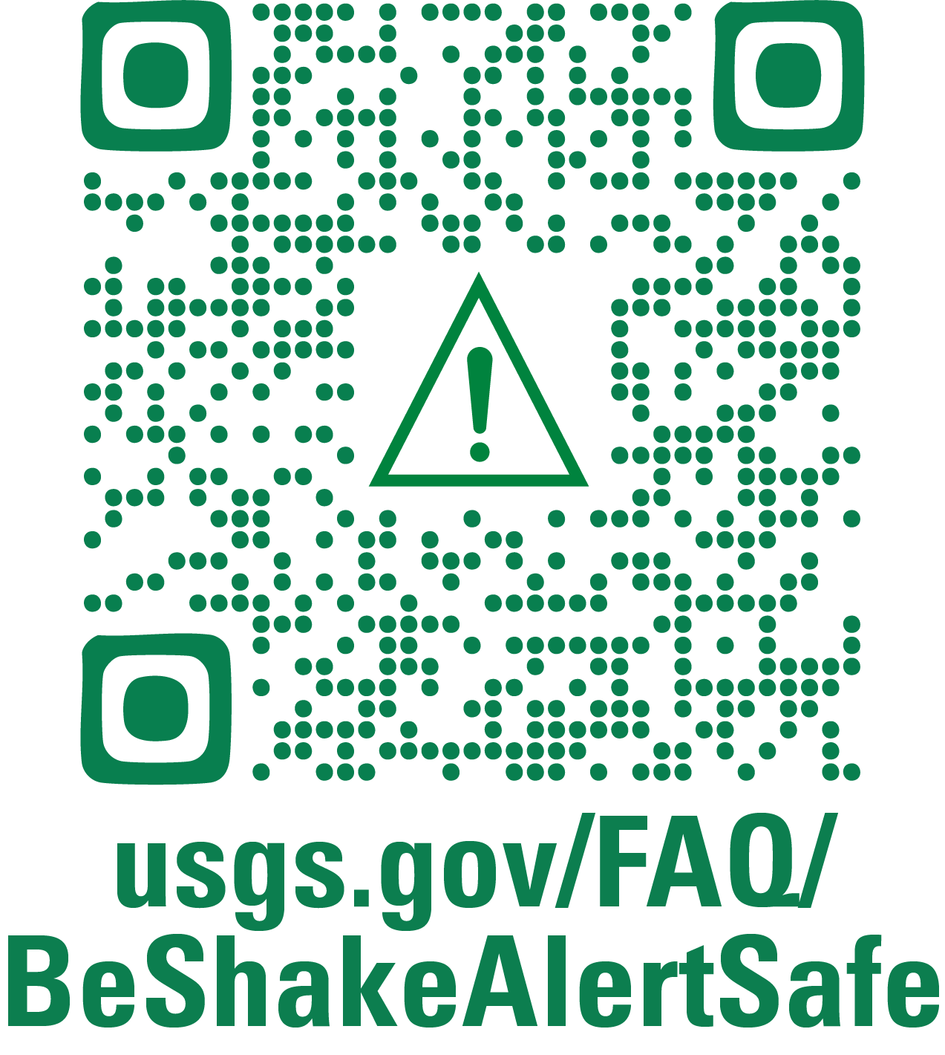
Check Your Settings and Spread the Word!
Notes:
This slide gives participants a chance to take action right away. Encourage everyone to pull out their phones and follow the steps on the screen to make sure they are ShakeAlert Ready. You can say something like, “Let’s take a minute to check our own phones so we can see what this looks like in real life.”
Have participants scan the QR code on the slide or visit usgs.gov/FAQ/BeShakeAlertSafe. The page shows how to confirm that Wireless Emergency Alerts are turned on for both iPhones and Android devices. Remind participants that they can receive alerts through the Wireless Emergency Alerts (WEA) system and Android and iOS phones have EEW built into their operating systems, powered by ShakeAlert.
Make it clear that as the instructor, you’re not asking to handle anyone’s phone or check settings for them. This is a self-check activity, and if participants want help, they can assist each other. Encourage that—helping a neighbor is great practice for how they can help others in their community after the class.
If time allows, revisit the three main ways alerts can reach them—Wireless Emergency Alerts, operating system alerts, and the MyShake app—and encourage everyone to check or download whichever applies to their device. End by saying, “Once your phone is ShakeAlert Ready, show someone else how to do it. That’s how we build awareness—one person at a time.”

Slide 50
Questions?
50
Notes:
Use this slide to wrap up the session and give participants a chance to ask questions or share final thoughts. You can say something like:
“We’ve covered a lot today—how ShakeAlert works, what happens behind the scenes, and how CERT volunteers can help others use and trust the system. What questions do you have?”
If questions come up that you don’t know the answer to, that’s fine. Model how to find reliable information by directing participants to ShakeAlert.org or USGS.gov/BeShakeAlertSafe for accurate, up-to-date details. Remind everyone that early warning is still evolving as the system expands and technology improves.
To close the session, thank participants for their time and engagement, and reinforce the core messages of ShakeAlert Ready CERT:
Learn how ShakeAlert works and make sure your phone is ShakeAlert Ready.
Act right away when you get an alert or feel shaking—Drop, Cover, and Hold On.
Share what you know so more people can use those few seconds of warning to stay safe.
You can end by saying something like: “ShakeAlert gives us time to act—but it’s people like you who turn those few seconds into safety. Thank you for helping your community stay prepared.”

