Slide 1
Presentation Title Page Option 1
Example subtitle or presenter names
[ Insert Partner Logo ]

Slide 2
Title Slide Option 2
[ Insert Partner Logo ]

Slide 3
Divider Slide

Slide 4
Content Slide Example
Bullets

Slide 5
Big Statement Slide
With supporting text

Slide 6
Big Statement Slide
With supporting text

Slide 7
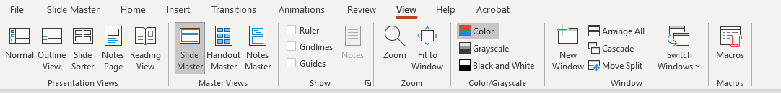
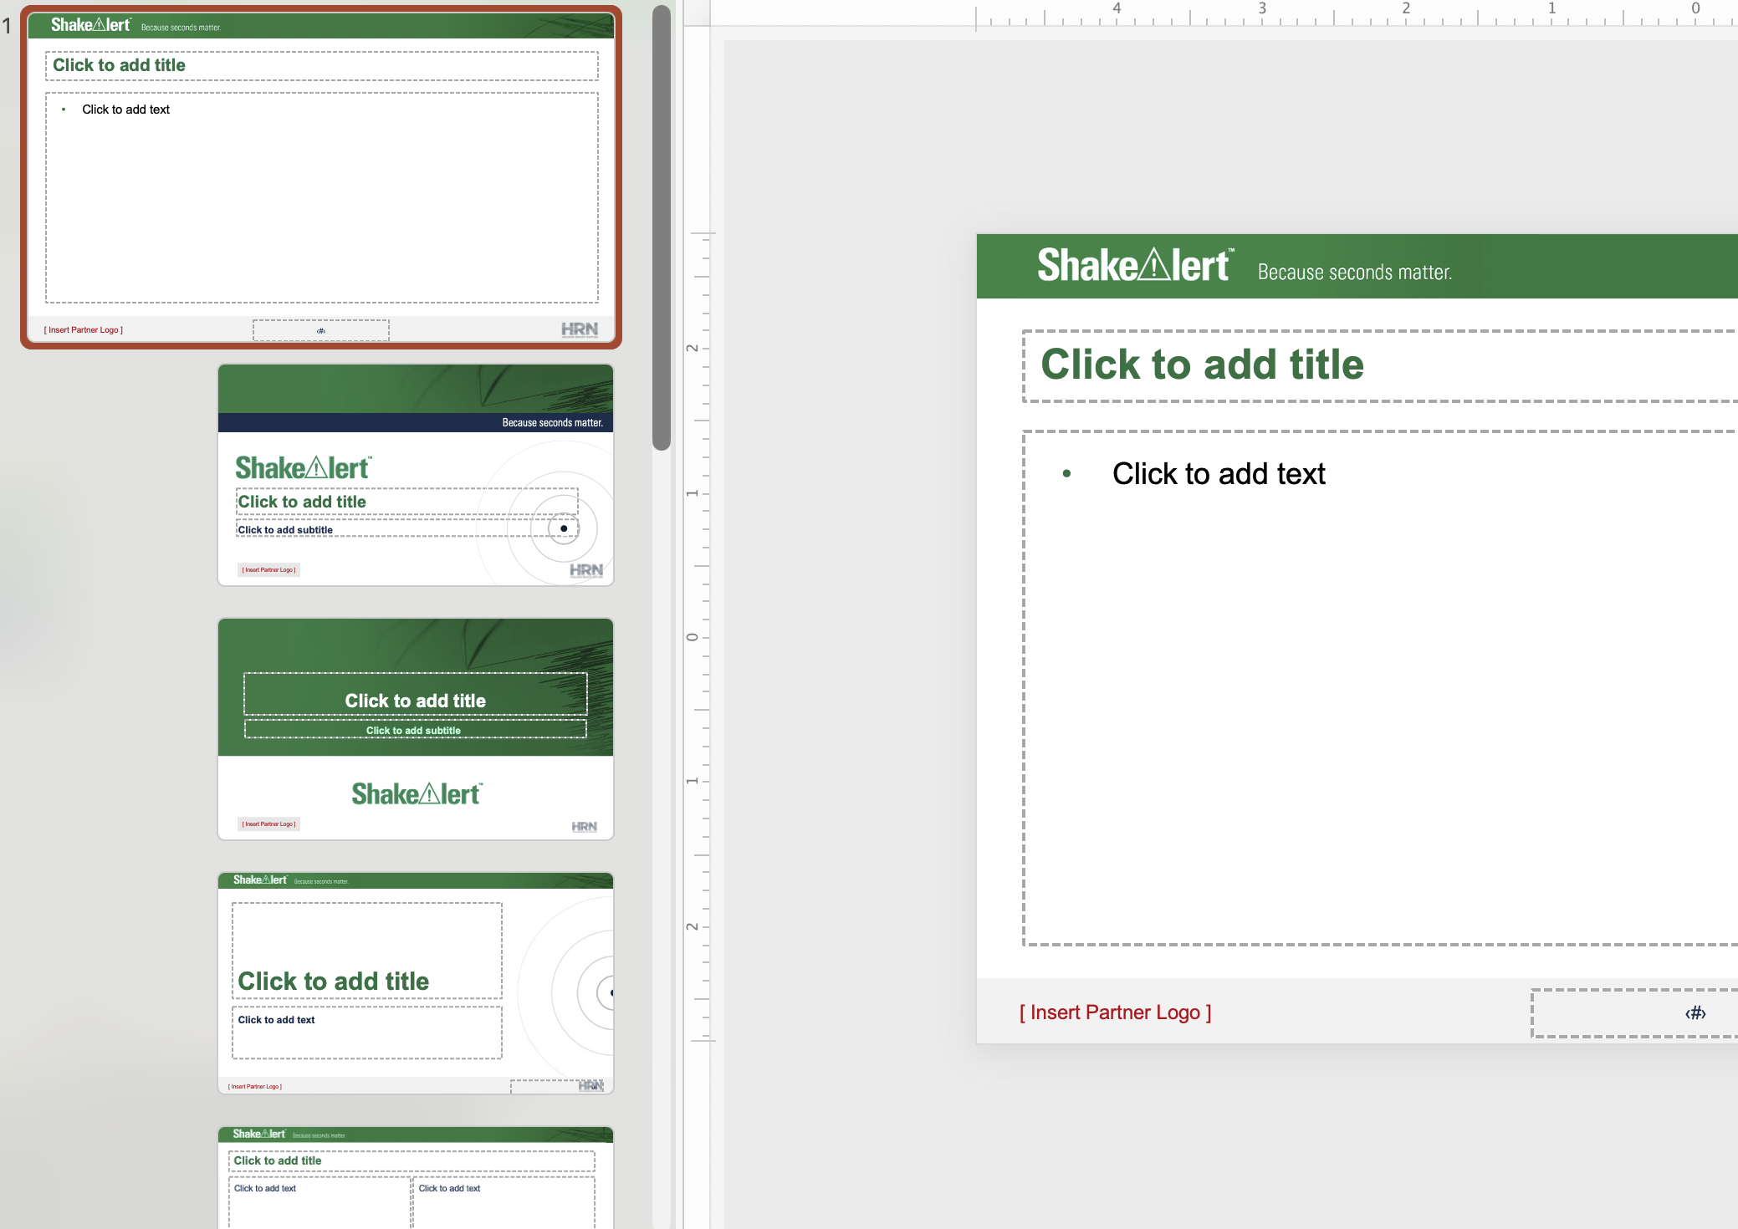
Adding your logo
To add your logo, click on VIEW, then SLIDE MASTER
Replace [INSERT PARTNER LOGO] with your logo on the first theme slide

Slide 8
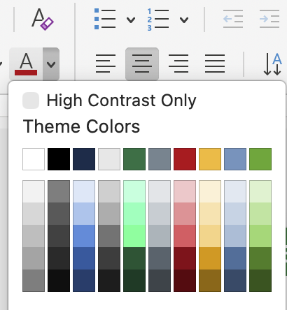
Colors
Green
Blue
Gray
Approved ShakeAlert brand colors and accents colors are built into the template
#006F41
#0E2849
#748591
Font Guidelines
Slide Titles: Arial Bold 21pt
Lighter tints of the three primary colors may be used to add flexibility to the palette.
Slide body copy: Arial minimum 16pt
Notes/Captions: Arial minimum 11pt

Slide 9





Graphic Assets
Key Takeaway Call Out Box
Text
Key Takeaway Call Out Box
Text
Highlighted content with a special check mark
Highlighted content with a special bullet
ShakeAlert System Activation Icon
ShakeAlert Alert Icon

