Slide 1
SHAKEALERT® READY
ShakeAlert Ready CERT Essentials
The Basics Every CERT Volunteer Should Know
August 2026
Version 2026.2
Notes:
Welcome participants to ShakeAlert Ready CERT Essentials. Explain that this short training focuses on the basic information every CERT volunteer should know: what earthquake early warning is, what ShakeAlert is, how alerts may reach them, what to do if they receive an alert or feel shaking, and how to help others become ShakeAlert Ready.

Slide 2
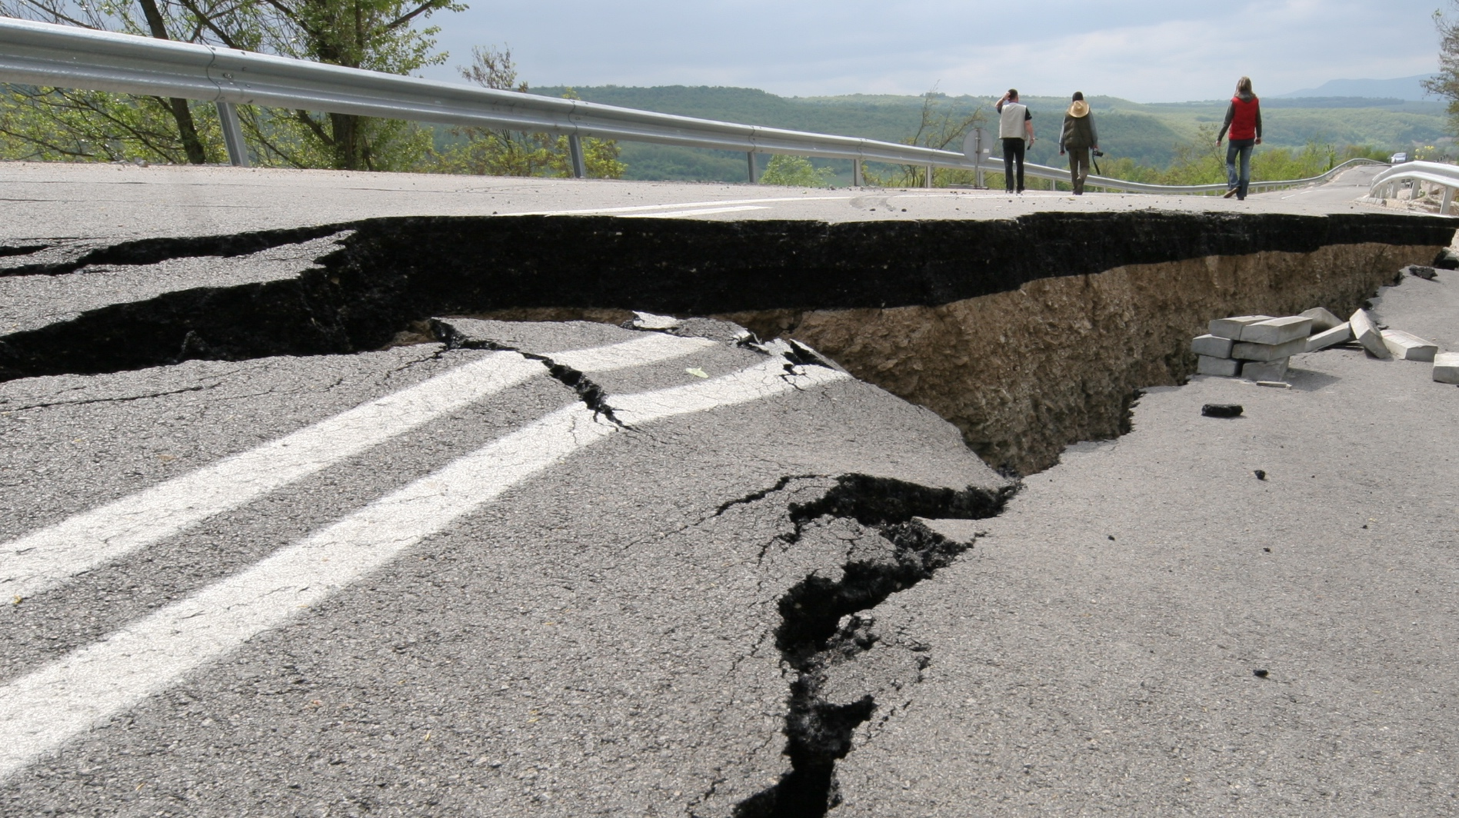
Did you know
you can get an earthquake early warning alert before strong shaking is expected near you?
Notes:
Ask participants to pause on this question: Did you know you may be able to get an earthquake early warning alert before strong shaking reaches your location? Explain that this is possible because ShakeAlert detects an earthquake after it begins and sends information quickly enough that some people and systems may receive warning before strong shaking arrives. Emphasize that the warning may only be seconds, but seconds matter when people know what action to take.

Slide 3
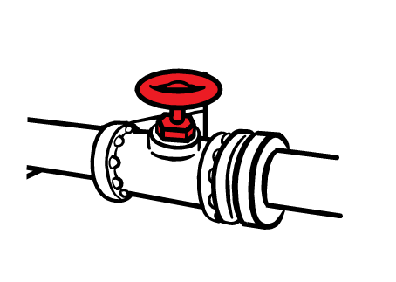
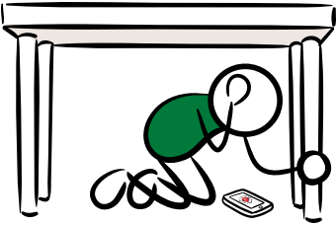
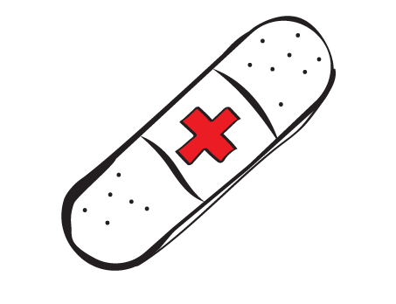
What is Earthquake Early Warning?
Earthquake early warning systems can detect significant earthquakes quickly, so alerts can be delivered before strong shaking arrives.
With public safety as a goal, earthquake early warning systems are designed to:
Trigger automated safety actions for systems we rely on.
Reduce injuries & other impacts from earthquake shaking.
Give people time to take protective action.
Even a few seconds can make a difference.
Notes:
Explain that earthquake early warning systems detect significant earthquakes quickly after they begin, so alerts can be delivered before strong shaking reaches some locations. The goal is public safety: giving people time to take protective action and giving automated systems time to take safety steps. Reinforce that earthquake early warning does not replace preparedness. It adds a layer of safety by giving people a chance to act on the plans and drills they already practice.
Instructor note: “Strong” shaking, or MMI 6 and greater, is widely felt and can cause minor damage. People may be frightened, heavy furniture may move, and plaster or other materials may fall.

Slide 4
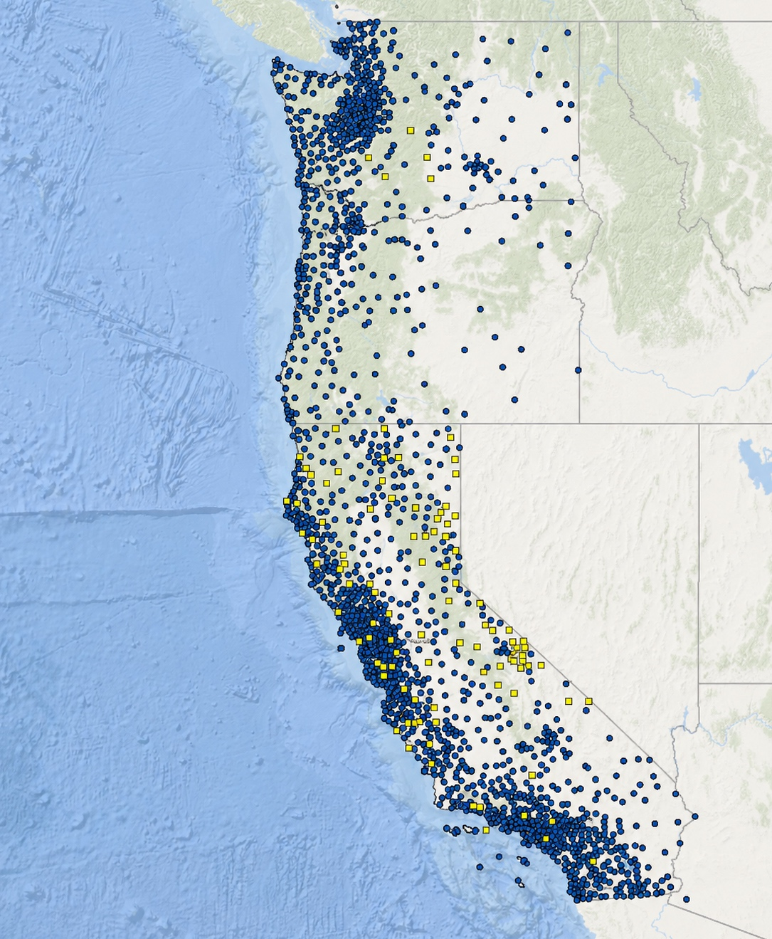
Meet ShakeAlert
The ShakeAlert System is the nation's only public Earthquake Early Warning System.
Today, it serves over 55 million people in the West Coast states of Washington, Oregon, and California.
When possible, it provides advance warning before strong shaking arrives, helping people and automated systems take protective action.
2,000+ Earthquake Sensors
You can—and should—trust ShakeAlert.
Notes:
Introduce ShakeAlert as the nation’s only public Earthquake Early Warning System. Explain that it is managed by the U.S. Geological Survey and serves more than 55 million people in Washington, Oregon, and California. When possible, ShakeAlert provides advance warning before strong shaking arrives, helping people and automated systems take protective action.
Use this slide to build confidence: ShakeAlert is a public safety system built on science, sensors, and partnerships.

Slide 5
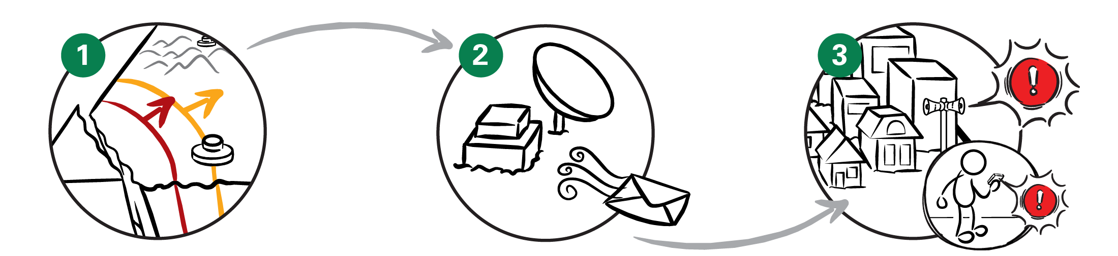
How Does ShakeAlert Work?
DETECT
A network of seismic quickly detects shaking when an earthquake begins.
PROCESS
Computers analyze the first data to estimate where the earthquake started, how big it is, and where strong shaking will occur.
DELIVER
Alerts are sent to apps, phones, and automated systems, giving people seconds to take protective action before strong shaking arrives.
Notes:
Use this as the simple three-step explanation of how ShakeAlert works. First, sensors detect ground motion when an earthquake begins. Second, computers quickly process the first data to estimate where the earthquake started, how large it is, and where strong shaking may occur. Third, alert delivery partners deliver ShakeAlert-powered alerts to people, phones, apps, and automated systems.
Keep the key message simple: digital alerts can travel faster than damaging seismic waves.

Slide 6
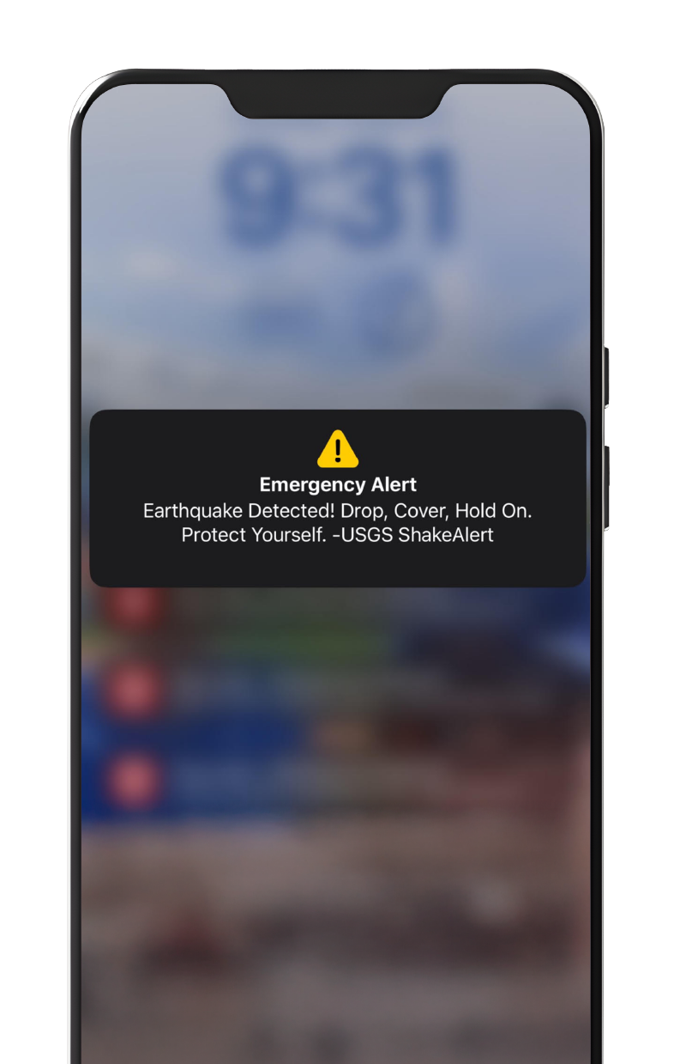
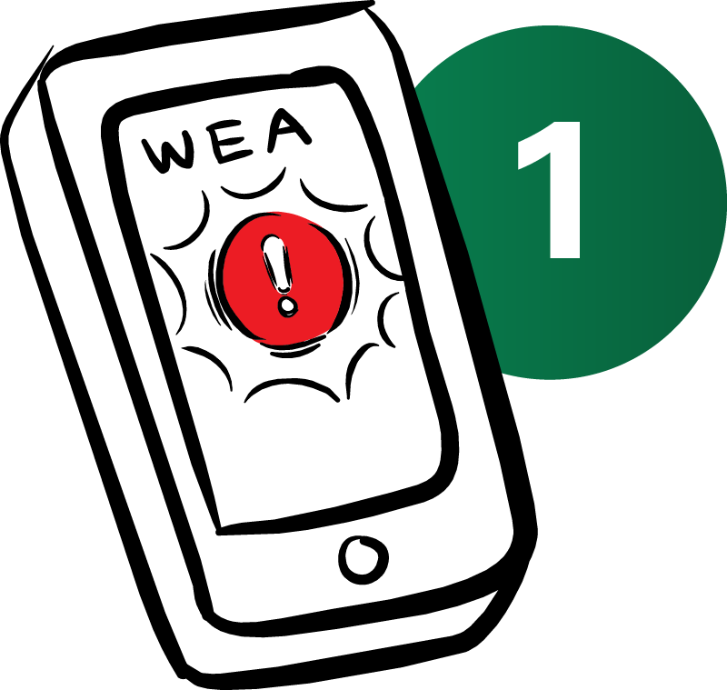
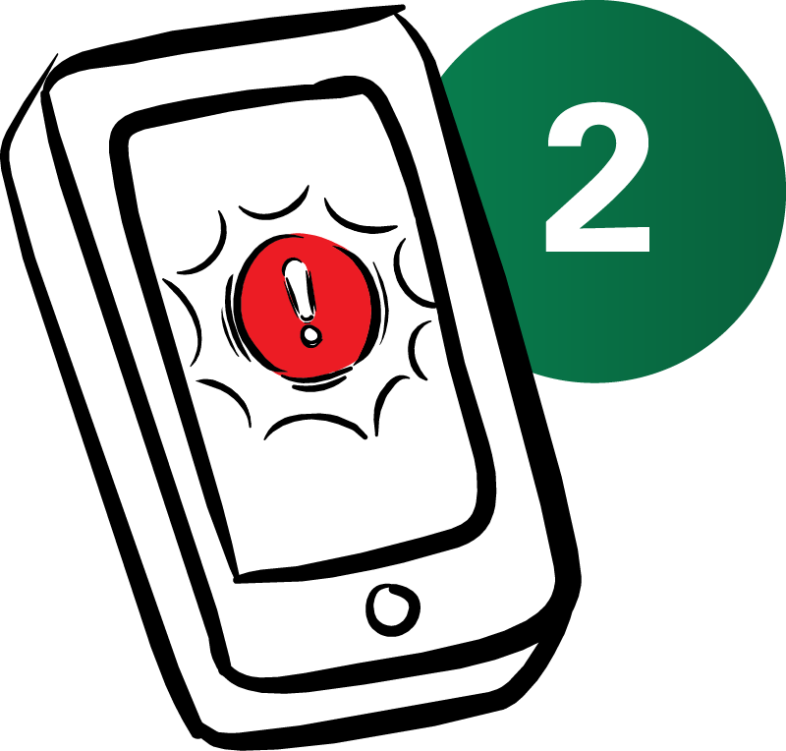
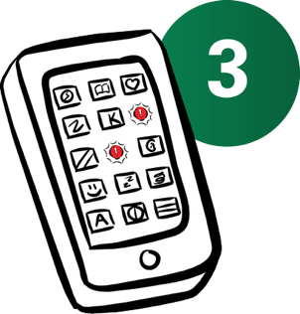
You Probably
Already Have It
Wireless Emergency Alerts from FEMA
Depending on your cell phone, this setting may be found under Emergency Alerts or Government Alerts.
Most newer smartphones can already receive ShakeAlert-powered alerts.
You may receive alerts on your phone through:
Cell Phone
Operating Systems
Android and iOS have built-in earthquake early warning alerting.
For Android: crisisresponse.google/ android-early-earthquake-warnings
For iOS: support.apple.com/en-us/102516
1
Wireless Emergency Alerts (WEA).
Your phone's built-in operating system.
The MyShake app.
2
Apps
Get the MyShake App from the App Store (iOS devices) or Google Play (Android devices).
There is no app called “ShakeAlert” to download.
3
Notes:
Explain that many newer smartphones can already receive ShakeAlert-powered alerts. Alerts may reach people through Wireless Emergency Alerts, built-in phone operating system alerts, or apps such as MyShake. Clarify that there is no app called “ShakeAlert” to download. Encourage participants to think of these as multiple ways to receive alerts, not competing systems.
Encourage participants to learn which alerting methods are available to them and use more than one when possible. Multiple methods can provide an added layer of readiness if one device or delivery method is affected by settings, connectivity, or other technical issues.

Slide 7



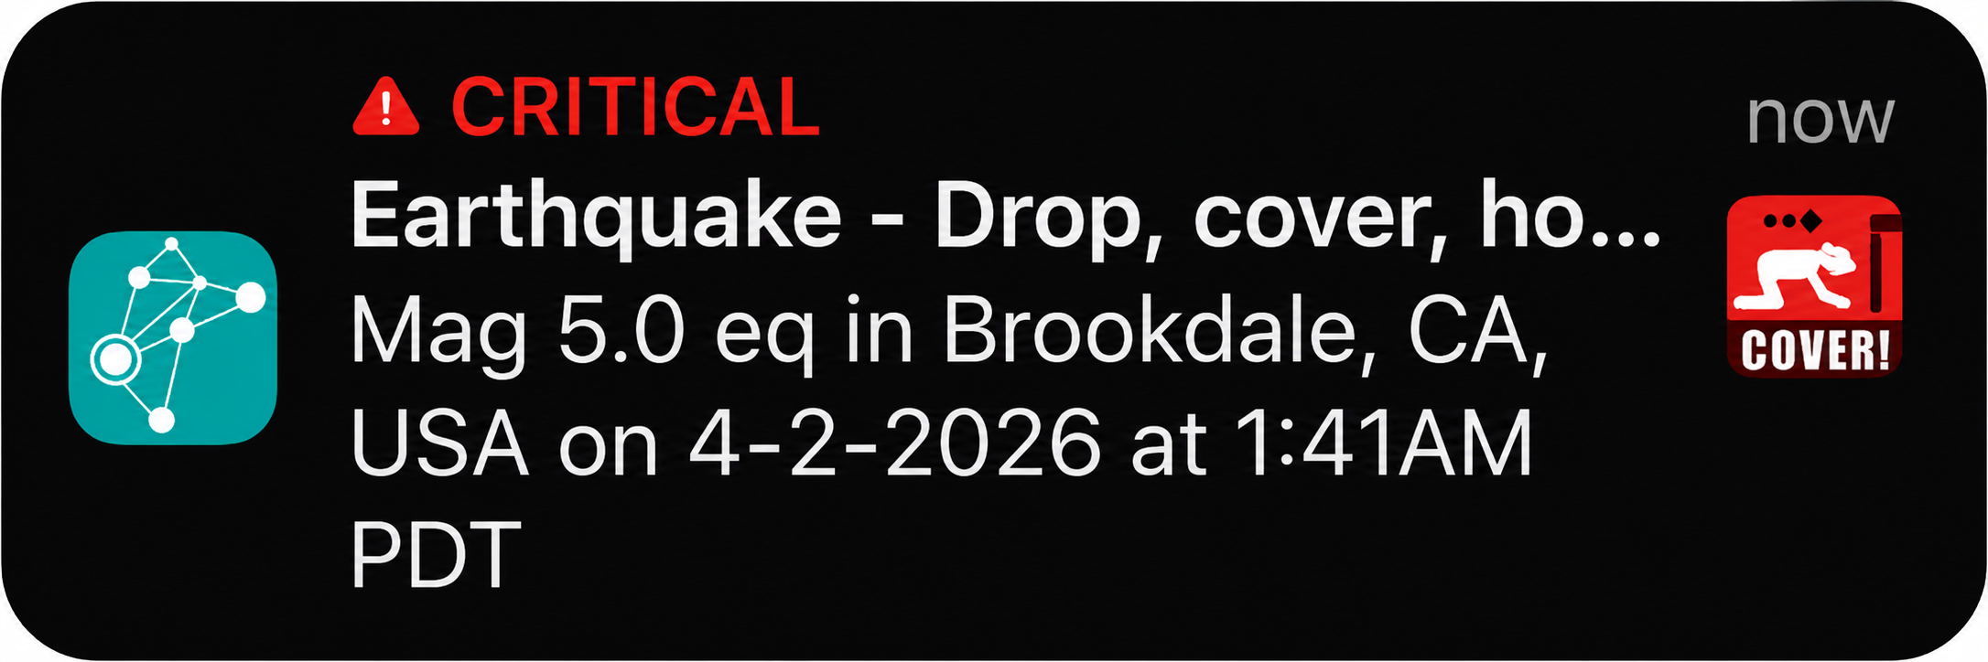
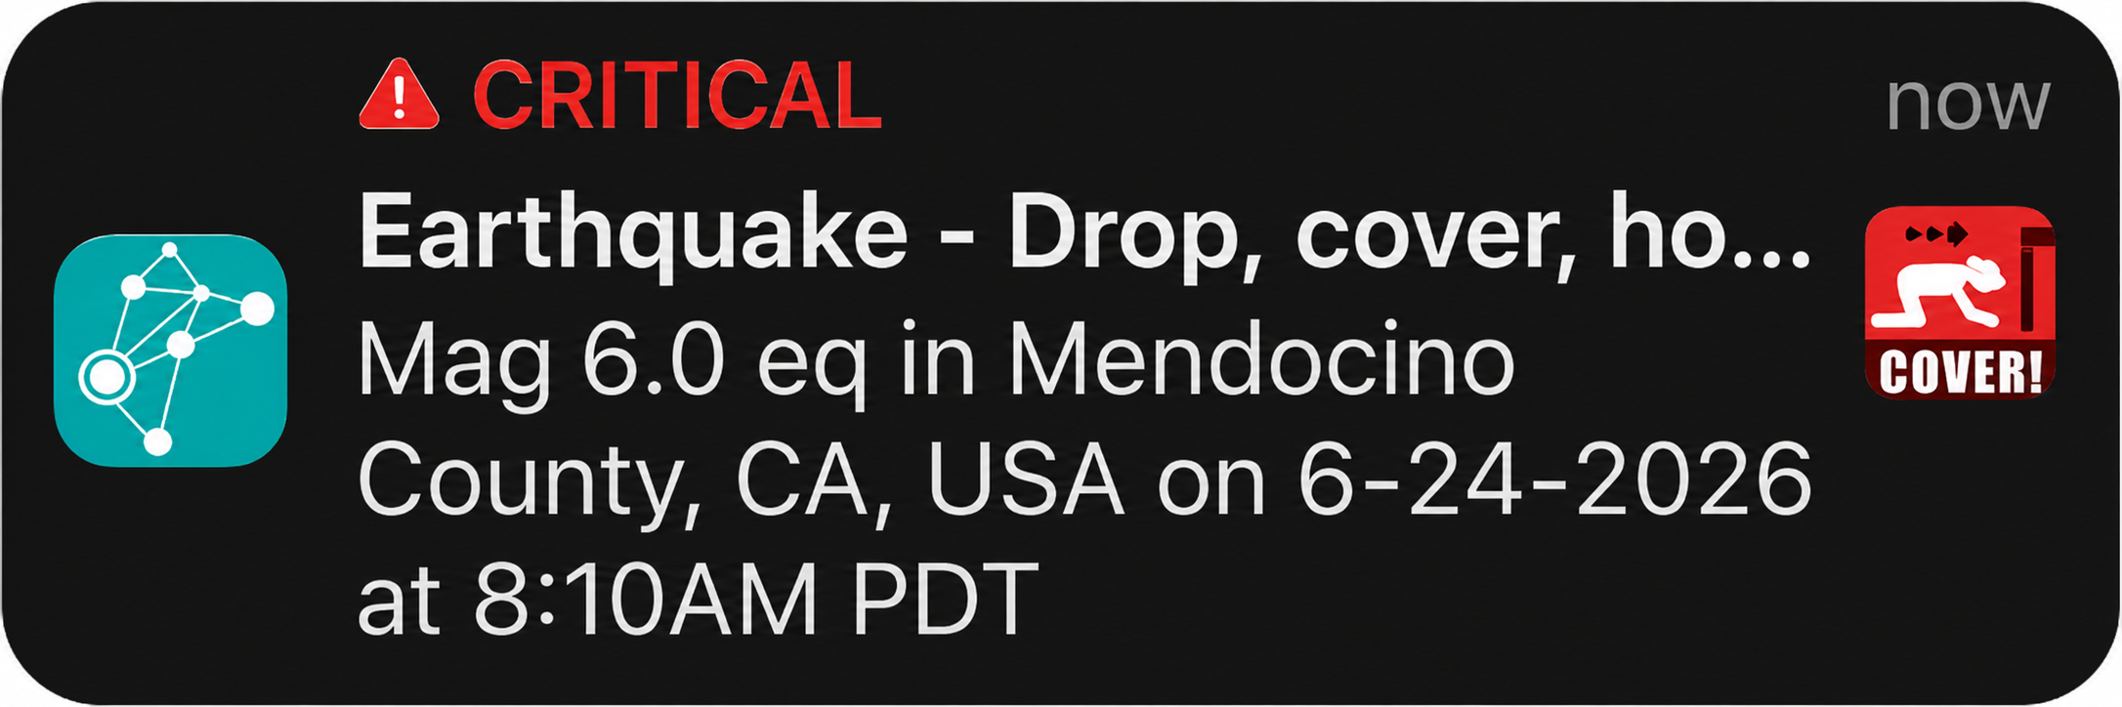
What Alerts Look and Sound Like
ShakeAlert-powered alerts may look or sound different depending on your phone, app, or delivery method.
MOST ALERTS INCLUDE:
Sound
A loud or distinctive alert tone.
Vibration
A noticeable vibration pattern.
Message
A short instruction such as:
“Earthquake detected! Drop, Cover, and Hold On.”
Don’t wait for the message to finish. Take action immediately.
Notes:
Explain that ShakeAlert-powered alerts may look and sound different depending on the phone, app, operating system, or delivery method. They may include a sound, vibration, full-screen message, banner, or other notification. Alerts may feel abrupt or startling, which is why practice is important. Do not wait for the message to finish—the action is the same: if you receive an alert or feel shaking, take protective action immediately.
Instructor note: Play the media file. If the media file is unavailable, briefly explain that alert sounds and displays can vary. The important point is that people should take protective action immediately when they receive an alert or feel shaking.

Slide 8
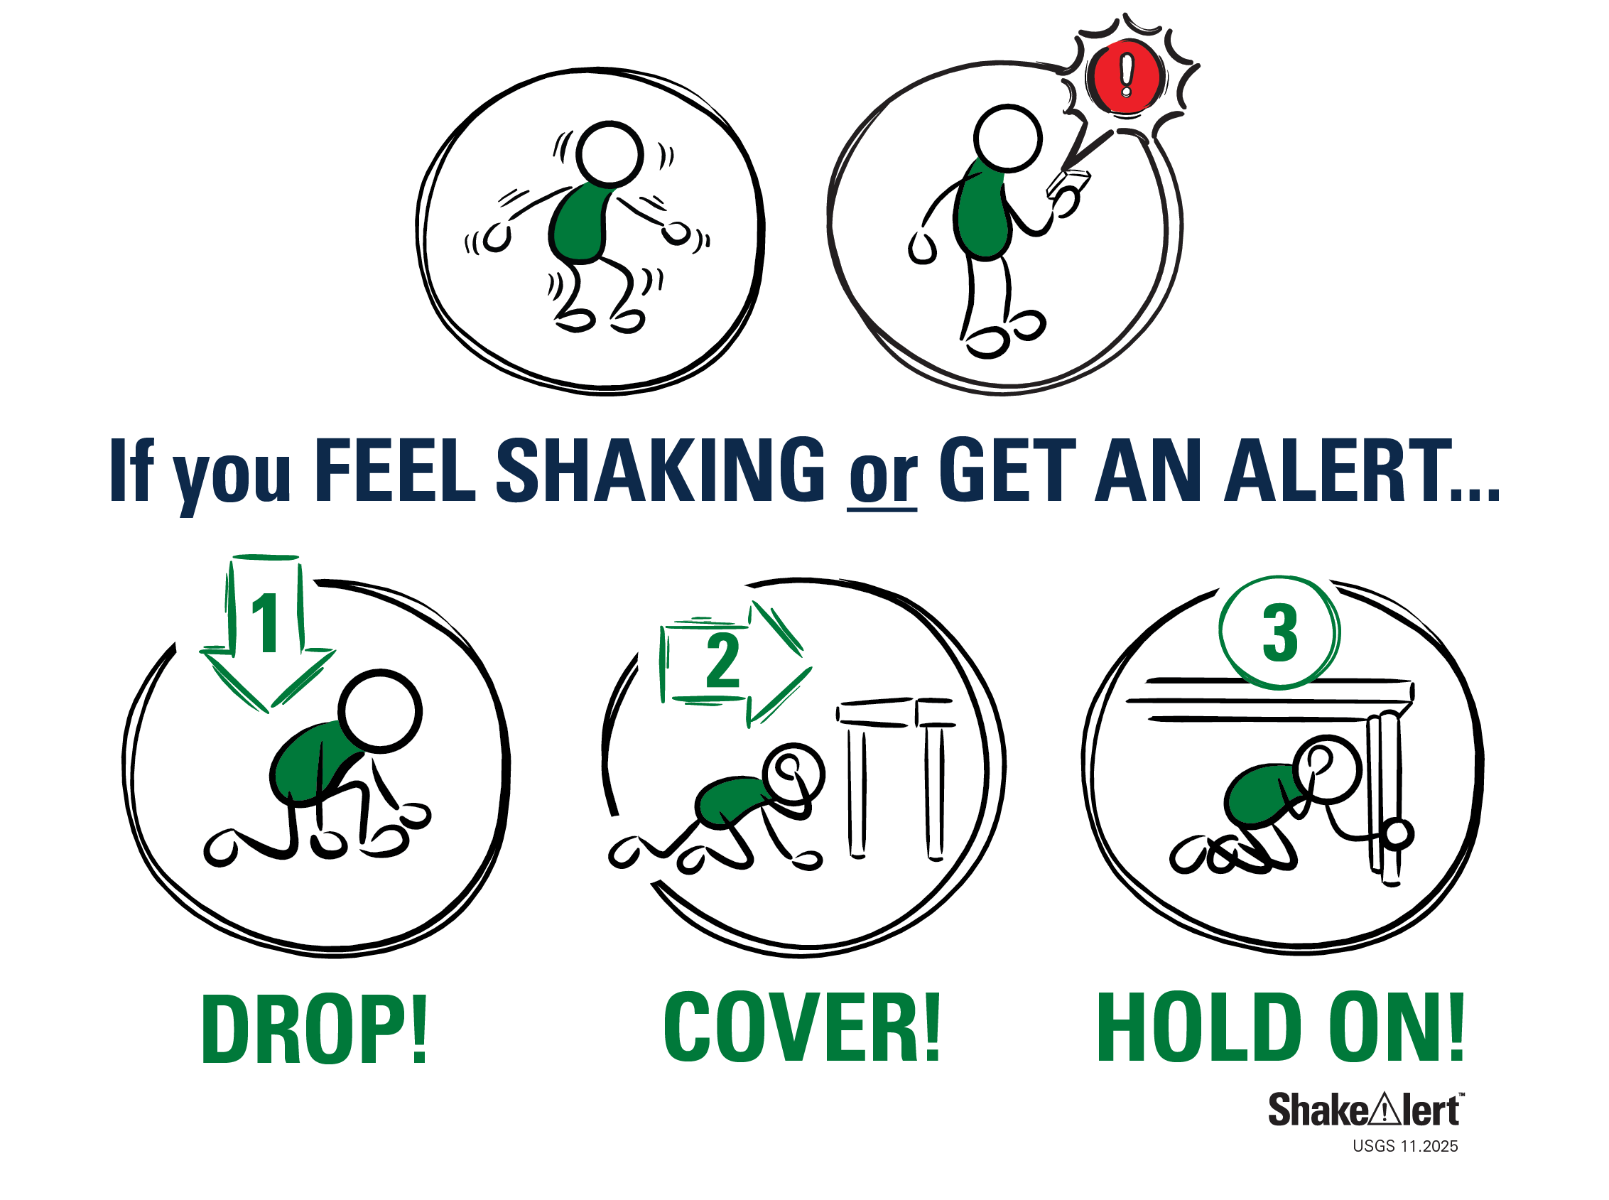
When You Feel Shaking or Get an Alert
If you receive an alert or feel shaking, take protective action immediately.
For most people, that means:
Drop, Cover, and Hold On.
Don't wait to see if the shaking gets stronger.
If you can't get under sturdy furniture, protect your head and neck where you are.
If you are near the coast, additional actions may be needed after shaking stops.
Protective actions may vary depending on your location or abilities.
Notes:
Emphasize the action message: if you receive an alert or feel shaking, take protective action immediately. For most people, that means Drop, Cover, and Hold On. Do not wait to see if shaking gets stronger, and do not stop to confirm the alert. If sturdy furniture is not nearby, protect your head and neck where you are. Note that protective actions may vary by location, ability, and environment. The next slide provides examples of how people can adapt protective actions to different settings.

Slide 9
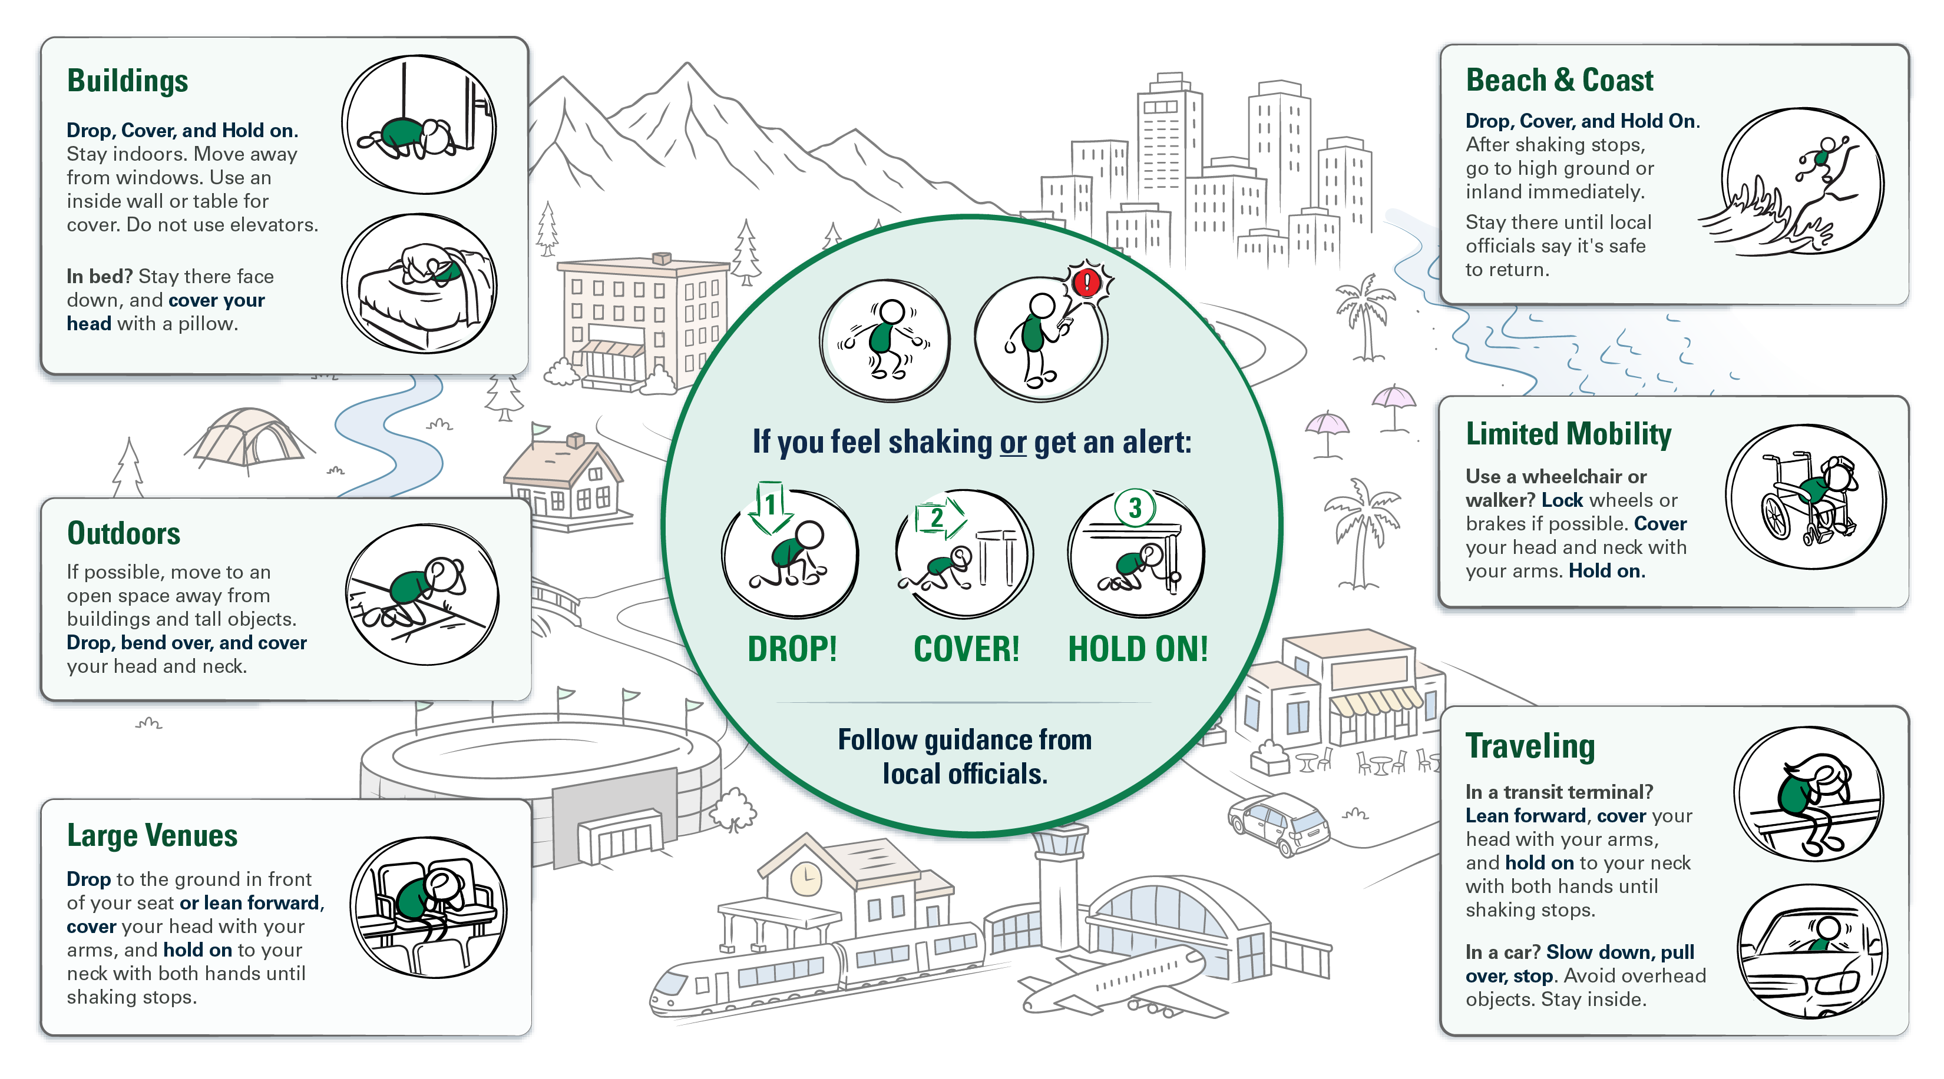
Protective Actions in Different Environments
Notes:
Use this slide to reinforce that the safest action may vary by location, surroundings, and ability. The consistent goal is to protect the head and neck and reduce exposure to falling or flying objects. Encourage participants to think ahead about the places where they spend time and the action they would take there.

Slide 10
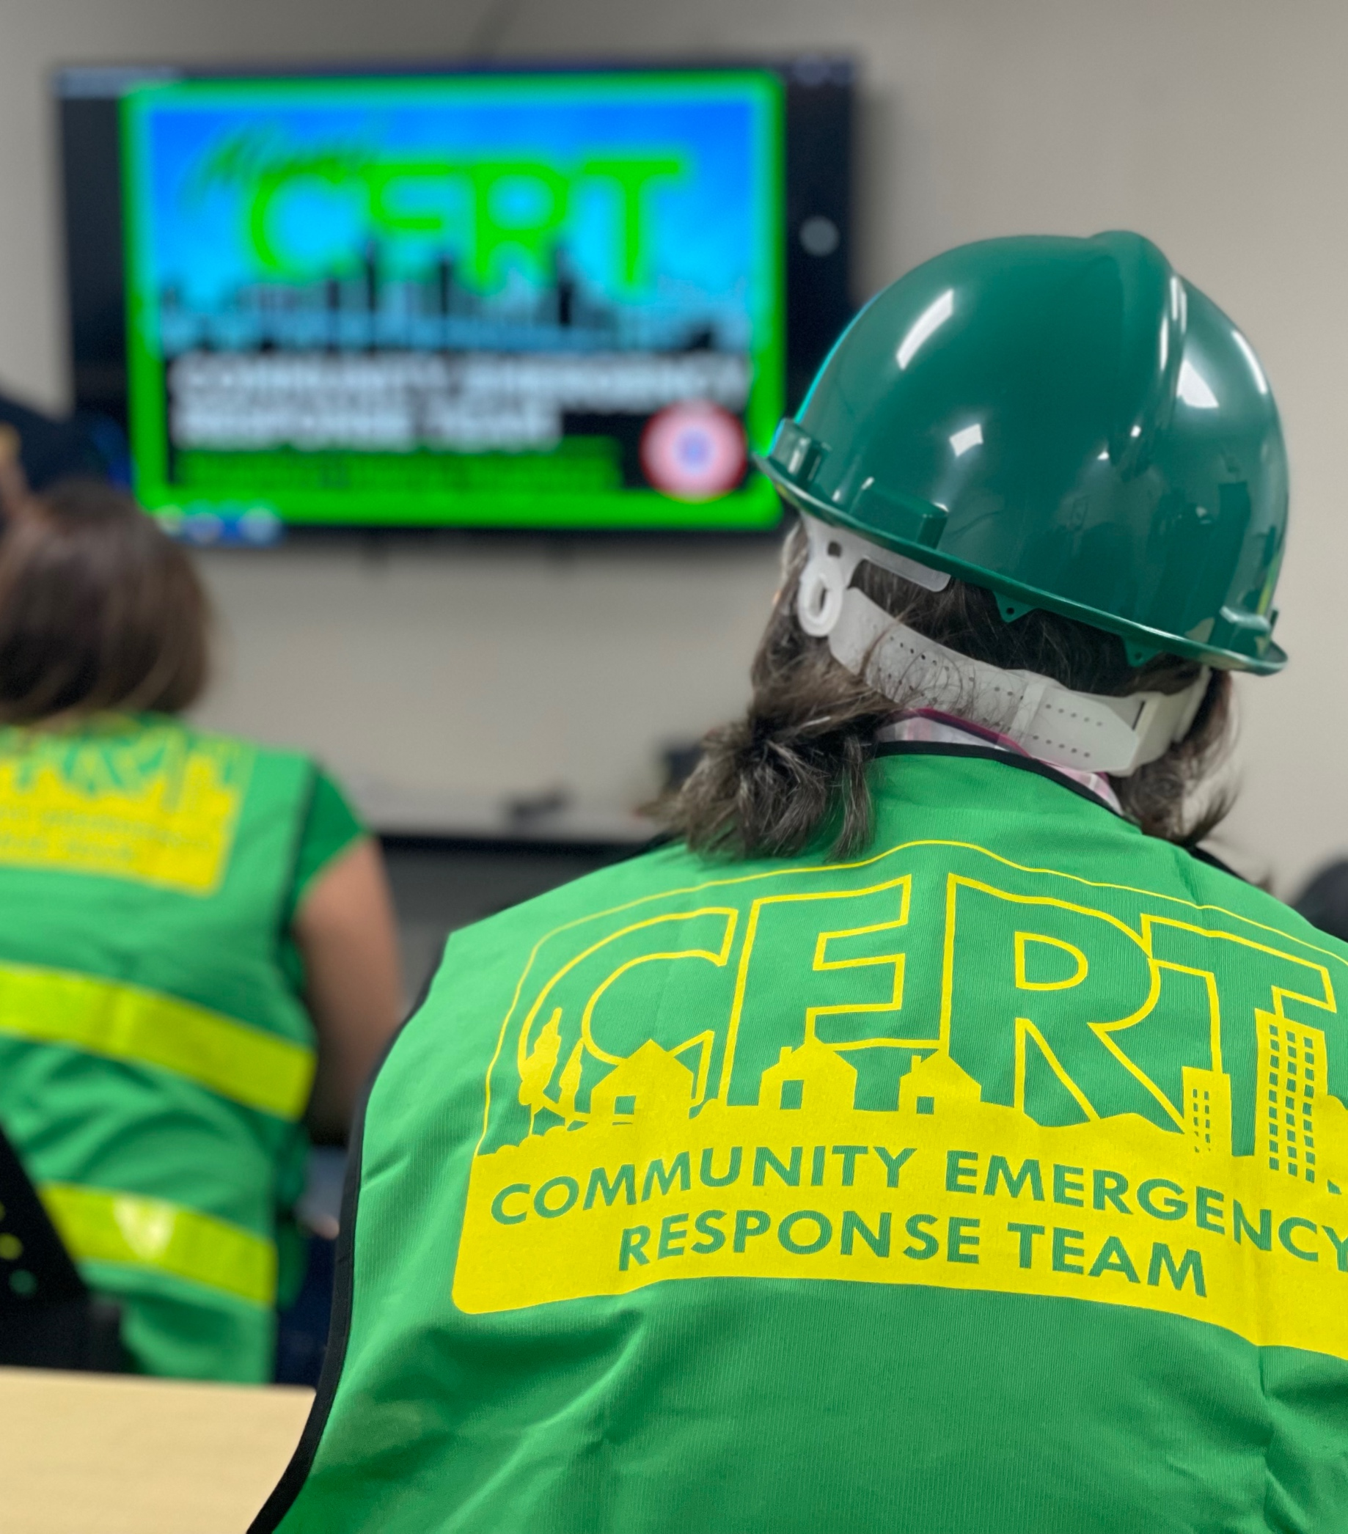
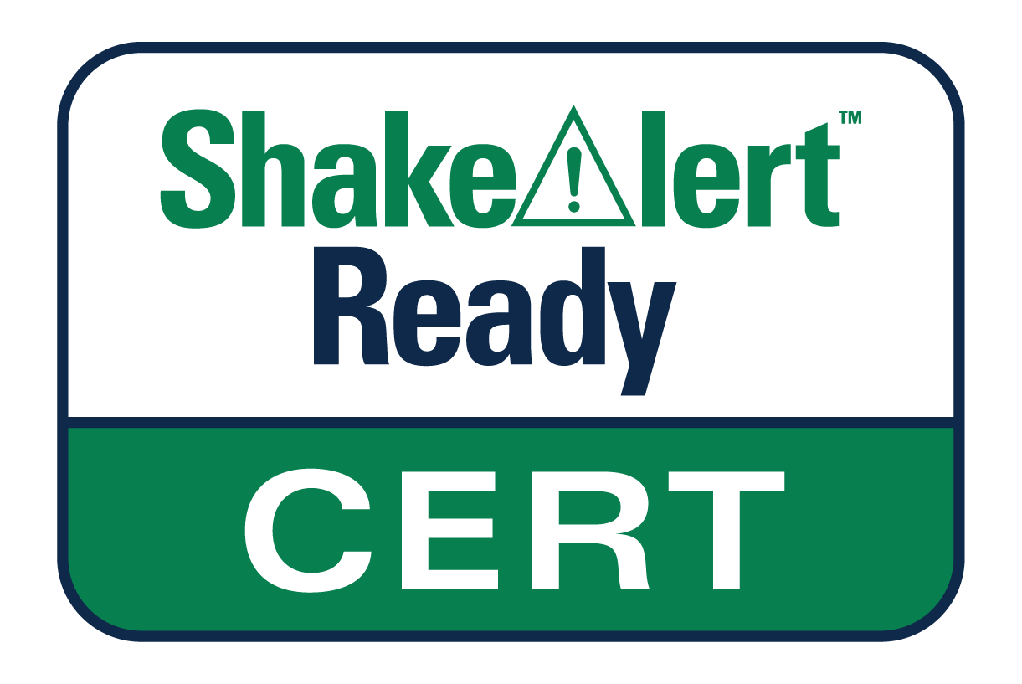
CERT Volunteers are
Trusted Messengers
You are trusted members of your communities.
By learning about ShakeAlert, you can help others:
  Understand earthquake early warning.
  Know how to receive alerts.
  Know what to do when you get an alert.
  Trust ShakeAlert earthquake early warning and act when an alert is received.
Image is courtesy of Miami.gov
Notes:
Emphasize that CERT volunteers are trusted messengers. They do not need to be earthquake scientists or have every answer; their role is to share clear, practical information about what ShakeAlert is, how alerts may reach people, and what to do immediately.
Reinforce that CERT volunteers can—and should—trust ShakeAlert earthquake early warning. If they do not know the answer to a question, they should use reliable ShakeAlert and USGS resources rather than guessing. Remind participants that alerts may look or sound different depending on the phone, app, or delivery method, but those differences do not affect the reliability of the ShakeAlert information behind the alert.

Slide 11
Three Things to Remember
Earthquake early warning can give you time to act.
ShakeAlert-powered alerts may provide warning before strong shaking reaches your location.
You probably already have it.
Many newer smartphones can receive ShakeAlert-powered alerts.
Be ready to act.
If you receive an alert or feel shaking, take protective action immediately.
1
2
3
Notes:
Summarize the Essentials section with three things to remember. First, earthquake early warning can give people time to act before strong shaking reaches their location. Second, many newer smartphones can already receive ShakeAlert-powered alerts. Third, people must be ready to act immediately if they receive an alert or feel shaking.
This is the core message CERT volunteers can share with family, neighbors, and community members.

Slide 12

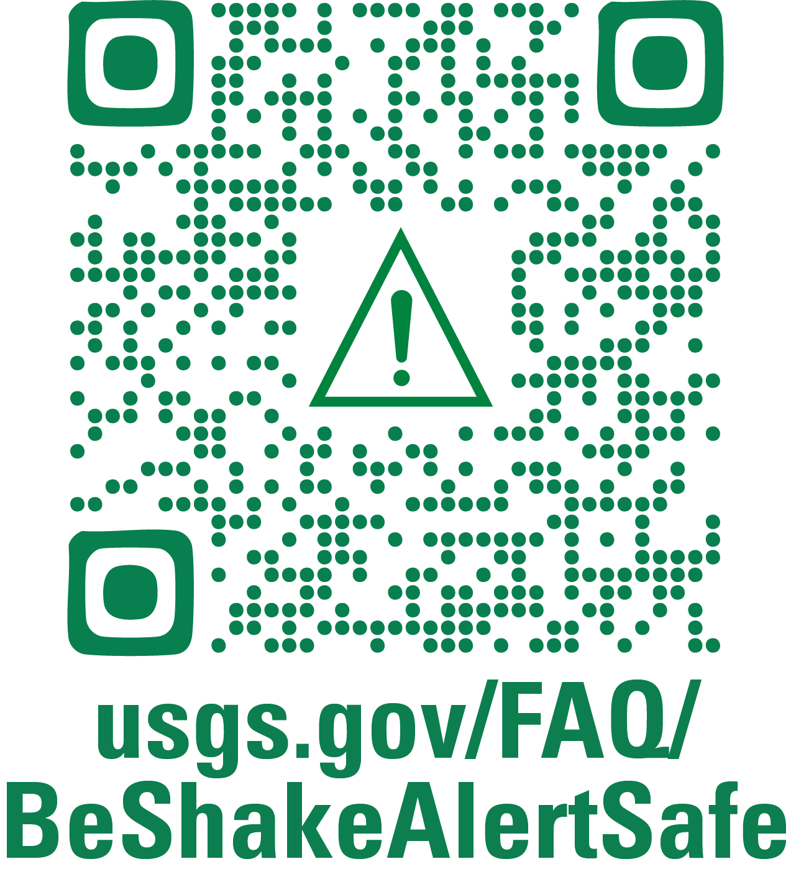

Become ShakeAlert Ready & Help Someone Else
Do the Same
LEARN MORE
usgs.gov/FAQ/BeShakeAlertSafe | ShakeAlert.org
Notes:
Being ShakeAlert Ready means knowing how you receive alerts, knowing how to act, and helping others prepare.
Close with a clear call to action. Ask each participant to take one step today to become more ShakeAlert Ready: check phone settings, download or open MyShake, identify safe cover in common locations, or explain ShakeAlert to one other person. Thank participants for the role they play in community readiness and remind them that sharing accurate information helps protect others because seconds matter.
Encourage participants to learn more at usgs.gov/FAQ/BeShakeAlertSafe | ShakeAlert.org.
Administrative disclosure for DOI requirements; no action is needed from presentation instructors or participants. This disclosure is included for transparency and can be disregarded for purposes of the presentation: During preparation of this training, the generative artificial intelligence (AI) tool OpenAI ChatGPT was used to refine and condense the wording of titles for priorities and strategic actions. All AI-generated suggestions were reviewed, revised as needed, and approved by the authors to ensure accuracy and maintain the integrity of the scientific content.

