Slide 1
SHAKEALERT® READY
A CERT Guide to
Earthquake Early Warning
Building Community Readiness through Earthquake Early Warning
August 2026
Version 2026.3
Notes:
Welcome participants to ShakeAlert Ready: A CERT Guide to Earthquake Early Warning. Explain that the training focuses on understanding earthquake early warning, knowing what to do when a ShakeAlert-powered alert or shaking occurs, and helping others become ShakeAlert Ready. The course begins with the Essentials overview and then provides additional depth on earthquake science, the ShakeAlert System, alerts, protective actions, and CERT outreach.

Slide 2
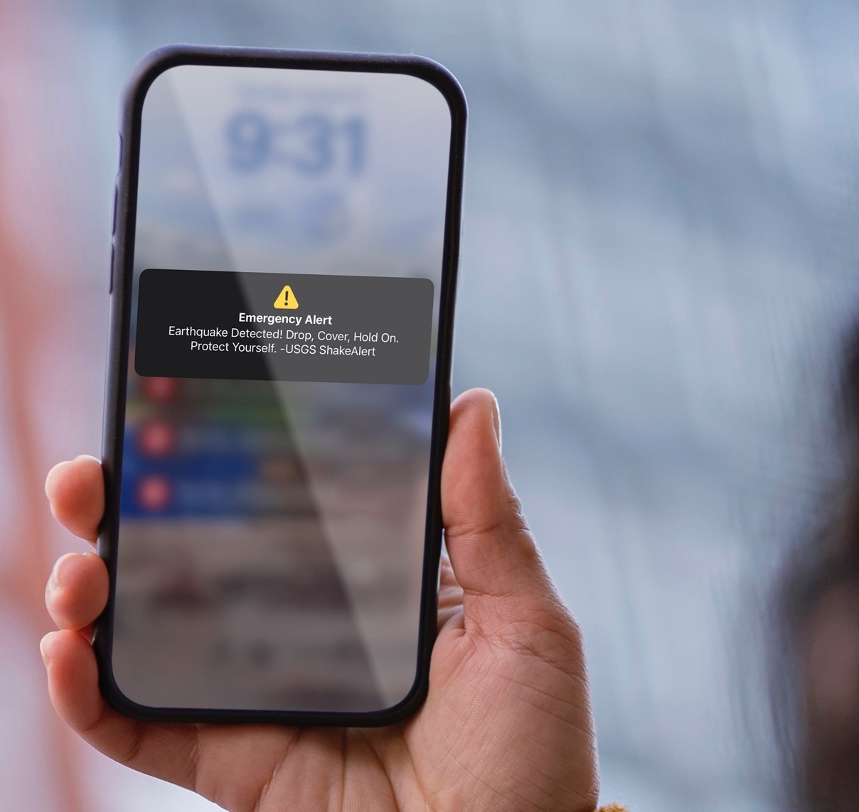
What We Will Cover
01
ShakeAlert Ready CERT Essentials
02
Earthquake Science and Impacts
03
Inside the ShakeAlert System
04
Experiencing ShakeAlert
05
Personal Protective Actions
06
The CERT Role in Earthquake Early Warning Outreach and Education
All images courtesy of USGS unless otherwise specified.
Notes:
Walk participants through the list of six modules. Explain that the course begins with ShakeAlert Ready CERT Essentials, then builds into earthquake science and impacts, the ShakeAlert System, what alerts may look and sound like, personal protective actions, and the CERT role in earthquake early warning outreach and education. By the end, participants should know how earthquake early warning works, how alerts may reach them, what protective action to take immediately, and how to explain the basics to someone in their community.
The ShakeAlert Ready CERT Essentials module can also be delivered as a shorter, 15-minute stand-alone training.

Slide 3

MODULE 1
ShakeAlert Ready CERT Essentials
The Basics Every CERT Volunteer Should Know
Notes:
Introduce Module 1 as the Essentials section: the basic information every CERT volunteer should know. This module answers the most important questions:
What is earthquake early warning?
What is ShakeAlert?
How might alerts reach me?
What should I do when I feel shaking or get an alert?
Let participants know this section provides the foundation for the rest of the course and can also serve as a stand-alone overview for audiences that only need the core ShakeAlert Ready messages.

Slide 4
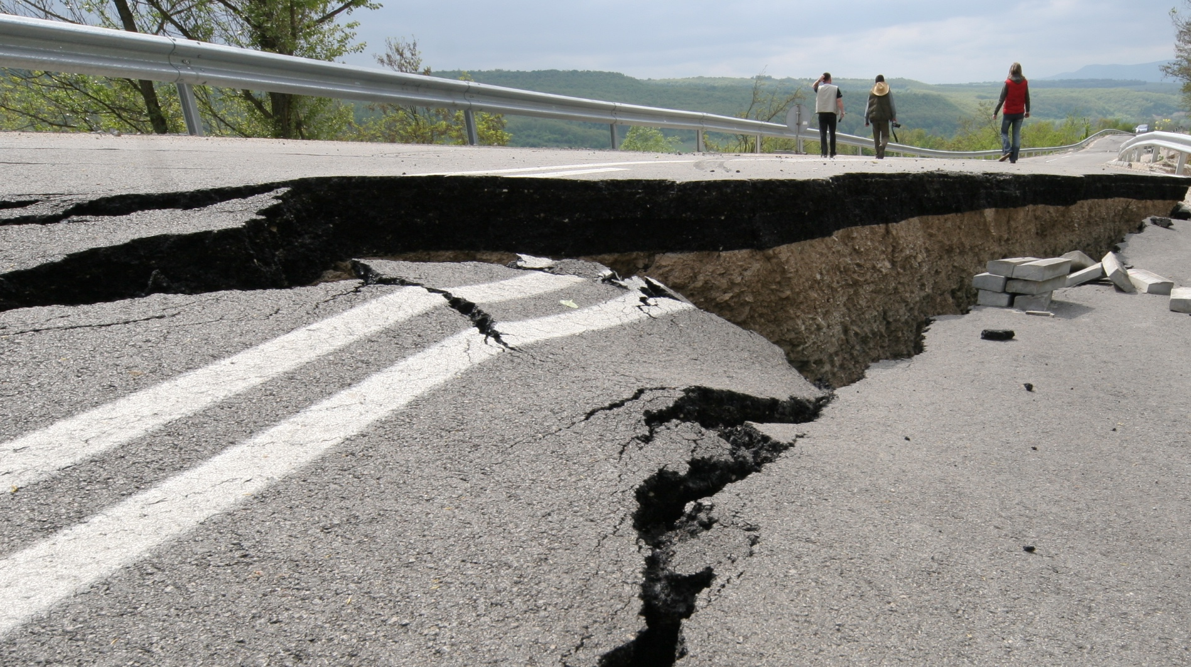
Did you know
you can get an earthquake early warning alert before strong shaking is expected near you?
Notes:
Ask participants to pause on this question: Did you know you may be able to get an earthquake early warning alert before strong shaking reaches your location? Explain that this is possible because ShakeAlert detects an earthquake after it begins and sends information quickly enough that some people and systems may receive warning before strong shaking arrives. Emphasize that the warning may only be seconds, but seconds matter when people know what action to take.

Slide 5
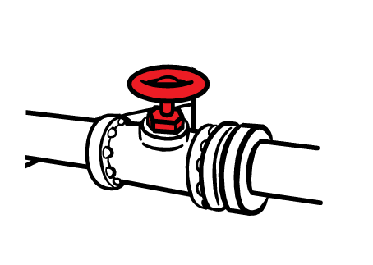
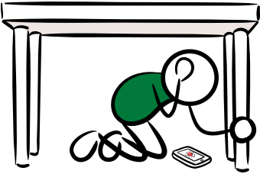
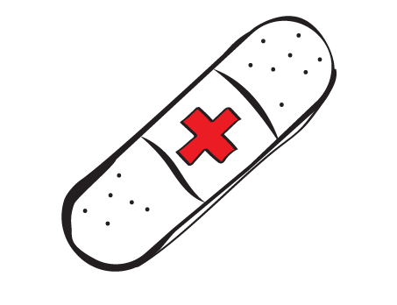
What is Earthquake Early Warning?
Earthquake early warning systems can detect significant earthquakes quickly, so alerts can be delivered before strong shaking arrives.
With public safety as a goal, earthquake early warning systems are designed to:
Trigger automated safety actions for systems we rely on.
Reduce injuries & other impacts from earthquake shaking.
Give people time to take protective action.
Even a few seconds can make a difference.
Notes:
Explain that earthquake early warning systems detect significant earthquakes quickly after they begin, so alerts can be delivered before strong shaking reaches some locations. The goal is public safety: giving people time to take protective action and giving automated systems time to take safety steps. Reinforce that earthquake early warning does not replace preparedness. It adds a layer of safety by giving people a chance to act on the plans and drills they already practice.
Instructor notes: “Strong” shaking (MMI 6 and greater) means shaking that is widely felt and can cause damage. This concept is covered later in the course.

Slide 6
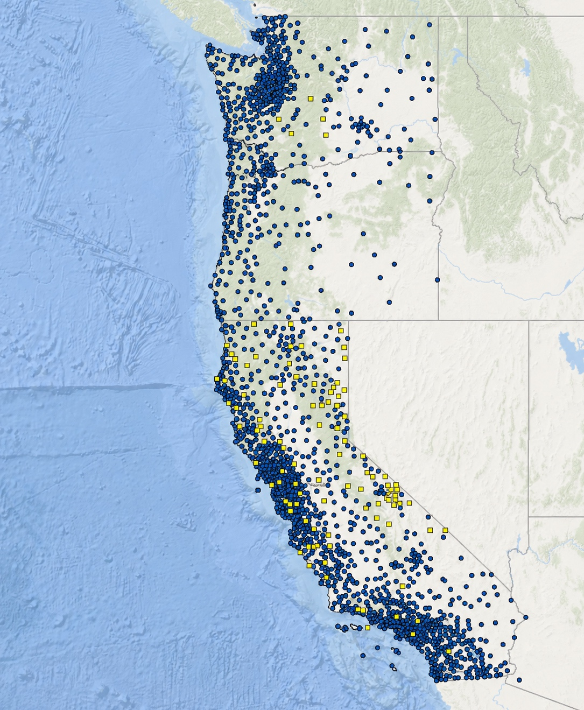
Meet ShakeAlert
The ShakeAlert System is the nation's only public Earthquake Early Warning System.
Today, it serves over 55 million people in the West Coast states of Washington, Oregon, and California.
When possible, it provides advance warning before strong shaking arrives, helping people and automated systems take protective action.
2,000+ Earthquake Sensors
You can—and should—trust ShakeAlert.
Notes:
Introduce ShakeAlert as the nation’s only public Earthquake Early Warning System. Explain that it is managed by the U.S. Geological Survey and serves more than 55 million people in Washington, Oregon, and California. When possible, ShakeAlert provides advance warning before strong shaking arrives, helping people and automated systems take protective action.
Use this slide to build confidence: ShakeAlert is a public safety system built on science, sensors, and partnerships.

Slide 7
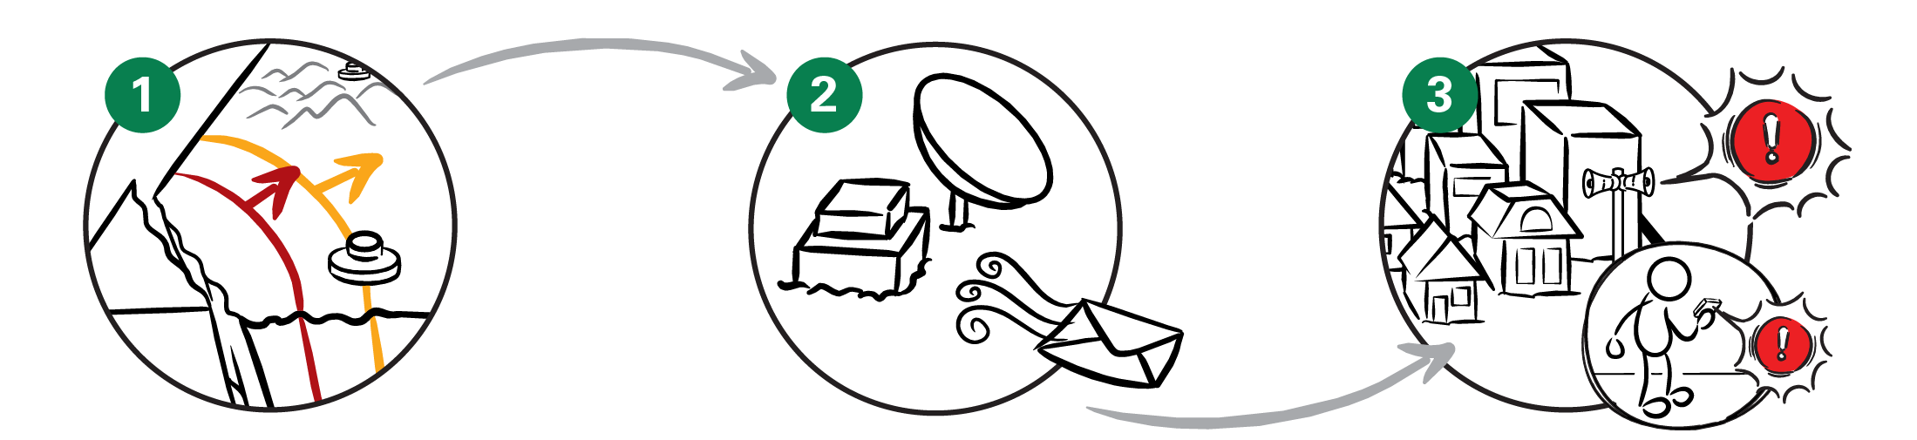
How Does ShakeAlert Work?
DETECT
A network of seismic quickly detects shaking when an earthquake begins.
PROCESS
Computers analyze the first data to estimate where the earthquake started, how big it is, and where strong shaking will occur.
DELIVER
Alerts are sent to apps, phones, and automated systems, giving people seconds to take protective action before strong shaking arrives.
Notes:
Use this as the simple three-step explanation of how ShakeAlert works. First, sensors detect ground motion when an earthquake begins. Second, computers quickly process the first data to estimate where the earthquake started, how large it is, and where strong shaking may occur. Third, alert delivery partners deliver ShakeAlert-powered alerts to people, phones, apps, and automated systems.
Keep the key message simple: digital alerts can travel faster than damaging seismic waves.

Slide 8
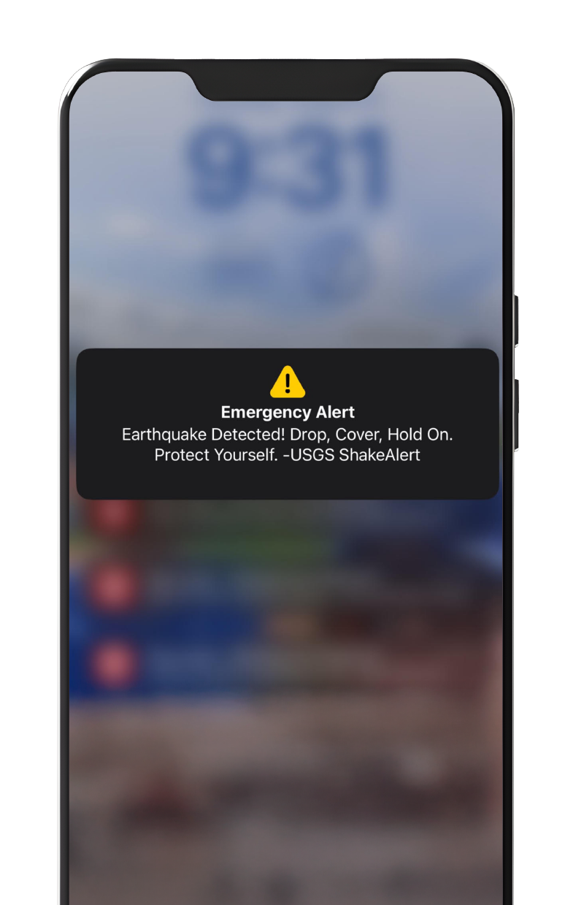
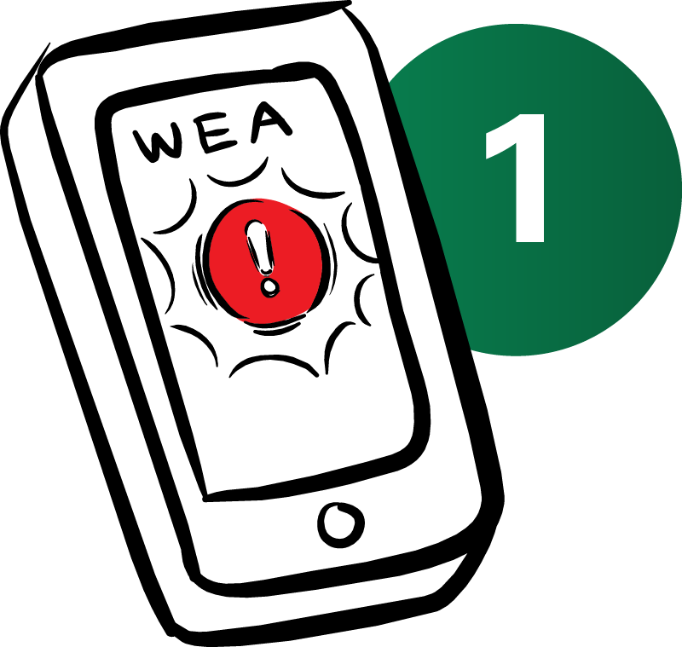
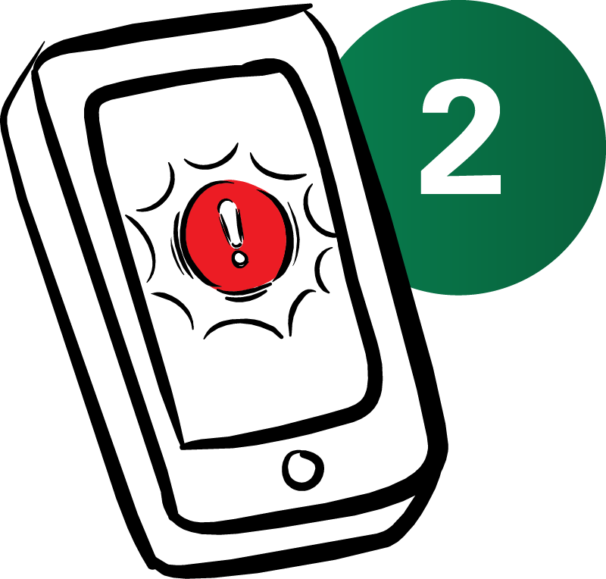
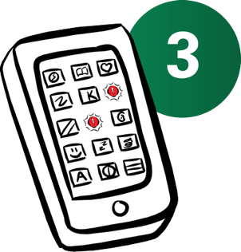
You Probably
Already Have It
Wireless Emergency Alerts from FEMA
Depending on your cell phone, this setting may be found under Emergency Alerts or Government Alerts.
Most newer smartphones can already receive ShakeAlert-powered alerts.
You may receive alerts on your phone through:
Cell Phone
Operating Systems
Android and iOS have built-in earthquake early warning alerting.
For Android: crisisresponse.google/ android-early-earthquake-warnings
For iOS: support.apple.com/en-us/102516
1
Wireless Emergency Alerts (WEA).
Your phone's built-in operating system.
The MyShake app.
2
Apps
Get the MyShake App from the App Store (iOS devices) or Google Play (Android devices).
There is no app called “ShakeAlert” to download.
3
Notes:
Explain that many newer smartphones can already receive ShakeAlert-powered alerts. Alerts may reach people through Wireless Emergency Alerts, built-in phone operating system alerts, or apps such as MyShake. Clarify that there is no app called “ShakeAlert” to download. Encourage participants to think of these as multiple ways to receive alerts, not competing systems.
Instructor note: We will discuss phone settings and alert methods more later in the course.

Slide 9
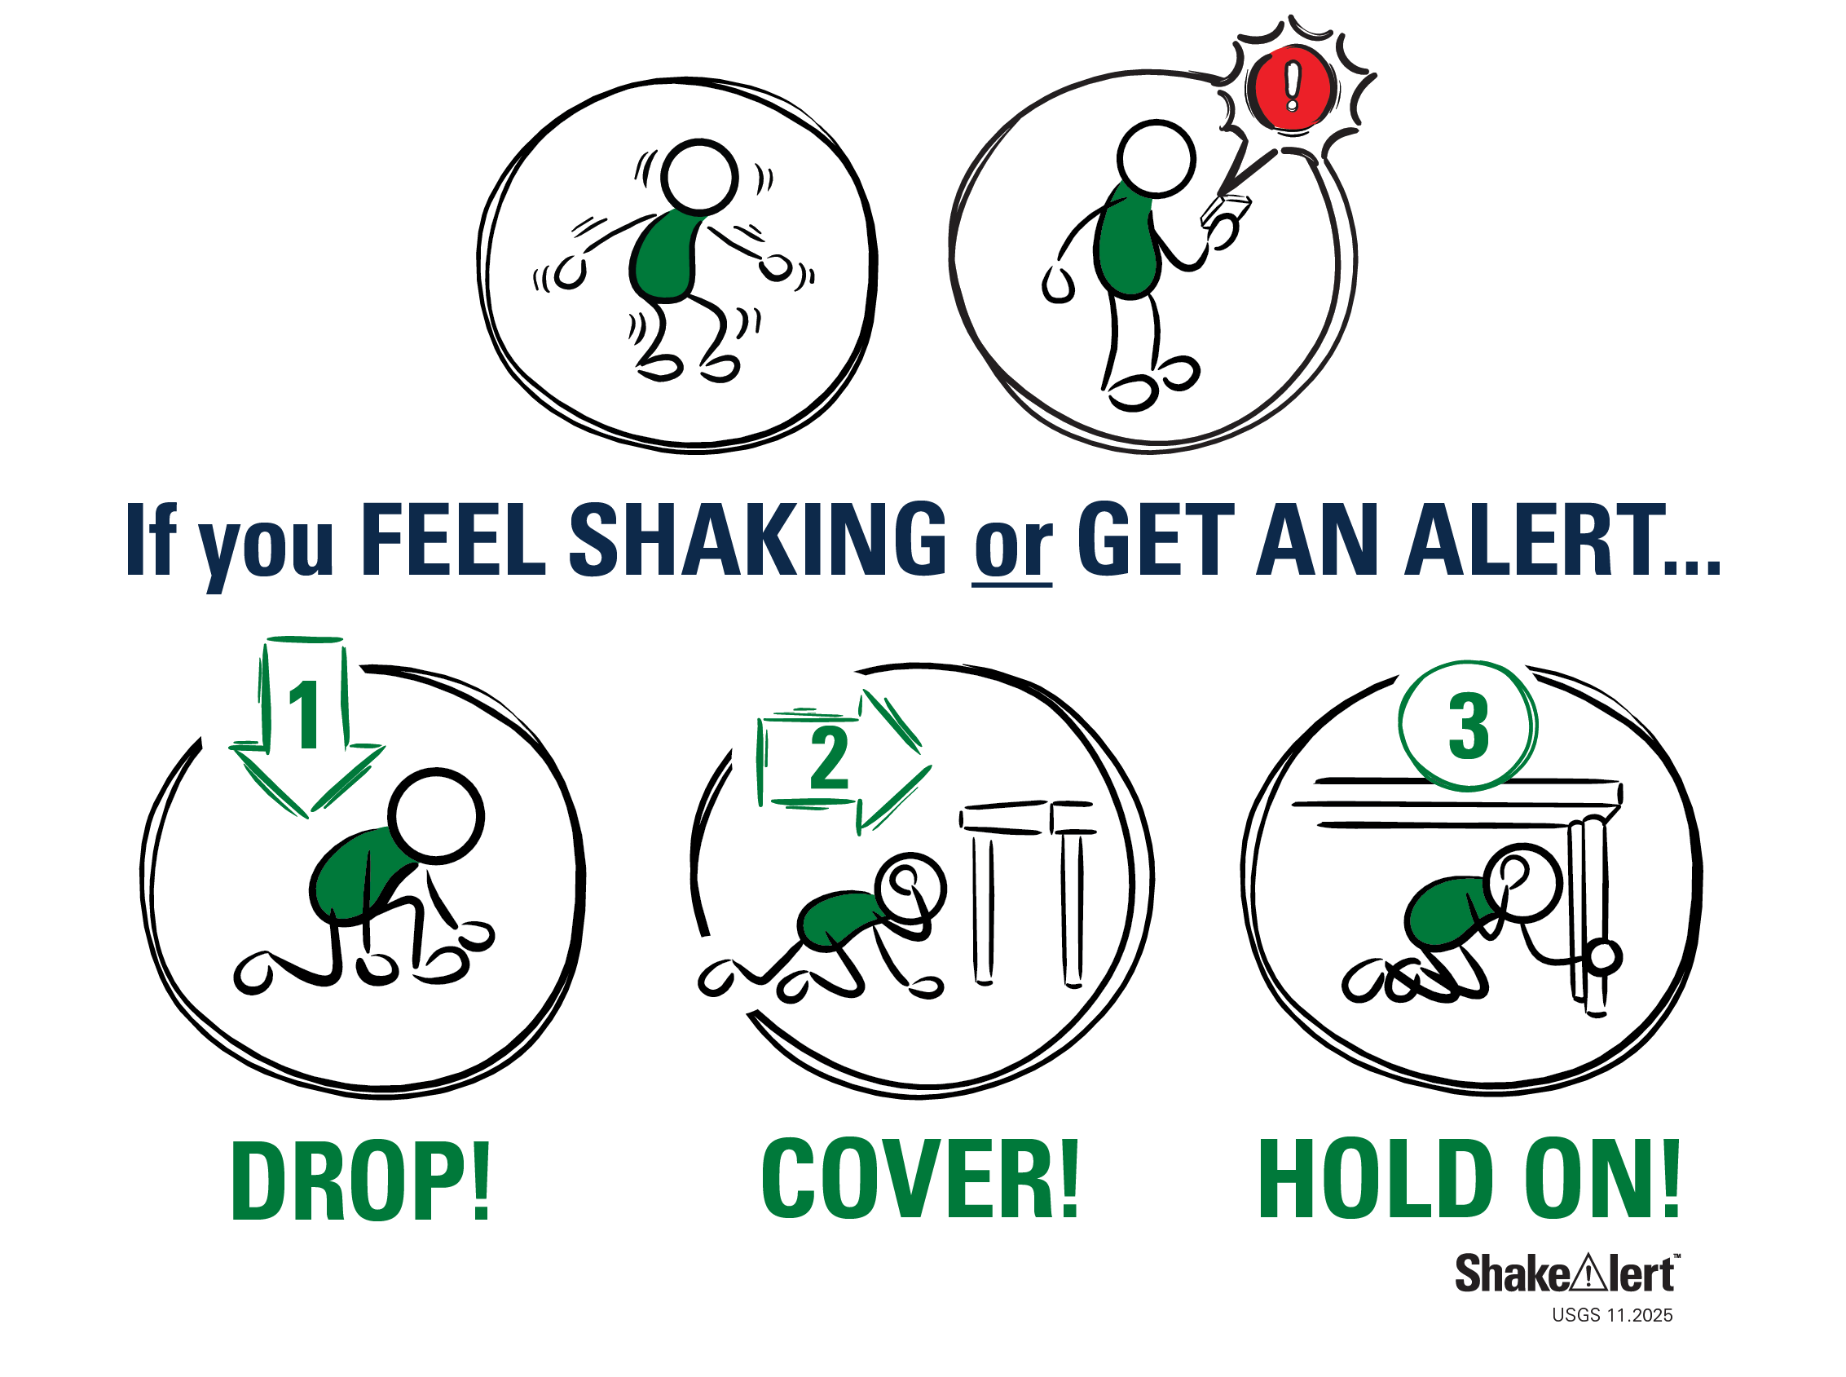
When You Feel Shaking or Get an Alert
If you receive an alert or feel shaking, take protective action immediately.
For most people, that means:
Drop, Cover, and Hold On.
Don't wait to see if the shaking gets stronger.
If you can't get under sturdy furniture, protect your head and neck where you are.
If you are near the coast, additional actions may be needed after shaking stops.
Protective actions may vary depending on your location or abilities.
Notes:
Emphasize the action message: if you receive an alert or feel shaking, take protective action immediately. For most people, that means Drop, Cover, and Hold On. Do not wait to see if shaking gets stronger, and do not stop to confirm the alert. If sturdy furniture is not nearby, protect your head and neck where you are. Note that protective actions may vary by location, ability, and environment, and those situations will be covered later in the course.

Slide 10
Three Things to Remember
Earthquake early warning can give you time to act.
ShakeAlert-powered alerts may provide warning before strong shaking reaches your location.
You probably already have it.
Many newer smartphones can receive ShakeAlert-powered alerts.
Be ready to act.
If you receive an alert or feel shaking, take protective action immediately.
1
2
3
Notes:
Summarize the Essentials section with three things to remember. First, earthquake early warning can give people time to act before strong shaking reaches their location. Second, many newer smartphones can already receive ShakeAlert-powered alerts. Third, people must be ready to act immediately if they receive an alert or feel shaking.
This is the core message CERT volunteers can share with family, neighbors, and community members.

Slide 11
MODULE 2
Earthquake Science and Impacts
Notes:
Transition into Module 2. Explain that participants now have the basic ShakeAlert message, and this section adds enough earthquake science to explain why earthquake early warning works. This is not meant to be a technical lecture. It is a practical refresh on earthquake hazards, seismic waves, magnitude, intensity, and impacts so CERT volunteers can explain ShakeAlert clearly and confidently.

Slide 12
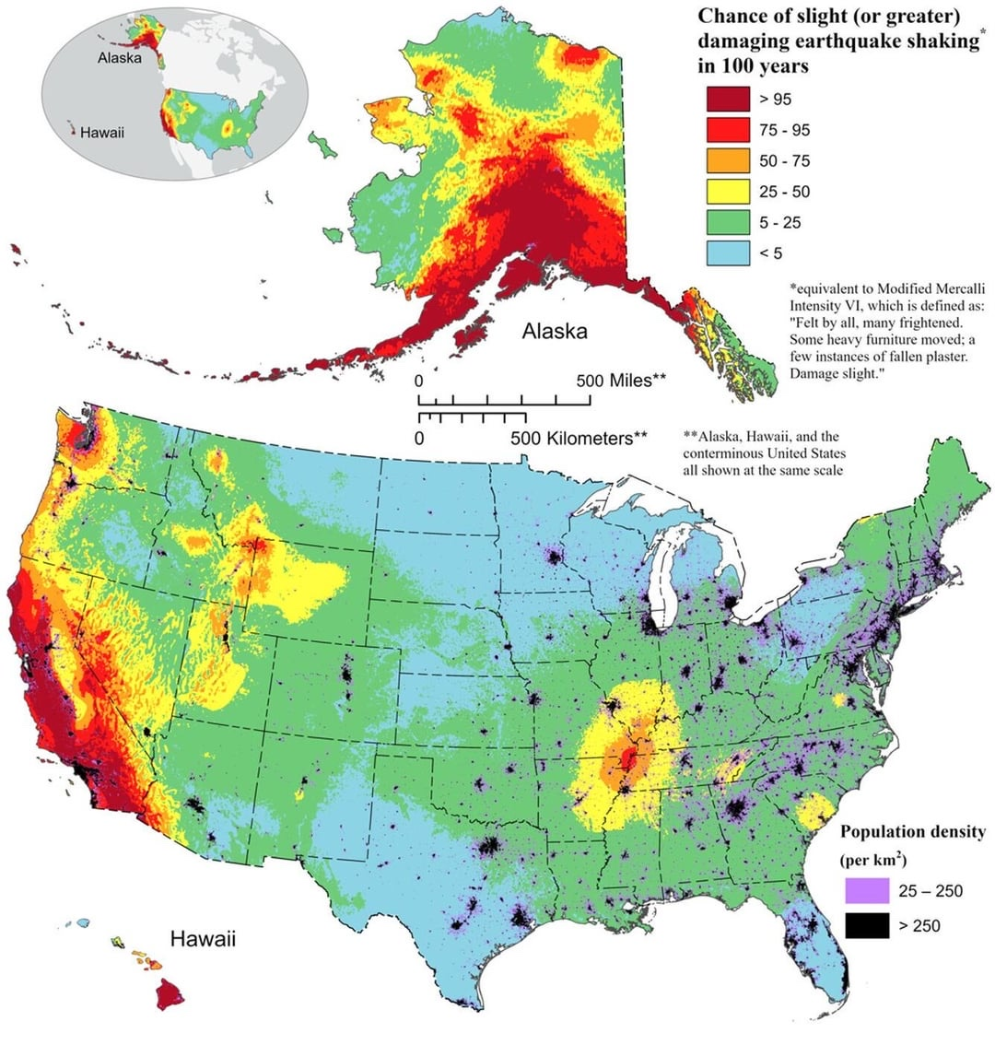
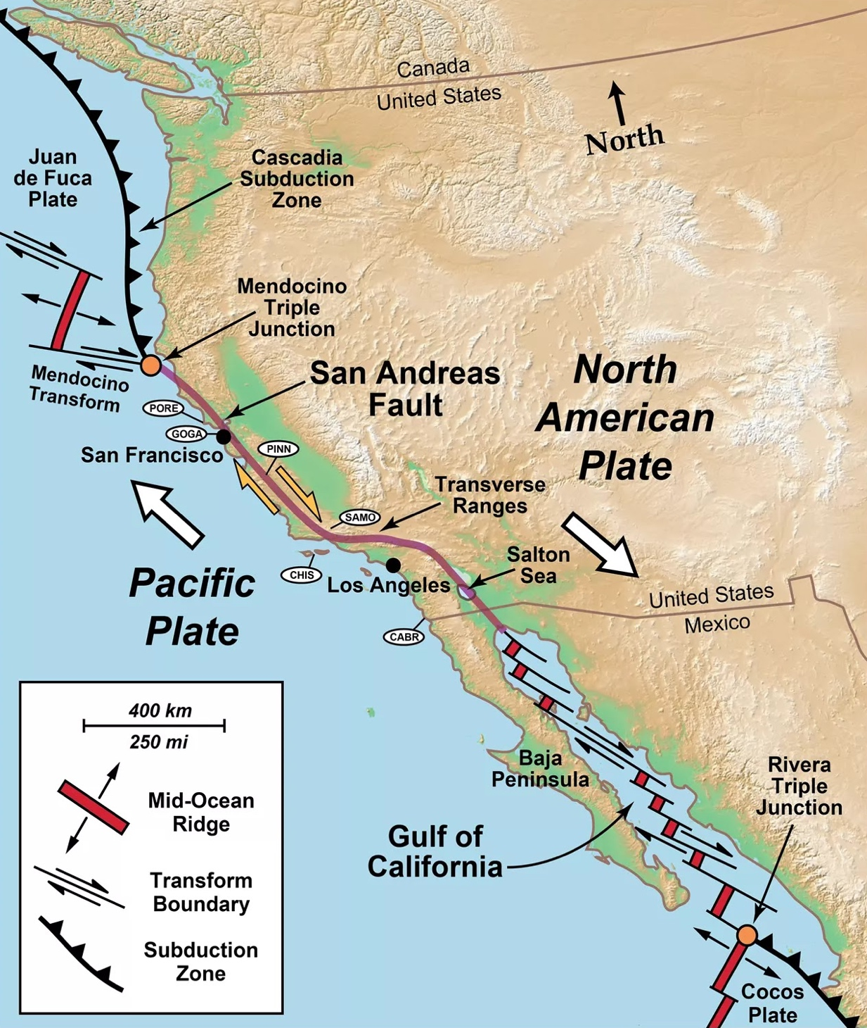
We Live in Earthquake Country
Large earthquakes have happened before—and they will happen again.
Notes:
Use the maps to reinforce that we live in earthquake country. Large earthquakes have happened before and will happen again. California, Oregon, and Washington are affected by active tectonic boundaries and fault systems. Point out a few key features on the map: the Cascadia Subduction Zone off the coasts of Oregon and Washington, where one plate slides beneath another and can produce very large earthquakes; and the San Andreas Fault Zone in California, where the plates slide past each other, generating frequent but usually smaller quakes.
Instructor note: If able, briefly identify a major fault or tectonic feature relevant to your audience, such as the Cascadia Subduction Zone or San Andreas Fault, to make the risk local. The main point is that earthquake early warning matters because earthquakes are a real and recurring hazard.

Slide 13
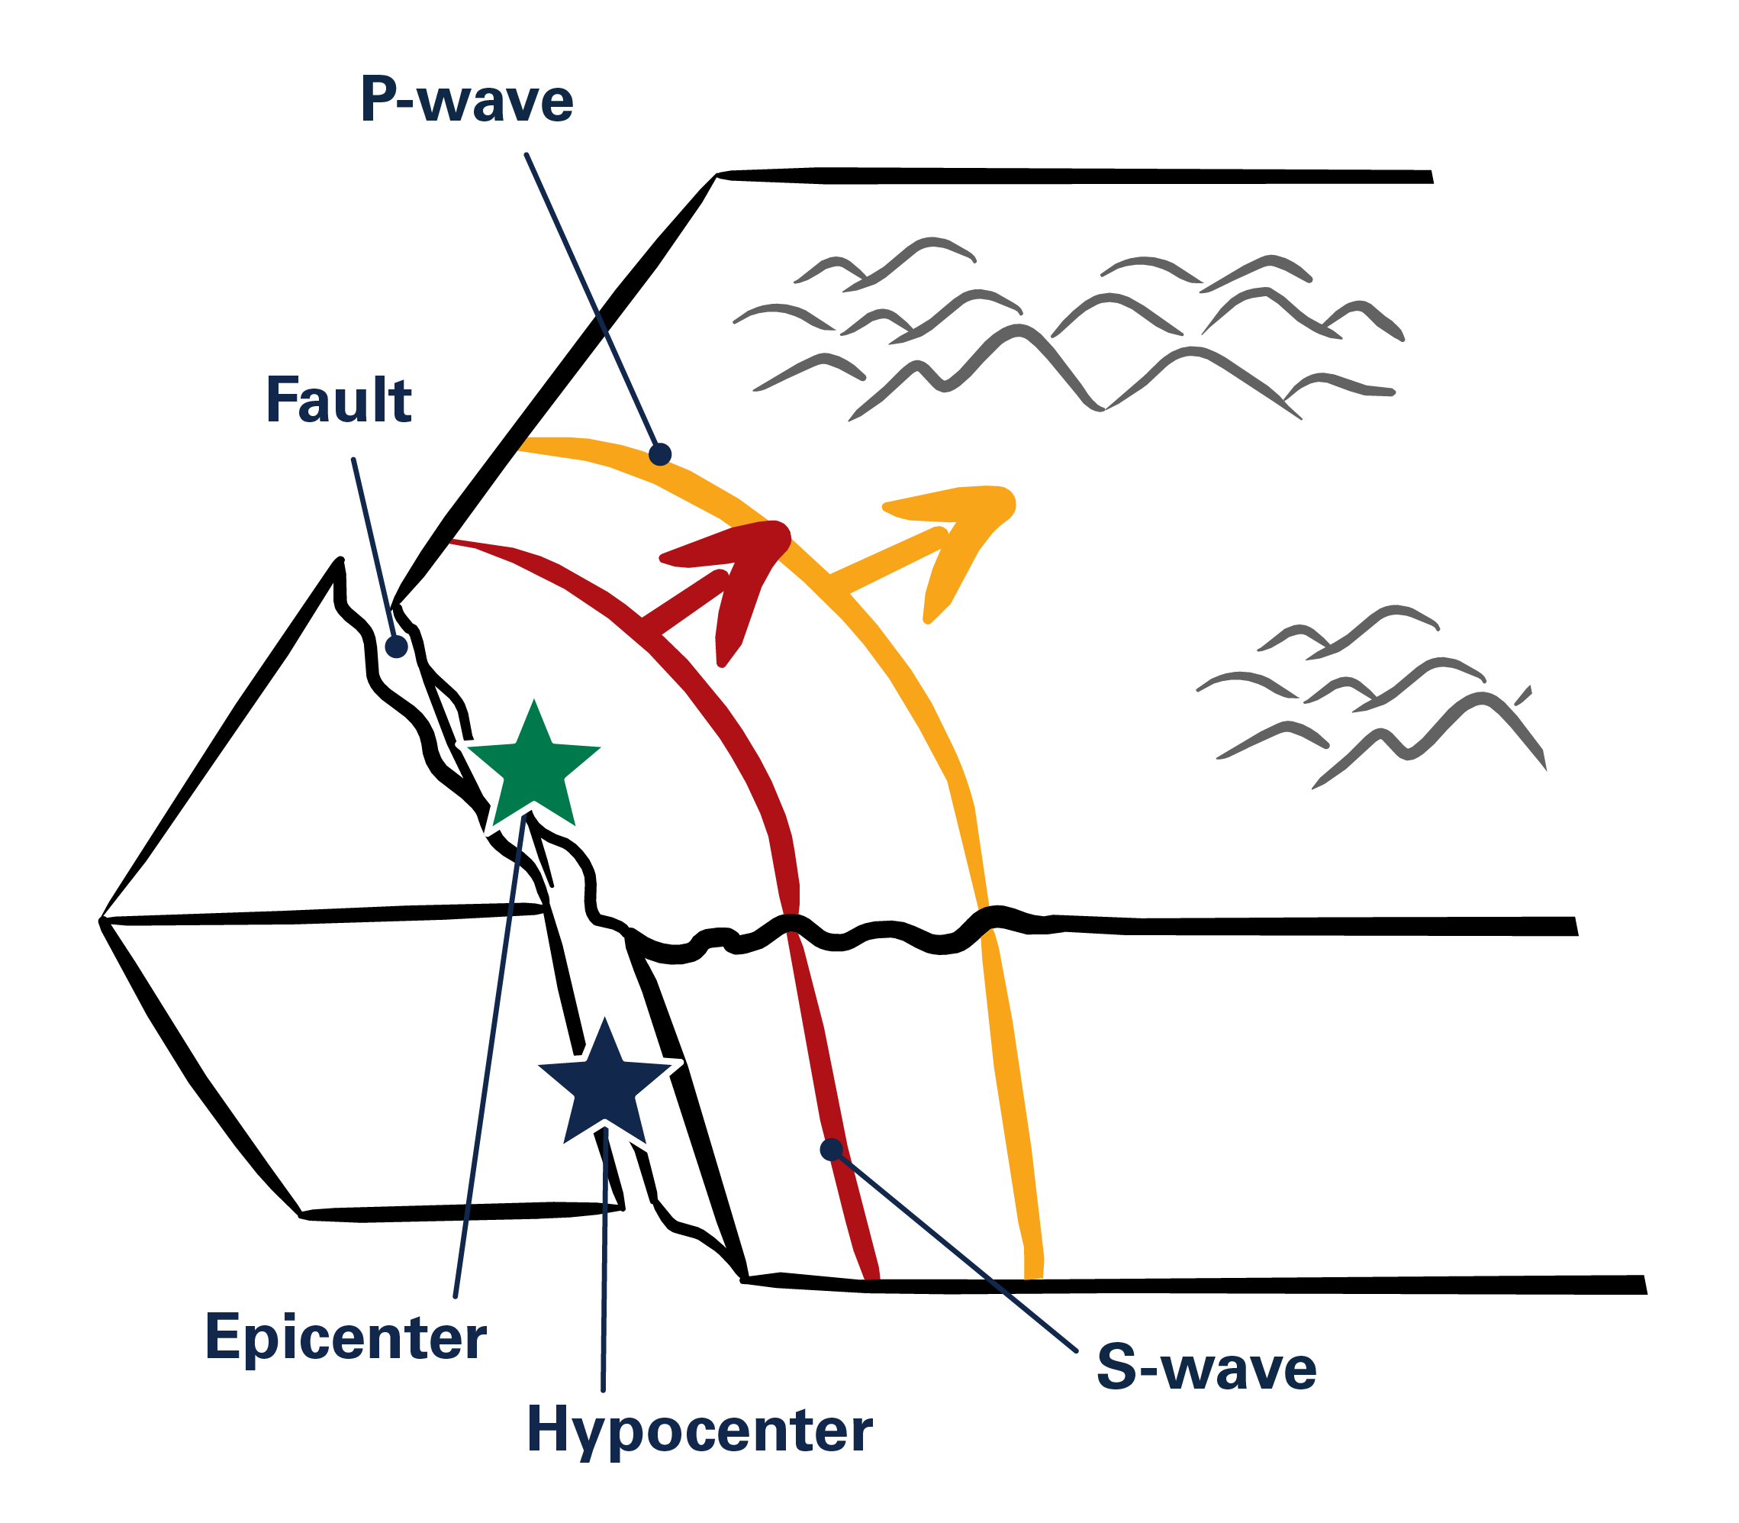
Earthquake Science Basics
Fault: A fracture or zone of fractures where blocks of rock can move.
Epicenter: The point on Earth’s surface where the seismic rupture begins.
Hypocenter: The point underground where the earthquake begins, directly below the epicenter.
P-waves: The fastest seismic waves; they arrive first.
S-waves: Slower seismic waves that usually produce stronger shaking.
Notes:
Briefly review the key terms on the slide. A fault is where blocks of rock (the earth’s crust) can move. The hypocenter is where the earthquake begins underground, and the epicenter is the point on the surface above it. P-waves are the fastest seismic waves and arrive first. S-waves are slower and usually produce stronger shaking. ShakeAlert uses the first detections to estimate the earthquake and support alerts before stronger shaking reaches some areas.
Instructor note: The fastest-moving seismic waves (primary, or P-waves) travel about 3.7 miles per second in rock and generally do not produce strong shaking. P-waves are followed by slower moving, more damaging waves (secondary ,or S-waves) and surface waves that travel about 2.5 miles per second.

Slide 14
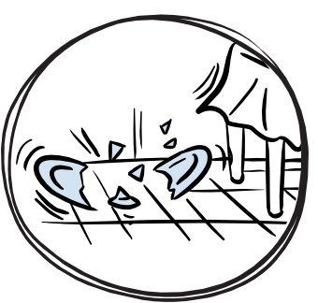

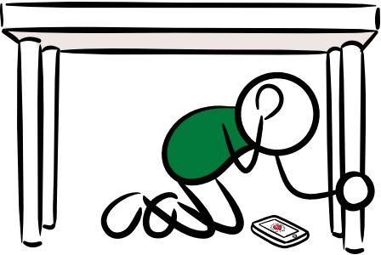
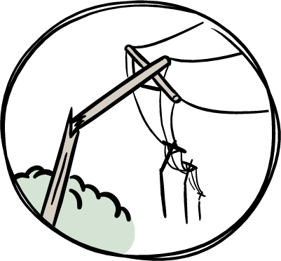
What You Might Experience During an Earthquake
  Earthquakes strike suddenly,
  sometimes with a roar.
  Objects can fall from shelves and walls, and furniture may move.
  Lights may flicker or go out, and alarms or sprinklers may activate.
  Windows may shatter.
  People and animals may react suddenly or panic.
  Trees and utility poles may sway or,
  in stronger earthquakes, could fall.
Notes:
Help participants picture what an earthquake can feel like. Earthquakes strike suddenly and may begin with a rumble or roar. Lights may flicker or go out, alarms or sprinklers may activate, windows may shatter, objects may fall, and people or animals may react suddenly.
If time allows, ask whether anyone has experienced an earthquake and invite one or two brief examples of what they saw, heard, or felt. Keep the focus on how sudden and disorienting shaking can be and why quick protective action matters.

Slide 15

Earthquake Magnitude vs. Intensity
MAGNITUDE
Measures the energy released at the earthquake’s source
One magnitude value for each earthquake
Reported as a number, such as M6.0
Each whole-number increase releases about 32 times more energy than the previous magnitude
Higher magnitudes generally affect larger areas
INTENSITY
Describes the strength of shaking at a specific location
Can vary from place to place
Commonly described using the Modified Mercalli Intensity (MMI) scale
Depends on distance, local ground conditions, and buildings
Describes what people experience and the potential for damage
Notes:
Explain the difference between magnitude and intensity. Magnitude describes the energy released at the earthquake’s source and is one value for the whole earthquake. Intensity describes the strength of shaking at a specific location and can vary from place to place. This distinction helps explain why people in different areas may have different experiences and why ShakeAlert-powered alerts are based on expected shaking where people are located.

Slide 16
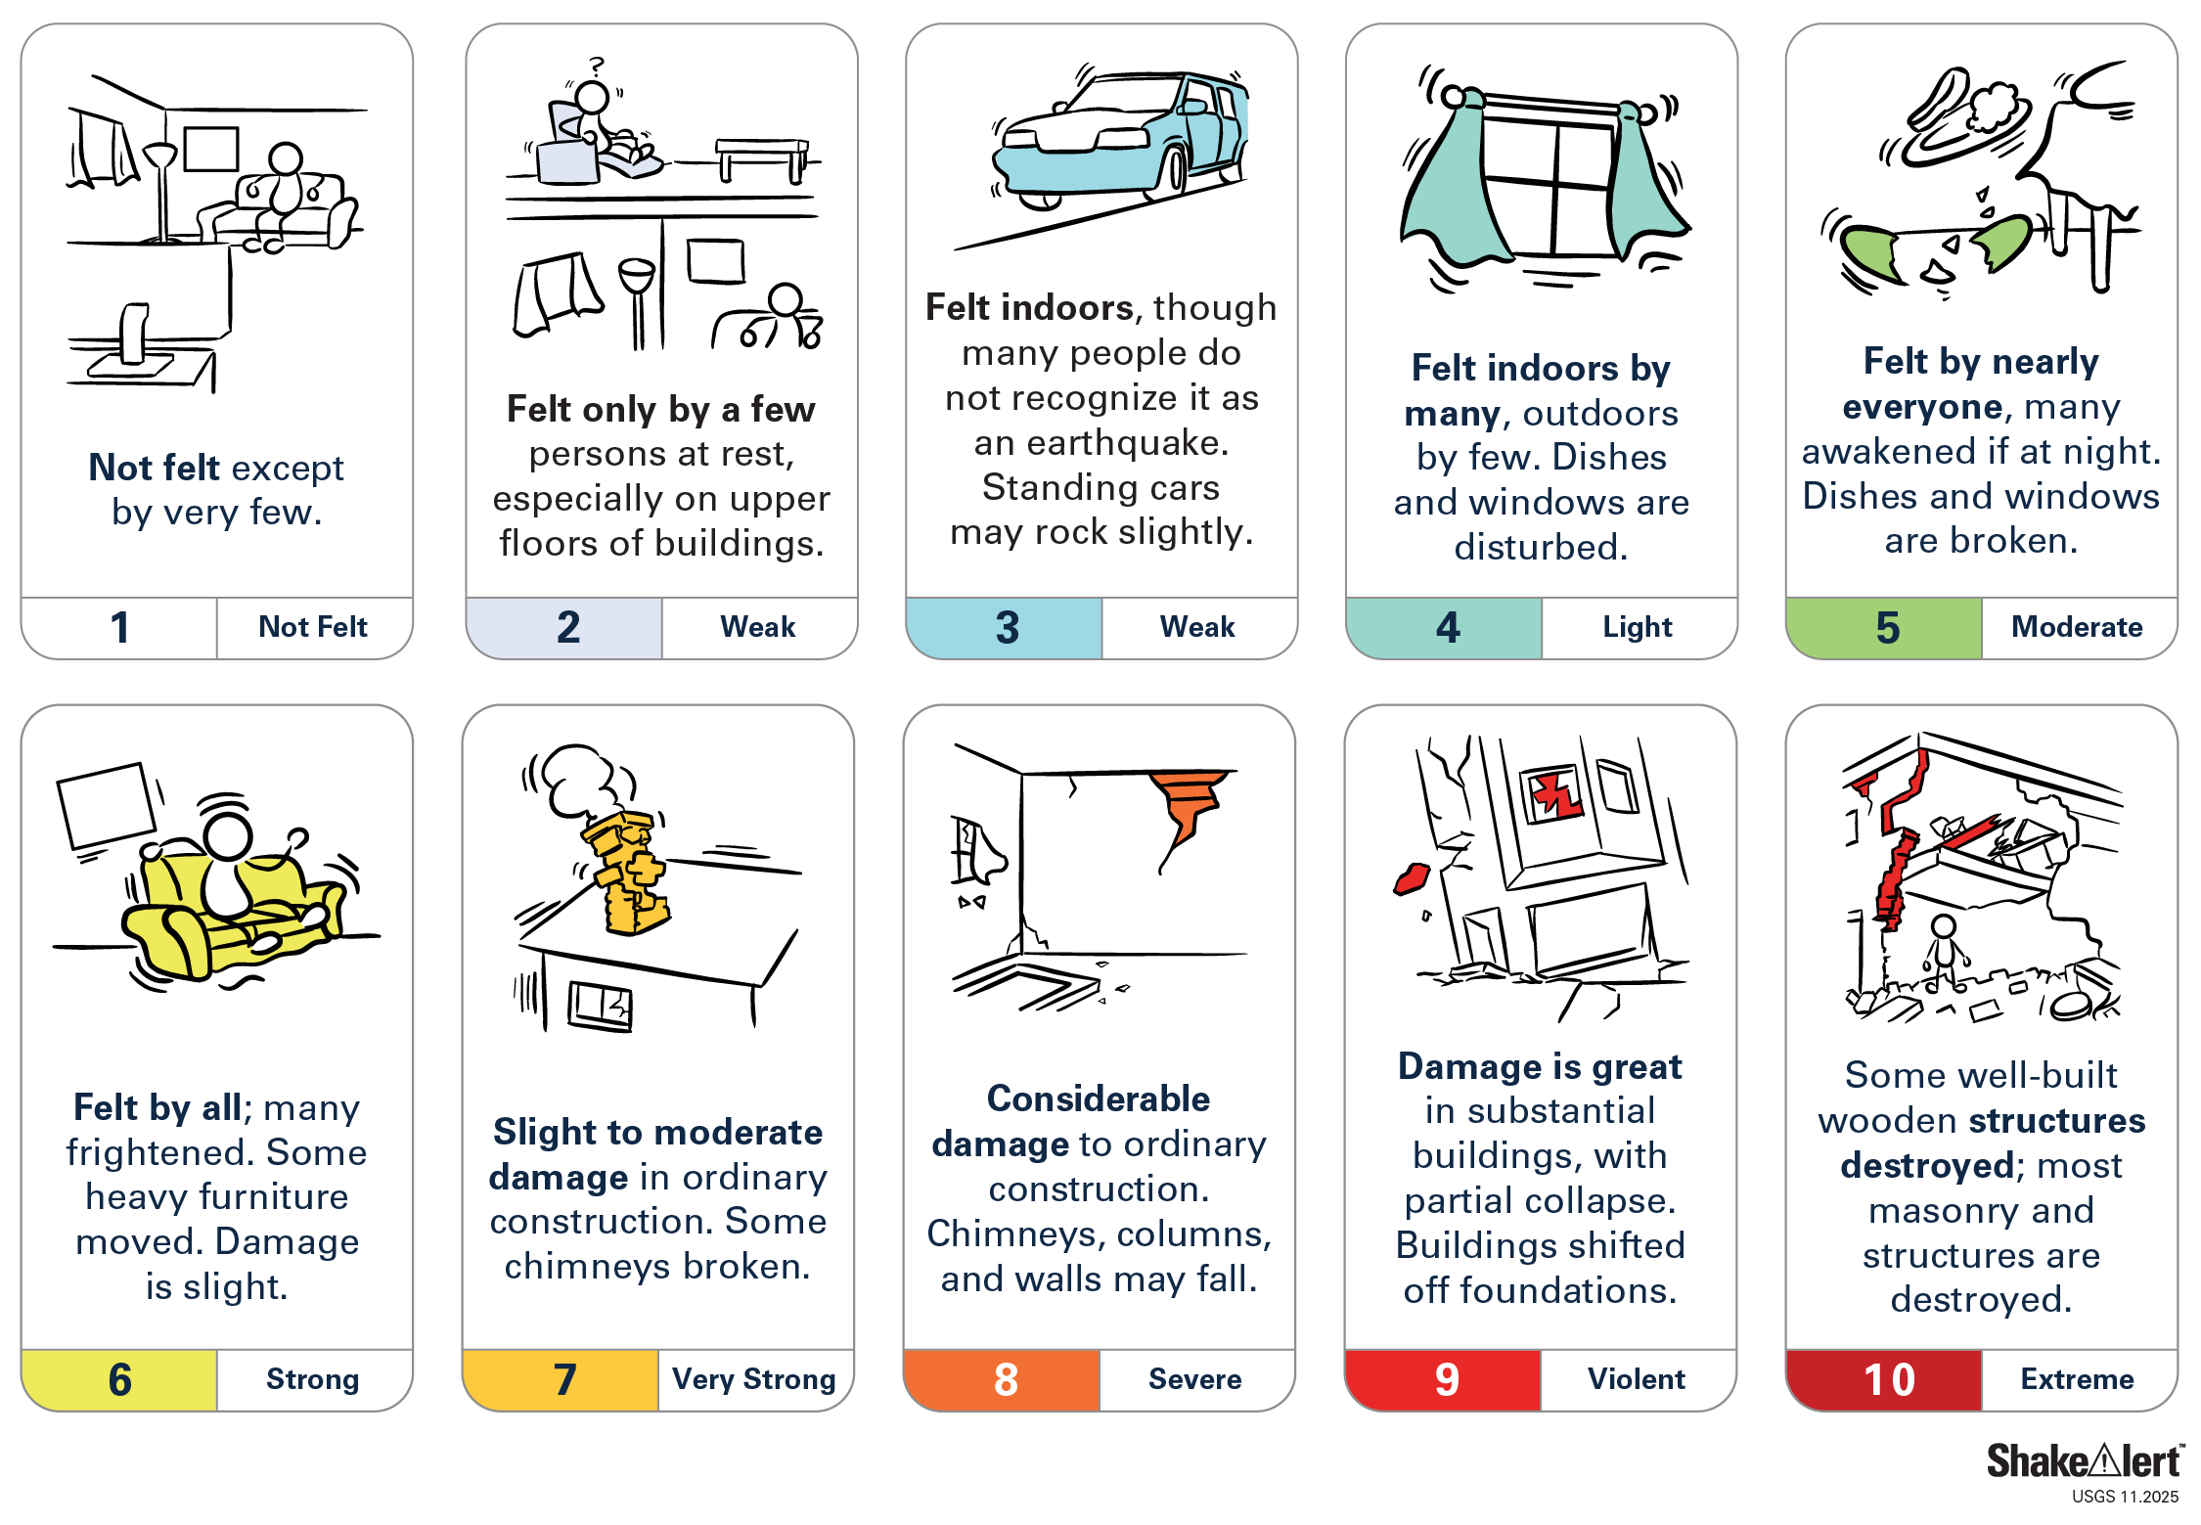
Earthquake Intensity Scale
Modified Mercalli Intensity (MMI)
Notes:
Use the Modified Mercalli Intensity scale to show that shaking can range from not felt to extreme. Point out that intensity describes what people experience and what damage may occur at a location. ShakeAlert uses estimates of expected shaking intensity, along with magnitude and alert delivery thresholds, to help determine where alerts should be delivered.
Keep this practical: intensity helps explain why alerts and impacts differ by place.

Slide 17
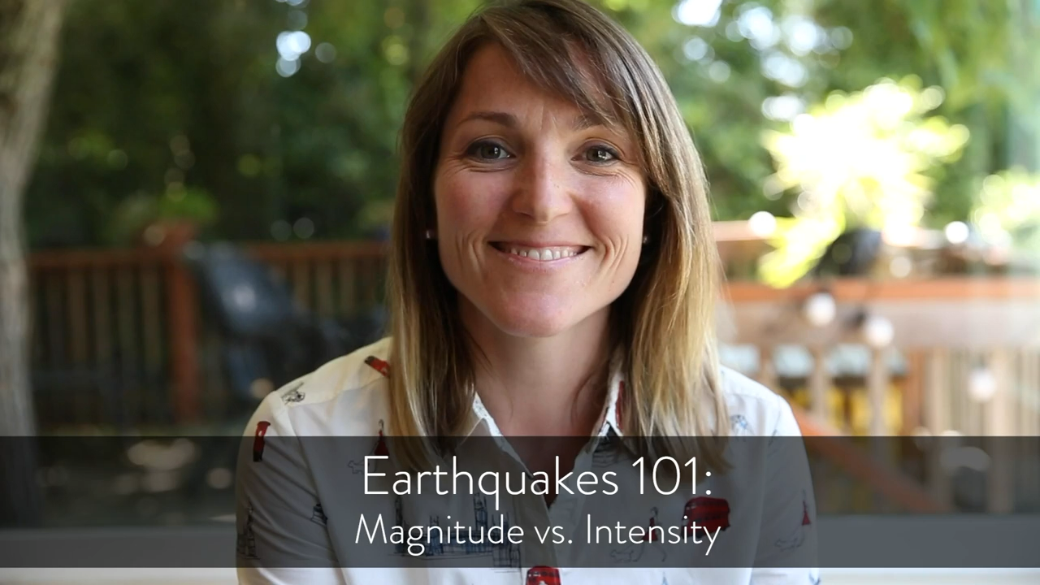
Video: Magnitude and Intensity in Action
As you watch, notice:
The earthquake has one magnitude.
Shaking intensity varies by location.
Stronger shaking can lead to greater impacts.
Notes:
Introduce the video by Angie Lux, PhD, as a quick way to see the concepts of magnitude and intensity in action. Ask participants to listen for three ideas: an earthquake has one magnitude, shaking intensity varies by location, and stronger shaking can lead to greater impacts. After the video, briefly restate those points.
Instructor note: If you cannot play the video, watch the video ahead of time, summarize the same concepts in your own words, and move on.

Slide 18





Earthquakes Can Trigger Other Natural Hazards
Strong earthquake shaking can also trigger:
LANDSLIDES
Movement of rock, soil, or debris down a slope.
SURFACE RUPTURE
The ground may crack, shift, or become permanently displaced along a fault.
LIQUEFACTION
Water-saturated soil can lose strength and behave more like a liquid.
TSUNAMIS
Undersea earthquakes can generate dangerous waves in coastal areas.
Notes:
Explain that strong earthquake shaking can trigger other natural hazards. Liquefaction can make water-saturated soil behave more like a liquid. Undersea earthquakes can generate tsunamis. Shaking can trigger landslides, and faults can rupture the ground surface. The main message is that shaking is often only part of the hazard picture, and local conditions affect what communities may experience.
Instructor note: If you feel comfortable, ask participants what secondary natural hazards might be likely where they live or serve. Encourage them to think beyond the shaking—what else could happen that would affect their neighborhood, their home, or their CERT team’s ability to respond? These examples help people see earthquakes as complex events that can affect many systems at once.

Slide 19



Earthquakes Can Also Damage Infrastructure
Earthquake shaking can damage or disrupt:
BUILDINGS & BRIDGES
Structural damage, falling materials, or collapse.
ROADS & TRANSPORTATION SYSTEMS
Blocked roads, damaged rail lines, and transportation interruptions.
UTILITIES & COMMUNICATIONS
Power, water, gas, internet, and phone service outages.
Notes:
Point out that earthquakes can also damage systems communities rely on every day. Buildings and bridges can be damaged, utilities and communications can be disrupted, and roads or transportation systems can become blocked or unsafe. This is one reason earthquake early warning is important for both people and infrastructure. Seconds of warning can help reduce injuries and support faster response and recovery.

Slide 20
MODULE 3
Inside the
ShakeAlert System
Notes:
Transition into Module 3. Explain that the course now moves from earthquake science into the ShakeAlert System itself. Participants will see how sensors, Processing Centers, and USGS-licensed Alert Delivery Partners work together to turn earthquake detection into ShakeAlert-powered alerts and automated protective actions.

Slide 21
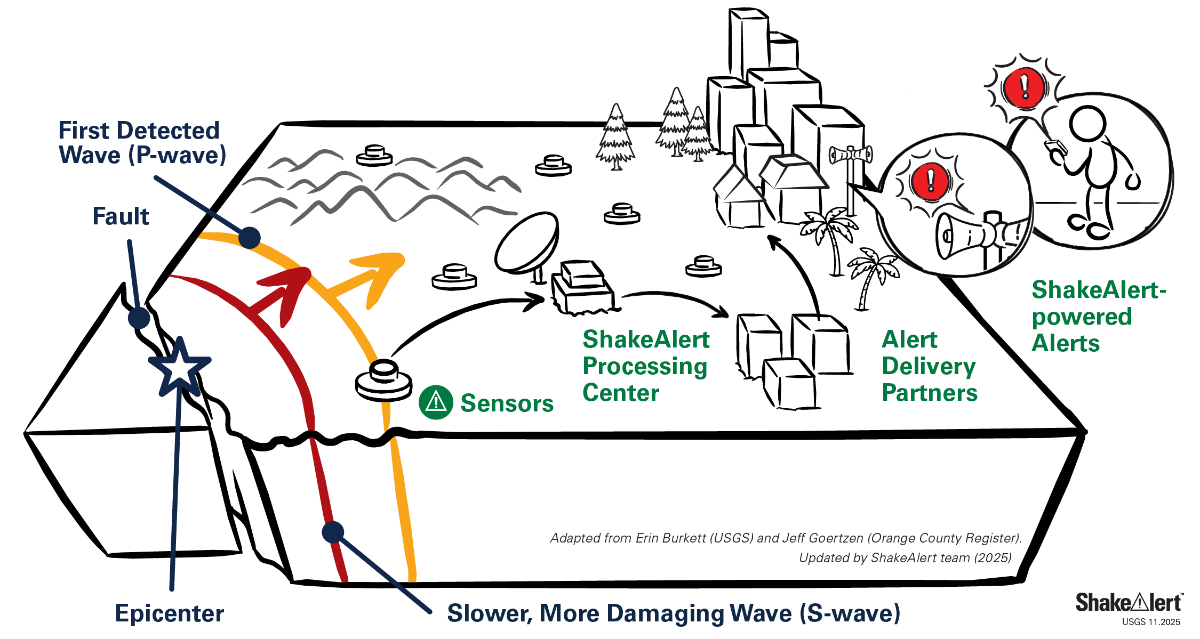
System Basics
ShakeAlert Earthquake Early Warning System
1
Detect
2
Process
3
Deliver
4
Protect
Notes:
Use the diagram as the big-picture view. The ShakeAlert System detects the first waves from an earthquake, processes information about the earthquake and expected shaking, delivers that information to partners, and supports protective action. Emphasize the full chain: sensors and Processing Centers create rapid estimates, Alert Delivery Partners send alerts, and people or automated systems protect themselves.

Slide 22

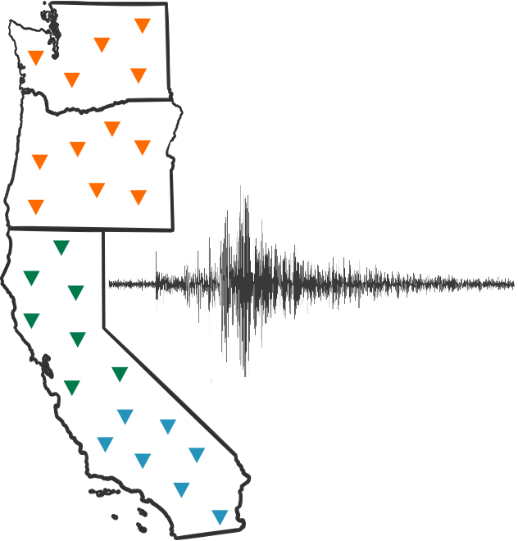
1
Detect
2
Process
3
Deliver
ShakeAlert sensors monitor ground motion across California, Oregon, and Washington 24 hours a day.
When an earthquake begins:
  Nearby sensors detect the first seismic waves.
  Multiple sensors help confirm that an earthquake is occurring.
  Data are transmitted immediately to ShakeAlert Processing Centers.
The goal: Detect the earthquake as quickly and reliably as possible.
Notes:
Explain the detect step. ShakeAlert sensors monitor ground motion across California, Oregon, and Washington 24 hours a day. The system also uses Global Navigation Satellite System (GNSS) sensors, which use satellite signals to measure how far the ground moves during an earthquake. GNSS data complement seismic-sensor data and can improve estimates for very large earthquakes.
When an earthquake begins, nearby sensors detect the first seismic waves. Multiple sensors help confirm that the shaking is from an earthquake rather than another local disturbance. Data are transmitted immediately to ShakeAlert Processing Centers so the system can begin estimating the event.

Slide 23
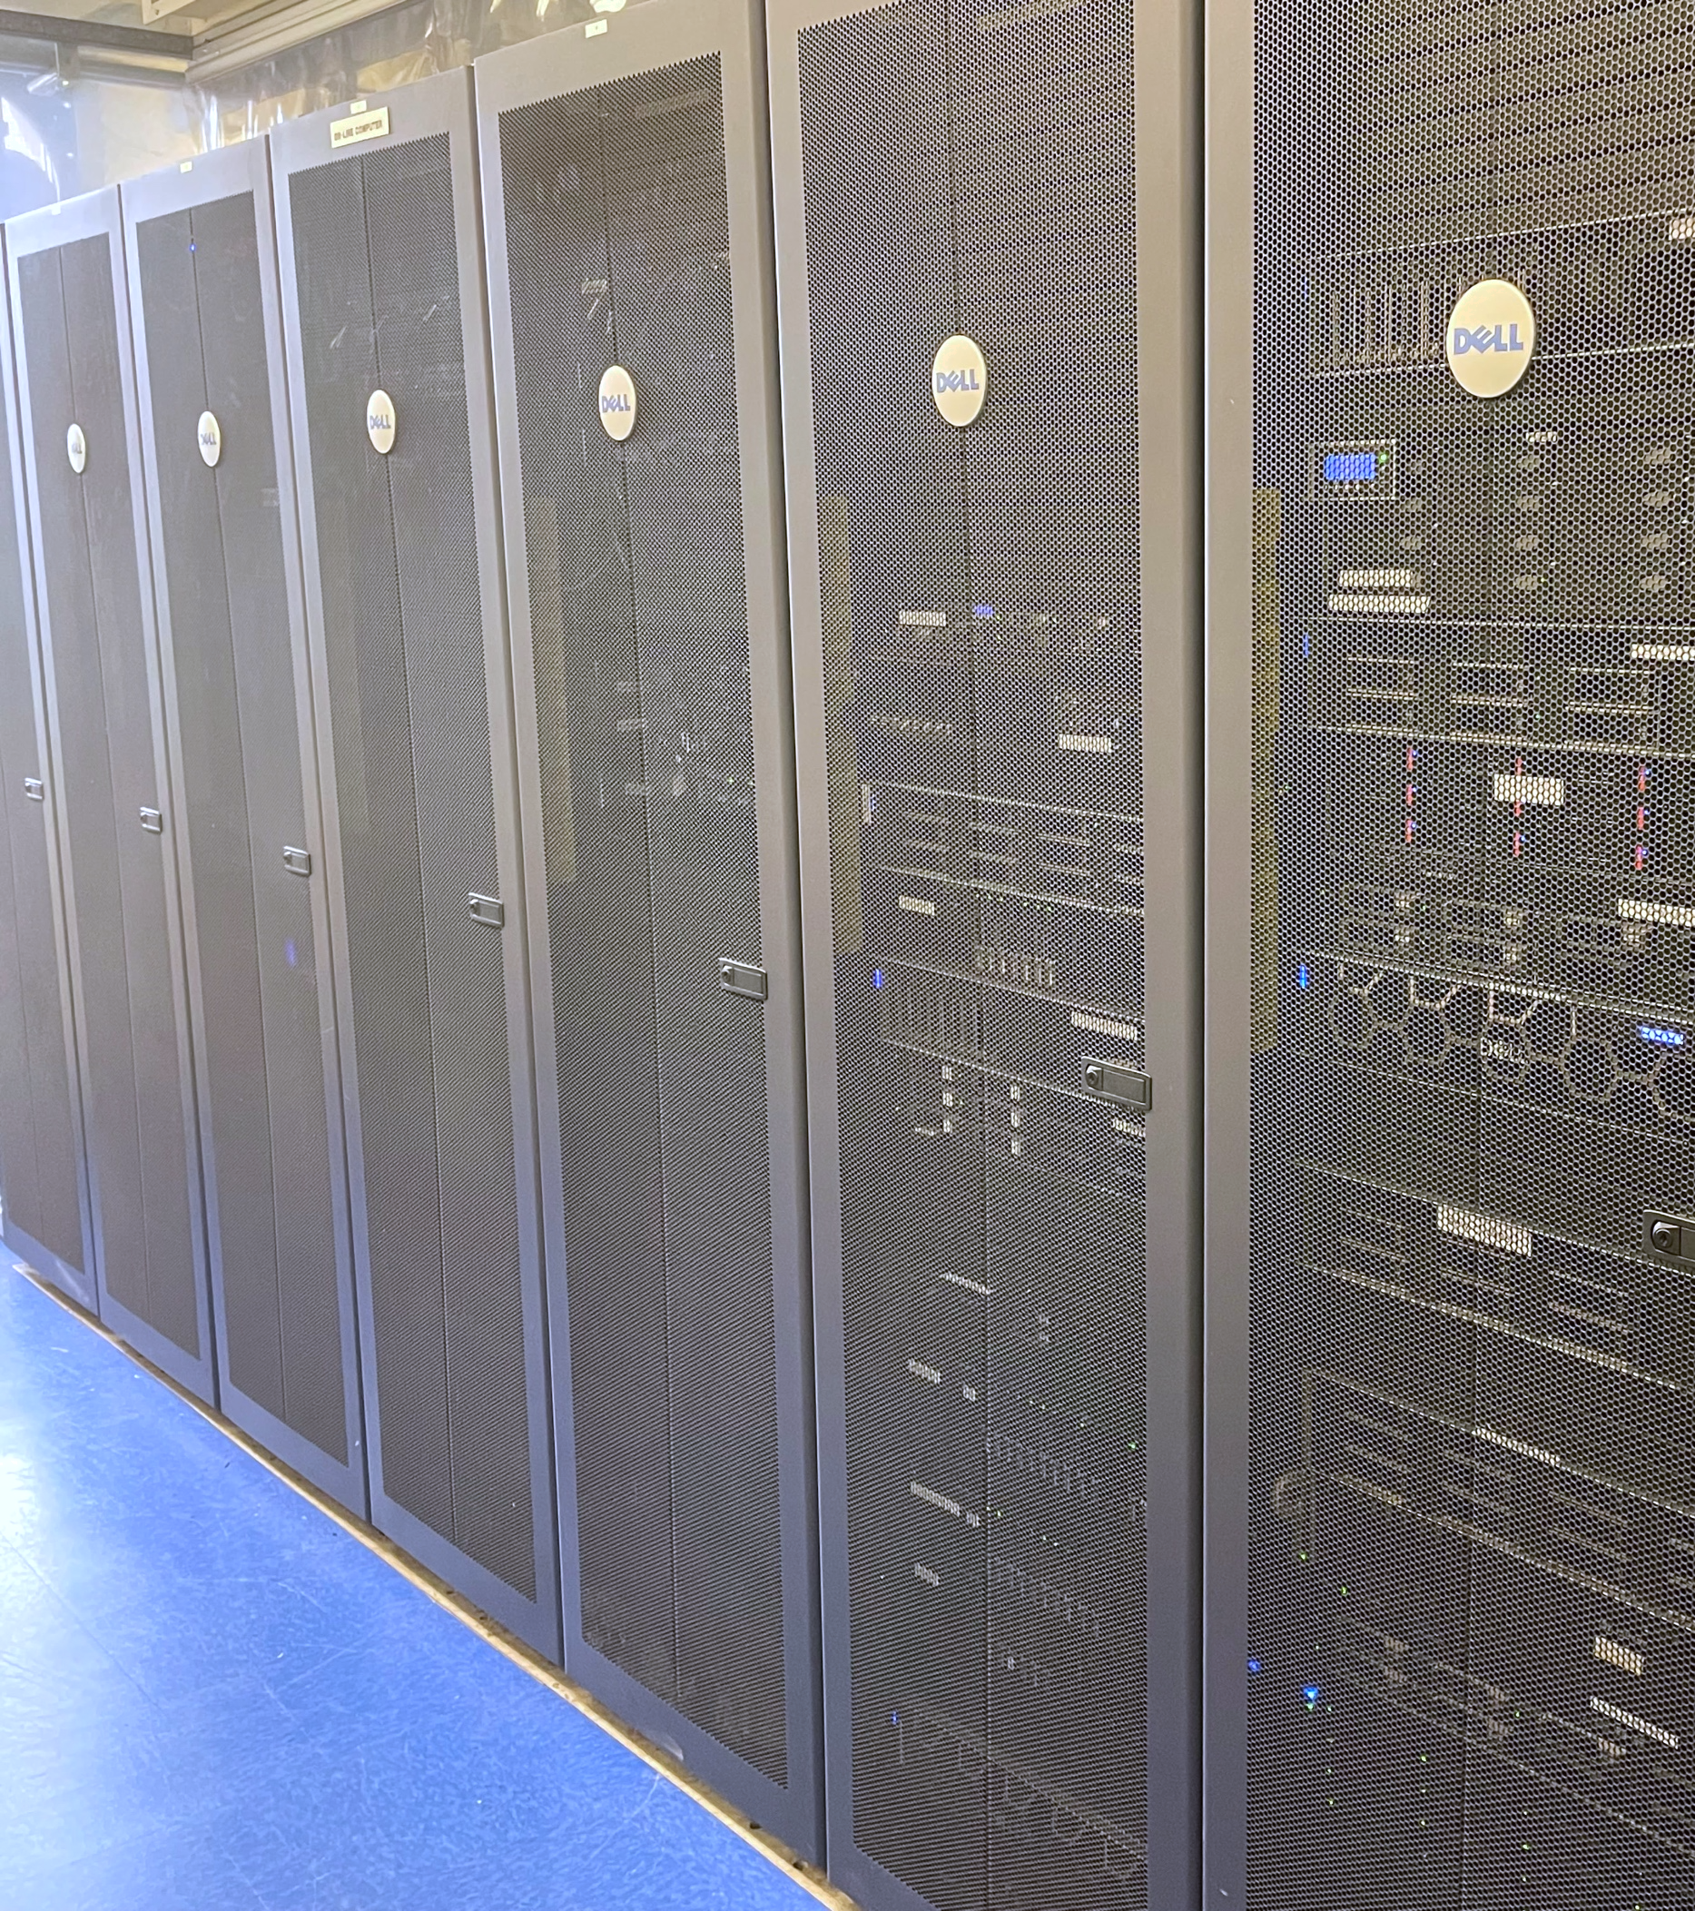
1
Detect
2
Process
3
Deliver
ShakeAlert Processing Centers analyze incoming sensor data simultaneously.
Within seconds, the system estimates:
  Where the earthquake began
  Its magnitude
  Where shaking is expected
  How strong that shaking may be
Estimates are updated as additional sensor data arrive.
The goal: Produce accurate, timely information that alert delivery partners can use.
Notes:
Explain the process step. ShakeAlert Processing Centers in Seattle (Washington), Menlo Park (California), and Pasadena (California) analyze incoming sensor data simultaneously. Within seconds, the system estimates where the earthquake began, its magnitude, where shaking is expected, and how strong that shaking may be. Because earthquakes can grow and change as the fault ruptures, estimates are updated as additional sensor data arrive.

Slide 24

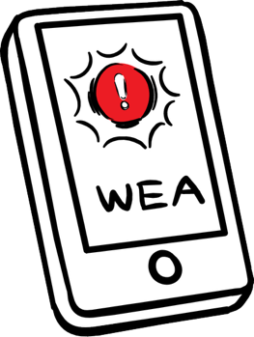
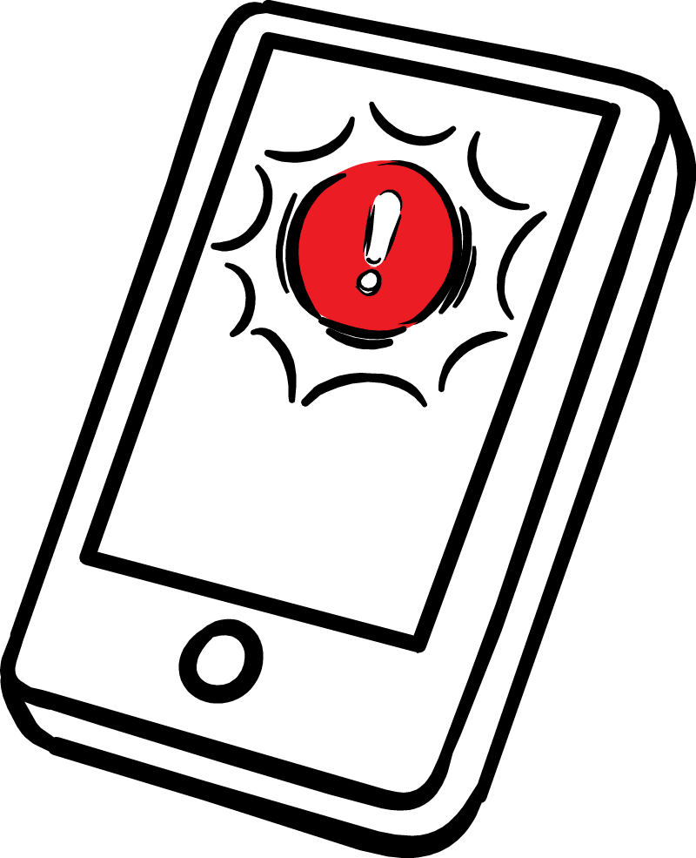
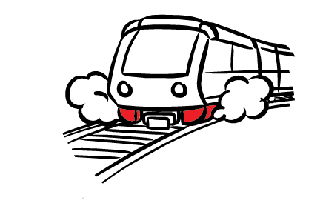
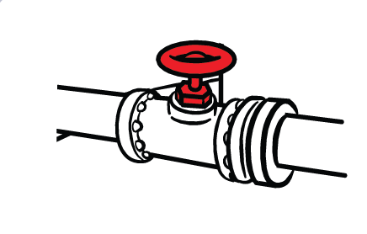

1
Detect
2
Process
3
Deliver
ShakeAlert rapidly produces information about the earthquake and expected shaking.
Alert delivery partners then use that information to:
  Send alerts through WEA, phone operating systems, and apps such as MyShake.
  Trigger automated actions in transportation, utilities, and other systems.
Different delivery methods may use different thresholds and geographic areas.
The goal: Get useful earthquake information to people and systems as quickly as possible.
Notes:
Explain the deliver step. ShakeAlert rapidly produces information about the earthquake and expected shaking, then provides that information to alert delivery partners. Those partners may send alerts through Wireless Emergency Alerts, phone operating systems, apps such as MyShake, or trigger automated actions in transportation, utilities, and other systems. Different delivery methods may use different thresholds and geographic areas.

Slide 25
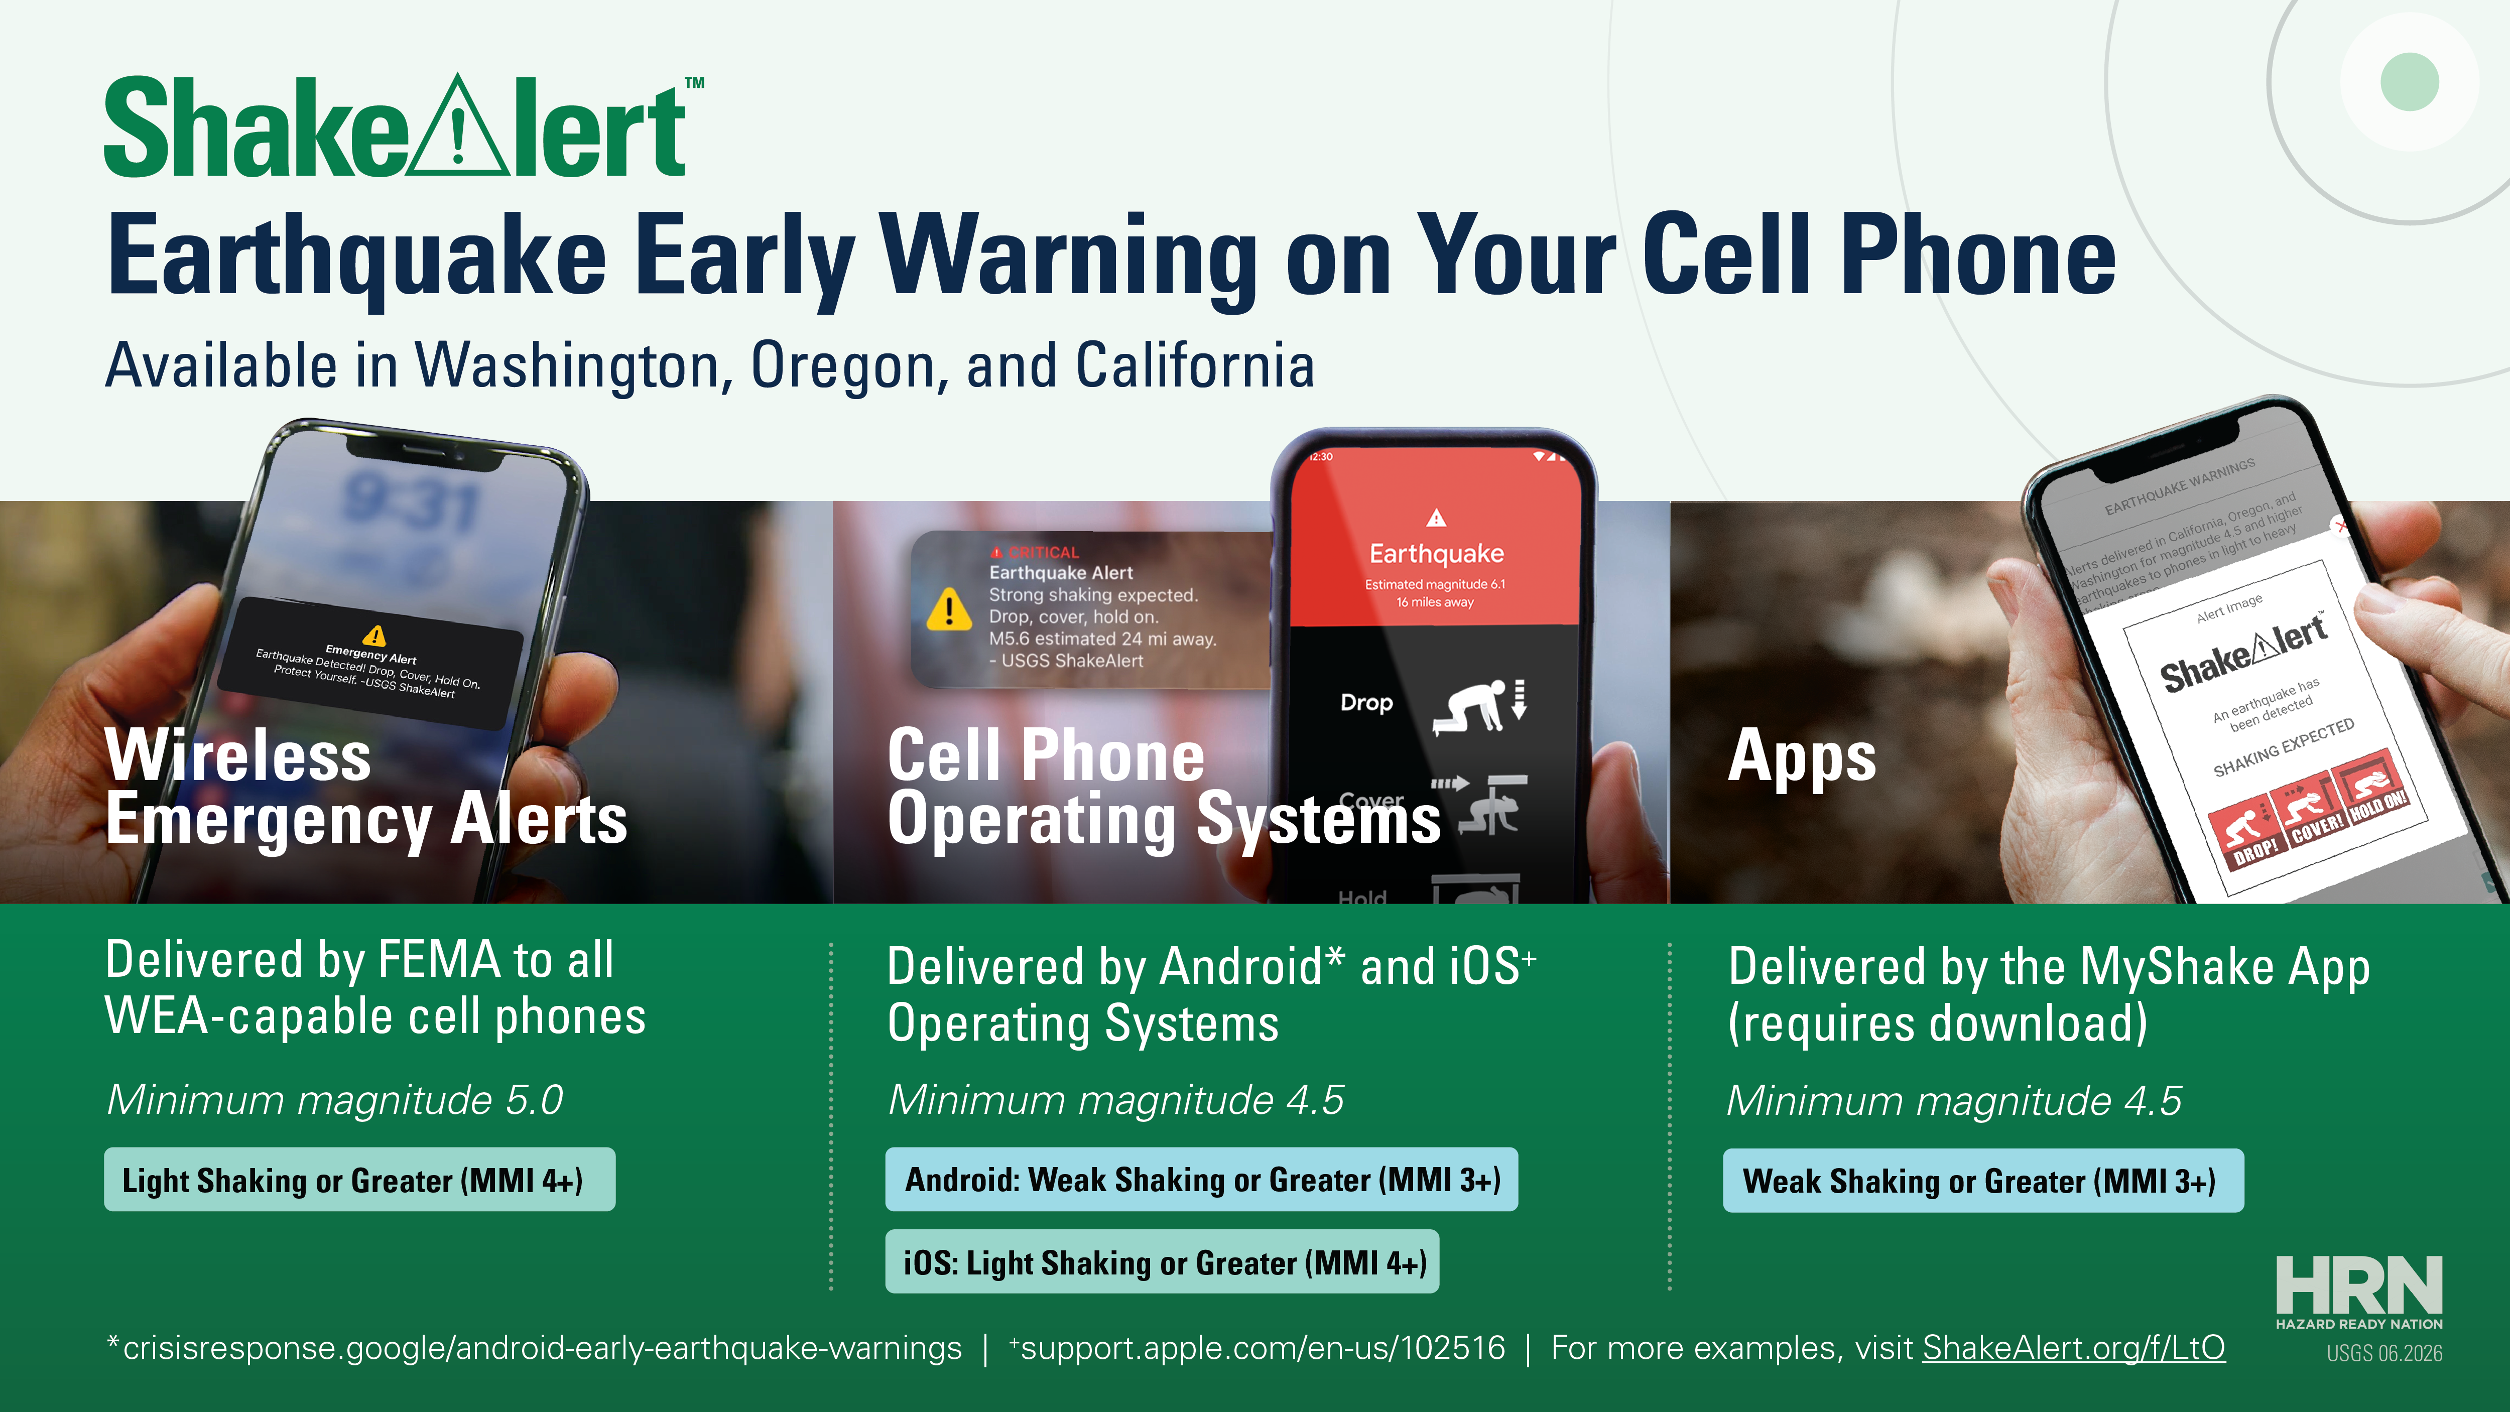
Notes:
Use this slide as a short transition or pause. Summarize the system in one sentence: ShakeAlert detects ground motion quickly, processes the data automatically, delivers useful earthquake information through partners, and helps people and systems protect themselves before strong shaking arrives when warning is possible. Then move into when alerts are sent.

Slide 26
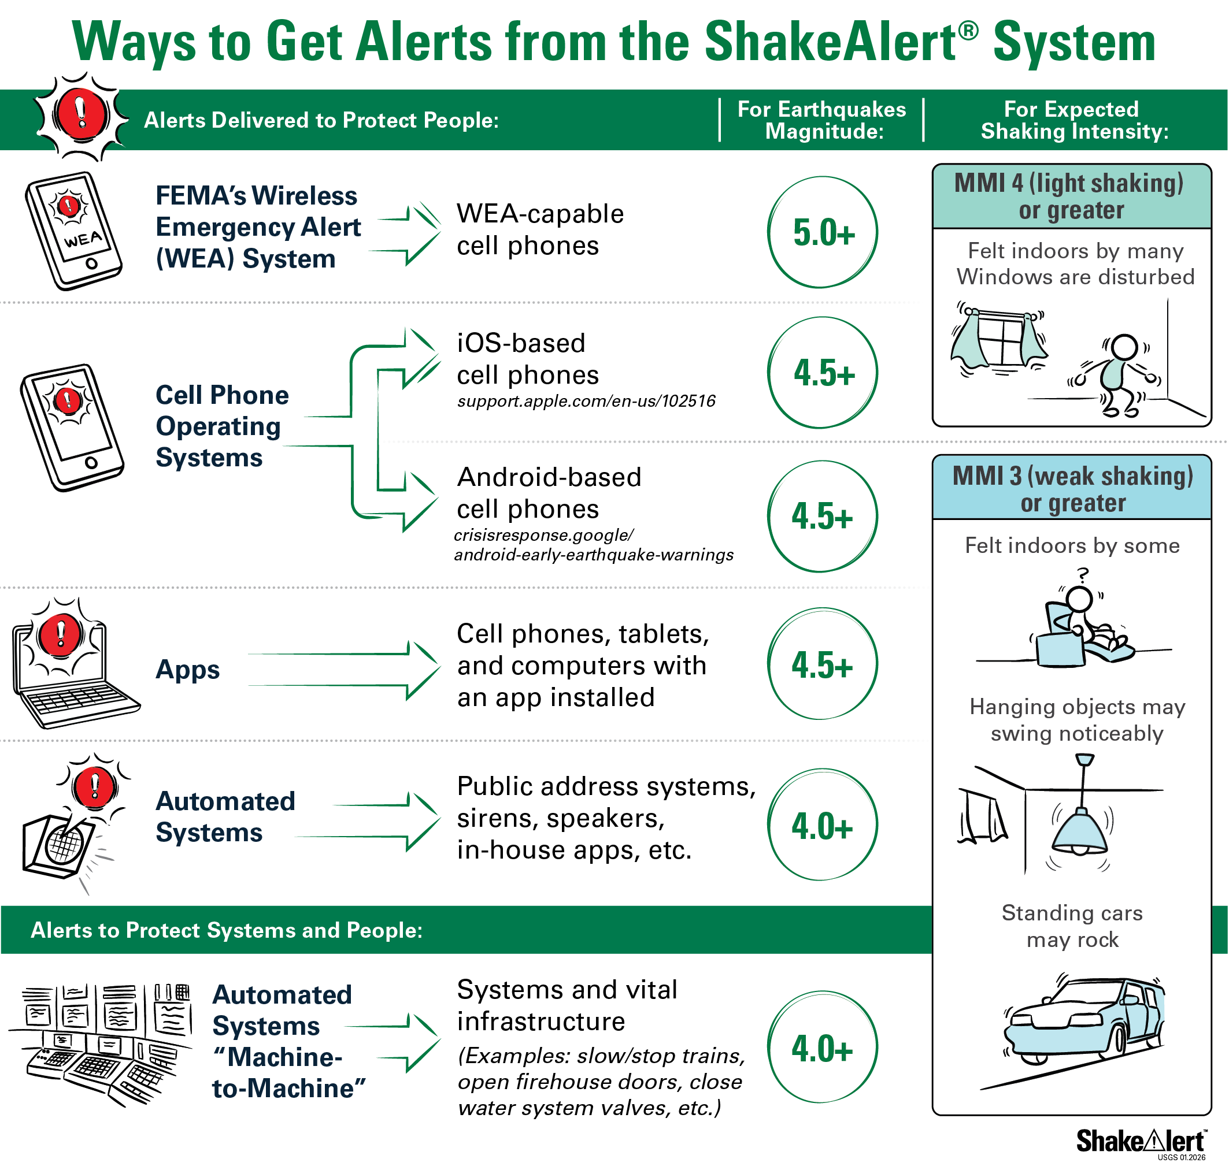
When Are Alerts Sent?
Whether you will get an alerts depend on:
Estimated earthquake magnitude
Expected shaking
at your location
The delivery method
being used
Notes:
Explain that alerts are not sent for every earthquake or to every device. Whether someone gets an alert depends on the estimated earthquake magnitude, the expected shaking at that person’s location, and the delivery method being used. Different delivery methods may use different thresholds. This is why one person may receive an alert while another person nearby may not.

Slide 27
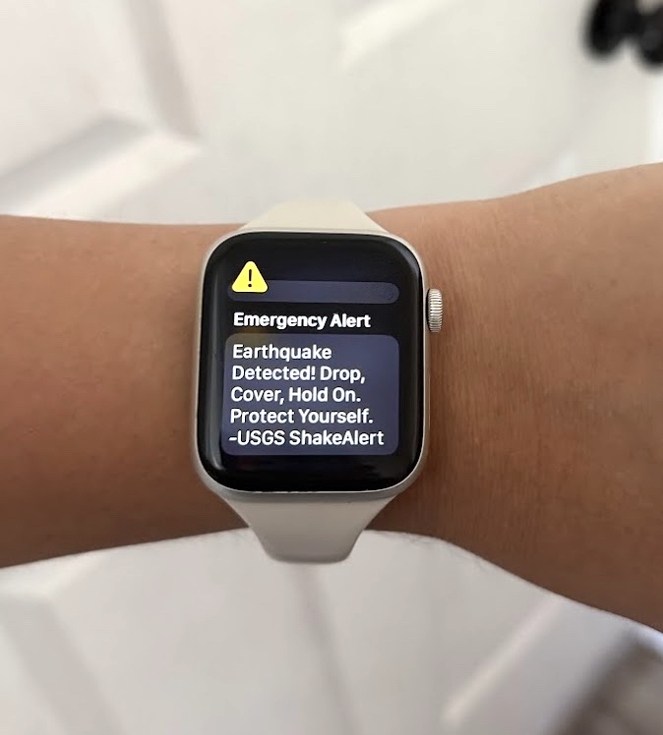
How Much Warning Might You Get?
The amount of warning depends on:
Where the earthquake begins
Your distance from the earthquake
You may receive:
Several seconds of warning
Very little warning
No warning
Always act immediately if you receive an alert or feel shaking.
Notes:
Explain that warning time varies. Some people may get several seconds of warning, some may get very little warning, and some may get no warning before shaking arrives. The most important factor is distance from where the earthquake begins. People closer to the epicenter are more likely to feel shaking before an alert can arrive.
The safest rule is simple: act immediately if you receive an alert or feel shaking.

Slide 28
Why You Might Not Receive an Alert
You might not receive an alert when:
The earthquake or expected shaking did not meet the delivery method’s threshold.
You were too close to the earthquake to receive a warning before the shaking arrived.
Your device settings, location services, connectivity, or delivery method affected receipt.
ShakeAlert does not currently serve your location.
Notes:
Normalize the limits of the system. A person might not receive an alert because the earthquake or expected shaking did not meet the delivery method’s threshold, they were too close to the earthquake, device settings or connectivity affected receipt, or ShakeAlert does not currently serve their location. Reinforce that people should not wait for an alert if they feel shaking. Shaking itself is a warning to act.

Slide 29
Myths and Facts About ShakeAlert Earthquake Early Warning
MYTH
FACT
Earthquakes can be predicted.
Earthquakes cannot be predicted. ShakeAlert detects
shaking after an earthquake begins and provides
information fast enough that alerts can be delivered to
people and vital systems before strong shaking arrives.
Every earthquake will trigger an alert.
Alerts are only delivered when magnitude and intensity
thresholds are met. Smaller or distant earthquakes may
not trigger alerts at all.
Everyone will get an alert.
Some devices may not get alerts and people near the
epicenter may feel shaking before they get an alert. Some
devices may miss alerts due to settings or issues with
connectivity.
Notes:
Use this slide to correct common misconceptions. ShakeAlert does not predict earthquakes; it detects shaking after a quake begins. Not everyone will get an alert, especially people close to the epicenter or those with device or connectivity issues. Not every earthquake triggers an alert because thresholds must be met.
CERT volunteers can build trust by explaining both what ShakeAlert can and cannot do.

Slide 30
MODULE 4
Experiencing ShakeAlert
Notes:
Transition into Module 4. Explain that participants have learned how the system works behind the scenes. Now they will look at what ShakeAlert-powered alerts may look and sound like, how alerts can reach people and systems, and why alerts may differ depending on the delivery method.

Slide 31



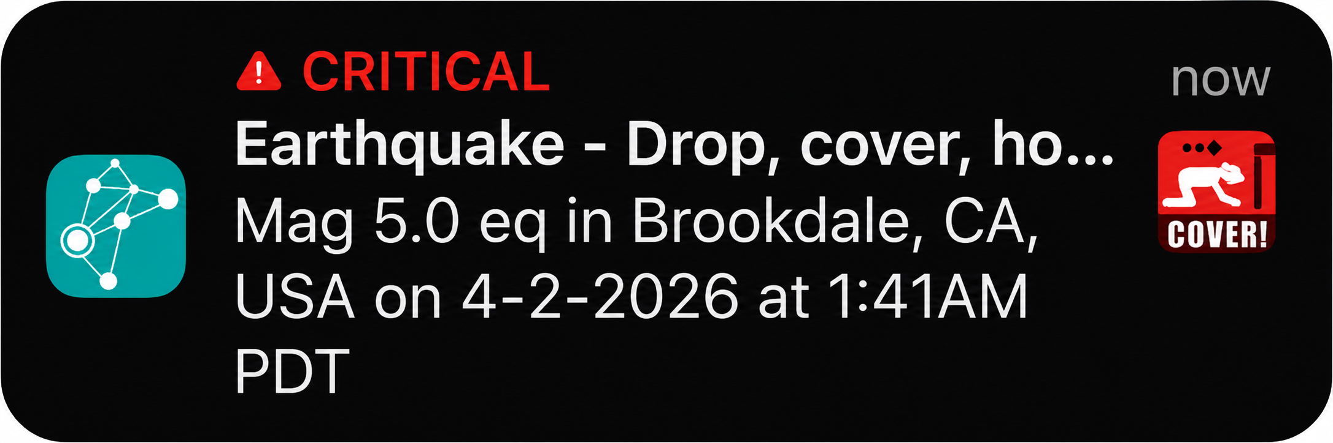
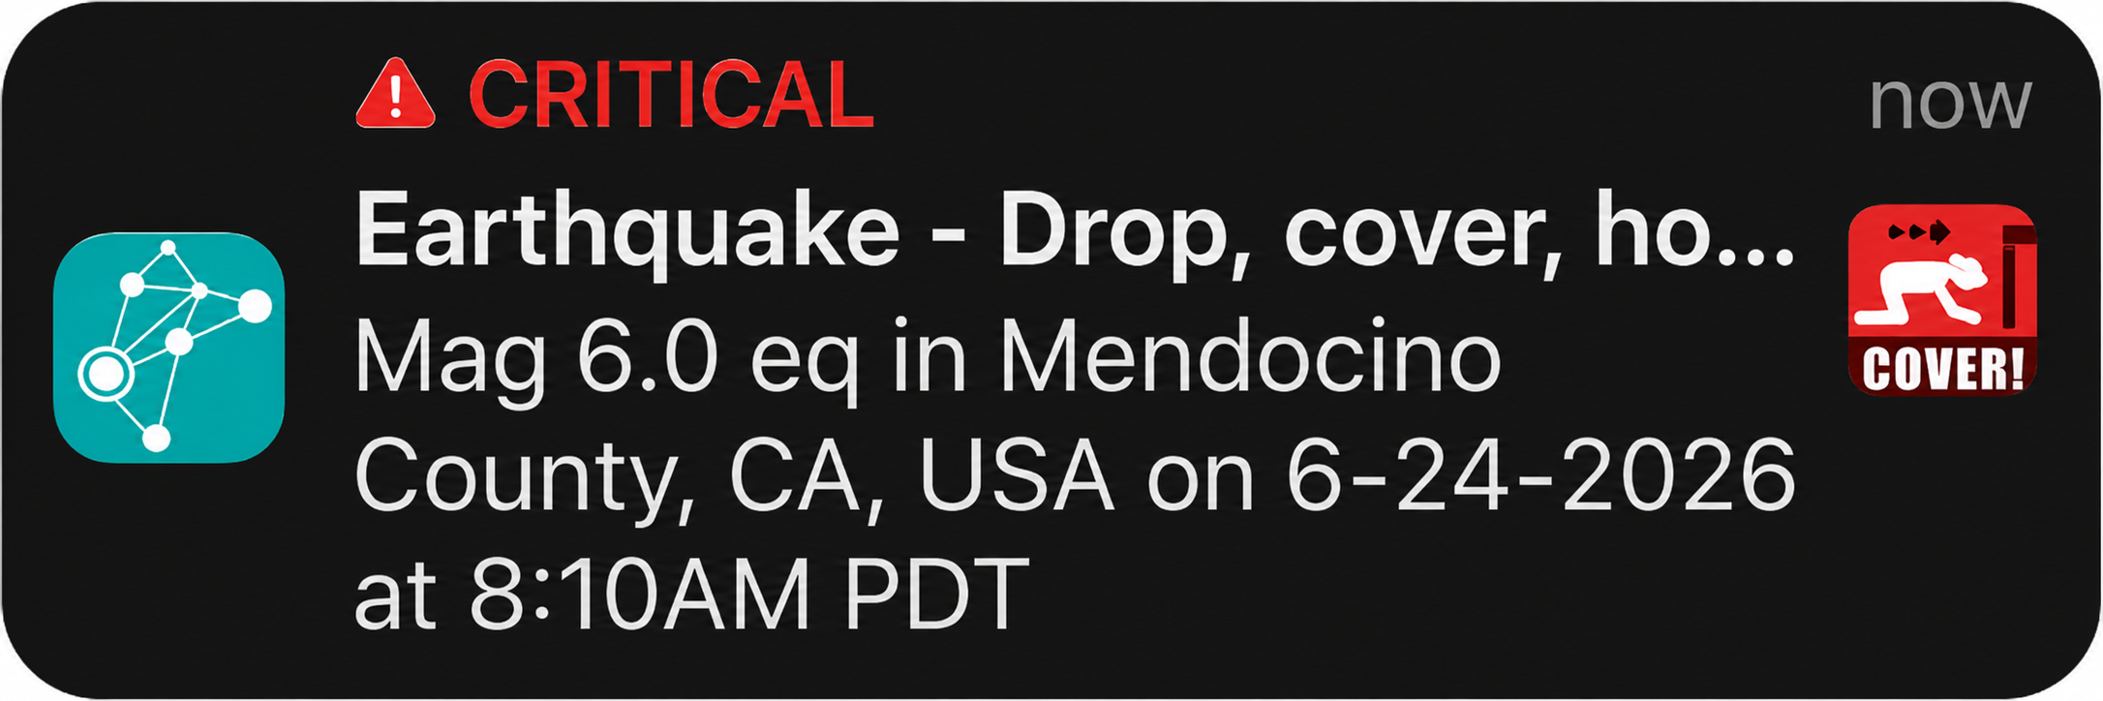
What Alerts Look and Sound Like
ShakeAlert-powered alerts may look or sound different depending on your phone, app, or delivery method.
MOST ALERTS INCLUDE:
Sound
A loud or distinctive alert tone.
Vibration
A noticeable vibration pattern.
Message
A short instruction such as:
“Earthquake detected! Drop, Cover, and Hold On.”
Don’t wait for the message to finish. Take action immediately.
Notes:
Explain that ShakeAlert-powered alerts may look and sound different depending on the phone, app, operating system, or delivery method. They may include a sound, vibration, full-screen message, banner, or other notification. Alerts may feel abrupt or startling, which is why practice is important. Do not wait for the message to finish—the action is the same: if you receive an alert or feel shaking, take protective action immediately.
Instructor note: Play the media file. If it is unavailable, briefly explain that alert sounds and displays can vary and continue to the next slide.

Slide 32
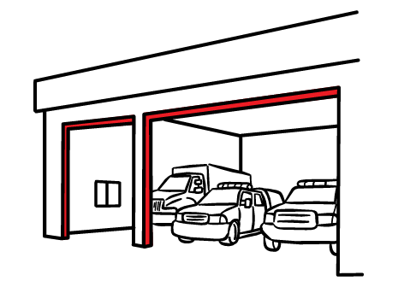
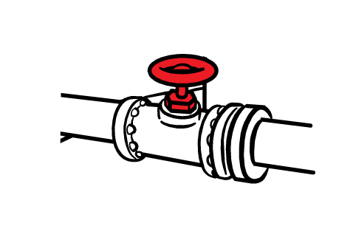
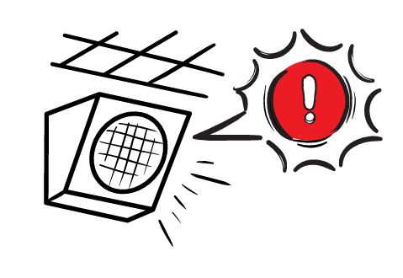
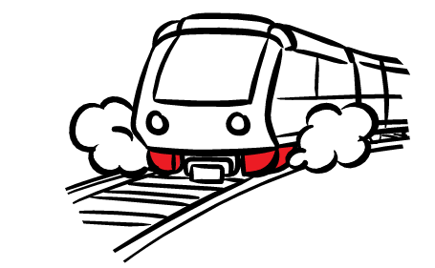
Automatic Protective Actions Help Keep Systems Safe
Alerts can trigger automatic safety steps, such as:
Issuing audible alerts through a public address system in a school or workplace
Slowing/stopping trains to prevent derailments
Opening
firehouse doors for emergency vehicles
Shutting off
gas valves
These actions protect people, infrastructure, and services.
Notes:
Explain that ShakeAlert-powered information can also trigger automated protective actions. These actions can happen without waiting for a person to respond. Examples include slowing or stopping trains, opening firehouse doors, shutting off valves, or issuing audible alerts through public address systems. These actions help protect people, infrastructure, and services before strong shaking arrives.
Let’s take a look at some real examples.

Slide 33
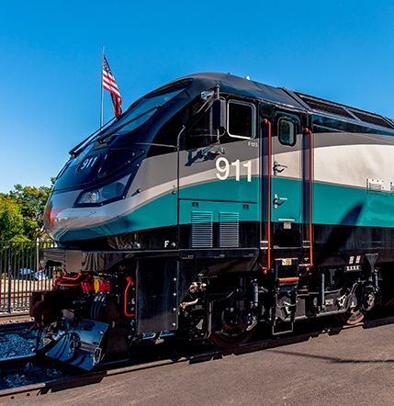
Rail Safety in Action
CASE STUDY
Metrolink | Southern California
ShakeAlert-powered seismic interface helps protect passengers, crews, and rail infrastructure before strong shaking arrives.
When shaking is expected, the system can automatically:
Reduce train speed.
Stop trains at safer locations, such as outside tunnels, bridges, or overpasses.
Produce a rapid report showing which parts of the rail network were exposed to shaking after the earthquake.
Image is courtesy of Metrolink.
Notes:
Use Metrolink as a concrete example of automated protective action. When shaking is expected, a ShakeAlert-powered seismic interface can reduce train speed, stop trains at safer locations, and support rapid reporting of which parts of the network were exposed to shaking. Emphasize why this matters: it helps protect passengers, crews, and rail infrastructure while supporting faster service restoration.

Slide 34


School Alerting in Action
CASE STUDY
Stanwood-Camano School District | Washington
ShakeAlert-powered equipment connected to public address systems helps protect students and staff across all 13 district buildings.
When shaking is expected, the public address system can automatically:
Play an alert tone.
Announce that shaking is expected soon.
Direct everyone to Drop, Cover, and Hold On immediately.
Image is courtesy of University of Oregon
Notes:
Use the Stanwood-Camano School District example to show how ShakeAlert can support school safety. ShakeAlert-powered equipment connected to public address systems can automatically play an alert tone, announce that shaking is expected, and direct students and staff to Drop, Cover, and Hold On. The same alerting approach can also support drills, helping people practice what they may experience in a real event.

Slide 35
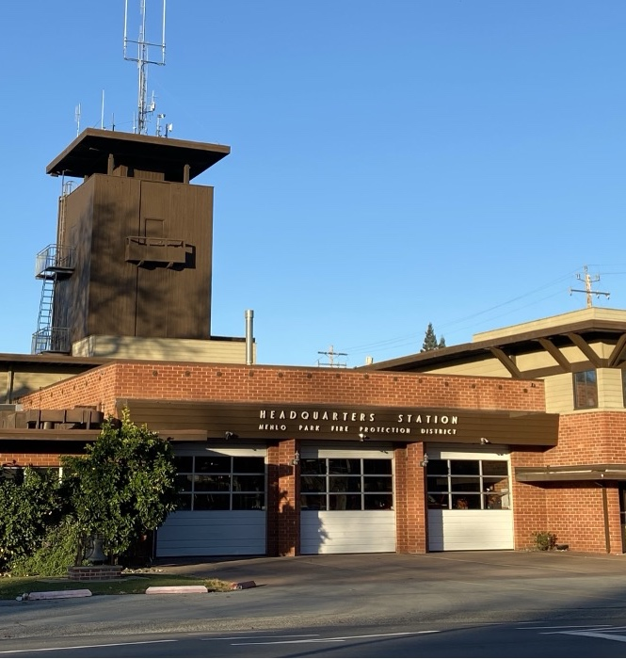

Fire Station Readiness in Action
CASE STUDY
Menlo Park Fire Protection District | California
ShakeAlert-powered hardware connected to its existing fire station alerting system helps protect firefighters and keep emergency vehicles ready to respond after an earthquake.
When shaking is expected, the system can automatically:
Play an audible warning and activate warning lights.
Shut off gas to cooking equipment.
Open firehouse bay doors before they could become inoperable.
Photo credit: David Croker, USGS. (Public Domain)
Notes:
Use the Menlo Park Fire Protection District example to show how ShakeAlert can support emergency response readiness. When shaking is expected, the system can activate audible warnings and warning lights, shut off gas to cooking equipment, and open firehouse bay doors before they may become inoperable. This helps protect firefighters and keeps emergency vehicles ready to respond after an earthquake.

Slide 36
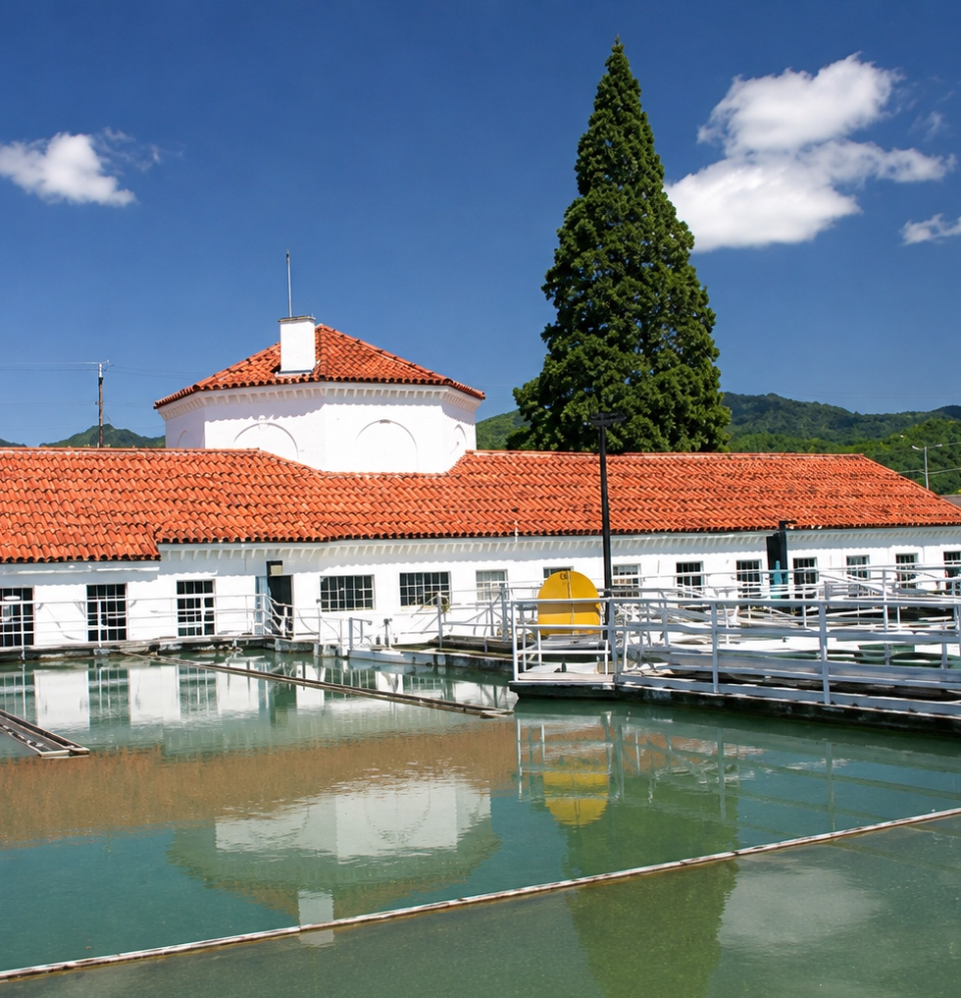

Water System Protection in Action
CASE STUDY
City of Grants Pass | Oregon
ShakeAlert-powered equipment connected to water system controls helps preserve water for drinking and firefighting after an earthquake.
When shaking is expected, reservoir valves can automatically:
Close before power is lost or pipes are damaged.
Reduce the risk of uncontrolled water loss.
Preserve millions of gallons for emergency use.
Image is courtesy of the
City of Grants Pass.
Notes:
Use the City of Grants Pass example to show how automated actions can protect water systems. When shaking is expected, reservoir valves can close before power is lost or pipes are damaged. This can reduce uncontrolled water loss and preserve water for drinking, firefighting, and emergency response. Emphasize that protecting infrastructure helps communities recover faster.
Instructor note: At one reservoir, the system could retain more than 3.5 million gallons of water, enough to provide each customer about 10 gallons per day for a month.

Slide 37
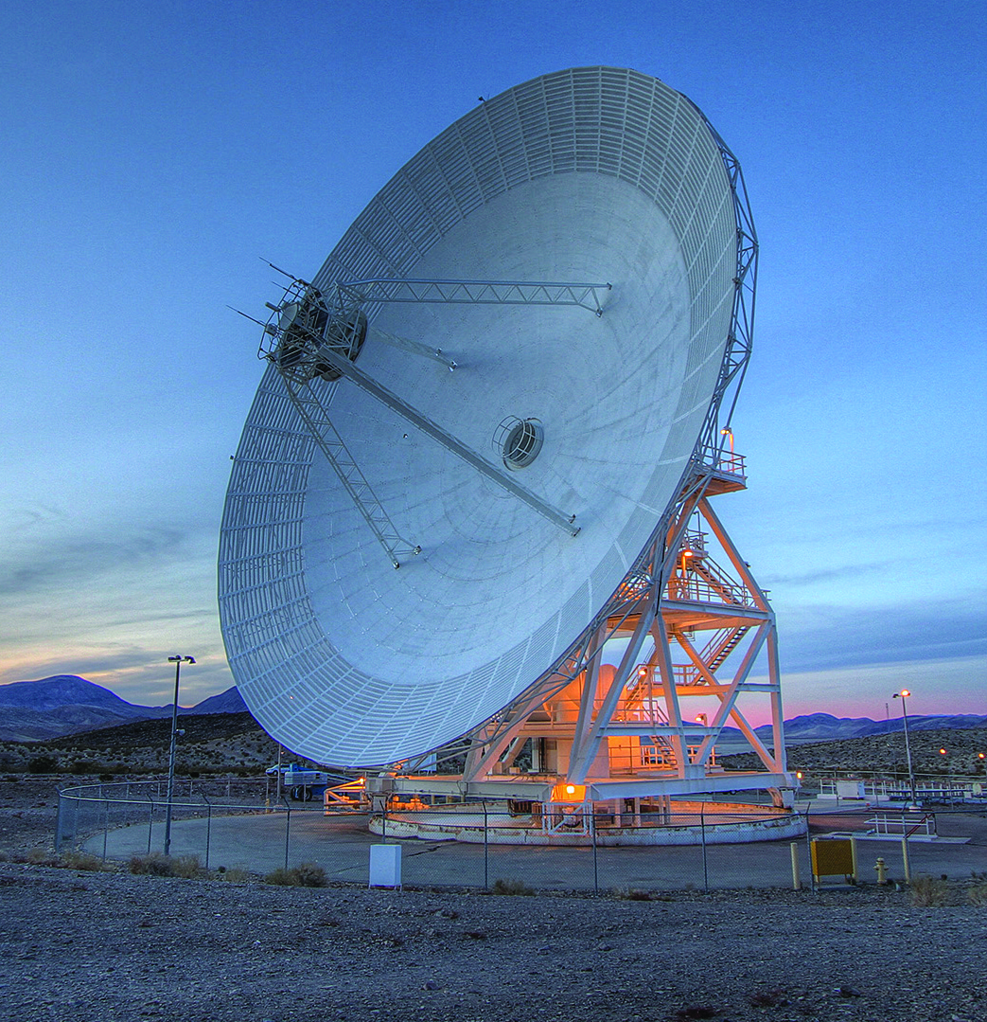
Space Communication System Protection in Action
CASE STUDY
NASA Deep Space Network | California
ShakeAlert-powered technology helps protect giant antennas that communicate with spacecrafts across the solar system.
When shaking is expected, the system can automatically:
Stop antenna movement.
Cut power.
Engage safety locks.
Image is courtesy of JPL.
Notes:
Use the NASA Deep Space Network example to show that ShakeAlert can protect specialized systems as well as everyday community systems. When shaking is expected, automated actions can stop antenna movement, cut power, and engage safety locks. The broader point is that ShakeAlert information can be used in many settings where seconds of warning can reduce damage or disruption.
Instructor note: The protected antennas can communicate with up to 40 space missions at one time, helping prevent damage to equipment worth tens or hundreds of millions of dollars.

Slide 38


Imagine the Possibilities
Think about the places, systems, and services your community depends on.
Where could an automated action help protect people or reduce disruption before strong shaking arrives?
CONSIDER
Schools and public buildings
Transportation systems
Utilities and communications
Emergency response facilities
Workplaces and community spaces
What would happen automatically?
Who or what would it help protect?
Notes:
Invite participants to imagine where automated protective actions could help in their own community. Ask them to think about schools, public buildings, transportation systems, utilities, communications, emergency response facilities, workplaces, and community spaces. Keep the discussion practical: What would happen automatically, and who or what would it help protect? Capture a few examples if time allows.

Slide 39
MODULE 5
Personal Protective Actions
Notes:
Transition into Module 5. Explain that the course now shifts from systems to personal protective actions. ShakeAlert can provide seconds of warning in some situations, but those seconds only help if people already know what to do. This section focuses on immediate action when someone receives an alert or feels shaking.

Slide 40
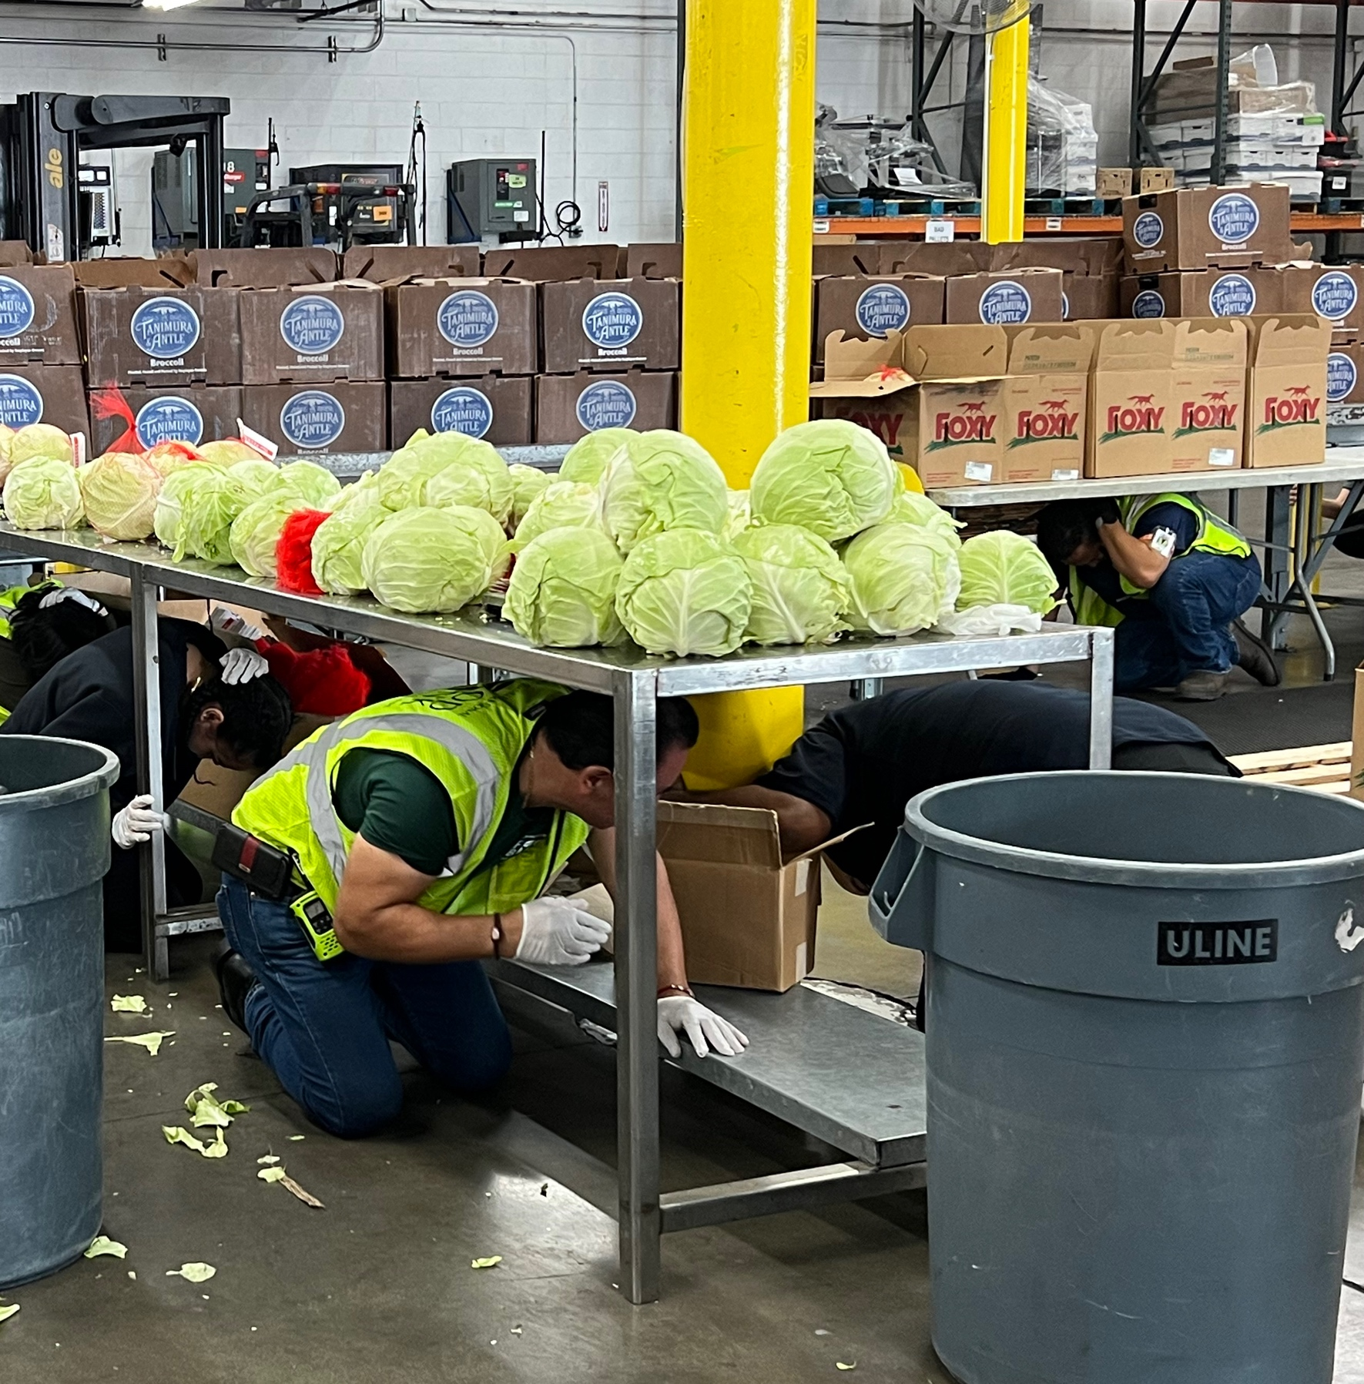
Drop, Cover, and Hold On
When you receive an alert or feel shaking:
DROP to your hands and knees. This helps keep you from being knocked down and allows you to move if needed.
COVER your head and neck. Get under a sturdy table or desk if one is nearby. Otherwise, protect your head and neck where you are.
HOLD ON until the shaking stops. Hold onto your shelter and be ready to move with it.
Act immediately. Do not wait to see whether the shaking gets stronger.
Notes:
Teach Drop, Cover, and Hold On clearly. Drop to your hands and knees so you are less likely to be knocked down. Cover your head and neck, preferably under a sturdy table or desk if one is nearby. Hold On until the shaking stops. If no furniture is nearby, protect your head and neck where you are. Act immediately and do not wait to see if shaking gets stronger.

Slide 41
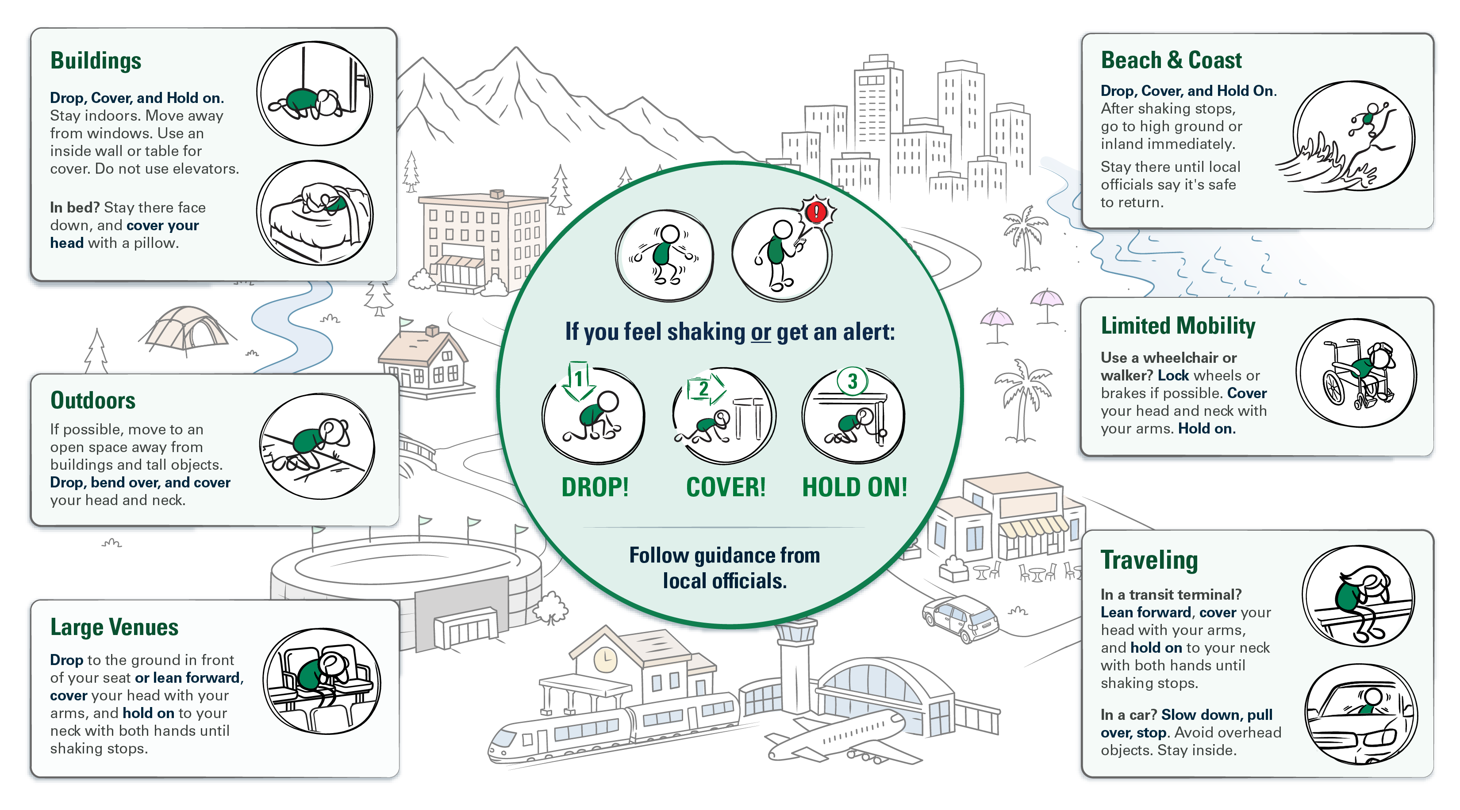
Protective Actions in Different Environments
Notes:
Use this slide to introduce modified protective actions. The safest action may vary depending on where someone is, what they are doing, and what their abilities are. The consistent goal is to protect the head, neck, and vital organs and reduce exposure to falling or flying objects.
Briefly walk through the examples: indoors, Drop, Cover, and Hold On and stay away from windows; outdoors, move to an open area away from buildings and overhead hazards; in large venues or transit terminals, stay in place, lean forward or drop, and protect your head and neck; in a vehicle, slow down, pull over, stop, and stay inside; and for people using wheelchairs or walkers, lock the wheels or brakes if possible and protect the head and neck. Near the coast, protect yourself during shaking, then move to high ground or inland once shaking stops.
For babies, children, and pets, keep them close and protect them when it is safe to do so without putting yourself at greater risk. Encourage participants to think about and practice what they would do in the places where they spend time.

Slide 42
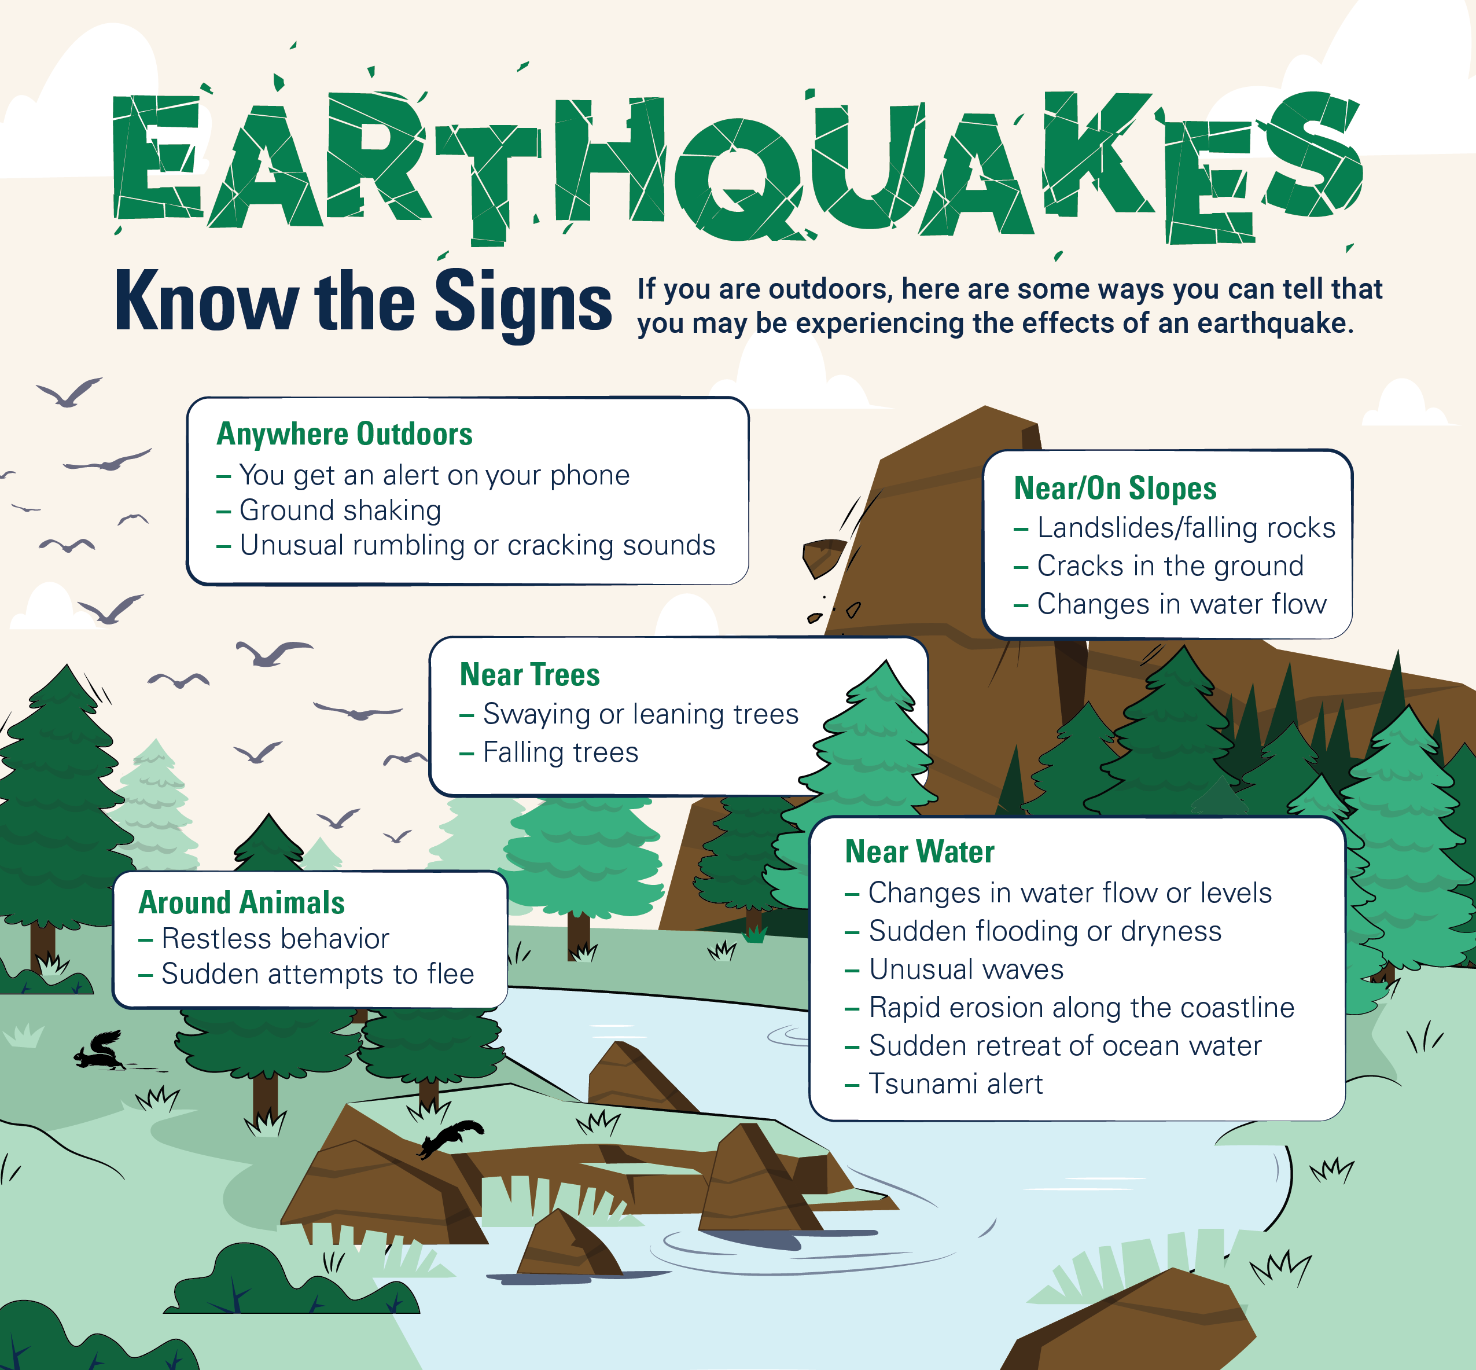
Know the Signs in Nature
If cell or internet service is limited or unavailable, it may undercut your ability to get an alert
Know the signs in nature that may indicate that shaking may be coming your way.
If you see or hear any of these signs, take protective action immediately.
Notes:
Use this slide to reinforce that people may not always receive a ShakeAlert-powered alert, especially when cell or internet service is limited or unavailable. If participants receive an alert, feel shaking, or see or hear signs of immediate danger, they should take protective action right away.
Briefly point out the examples: unusual rumbling or cracking sounds; changes near trees, slopes, or water; and unusual water behavior near the coast. These signs do not predict earthquakes, but they may indicate that an earthquake or related hazard is affecting the area.
Near the coast, unusual water behavior can signal tsunami danger. The next slide explains what to do after strong or long shaking.

Slide 43


Focus on Coastal Considerations
Go to high ground or inland immediately
ShakeAlert provides earthquake early warning—not tsunami warning.
If you are near the coast:
Strong or long earthquake shaking is your natural tsunami warning.
After the shaking stops, move immediately to higher ground or inland.
Don't wait for an official tsunami alert or warning before evacuating.
Follow local evacuation routes and instructions from emergency officials.
Stay there until local officials say it's safe to return
If you experience strong or long shaking near the coast: Protect yourself
during the earthquake. Evacuate for a tsunami after the shaking stops.
Notes:
Explain the coastal consideration clearly: ShakeAlert provides earthquake early warning, not tsunami warning. If someone is near the coast, strong or long shaking may be a natural tsunami warning. During shaking, protect yourself first. After shaking stops, move immediately to high ground or inland, follow local evacuation routes, and stay there until local officials say it is safe to return.
Note that this is a coastal-specific consideration, not something everyone needs to act on after an earthquake. The key point is that ShakeAlert is not a tsunami warning system. People near the coast should recognize strong or long shaking as a possible natural warning and know their local evacuation route in advance.
The National Oceanic and Atmospheric Administration (NOAA), the federal agency that provides tsunami warning and preparedness guidance, recommends: If shaking is strong or lasts 20 seconds or more, move out of the tsunami hazard zone as soon as shaking stops—ideally to about 100 feet above sea level or 1 mile inland. If that is not possible, move to the fourth floor or higher of a sturdy building.

Slide 44
What Not to Do When You Get an Alert or Feel Shaking
Do not
run outside.
Do not stand in a doorway
Do not move farther than necessary
Exterior walls, windows, and building exits may expose you to falling debris.
In most modern buildings, doorways do not provide added protection.
Take cover under nearby sturdy furniture or protect your head and neck where you are.
Act immediately. Stay where you are
unless moving a few steps will provide safer cover.
Notes:
Emphasize what not to do. Do not run outside during shaking, do not stand in a doorway, and do not move farther than necessary. Exterior walls, windows, and building exits can expose people to falling debris. In most modern buildings, doorways do not provide added protection. The safest response in most situations is to stay where you are, get low, and protect your head and neck.

Slide 45
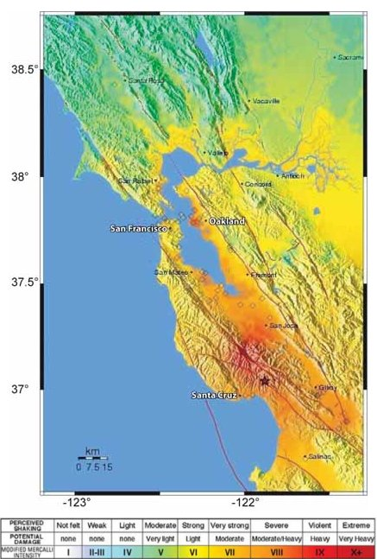
Learning From Loma Prieta
Northern California Loma Prieta Earthquake
M6.9/MMI VIII
OCTOBER 17 | 1989 | 5:04 PM
63 deaths
3,757 injuries (400 serious)
Damage to 12,000 homes and 2,600 businesses
$80 million in damage
(equivalent to $203 million today)
1.4 million people experienced power losses
News stations off air for 15-40 minutes
VIII
Notes:
Use the 1989 Loma Prieta in the San Francisco Bay Area as a real-world example of how suddenly a damaging earthquake can disrupt a community. The earthquake struck at 5:04 p.m. during the 1989 World Series and caused deaths, injuries, damage to homes and businesses, power outages, and major transportation and communications disruptions. At the time, there was no public earthquake early warning system providing advance notice. Keep the emphasis on the human and community impacts, then transition to imagining how early warning could have helped people act before strong shaking arrived.
Instructor note: Roman numerals (e.g., VIII) are used when referring to Modified Mercalli Intensity (MMI) as a qualitative description of how strongly shaking was experienced and its effects. Arabic numerals (e.g., 8) are used when referring to instrument-measured or numerical outputs, if applicable. This is still the same concept of intensity covered earlier.

Slide 46
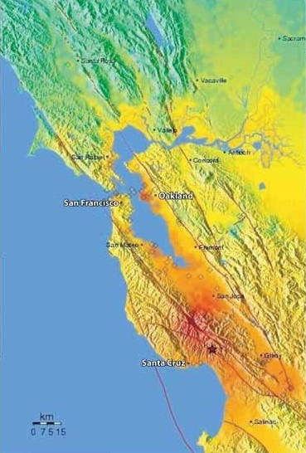
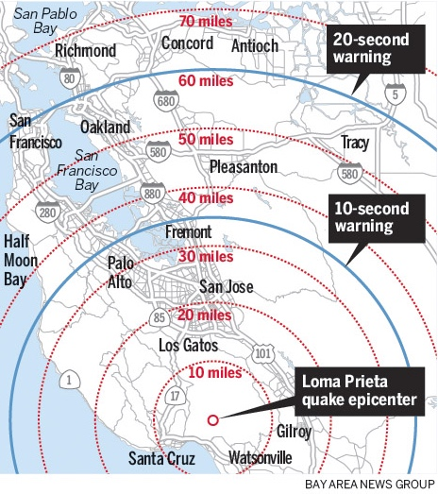
If ShakeAlert Had Been There
Imagine people in the
San Francisco Bay Area received a ShakeAlert-powered alert before strong shaking arrived.
Where might people have been at 5:04 p.m.?
What protective actions could they have taken immediately?
Notes:
Ask participants to imagine the San Francisco Bay Area receiving a ShakeAlert-powered alert before strong shaking arrived during Loma Prieta. You can point to the map or image on the slide and show that San Francisco is on the west side of the bay and Oakland on the east, connected by the Bay Bridge. If your group includes people unfamiliar with California geography, explain that they can imagine a long bridge linking two major cities across the water—this is the structure where the upper deck collapsed during the quake.
Because the sensors would have been closer to the epicenter, alerts could have reached San Francisco and Oakland about 20 seconds before the strongest shaking arrived. Those 20 seconds might have allowed drivers to slow or stop, broadcasters to stay live on the air, and people to drop, cover, and hold on before the violent shaking began. You can remind participants that twenty seconds may not sound like much, but it can make a huge difference in preventing injuries and saving lives.

Slide 47
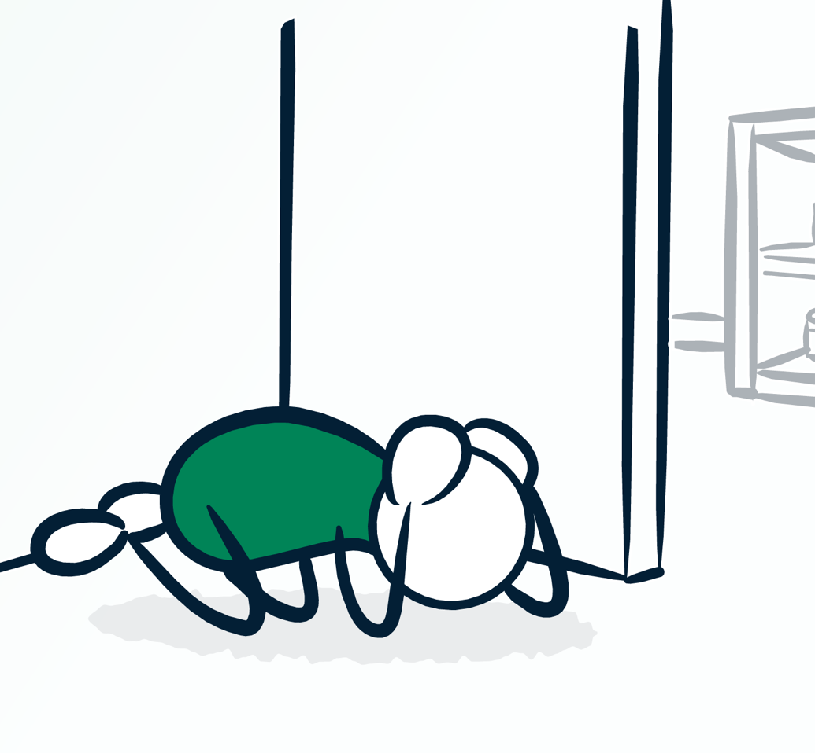
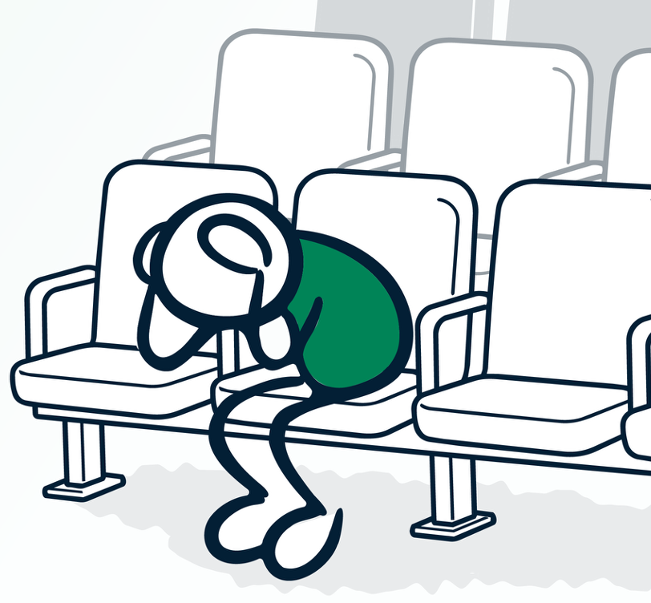
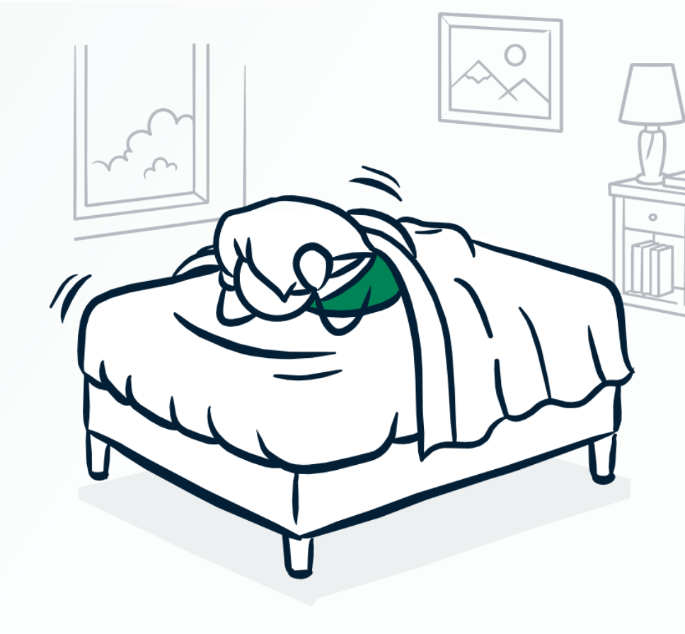

Protective Actions in
Your Everyday Life
Imagine you receive a ShakeAlert-powered alert or feel shaking.
Think about a location you've been in over the past week (home, work, in a vehicle, or outdoors).
What protective action could you take if you got an alert?
Notes:
Make the protective action message personal. Ask participants to think about a place they were in over the past week: home, work, a vehicle, outdoors, a store, or near the coast. If they received a ShakeAlert-powered alert or felt shaking there, what would they do? Give participants a moment to think or share with a partner, then reinforce planning ahead.

Slide 48
MODULE 6
The CERT Role in Earthquake Early Warning Outreach and Education
Notes:
Transition into Module 6. Explain that CERT volunteers can help turn awareness into readiness. This section focuses on how to talk about ShakeAlert, how to share trusted information, and how to help community members know both how they may receive alerts and what to do when an alert or shaking occurs.

Slide 49
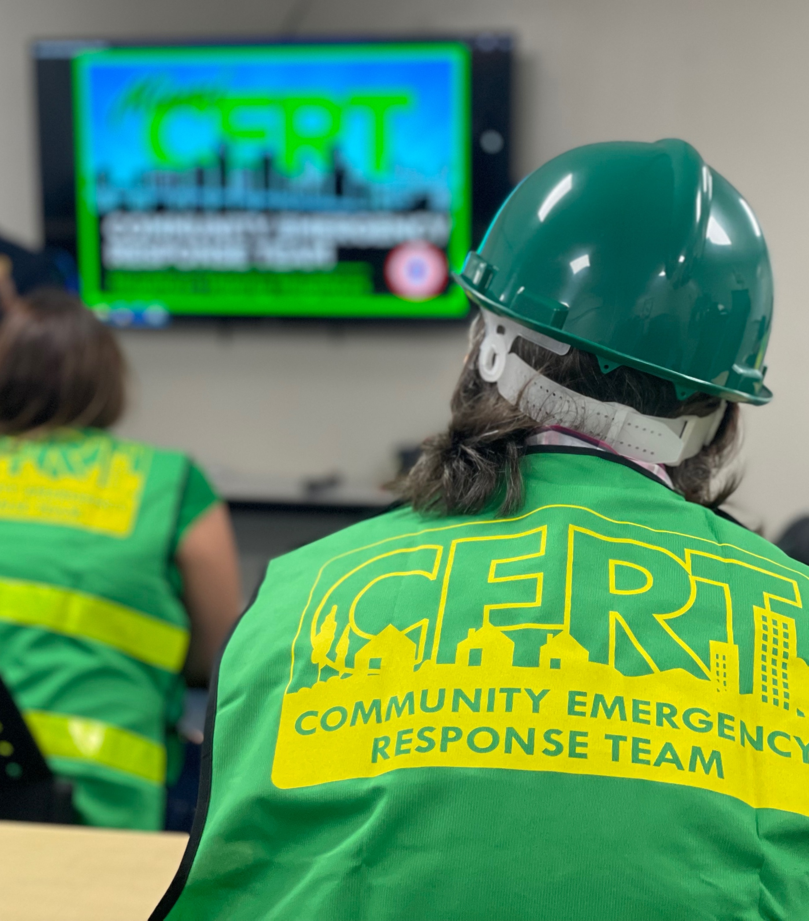

CERT Volunteers are
Trusted Messengers
You are trusted members of your communities.
By learning about ShakeAlert, you can help others:
  Understand earthquake early warning.
  Know how to receive alerts.
  Know what to do when you get an alert.
  Trust ShakeAlert earthquake early warning and act when an alert is received.
Image is courtesy of Miami.gov
Notes:
Emphasize that CERT volunteers are trusted messengers. Friends, family, neighbors, and community members may look to them for practical guidance. CERT volunteers do not need to be scientists or earthquake experts; their role is to share clear, accurate information about what ShakeAlert is, how alerts may reach people, and what protective action to take immediately. Remind participants that being a trusted messenger does not mean having every answer—it means knowing where to find reliable information and communicating it clearly.
Instructor note: You can also mention that after earthquakes, information spreads quickly, and not all of it is accurate. CERT volunteers can play an important role by sharing verified information from official sources such as USGS, FEMA, state emergency management agencies, and local CERT leadership.

Slide 50

Be ShakeAlert Ready
Before You Teach Others
Before conducting outreach:
Know how you may receive ShakeAlert-powered alerts.
Check your phone settings.
Practice protective actions appropriate for the places where you spend time.
Be prepared to explain what ShakeAlert earthquake early warning does—and what it does not do.
Image is courtesy of Humboldtcert.com
Notes:
Explain that CERT volunteers should be ShakeAlert Ready before teaching others. That means knowing how ShakeAlert-powered alerts may reach them, checking their own phone settings, practicing protective actions for the places where they spend time, and being prepared to explain what ShakeAlert does and does not do. Trusted messengers model the behavior they encourage.

Slide 51
Keep the Message Simple
When talking about ShakeAlert earthquake early warning in your community, reinforce these three ideas:
Earthquake early warning can give you time to act.
ShakeAlert-powered alerts may provide warning before strong shaking reaches your location.
You probably already have it.
Many newer smartphones can receive ShakeAlert-powered alerts.
Be ready to act.
If you receive an alert or feel shaking, take protective action immediately.
1
2
3
Notes:
Teach the simple outreach message. First, earthquake early warning can give you time to act. Second, many newer smartphones can receive ShakeAlert-powered alerts. Third, be ready to act immediately if you receive an alert or feel shaking. Encourage participants to use plain language and avoid overexplaining unless someone asks a deeper question.

Slide 52

Start a ShakeAlert Conversation
ShakeAlert.org
CERT volunteers can ask:
“Did you know you may get an alert before strong shaking reaches you?”
Explain ShakeAlert in one or two sentences.
Connect the alert to immediate protective action.
Show how to check phone settings or find MyShake.
Image is courtesy of sjncert.org
Notes:
Show how to start a short, practical ShakeAlert conversation. A useful opener is: “Did you know you may get an alert before strong shaking reaches you?” Then explain ShakeAlert in one or two sentences, connect the alert to immediate protective action, and show people where to check phone settings or find MyShake. Keep the conversation focused on what people can do.

Slide 53




ShakeAlert into CERT Readiness Activities
CERT teams can strengthen community readiness by weaving ShakeAlert into the activities they already do.
Exercises and Drills
Start earthquake exercises with a simulated ShakeAlert-powered alert so volunteers can practice taking immediate protective action before continuing the drill.
Communications & Outreach Plans
Include ShakeAlert messaging in team communications, educational materials, presentations, newsletters, and social media. Reinforce that earthquake early warning complements—not replaces—preparedness.
CERT Training & Continuing Education
Include ShakeAlert in CERT classes, refreshers, and advanced training so volunteers stay familiar with the system and can answer common questions accurately.
Preparedness Booths, Fairs, Community Events
Show people how to check phone settings, understand alerting methods, and recognize what alerts may look like. Brief demonstrations can build confidence in receiving and acting on alerts.
Notes:
Explain that CERT teams do not need to create a separate ShakeAlert program. They can build earthquake early warning into activities they already conduct.
Briefly review the examples: start drills with a simulated ShakeAlert-powered alert; show people how alerts may reach them and where to check phone settings at community events; include the three simple ShakeAlert messages in outreach materials; and incorporate ShakeAlert into CERT classes and refresher training.
Reinforce that earthquake early warning complements—not replaces—standard earthquake preparedness.

Slide 54

Practice: Start a ShakeAlert Conversation
Role-play with a partner.
One person is a CERT volunteer.
The other is a community member who asks: “I’ve heard of ShakeAlert, but what is it?”
Use the conversation tips from the previous slide to respond. Then:
Switch roles.
Briefly discuss what made the explanation clear and easy to act on.
Notes:
Have participants practice a short role-play. One person is the CERT volunteer, and the other is a community member who asks, “I’ve heard of ShakeAlert, but what is it?” Encourage the CERT volunteer to use the three simple messages from the previous slide rather than giving a technical explanation. Switch roles if time allows, then ask what made the explanation clear, accurate, and easy to act on. Reinforce that CERT volunteers do not need to know every technical detail to be effective trusted messengers.

Slide 55
Wrap-Up
Notes:
Use this slide to bring the course together. Remind participants that they learned the basics of earthquake early warning; reviewed earthquake science and impacts; followed how the ShakeAlert System detects, processes, and delivers information; saw how ShakeAlert-powered alerts may reach people and automated systems; practiced protective actions; and explored the CERT role as a trusted messenger.
Reinforce the three most important points: First, earthquake early warning can give people time to act before strong shaking reaches their location. Second, many newer smartphones can already receive ShakeAlert-powered alerts. Third, people must be ready to act immediately if they receive an alert or feel shaking.

Slide 56


Be ShakeAlert Ready
1
2
3
Know how ShakeAlert-powered alerts may reach you and confirm your phone settings.
Take protective action immediately when
you receive an alert
or feel shaking.
Help others understand ShakeAlert and know what to do.
Being ShakeAlert Ready means knowing how you receive alerts,
knowing how to act, and helping others prepare.
Notes:
Review the final checklist. Being ShakeAlert Ready means knowing how ShakeAlert-powered alerts may reach you, confirming phone settings where possible, considering multiple alert methods such as MyShake, taking protective action immediately when you receive an alert or feel shaking, and helping others understand what to do. This connects personal readiness with CERT community outreach.

Slide 57



Become ShakeAlert Ready & Help Someone Else
Do the Same
Be sure alerts are enabled on your cell phone.
Notes:
Being ShakeAlert Ready means knowing how you receive alerts, knowing how to act, and helping others prepare.
Close with a clear call to action. Ask each participant to take one step today to become more ShakeAlert Ready: check phone settings, download or open MyShake, identify safe cover in common locations, or explain ShakeAlert to one other person. Thank participants for the role they play in community readiness and remind them that sharing accurate information helps protect others because seconds matter.

Slide 58
We’d appreciate your feedback on today’s training.
FEEDBACK FORM
LEARN MORE: ShakeAlert.org
Notes:
Encourage participants to learn more at usgs.gov/FAQ/BeShakeAlertSafe | ShakeAlert.org.
Administrative disclosure for DOI requirements; no action is needed from presentation instructors or participants. During the preparation of this training, the generative artificial intelligence (AI) tool OpenAI ChatGPT was used to refine the material. All AI-generated suggestions were reviewed, revised as needed, and approved by the authors to ensure accuracy and maintain the integrity of the scientific content.

