Slide 1





Waves Move You: Middle School Seismology with ShakeAlert
Download
the app
now!
Katrina Arras, ShakeAlert Ready Coordinator for K-12 School Communities
Notes:
Note: many ways to get ShakeAlert-powered messages, but MyShake is one we use in this workshop.

Slide 2
If you felt earthquake shaking or got an alert right now …
Would you know what to do to be safe?
2

Slide 3
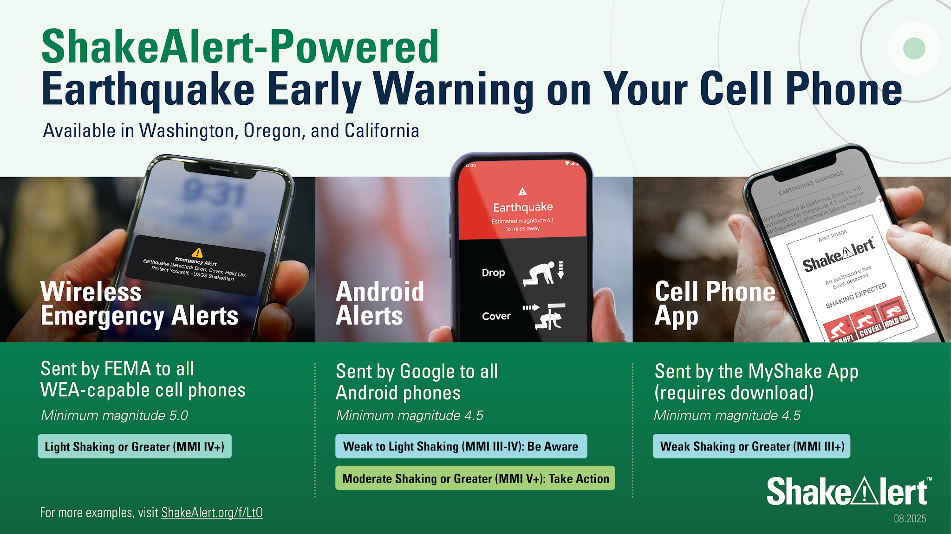
Notes:
Add newest graphic to this slide.

Slide 4
Agenda
Kathmandu earthquake _____________
Modeling earthquake waves _________
Analyzing seismograms _____________
Modeling ShakeAlert Earthquake Early Warning _________________________
Planning for earthquake education ____
Engage (Phenomenon)
Explore (Modeling)
Explain (Model → Graphical representation)
Elaborate (Application)
Evaluate (Sensemaking/planning)
4

Slide 5
MS-PS4-1
Use mathematical representations to describe a simple model for waves that includes how the amplitude of a wave is related to the energy in a wave.
NGSS 3 Dimensions:
Science and Engineering Practices
Disciplinary Core Ideas
Crosscutting Concepts
Learning Target:
I can model seismic waves.
I can experiment with seismic wave models to learn how waves with different amounts of energy affect objects.
I can analyze seismograms to determine the distance to the epicenter.
I can model how the ShakeAlert Earthquake Early Warning System takes advantage of the behavior of seismic waves to send alerts when an earthquake starts.
5

Slide 6
Engage
What does it feel like to be in an earthquake?
6

Slide 7
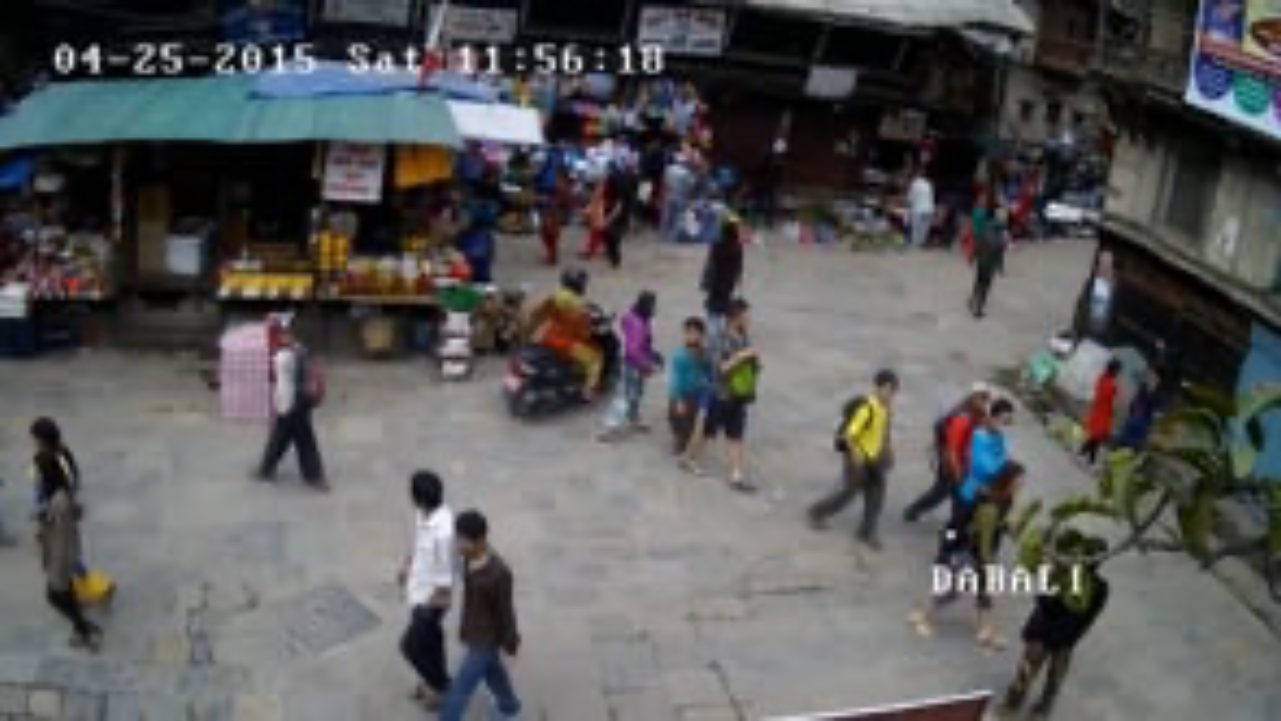
Kathmandu Earthquake
Watch the video: Notice & Wonder
Think, Pair & Share:
What you noticed and wondered from watching the video
What opportunities does this video give for social and emotional learning?
Videos are a new source of data for scientists!
7

Slide 8
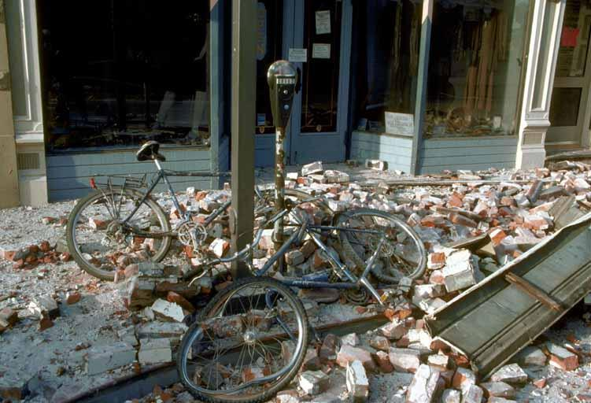
What is an earthquake?
Why do they happen?
What are some things that happen during an earthquake?
Image courtesy of USGS
8
Notes:
TEACHER NOTE: Students may have a lot of background knowledge about plate boundaries and earthquakes if they’re already learned about plate tectonics. Feel free to adapt the speed with which you go through the following science content slides accordingly.
This image shows damage caused by the 1989 Loma Prieta earthquake.
IMAGE: Image courtesy of USGS

Slide 9
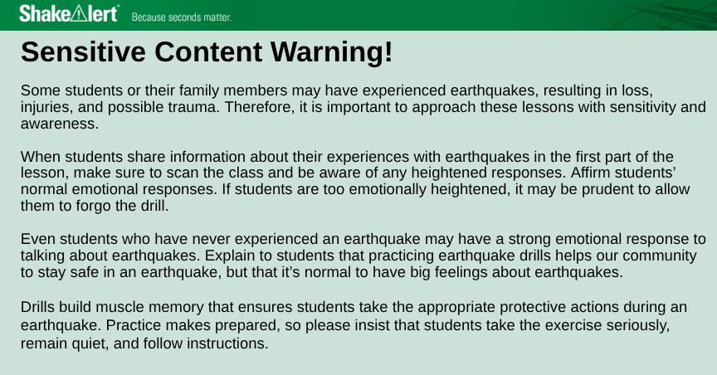
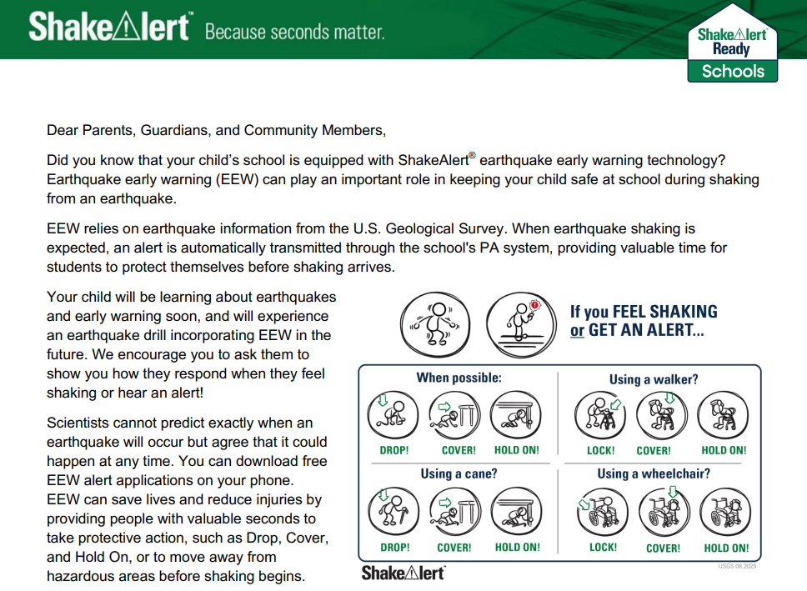
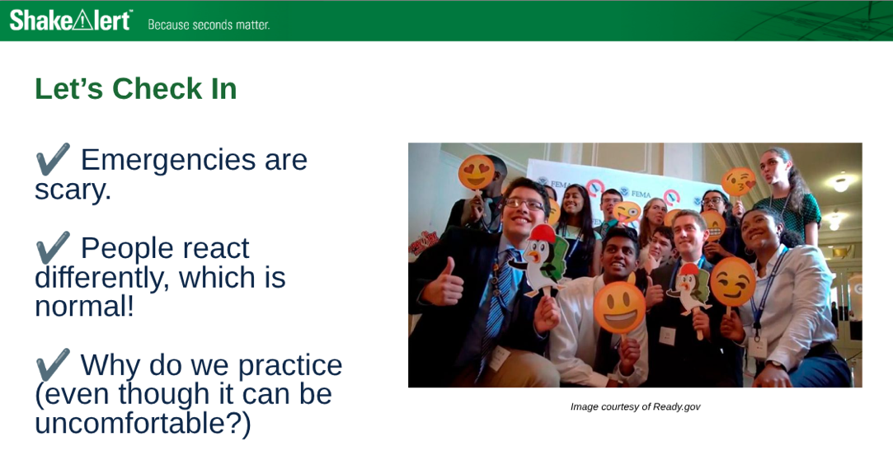
Social Emotional Learning
9
Notes:
Cost-free materials on ShakeAlert.org/Schools include a sensitive content warning to alert teachers that some students will struggle with this content, and a family engagement letter to let families know in advance that this is being taught. Lessons also acknowledge that emergencies are scary, and provide opportunities for teachers to check in with their students.

Slide 10
Explore
Modeling Waves in Multiple Ways
10
Notes:
First we’ll look at a few slides from ShakeAlert Ready Schools lessons.

Slide 11
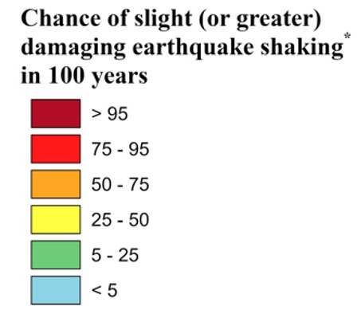
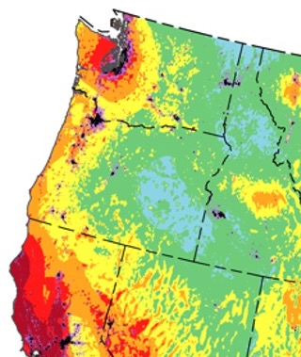
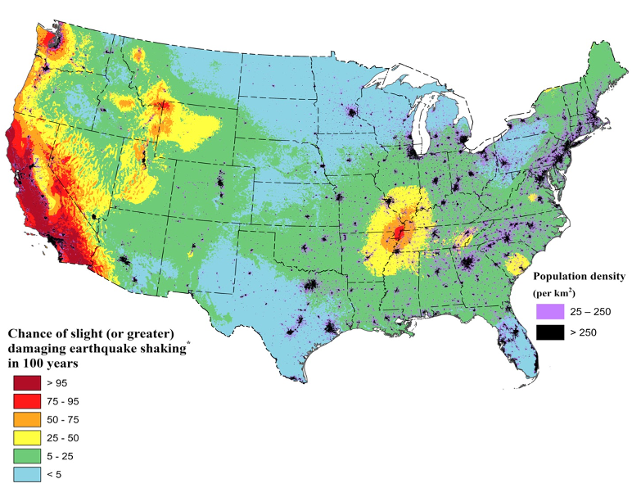
You are in
Earthquake Country!
Areas in red have a more than 75% chance of a damaging earthquake in the next 100 years.
Credit: 2023 50-State Long-term National Seismic Hazard Model
11
Notes:
It’s possible that you’ve never experienced an earthquake in Oregon. We don’t have the frequent small earthquakes experienced near the San Andreas Fault, but there are areas at some areas in Oregon have a more than 75% chance of experiencing an earthquake with strong to extreme shaking in the next 100 years.
Modified Mercalli Intensity
An MMI of 6 on the 10-point scale will be felt by everyone and may be frightening and cause slight damage. Increasing intensity will result in a range of damage from overturned furniture to partial or complete building collapse. Because of this risk, it is important to prepare your staff and students to respond safely to an earthquake. In case there’s a question regarding MMI scale, show this scale and explain briefly.

Slide 12
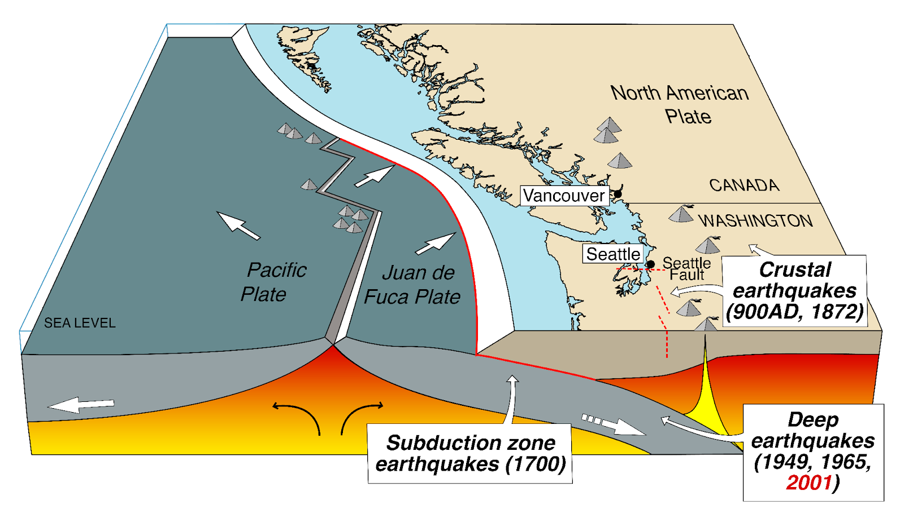
Sources of Earthquakes in Washington
Notes:
“Earthquakes come from four different sources: crustal, subduction zone, intraplate, and volcanoes. The most common are crustal earthquakes, which occur along faults, or breaks in the earth’s crust, at shallow depths of 6-12 miles (10-20 km) below the surface. The two largest earthquakes in recent years in Oregon, Scotts Mills (magnitude 5.6) and the Klamath Falls main shocks (magnitude 5.9 and magnitude 6.0) of 1993 were crustal earthquakes.” DOGAMI, https://www.oregon.gov/dogami/earthquakes/pages/earthquakehome.aspx Volcanic earthquakes occur when rocks move as magma shifts below ground.
https://pnsn.org/education/pnw-earthquakes/sources

Slide 13
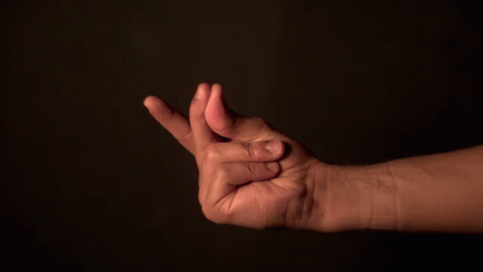
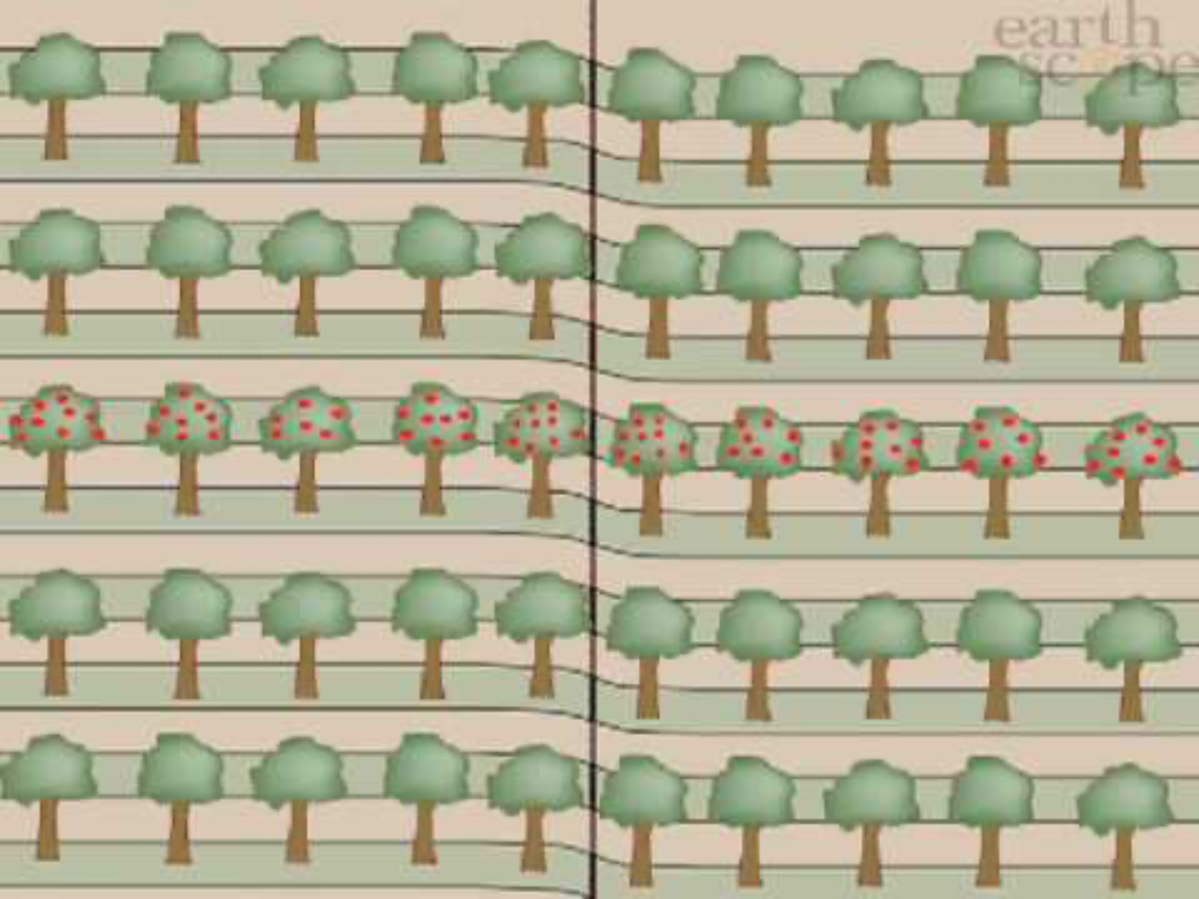
Friction causes potential energy to build up between tectonic plates. When they break free, an earthquake happens.
13
Notes:
We can model an earthquake with a snap of a finger. When we press our two fingers together, there is friction between them which prevents them from moving in the direction of the force, creating a build up of stored potential energy. When friction is overcome, the potential energy is transformed into kinetic energy, or movement, much like an earthquake. Earthquakes can happen at faults, including plate boundaries. Ask students to share their observations of the earthquake animation. In the animation, they should observe a buildup of potential energy, and then sudden lurching motion, causing apples to fall from the trees.
VIDEO: Video courtesy of Earthscope Consortium
IMAGE: GIF made from: https://www.youtube.com/watch?v=cFy3uJYctZs

Slide 14
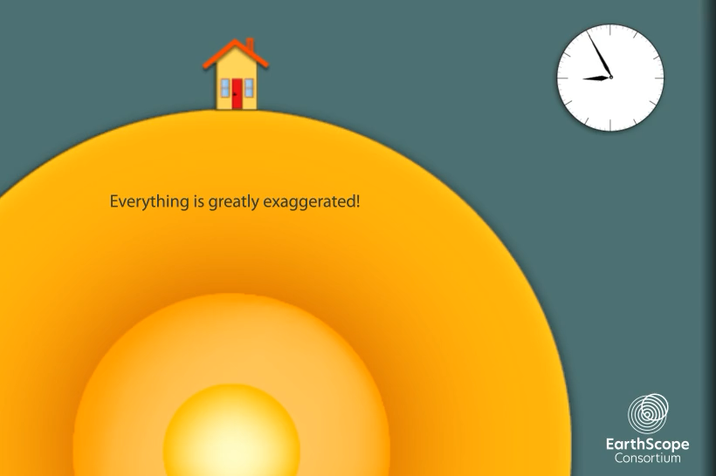
Earthquake Waves are Called Seismic Waves
How does each type of wave affect the building?
How are the waves of energy SIMILAR?
How are they DIFFERENT?
14
Notes:
Teacher Notes: The slide is animated so that the questions appear one at a time. The video will play automatically when you open the slide. To play the video again, click the white play button.
Tell students that waves of energy are released during an earthquake, which we call seismic waves. There are different kinds of seismic waves. Students should observe that the p-wave arrives first and moves the house up and down, the s-wave is second and moves the house side to side, and the surface wave arrives last, and moves the house in an undulating motion. The waves are similar because they all move the house. They are different in the time it takes for them to arrive at the house, whether they move through the earth or across its surface, and in how they move the house. Point out to students that seismic waves transfer energy and not matter. The house moved because energy was transferred from the earthquake to the house, not because matter was transferred from the earthquake to the house.
To view a more detailed model of seismic waves, go to: https://www.iris.edu/hq/inclass/animation/1component_seismogram_building_responds_to_p_s_surface_waves
VIDEO: Video courtesy Earthscope Consortium

Slide 15
Seismic Waves with Different Amounts of Energy
Amplitude - the distance the wave moves from where it started.
Amplitude
15
Notes:
Teacher Notes: This slide is optional. If you are modeling waves using a SlinkyⓇ or section of rope, use this slide to guide your demonstration.
To start, explain to students that amplitude is one way we can describe the energy in a wave. Point out that amplitude is the distance from the midline of the wave to the furthest point from the midpoint, called the crest or trough. Ask students to record their ideas on the student sheet.

Slide 16
4 Seismic Wave Models
SlinkyⓇ
People
Glass of Water
MyShake app

Slide 17

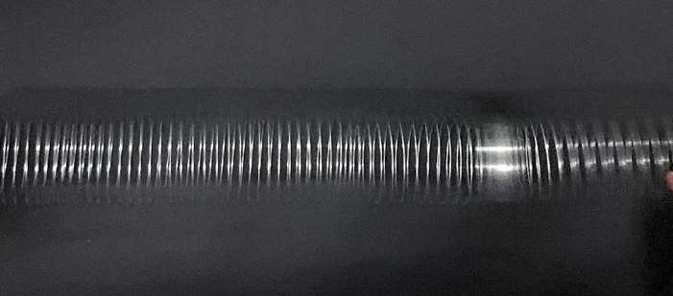
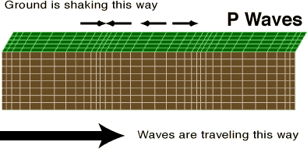
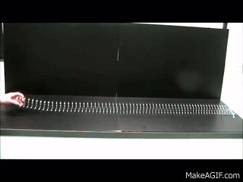
Modeling P-Waves with SlinkyⓇ
17
Notes:
Teacher Notes: Tell students that we can model seismic waves using a Slinky. A giant Slinky works best for this. If you have one, have two students hold either end and stretch it out between them on the floor. If you don’t have a Slinky, just show and discuss the animations on the following two slides. Model a p-wave with the Slinky by having the student on one end of the Slinky push it toward the other student. Instruct other students to observe. Repeat this step a few times as students share their observations.
SOURCE: Seismic Slinky https://www.iris.edu/hq/inclass/lesson/seismic_slinkymodeling_p_and_s_waves
VIDEO: To watch a video of a teacher demonstrating modeling seismic waves with a Slinky, go to https://www.iris.edu/hq/inclass/video/seismic_slinky_modeling_p_and_s_waves_in_the_classroom
GIF: https://makeagif.com/gif/longitudinal-waves-on-a-slinky-ZChjoc
IMAGE: https://www.usgs.gov/media/images/p-waves

Slide 18
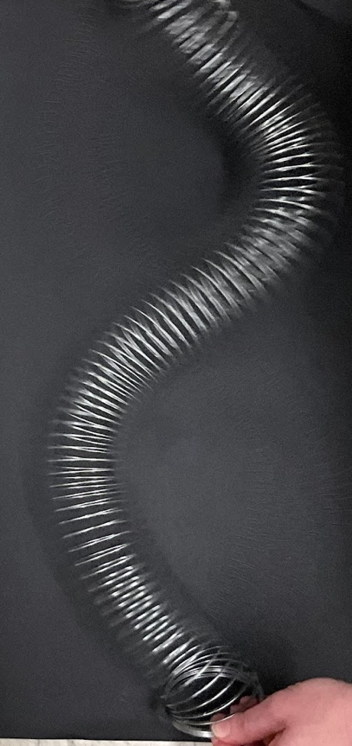
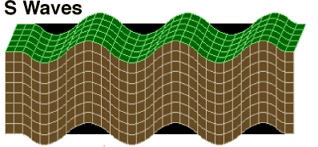
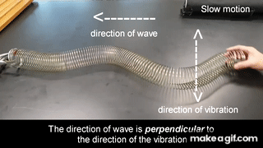
Modeling S-Waves with SlinkyⓇ
18
Notes:
Teacher Notes: Model an S-wave with the Slinky by having the student on one end of the Slinky move it back and forth. Instruct other students to observe. Repeat this step a few times as students share their observations.
SOURCE: Seismic Slinky https://www.iris.edu/hq/inclass/lesson/seismic_slinkymodeling_p_and_s_waves
GIF: https://makeagif.com/gif/transverse-wave-using-slinky-coil-UJEhkl
IMAGE: https://www.usgs.gov/media/images/s-wavesgif

Slide 19
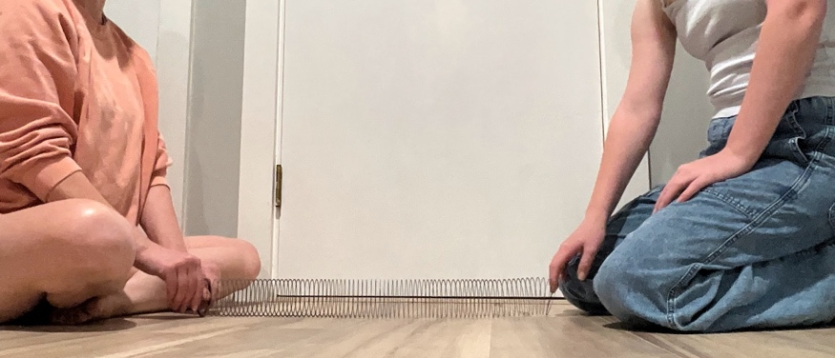
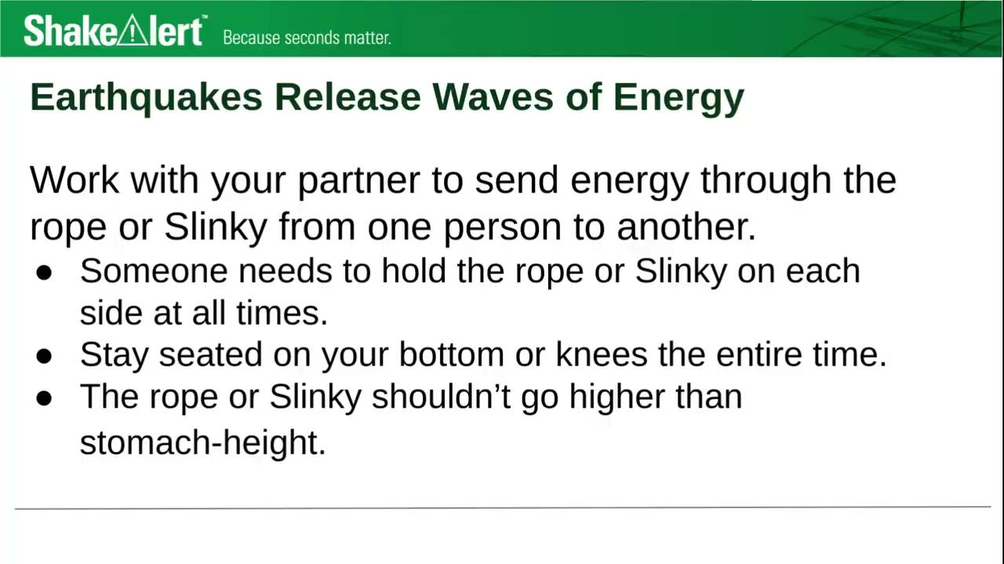
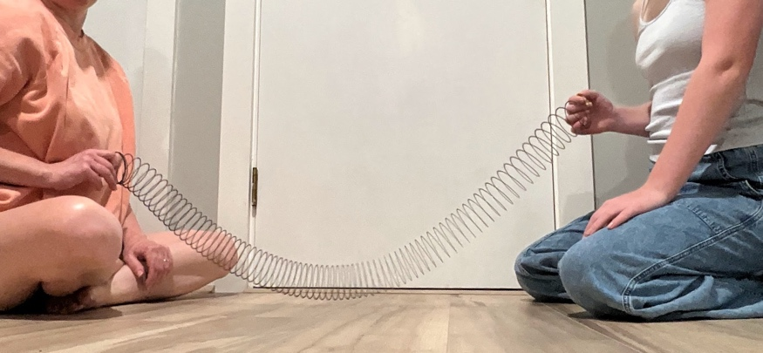
Seismic SlinkyⓇ
SlinkyⓇ
19
Notes:
Teacher Notes: This slide is optional for teachers who are providing small groups of students with a rope or SlinkyⓇto experiment with. The audio describing how to experiment safely will automatically play.
If you are providing students with a Slinky, rope, yarn, etc. to model waves, go over the safety guidelines, and give them time to discover ways to send energy through the material. Consider setting a 4 minute timer for students to experiment, and ask students to be ready to share their observations with the class once time’s up!
SUGGESTED SAFETY GUIDELINES:
Someone needs to hold the rope or Slinky on each side at all times.
Stay seated on your bottom or knees the entire time.
The rope or Slinky shouldn’t go higher than stomach-height.
IMAGE: Image and video courtesy Katrina Arras. Used with permission.

Slide 20
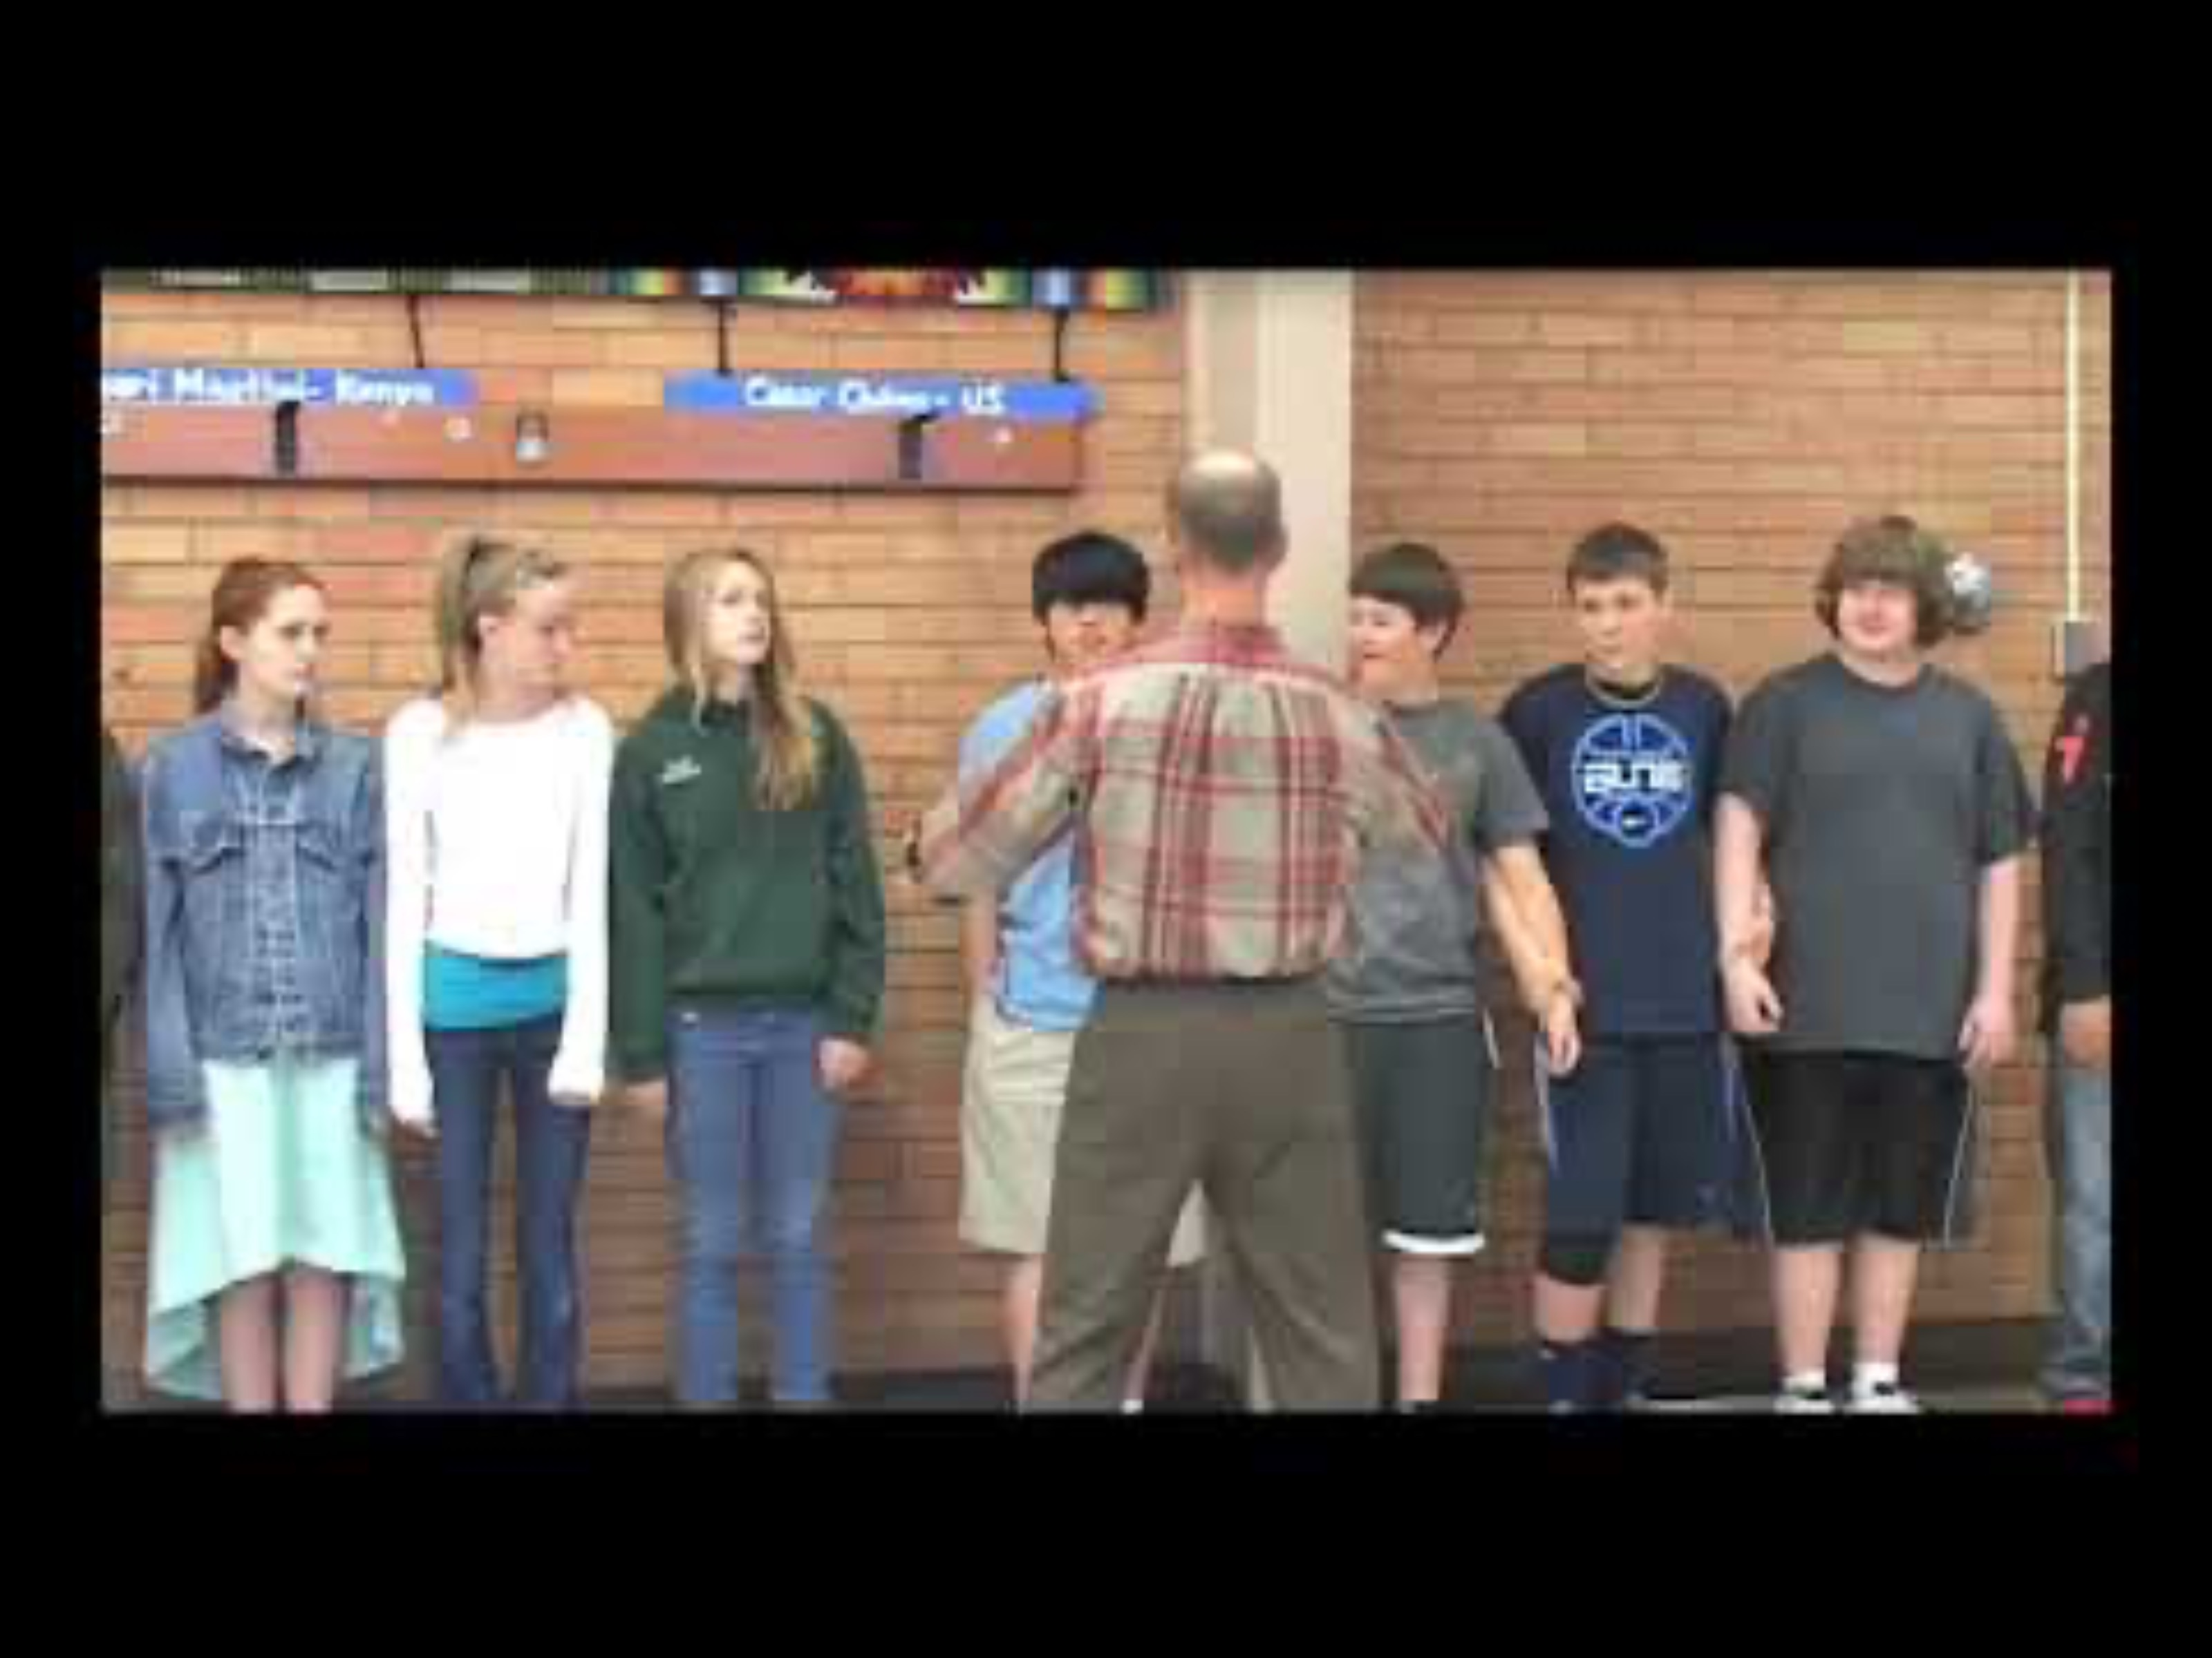
People Model
No-Touch Options
P-Wave Alternatives
Seated Wave
Personal Space P-wave
S-Wave Alternatives
Arm S-wave
Step Forward Wave
Bowing S-wave
20
Notes:
If teachers don’t want to have students physically model this, they could share gifs and videos about waves, and then ask students to watch these students model P- and S-waves. Students could assess whether the 7th graders pictured in the video modeled it correctly, and what else they were able to learn about seismic waves after watching the video clip.
No Touch Options
Seated Wave: Students sit in a row side-by-side. The student on the end sways sideways toward the next student, and the student next to them sways toward the next student and so on.
Personal Space P-wave: Students stand side-by-side with some space between them. When the earthquake starts, the first student sways toward the next student without touching them, and the next student passes it on until it makes it down the line.
Arm S-wave: Students stand side-by-side with space between them. When the earthquake starts, the first student raising their outer arm up and then the arm closer to the next student. Then the next student does the same until the wave has travelled down the entire chain.
Step Forward Wave: Students stand side-by-side. When the earthquake starts, the first student steps forward and then back. Once they’re back in their original position, the next student steps forward and back. This continues until the last student has stepped forward and back.
Bowing S-wave: Students stand side-by-side. When the earthquake starts, the first student bows over from the waist and then straightens back up. Then the next student repeats this motion and so on until the wave has travelled down the entire chain.

Slide 21

Water Seismometer - Waves in 2-D
Explore (Modeling)
Slam your fist into the table and watch the water “record” the wave.
Options:
Different tables (subsurface rock)
Different distances
Larger & smaller “earthquake”
Use a roasting pan. Start earthquakes with pebbles.
How could you quantify the waves?
21

Slide 22
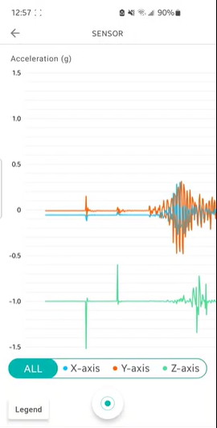
MyShake Sensor Seismometer -
Waves in 3-D
Explore (Model → Graphical representation)
Select “Sensor” under the menu
Similar experimentation as for water seismometer
Questions:
What are the units on the x and y axes of this graph?
Why are there 3 graphs?
How does what you see in the graph relate to what you saw in the water seismometer activity?
Introduce amplitude, seismogram and wave travel time as terms.

Slide 23
Explain
How do we read graphs from seismometers?
23

Slide 24
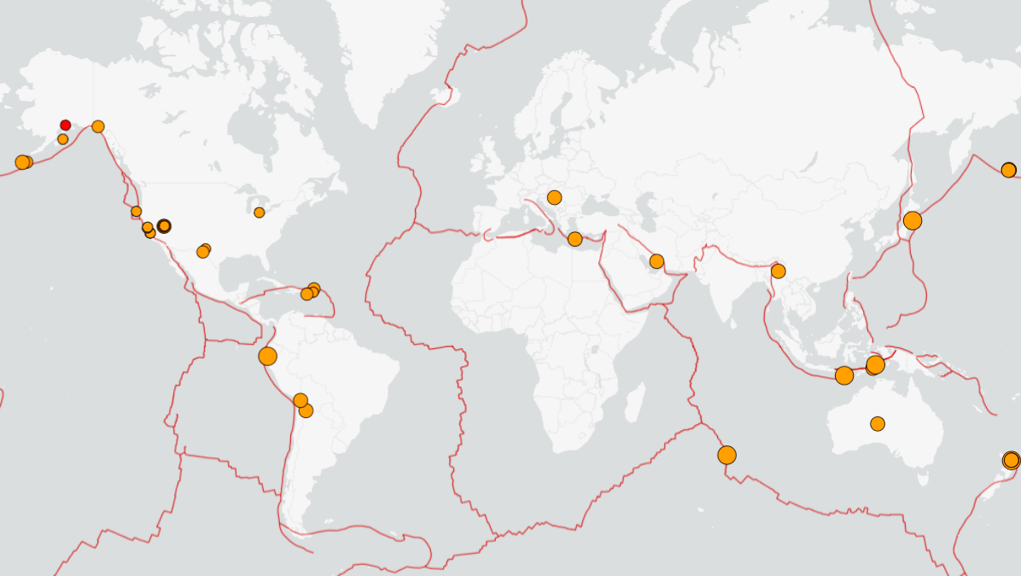
Can we predict earthquakes?
NO!
But earthquakes happen everyday all over the world.
43 earthquakes
magnitude 2.5+ in 24 hours
MAY 5, 2026
Notes:
Scientists cannot predict exactly when earthquakes will happen. However, recent technology constantly monitors the ground for shaking or movement, and can send out alerts to people once the earthquake starts that may arrive to certain people before strong shaking begins in their area. Earthquakes happen everyday all over the world. The map on the screen shows the 43 magnitude 2.5 and greater earthquakes that happened within 24 hours on May 5, 2026.

Slide 25
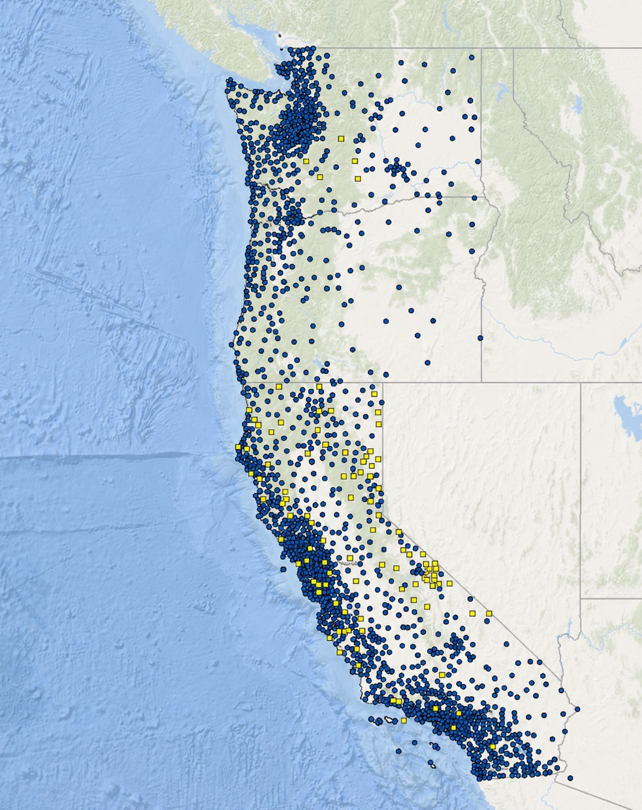
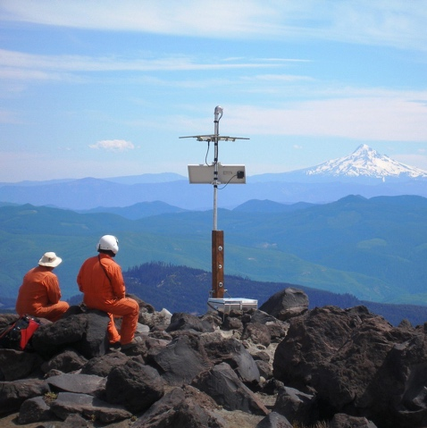
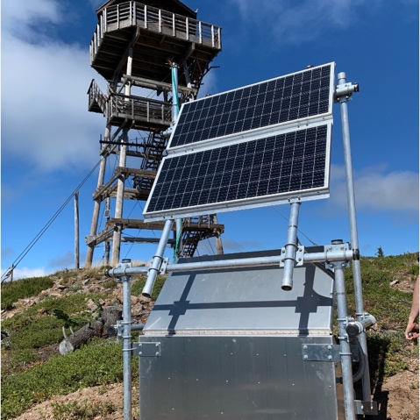
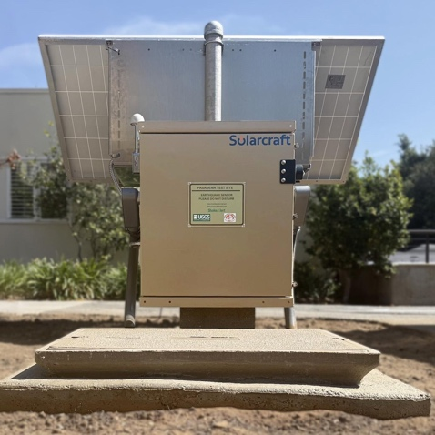
Earthquake Sensors
2,000+
seismic and Global Navigation Satellite System (GNSS) sensors in CA, OR, WA to detect ground movement during earthquakes
Seismic sensors measure how fast the ground moves
GNSS sensors
measure how far the ground moves
Notes:
As of December 2025, the ShakeAlert earthquake-sensor network consists of over 2000 seismic stations in California, Oregon, and Washington. About 1600 of the sensors are seismometers which measure how fast the ground moves when the Earth shakes. There are also high-precision Global Navigation Satellite System sensors that measure how far the ground moves, which is used primarily with larger earthquakes. The images shows a ShakeAlert seismic station in Mt St Helen, WA, Mt Scott Lookout, OR and Pasadena, CA.
SOURCE: https://www.congress.gov/crs-product/R47121#_Ref101190788
IMAGE: https://pnsn.org/blog/2021/03/05/oregon-rolls-out-public-alerting-for-earthquakes-on-march-11-2021

Slide 26
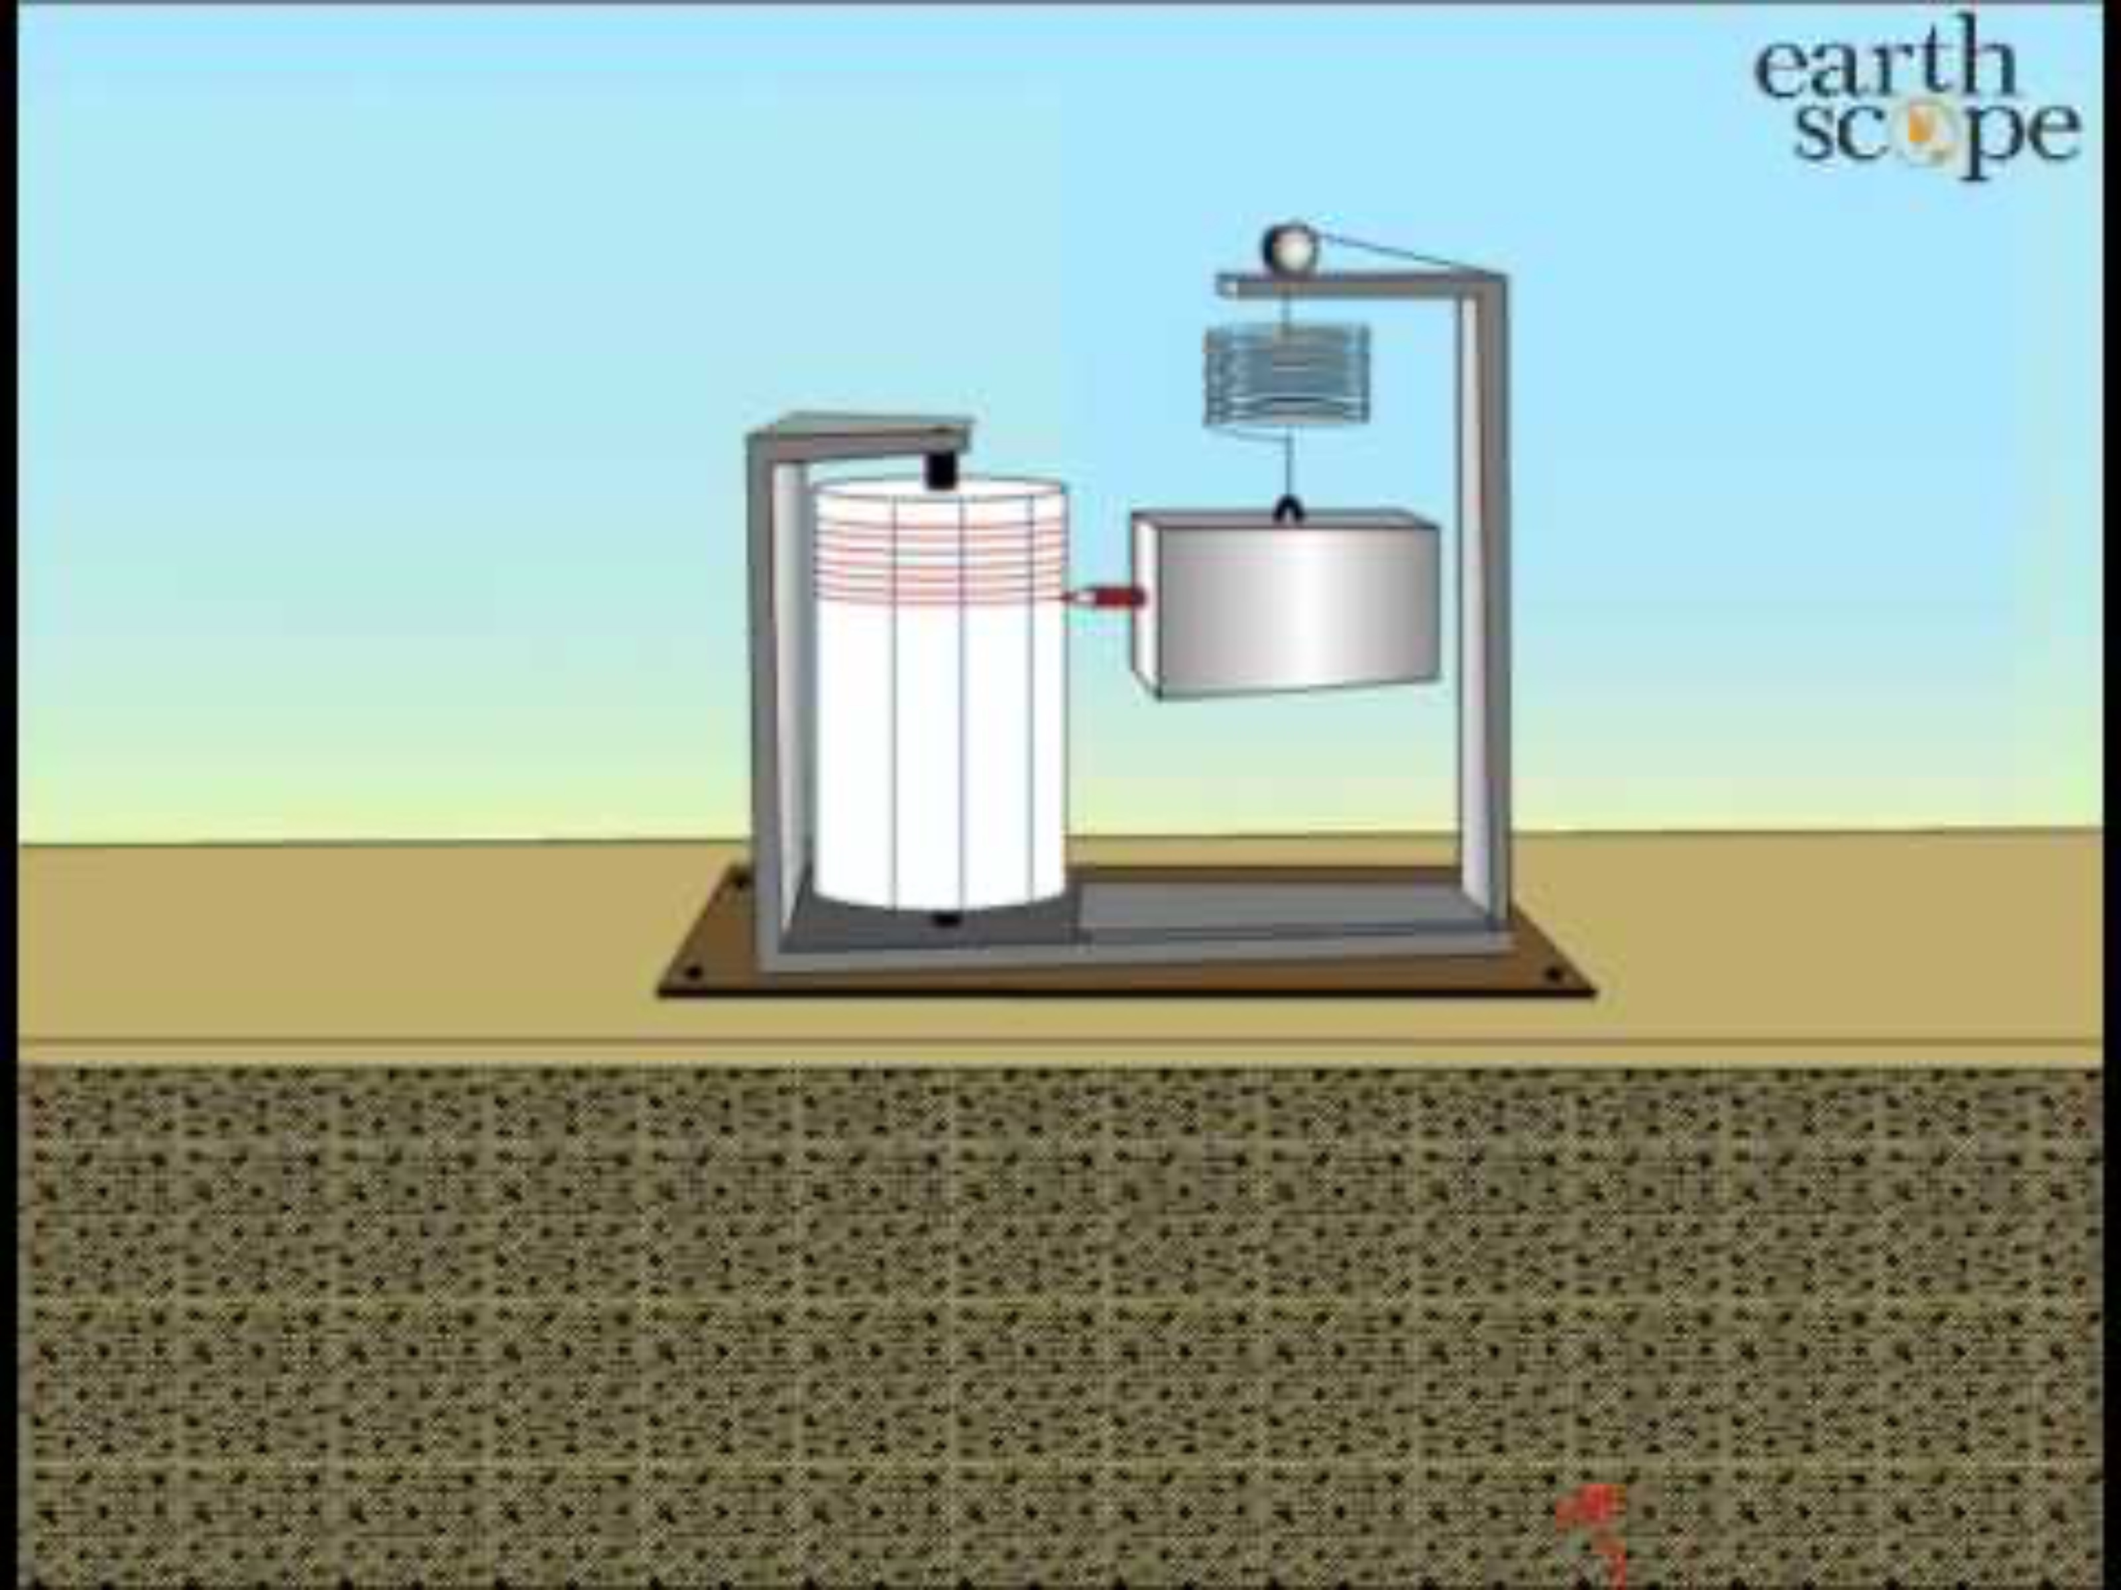
Vertical Seismograph Record Seismic Waves
26
Notes:
Video from Earthscope: https://www.youtube.com/watch?v=DX5VXGmdnAg

Slide 27
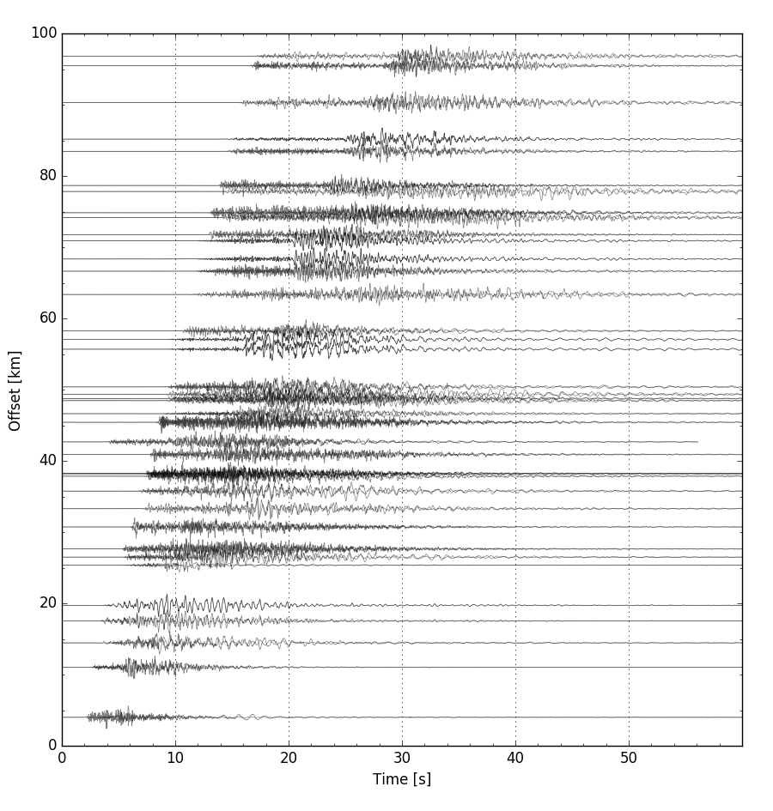
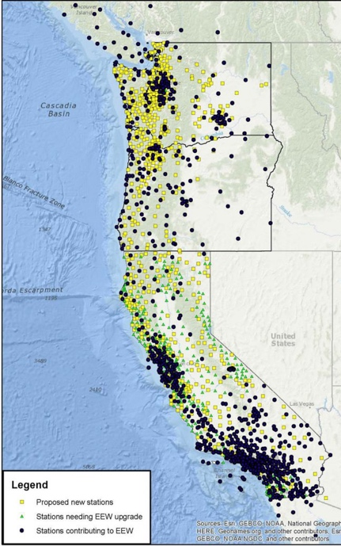
West Coast Integrated Seismic Network
South Napa Earthquake: M6.0
Seismograms
Elaborate (Place-based application)
Real Data from the “Wild”
Notice and Wonder: How does this data compare to the human wave? The MyShake sensor?
Can you explain the similarities and differences in terms of wave amplitude and travel time?
When is the largest wave amplitude happening on the graphs?
27
Notes:
These are seismograms collected on many seismometers in the network at different distances from the epicenter. Note each individual graph is still amplitude, but the whole figure has distance on the y-axis.

Slide 28
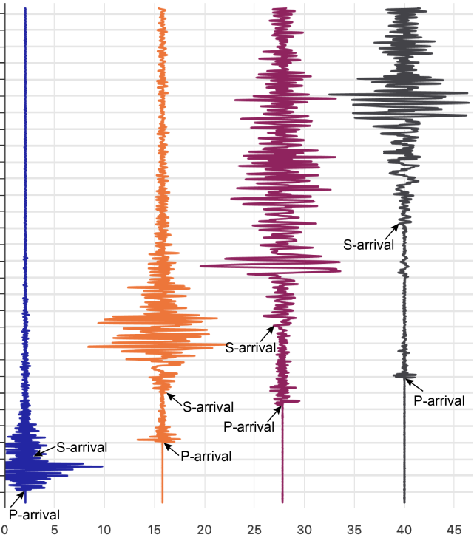
Distance from Hypocenter vs. Time Between Waves
The farther you are from where the earthquake started, the _____________ the time between when the P-wave and S-wave arrive.
0 5 10 15 20 25
Time Since Earthquake Started (min.)
Distance from Earthquake Start
28
Notes:
https://uhlibraries.pressbooks.pub/physicalgeologylab/chapter/earthquakes/
Explain to participants that the horizontal axis shows the distance from where the earthquake started, and the y-axis shows time since the earthquake started. Each of the marks on the y-axis represents one minute.

Slide 29
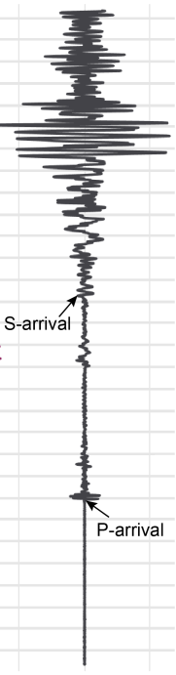
Your Turn!
For each earthquake, calculate the time between the arrival of the P- and S-waves.
Find the cities on the map. Record the times.
Can you infer where the earthquake started?
29
Notes:
https://www.scsn.org/index.php/2025/04/14/04-14-2025-m5-2-near-julian/

Slide 30
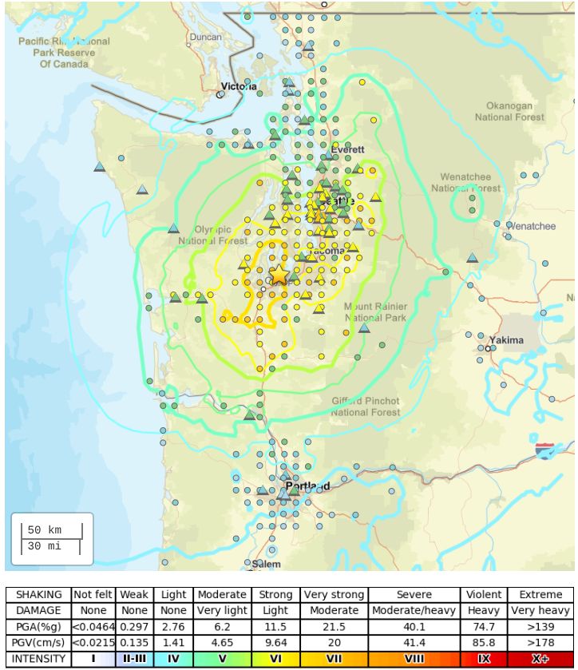
M 6.8 - The 2001 Nisqually, Washington Earthquake
February 28, 2001
Modified Mercalli Intensity Index VII
$ 1-4 billion in damage
Notes:
https://earthquake.usgs.gov/earthquakes/eventpage/uw10530748/shakemap/intensity

Slide 31
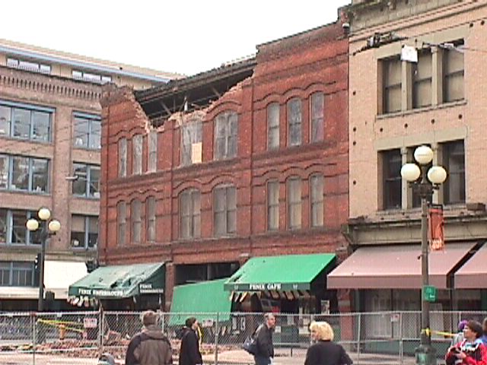
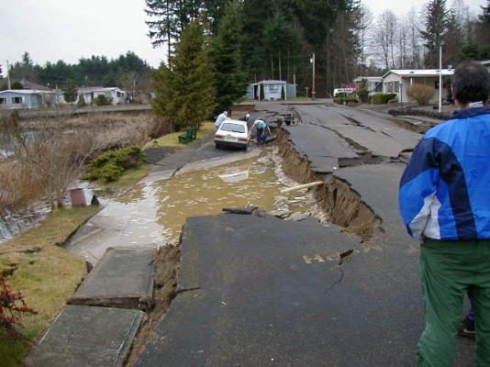
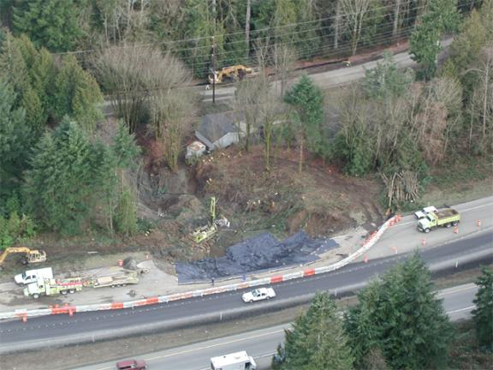
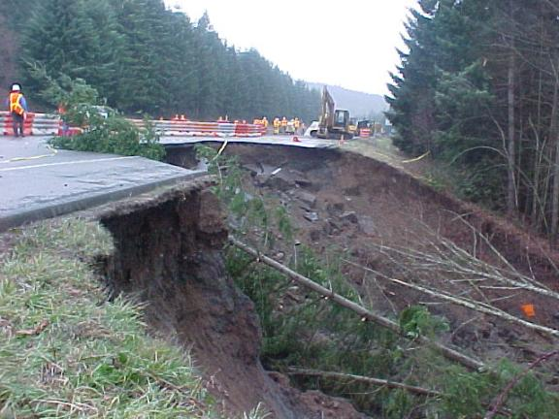
M 6.8 - The 2001 Nisqually, Washington Earthquake
February 28, 2001
Modified Mercalli Intensity Index VII
$ 1-4 billion in damage
Notes:
https://earthquake.usgs.gov/earthquakes/eventpage/uw10530748/shakemap/intensity

Slide 32
Elaborate
Application of Seismic Waves to ShakeAlert Earthquake Early Warning
32

Slide 33
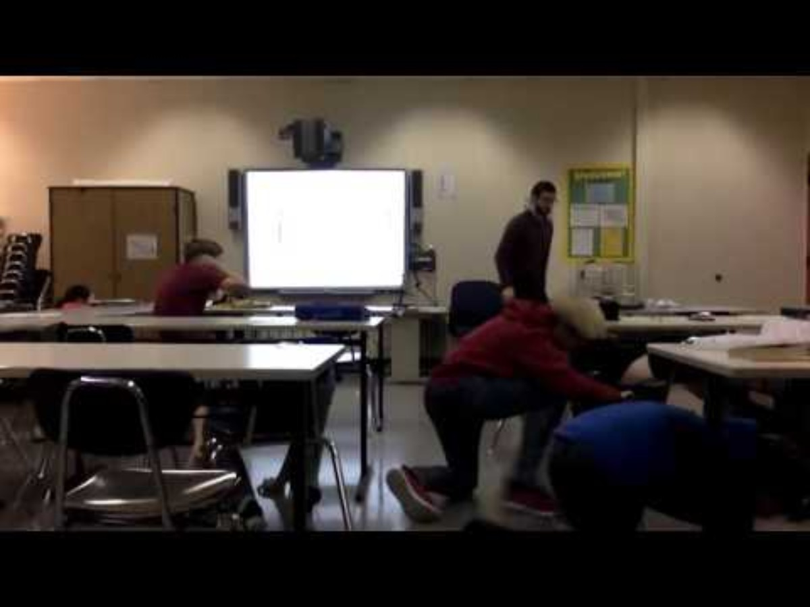
2018 Magnitude 7.1 Earthquake in Anchorage, Alaska
Protective Action Demonstrated
Watch initial jolt and almost immediate action of class.
33
Notes:
Video of a magnitude 7.0 earthquake in Anchorage Alaska on Nov 30, 2018. You can stop the video at 0:58 minutes if desired, as that first clip captures the initial shaking, the class immediately taking protective actions, and then being protected during the subsequent more damaging shaking.
This video shows why immediate action is imperative. We can’t feel the build up of potential energy in the Earth. What we can feel is the transformation of potential energy into kinetic energy, which results in ground shaking. Energy from an earthquake travels at different speeds through the Earth, and here you see students react immediately and appropriately to the first jolt of ground shaking as they Drop, Cover, and Hold On. Therefore, when the slower more damaging energy from the earthquake arrives, they are protected.
VIDEO: https://www.youtube.com/watch?v=NJZqREPc9k0&t=225s from Anchorage School District
IMAGE: GIF made from: https://www.youtube.com/watch?v=cFy3uJYctZs

Slide 34
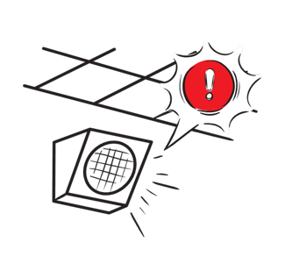
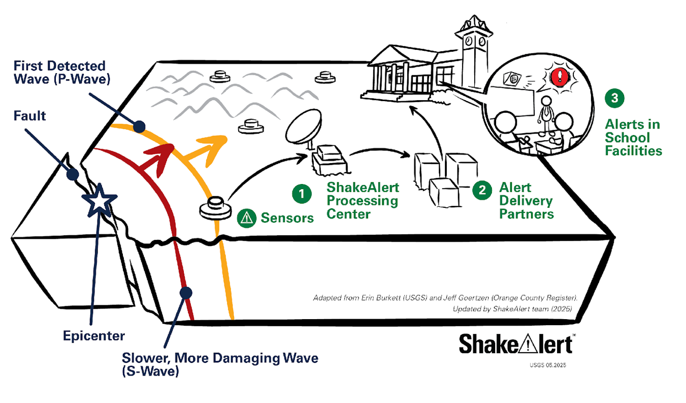
Application: ShakeAlert Earthquake Early Warning
Elaborate (Place-based application)
This is an engineering application of what we have learned.
Use wave amplitude and travel times to explain why this system works.
P-waves: faster & less damaging
Surface and S-waves: slower & more damaging
Alerts: delivered as soon as first earthquake wave detected.
34

Slide 35
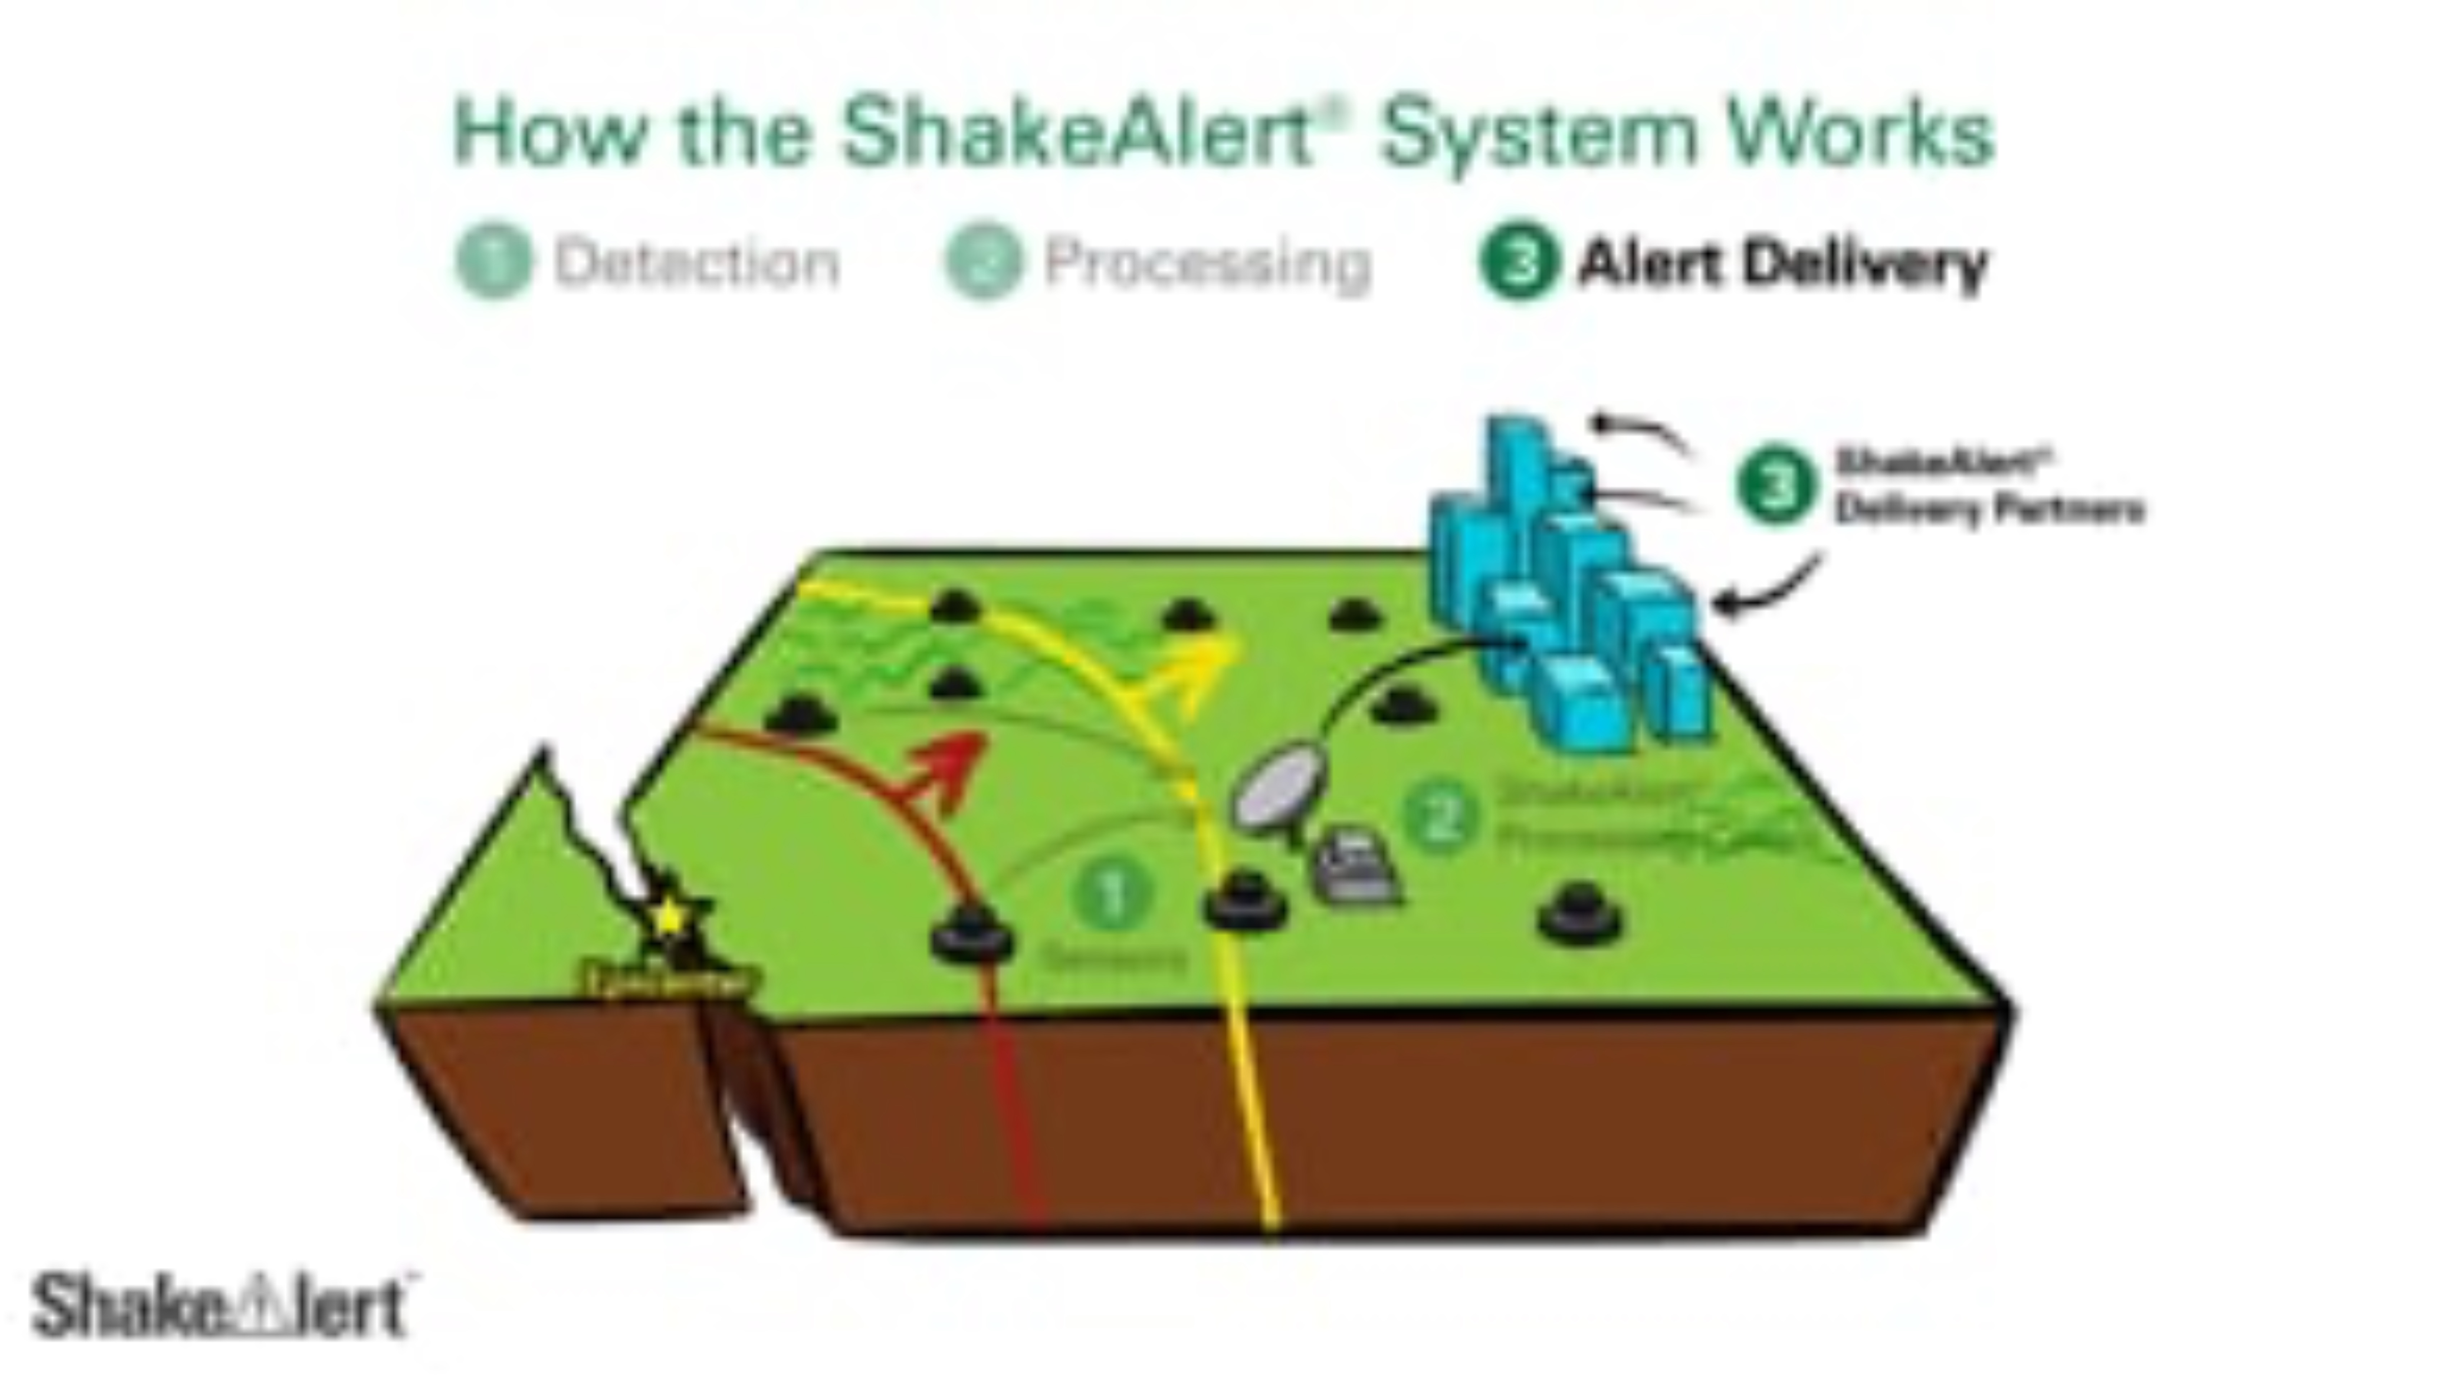
35
Notes:
Now that we learned about WHY and Earthquake happens (friction) and the 2 types of seismic waves, we will watch a video that puts all of our learning together. Pay attention to other details about the ShakeAlert Earthquake Early Warning System. After the video I will ask you to share a few things you learned about how ShakeAlert-powered earthquake early warning systems protect our community.
ShakeAlert Earthquake Early Warning System Overview. This animation is available on ShakeAlert.org in the Messaging Toolkit at https://drive.google.com/file/d/13kDF4Fx_8bbyLwPu4ROKuhyDMviyDBhH/view?usp=drive_link

Slide 36

Notes:
Assign a student to be the earthquake, and give them the earthquake card to hold up when they trigger the earthquake. Either read to them or have them read to the class how they’ll model the random nature of earthquakes starting.

Slide 37
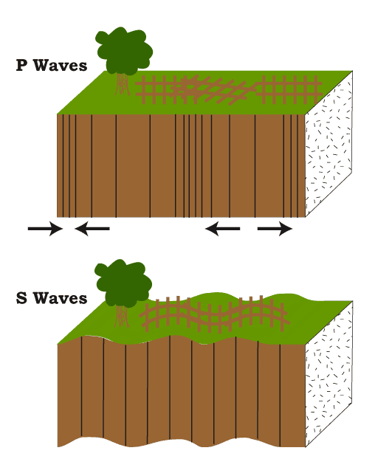
Earthquakes Generate Seismic Waves
P Waves
P-Waves are
the fastest.
They compress and stretch the lithosphere parallel to the direction the seismic wave travels.
Notes:
Tell students that earthquakes generate seismic waves. P-Waves are the fastest, and compress and stretch the lithosphere parallel to the direction the seismic wave travels. If you have time, consider modeling this with a giant metal spring.

Slide 38

Notes:
Distribute the P-Wave card to a student. Either have them read the directions on how they’ll model this, or read it aloud to the class yourself.

Slide 39
Earthquakes Generate Seismic Waves
S Waves
S-Waves are slower than P-Waves.
S-Waves cause the lithosphere to move back and forth perpendicular to the direction they are travelling.
Notes:
Tell students that earthquakes also generate S-waves. S-Waves are slower, and cause the lithosphere to move back and forth perpendicular to the direction they are travelling. If you have time, consider modeling this with a giant metal spring.

Slide 40

Notes:
Distribute the S-Wave card to a student. Either have them read the directions on how they’ll model this, or read it aloud to the class yourself.

Slide 41
Let’s Model an Earthquake!
As you watch, what do you notice about P-waves and S-waves?
Notes:
Provide all students with the student sheet.

Slide 42



Let’s Model an Earthquake!
As you watch, what do you notice about P-waves and S-waves?
Notes:
The diagram is animated. As you click you will see the earthquake appear, and the P- and S-Waves move across the room.
After students model the random time the earthquake starts, and the P- and S-Waves, ask them to record observations on their student sheet and then share them with the class.. They should notice that the P-Wave moved faster than the S-Wave, and arrived at the other end of the room before the S-Wave. They should also notice that the further the seismic waves are from where the earthquake started, the larger the distance between them.

Slide 43



Notes:
This slide is animated. Click to show the seismic station saying beep as the P-wave passes it.
Assign a student to be the seismic station. That student will stand 1 meter in front of where the P- and S-waves will start, and face from them. They will say, “Beep!” when they see the P-wave in their peripheral vision.

Slide 44
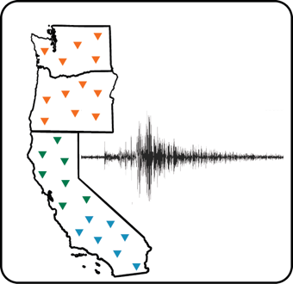
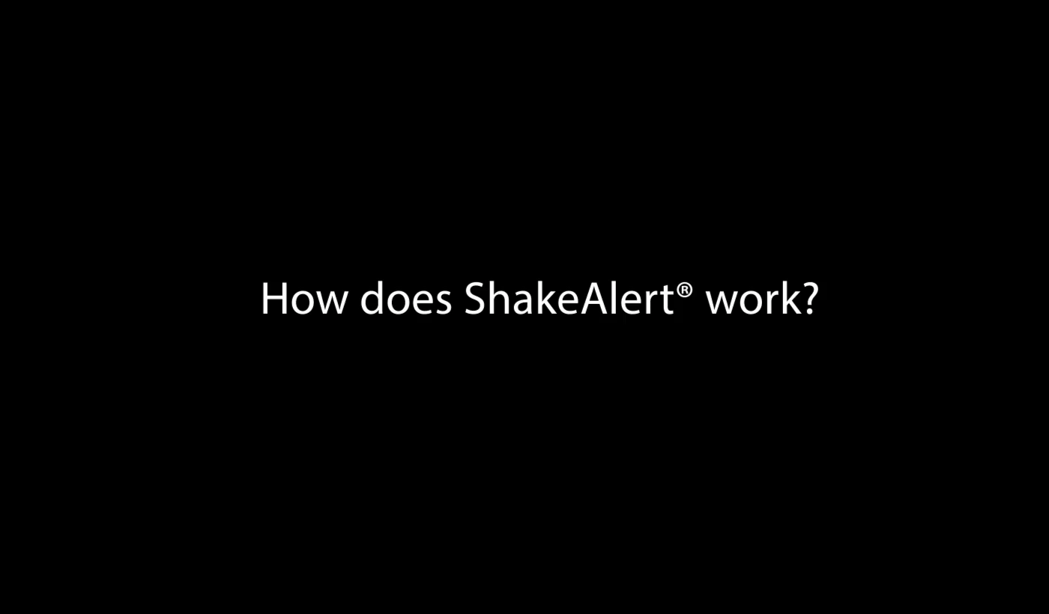
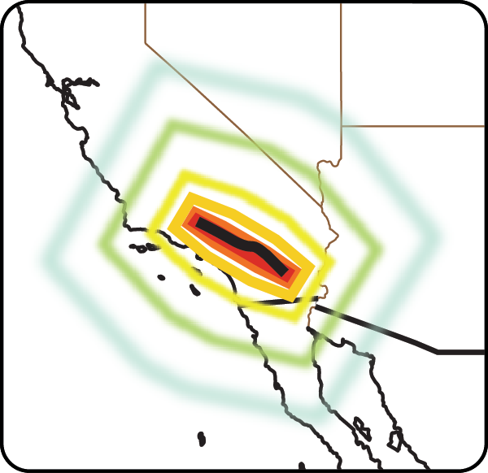
Processing Center
Monitors ground motion in real time
Estimate earthquake location, size and shaking distribution
Notes:
Click to play the video.
Tell students that when an earthquake is detected by the seismic sensors, the information is passed to the Processing Center. ShakeAlert quickly estimates the location, magnitude, and shaking intensity of the earthquake. If the event fits the right profile, a ShakeAlert Message is issued by the USGS. Play the video clip (0:32) that reviews what students have learned so far about earthquakes and explains how data is processed to determine whether to issue a ShakeAlert Messages.

Slide 45

Notes:
Click to repeat the seismic station animation from the previous slide and show the processing center holding up their sign to represent the ShakeAlert Message.
Assign a student to model the process center. To do this, they will make calculating noises and raise their “ShakeAlert Message” card when they hear the seismic station beep.

Slide 46
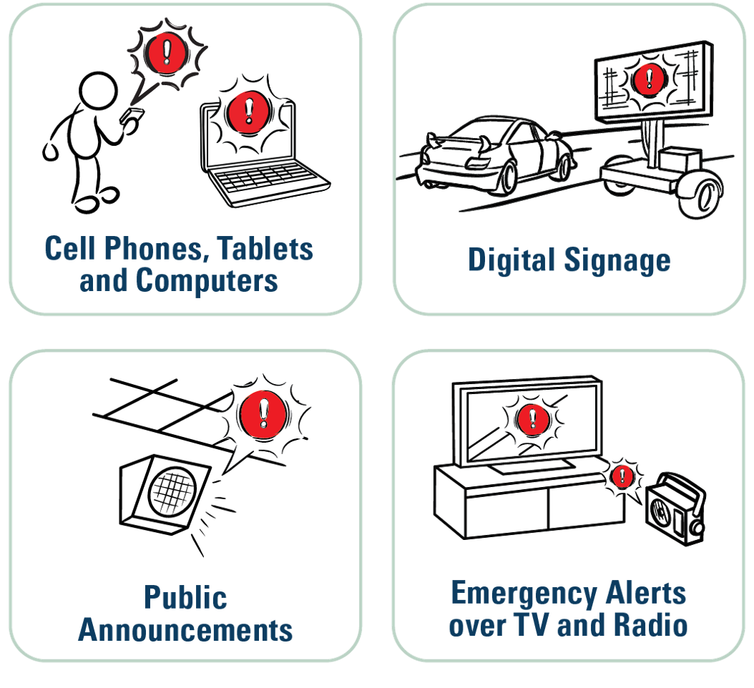
Alert Delivery Partners
Publish the alerts on multiple devices
Trigger automated actions
Notes:
Once a ShakeAlert Message is issued, it’s picked up by alert delivery partners. They publish the alerts on multiple devices including cell phones, public announcement systems, chromebooks, TV and radio, and billboards. They also trigger automated actions.

Slide 47


Notes:
Click to show ShakeAlert Message animation and Alert Delivery Partner responding after ShakeAlert sign is raised.
Assign a student to be the Alert Delivery Partner in the model. When they receive the message from the Processing Center, they’ll immediately say, “Earthquake Detected. Expect Shaking. Drop, Cover, and Hold On!”

Slide 48





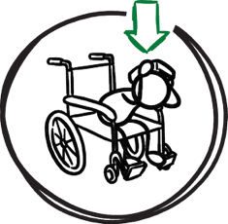

What would YOU do if you had seconds of warning
before strong shaking from an earthquake arrives?
In a wheelchair?
Lock
Cover
Hold On
Notes:
Tell students that the ShakeAlert Earthquake Early Warning System can provide seconds of warning before strong shaking arrives.
Ask students what they should do if they had seconds of warning before strong shaking from an earthquake arrives.
Make sure students know they should drop to their knees (not their bottoms), have one hand over their head and neck, and try to get away from glass or any other objects that could fall on them. If they’re able to get under a table or desk while staying on their knees, they should. Once there, they should hold on to the leg of the table. Add two table groups of students - one about 5-10 feet from where the earthquake will begin, and another at or toward the end of where the earthquake will reach in the classroom.
If it’s helpful, provide those students with the instruction cards. Ask everyone else to observe what the students do, and whether they were able to Drop, Cover, and Hold On before the S-wave reached them.

Slide 49










Let’s Model an Earthquake with ShakeAlert
Will the students be able to DROP, COVER, and HOLD ON before the stronger S-Wave arrives?
Notes:
The diagram is animated. As you click you will see the earthquake appear, the P- and S-Waves move across the room, the seismic station observe the earthquake, and the ShakeAlert message be delivered to the classroom.
Repeat the model of an earthquake, but include the seismic station, processing center and alert delivery partner. Ask students who aren’t participating in the model to record observations on their student sheet. Consider asking a student to time different aspects of the model, such as how long it takes the alert delivery partner to issue an alert after the seismic station beeps, or the time between the alert delivery partner issuing their alert and the S-wave arriving at the back of the room.

Slide 50
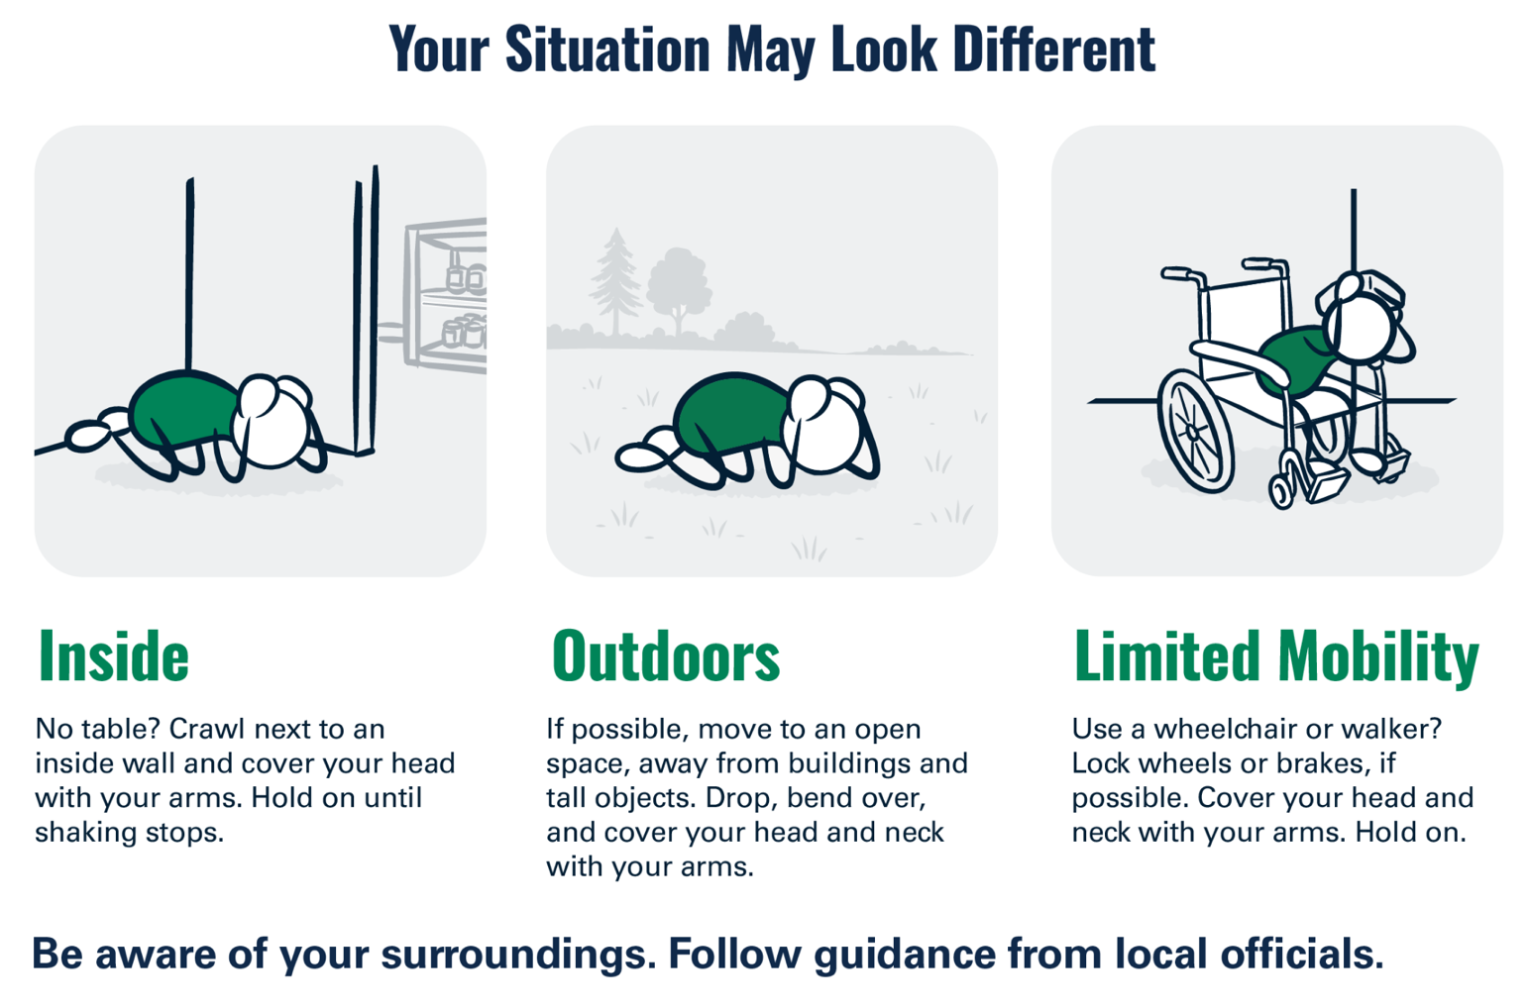
50
Notes:
Tell students that Drop, Cover, and Hold On looks different for different bodies. Review modified protective actions for people who use wheelchairs. While you may not have students who use wheelchairs in your class, it is likely that there are members of your community who do. Ask students to help their family members or friends who use a wheelchair by sharing that “Lock, Cover, and Hold On” is how they can protect themselves during an earthquake. Have students repeat the phrase, “Lock, Cover, and Hold On” after you’ve said it.
IMAGE: Image courtesy of USGS

Slide 51

51

Slide 52
Evaluate
Planning for Earthquake-related Education

Slide 53
Waves are what move you!
Other Middle School Science Standards
MS-PS4 (Waves and Their Application in Technologies)
1. Use mathematical representations to describe a simple model for waves that includes how the amplitude of a wave is related to the energy in a wave.
3. Integrate qualitative scientific and technical information to support the claim that digitized signals are a more reliable way to encode and transmit information than analog signals.
MS-ESS2 (Earth’s Systems)
2. Construct an explanation based on evidence for how geoscience processes have changed Earth's surface at varying time and spatial scales.
3. Analyze and interpret data on the distribution of fossils and rocks, continental shapes, and seafloor structures to provide evidence of the past plate motions.
MS-ESS3-2 (Natural Hazards Data Interpretation)
Analyze and interpret data on natural hazards to forecast future catastrophic events and inform the development of technologies to mitigate their effects.
53

Slide 54
Reflect
How does earthquake science and preparedness fit with what you already teach?
How does it relate to the places your students live and visit?
What standards could we address while also teaching students how to stay safe if they feel shaking or get an alert?
How can we help students to feel optimistic (not fatalistic) about earthquakes?
54

Slide 55



ShakeAlert Ready Schools is tailored for K-12 schools and districts, and provides a suite of earthquake preparedness information tools for use across the educational community, including to families.
Modular materials and activities are teacher-developed and teacher-tested, and will continue to reflect educational and informational needs that promote earthquake safety and resilience.
USERS OF SCHOOLS RESOURCES
Teachers and school staff
Administrators
Students (K–12)
Parents and guardians
(Optimized for ShakeAlert-connected schools in CA, OR and WA)
55

Slide 56








Available Resources
Grade-appropriate lessons
Professional development materials
A parent/guardian presentation and family engagement letter
Resources for administrators
Brief video tour of resources
56
Notes:
Katrina Also Rocket Rules resources.

Slide 57

Multi-Hazard Risk Reduction Education Program for Schools and Other Learning Environments
Free course about multi-hazard preparedness in Science, Technology, Engineering, and Math (STEM), Career Technical Education (CTE), and other learning environments
Includes protective action information for earthquakes and how to use ShakeAlertⓇ EEW (in CA, OR, & WA)
Developed by Safer STEM, Rutgers University, and USGS ShakeAlert Project to help build a Hazard Ready Nation
Image courtesy of USGS
SaferSTEM.com/multi-hazard-safety-course-for-k-12-schools
57
Notes:
The U.S. Geological Survey-managed ShakeAlert® Earthquake Early Warning System collaborated with Rutgers University and Safer STEM to develop Multi-Hazard Safety for Science, STEM, and CTE Programs, a free online course for K-12 schools.
The course examines how earthquakes, severe weather, power failures, chemical releases, infrastructure disruptions, and other emergencies may affect laboratories, makerspaces, workshops, culinary kitchens, health science labs, agricultural programs, construction spaces, and related settings.
It also provides context for earthquake early warning. ShakeAlert detects earthquakes that have already begun and issues messages when USGS alert thresholds are met. Delivery partners use those messages to produce alerts that can prompt recommended protective action or automated action.
For more information about the course, go to https://saferstem.com/multi-hazard-safety-course-for-k-12-schools/

Slide 58

Thank you
All workshop materials are available in digital format here:
Notes:
QR codes leads to our educational resources page. Scroll to the bottom to find digital copies of workshop handouts.

